Slide 1

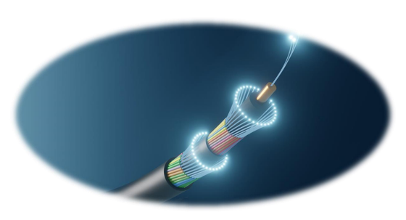
Fibre Optic Sensing
A Disruptive Technology on top of GÉANT Network Infrastructure
Fast & Furious - Research Edition: 2025-06-10
Community Hub - Future Ready Networks: 2025-06-11
TNC25: Brighton, United Kingdom, 2025-06-09 - 2025-06-13
Rene Belsø
rene.belso@deic.dk
https://orcid.org/0000-0001-6912-0498

Slide 2
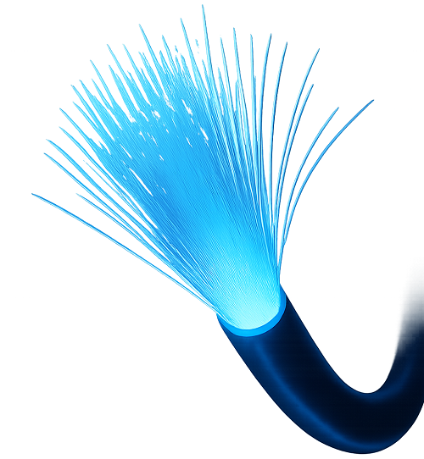
Content
Introduction: Affiliation; Speaker; Relevance
Fiber Optic Sensing (FOS) – What is it?
FOS Research Application Areas
Research Behind the FOS Technology
The FOS challenges
From Dilemma to Symbioses
GÉANT and NREN e-Infrastruktur Relevance
A FOS Collaboration-framework
A FOS Trusted Research Environment (TRE)
Example: National Supercomputer Centre (NSC)
The FOS Security Recommendations
Open Questions
Strategy: Where is GÉANT going?
A Focus More on
Strategy and Policy
than Technology

Slide 3
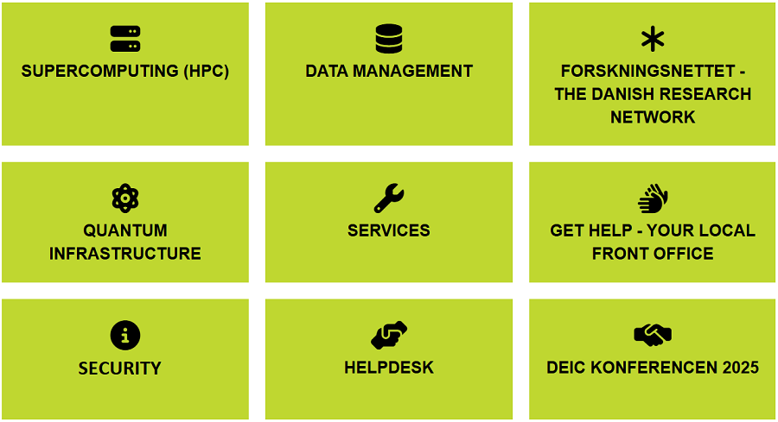
Introduction: Affiliation; Speaker; Relevance
A Focus More on Strategy and Policy than Technology
Affiliation:
The Danish e-infrastructure Consortium (DeiC), mandated and financed jointly by the Danish Ministry of Higher Education and Science and the eight Danish universities, coordinates cooperation on digital research infrastructure with the aim of enabling research and education at a high international level. DeiC facilitates cooperation on e-Infrastructure in the following areas:
Speaker: Rene Belso
Degrees in Political Science and Computer Science.
25 years’ experience with research strategy and policy.
International research infrastructure, HPC; Data management.
Relevance: FOS
Networking; DM; HPC; Security.
Research Strategy, Politics, Organisation, Economy.
Research Instrumentation and infrastructure, very international but also very much national security.
SUBMERSE White Paper – Fibre Optic Sensing Security Architecture.

Slide 4
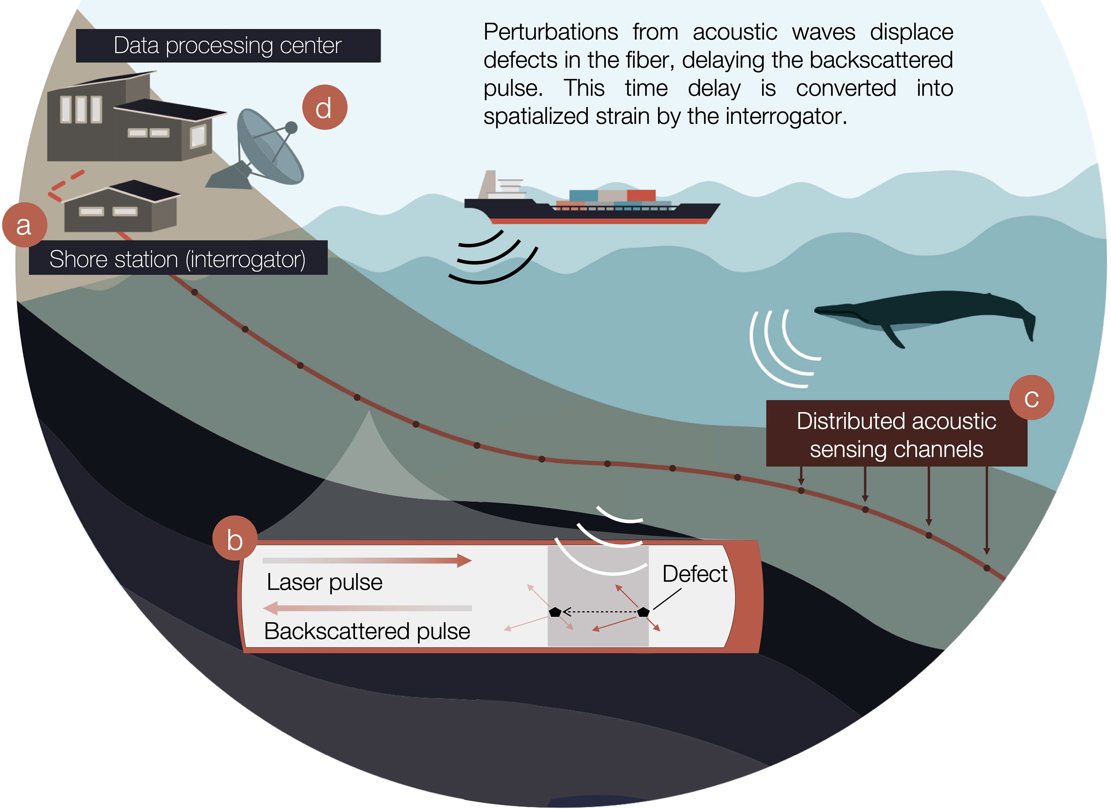
Fiber Optic Sensing (FOS) – What is it?
FOS is utilised in research and industry, by applying the ability to detect subtle acoustics, strain as well as slight pressure and temperature changes along underwater fibre optic cables.
FOS produces high-value data products through Event Fingerprinting, using advanced interrogator technologies like Distributed Acoustic Sensing (DAS) and State of Polarisation (SoP), enhanced by
artificial intelligence (AI) signal analytics.
However, high volumes of complex data pose
significant data management challenges
and non-trivial security concerns.
Bouffaut et al.

Slide 5
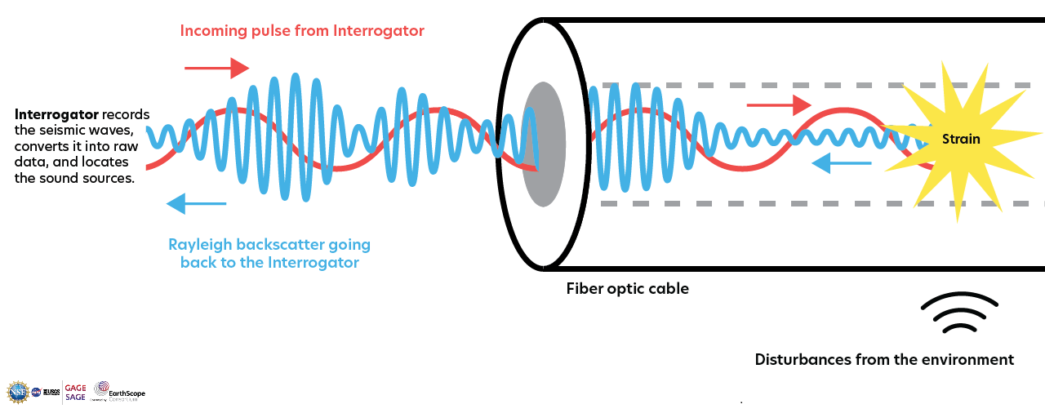
Fiber Optic Sensing (FOS) – What is it?
Interrogators: DAS; SoP …
Distributed Acoustic Sensing (DAS)
Source:

Slide 6
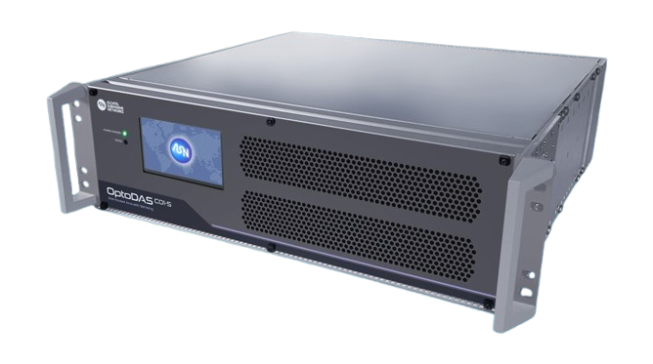
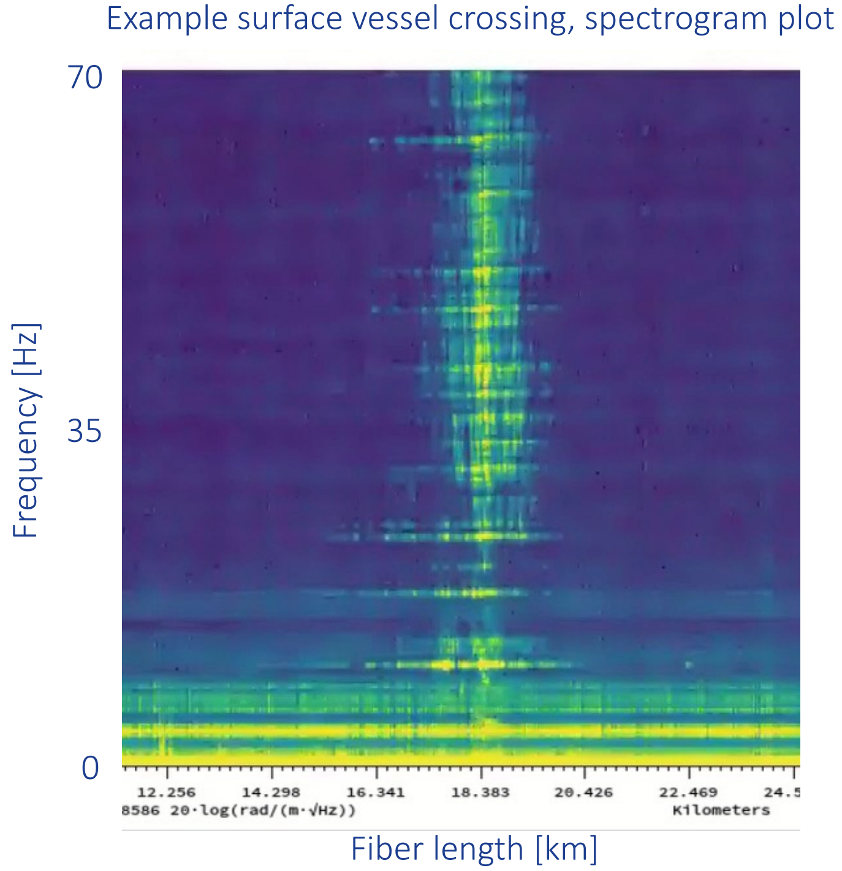
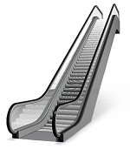

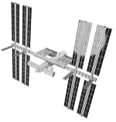
FOS Research Application Areas
Marine Seismology:
Volcanoes, earthquakes and tsunamis (Early warning systems)​
Oceanography:
Sea currents, wave activity, other physical processes
related to climate change​
Marine Ecology:
Monitor habitats and the movement of marine species​
Underwater Infrastructure Monitoring:
Cable and pipeline monitoring and quality control​
Security and Defence:
Ocean vessel tracking and monitoring
… and so much more:
NORDUnet Conference 2024

Slide 7
Research Behind the FOS Technology
“As we are only in the beginning of understanding acoustic signals from FOS, we have only initially begun to use Artificial Intelligence (AI) in "Event Fingerprinting", and because the variety of interpretations of such signals in different geographies and research communities, research and security interests must go hand-in-hand for many years going forward” (SUBMERSE White Paper, 2025)
Optical Physics ➔ Light scattering theory, coherent detection
Optical Engineering ➔ Laser systems, photodetectors, interrogators
Telecom Engineering ➔ Fiber optics, backscatter analysis
Computer Science ➔ Signal analysis, AI for pattern recognition (fingerprinting)
Infrastructure Experts ➔ Networking, Data management, HPC and Security
Geophysics ➔ Feedback loop from DAS, SoP etc. applications
Marine Ecology ➔ Feedback loop from DAS, SoP etc. applications
Security and Defence ➔ ?
… and more ➔ ??

Slide 8
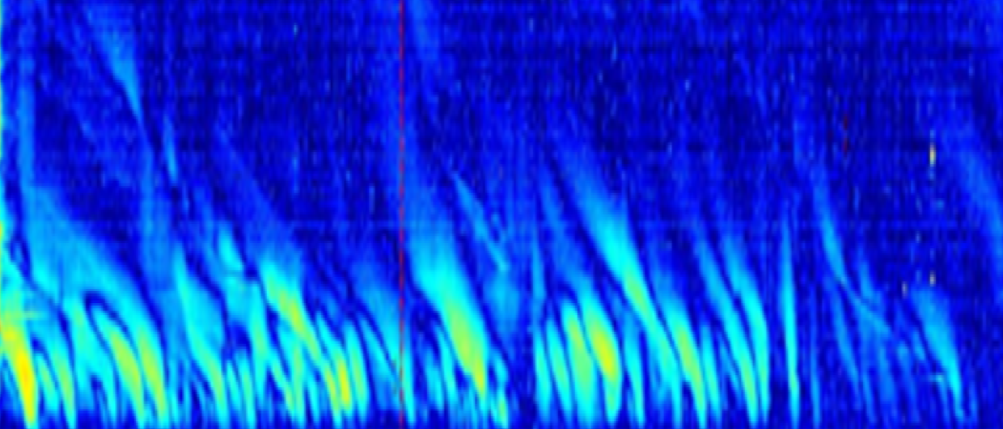
The FOS challenges
Signal analytics, Data management and Security
.
.
.
.
.
.
.
.
.
.
.
.
.
Signal analytics (Event fingerprinting) [Researchers]
Research utilisation of FOS data is non-trivial, namely when automating in real time.
The data management challenge: [Infrastructure Experts]
Data is initially unintelligible noise, distortions to be analysed (e.g. by AI).
Data is streamed endlessly, in real-time, in overwhelming amounts,
collected from the bottom of the ocean and processed at numerous locations.
Data is used in very different and often unpredictable ways, by numerus research communities.
Data can be buffered but is un-storable. Value must be extracted instantly, on-the-fly.
FOS implementation about combining compute and data management
The security challenge: [Agencies]
Some data is military sensitive (e.g. ocean vessel movements, and other "special" events).
Only a tiny vetted fraction of data is made available; even less in open FAIR data repositories.
The data flow must, therefore, be meticulously managed (controlled in a secure and automated manner).
Image supplied by Luna

Slide 9

From dilemma to symbioses
The SUBMERSE White Paper Conclusions
To mitigation the challenges SUBMERSE suggests a focused cooperation, between researchers, Infrastructure experts and security agencies.
Key collaboration elements include:
Collaborative Framework: A joint architecture and structured agreements that implement mutual understanding, goals and responsibilities, fostering trust and transparency, while incrementally advancing FOS technology.
Data Segmentation: Algorithms filter out sensitive time and/or frequency segments, producing a non-sensitive data stream for researchers to produce FAIR data products – Findable, Accessible, Interoperable, and Reusable.
Researcher Vetting: Authorized researchers with appropriate security clearance, that can justify access to raw data, aiming to produce secure FAIR data products from the security sensitive raw data.
Data Management: A strong focus on segregated data-products production – closed for security agencies, and FAIR for research.
Trusted Research Environment (TRE): FOS utilisation should be embedded in an agency-controlled High-Performance Computing (HPC) centre.

Slide 10
From dilemma to symbioses
The SUBMERSE White Paper’s two main conclusions
Researchers, Infrastructure Experts and Agencies alike need:
(1) Collaboration-framework
...... ..... ..... ..... ..... ..... ..... ........... ..... ..... ........... ..... ..... ........... ..... ..... ..... .......... ..... ..... ..... ..... ..... ..... ........... ..... ..... ........... ..... ..... ........... ..... ..... ..... ..... ..... ..... ..... ..... ..... ..... ..... ........... ..... ..... ........... ..... ..... ........... ...
(2) Trusted Research Environment (TRE)

Slide 11
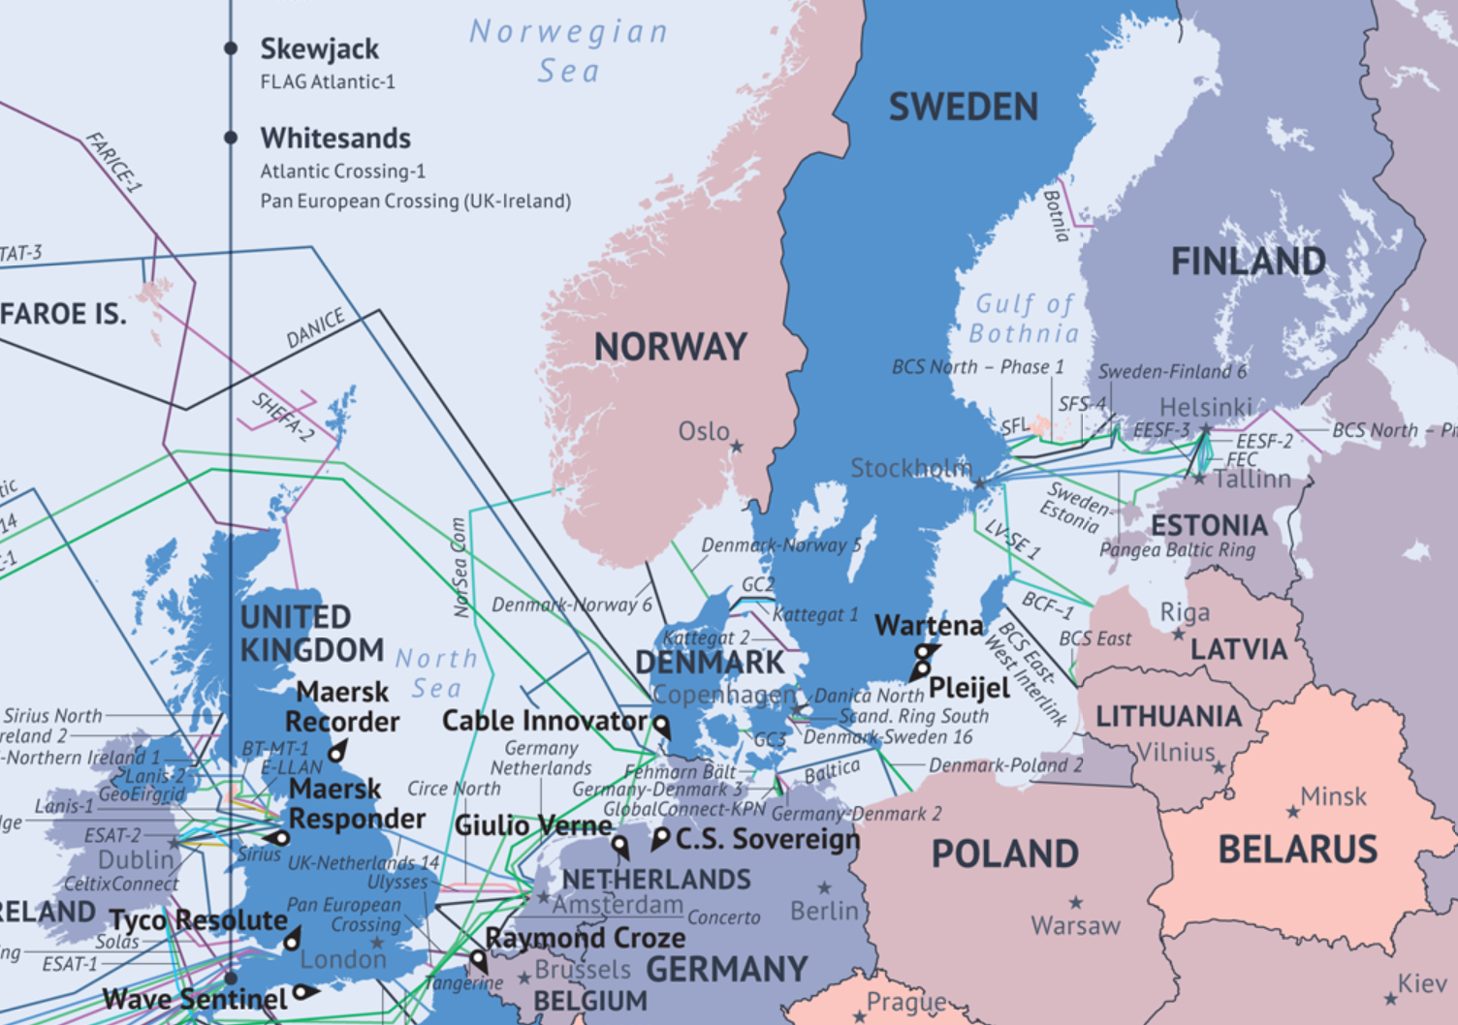
GÉANT and NREN e-Infrastruktur Relevance
Raison d'etre of national e-Infrastructure organisations (e-Infra) is arguably about: Networking; DM; HPC; Security.
FOS as infrastructure encompasses all e-Infra activities.
FOS is national and well as international in its essence
  Signal analytics [Researchers]
  The data management [Infrastructure Experts]
  The security [Agencies]
FOS security is national and international security, hence not commercial (FOS data not a marked commodity). E.g. nothing goes in or out of:
  the Baltic Sea without passing through Denmark (arguably Sweden)
  the North Atlantic without passing GÉANT infrastructure
  GÉANT as a nationally and internationally controlled organisation is “Trustworthy”.
  GÉANT as an international e-Infrastructure organisations is relevant as well as needed for timely FOS uptake and impact.
Source: https://submarine-cable-map-2014.telegeography.com/

Slide 12
A FOS Collaboration-framework
Building mutual trust and understanding in managing the security dilemma
Optimal instrumentation while meeting security concerns. I.e. avoiding down-grading data, when possible.
Striking the above balance and pursuing its political-, organisational-, economic- and technical roadmap, is only possible via robust dialogue between agencies and research.
Pursuing technology and advanced infrastructure, European agencies cannot go-it-alone, like the USA can.
Assumption: Grounds for a strong degree of synergy and symbiosis in agencies and research cooperation.
Different national understandings as to above points ==> National implementations, which might or might not foster cooperation conglomerations.
Dialogue with agencies: Policies for data flows, data management, compute, data publication.
A joint multifaceted approach: Collaboration-framework pursuing how-to Trusted Research Environment (TRE), with vetting of researchers, algorithms, data products (public and classified).

Slide 13
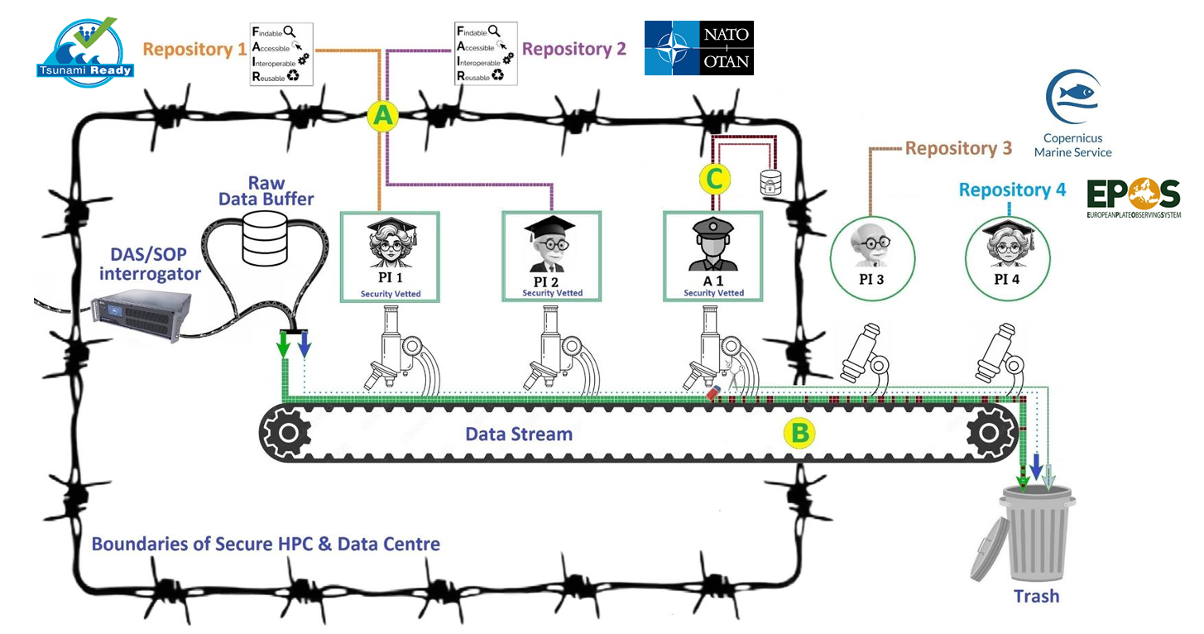
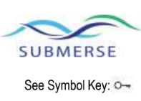
A FOS Trusted Research Environment (TRE)

Slide 14
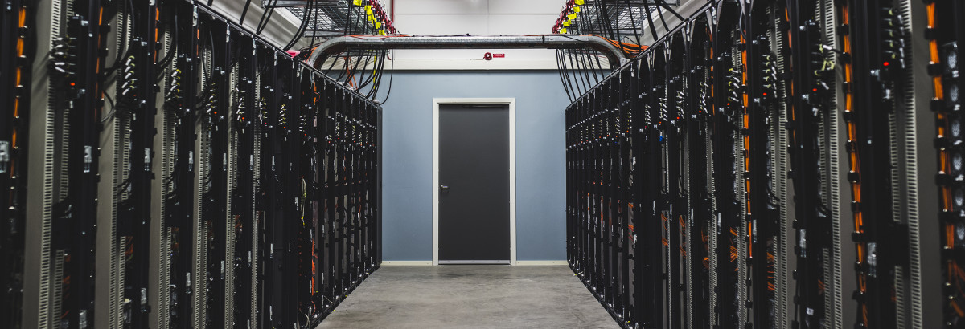
Example: National Supercomputer Centre (NSC) at Linköping University, Sweden (a de facto TRE)
NSC plays a significant role in supporting military and defence-related applications, primarily through its collaboration with Saab AB, a leading Swedish aerospace and defence company. This partnership leverages NSC's high-performance computing (HPC) capabilities to advance various technologies and applications:
Aerodynamics and Flight Dynamics: Simulating airflow and aircraft behaviour under various conditions.
Structural Analysis: Assessing the integrity and performance of aircraft structures.
Radar Cross-Section Modelling: Evaluating the stealth characteristics of aircraft designs.
Autonomous Systems: Developing intelligent
behaviours for unmanned vehicles and drones.
Predictive Maintenance: Anticipating equipment
failures to improve reliability and reduce downtime.
Cybersecurity: Detecting and responding to cyber
threats in real-time.
NSC, Linköping

Slide 15
The FOS Security Recommendations
Fiber Optic Sensing to be conducted in a dedicated Secure HPC & Data Centre, a TRE, meaning:
Vetting of researchers, algorithms as well as output (TRE under agency control, aided by researchers and eInfras).
A multifaceted data processing approach is offered, includes providing:
  Unfiltered raw data from DAS/SOP interrogator; maximum technical quality; an endless stream of sensitive data. Only provided inside the Secure HPC & Data Centre and only to governmental security concerned agencies and vetted researchers.
  Down-sampled raw data (Miniseed) where frequencies/channels have been removed (A particular seismological data format optimised for single time series).
  Incomplete, time vetted data, i.e. original raw data, but incomplete (discontinuous) only due to some missing sensitive time segments.
  Incomplete, frequency/channels vetted data, i.e. original raw data, but incomplete only due to some sensitive frequences/channels being filtered out, like the Miniseed but excluding a little instead of including a little data percentage.
Research output can only exit the Secure HPC & Data Centre:
  as non-sensitive FAIR data resulting from vetted researcher/algorithm, possibly submitted to public repositories
  as non-sensitive incomplete data from the Miniseed, time vetted or frequency/channel vetted data, submitted to known research communities.
  at the discretion of governmental security concerned agencies.
Raw (sensitive) data is buffered first-in-first-out (fifo), for approx. 3 months enabling rerun of algorithms on raw data back in time. Accessible only for vetted PI’s
Incomplete data (non-sensitive) can be buffered or processed at the initiative of and cost to known research communities.

Slide 16
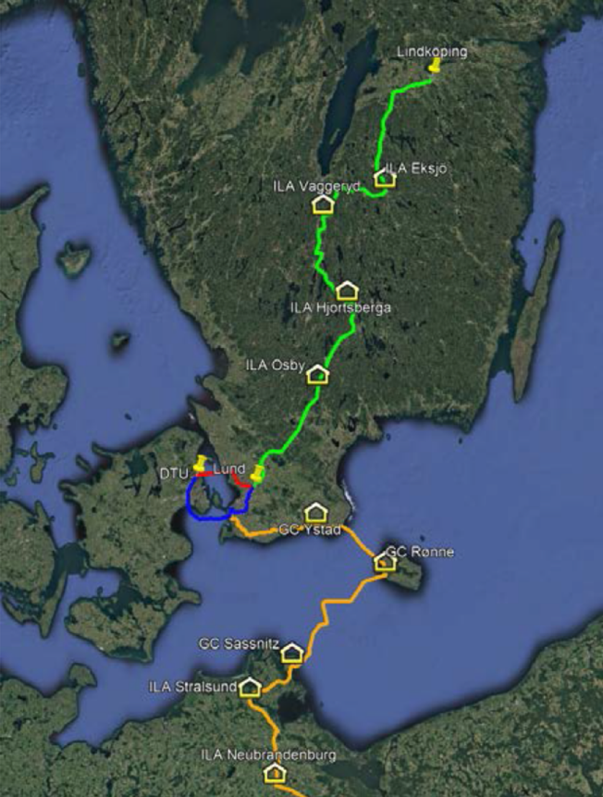
Open Questions
Which, if any, concerns or interests do government agencies (e.g., the Royal Danish Navy, or the Russian FSB) have regarding researchers collecting and publishing FOS data?
To what extent is FOS Collaboration-framework needed?
Is it doable/feasible to "gather" interested parties (Researchers, Infrastructure Experts, Agencies)?
Is there a basis for establishing pilot projects, for example:
  Installing and operating FOS on cable stretches of particular interest?
  Coordinating and promoting FOS research and development, nationally or European, e.g. through joint financial instruments?
Such questions should be put to your national agencies since it might call for concrete short-team action and/or longer-term strategic interest.
Meanwhile: Do support if not indulge, in implementing this disruptive technology on top of GÉANT network infrastructure.

Slide 17
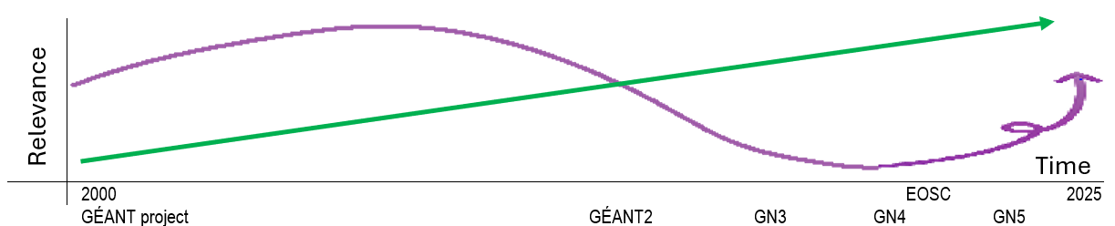
Strategy: Where is GÉANT going?
History (Arguably): GÉANT vs. TELCO
?
V
V
Will the NREN and GÉANT community seize the day and embrace Fibre Optic Sensing as a disruptive technology on top of the NREN and GÉANT Network Infrastructure ?

Slide 18
Thank you for inviting me talk
Rene Belsø
rene.belso@deic.dk
https://orcid.org/0000-0001-6912-0498

