Slide 1
MARCOM in Crisis Management: Communicating NREN Network Outages, Cybersecurity Incidents, and Service Disruptions
TNC25 | Brighton, UK
Hussein Sabrie
Chief Communications Officer
Somali Research & Education Network (SomaliREN)

Slide 2
Why This Matters
NRENs are lifelines for education and research
Service disruptions can harm trust, productivity, and reputation
Communication failures can be as damaging as technical failures

Slide 3
Typical Crisis Scenarios for NRENs
Network failures (e.g., fiber cuts, hardware crashes)
Cyber intrusions (e.g., data breaches, DDoS attacks)
Service disruptions (e.g., DNS failures, certificate expiry)

Slide 4
The Hidden Cost of Silence
Network outages, cyber threats, and service disruptions are inevitable
Stakeholders expect timely, clear updates
Lack of communication causes confusion and mistrust
Keeping people informed builds trust; staying silent creates confusion

Slide 5
Goals of Crisis Communication
Provide timely, accurate information
Coordinate across teams and platforms
Maintain user confidence and organizational credibility

Slide 6
Key Communication Principles
Be timely: Share initial updates within 5-30 minutes
Be clear: Avoid technical jargon for external audiences
Be accurate: Communicate verified facts only.
Be consistent: Use approved templates and channels
Be empathetic: Acknowledge the impact

Slide 7
The Crisis Communication Lifecycle
Before: Plan, prepare templates, assign roles
During: Coordinate updates, provide ongoing information
After: Review, document lessons, and follow up with stakeholders

Slide 8
Core Components of a Crisis MARCOM Plan
Pre-approved message templates
Defined roles and responsibilities
Clear communication channels
Coordination with technical and PR teams

Slide 9
Communication Tools and Channels
Primary Channels: Email alerts, SMS, internal chat groups
Secondary Channels: Facebook, Twitter, and LinkedIn
Support Assets: Incident dashboards, FAQ pages, media statements

Slide 10
Communication Timing
Initial alert within 5–30 min
Status update every 1–2 hours
Final summary within 24–48 hours

Slide 11
Communicating Cybersecurity Incidents
Limit detail but acknowledge breach
Focus on containment, impact, and actions taken
Notify authorities and affected parties
Legal and reputational considerations

Slide 12
Leveraging Digital Platforms
Use clear, timely posts to inform and reassure.
Create infographics to simplify updates.
Encourage two-way communication where appropriate (feedback loops).

Slide 13
SomaliREN’s Proactive Monitoring and Incident Readiness
Built for real-time issue detection and proactive response.
Uses automation to act before disruptions are noticed.
Ensures fast coordination, clear messaging, and continuous engagement.
Reflects SomaliREN’s commitment to reliability and transparency.

Slide 14
Integrated Incident Detection and Response System
Zabbix monitors the network in real time and sends alerts via webhooks.
Discord serves as the coordination hub for immediate response by technical and communications teams.
Signal 4 auto-assigns alerts based on severity, ensuring accountability and timely resolution.

Slide 15
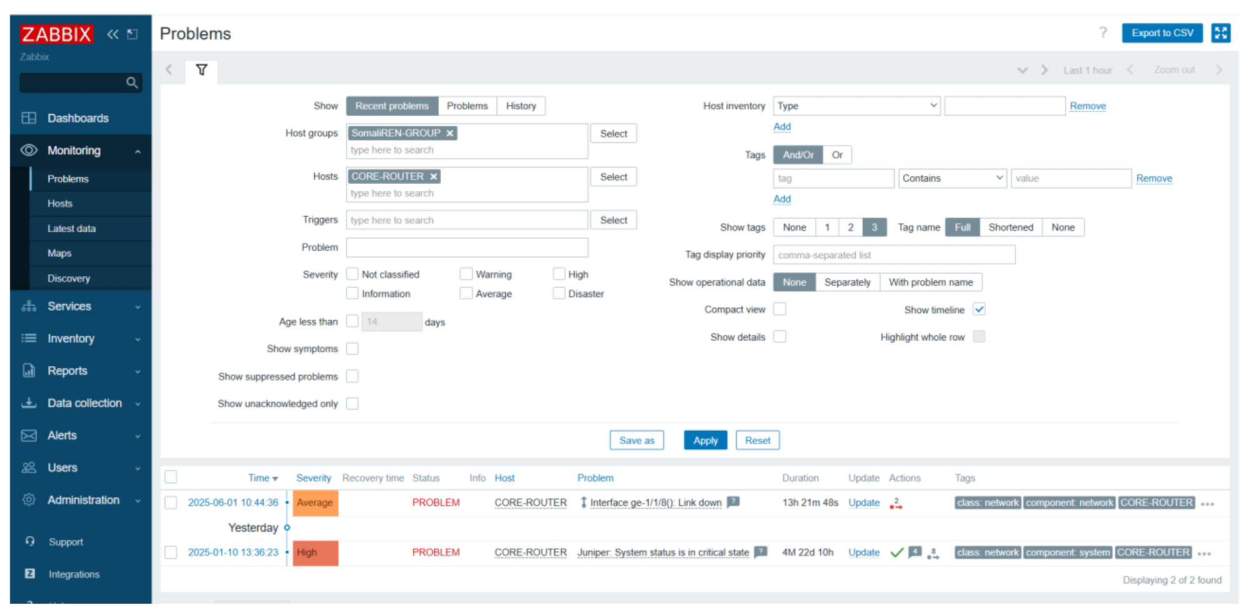

Slide 16
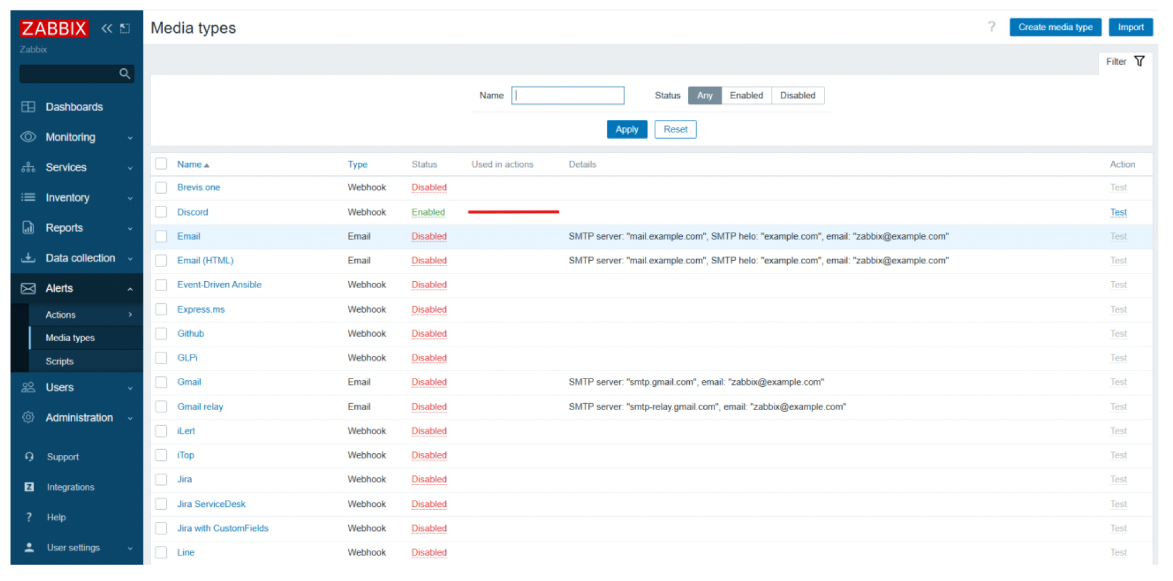

Slide 17
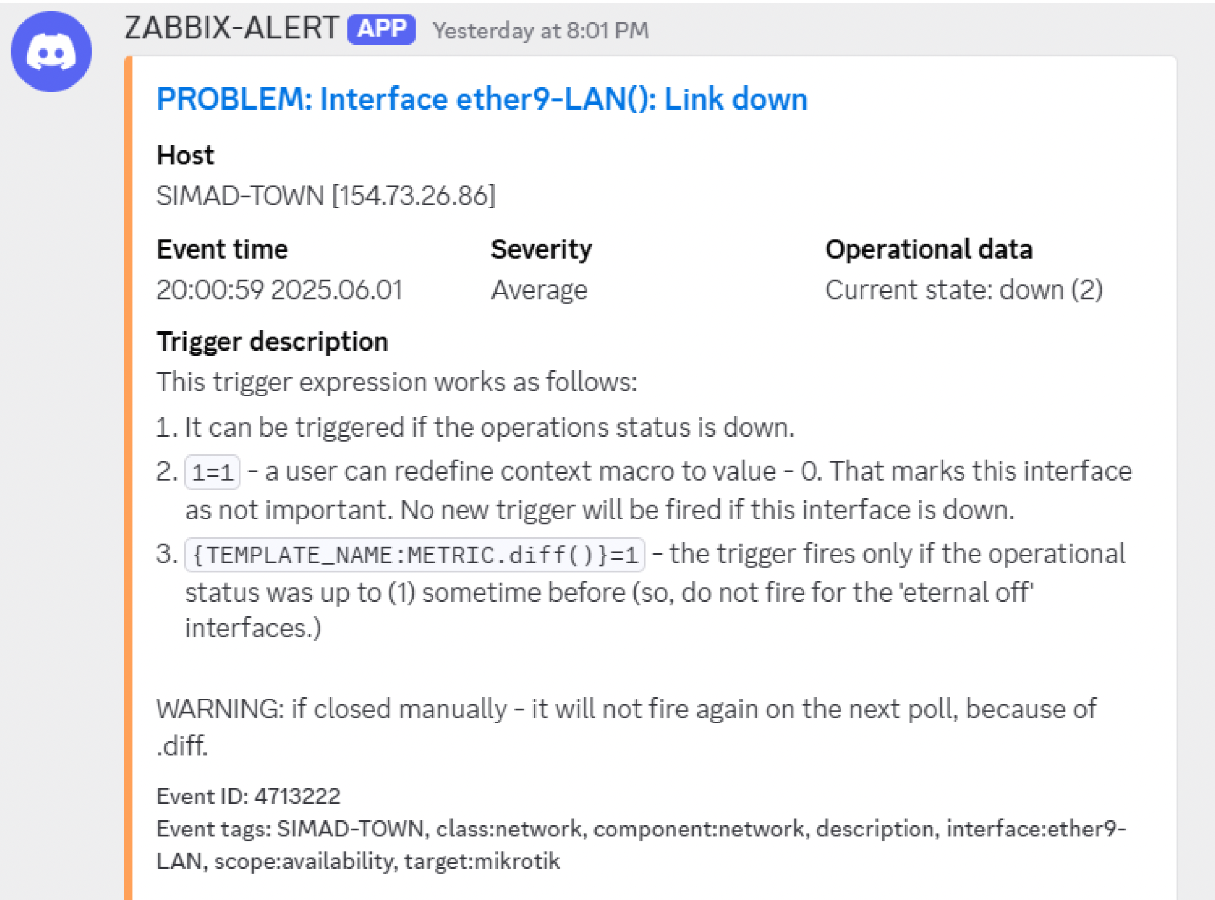

Slide 18
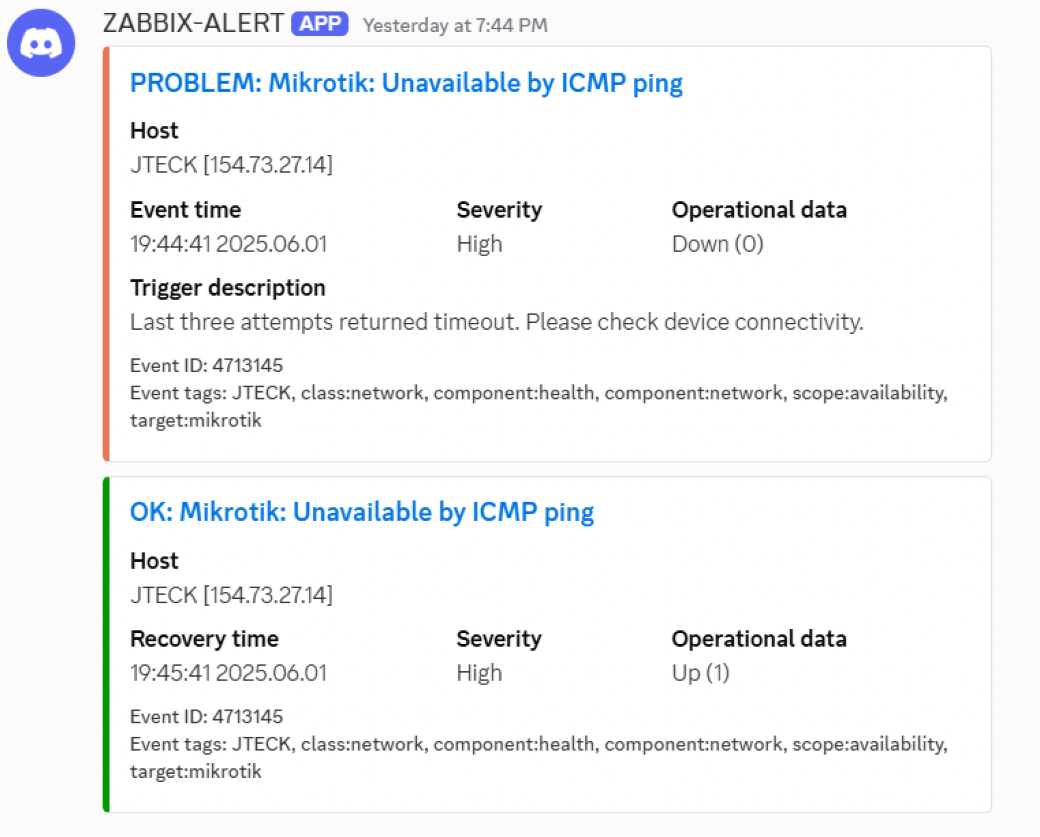

Slide 19
Member Communication Channels
Each member has a dedicated WhatsApp group with SomaliREN’s technical and communication teams.
Enables early, direct updates—often before issues are noticed.
SomaliREN uses pre-approved message templates tailored for each incident type, ensuring speed, accuracy, and consistency

Slide 20
Key Operational Lessons Learned
Automation speeds up response and minimizes downtime.
Tool integration ensured no incidents were missed or mishandled.
Proactive communication builds trust and prevents confusion.

Slide 21
Post-Crisis Communication Strategy
Stakeholder survey for feedback
Share lessons learned with stakeholders
Share post-mortem with transparency
Rebuild trust by demonstrating improvements
Recognize stakeholder patience and show understanding

Slide 22
Key Takeaways
Effective communication is as critical as technical response.
Incident detection systems enable timely responses.
Coordination across teams ensures unified action.
Clear, early communication shapes perception.
Proactivity builds confidence; silence breeds doubt.
Every crisis is an opportunity to strengthen your credibility.

Slide 23
In the age of instant information, silence in a crisis is its own kind of failure.

Slide 24
?

