Slide 1
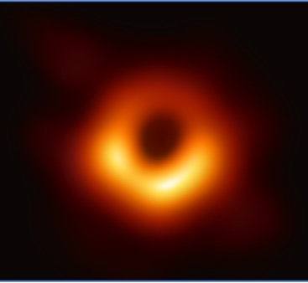

Accelerating the Event Horizon Telescope Speed to Science:
Leveraging High-Speed Networks for Early Data Validation
Edward Moynihan, International Networks @ Indiana University
Jason SooHoo, Massachusetts Institute of Technology Haystack Observatory
Brenna Meade, International Networks @ Indiana University

Slide 2

Indiana University
Founded in 1820
System of IU campuses across the state
  IU Bloomington
  IU Indianapolis
  5 other campuses
  2 regional centers
  9 School of Medicine campuses
68,000+ degree seeking undergrads
20,000+ graduate and professional students
6,500+ international students from 166 countries

Slide 3
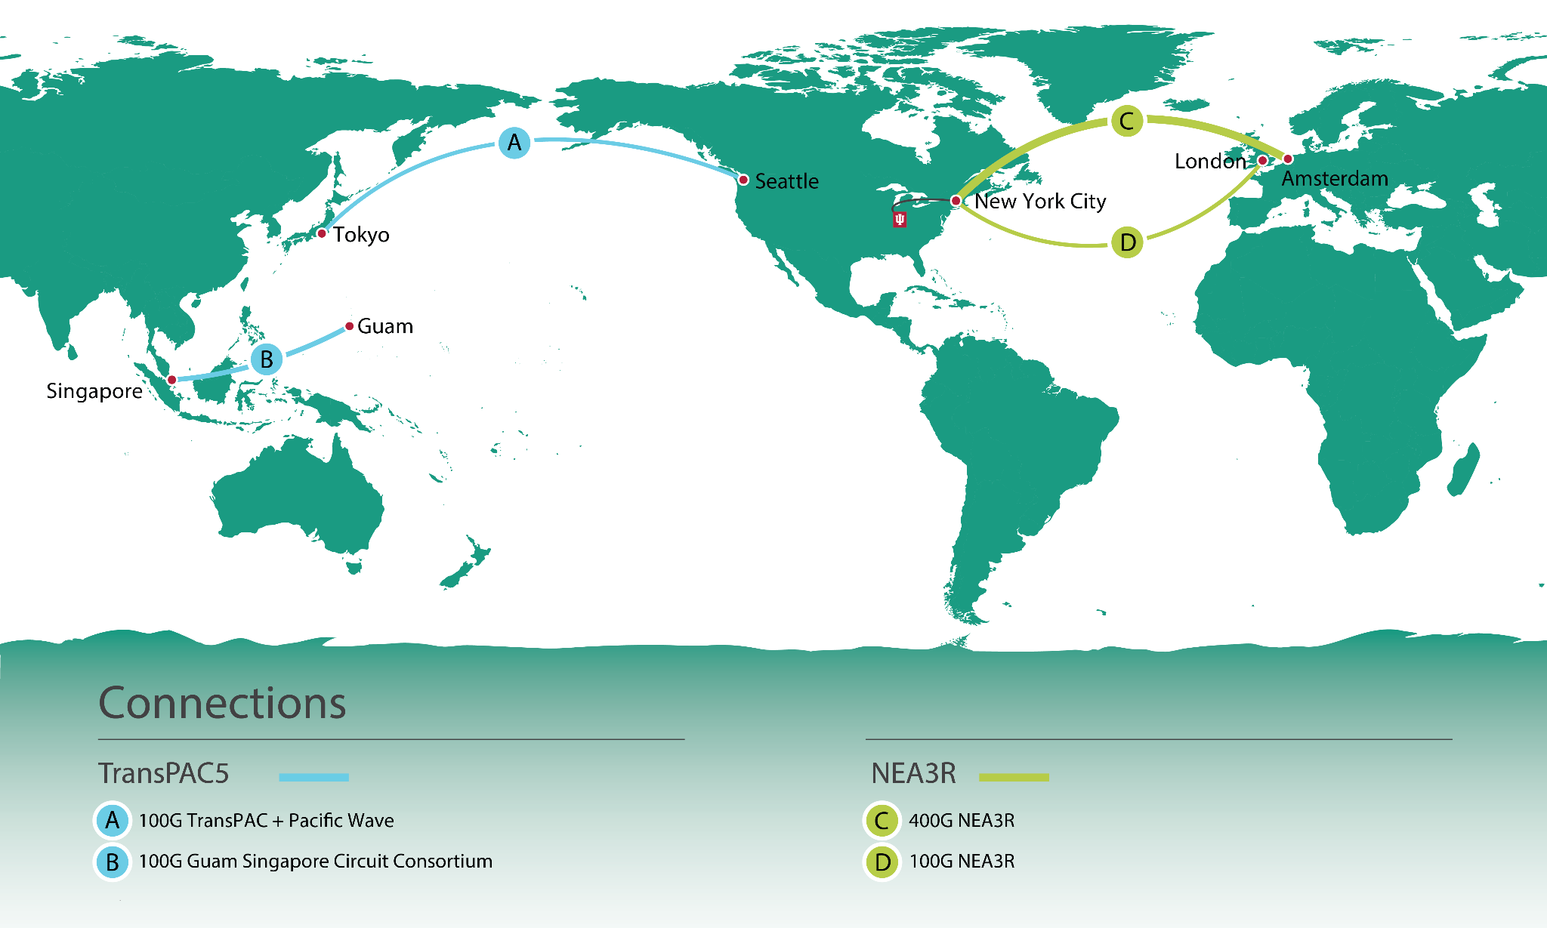
International Networks @ Indiana University (IN@IU)
25 year history of operating international networks
Over 50 formal partnerships with RENs around the world
Currently support 4 links (1 400G and 3 100G) with 2 US NSF awards (TransPAC and NEA3R)
Coordinate globally to ensure US researchers have worldwide access to networking services
Work with research groups to improve international data flows via engagement and training
Projects carry traffic data from researchers in 84% of the world

Slide 4
NSF-funded projects since 1998
TransPAC - 1998- 2005, Chicago > Tokyo; 35Mpbs to 73Mpbs to 100Mbps to 155Mpbs
TransPAC2 - 2005 - 2010, 10Gb Los Angeles > Tokyo; 155Mb Singapore > Karachi
TransPAC3 - 2010-2015, 2 10Gb Los Angeles > Tokyo
America Connects to Europe (ACE) - Multiple 10Gb US <> Europe
TransPAC4 - 2015 - 2021, 100Gb Seattle > Tokyo; 10Gb Guam > Hong Kong
NetSAGE - 2015 - 2021 - IRNC Measurement and Monitoring
NEAAR - 2016 - 2021 - 100Gb New York > London
NEA3R - 2020 - current - 100Gb New York > London; 400 Gb New York > Amsterdam
TransPAC5 - 2020 - current - 100Gb Seattle > Tokyo; 100Gb Guam > Singapore

Slide 5
NEA3R
Networks for European, American, African, and Arctic Research
NSF IRNC program (Core : Improvements)
Circuits
  New York <> London 100G on AEC-1 cable
  New York <> Amsterdam 400G on AEC-2 cable
System of partner provided circuits as named points of collaboration
  GÉANT 100G New York <> Paris
  Internet2 400G Boston <> Paris
  NORDUnet/SURF 100G Copenhagen <> Montreal
  UbuntuNet Alliance 10G Dar es Salaam <> Amsterdam
  KAUST 2 100G AMS <> Jeddah <> Singapore
Services
  Measurement and Monitoring Framework
  Support for Network Experimentation
  Targeted Science Engagement

Slide 6
TransPAC5
NSF IRNC program (Core : Improvements)
Circuits
    TransPAC-Pacific Wave 100G between Seattle and Tokyo.
    Guam-Singapore Connectivity Consortium 100G between GOREX and SingAREN
    Part of APOnet Consortium
Services
    Measurement and Monitoring Framework
    TestBed support
    Experiment support (SuperComputing/Data Mover Challenges)
    LHCONE Network Service Provider
    Science Engagement

Slide 7
Community and Science Engagement
Global Support for International Data Movement
Science Outreach and Engagement with Research Communities
Direct Support for Specific Science Projects
Performance Improvement via testing, documentation, training, and investment
Coordinating and Improving Operations and Engineering of Regional Systems
Measurement and Monitoring tools for Global Systems
Notes:
Shift from procurement to more direct and explicit support for Science instruments and science teams
Chair of various working groups

Slide 8
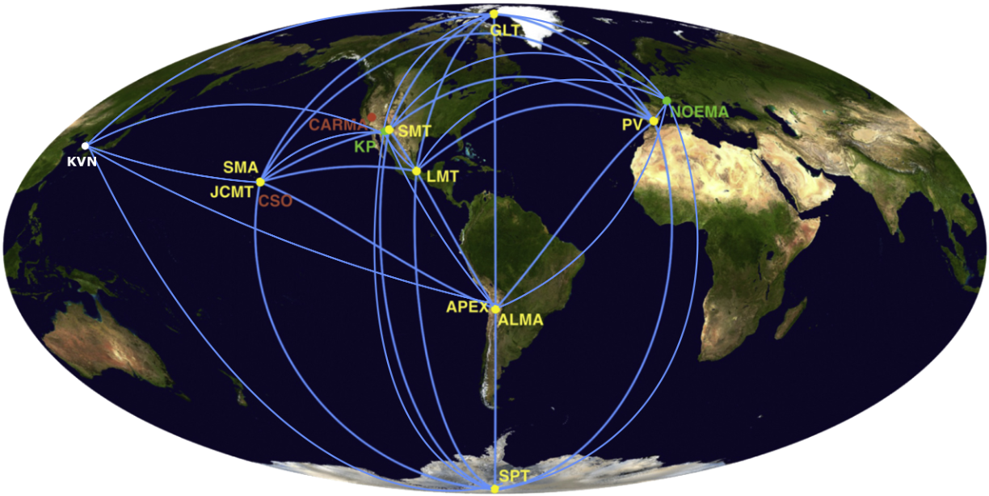

The Event Horizon Telescope (EHT)
The Event Horizon Telescope (EHT) is an international collaboration of millimeter and sub-millimeter wavelength radio telescopes measuring the size of emission regions around supermassive black holes, using Very Long Baseline Interferometry (VLBI). The array spans the world creating a telescope with an effective Earth-sized aperture.
M87 2017
SgrA* 2018
Notes:
EHT Introduction - Who we are

Slide 9
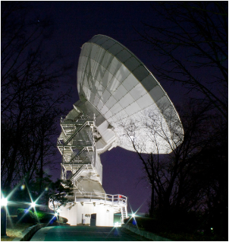
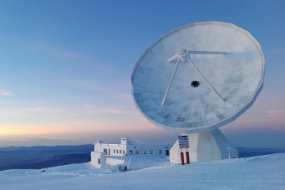
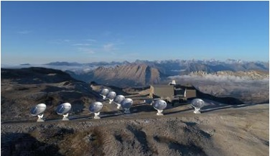
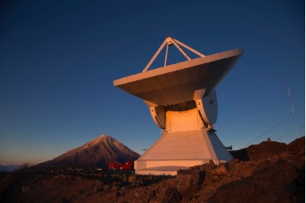
EHT Collaboration Stations
Submillimeter Array (SMT) - Arizona
Kitt Peak 12-meter Telescope (KP) - Arizona
Atacama Pathfinder Experiment (APEX) - Chile
Atacama Large Millimeter/Submillimeter Array (ALMA) - Chile
IRAM 30-meter telescope (PV) - Spain
James Clerk Maxwell Telescope (JCMT) - Hawaii
Large Millimeter Telescope (LMT) - Mexico
Submillimeter Array (SMA) - Hawaii
South Pole Telescope (SPT) - Antarctica
Greenland Telescope(GLT) - Greenland
IRAM NOEMA Observatory (NOEMA) - France
KVN Yonsei Radio Observatory (KVN)- Korea
Notes:
EHT - overview of all the stations (note PV (Spain), NOEMA (France))

Slide 10
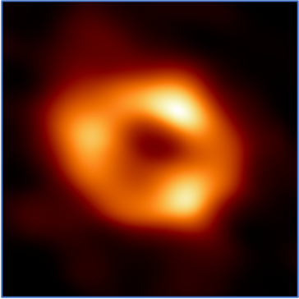
The Event Horizon Telescope (EHT)
In 2019, We released the very first image ever taken of a black hole, M87. And in 2022, we were able image the black hole at the center of our galaxy, SgrA*.
Today we continue our research by improving our science and technology while expanding our global collaboration with new telescopes from around the world.
M87
SgrA*
Notes:
EHT - Notable achievements

Slide 11
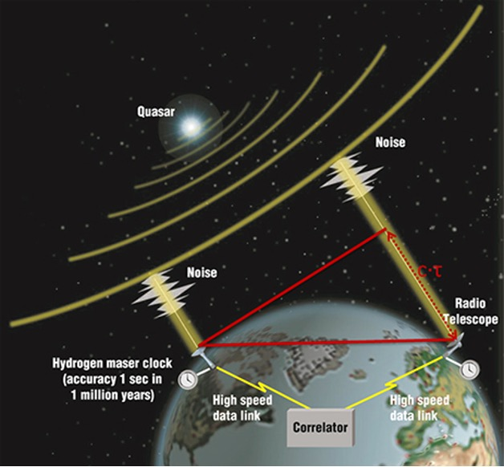
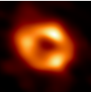
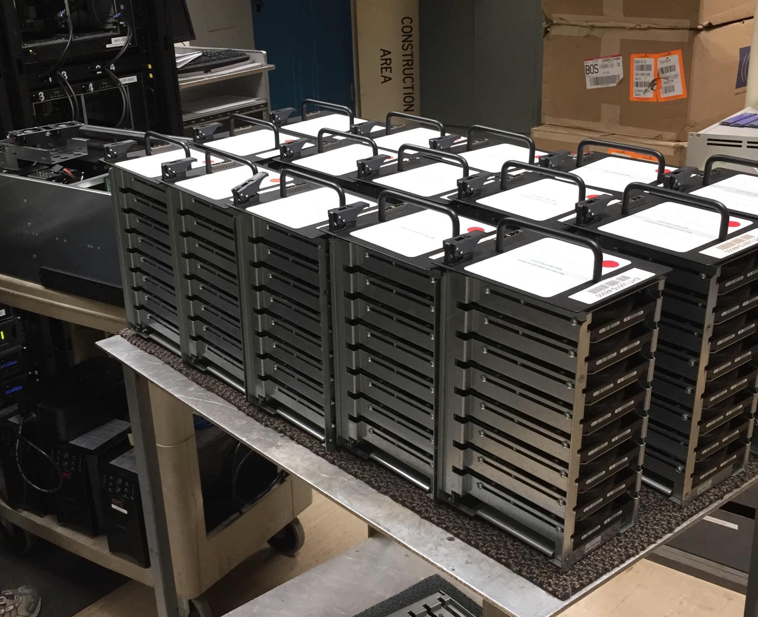
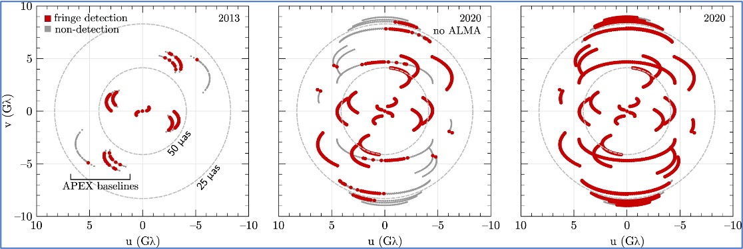
EHT Science and Operations
During an EHT campaign, each telescope observes various sources, collecting about 700 TBytes of raw data onto large disk recorders at 64Gb/s over 7-10 days. This data is then shipped to one of our Correlators.
(MIT Haystack Observatory, MA, USA and MPifR, Bonn, Germany)
The data is then correlated and processed by our imaging and analysis science teams.
Notes:
EHT - Summary overview of a campaign and process to get data to Correlators

Slide 12
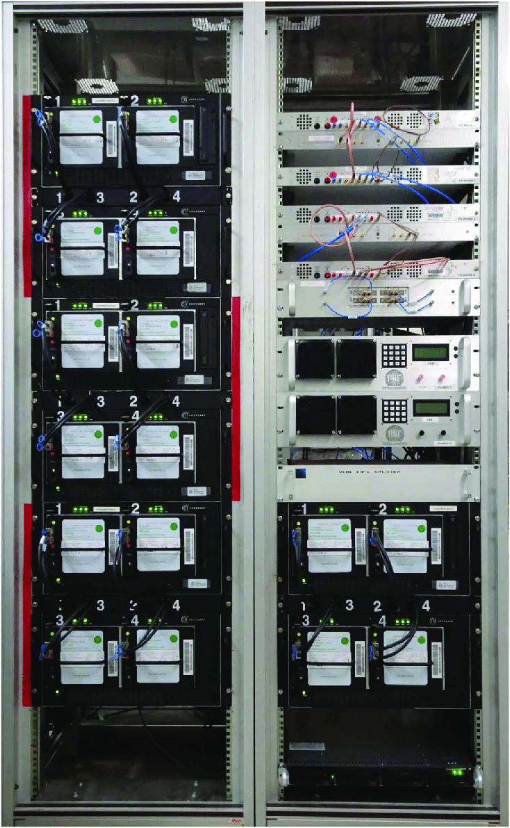
EHT Science and Operations
When an EHT station prepares for operations there are a series of site checks that can be done:
Pointing modeling and checks, using sky sources
Frequency tuning and calibration, spectrum analysis
Timing calculations and system offsets using Hydrogen masers
Digitization signal power level checks
Receiver check out
Backend VLBI system check out
These site checks has to be done but they also have to be consistent with each other station to successful correlate the data.
Notes:
EHT - site checks, noting complexity but also has to be consistent with other stations to process successfully

Slide 13
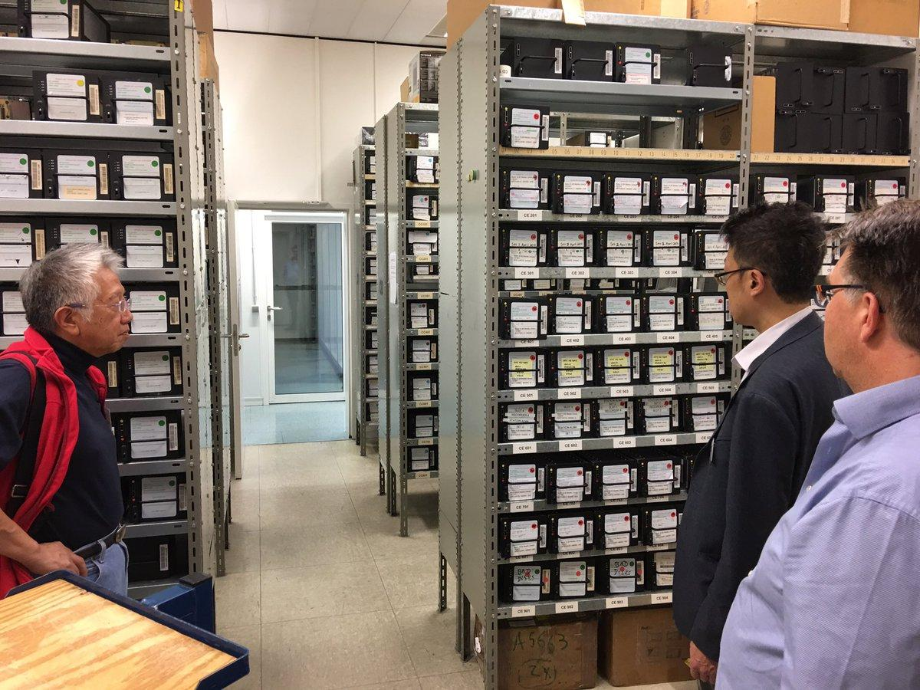
EHT Science and Operations
The Precheck Test:
At the start of an EHT Campaign window, stations record a small sample of data on a known bright source.
This data is transferred over the network, “eTransfer”, back to the Correlator.
The Correlator processes the small sample with a quick turn around and can cross reference each site verifying their set up. If no fringe detection are found. Analysis teams can work with the stations to troubleshoot a problem.
The precheck tests can resolve many issues ahead of the full campaign, saving a lot of time and resources.
Due to the complexity of instrumentation at each telescope, being able to utilize the networks would increase the success of our science observations!
Notes:
EHT - Precheck description and benefits - Hand off note, We’ve been collaborating with IU on the prechecks and here’s Brenna

Slide 14
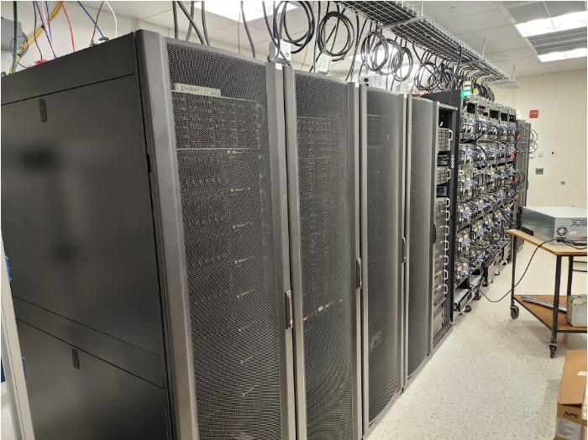
EHT Network Today
EHT stations’ network performance varies due to their remote locations.
  Some stations only have 100Mbps connectivity while only a couple have up to 10Gbps.
The Correlators have 10Gbps and 100Gbps capability.
  MIT-Haystack recently upgraded to 100Gbps
The last mile is one of the major bottlenecks for most sites
Stations are connected to R&E networks where available
The EHT would highly benefit utilizing these R&E networks as it would improve the success of our science research
Current pre-checks can take many hours to days to verify a station is ready for observations.

Slide 15
Issues identified with EHT stations
People Issues
  Many sites don’t have network engineers and some don’t have any IT at all.
  Funding and Hiring issues
  Sites that do have IT staff don’t have expertise in networking or security (Education)
  Staff are overworked and spread thin
  Not a priority since “Shipping disks” just works
Last Mile Issues connectivity issues (some extreme)
  Greenland, South Pole
Connections to regional networks
Internal Site Networking Issues
Instruments are very busy and scheduling time is a challenge
Notes:
Problems even in Hawaii getting staff time at the stations. Thats why this was done from the “Lunch Room”

Slide 16
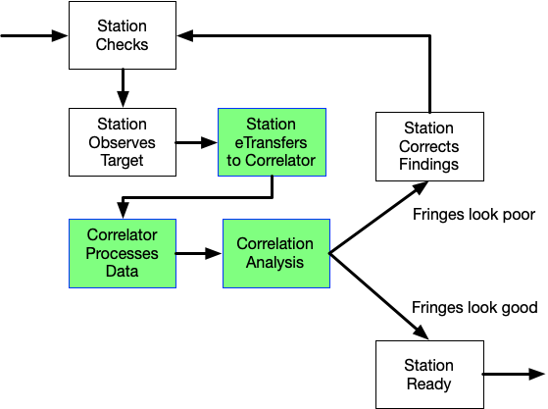
Using the networks- “EHT Precheck”
Quantify the network between station and correlator.
Check current performance (perfSonar)
Transfer actual observation data over the R&E networks live (m5copy)
Prepare the data on the correlator for processing
Kick-off correlation - Correlation will produce fringe plot and statistics of the cross-correlated data between 2 or more stations. (SMA and ALMA)
Analysis of the fringe plot, identifying any issues
Relay information to the stations for correction
Process takes less than 5 minutes per station
Repeat Precheck until correct
Nanosecond timing perfect between sites
Notes:
Demo in green of pre-check process

Slide 17
April 2025 Pre Check Results
Participating locations:
Northern Extended Millimeter Array (NOEMA) to James Clerk Maxwell Telescope(JCMT)
France <> Hawaii
Results:
Transfer speeds ~ 50mbps due to 1G internal switch bottleneck
Pre check was successfully completed and configuration was confirmed for the EHT run
Identified network improvements
Takeaways:
Helped us to identify potential future investments for better performance
Configuration was able to be verified before the run, leading to accurate data to analyze over the next year

Slide 18
Looking to the future
Increase engagement with global NREN community to support the pre check initiatives
Establish pre check as a part of the EHT process by proposing a model / template to integrate into operations
  Increase the number of sites participating in the pre check efforts
Install or add all perfsonar nodes at all sites to participate in the madd dashboard to monitor performance, site connectivity, latency etc
  Existing dashboard only has 3 sites

Slide 19
Acknowledgements
IN@IU is funded by
  US NSF award #2028501 for TransPAC5
  US NSF award #2028495 for NEA³R
Thanks:
  Florida International University
  University of Hawaii
  MIT
Notes:
‹#›

