Slide 1
FAST & FURIOUS
Leveraging EUMETCast Terrestrial and NREN Infrastructure for Efficient, Reliable Near Real-Time Weather Data Distribution
Ruth Britton & Rich Adam
Brighton
10th June 2025

Slide 2

Automatic Multicast Tunnelling (AMT) Relays
Dynamic Unicast tunnels for Multicast transport.
Current relay model Juniper MX204
100G connection to R&E and IAS tables
Certified for 95gbps encapsulation of 64byte multicast packets.
Anycast operation
There are still caveats (IPv6, multi-vendor and VMX)

Slide 3
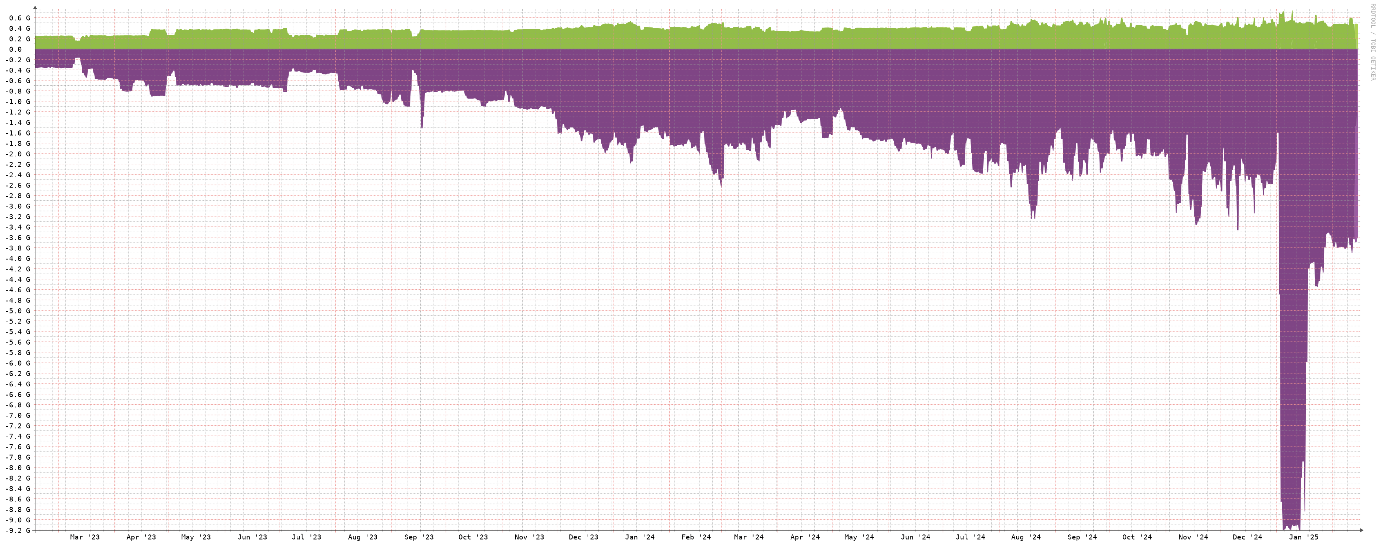
Service Usage
400mbps multicast streams encapsulated in 10-20gbps with peak of 30-40gbps.

Slide 4
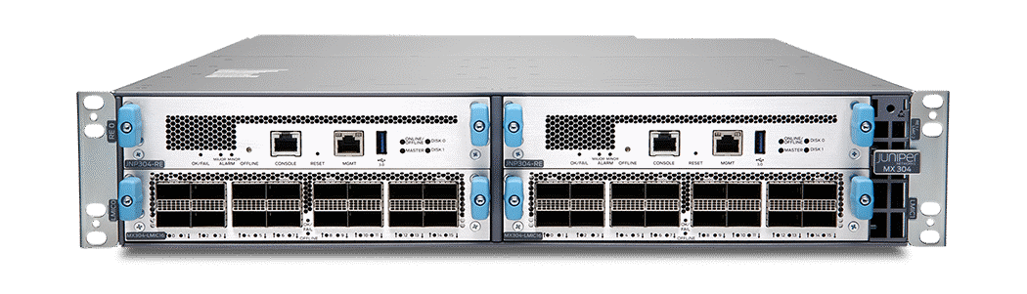
Into the Future
GRE vs. AMT
MX Upgrade path to 300G and beyond.
Feature request for Nokia
Live event streaming

Slide 5
Further Encapsulation
RFC9706 - TreeDN: Tree-Based Content Delivery Network (CDN) for Live Streaming to Mass Audiences
TreeDN POC deployment: https://www.treedn.net/
  Webpage/Portal with a list of active multicast streams
  Script periodically crawls through Looking Glasses at GEANT and I2 for multicast routes
  Can manually add streams as well
  Launch streams in browser or VLC to open
  Supports Offnet Sourcing
  Developed by Lauren Delwiche/Yale/TJHS
  Demonstrated in IETF 114 and IETF 115

Slide 6

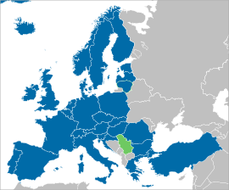

Introduction to EUMETSAT
European Organization for the Exploitation of Meteorological Satellites
Intergovernmental public sector organization created in 1986 through an international convention and agreed by a current total of 30 European Member States.
Primary objective is to establish, maintain and exploit European systems of operational meteorological satellites. EUMETSAT is responsible for the launch and operation of the satellites and for delivering satellite data to end-users as well as contributing to the operational monitoring of climate and the detection of global climate changes.
Established cooperation with operators of Earth observation satellites from Europe, China, India, Japan, Russia, South Korea and the United States

Slide 7
EUMETCast System Overview

Slide 8
EUMETCast Terrestrial over AMT

Slide 9
EUMETCast Terrestrial over AMT - Implementation
Technical
Highly scalable and redundant solution which builds upon existing infrastructure, software, and interfaces
Collaboration with GÉANT for the installation of 3 AMT Relays (HW) in their multicast network, each with direct access to data incoming from TelliCast server
Operational
Relies on existing operational tools for service monitoring
Tests have shown a file-based availability greater than 99.95% for a 400Mbps data stream, which is equivalent to the EUMETCast Satellite SLA
Security
User access is strictly controlled to ensure that only authorised users have access to the data.
Builds on top of EUMETCast Terrestrial security features, which use authentication and encryption to ensure EUMETSAT’s data is securely transferred
EUMETCast Reception stations will host the AMT Gateway and EKU-less TelliCast Client software, with no reliance on physical hardware
AMT deprecates the use of GRE tunnels, reducing maintenance overhead
Preserves the integrity of the EUMETCast Service by maintaining internal and external interfaces
Possibility to on-board up to ~ 200 users (each at 400 Mbps bandwidth)

Slide 10
Automatic Multicast Tunnelling - Advantages
Carrier Independence
Works across different types of networks
Software-based solution
No dedicated hardware required
Simple setup
Simple and straight-forward setup process
Allows flexibility and adaptability for users
Can be installed on a virtual machine or physical hardware
Setup for AMT Gateway software < 30 minutes
NAT Traversal
Firewall friendly
Cloud friendly
AMT tunnel initiated by end-user reception equipment
Works seamlessly across networks that use Network Address Translation
No need for router configuration by end-users
Should not require any firewall rules updates for correct operation
Easy to integrate into cloud-based environments

Slide 11
EUMETCast Terrestrial over AMT – Deployment
Simple and straight-forward setup, with ansible scripts available for quick installation
Steps:
Registration: Users follow the standard EUMETCast Terrestrial registration process via EO Portal
Credentials: EUMETSAT Helpdesk provides TelliCast credentials once registration is finalised
Station setup: Users create a EUMETCast Terrestrial over AMT station using a pre-prepared ansible script
SW Installation: Software is installed and activated automatically allowing the user to start receiving data according to EO Portal subscription

Slide 12
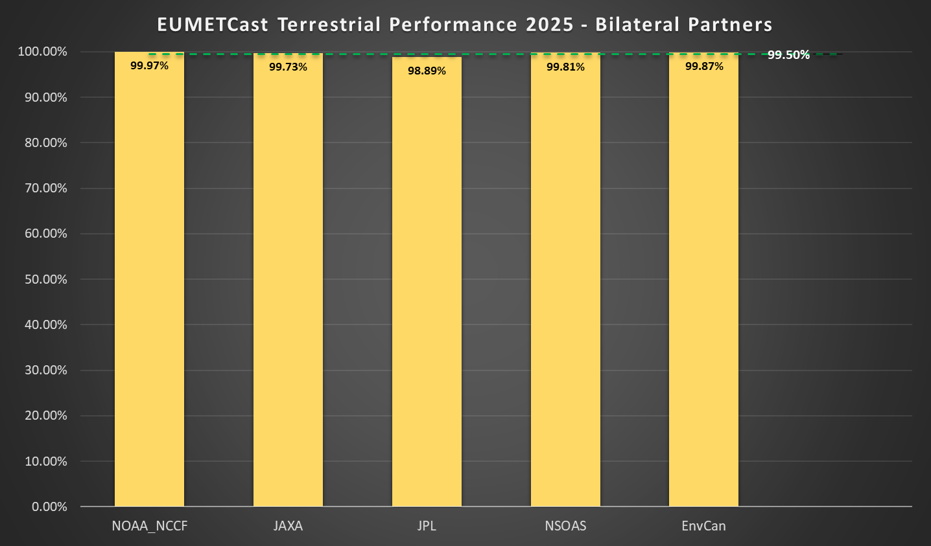
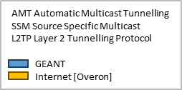
EUMETCast Terrestrial over AMT - Performance
Average file-based availability EUMETCast Terrestrial for Bilateral partners from January to April 2025 shows ~99.65% (dependent on user’s last mile connectivity)
Overall availability for users of the EUMETCast Terrestrial services from January to April 2025 (including GRE, AMT, Internet and native multicast services) is 99.95%, with files arriving at end-user Reception station shortly after they are made available in EUMETSAT.

Slide 13
Thank you
Any questions?
richard.adam@geant.org
ruth.britton@eumetsat.int

