Slide 1
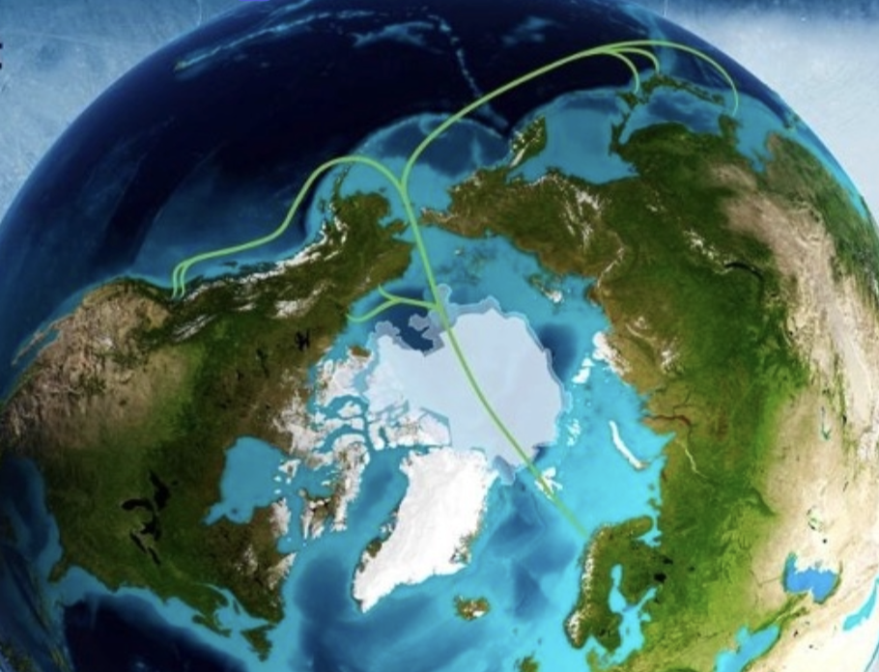
Technological and scientific opportunities with submarine cables -with focus on Polar Connect
12th june 2025
Olaf Schjelderup, Sikt and NORDUnet

Slide 2
Polar Connect – a new, unique and innovative cable route
Shortest and safest cable route between Northern Europe and East-Asia. Possible brances to Canada and US.
From Northern-Norway to Japan, 10.000km, > 20 Terabit/s per fiber pair.
Increases digital sovereignty for Europe and Asia, and increases resilence for GREN and the global internet. Today´s routes are much longer and some of them passes geopolitical challenged regions,.
Opens up for more climate-friendly IT-industry by moving the digital gravity center in Europe northwards – with clean energy and natural cooling.
3 project stages have received Co-funding from EU. Run by the Swedish Research Council/Polar Research Secretariat and NORDUnet.
Several industrial partners have embarked
Ready from ca. 2031

Slide 3
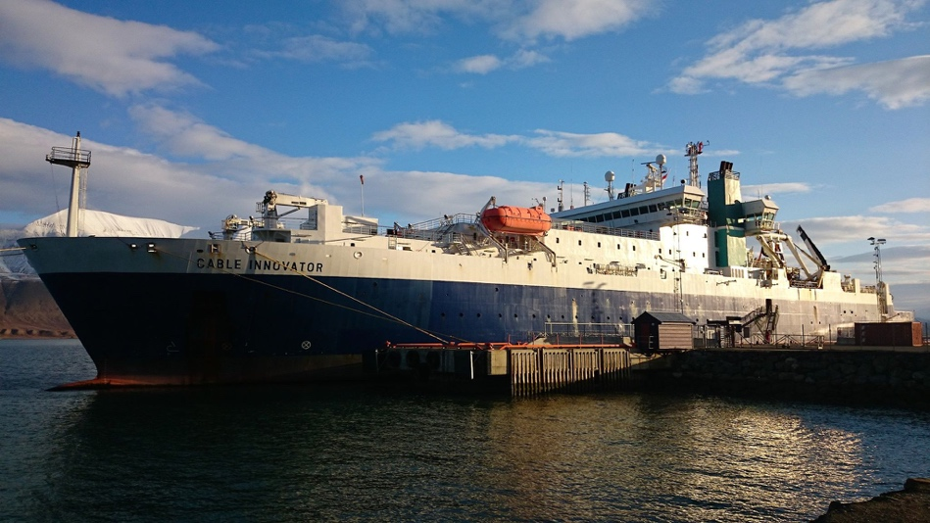
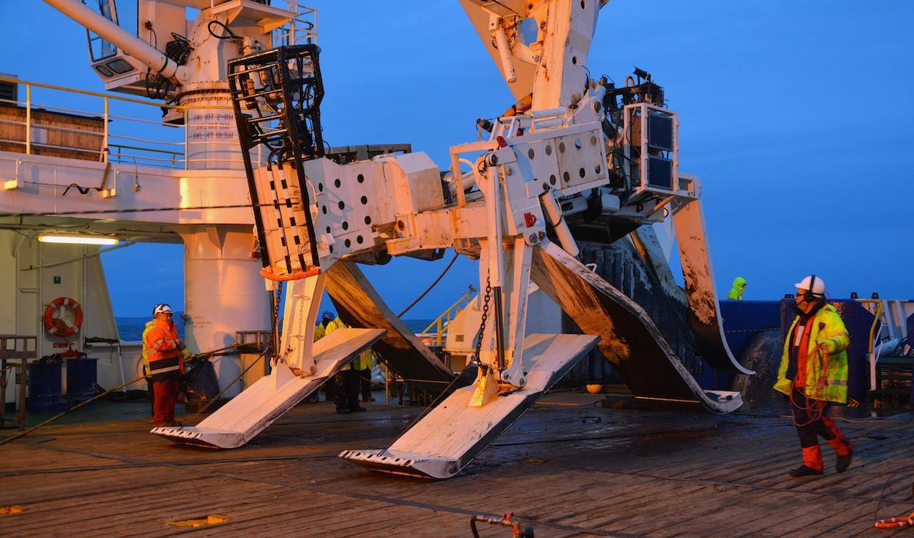
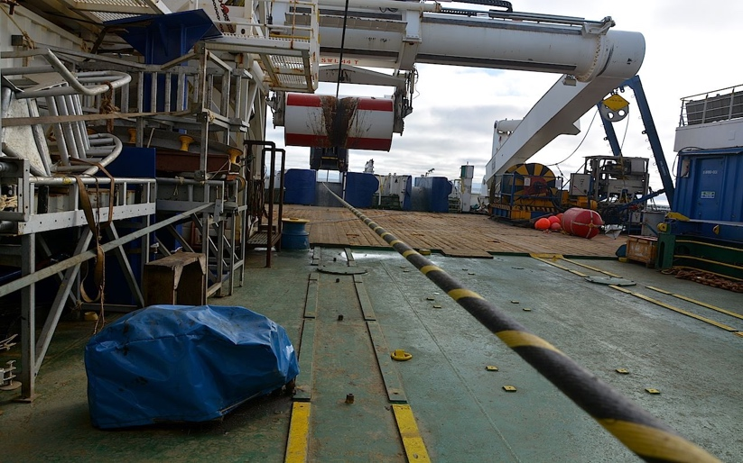
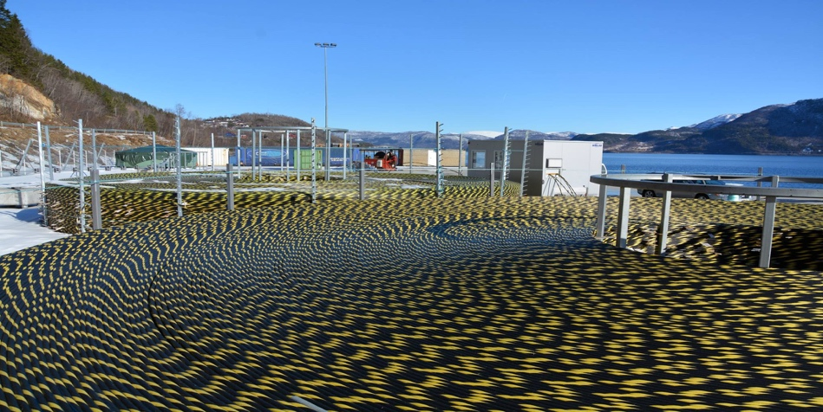
A tribute to the submarine cable laying industry
Extremely skilled and advanced industry in many fields. Many stages involved bulding a cable system, among them:
Project admin and business model
Cable route proposals and decision
Permits
Pre-lay route survey
Cable design and manufacture
Pre-Lay Grapnel Run
Mobilization and operations of ships
Main lay and burial
Landings and landing stations
Post-lay inspection
Photos: Helge Stranden, Uninett. Laying of the Sikt/Uninett-cable outside Svalbard
Most of these stages are Technology and Science/Research driven

Slide 4
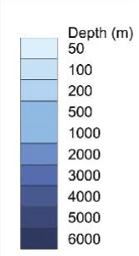
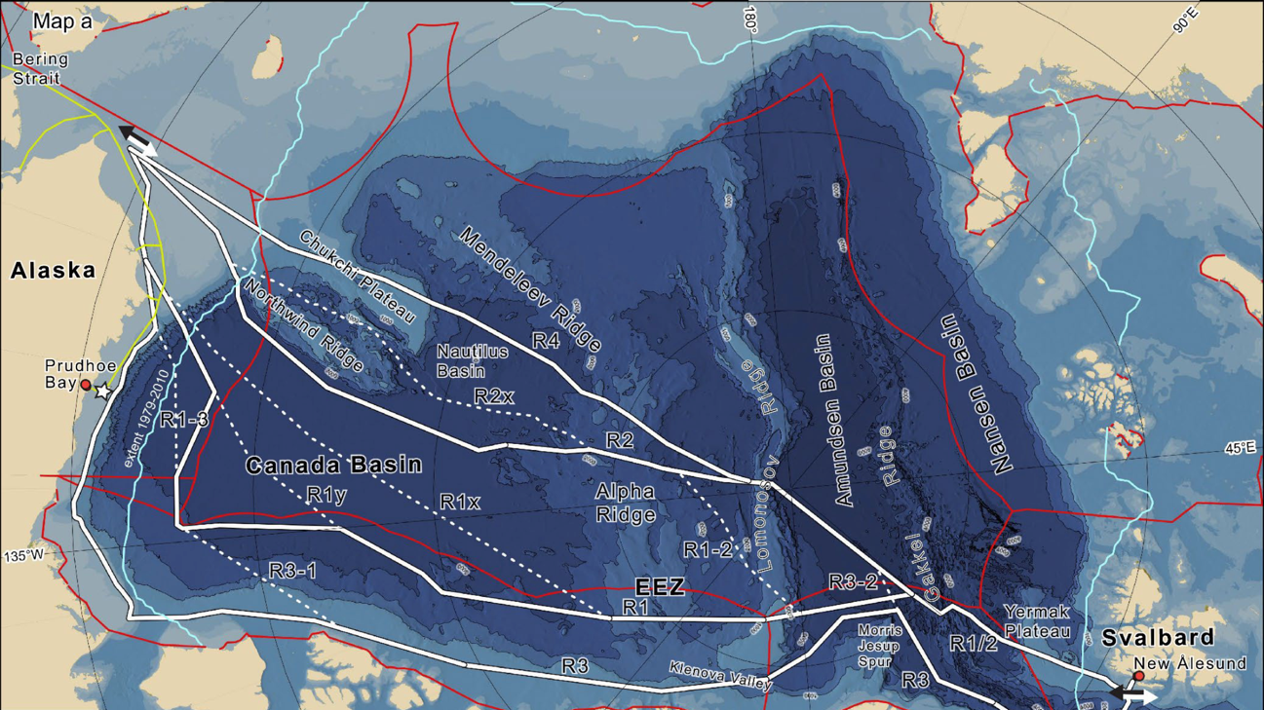
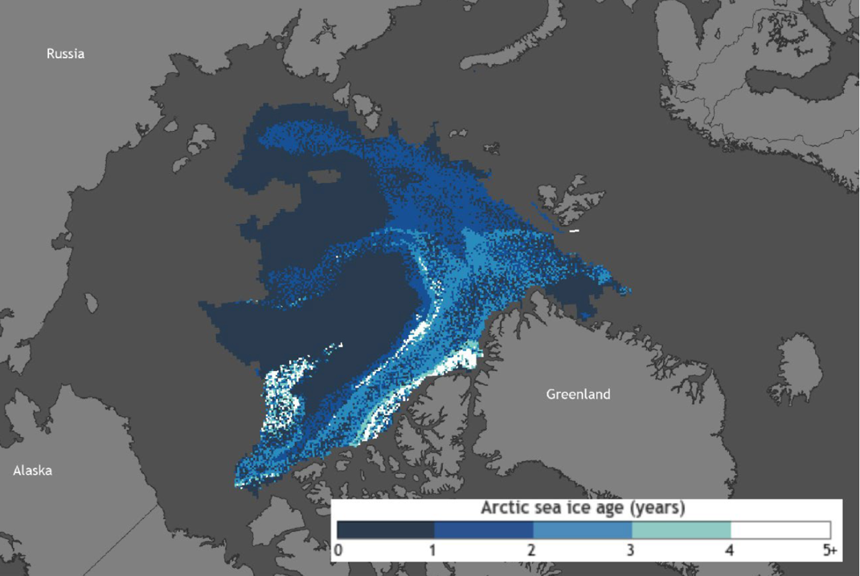
Central Arctic Ocean
Unexplored – only 25% chartered
4000 meters deep basins
Covered by an ice cap
2-6 m thick
2000 km edge-to-edge in summer (expands horizontally in winter)
Different kinds of ice: 1 year vs multi-year ice
Inaccessible in the winter without a heavy icebreaker (Polar Class 1-2)
09/03 2024
4
Notes:
Largely unexplored – 25% chartered
4000 meters deep basins and some ridge crossings
2-6 m thick but can change dramatically (0 m-ridges of 15 m)
The ice cap is 2000 km edge-to-edge in summer. Expands horizontally (not vertically) in winter.

Slide 5
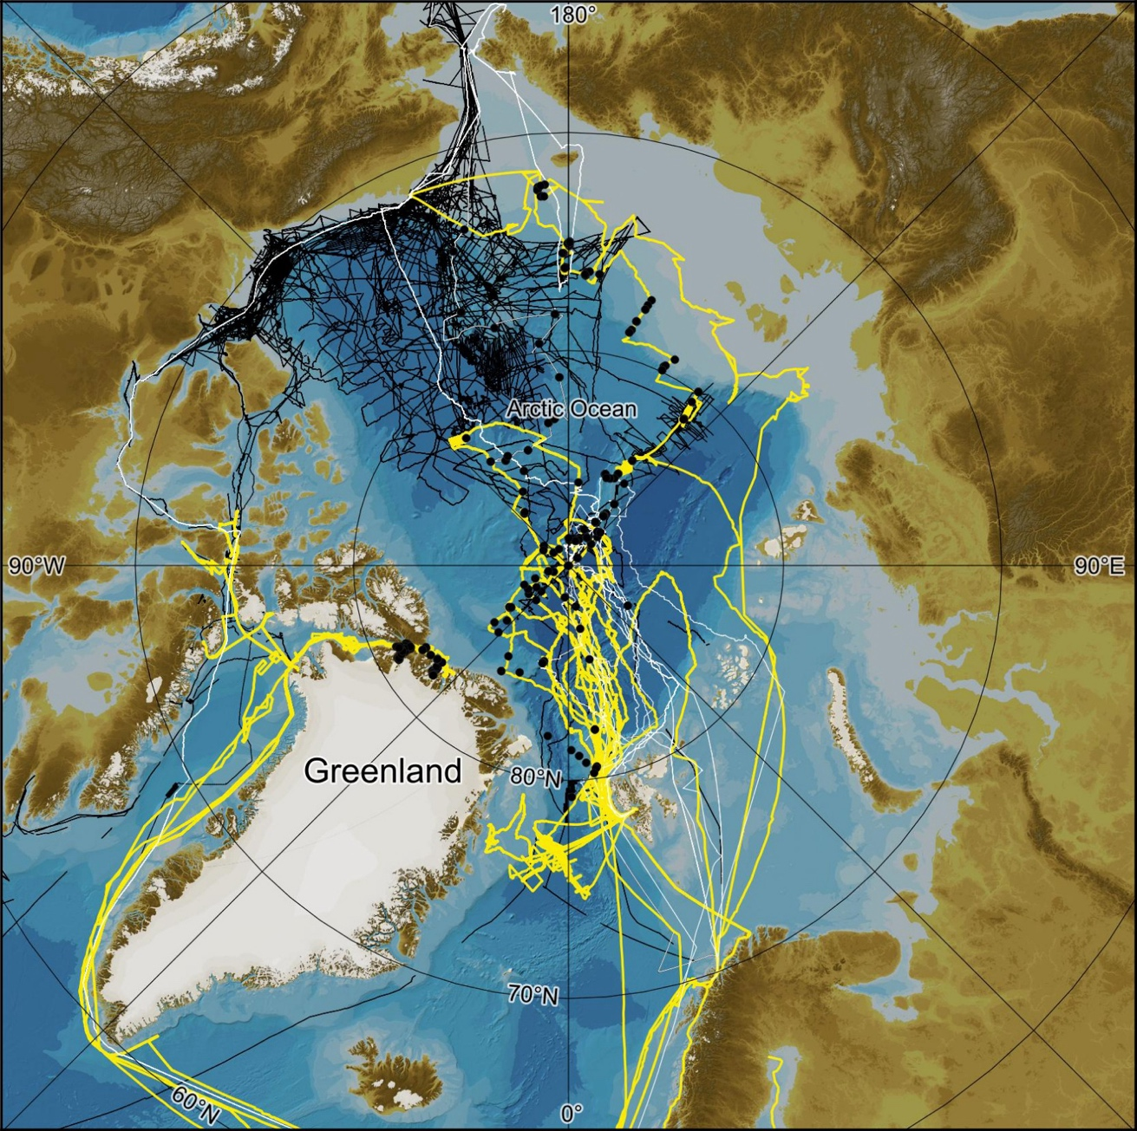
About the Swedish Polar Research Secretariat (SPRS)
Unique experience and access to the world’s heaviest research icebreaker Oden.
29 Arctic expeditions with IB Oden since 1991
The SPRS’s crews’ captains are “ice whisperers”
Close collaboration with Canada
Have written the technical specification and started the procurement for a new Swedish heavy icebreaker, able to do maintenance in the Arctic year round
Multibeam tracks in yellow
09/03 2024
5
Notes:
Black lines represent the Canadian seafloor mapping.

Slide 6
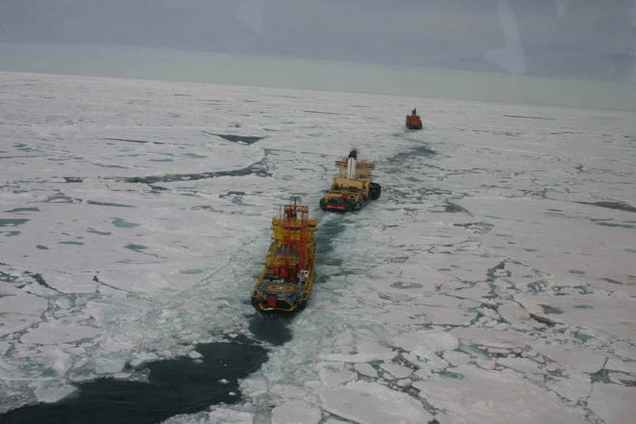
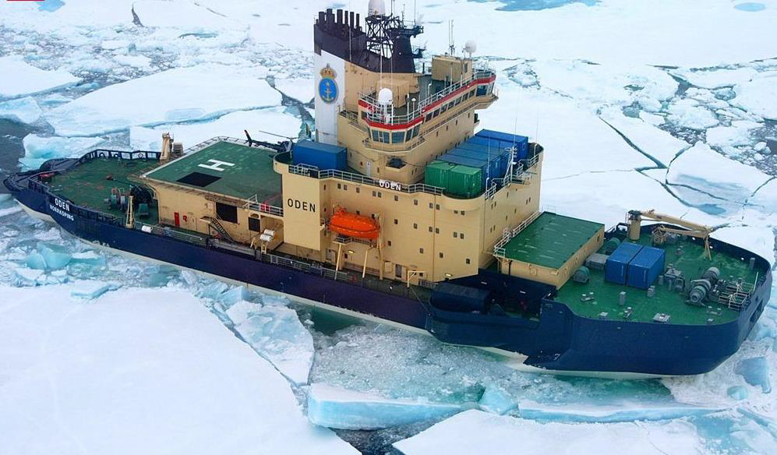
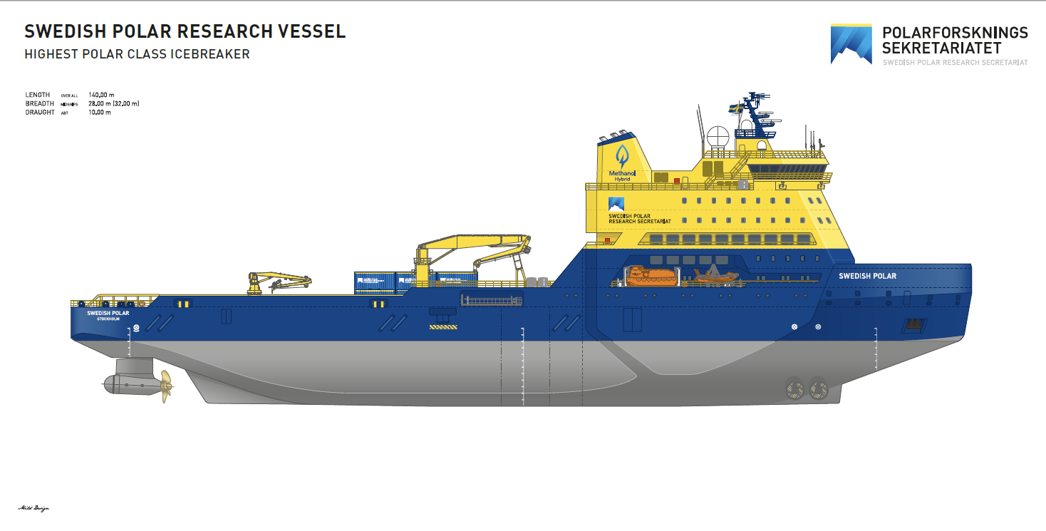
Three wessel approach to deploy a fiber optic cable across the Arctic – creating a corridor for a polar class cable ship
Crossing the North Pole Ice in estimated 42 days
Notes:
In 2004
Exp 302 – Platforms at Sea
Three platforms were used during the offshore phase of the Arctic Coring Expedition: the drillship Vidar Viking and two icebreakers, Oden and Sovetskiy Soyuz (7 August - 15 September 2004).
We would estimate to lay the cable could be done during one summer.
So in essence we need two icebreakers and a cable laying ship (capable for the arctic conditions).
Within the Swedish government there is discussion, about the build of of the highest class ice breaker, comparable to Russia largest ice breakers.
The current timeline is well within the 2030 vision.
Rear part of the ice breaker can be exchanged with other parts and equipment and more features
11 000 km totalt, kan göras i tre steg
Korea/Japan – Kanada/Alaska
Svalbard – Kanada/Alaska
Skandinavien – Spitsbergen

Slide 7
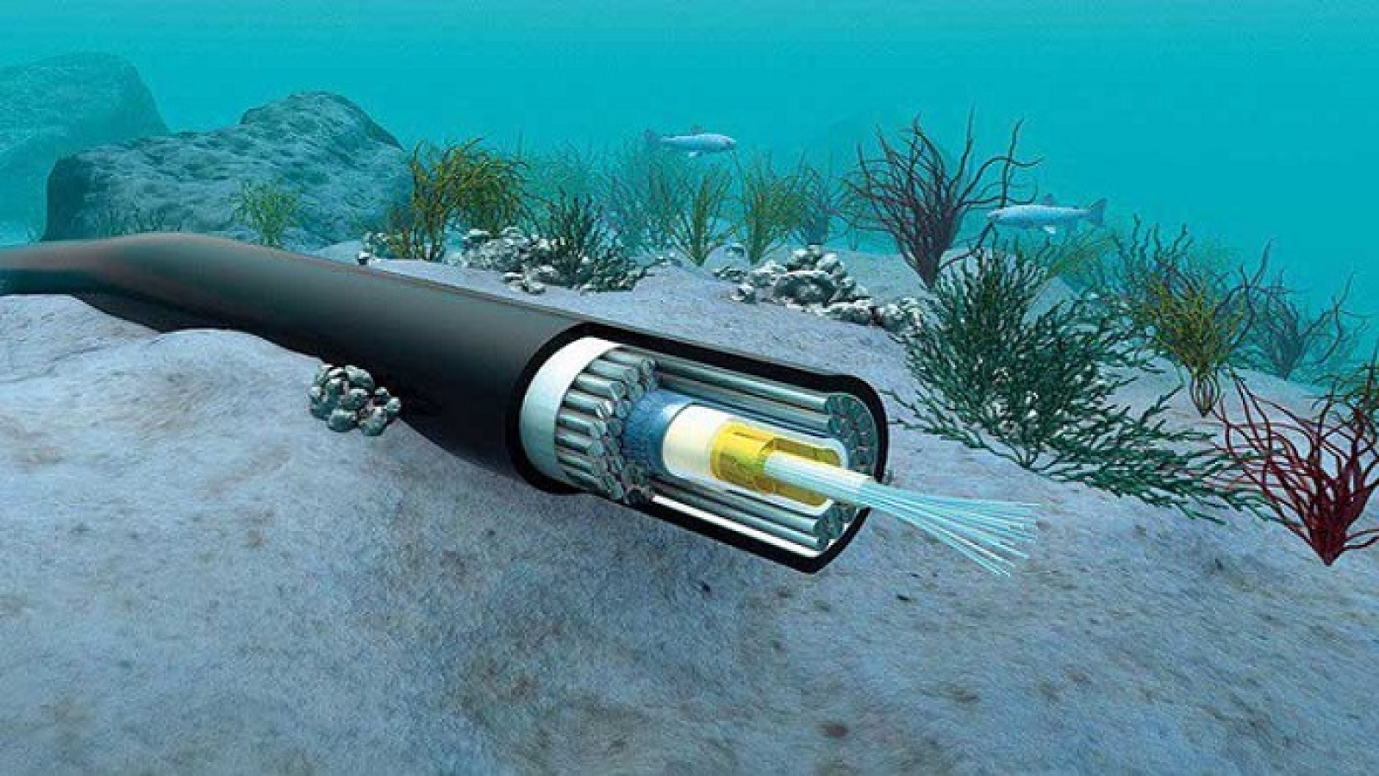
Science and Research with sensors applied to fiber optic cables
Sensors permanently embedded into the cable (SMART cables, CC nodes):
The fiber inside the cable as a sensor (Distributed Optical Fiber Sensing, DOFS):
Rapid development in sensing on submarine fiber cables!
https://dpi.ac/submarine-communication-cable/

Slide 8
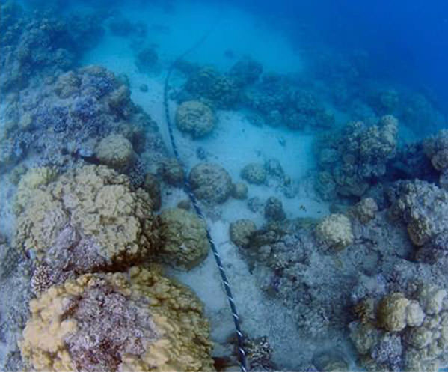
Distributed Optical Fiber Sensing (DOFS)
Measuring along the optical fiber
Scattering based:
Rayleigh (DAS, strain and temperature)
Raman (DTS, temperature only)
Brillouin (DSTS, strain and temperature)
Forward transmission based:
State Of Polarization
Interferometric (on received signal or Fiber Bragg Grating reflected signal)
https://www.asn.com/fiber-sensing/
Notes:
Fiber Bragg Grating: use UV light to create reflector in fiber that acts as a grate. A certain frequency will be reflected and the frequency will change if the fiber is bent/stretched
Rayleight: Primary reason for attenuation of the wave. With DAS we can detect acoustic waves and temperature changes - if the cable is compressed, strained, bend, elongations and refractive index of the fiber vary and the scattered signal changes. Elastic scattering – no change in frequency
Raman: only temperature matters. Inelastic scattering (like Brillouin). Interaction of light with molecules/ molecular vibrations. If molecules excited, an anti stokes photon can be created, with higher energy. Large gain spectrum - Raman Amplifier, pump in reverse direction, at 13 THz higher frequency, or 100 nm lower wavelength, any wavelength can be amplified - used in submarine cables!
Brillouin: scattering depends intrinsicly on strain and temperature.
interaction of the light wave with a carrier-deformation wave inelastic interaction with acoustic waves - phase matching relevant, only certain directions allowed. Bulk properties of material are important -

Slide 9
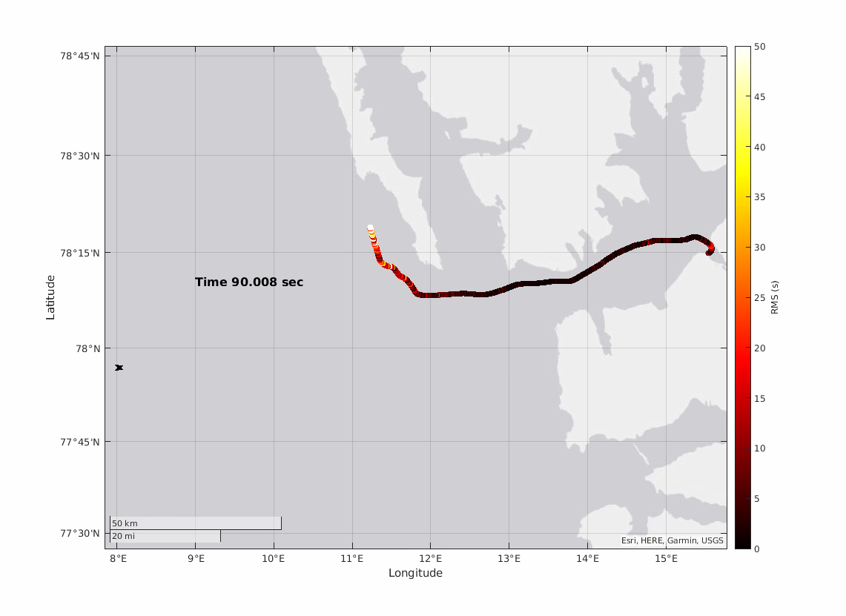
Distributed Acoustic Sensing - DAS “turning an optical fiber into a long microphone”
DAS unit on shore sends frequency swept pulses into the fiber and measure tiny phase changes in the scattered signal.
The fiber is synthesized into an array of sensors measuring acoustic energy by recording tiny strains.
Ordinary telecom fiber optic cables
High spatial resolution (~ 1-2 m)
Measurement over 100 km of cable
Image by prof. Martin Landrø, NTNU
Earth quake

Slide 10
Interrogator - OptoDAS, made by ASN, Trondheim)
High precision sweeping laser, FPGA preprocessing circuitry
Sending fast pacing sweeping pulses into the fiber, records phase shifts in backscattered signal
Both C-band and L-band
Reach 100-150km in basic setup
Can handle multiple fiber legs:
MUX (4 cables simultanously)
With Optical Switch > 100 fibers, one at a time.
Runs Linux and processing software, equipped with storage and GigE-interfaces.

Slide 11
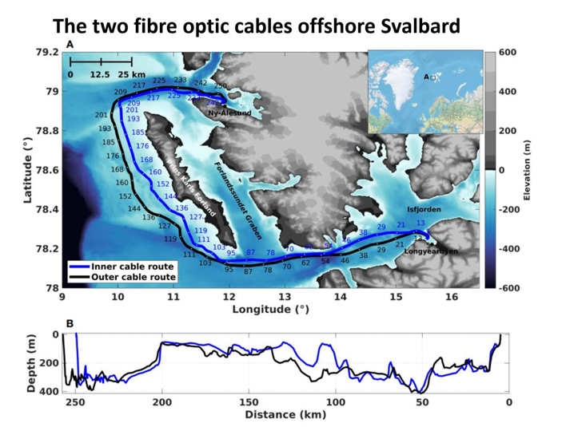
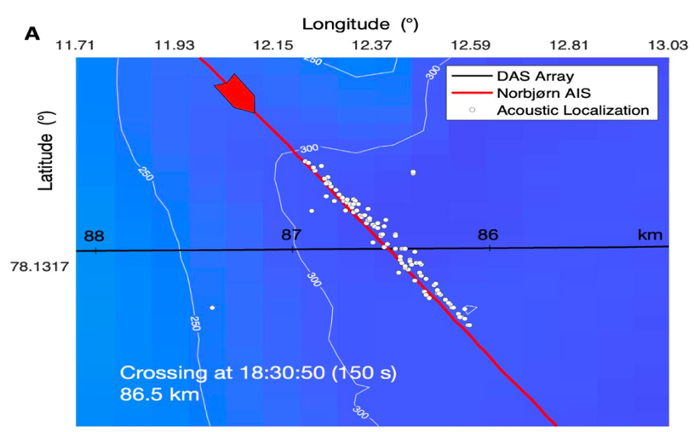
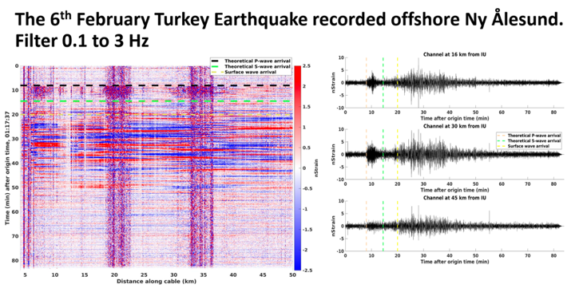
DAS on Sikt´s submarine cables outside Svalbard. 7TB raw data per day per interrogator.
Notes:
OptoDAS in the North Sea; 10 times more earthquackes were detected, compared with previous setups.

Slide 12
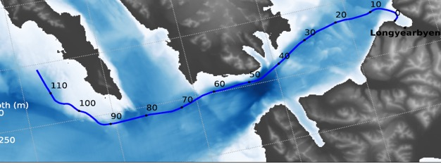
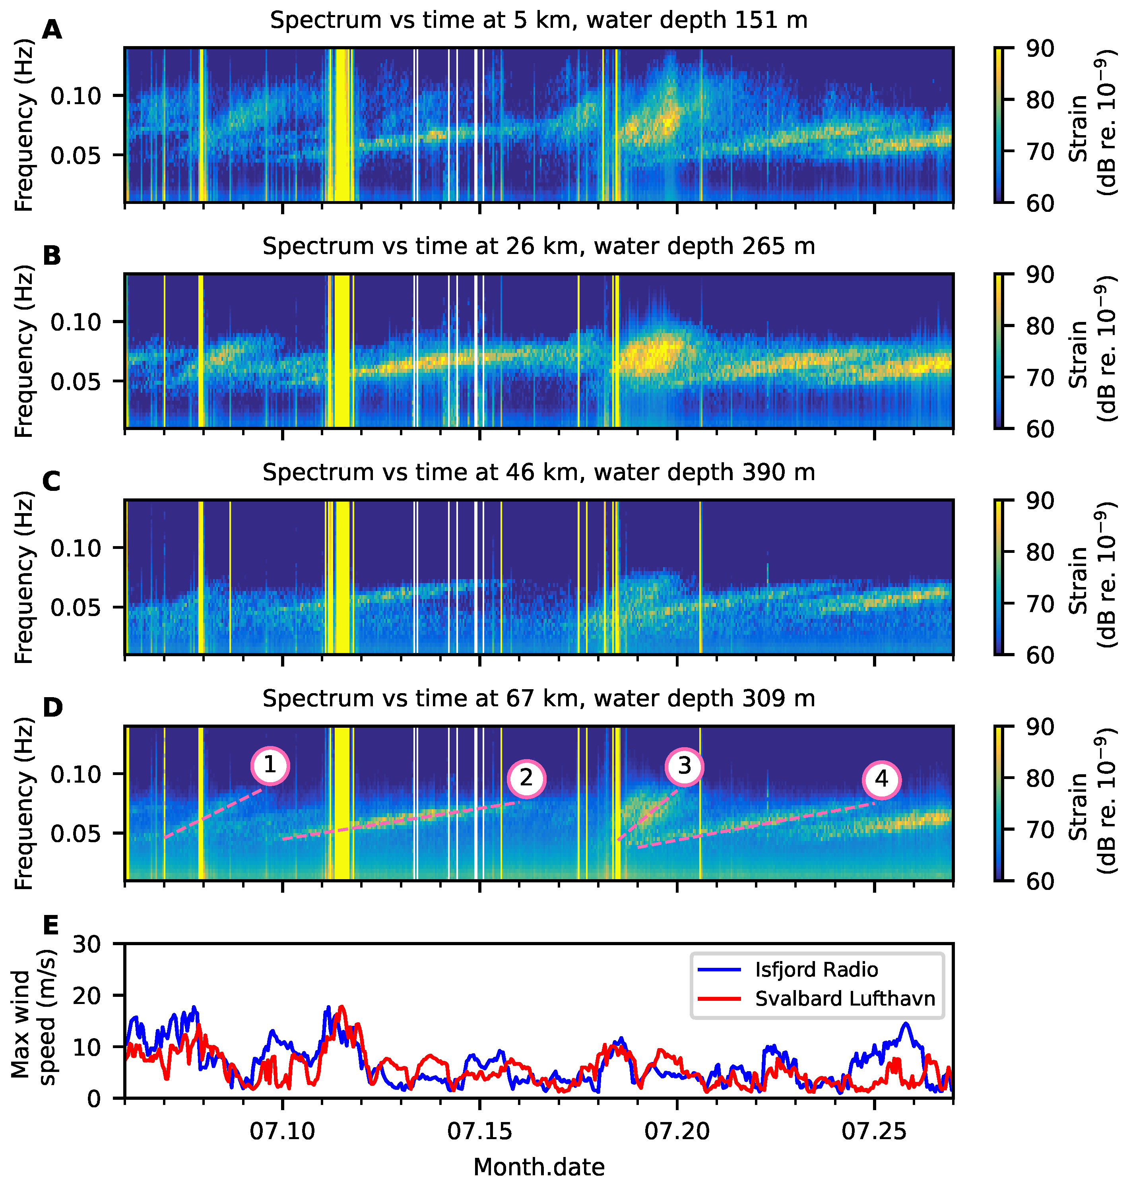
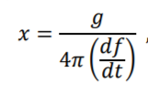
Low frequency DAS – Distant storms
* Svalbard Lufthavn
* Isfjord radio
Munk, 1963:
1: Edouard 4100 km
2: Offshore Brazil, 13000 km
3: Storm between Iceland and Greenland 2400 km
4: Offshore Brazil, 11 000 km
Source: Martin Landrø et al., Sensing whales, storms, ships
and earthquakes using an Arctic fibre optic cable, Nature Published: 10 November 2022, https://www.nature.com/articles/s41598-022-23606-x

Slide 13
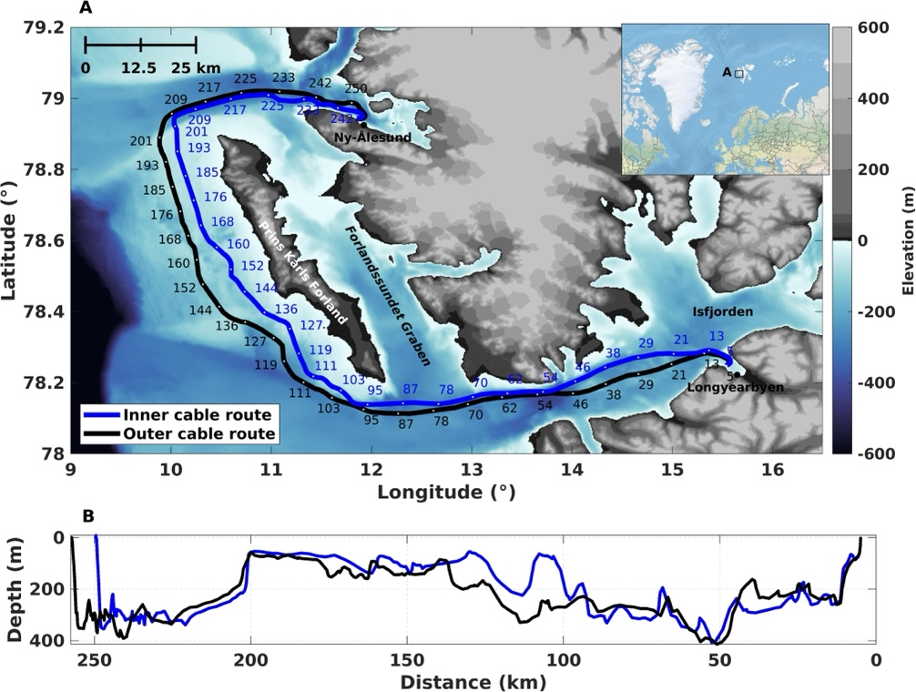
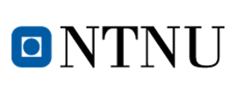
Field test 2023: comparing DAS sensitivity over DWDM vs. dark fiber
L–band DAS (OptoDAS, ASN) connected to Nokia DWDM and C-band DAS connected to dark fiber over the same cable
We have demonstrated uncompromised L-band DAS and telecom coexistence by showing equal event amplitude between L-band DAS muxed onto Live live telecom link and C-band DAS interrogating a dark fiber in the same submarine cable, and unaffected pre-FEC BER, post-FEC BER and Q-factor.
125 km
125 km
Ny-Ålesund
Longyearbyen
DAS
Dedicated Fiber
Tx
$$λ_{1}$$
$$λ_{1}$$
Rx
Tx
$$λ_{2}$$
DWDM
DWDM
$$λ_{2}$$
Rx
EDFA
Several channels at X00 Gbps per 𝜆
EDFA
…
…
DAS Signal multiplexed with other communication traffic. DAS at L-band
Raman Pump
DAS
250 km

Slide 14
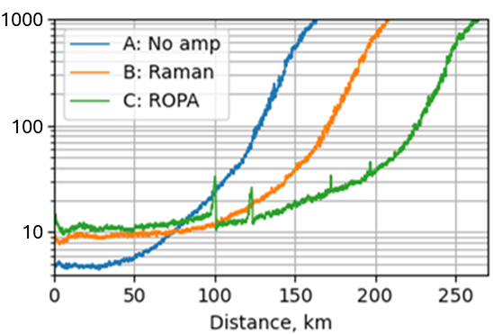
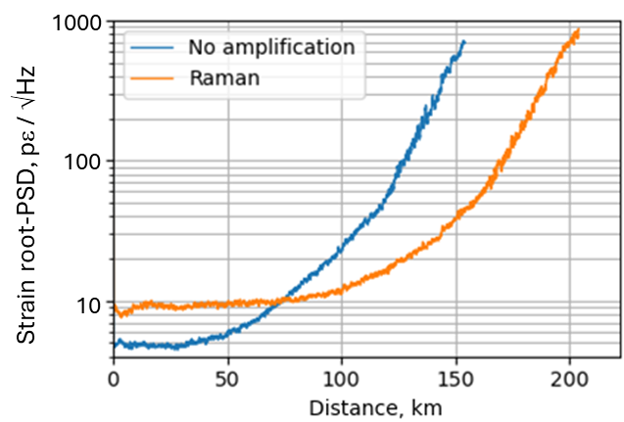
Well-known “telecom techniques” extending the DAS range on passive cables
Raman amplification:
Optical RAMAN pump on shore enables distributed amplification in the fibre
Retrofit possible
Pump
ROPA
(assuming 0.166 dB/km)
ROPA (Remote Optical Pump Amplifier):
Optical pump on shore
Addition of passive in-line Erbium fibre (EDF) points along the cable
Same ROPA as telecom systems
Addition of a custom engineered fibre at the far end gives a +10dB addition in backscatter, thus increasing range to over 300km.
DAS system self-noise VS. fiber position
DAS system self-noise VS. fiber position
+45km
+55km
+45km
+40km
+42km
+40km
Several others, among them SUNET and DTU, have also demonstrated that Raman can extend the reach.
OptoDAS + ROPA
OptoDAS + Raman
OptoDAS
Rønnekleiv, et. al. “DAS with 302 km sensing range using remote amplification and engineered fiber”, Paper Tu3.6, OFS-29, 2025.
Notes:
Detection of weak strain signals (30pstrain/rtHz):
No amp: 105 km
Raman: 144 km
ROPA: 186 km

Slide 15
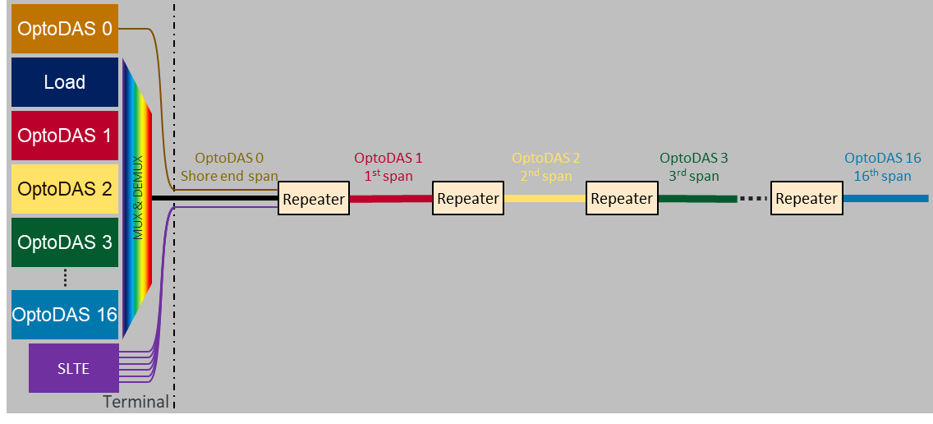
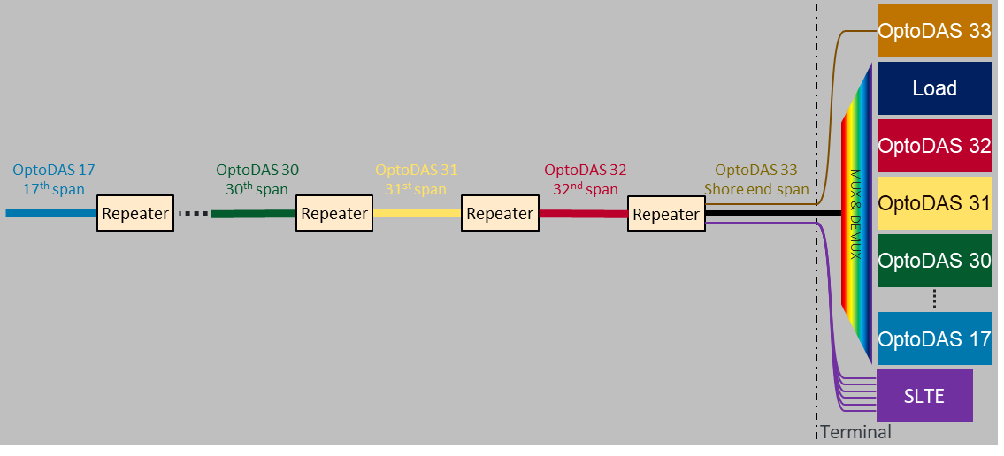
ASN´s solution for repeatered DAS, using adapted repeater technology
Full link coverage by covering one half from each shore end
Shore-to-shore DAS measurements feasible across the full link length, with:
One dedicated fiber pair
Spatial resolution: ≥ 2 m
Sampling frequency: 1 kHz
High-end DAS sensitivity enabling detection of trawls, anchors, sabotage, seismic waves, mammals and for oceanography studies ++
Scalable system topology for 1000’s of km long links

Slide 16
ASN´s promising results from a 2,227 km repeatered line testbed
DAS
Repeater
Repeater
Repeater
Repeater
Repeater
Repeater
Repeater
Repeater
Terminal
2,227 km
40km
50km
1000’s of km
Scalable system topology for 1000’s of km long links
Constant sensitivity along the cable
This is basically a POC showing that high quality DAS under the north pole ice cap is possible –and with much longer reach beyond that!

Slide 17
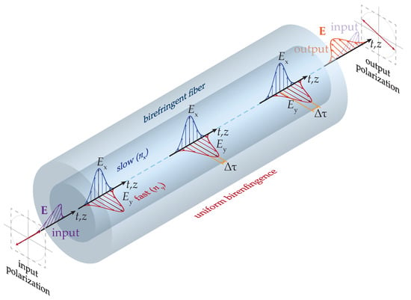
State of Polarisation (SOP) Sensing
Works in existing optical DWDM telecom network equipment by injecting an alien high stability laser signal.
Less sensitive than DAS, but also cheaper
Measures cumulated changes in polarisation of light, caused by events along the cable. Detects changes in strain, pressure and temperature.
Good at detecting changes in the cable layout geometry – useful for telecoms
Measures over long distances (10 000 km)
Calculating the localization of the disturbance by
Using bidirectional laser signals and high precision synchronized timing at the landfalls to calculate the location
Measuring the difference in arrival time caused by chromatic dispersion from different wavelengts.
(NTNU, Sikt, Tampnet, SUBMERSE project)
Dubovan et al. 2020
More on SOP in the side meeting 0900-1300 tomorrow, presented by Kurosh Bozorgebrahimi.
Notes:
- Based on fiber birefringence: the refractive index of the fiber depends on the polarisation of the light
In turn, different group velocities of the two orthogonally polarized modes lead to changes in polarisation characteristics of the light
- two polarimeters using light with different wavelengths uses frequency dependency of the speed of light
Dubovan, Jozef, Jan Litvik, Daniel Benedikovic, Jarmila Mullerova, Ivan Glesk, Andrej Veselovsky, and Milan Dado. “Impact of Wind Gust on High-Speed Characteristics of Polarization Mode Dispersion in Optical Power Ground Wire Cables.” Sensors 20, no. 24 (January 2020): 7110. https://doi.org/10.3390/s20247110.
Figure 1. Schematics of the uniform birefringence and its influence on the polarization state of orthogonal modes propagating along the optical fiber.
Fig. 2. a) SOP variation frequency analysis during the 21 August 2022 ML2.70 earthquake. From DAS analysis, the timing of the on-set of the P-wave (red) and the S-wave (green) and the duration of the signal (signal ending time at DAS: black) is shown. b) DAS plot for the same earthquake. The DAS signals are analyzed from two interrogators situated on each side of the cable. The interrogator in Longyearbyen is set as zero distance. c) Frequency analysis from the DAS plots during the same earthquake for different distances along the cable.

Slide 18
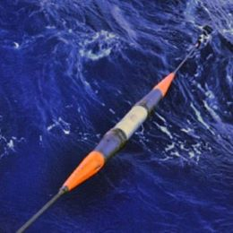
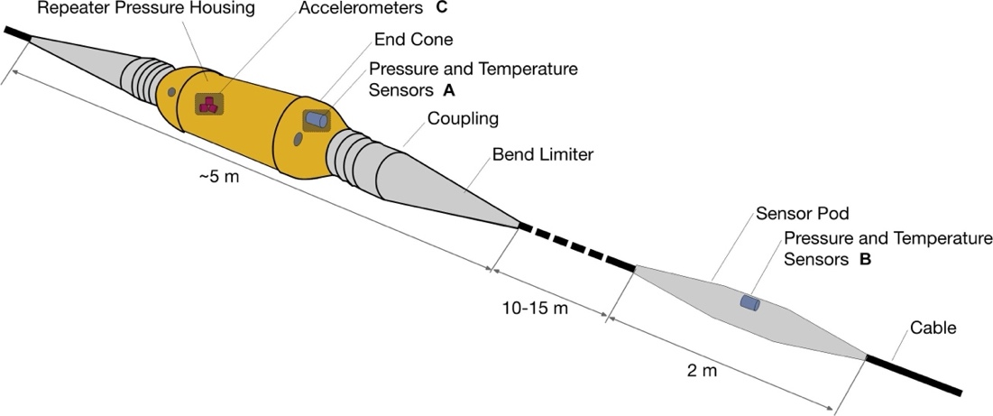
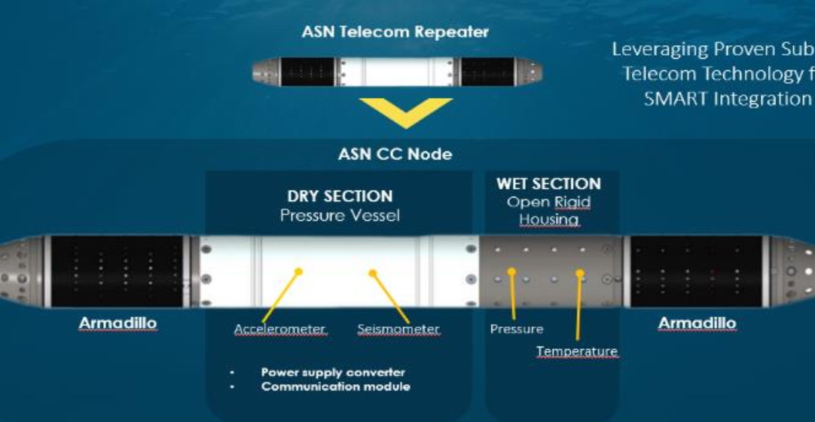
SMART cables
Science Monitoring And Reliable Telecommunications
Use power from cable and use the telecom part of the cable to send data.
Sensor housing either within or “in series” with the repeater node.
"Climate Change nodes” (CC-Nodes - ASN) measure:
ocean bottom water temperature
ocean bottom pressure
seismic motion (acceleration & velocity)
Challenges:
Power supply with very long cables
Maintenance of sensors, drift in sensors, biofouling
Howe et al. 2019
Joint Task Force on SMART cables
https://www.smartcables.org/smart
Notes:
Scientific monitoring and research & Security and health of the cable
Howe, Bruce M., Brian K. Arbic, Jérome Aucan, Christopher R. Barnes, Nigel Bayliff, Nathan Becker, Rhett Butler, et al. “SMART Cables for Observing the Global Ocean: Science and Implementation.” Frontiers in Marine Science 6 (August 2, 2019): 424. https://doi.org/10.3389/fmars.2019.00424.

Slide 19
Quantum sensors – for extreme sensitivity and stability
Quantum Technology
Quantum Computing
Quantum Communication
Quantum Sensors
Quantum sensors could be embedded in CC-nodes in SMART cables
Relevant quantum sensors:
Single photon detection
Magnetometers
Gravity sensors
Accelerometers
Gyroscope
Temperature
Photo: AZoQuantum

Slide 20
Kongsberg´s suggested solution for an ultra stable quantum based temperature sensor (-> 5 sekund)
Custom designed Quartz crystal element, simple electronics fitting into a SMART Cable Housing. Sub milliwatts power consumption.
MilliKelvin accuracy. No drift and stable over decades.
The sensor sends an “tone” which represent temperature -> translated to a specific optical wavelength injected into the optical line system towards landing station.
Signal comparison with an atomic clock signal on the landing stations, calculating exact temperature
High numbers of sensors could be fit in series into a submarine cable system
Could be combined with other similar types of sensors, for instance measuring pressure.
Patents pending
This also demonstrate the relevance of Time&Frequency transfer in NRENs

Slide 21
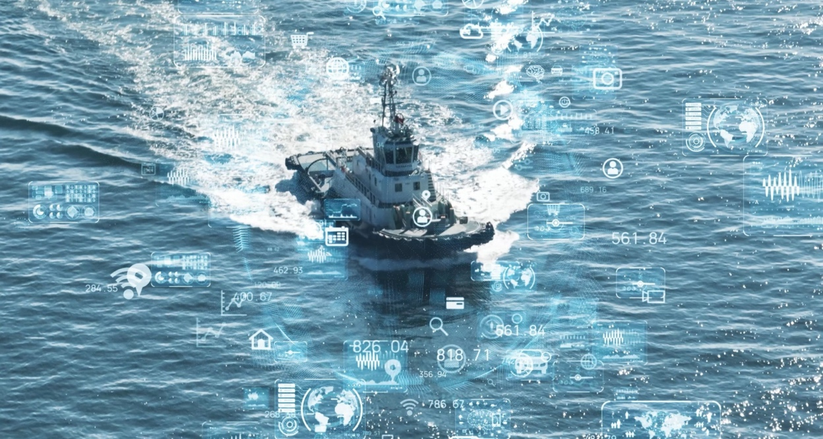
Cables, permissions and national security
Permission are needed for both cable laying and sensing in territorial waters and exclusive economic zones
Acoustical recordings of protected and sensitive objects (for instance military wessels) that in wrong hands may harm national security, are considered illegal in several countries.
Filtering techniques can remove sensitive signals so that the rest of the data could be shared for research and security enchancing purposes. A government trusted entity could be granted such a task on a national level.
Huge potential utilizing AI for doing rapid auto-filtering and -screening. Model training requires both a lot of data, researchers and security competence.
Photo: Aranca (AI)

Slide 22
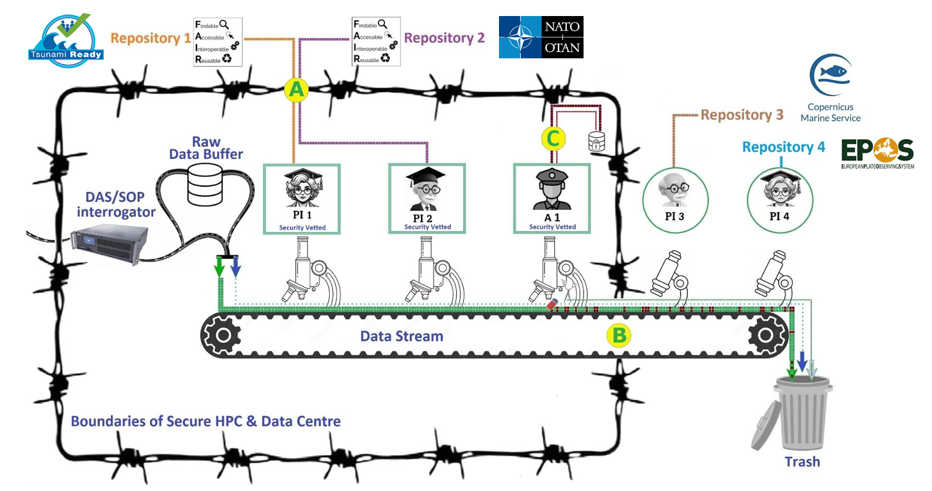
The FOS Trusted Research Environment (TRE)

Slide 23
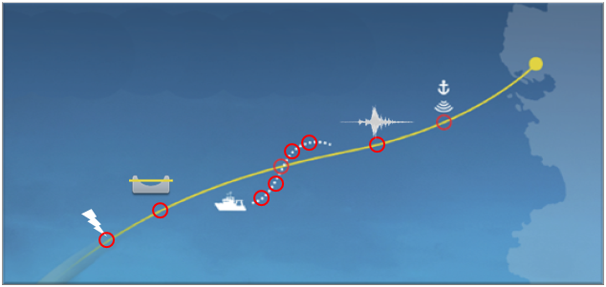
DAS for protection, enhanced security and derisking
Cable condition
Abrasion, movement, burial condition, faults
Cable threats
Seabed fishing, anchoring, submarine operation, physical contact and sabotage attempts
Surveillance
Seismic imaging, vessels, explosions, earthquakes and tsunami risks, marine life, ocean currents, weather impact
Huge potential in many terrestrial infrastructure areas as well; railroads, roads, tunnels, bridges, pipelines, power grids, avalanche detection, perimeter monitoring etc.

Slide 24
Unique science opportunities by cable sensing
Oceanography
ocean temperature
internal waves
upwelling,
current velocities, turbulent mixing, wave height
Climate
sea level change
ocean heat content
ocean circulation)
Geophysics / Seismology
earthquakes, underwater volcanoes, tsunamis
Marine biology
tracking mammals by their sound
Plus; Science&Security=True!

Slide 25
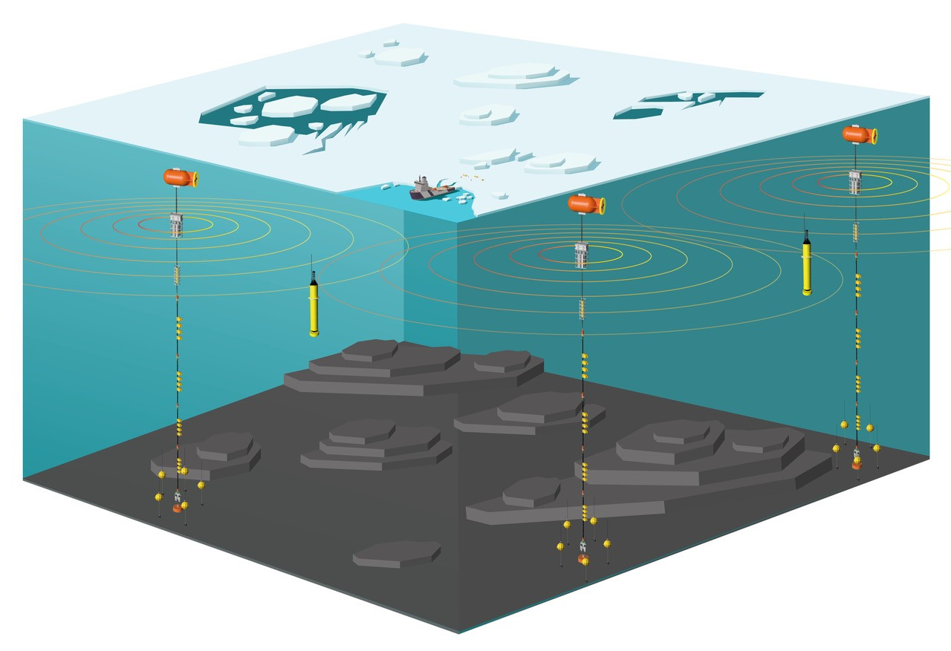
The future: Integrated Arctic Infrastructure
Submarine cable systems + ocean mooring systems + active acoustics
Observations near the seafloor and in the entire water column
Additional sensors can dock/connect with the cable
Acoustic tomography (ocean temperature)
Underwater gps and time
Fast data transfer
AUVs for maintenance of sensors
Power supply to AUVs
©Sagen, NERSC
https://hiaoos.eu/2024/09/25/large-scale-multipurpose-ocean-observation-system-installed-in-the-central-arctic/
see HiAOOS (High Arctic Ocean Observation System), led by Hanne Sagen
and Howe et al. 2007, “Sensor Network Infrastructure: Moorings, Mobile Platforms, and Integrated Acoustics”
Notes:
Figure 1. The conceptual description of the Multipurpose Ocean Observation System planned for the Central Arctic. ©Sagen, NERSC

Slide 26
Thank you for your attention!

