Slide 1
OpenRoaming 101
Stefan Paetow
Federated Roaming Technical Specialist

Slide 2
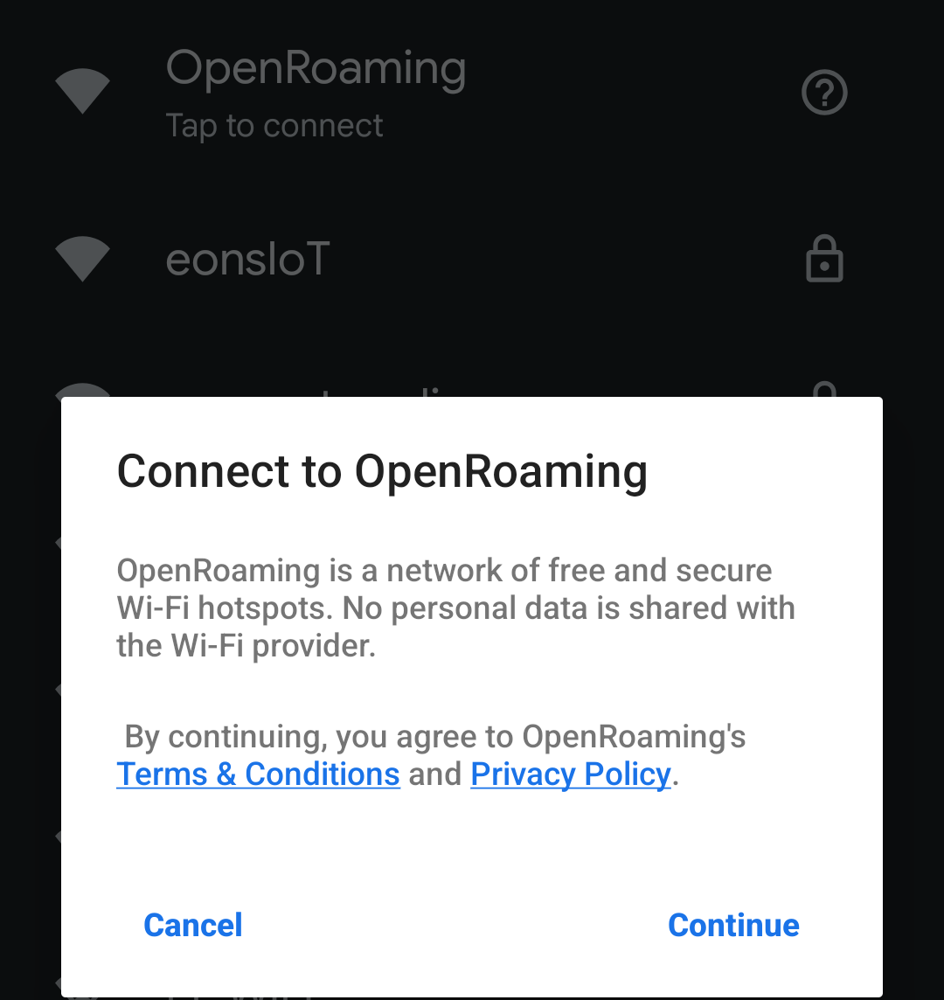
OpenRoaming Support Today
Mobile Phones
Google Pixel phones
  Built-in, use your Google account!

Slide 3
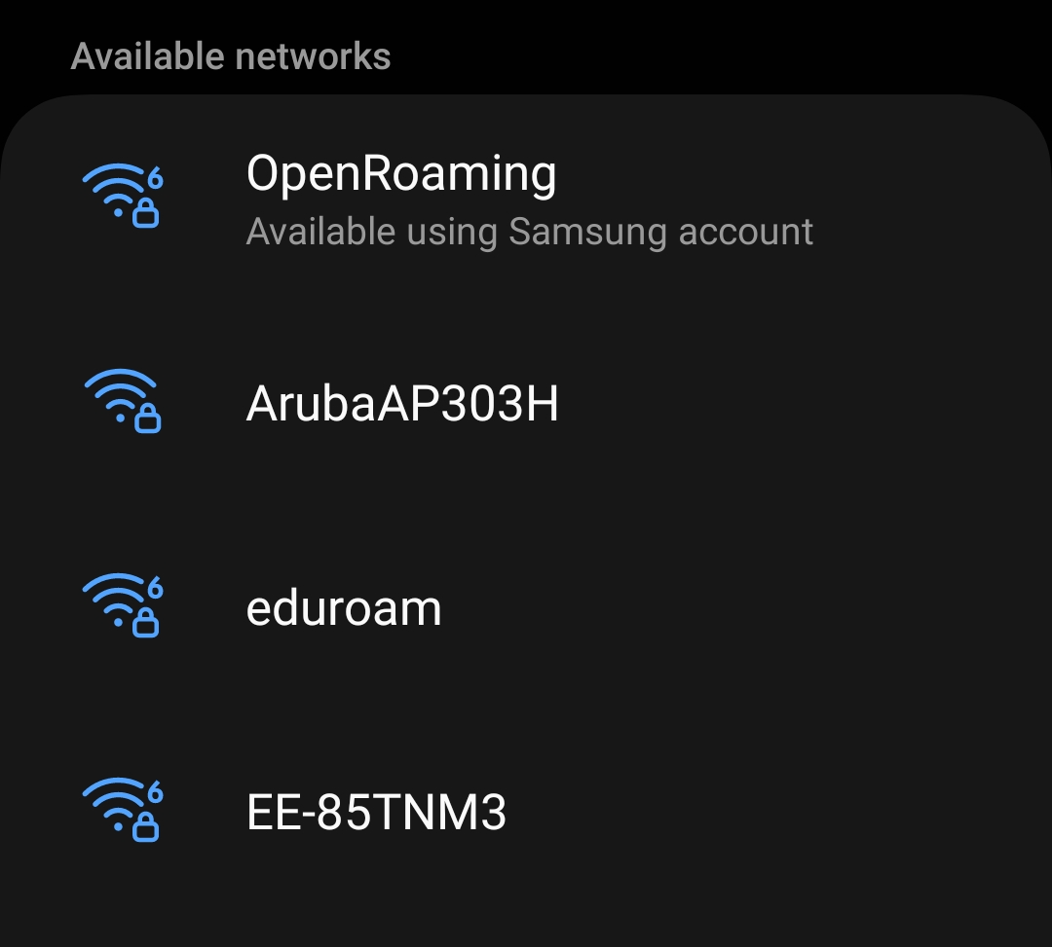
OpenRoaming Support Today
Mobile Phones
Google Pixel phones
  Built-in, use your Google account!
Samsung phones
  Galaxy S-Series, some A-Series
    Built-in, use your Samsung account!

Slide 4
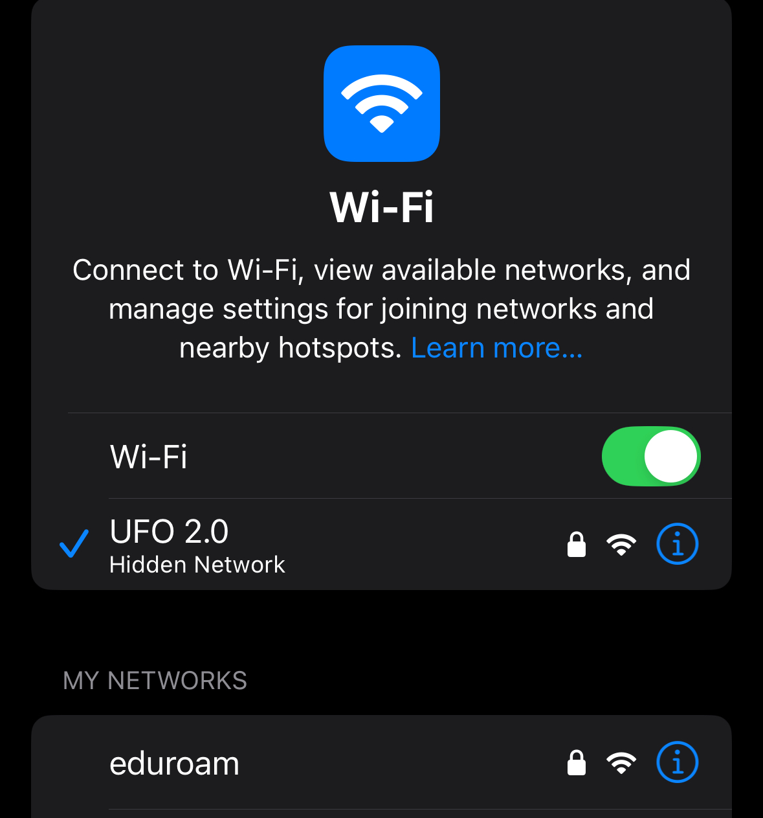
OpenRoaming Support Today
Mobile Phones
Google Pixel phones
  Built-in, use your Google account!
Samsung phones
  Galaxy S-Series, some A-Series
    Built-in, use your Samsung account!
Apple iDevices
  Support, but not built-in, needs app
    Cisco, GlobalReach, geteduroam

Slide 5
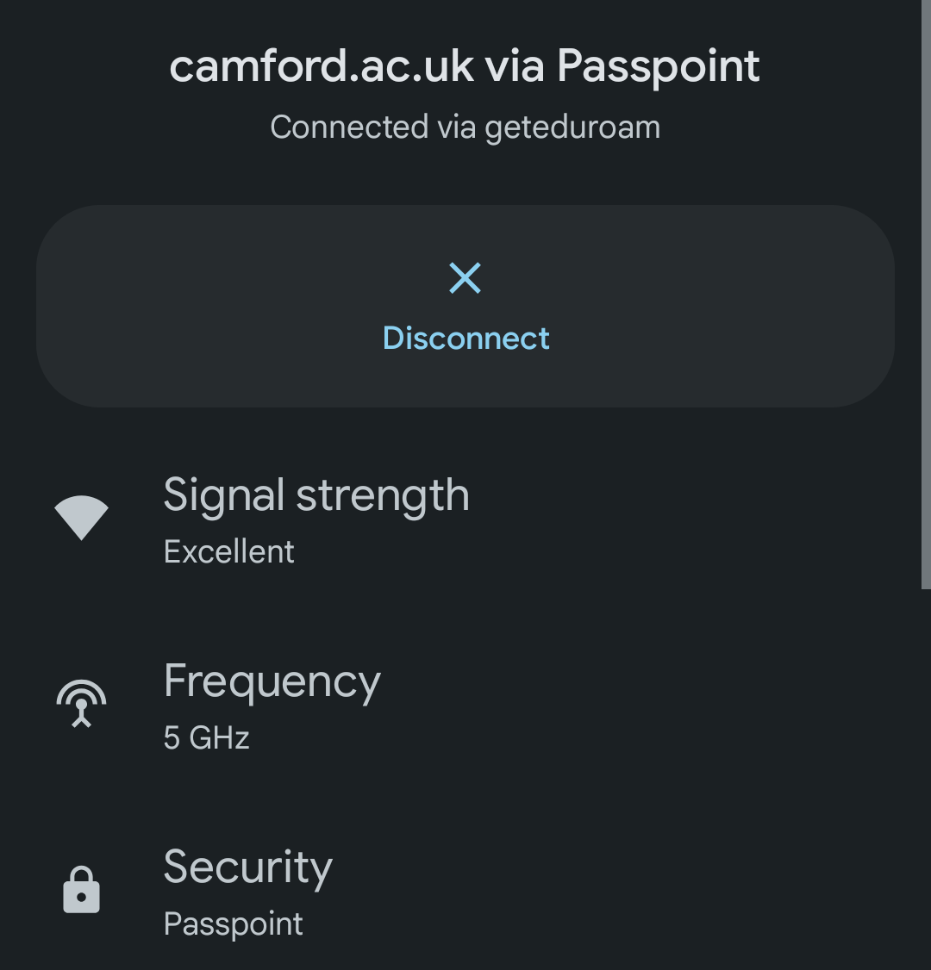
OpenRoaming Support Today
Mobile Phones
Google Pixel phones
  Built-in, use your Google account!
Samsung phones
  Galaxy S-Series, some A-Series
    Built-in, use your Samsung account!
Apple iDevices
  Support, but not built-in, needs app
    Cisco, GlobalReach, geteduroam
Other Android phones
  Use an app: geteduroam, GlobalReach

Slide 6
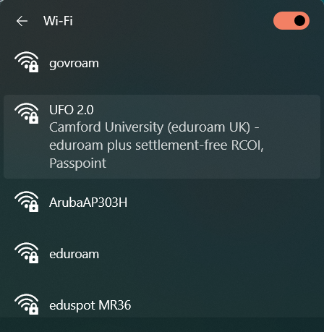
OpenRoaming Support Today
Laptops
Windows 10 + 11
Apple macOS
Linux
All require a profile of some sort
  macOS = .mobileconfig file
  Windows = Profile XML file
  Linux = wpa_supplicant config file

Slide 7
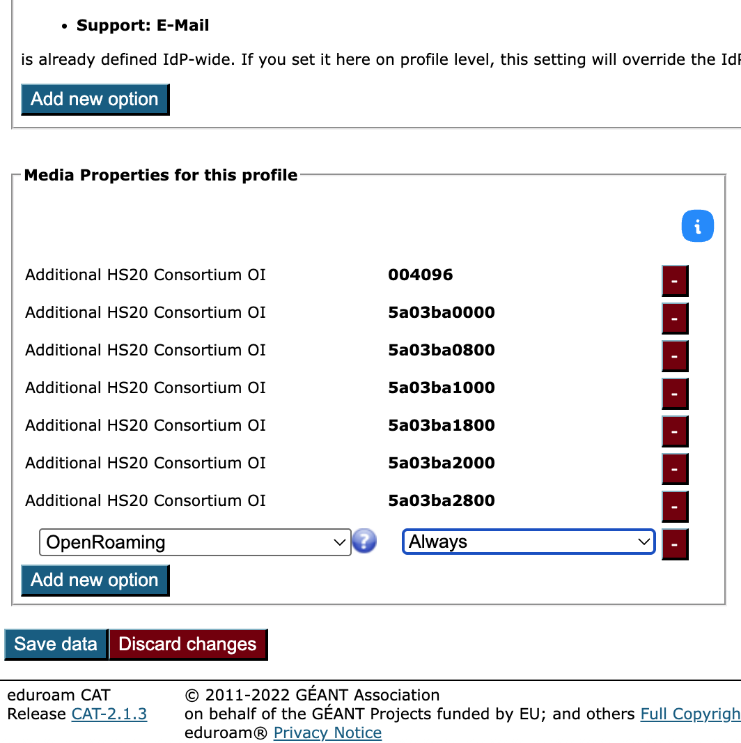
OpenRoaming Support Today
eduroam CAT
NRO needs to enable functionality
Support in the Media Properties of your profile
Choose “OpenRoaming” or “Additional Consortium OIs”
geteduroam will install OpenRoaming profile if
  Always is selected in the profile

Slide 8
OpenRoaming Support Today
Network equipment
All major network equipment vendors support it
  Cisco
  HPE Aruba
  Ruckus/CommScope
  Ubiquiti
  List goes on!
Prosumer network equipment
  Some vendors do

Slide 9
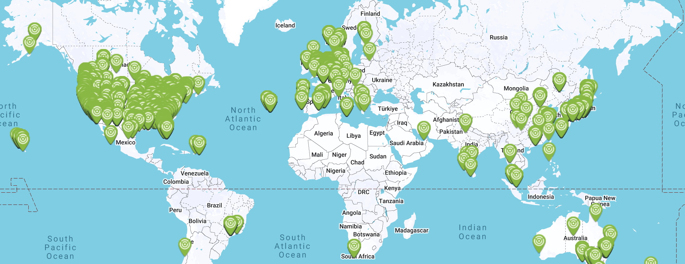
OpenRoaming Support Today

Slide 10
OpenRoaming Support Today
Locations
6 continents
Biggest rollouts
  USA (Adentro US-wide, University of Utah, San Jose)
  Japan (cityroam + others)
  Luxembourg (Cité de Luxembourg with RESTENA)
  Belgium (Delhaize Supermarkets)
  Netherlands (Wageningen University + Research)
  Germany (Universität Stuttgart)
  UK (Loughborough University, Harlaxton College, Co-Op Arena, City of Westminster)

Slide 11
OpenRoaming – What do you need?
As an IdP (home organisation)
NAPTR record (very important!)
RADIUS server that speaks Radsec
  Radiator, FreeRADIUS, radsecproxy
  Must also be able to generate CUI
eduroam CAT profile
WBA certificate (from Cisco, Google, WBA, …)
  Will cost €€
Or
OpenRoaming proxy (eduroam Europe, eduroam UK, others…)
  eduPKI certificate (€0)

Slide 12
OpenRoaming – What do you need?
As an ANP (service provider / visited network)
RADIUS server that speaks Radsec
  Radiator, FreeRADIUS, radsecproxy
Passpoint-compatible access points
WBA certificate (from Cisco, Google, WBA, …)
  Will cost €€
Or
OpenRoaming proxy (eduroam Europe, others…)
  eduPKI certificate (€0)

Slide 13
OpenRoaming – HELP!?
Help is available
eduroam Slack channel #openroaming
  https://join.slack.com/t/eduroam/shared_invite/zt-36t6jbwtu-YIJyKTQbKWrkFIIriGWlNg
eduroam Wiki
  https://wiki.geant.org/pages/viewpage.action?pageId=133763844
  https://wiki.geant.org/pages/viewpage.action?pageId=121346191
By email
  Stefan.Paetow@jisc.ac.uk

Slide 14
Stefan Paetow
stefan.paetow@jisc.ac.uk

