Slide 1
Risks of Digital Identity in Education and Research Wallets
Amineh Akhavan saraf, Leibniz Supercomputing Centre – Munich
GN5-2 WP5 Trust and Identity – Wallets Team
TNC25: Brighton, UK
10 June 2025

Slide 2
Agenda
Introduction
Risk Management
Financial Risks
Legal Risks
Strategic Risks
Security Risks
Risks Assessment
Conclusion

Slide 3
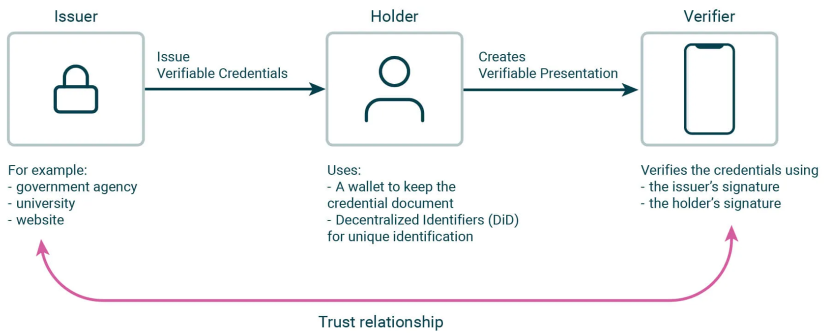
Introduction
A Digital identity in wallet enables you to securely prove and manage who you are in the digital world, in a way that is trusted, verifiable, user-controlled, and interoperable across services. Unlike traditional systems where your data lives with the identity provider, wallet-based identity lives with you.
Notes:
The essence of DI lies in its potential to establish cross-sectorial standards and prioritize user-centrism, ensuring that users have consistent and secure identity experiences across various domains.
Digital Identity (DI) attestation of attributes refers to a process that verifies and confirms specific pieces of information about an individual or entity within the context of digital identity management.

Slide 4
Introduction
Wallet: A digital identity wallet is a secure, encrypted database that collects and holds keys, identifiers, and verifiable credentials (VCs). The wallet is also a digital address book, collecting and maintaining owner‘s relationships.
VCs in research and education sector:
Academic/Research identity in the VC list
Diplomas and Degrees
Certificates
Transcripts
Digital Badges
Letters of Recommendation

Slide 5
Risk Management
Risk management is the process of identifying, assessing and controlling financial, legal, strategic and security risks to an organization’s capital and earnings. [IBM]
Main Categories:
Financial
Legal
Strategic
Security

Slide 6
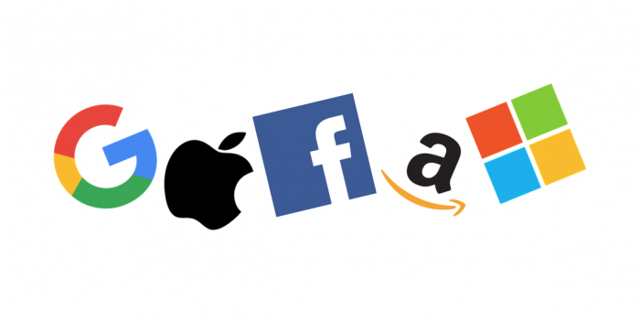
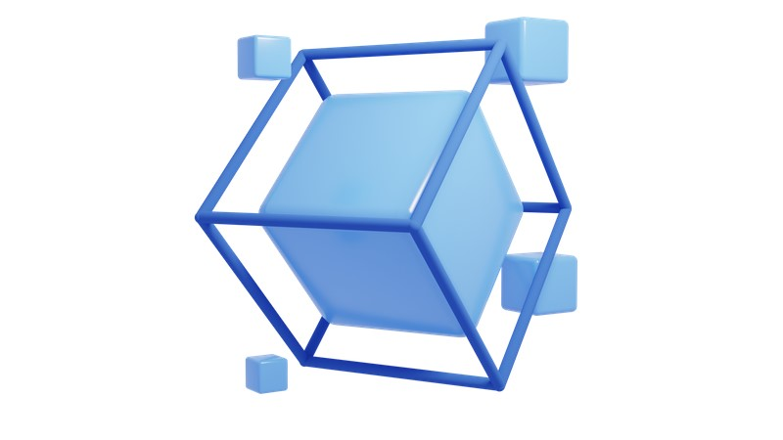
Financial Risks
Big Tech Companies (GAFAM)
Google
Apple
Facebook(Meta)
Amazon
Microsoft
Competing Technology
Ledger Technologies
Blockchain based
DAG based
Non-Ledger Model
Environmental Cost / Cost
Running and maintaining cost of Server vs Blockchain
Electricity consumption
Notes:
Google: Cloud Identity is centralized but it can get federated with Active Directory and Microsoft Entra ID (formerly Azure AD) + biometric with Indico + DIF
Apple> Cloud identity
Facebook (Meta)> Meta wants to raise the privacy bar higher by de-identifying users while still maintaining a form of authentication to protect users and services. Anonymous Credential Service (ACS) support de-identified authentication by splitting authentication into two phases + Metaverse
Amazon: cloud Identity on AWS + Zero Trust architectures + want to accept EU national ID and integrate EUDI into its ecosystem
Microsoft> actively involved in Decentralized Identifiers (DIDs) and verifiable credentials and Decentralized Identity Foundation (DIF) and W3C
Microsoft Entra Verified ID Service is an issuance and verification service in Azure and a REST API for W3C Verifiable Credentials that are signed with the did:web method. They enable identity owners to generate, present, and verify claims. This forms the basis of trust between users of the systems.
ION has been launched on Bitcoin main net and ION is designed for scale, supporting thousands of DID operations per second
BC>
IBM
Sovrin
Dock
Chainlink
uPort
Non-Benefit:
Decentralized Identity Foundation (DIF)
DID Alliance
Non-ledger Technologies>
YIVI (IRMA)
Blockchains do use electric power, and it uses a significant amount, particularly for proof-of-work blockchains like Bitcoin.(energy consumption)

Slide 7
Financial Risks
Funding: A particular scarcity risk, due to lack of funding
Supporting from government or institutes for research and development of DI is needed
Only users benefit from it, not issuers
Business-Plan definition is still in progress. Not only for R&E sector, but also being explored within the context of EUDI large-scale pilots.
Marketing
Lack of delivering attractive and user friendly services
Highlighting practical user and stakeholders benefits of identity workflows
GEANT is experienced in Fed- ID and need more funding to extend supporting wallet related activities
Notes:
Highlighting Practical User Benefits of Identity Workflows:The service workflow has not been effectively promoted to users: What specific tasks or actions are made easier by using this type of identity. Ineffective Marketing of Extended Identity Services: Despite the technological advancements, our community might struggle to effectively market the benefits and capabilities of the extended identity services to relevant stakeholders.
Fill a supply/demand gap takes long time: Identity programs often need to fill a supply/demand gap in a marketplace, needing to persuade both users and service providers to join their identity ecosystem, rather than use existing or alternative services.
Mention that DI does not need BC

Slide 8
Legal Risks
Governmental Laws
Some governmental policies impose to take a special orientation in technologies or protocols.
Not enough maturity in existing legislations. Changes in governmental rules are not futuristic enough.
The progress of codifying related rules is very slower than coming new technologies.
eIDAS
eID in education sector is not the same as eID in eIDAS
Education sector is beyond Europe
Overcoming national borders might impose barriers.
Rules in the Case of Misusing
Unclear rules, undefined responsibility
Notes:
Unclear Rules, Undefined Responsibility
In the real world, there are well-defined laws and penalties for misuse or abuse. However, when it comes to digital identity (DI), such rules and legal commitments are often unclear or insufficient, both at the national and international levels. This can result in uncertainty about who is responsible when things go wrong. If someone misuses a digital identity and there aren't clear laws or rules, no one may be held responsible, and the wrongdoer might not face any punishment.

Slide 9
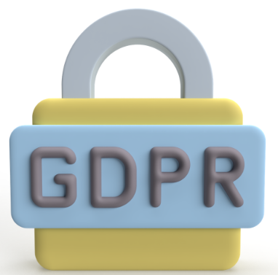
Legal Risks
International Compatibility (ex. GDPR)
Some countries have legal commitments, while others have none or follow different regulations, leading to incompatibility
Different use of existing rules
Local legislations (also sector or domain legislations) affects international behaviors. Local rules are various and people bring these to the international ecosystem and cause problems.
User Responsibility (consent)
Users will need to be mindful of what data they share and with whom.
Notes:
Users will need to be mindful of what data they share and with whom. Managing which verifies/relying parties should have access to which type of personal data can become complex. There is no rule in this regard.

Slide 10
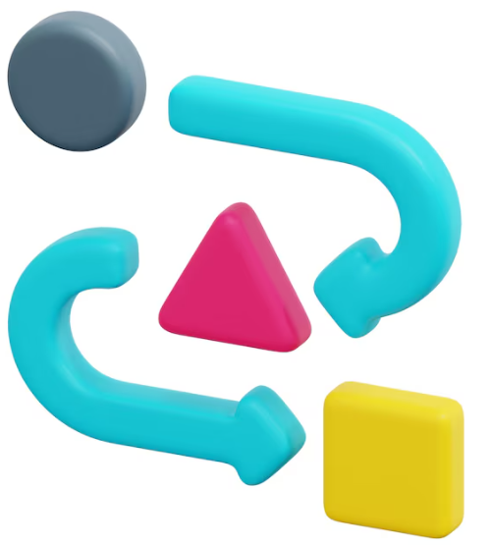
Strategic Risks
Dependency→ whenever the system has a dependency on something or
someone else.
Paper credential: in many cases just traditional paper credential flows are accepted or a digital one have to be confirmed by paper credential.
Impact of EUDI: limited coverage of EUDI leads to parallel ecosystem
Non-scalable and change-resistant architecture
GAFAM Connected Services
Notes:
Paper credential: in many cases just traditional papers credential flows are accepted or a digital one have to be confirmed by paper credential.
Redundant i.e. paper usage coexists with "new" system. It may result in fragmented acceptance. The traditional and modern solution, both are required by people
In traditional identity systems, intermediaries like ZAB, Uni-Assist, and local translators play a role by verifying and relaying identity information between individuals and institutions.
Impact of EUDI: It remains unclear how much impact the EUDI will have on the education sector. If it remains limited to government-issued data, there’s a risk that the education community may develop a parallel ecosystem to meet its own needs.
Non-scalable and change-resistant architecture: legacy system are not improvable (dependency on existing infrastructures) The infrastructure is not ready, separate DI in education in various countries are not ready to join global Edu-Identity. Sometimes lack of software or any resources
GAFAM Connected Services: These services are already well-established and familiar to users. Both users and service providers rely on them and often find it convenient to use a single company identity across multiple services. GAFAM are also actively developing digital identity wallets.

Slide 11
Strategic Risks
Usability → risk of developing systems that do not achieve users
"needs and expectations“
User-friendliness: process, same terms
Inclusion Challenges (Exclusion Impact)
Support mechanisms: face-to-face, video or telephony
Fragmented design solutions (Silos): Inefficient or disjointed user experiences across different platforms or services
GAFAM
GAFAM Services: easy of use leads to user spoiling
GAFAM shape user expectations
Notes:
terms
Inclusion Challenges (Exclusion Impact): Underestimating the impact of exclusion on certain groups or individuals. On top of this, where digital identity serves a public sector need, the service typically cannot choose to ignore these barriers because they will need to reach and serve all citizens. (Not enough availability for all users and infrastructure e.g. old people, not skilled or impaired people )
Support mechanisms: Related, providing services that are properly inclusive often requires the creation of support mechanisms, either face-to-face, via video or telephony. Supporting includes relation between different parties and it could be technically, organizationally and financially complex.
Fragmented design solutions (Silos):Providing a user-friendly experience is essential for the adoption and success of identity services. However, the complexity of integrating various systems and platforms within the research and education sector may result in fragmented solutions or "silos," which can negatively impact usability. Inefficient or disjointed user experiences across different platforms or services can lead to frustration and reluctance among users to adopt the identity services.
GAFAM Services: Google and Microsoft provide unified identity systems that seamlessly connect their services, making them practical and easy for users. However, this convenience can lead to user spoiling.
GAFAM Tools: Users are familiar with GAFAM tools and expects something like them. A new model of interface even user-friendly could be rejected by users because they are not similar to GAFAM tools.

Slide 12
Strategic Risks - Usability
6. Complexity vs. Control: Balancing technical complexity with intuitive user control and overall ease of use.
Identity management involves trust, authentication, privacy, personal information, and security, with complex edge cases and technical standards.
Trust is built through understanding. If a system is too complex, it becomes difficult for users to use and accept it.
Complexity for users
Complexity for other parties
Notes:
Complexity for users: A good service should simplify these aspects for users, avoiding overwhelming them with choice or repeated consent requests. However, some users may not care about this, risking not understanding the spectrum of control and convenience. Self-sovereign identity systems, where users hold their identity in a secure digital wallet, offer high levels of control but also greater responsibility. Technical solutions may be less easy for users to understand than centralized systems. [2]
Complexity for other parties: Other parties like verifiers are involved with this complexity too. It comes from various methods and rules in countries.
Term of Use (ToU): Definition of 'term of use' is another complexity. Defining a TOU that is unambiguous, simple, and understandable to the user, while also being comprehensive, is not an easy task.

Slide 13
Strategic Risks
Interoperability (Standards and Protocols)
Lack of standards and protocols
Influence of external standards and architectures
Incompatibility with legacy systems: Interoperability with existing systems and standards, both within the research and education sector and with external stakeholders, is crucial. It brings also technical complexity
Agreement delays: Reaching consensus across many parties with different needs can be time-consuming. e.g.
The Digital ID and Authentication Council of Canada (DIACC): 4-6 years
The process of creating a framework for agreement by Australian government: 2015-2021
EU standardization process e.g. ELM v3, ARF
National ID governance and EUDIW: e.g. Unclear Cross boarding DI mapping in eIDAS 2
Notes:
(Not exact Protocols addressing our problem): Sometimes, communication protocols are not fully compatible with our requirements. This creates risks, as relying on external dependencies often means we must adhere to specific protocols that may not align with our intended functionality or goals.
Adoption cost
Lack of trust framework in EUDI wallet model which could not get scaled for edu sector
2. External Standards and Architectures: Many external standards and reference architectures are imposed upon us, often requiring significant adaptation that does not align with our specific needs or operational models
3. Ensuring interoperability with existing systems and standards, both within the research and education sector and with external stakeholders, is crucial for the successful integration and adoption of extended identity services. Incompatibilities or difficulties in integration could hinder seamless operation and collaboration across different platforms and organizations.
4. Agreement delay: Public digital identity programs have large numbers of users, public services, and identity attribute services with different needs and requirements. Creating something that both works for users and meets the needs of a wide variety of services is not a simple undertaking. It can take many years to reach agreement on technical and identity standards, liability, and other policies.
Exposure to protocols, standards and governance rules → risk of not being engaged in particular protocols and standards
Influence of GAFAM: GAFAM tend to enforce their own approaches — including browser-driven implementations — that align with their business interests, limiting our autonomy and interoperability.
EU standardization process: The EU standardization process is frequently non-transparent, politically influenced, or progresses without our direct input e.g. ELM v3, ARF
National ID Governance: There is a lack of clarity regarding the governance of National ID systems and their relationship with the EUDI Wallet. This creates uncertainty and potential dependency on future political or regulatory decisions.
(is it still a risk when eIDAS 2 revise is there? Explain it? Check the mata file) Cross boarding(between countries) DI mapping not clearly covered in eIDAS 2.

Slide 14
Strategic Risks
Acceptance → any risk regarding to acceptance from users and stakeholders
Resistance to Change: Resistance to change among stakeholders in the research and education sector and users.
Social trends (Culture)
Intermediaries → Intermediaries in digital ecosystem trying to keep their influence
Identity validation company with various rules. They are still needed despite the wallet ecosystem is promised.
Paper intermediaries
Wallet creators: GAFAM and BCs…
Notes:
Resistance to change from stakeholders within the research and education sector, such as institutions, administrators, or users, could impede the successful implementation and adoption of extended identity services. Resistance may stem from factors such as inertia, cost or fear of technology, requiring effective change management strategies to overcome. There is a lack of good business case in some stakeholders side. Overcoming these barriers requires effective change management strategies. Social trends (Culture)
Social trends in service adoption reveal that some communities are conservative toward new models of workflow and trust, leading to limited interest in transitioning to newly available services despite their potential benefits.

Slide 15
Strategic Risks
Integration (technical aspects)
Technical and Policy Shortcomings: Missing libraries, interfaces, tools
Failure to extend identity services without gap: other market solutions succeed to fill the gap
Ontopiness → The old solution remained and new solutions extend the existing one and do not replace. It mean new stuffs are all on the top.
Notes:
Technical and policy: Some technical and policy compatibility issues cause troubles in integration, lack of library, interfaces, tools
Co-existence of "Old" and "New" Systems: The transition to the expanded identity services might not occur smoothly, leading to a prolonged co-existence of traditional methods alongside the new ones. This could technically result in increased complexity and maintenance efforts for our sector.
Failure to Extend Identity Services without gap: If our community fails to successfully expand our identity services to encompass document presentation, it may create a gap that other market solutions succeed to fill. These alternative solutions might not be tailored to the specific needs of the research and education sector, potentially offering less functionality and security to end-users.
Ontopiness → The old solution remained and new solutions extend the existing one and do not replace. It mean new stuffs are all on the top.
Parallel workflow with the same goal, both traditional and modern are requested by people. e.g. The eIDAS v.2 access with new method have to include old method as well. Without the old one it does not work.

Slide 16
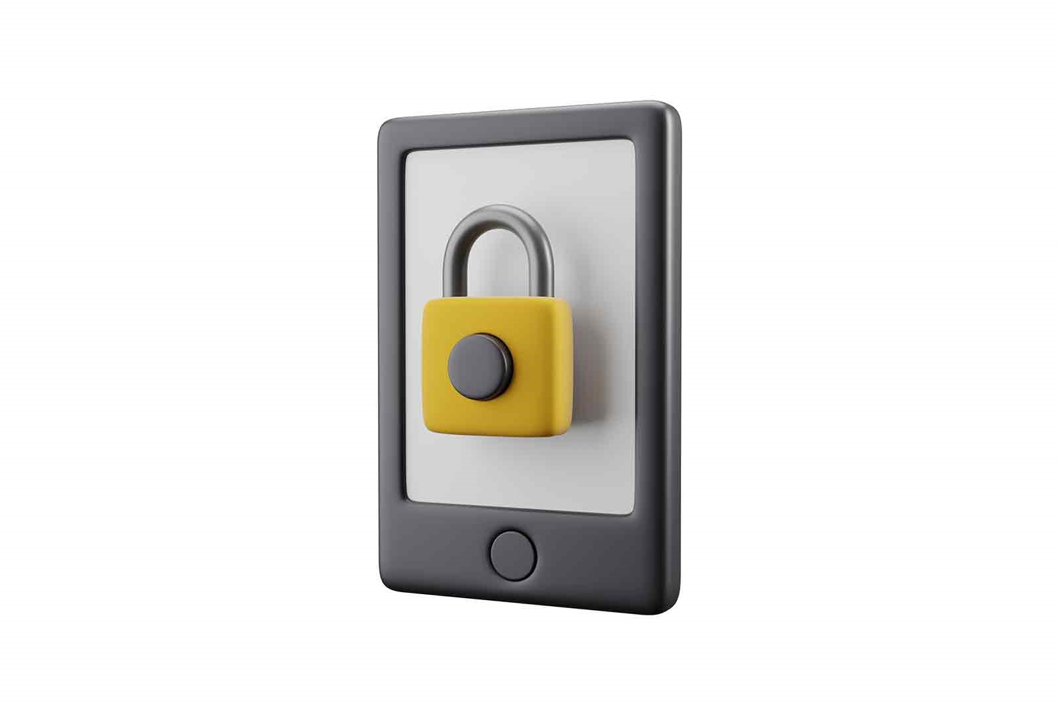
Security Risks
Protecting Data → challenges in implementing various level of security
Security of devices
Physical vulnerabilities: Device lost/defection (not availability of device or no battery)/ stolen
Lack of Device Security
Security of Wallets: A Wallet (one App or Web page) with lots of functionalities and different sectors may face up with increasing Vulnerabilities
Security of Services (ex. Healthcare system): It means security dependency to
Service/Issuer security
Relying parties/Verifier
Intermediaries
Notes:
Security of Wallets
Phishing Attacks
Malware and Viruses
Social Engineering
Security of Verifiable Credentials
Just like with traditional passwords, weak keys or improperly stored credentials in distributed identity systems can be vulnerable for hacking
End user
Service providers
Issuers (tricky)
Third parties → Misusing or reusing data by third parties through illegal access e.g. Intrusion through malicious App, social engineering, duplication, skimming

Slide 17
Security Risks
Losing Data and Recovery Mechanism→ lack of support mechanism by security issues
Not enough recovery solution
No insurance
Revoking process
Dark Net → security economic: there is a business to generate fake IDs or misuse of real IDs, which could be used for money laundering or any other illegal activities
Fake ID
Misusing of VC
EUDI wallet legislation like ARF, Implementing Acts, eIDAS 2.0 defines requirements to address security vulnerabilities. However, the supporting standards, technologies (both hardware and software), and protocols are not yet mature enough for full implementation.

Slide 18
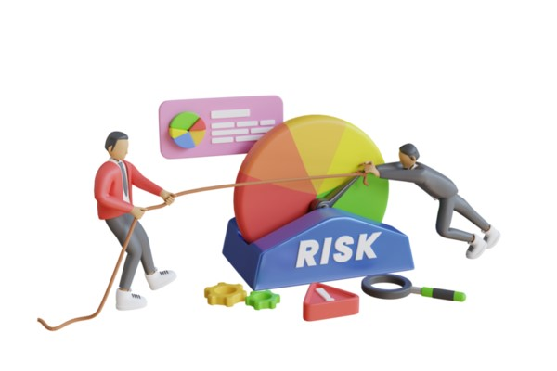
Risks Assessment
Probability of occurrence
Once in 10 years
Once in 5 years
Once in 2 years
Once in 1 years
Many times in a year
Potential damage
Low
Medium
High
Very High

Slide 19
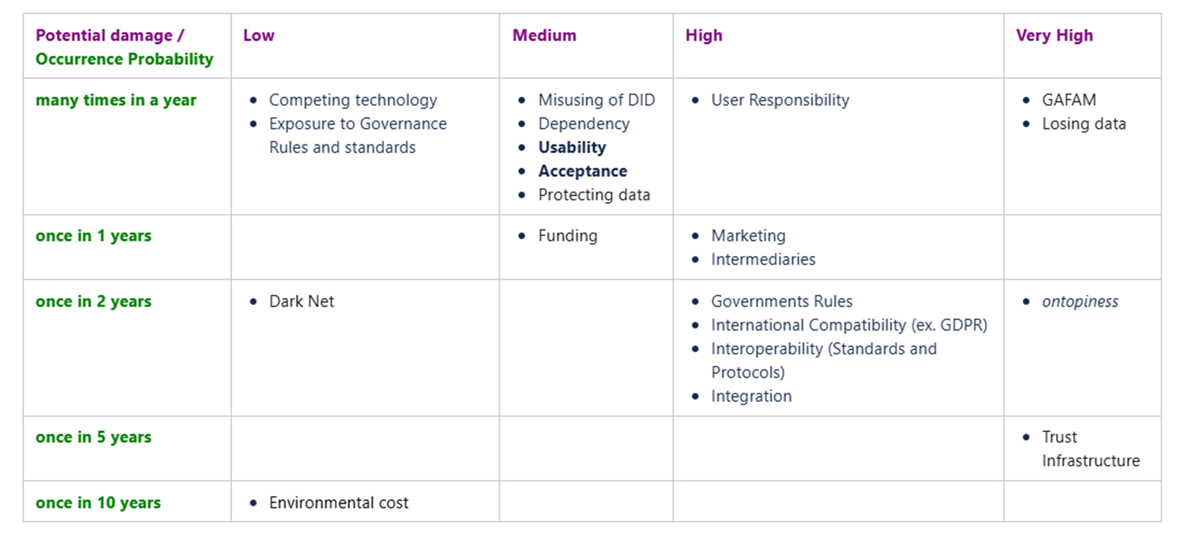
Results from assessment in GN5-1

Slide 20
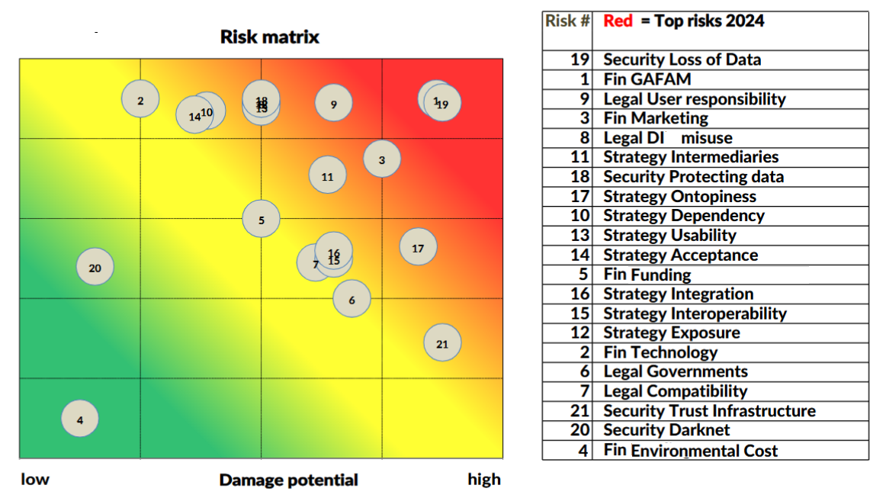
Conclusion

Slide 21
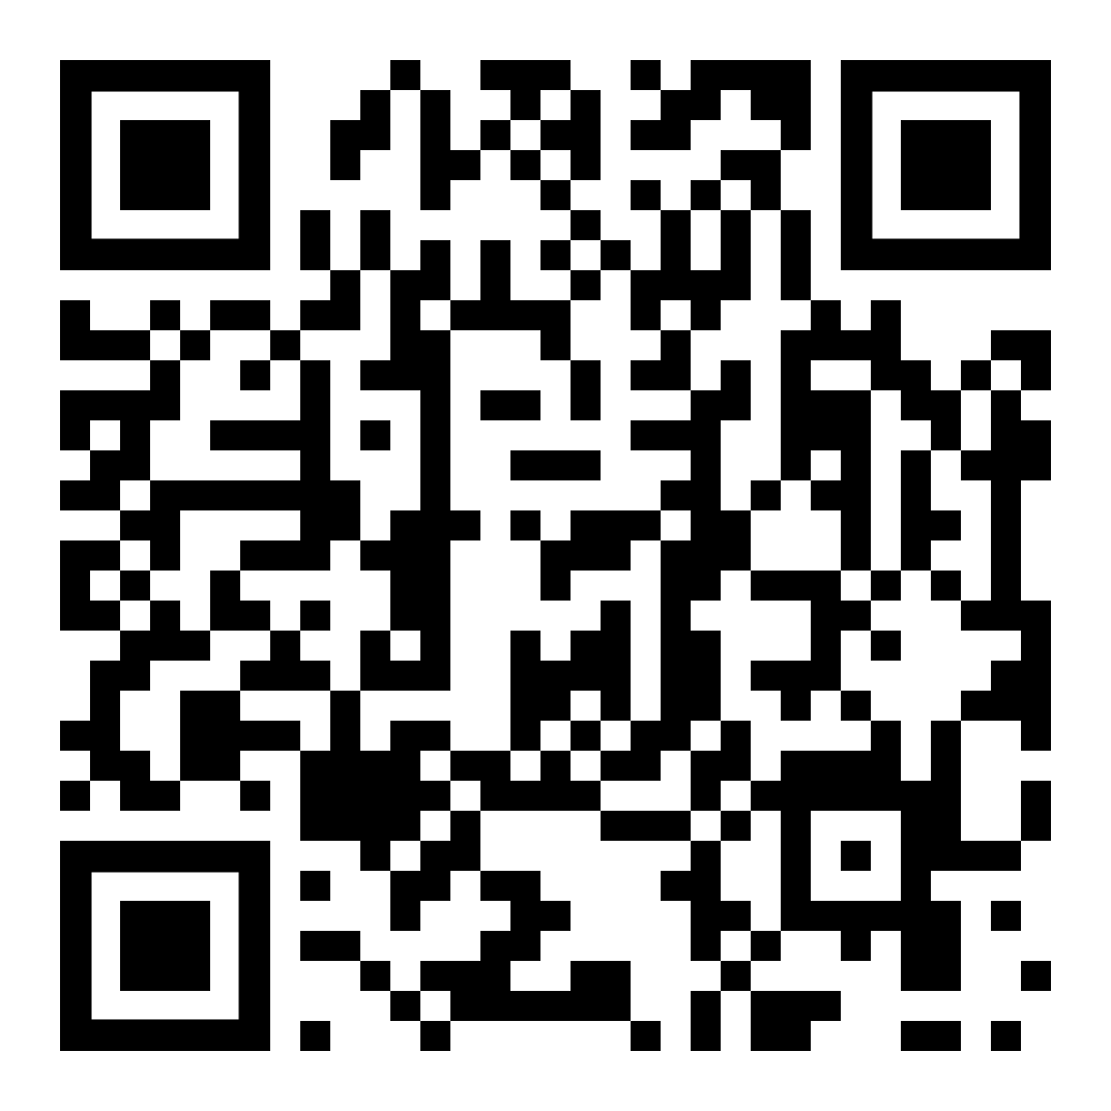
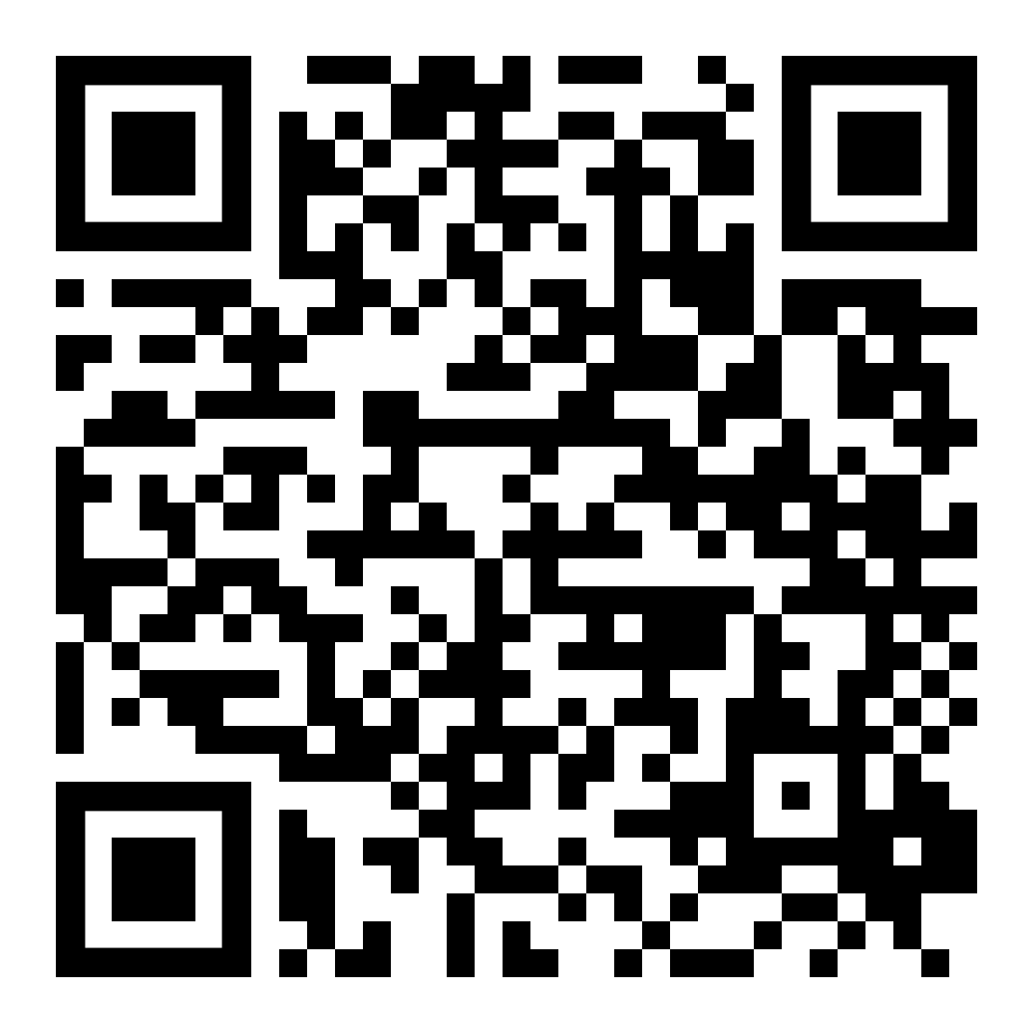
Start planning now for changes in Digital Identity
GEANT 5-2 WP5 T6 - Wallets Team
Join GEANT Wallet Community:
More Info on Wallet Wiki:

Slide 22
Thank You
GEANT 5-2 WP5 T6 - Wallets Team

Slide 23
References
IDEA: Distributed Digital Identity and Decentralized Identifier
Wallet: Windley, Phillip J.. Learning Digital Identity: Design, Deploy, and Manage Identity Architectures (p. 510). O'Reilly Media. Kindle Edition.
What is Risk Management? | IBM
How to control your biggest risks in digital identity — Public Digital

Slide 24
The main goal is to empower identity owners with more control over their digital identities, enhancing privacy, security, and interoperability.

