Slide 1
Orchestrating the GÉANT Packet Layer Network
An introspection
Neda Moeini & Simone Spinelli
Brighton, UK
2025/06/12

Slide 2
Hello!
Neda Moeini
Senior Software Engineer @ Digital Services Software Engineering
Simone Spinelli
Network Architect @Network Evolution
Aleks, Karel, Mohammad, Neda, Saket, Simone: Some of them are around, get in touch!
Notes:
This will be a two-voice presentation — both Simone and I will take turns. Hopefully we stay in sync, but if not, you’ll just hear both sides of the story.
What we’re going to share is the result of many people working together — software engineers, network engineers, and architects combining forces to bring automation into the GÉANT network.
And many of us are here at TNC this week — so if you’d like to go deeper, we’ll be at the GÉANT booth right after this session. Feel free to stop by for a chat.
So, let’s get started — Simone will walk you through the agenda and how we’ll tell the story today.

Slide 3
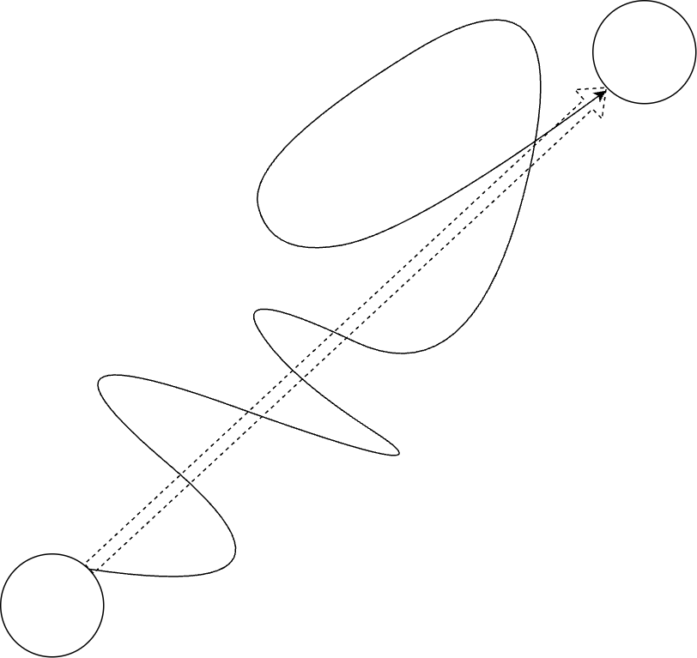
Our story today…
Simone:
GÉANT migration to new packet-layer platform
Status update
Mechanics
Neda:
Using a software-oriented approach to model the GÉANT network
Practices
Challenges
TNC25
TNC23

Slide 4
The Problem – Hidden Complexity
Challenging – at the beginning – to imagine how it was going to look operationally
Reliance on nos-specific constructs and values
Customizations and exceptions makes it hard to generalize
Process documentation often in different formats, sometimes hidden.
Notes:
Migration are always complex, and you can imagine but not exactly. The more you you dig in the more you find things. So we needed something in terms of product and process that could adapt quickly.
And the deeper you go, you realise the complexity isn’t only technical . There’s also a lot of cultural complexity: different ways of doing things, different habits across teams.
Some of that complexity isn’t even visible at the beginning— you find vendor-specific behaviours, service dependencies, and many small exceptions that make automation much harder than it sounds on paper.

Slide 5
Transforming Infrastructure into a Product
We stopped thinking about configuration lines and started thinking about services.
GAP models intent, tracks state and drives execution — like CI/CD for infrastructure.
Operators trigger workflows. Output is validated. All logs are inspectable and stored.
We now build, test, and deploy network infrastructure like software.
Notes:
As we moved towards modern network operations, we realised we had to change how we think about the network. Instead of seeing it as a set of boxes to configure, we started to treat it more like software.
With GAP, our goal was to give operators a way to deploy services that’s safe, repeatable, and predictable — like how software teams ship code.
So we took the same principles:
Design is our starting point — that’s our source of truth.
Config is generated from templates and models.
And we put effort into mapping out dependencies properly.
Of course, we didn’t get it perfect on the first try — we refined the models over time as we tested and deployed.

Slide 6
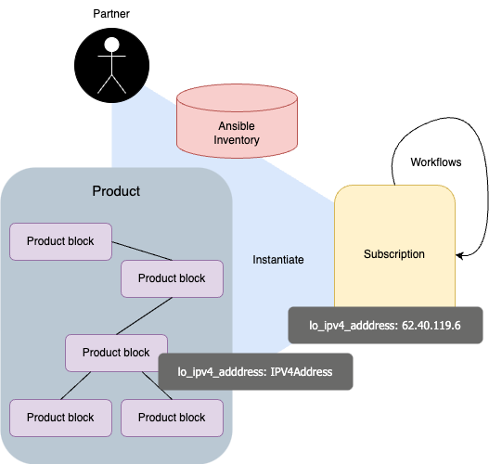
Design-First Mentality
Design serves as the primary source of truth, surpassing the live network.
Configuration is abstracted into reusable models.
Dependencies are re-evaluated to match real use
Many iterations

Slide 7
Why Scripts Break and Orchestration Works
Scripts solve tasks. Orchestration solves process.
Migration wasn’t just config — it involved inventory, validation, and OSS updates.
Needed repeatability, safety, and accountability.
Orchestration coordinates logic, systems, and teams.
Notes:
Automation with scripts is a great starting point — it works well for simple, one-off tasks.
But as soon as you try to scale, you need more than just pushing configurations.
you’re building a software application. You write a script to build your code — that’s automation. It’s fast, it works, and it’s great… until you need to do more. Now imagine you need to not only build the code, but also run tests, check dependencies, build a container, push it to a registry, and notify your team when it’s done. Suddenly, one script isn’t enough — you need a pipeline. What I’ve explained right now, that’s basically the orchestration And in networks, it’s the same. Scripts can push config. But orchestration knows the state of the network, handles all the dependencies — OSS, IPAM, inventory — and helps people follow the same process safely. That’s how we can deliver complex changes reliably — at the scale of a network like GÉANT.

Slide 8
How GAP Works: Architecture Overview

Slide 9
GAP coverage

Slide 10
Migration: an update

Slide 11
What Worked – Cross-Functional Collaboration
GAP was only possible because we didn’t work in silos !
Top-down approach is winning
Knowledge contamination is a good thing:
Context is important
Many cycles of refinement
Documentation
Fast feedback from the user is paramount
Notes:
One of the most important things that made GAP successful is that we didn’t approach it as a pure software or pure network problem. Instead, we built a fully cross-functional team where each group brought their expertise to the table:
Software Engineering — wrote the models and workflows, and built the automation logic that makes service deployment safe, testable, and reusable.
Network Engineering — provided the deep domain knowledge, defining the operational intent and how services should work in real life.
Architecture — ensured design consistency and compliance, helping connect the high-level goals with the technical implementation details.
Operations — heavily involved in testing, quality assurance, giving feedback, and also being our first real users in production.
This combination allowed us to align design, automation, and operations — and it gave us the feedback loops we needed to improve fast and safely.

Slide 12
The process
DTAP:
Network Engineering provides Design documents
GOAT creates workflows and ansible logic
Testing in UAT environment is done by GOAT/NE/OPS
Rollout in production for migration use

Slide 13
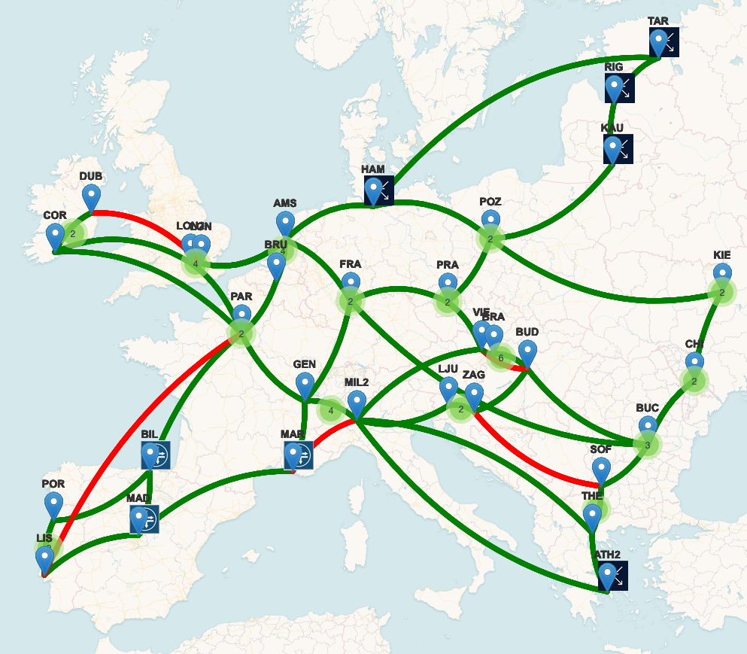
GAP ecosystem today
GSO is ±28K LoC with 2024 commits (from Apr 2023)
GAP Ansible collection is 3.8K LoC with 941 commits
And more:
LSO,
Deployment logic
Moodi
Maps
…

Slide 14
Key Takeaways from Building GAP
Design-first approach — models, not device configs
Iterative service modeling — refine and improve over time
Strong process & validation — DTAP pipeline ensures trust
Community collaboration — Working with SURF, ESNet, GARR and others sped us up
Cross-functional teamwork — network, software, ops, architecture
Notes:
So just to wrap up everything we’ve talked about, these are really the key elements that made GAP work — or are making it work, because some of it is still very much in progress. We started with design-first — having models to drive everything else. We accepted that modeling is an iterative process. We refine, adjust, and improve as we learn from real deployments. The cross-functional teamwork — bringing software, network, operations, and architecture together — has been a huge part of turning this into something usable. Building strong processes and validations gives us confidence when we go into production. And finally, collaborating with the community — working together with SURF, ESNet, GARR, and others — has helped us move much faster and avoid reinventing things that others have already solved.

Slide 15
The future looks good!
Migration is only the starting point: many directions to explore!
Operations:
Expand coverage of standard changes
Automated diagnosis
Technology transition
ST
New tooling can follow the same recipe
AI/ML
Modern infrastructure
User Experience
Self-service
Exceptions management
The sky is blue: no clouds on the horizon ☺

Slide 16
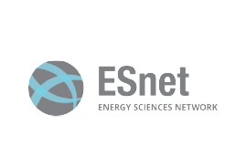
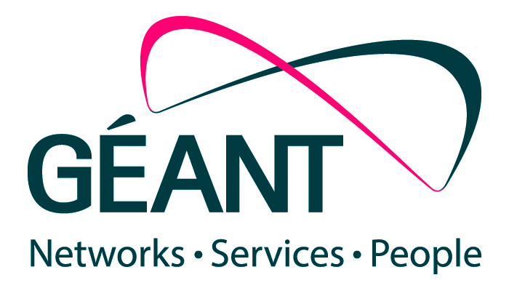
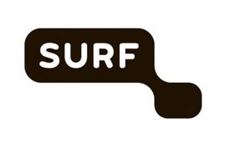
Join the discussion
https://workfloworchestrator.org/
Join us on Discord
WFO + NSO
WFO + Ansible (Juniper/Nokia)
WFO + Infinera/Nokia
Lots of integration already working
Find us around!
16

Slide 17
Thank you
Any questions?
goat@geant.org

