Slide 1
A Bright Future in the Cloud –
Unique Collaboration on Cloud Procurement
Garvan McFeeley
HEAnet Monique Pellinkhof
GÉANT
10th of June 2025
TNC25 | Brighter together
Notes:
Introduction + To share the story of the new Open Cloud for Research and Education 2024 project- OCRE2024t—the new pan-European tender uniting 39 National Research and Education Networks (NRENs) and their participating entities on procuring cloud services for the future.

Slide 2
What is OCRE2024
Stands for
Pan European Framework agreement procured by
Tender collaboration covering >10,000 Research and Education Institutions in 39 countries
Allowing easy and quick access to cloud services from National, European and global platforms
Without having to tender individually
At discounted costs and beneficial Terms & Conditions needed by the Research & Education sector

Slide 3
Why is GÉANT running these tenders
To join forces: combine buying and negotiation power to create economy of scale
To secure European R&E with the best portfolio of platforms and services
To provide the European R&E sector most favourable access to flexible infrastructure services
To keep it simple: cloud services and tenders are complex
To enable knowledge exchange: sharing is caring
Over 1,000 R&E institutions across 28 countries have used the frameworks
The numbers continue to grow

Slide 4
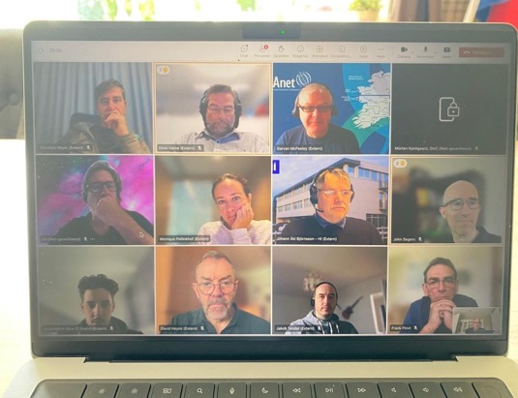
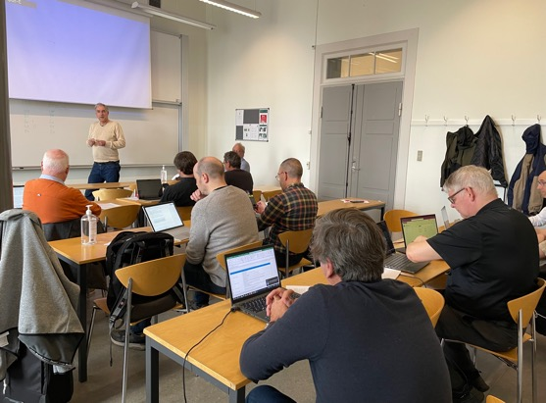
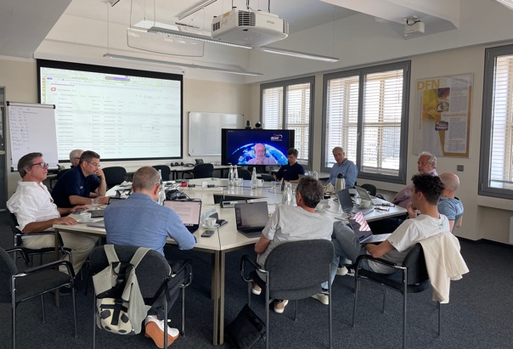
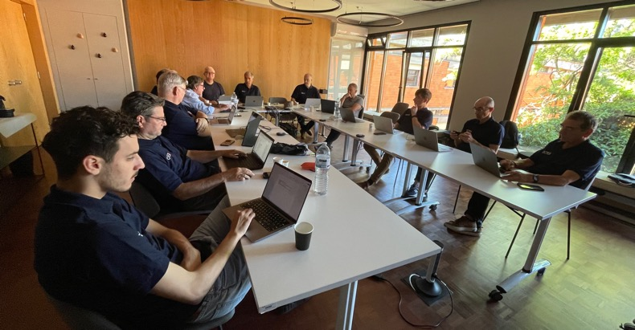
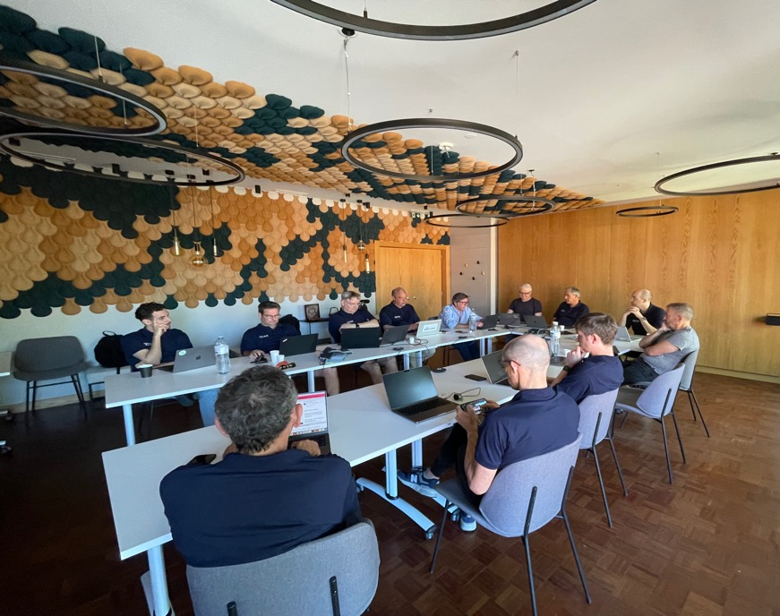
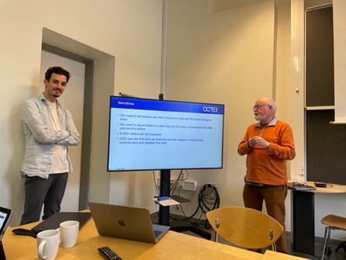
Work hard…
Notes:
This collaboration is unique and allows the community already for years to streamline procurement processes, reducing redundancy and administrative burden for participating entities. Continuously improving its procedures and documentation, adapting to current times, requirements, developments and dynamics in (EU) legislation. The new OCRE2024 initiative highlights the transformative potential of community collaboration in cloud procurement. By joining forces, we achieve better outcomes and create a more resilient, future-proof and innovative research and education ecosystem in Europe. GEANT’s central role is crucial in harnessing our community’s collective power while honouring the unique needs of each participating entity.

Slide 5
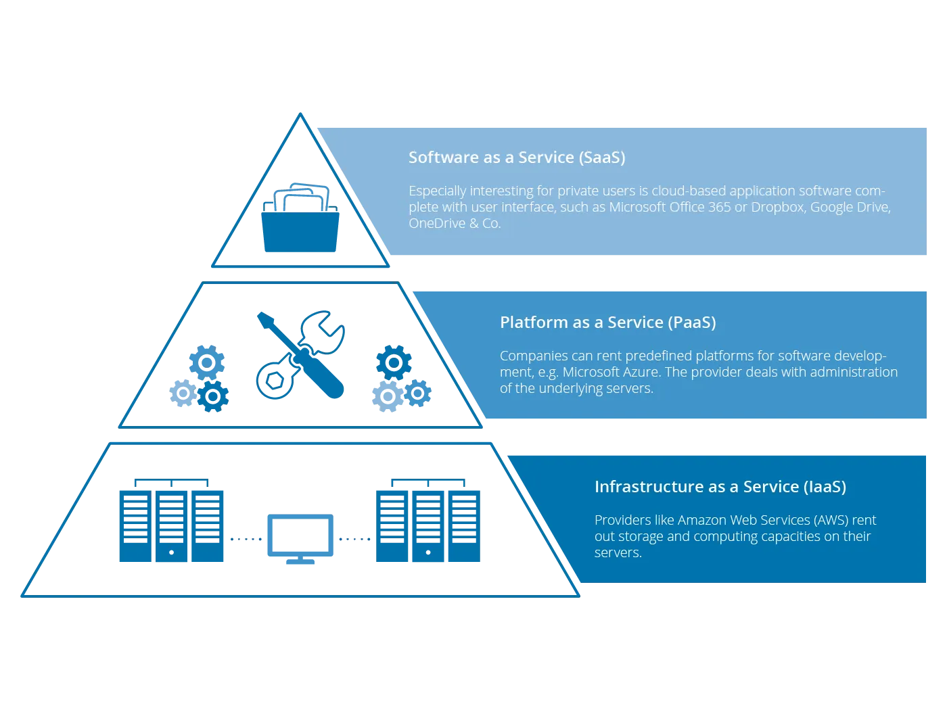
OCRE 2024 Deliverables
Scope: IaaS+
Framework
1 Lot per country
Sub lots per platform
Max 3 suppliers per sub lot
No obligation to procure
Contract value 1.7 B

Slide 6
Goal and key benefits of OCRE 2024
Easy to use and compliant agreements. Fitting requirements of the R&E community
Set up of Cloud
Identity Management
Shared use across institutions
BYOL
Local support & trainings
Access to best in class suppliers and technologies. Suppliers are continously monitored and managed
Pricing & Conditions
Minimal discount 8% for User groups A&B
Access to vendor’s senior management via GÉANT CMG
Access to trainings and workshops on new technologies
Services offered by suppliers are compatible with GÉANT infrastructure
Connectivity
Peering Connection (Géant / NREN)
Ingress fully waived
Minimum Egress waiver caped at 15% of monthly consumption and exit support
Data Protection
GDPR analysis updated yearly
Information of data processing changes during contract
No AI training with customer data
Available standard GPA upon request
Safe data handling, GDPR compliant
Ease of doing business, reporting
Reporting
Online Portal
Split billing and E-invoicing / billing in local currency
Security incident reporting

Slide 7
How did we end up here
2012
A seed is planted
2013
A quest begins
2014
Engagement time
2015
Getting ready for launch

Slide 8
How did we end up here
2016
Launch of the 2016 tender
c. 80 bids
27 Frameworks
2017
Lighthouse adoption
10 Countries
2018
Moving up a gear
18 Countries

Slide 9
How did we end up here
2019
18 Countries
More institutions per country
2020
Pandemic
Step change
Launch OCRE tender
2021
Pandemic continues
23 Countries

Slide 10
How did we end up here
2022
26 Countries
More institutions per country
2023
28 Countries
OCRE 2024 project starts
2024
28 Countries
OCRE 2024 tender executed

Slide 11
Annual consumption

Slide 12
Scoring the monster tender….
Almost 500 bids
Scored by 13 people from 8 countries – different (N)RENs
Creating multidisciplinary teams
Working 3 days a week over 6 months
Scoring in teams in consensus
Resulting in 416 FW Agreements operational

Slide 13
Costs and Benefits
Costs
Total costs: tender, contract management, Strategic Vendor Management, NREN cloud community
Benefits
Not running individual tenders and discounts
Economies of scale
Individual tenders would not result in favourable conditions or discounts
European scale enables unique access to platforms C level management and concessions
≈ €7M
≈ €210M
Tender effectiveness: 30X

Slide 14
Could we take this global?
Top bun: tender procedure, scope, process ≈ 75%
Add up to 25% local toppings
Slide in the burger: minimum requirements and awarding criteria, globally identical
Add up to 25% local toppings
Bottom bun: Contracts, ≈ 75% standard
Coming to you in 2028? 5 countries? in 5 continents?
Notes:
No business model; GEANT will not seek any profit margins

Slide 15
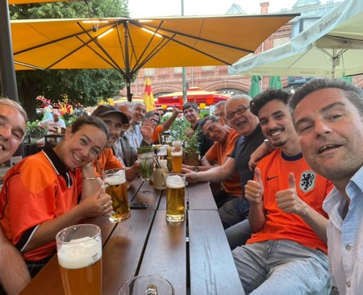
Takeaways
Use the power of community-driven collaboration
Joint tenders are valuable, and collaboration is priceless
Ensure community support via collaboration
Cloud = Change, use abstract scope and limit requirements
Know your market: perform market analyses and built and maintain platform relations
Keep it simple

Slide 16
Thank you!
Questions? Please reach out to:
Cloud Team Service Desk <clouds.servicedesk@cloudteam.geant.org>

