Slide 1
MOODI and CaaS
Two new tools to help you simulate and validate complex changes in your network
Mohammad Torkashvand (GÉANT)
Adrián Pino (i2CAT)
TNC, Brighton, UK
9-13 June 2025

Slide 2
MOODI
Real-time telemetry of network workflows
Mohammad Torkashvand (GÉANT)

Slide 3
Why We Built Moodi?
GÉANT was migrating its entire backbone from Juniper to Nokia
Cross-team workflows automated with GAP (GÉANT Automation Platform)
Needed real-time, per-change monitoring: focused, ephemeral, trusted
Idea💡: What if we could run telemetry only during active workflows, collecting high-resolution data at 1-second intervals?

Slide 4
Meet Moodi – On-Demand Telemetry
Moodi = ephemeral telemetry stack integrated into GAP
Starts when a workflow begins, stops when it's done
High resolution: 1 second!
No persistent agents or overhead
Built for engineers to see what’s happening live

Slide 5
Moodi Stack – At a Glance
gNMIc – subscribes to device metrics (OpenConfig/YANG paths)
Prometheus – scrapes metrics from gNMIc
Grafana – shows live dashboards
All launched by the GSO and LSO, then cleaned up
Moodi
GÉANT NETWORK
gNMIc
Prometheus
Ansible Playboooks
Workflow Orchestrator
LSO
Grafana

Slide 6
gNMIc in Focus – Streaming Structured Telemetry
Streams real-time data using OpenConfig/YANG paths
Works even for non-existent paths (auto-expands structure)
Automatically converts telemetry into Prometheus metrics
✅ Fine-grained metrics ✅ Model-driven structure ✅ Ready for obsv stacks

Slide 7
gNMIc in Action – Modern Alternative to SNMP
Supports all gNMI subscription modes: ONCE, POLL, STREAM
Outputs to Prometheus, Kafka, InfluxDB, or local file
Scales across many routers with targeted path filters
Compared to SNMP:
✅ Push-based (vs. polling) ✅ Secure (TLS/mTLS) ✅ Structured YANG data ✅ Vendor-agnostic paths

Slide 8
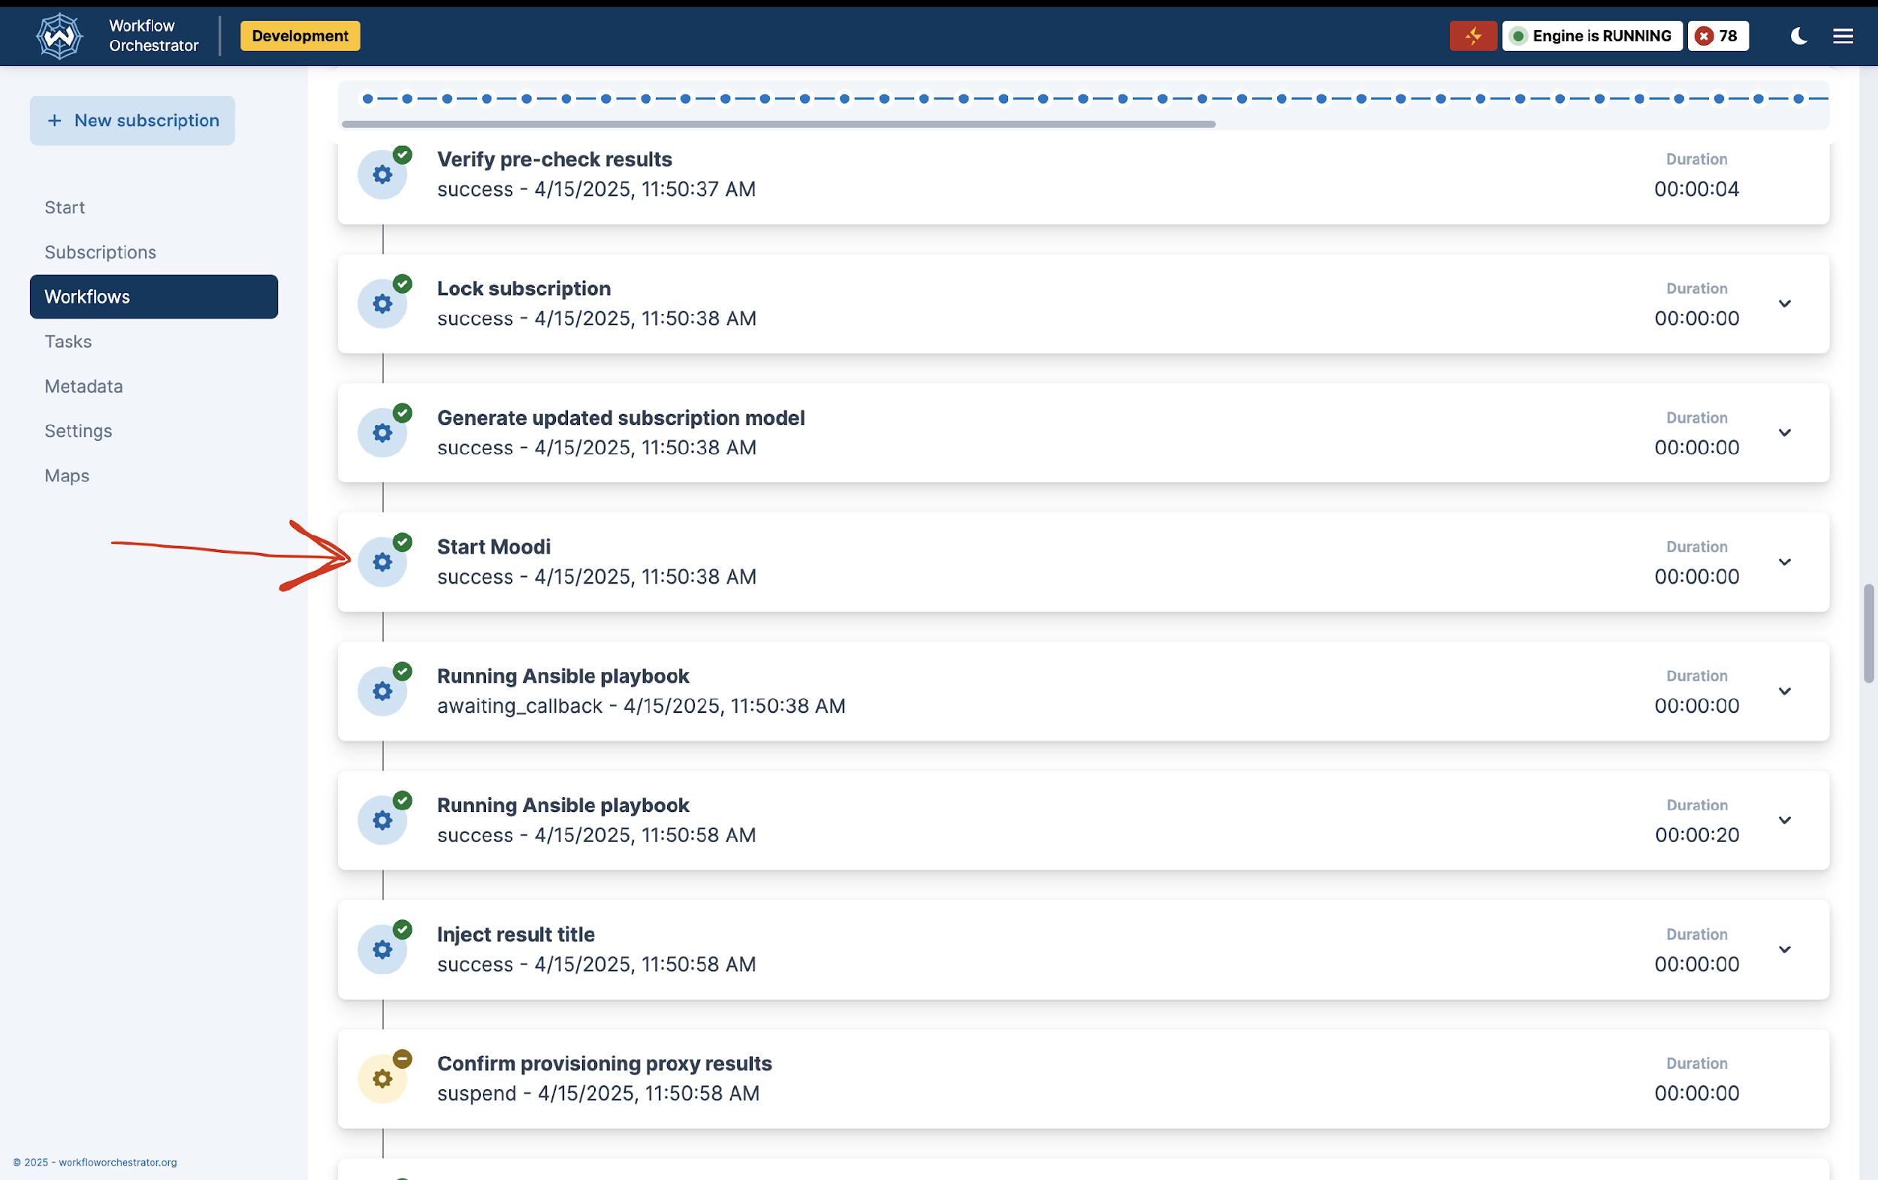
How It Works in Workflow Orchestrator
In any workflow (e.g. “Create IAS”), start_moodi() is a step
Ansible generates gnmic telemetry configs from subscription model
Dashboards are created based on involved devices
Once workflow is done → stop_moodi() cleans it up
Or operator can run it manually for a specific device without even running a workflow!

Slide 9
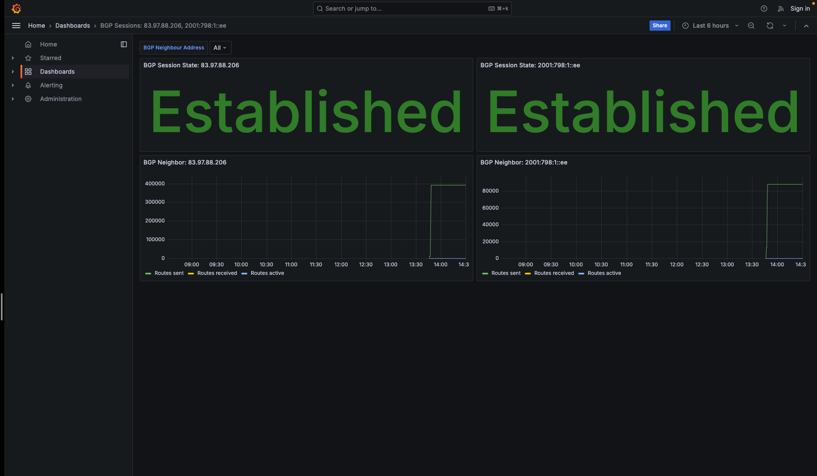
Example – Migrating an Edge Port
Migrating an Edge Port?
Monitors:
BGP Session State
Neighbor Routes Sent
Neighbor Routes Received
Neighbor Routes Active
Engineers verify correctness visually before declaring success in each step

Slide 10
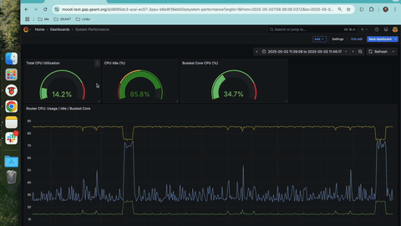
What Engineers See – Grafana Live Dashboards
Auto-generated views:
Interface rates, errors
Optical levels
BGP route counts
CPU/memory usage
Tailored per workflow no noise, just what matters

Slide 11
Ephemeral by Design
🧠 Spins up on workflow start, gone after completion
🧼 Clean shutdown: no stale gNMI sessions, no leftover dashboards
🪶 Lightweight: all containers, zero long-term footprint
🔁 Each run is fresh – avoids drift and ghost configs

Slide 12
Takeaways & What’s Next
Moodi gives automation a pair of eyes – real-time, task-scoped telemetry
Boosts confidence in automated changes
Easy to adopt: built on open tools, API-driven
Let’s extend this: other domains, other workflows, other communities

Slide 13
CaaS:
Containerlab-as-a-Service
Simplifying deployment of network topologies for pre-production validation
Adrián Pino (i2CAT)

Slide 14
"Will this work in production?" – The pain of network validation

Slide 15
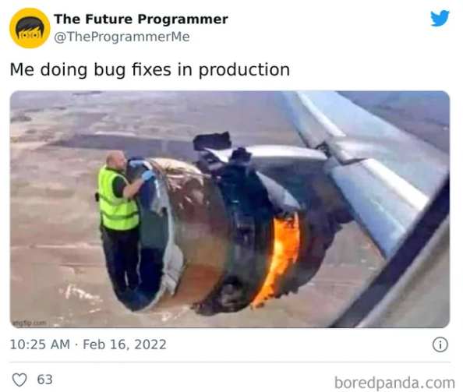
"Will this work in production?" – The pain of network validation

Slide 16
"Will this work in production?" – The pain of network validation
A common target: avoid the unexpected in production
Every network change carries risk.
A single misconfiguration can cause outages, security flaws, or performance issues.

Slide 17
"Will this work in production?" – The pain of network validation
A common target: avoid the unexpected in production
Every network change carries risk.
A single misconfiguration can cause outages, security flaws, or performance issues.
Challenges in replicating production complexity
Lab environments are useful but often lack full-scale realism.
UAT environments aim to mirror production, but tooling limitations can hinder repeatability.
Physical test labs are costly, slower to scale, and harder to maintain than virtualized setups.

Slide 18
"Will this work in production?" – The pain of network validation
A common target: avoid the unexpected in production
Every network change carries risk.
A single misconfiguration can cause outages, security flaws, or performance issues.
Challenges in replicating production complexity
Lab environments are useful but often lack full-scale realism.
UAT environments aim to mirror production, but tooling limitations can hinder repeatability.
Physical test labs are costly, slower to scale, and harder to maintain than virtualized setups.
We need a better way
What if we could test in an environment that mirrors production?
What if we could validate scripts before they touch real routers?

Slide 19
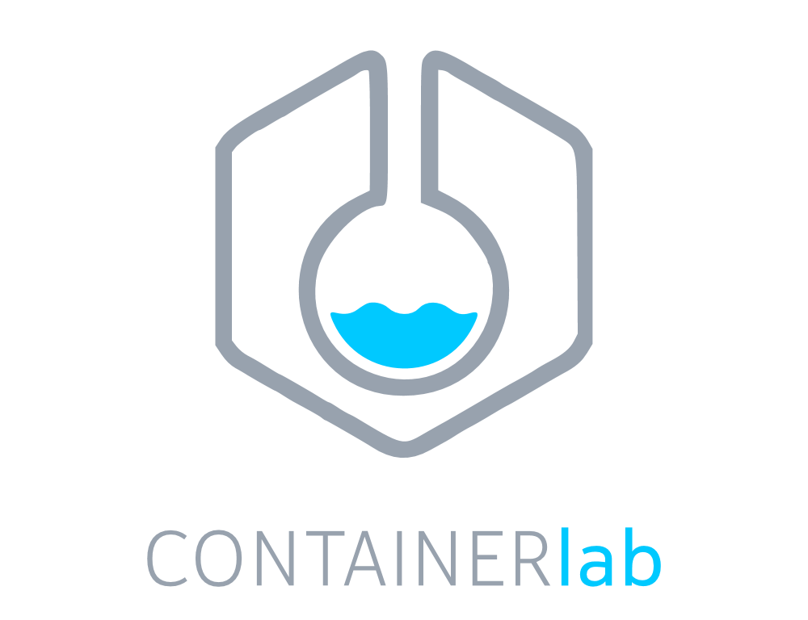
"Will this work in production?" – The pain of network validation
A common target: avoid the unexpected in production
Every network change carries risk.
A single misconfiguration can cause outages, security flaws, or performance issues.
Challenges in replicating production complexity
Lab environments are useful but often lack full-scale realism.
UAT environments aim to mirror production, but tooling limitations can hinder repeatability.
Physical test labs are costly, slower to scale, and harder to maintain than virtualized setups.
We need a better way
What if we could test in an environment that mirrors production?
What if we could validate scripts before they touch real routers?
Containerlab: a nice open source solution!

Slide 20
Our baseline: Containerlab

Slide 21
Our baseline: Containerlab
Orchestrator of containerised Network Operating Systems (Cisco, Nokia, Juniper, etc).
It also supports launching traditional virtual machine based routers.

Slide 22
Our baseline: Containerlab
Orchestrator of containerised Network Operating Systems (Cisco, Nokia, Juniper, etc).
It also supports launching traditional virtual machine based routers.
Simple deployment of proprietary network devices for pre-production evaluation.
Pluggable system.
Easy setup for licence and configuration per box.

Slide 23
Our baseline: Containerlab
Orchestrator of containerised Network Operating Systems (Cisco, Nokia, Juniper, etc).
It also supports launching traditional virtual machine based routers.
Simple deployment of proprietary network devices for pre-production evaluation.
Pluggable system.
Easy setup for licence and configuration per box.
Cloud-native & standard-like approach.
Default: Docker ("Containerlab").

Slide 24
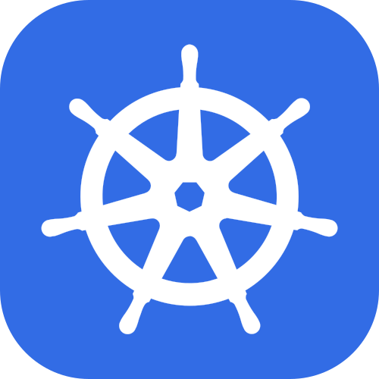
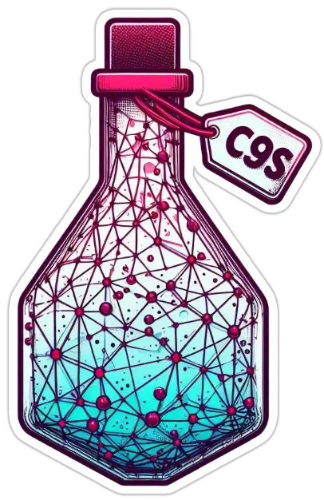
Our baseline: Containerlab
Orchestrator of containerised Network Operating Systems (Cisco, Nokia, Juniper, etc).
It also supports launching traditional virtual machine based routers.
Simple deployment of proprietary network devices for pre-production evaluation.
Pluggable system.
Easy setup for licence and configuration per box.
Cloud-native & standard-like approach.
Default: Docker ("Containerlab").
Also with Kubernetes support ("Clabernetes" -> C9s).
C9s

Slide 25
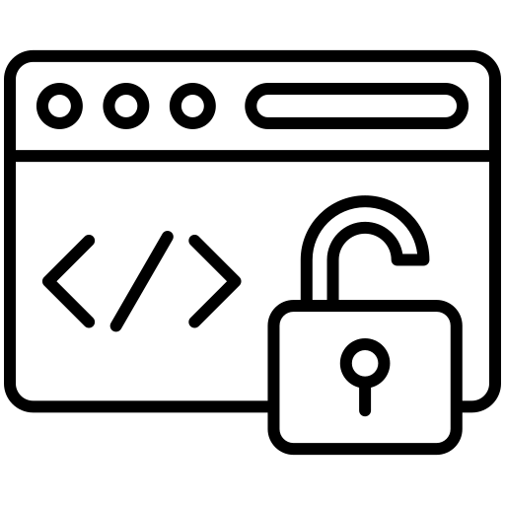
Our baseline: Containerlab
Orchestrator of containerised Network Operating Systems (Cisco, Nokia, Juniper, etc).
It also supports launching traditional virtual machine based routers.
Simple deployment of proprietary network devices for pre-production evaluation.
Pluggable system.
Easy setup for licence and configuration per box.
Cloud-native & standard-like approach.
Default: Docker ("Containerlab").
Also with Kubernetes support ("Clabernetes" -> C9s).
Open-source, community-maintained project.
C9s

Slide 26
Our baseline: Containerlab – Some limitations (we overcome)
Command line-driven → not user-friendly for non-experts.
Manual configuration → manually manage topology, config, licence.
No multi-tenancy support.
C9s

Slide 27
Our solution: Containerlab-as-a-Service (CaaS)
"A multi-tenant sandbox for easy orchestration and validation of network OS topologies"

Slide 28
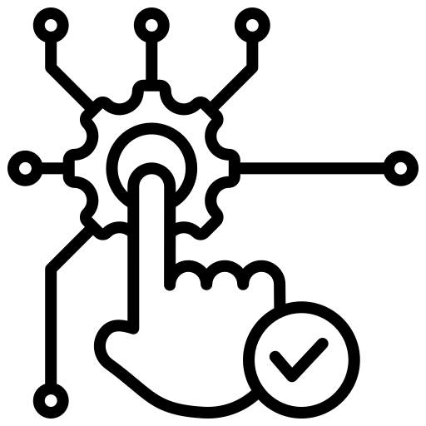
Who can benefit from CaaS?
1) Network operators
Test safely before deploying/applying to production
Explore how different vendors' devices behave
2) Academia environments
Teach networking topics using real NOS images
Isolated sandboxes for student labs & research

Slide 29
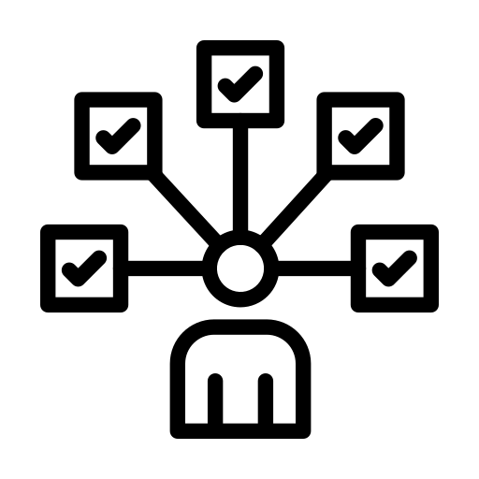
Our solution: Containerlab-as-a-Service (CaaS)
Benefits:
User-friendly network topology deployment: using GUI and in ~3 clicks.
Easy to deploy: stack shipped with containers & 1 command for setup/teardown.
Concurrent deployment of topologies & continued status polling during deployment.
Supporting multi-tenancy: teams and users with configurable permissions.
(Built-in K8s) Isolation guaranteed among different network topologies.
"A multi-tenant sandbox for easy orchestration and validation of network OS topologies"

Slide 30
CaaS specs: Kubernetes

Slide 31
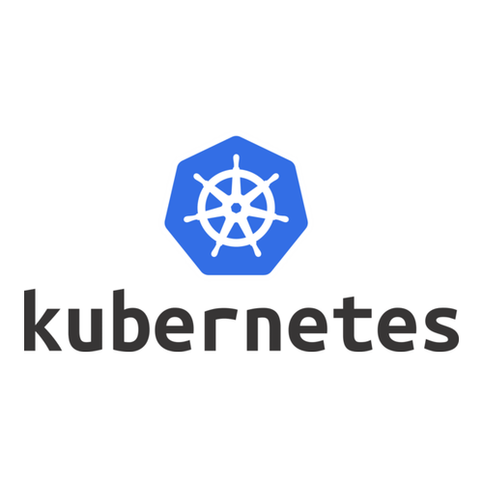
CaaS specs
Minimum requirements:
Kubernetes
Load-balancer (e.g: Kube-vip)
CNI (e.g. Cilium) for multi-node environments
Production setup:
High availability (HA) Kubernetes cluster
Number of nodes depend on the availability zones, but at least >3
Compute nodes resources completely depend on the expected topologies to be deployed
Load balancer + CNI

Slide 32
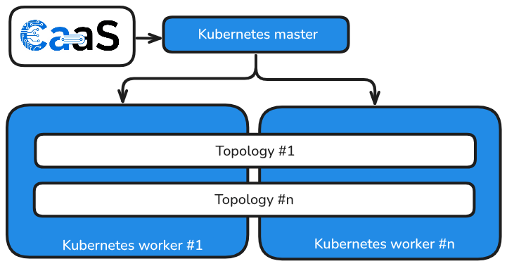
CaaS architecture

Slide 33
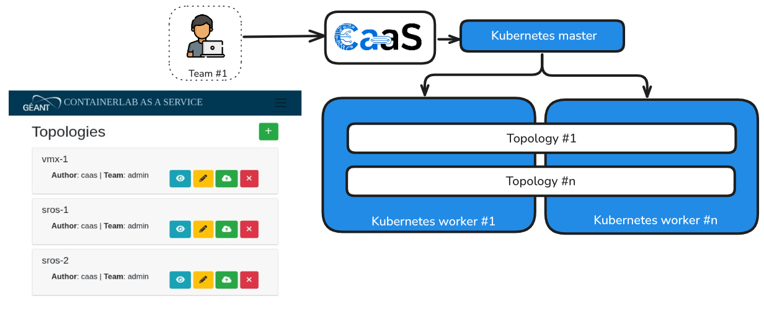
CaaS architecture
Users can straightforward upload & deploy topologies!

Slide 34
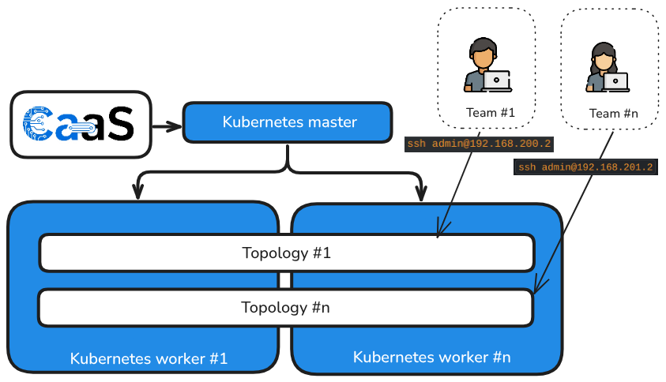
CaaS architecture
Topology elements (e.g. routers) are exposed to users
Users simply SSH them
No need of Kubernetes knowledge

Slide 35
CaaS - some technical details
Tech stack based on Django & PostgreSQL DB (Docker containers).
User and team management with configurable permissions.
Soon: single sign-on (SSO) integration with GÉANT identity provider.
Bundle upload: topology, licence, configuration.
For a given topology, multiple instances can be deployed (concurrently).

Slide 36
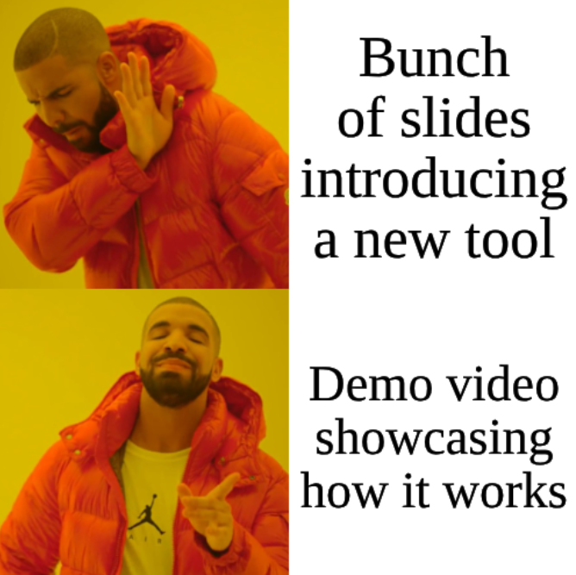
CaaS in action

Slide 37
CaaS in action
Network topology deployment:
Experiment
Creation
Topology
Creation
Upload topology file
Details
Topology network
Deployment in Kubernetes
Details
Review from Kubernetes

Slide 38
What is next?

Slide 39
What is next?
Development & deployment pipeline
Resource management:
Quotas for limiting computing and networking usage per user/team.
Containerlab integration:
Easier access to the deployed networking devices through e.g. SSH keypairs.
Better checks to determine reachability/availability of routers.
Integration with Workflow Orchestrator: as part of testing workflows.

Slide 40
What is next?
Development & deployment pipeline
Resource management:
Quotas for limiting computing and networking usage per user/team.
Containerlab integration:
Easier access to the deployed networking devices through e.g. SSH keypairs.
Better checks to determine reachability/availability of routers.
Integration with Workflow Orchestrator: as part of testing workflows.
Contributions to Containerlab / Clabernetes (C9s) project
Under evaluation: resilient baseline, detailed Topology CRD status.

Slide 41
Thank you
Any questions?
mohammad.torkashvand@geant.org
adrian.pino@i2cat.net

