Slide 1
Communication Plan
for ICT Nerds
Barbara Carroll, 12/06/2025

Slide 2
“Work in silence and let the success make the noise”
*AI Generated Image

Slide 3
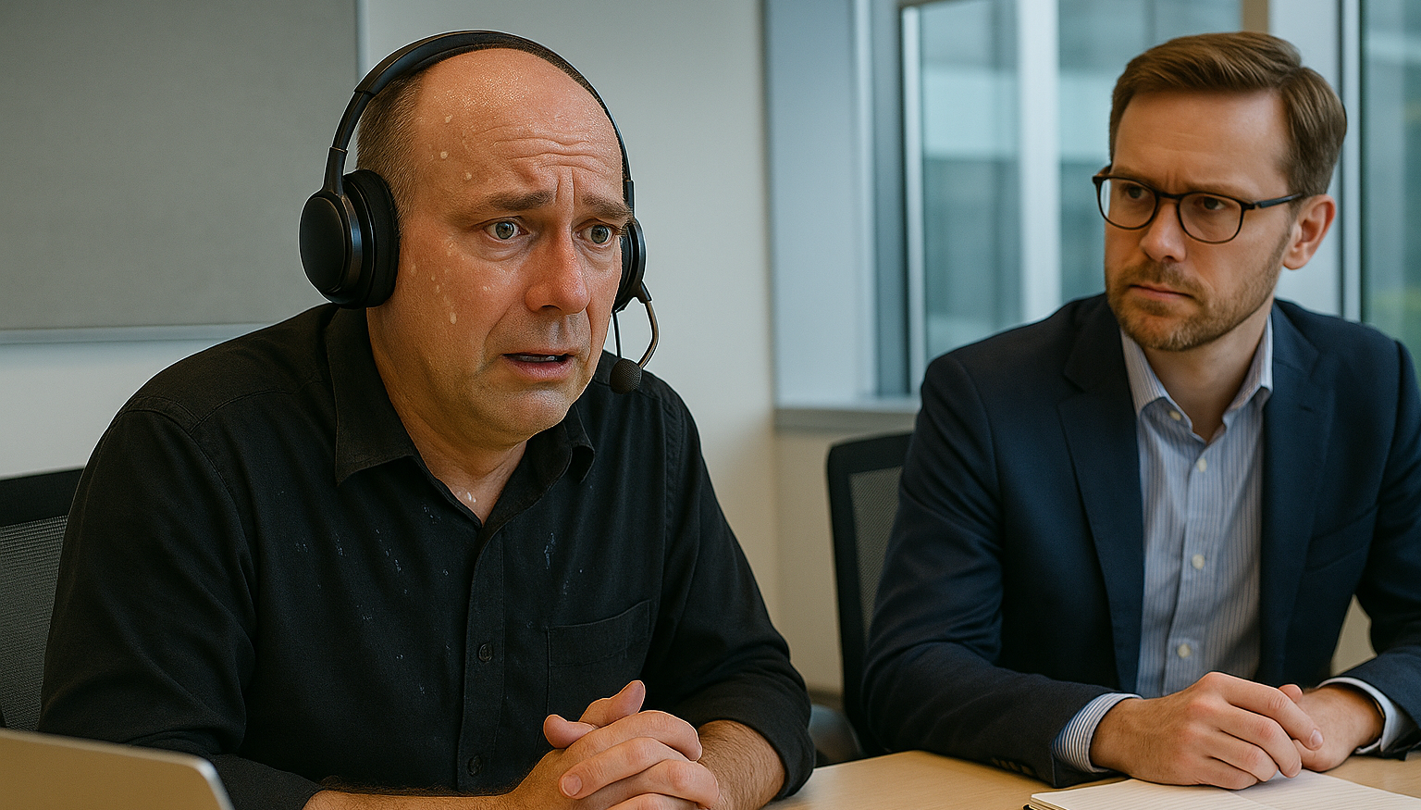
*AI Generated Image

Slide 4
WHO?
WHEN?
WHAT?

Slide 5
WHO?

Slide 6
My team
My manager
End users
Clients
GÉANT SIG/TF
Innovation manager
Product manager
GÉANT Team

Slide 7
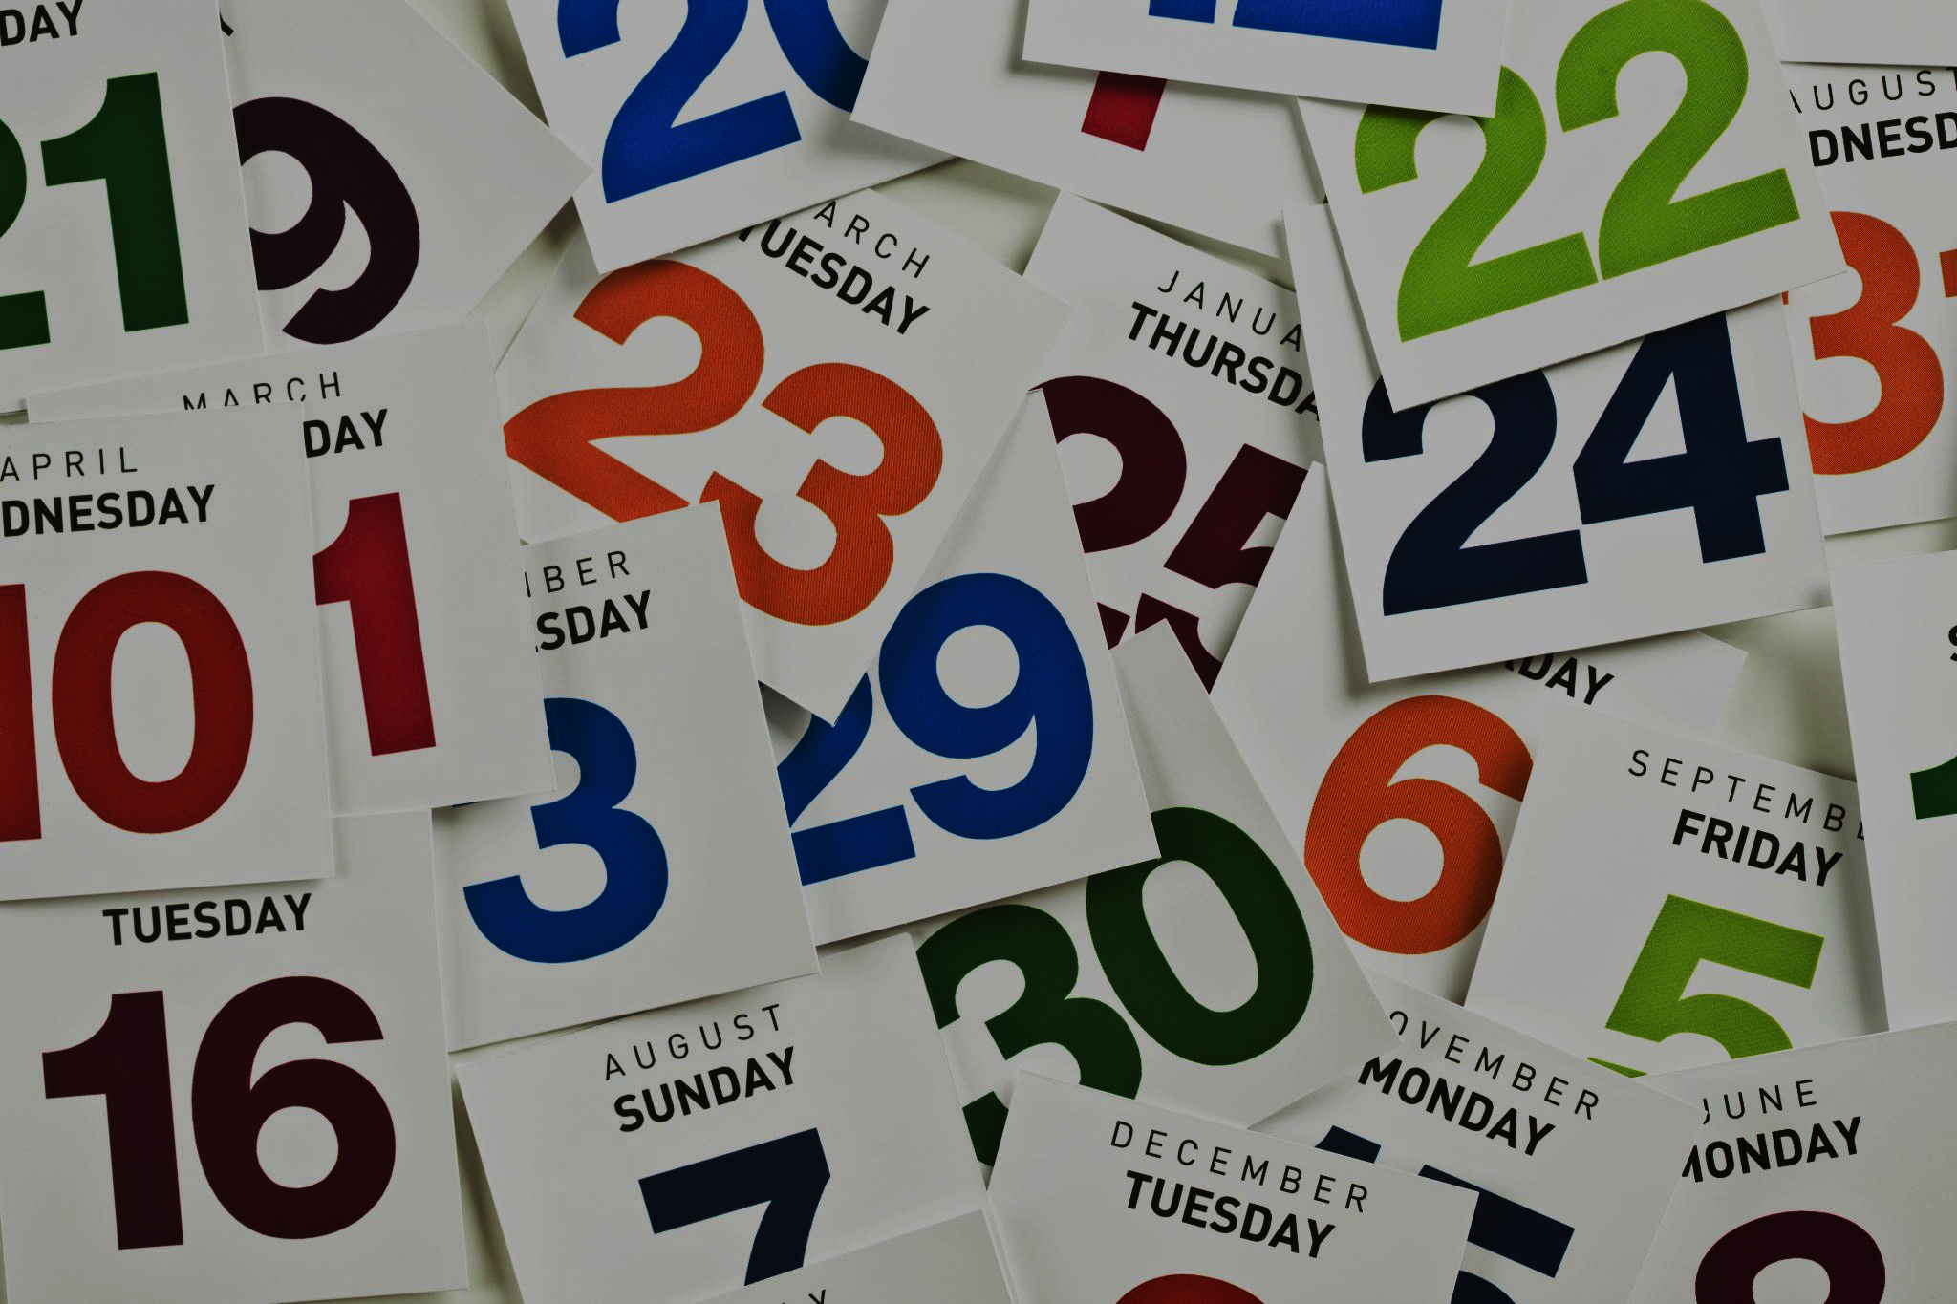
WHEN?

Slide 8
Internal Stakeholders
External Stakeholders
Action | When | Status
Chat with my manager during our 121 meeting | 10th June | Done
Chat with my team | 11th June | Done
Set up a coffee with the product manager | 12th June | Scheduled
Set up a coffee with the innovation manager | 16th June | Scheduled
Action | When | Status
Get in touch with the GÉANT Team | 17th June | To do
Research if there is a relevant GÉANT SIG/TF | 19th June | To do
Clients | N/A | N/A
End users | N/A | N/A

Slide 9
WHAT?

Slide 10
Human to Human (H2H)
*AI Generated Image

Slide 11
WHO?
WHEN?
WHAT?
*AI Generated Image

Slide 12
WHEN IN DOUBT…

Slide 13
THANK YOU
barbara.carroll@heanet.ie
www.linkedin.com/in/bjkcarroll

