Slide 1
“It’s Fine” a story of NREN culture
Neil Shewry
Director of Networks, Jisc

Slide 2
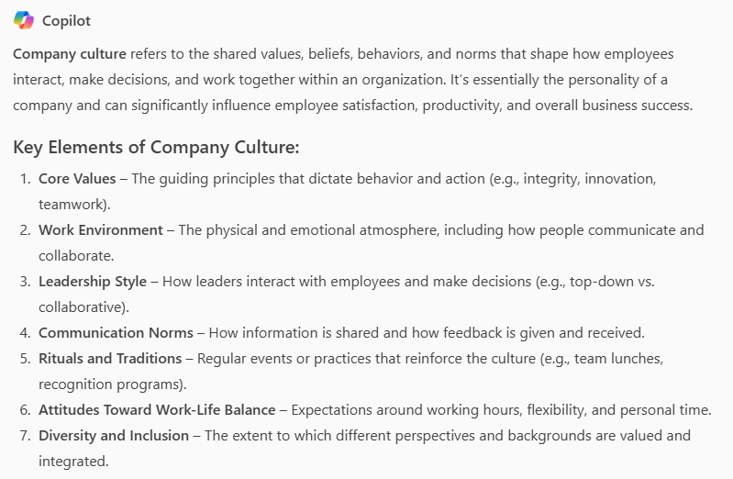
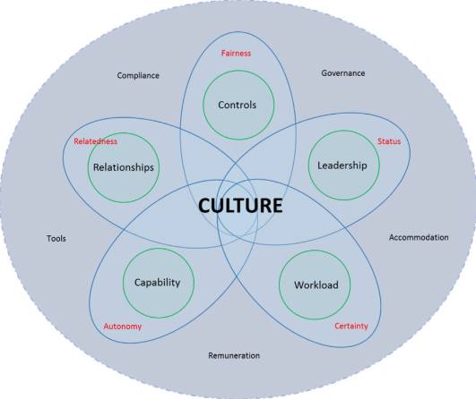
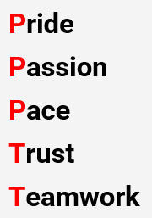
Culture
Notes:
We like culture
We’re NRENs, the good guys
Lots of words
What does it mean, feel like

Slide 3
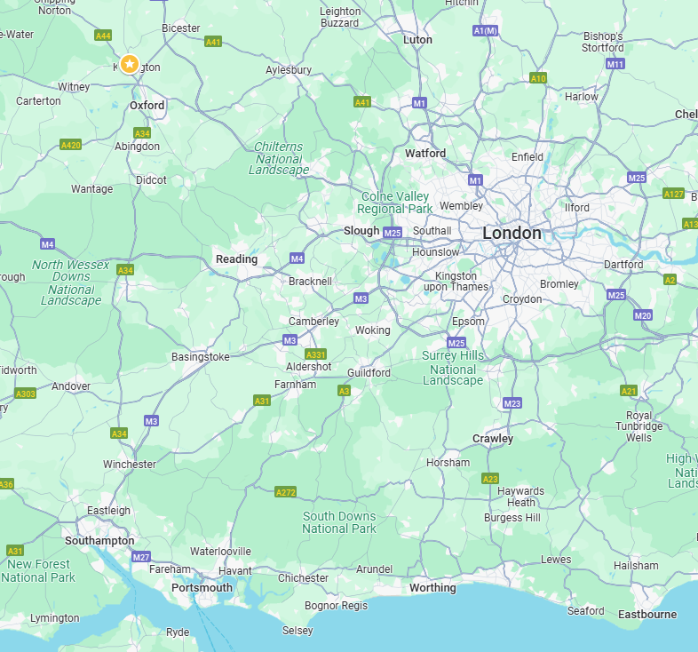
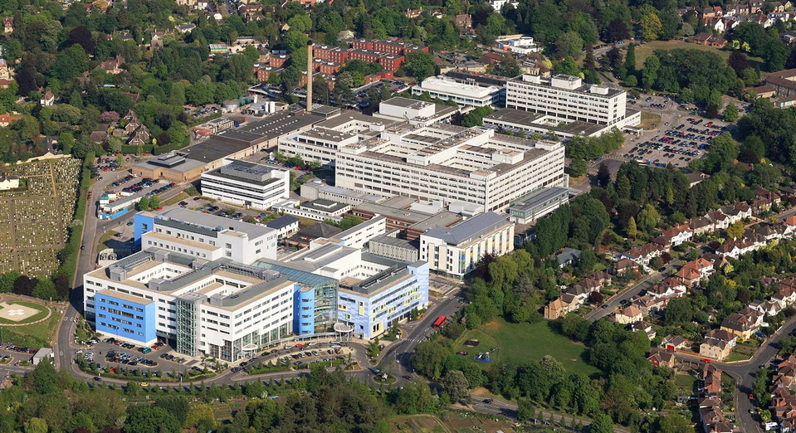
A story
January 2011, Oxford UK
130km
Notes:
Personal and emotional
Happy ending
Took place in Oxford, UK in January 2011
130km from here
JR hospital
University hospital, eduroam & really good connectivity ☺
Maternity unit where people have babies, where I was born

Slide 4
A story
January 2011, Oxford UK
Notes:
Been in a week
Small baby, lots of test and monitoring
Doctor came in, picked myself up, noticed her shoes -> ‘the look’
They left, I paced up and down, seemed like hours, screaming

Slide 5
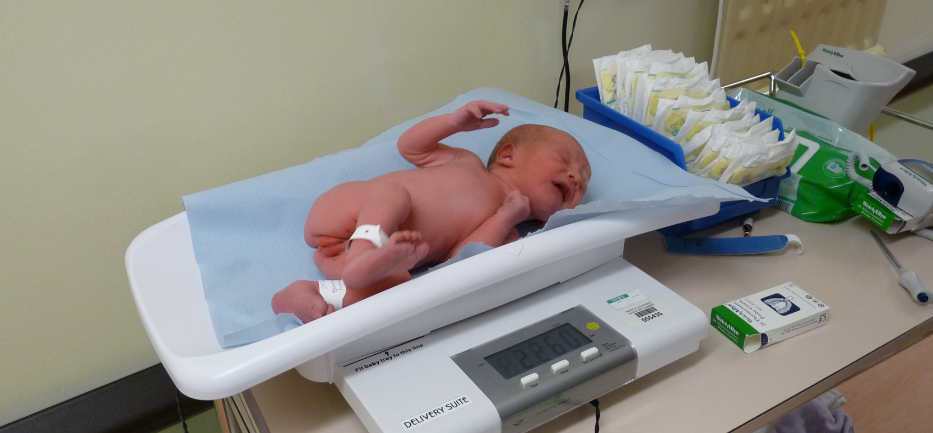
A story
January 2011, Oxford UK
Notes:
2.2kg, <5th percentile

Slide 6
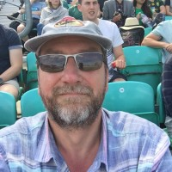
Back to Jisc
“If you don’t ask…”
“there are 2 ways…”
Notes:
Remember when I picked myself up off the floor?
This was my boss in 2011
Lovely chap, had a reputation (dog picture appears)
Thursday, had to contact him
Long text message, hit send, phone rang
3 things – are you ok, is your wife ok, it’s fine
Weight lifted, relief

Slide 7
Fast forward to today
Builders here today
Meeting with teacher
23 years at Jisc, 12 as a manager
Friend needed my help
Needed some fresh air
Parents evening
Nan’s carer cancelled
Hospital visit
Sick children
School sports day
Doctors' appointment
My pet died
University open day
It’s fine. It’s always fine.
Notes:
Lucky to have had a succession of good managers
Nothing I haven’t heard
I’m the lucky one who gets to say it’s fine
Can see the relief and weight lifted, just like me in the hospital
The best part is what you get back

Slide 8
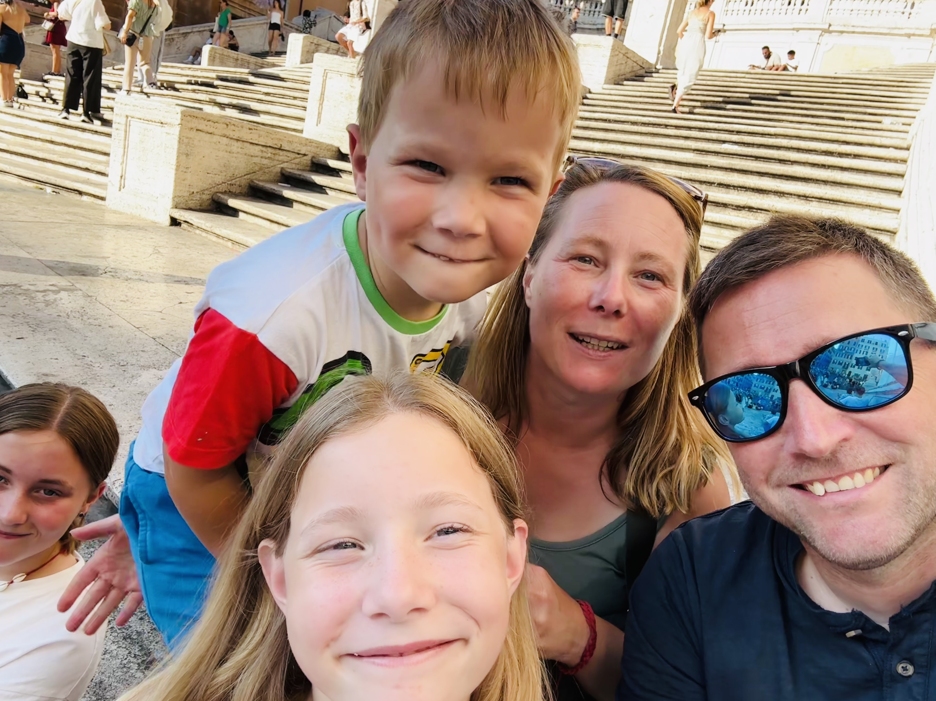
Fast forward to today
Notes:
I said the story had a happy ending – this is us in Italy last year
Tired & stressed ☺

Slide 9
Takeaways
Manage expectations
Treat people well
It’s fine

Slide 10
Neil Shewry
Director of Networks
Neil.shewry@jisc.ac.uk
linkedin.com/neilshewry

