Slide 1
Does the World Need More NRENs?
KITUYI JOSHUA BRIAN
RENU, Uganda
10/06/2025

Slide 2
Do we need more NRENs?
or
Better NRENs?

Slide 3
Universal Goal of NRENs
To provide the research and education community in its country with high quality network connectivity and related advanced services, interconnecting campuses to one another and to the wider Internet so that students, teachers and researchers can collaborate and access digital resources effectively.
https://about.geant.org/nrens/

Slide 4
Is it Infrastructure for R&E or Improvement of Quality in R&E?
Not Just Infrastructure
NRENs are meant to be more than Internet pipelines. They provide advanced services like Trust & Identity (eduGAIN & eduroam), cloud & HPC, security operations tailored to R&E.
Quality Enhancement NRENs enable access to global academic content, joint research platforms, and virtual labs. They foster innovation by reducing digital barriers, especially in developing contexts.
Infrastructure is foundational, but its real impact lies in improving the quality and inclusiveness of education and research.

Slide 5
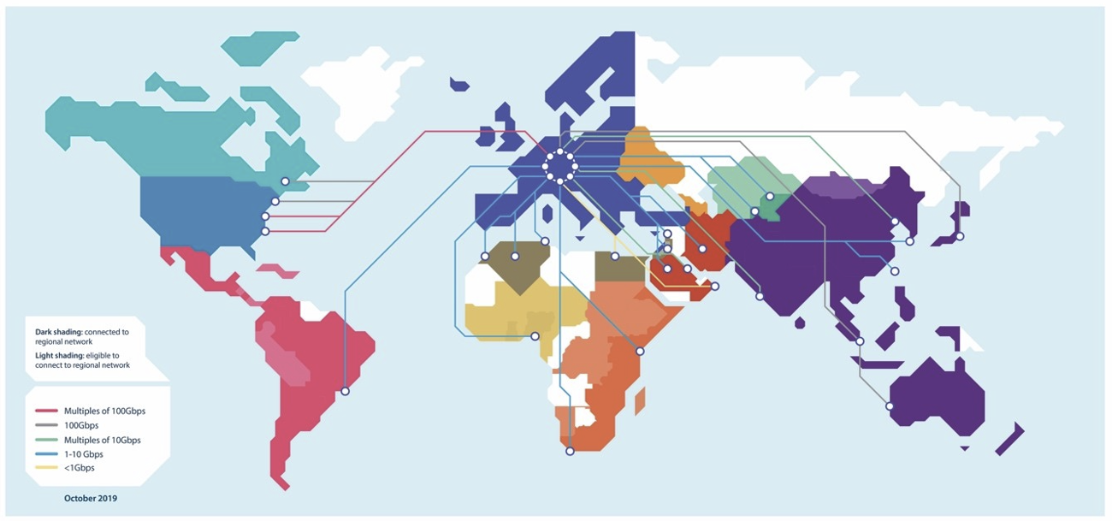
Global NREN Landscape
About 125 functional NRENs worldwide (all continents).
Coverage gaps: 30+ countries lack any dedicated R&E network.
Gaps in Central Africa, Pacific Islands, Middle East.
Regional aggregator - GEANT, WACREN, RedCLARA, UbuntuNet Alliance, ASREN.

Slide 6
The Problem Landscape

Slide 7
Global NREN Landscape
https://www.statista.com/
Notes:
Research output in the NREN space refers to peer-reviewed publications, datasets, software, and other scholarly products generated through high-speed academic networks. These outputs benefit from collaborative research environments and shared digital infrastructure provided by NRENs. By supporting access, validation, and dissemination, NRENs enhance the credibility, reach, and impact of research outputs. 2. Internet poverty is the lack of reliable, affordable, and meaningful internet access. It limits people's ability to learn, work, communicate, and access essential digital services. This deepens social and economic inequality, especially in underserved communities.

Slide 8
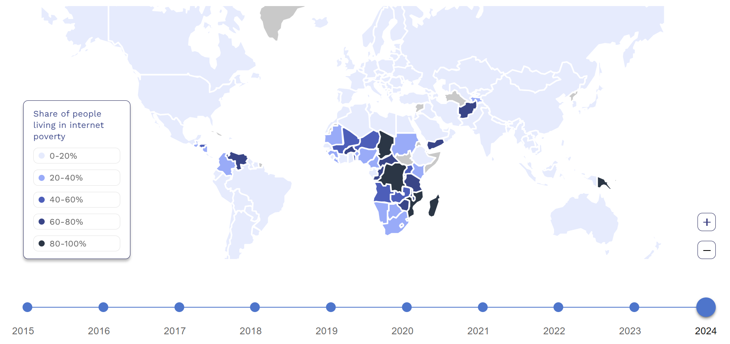
Internet Poverty

Slide 9
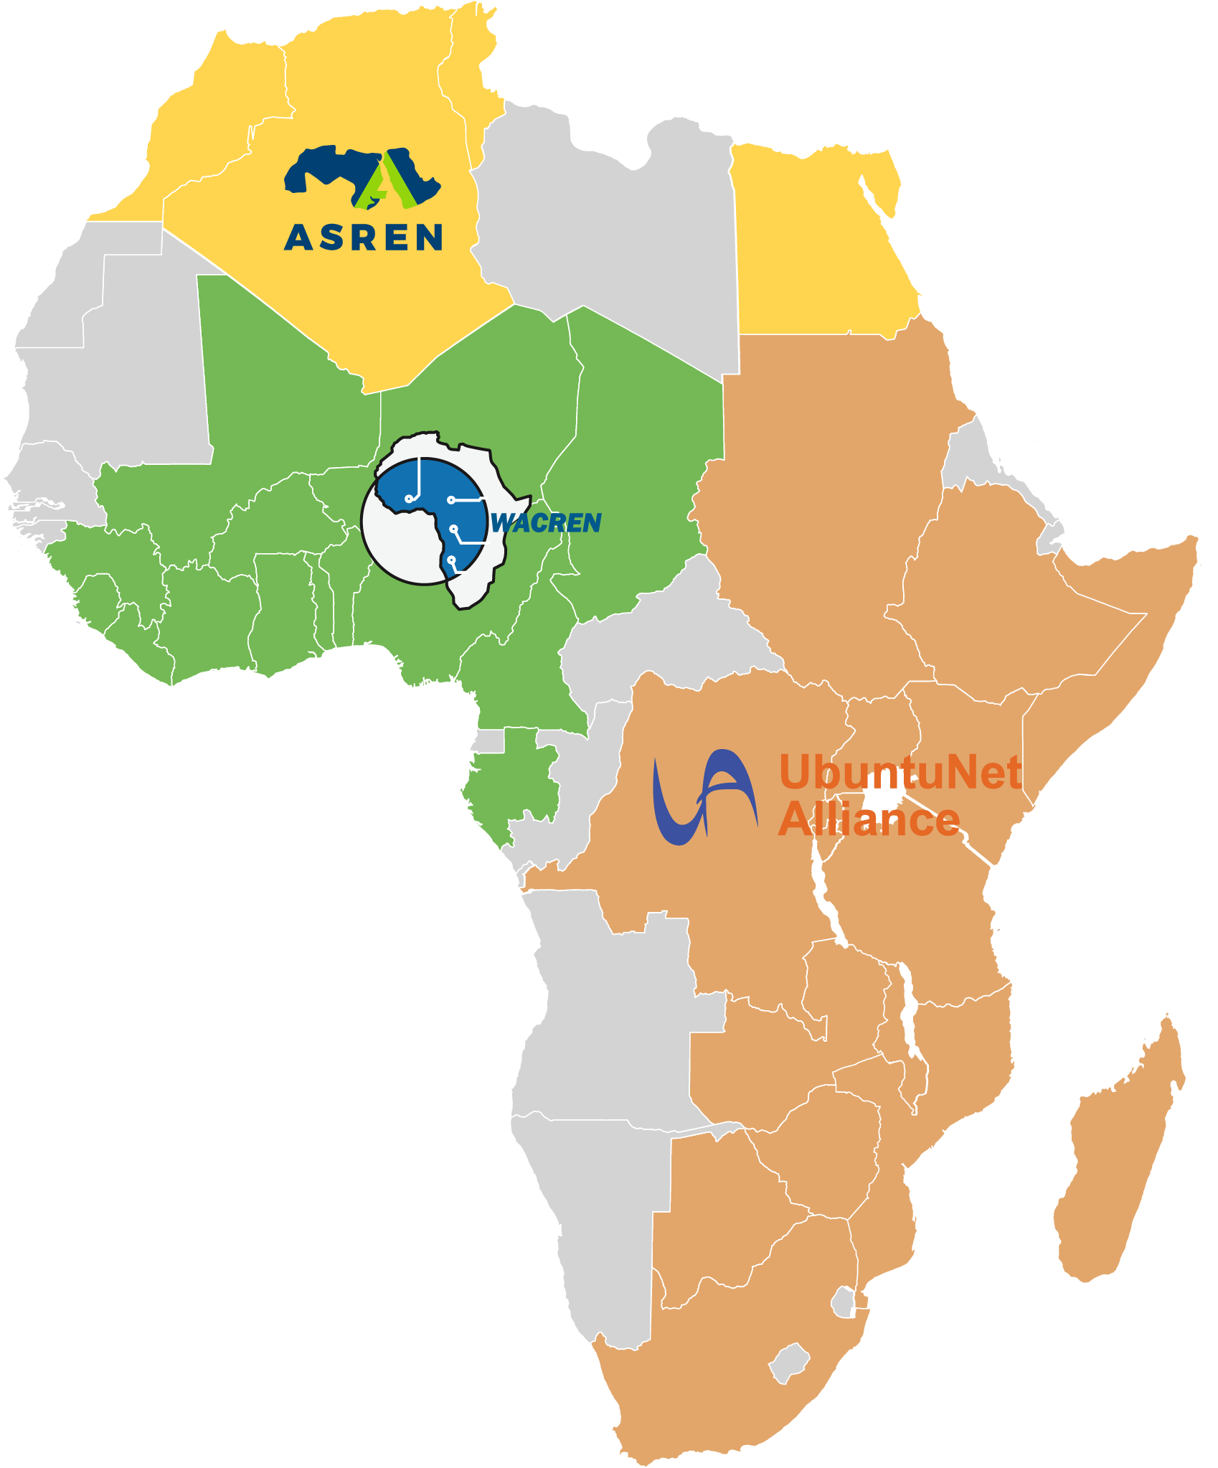
What is the Current Setup in Africa
NRENs are a non-for profit organisations dedicated to supporting research and education nationally and internationally through high-capacity connectivity and other value added services.
ASREN
WACREN
UbuntuNet Alliance
Algeria, ARN
Egypt, EUN
Morocco, MARWAN
Tunisia, CCK
Bénin, RerBénin and RBER
Burkina Faso, FasoREN
Cameroon, RIC
Tchad, TchadREN
Côte d’Ivoire, RITER
Ghana, GARNET and GhREN
Guinea, Gn-REN
Liberia, LRREN
Mali, MaliREN
Nigeria, NgREN and Eko-Konnect
Niger, NigerREN
Sierra Leone, SLREN
Togo, TogoRER
Botswana, BotsREN
Burundi, BERNET
DRC, Eb@le
Ethiopia, EthERNet
Kenya, KENET
Madagascar, iRENALA
Malawi, MaREN
Mozambique, MORENET
Rwanda, RWEDNET
Somalia, SomaliREN
South Africa, TENET
Sudan, SudREN
Tanzania, TERNET
Uganda, RENU
Zambia, ZAMREN
Zimbabwe, ZIMREN

Slide 10
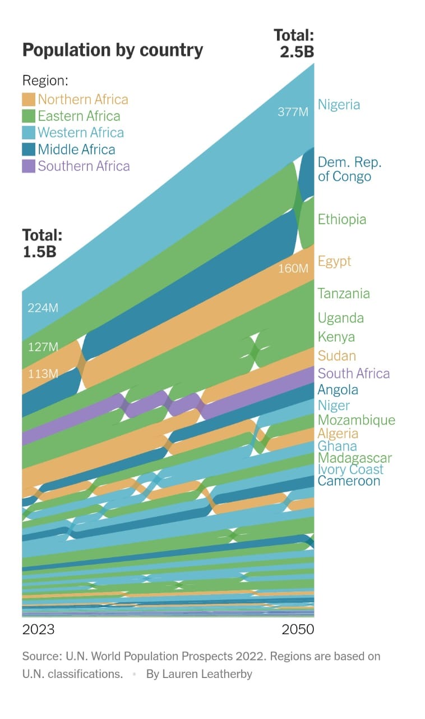
What is the Current Setup in Africa
Notes:
Which regions need more NRENS ?
Which regions need better NRENS?

Slide 11
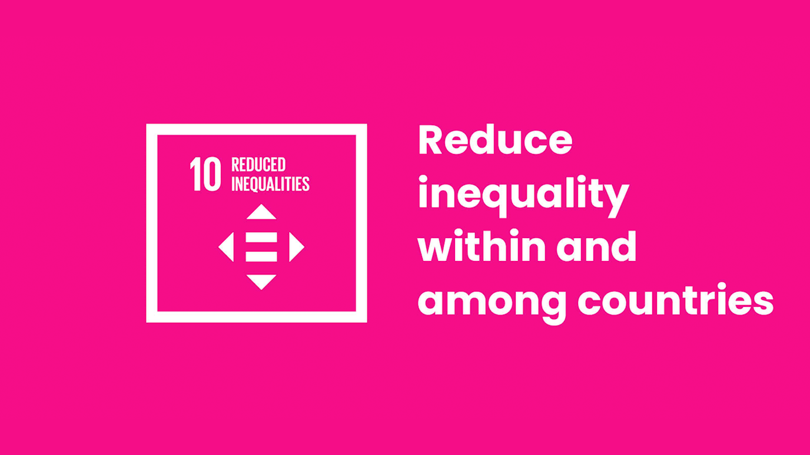

Slide 12
Notes:
1. Basic Educational Infrastructure
Classroom shelter: A simple structure to protect from harsh weather (sun, rain, wind).
Desks and chairs: To improve comfort and concentration during lessons.
Writing materials: Exercise books, pencils, and chalk are likely in short supply.

Slide 13
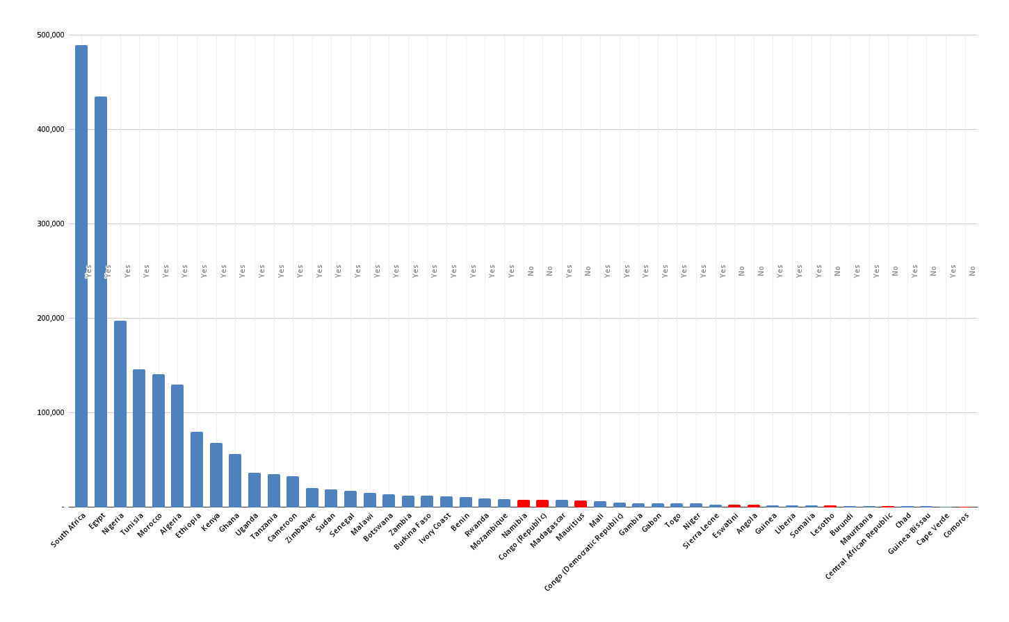
Africa NREN Landscape- Peer Reviewed Research Output

Slide 14
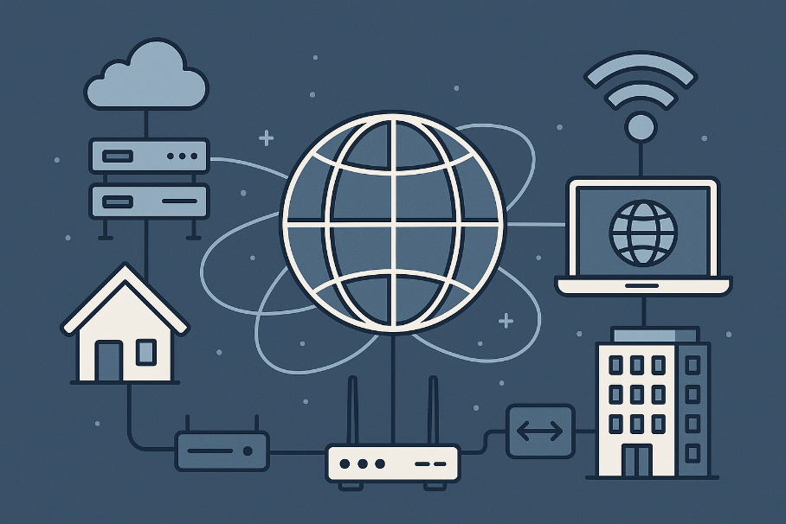
Is it Infrastructure for R&E or Improvement of Quality in R&E?
R&E networks correlate with a far richer publication pipeline - countries that invest in an NREN tend to publish far more peer-reviewed work even after accounting for big outliers like South Africa and Egypt.
NREN presence coincides with less severe connectivity gaps - Median “poor internet” share drops from 80 % to 63 % when an NREN is present meaning an NREN helps-
but only if last-mile and affordability issues are addressed in parallel.
Notes:
When a country invests in a National Research and Education Network (NREN), it usually ends up publishing more peer-reviewed research papers.
Even after removing big research producers like South Africa and Egypt, countries with NRENs still publish far more scientific work than those without.
In countries without an NREN, about 80% of universities and schools report having poor internet.
But when an NREN is present, this drops to 63%. That means NRENs help close the connectivity gap, giving students and researchers better access to the internet. Meaning an NREN helps But……..

Slide 15
RENU’s Journey

Slide 16
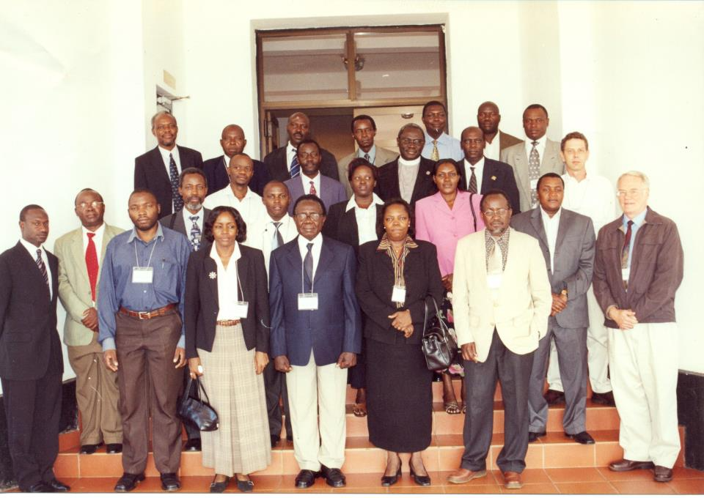
The Beginning
2006, Entebbe
VCs of Universities
CEOs and EDs of Research Institutions

Slide 17
The Beginning
Initial challenge
Reliable & affordable connectivity
BUT
Connectivity just a means to an end
What’s the end?
High quality education and research
Access to resources
Improved methods
Improved collaboration

Slide 18
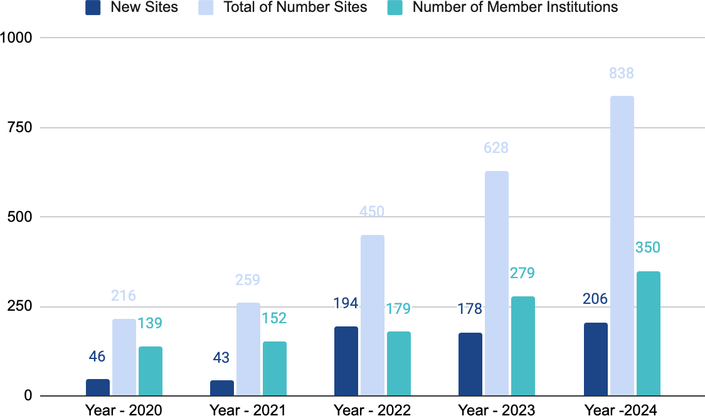
Connected Sites over the Years

Slide 19
Connected Sites over the Years
Africa Connect
Africa Connect 2

Slide 20
Notes:
Innovations like metro eduroam

Slide 21
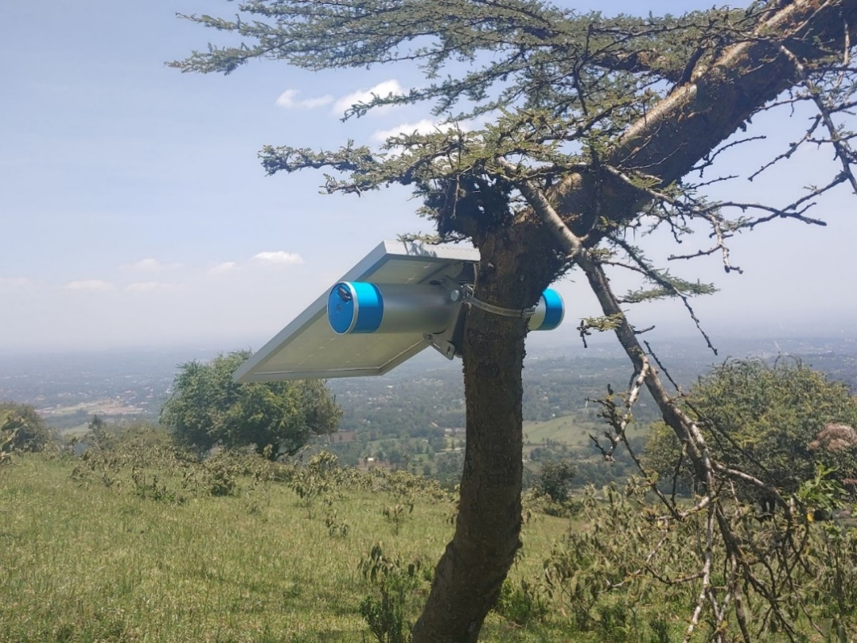
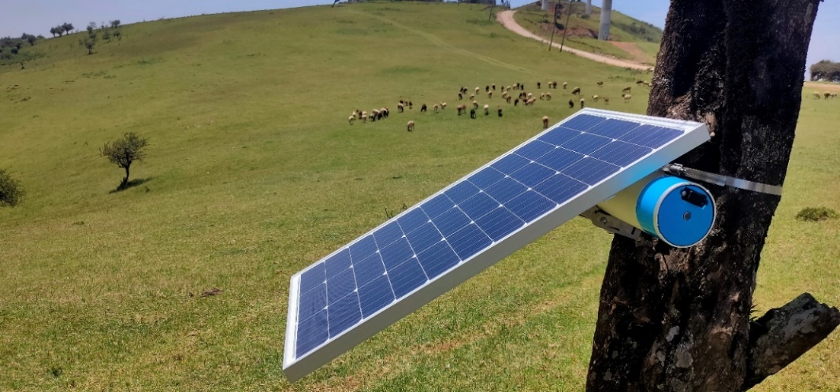
Solar – Powered Internet Routers
Notes:
According to the Uganda Communications Commission (UCC), Uganda had 27.7 million active internet subscriptions by mid-2023. However, the average user consumed just 1.7 GB of mobile data per month in early 2023—barely enough to stream a single two-hour lecture in standard definition. High data costs, limited bandwidth, and inconsistent coverage continue to push students and researchers offline the moment they leave campus.
We have increased the number and quality of our Metro eduroam hotspots by using solar-powered routers, and by doing that, we are eliminating the barriers with affordable, high-speed Internet connectivity across hostels, cafés, airports, research centers, and campuse
The number of institutions joining eduroam has increased drastically, rising from 20 in December 2020 to 256 in April 2025, driven by the desire to access the Metro eduroam service.

Slide 22
Does the World Need More NRENs? - Yes
Better NRENs? - Yes

Slide 23
However,
For NRENs: Be more people-centered
1
Listen, communicate, and co-create.
For institutions: Engage actively with your NREN
2
Push for better services, share feedback, and participate in governance.
For funders and policymakers: Invest in digital equity, not just infrastructure
3
Support capacity building, innovation, and regional collaboration.
The world needs more better NRENs

Slide 24
Sustainable NRENs
1
How do we diversify revenue streams ?
How do we strengthen institutional capacity ?
How do we expand the user base ?
How do we integrate green and efficient technologies ?
How do we improve our communication and marketing ?
How do we sit in and participate on policy advocacy ?
2
3
4
5
6
Notes:
1. Sustainable financial models for NRENs 2. Strong internal governance, staff development, and capacity building for operational sustainability. 3. Membership beyond High education Institutions to Hospitals, Schools etc
4. Transition to energy-efficient infrastructure.
5. Boosting visibility, stakeholder engagement, service adoption, and policy support. 6. Engage government stakeholders early and align with national development goals

Slide 25
Thank you
Any questions?
jbkituyi@renu.ac.ug

