Slide 1
In The Field Stories:
Celebrating a decade of global NREN collaboration
Jane Gifford, AARNet Director Marketing & Communications
TNC25 12 June 2025
Notes:
Welcome & Intro – 2 mins
“Ten years ago, a simple idea sparked a global collaboration — one that’s stood the test of time, gathered hundreds of stories, and, for me, led to friendships with incredible people around the world.
That’s the power of our shared purpose, and of the collaborative spirit of the global NREN community — and of storytelling.”
I’m Jane Gifford, Director of Marketing and Communications at AARNet — Australia’s NREN — and I’ve had the pleasure of leading the In The Field project from the very beginning.

Slide 2
Notes:
For Australian researchers, the international connectivity we provide is vital for overcoming the tyranny of distance. To support them, AARNet has even invested in ownership of subsea cable systems).
Our services are essential for enabling Australian researchers and educators to participate on the global stage.
Which means that promoting how researchers and educators use our international network — and the outcomes it makes possible — has always been, and will continue to be, a driving force in my work.
In The Field has a special place for me because it brings those outcomes to life — not just for Australia but for the entire ecosystem of NRENs we rely on for enabling collaboration and discovery across borders.

Slide 3
Why we’re here
Agenda:
Past
Practice
Possibilities
Notes:
Many of you here today have been part of this journey — as storytellers, champions, contributors, or supporters — and I want to say a heartfelt thank you.
And if you’re new to the platform — welcome!
I hope today gives you a spark of inspiration to get involved and share your own stories. I’m so glad you’re here to celebrate In The Field’s 10-year milestone.
In this session, we’ll reflect on what we’ve learned, dive into a few practical storytelling tips, and— look ahead to where we take it next.

Slide 4
Past: Reflecting on 10 Years

Slide 5
A little history...
Notes:
Let me take you back to 2014, maybe early 2015.
At the time, there was a shared need across the global NREN community to better communicate our collective value to stakeholders including members, funders and policy makers — especially the importance of international connectivity for research and education.
A few CEOs — including mine — asked their communications leads to work together on a global case study to show the impact of NREN connectivity for boosting access to education.
So, a group of us repurposed an existing case study, added more examples from more countries, and produced a PDF — which took quite a while to pull together.
Along the way, I started thinking: there must be a better way. What if we had a platform — something dynamic — where stories from all over the NREN world, whether they were about one or several NRENs, could live and build a richer, ongoing picture of global impact?
I was inspired by the Humans of New York blog — something story-driven, personal, and human.
I pitched the idea to my CEO, who loved it and agreed to fund it. Then I pitched it to the GÉANT comms leads, who were enthusiastic, and then NORDUnet, CANARIE, SURF, RNP, Internet2, Ubuntunet, Red Clara and others joined in.
We took a proposal to our CEOs — they approved it, and we got to work.

Slide 6
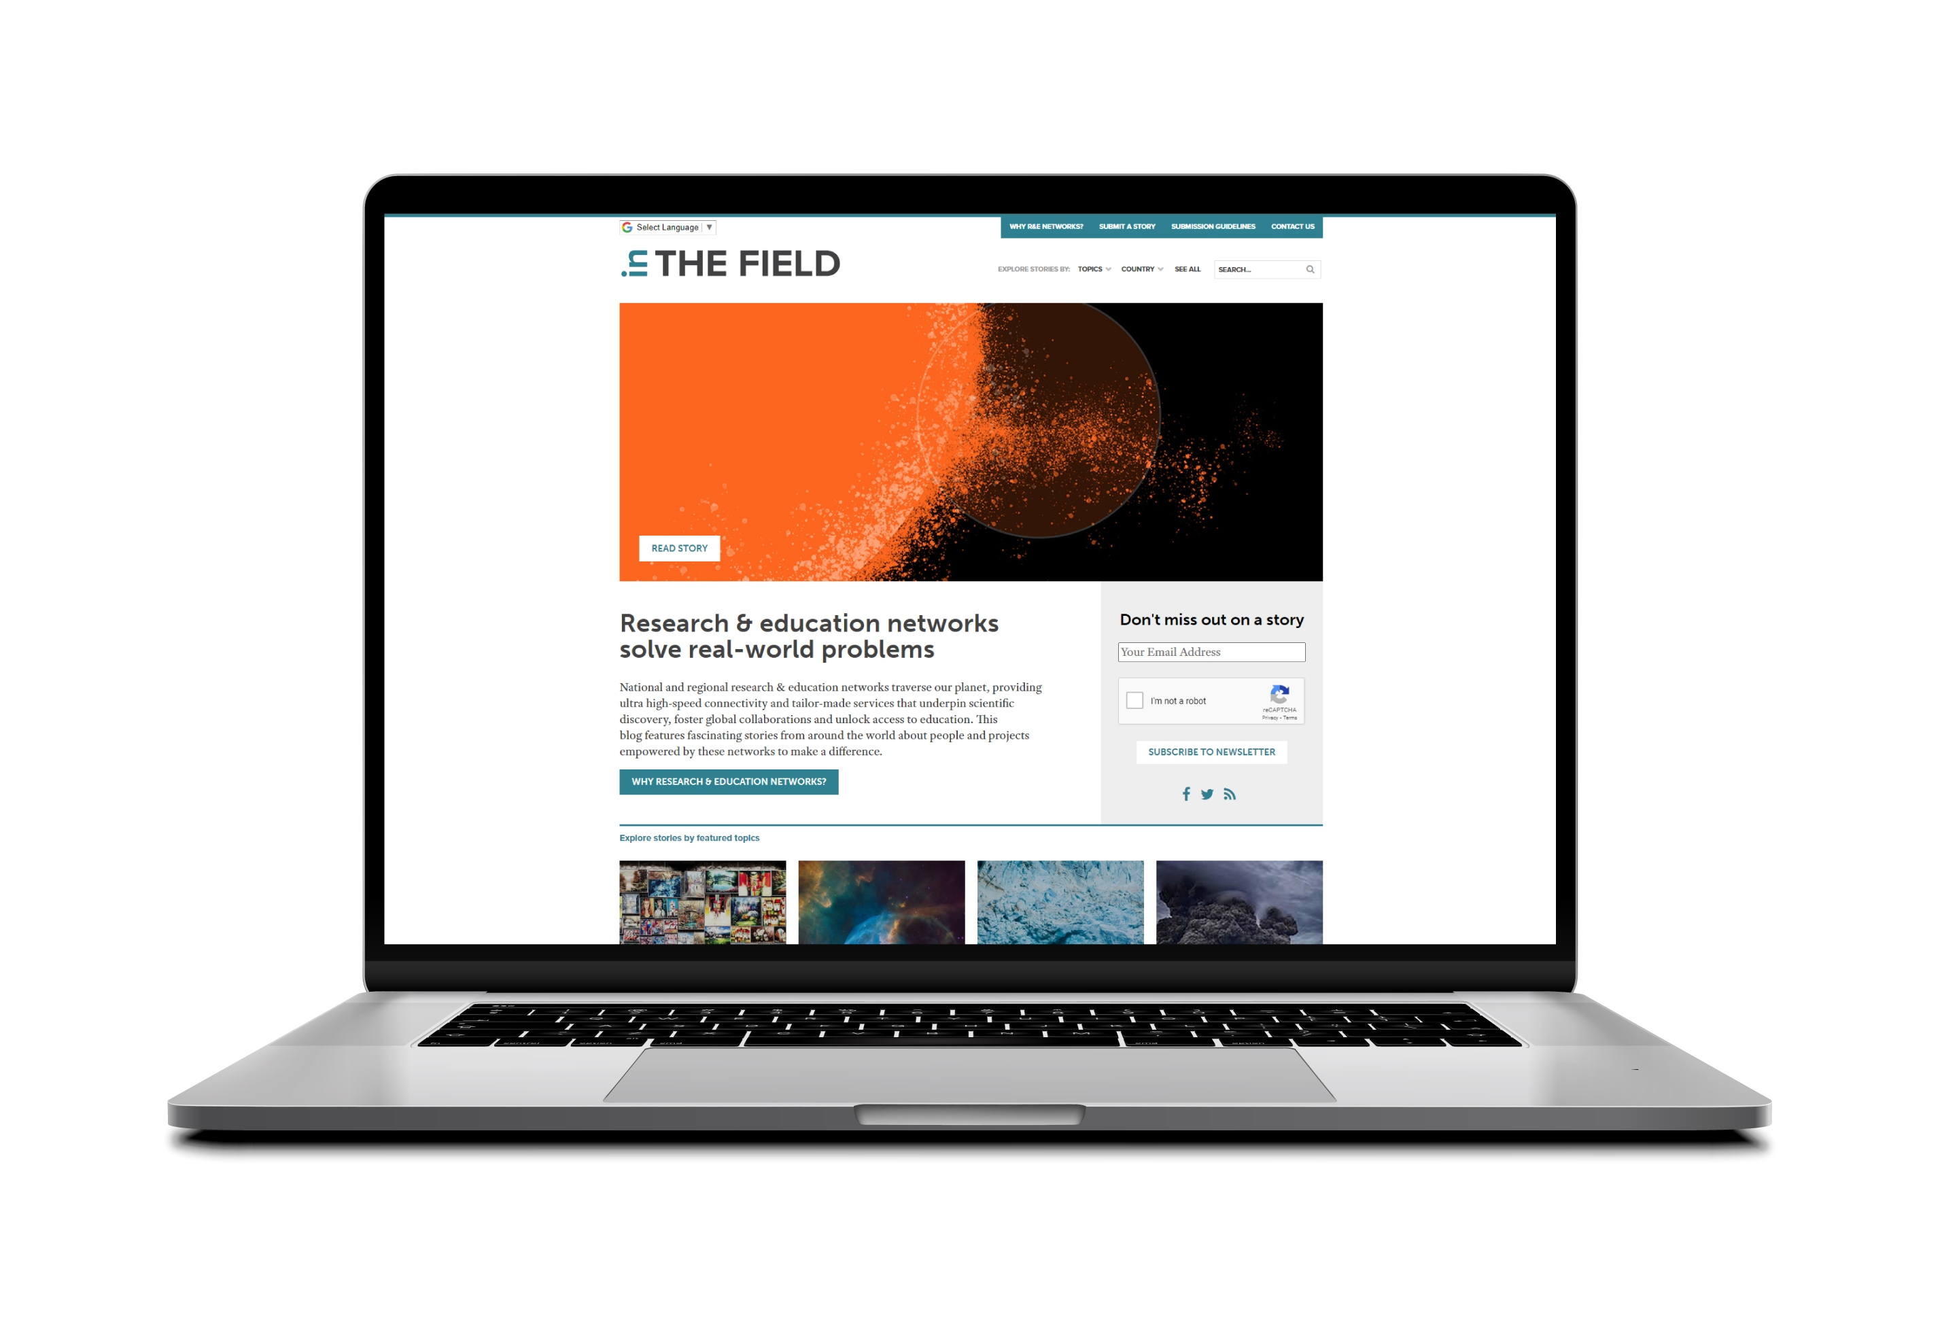
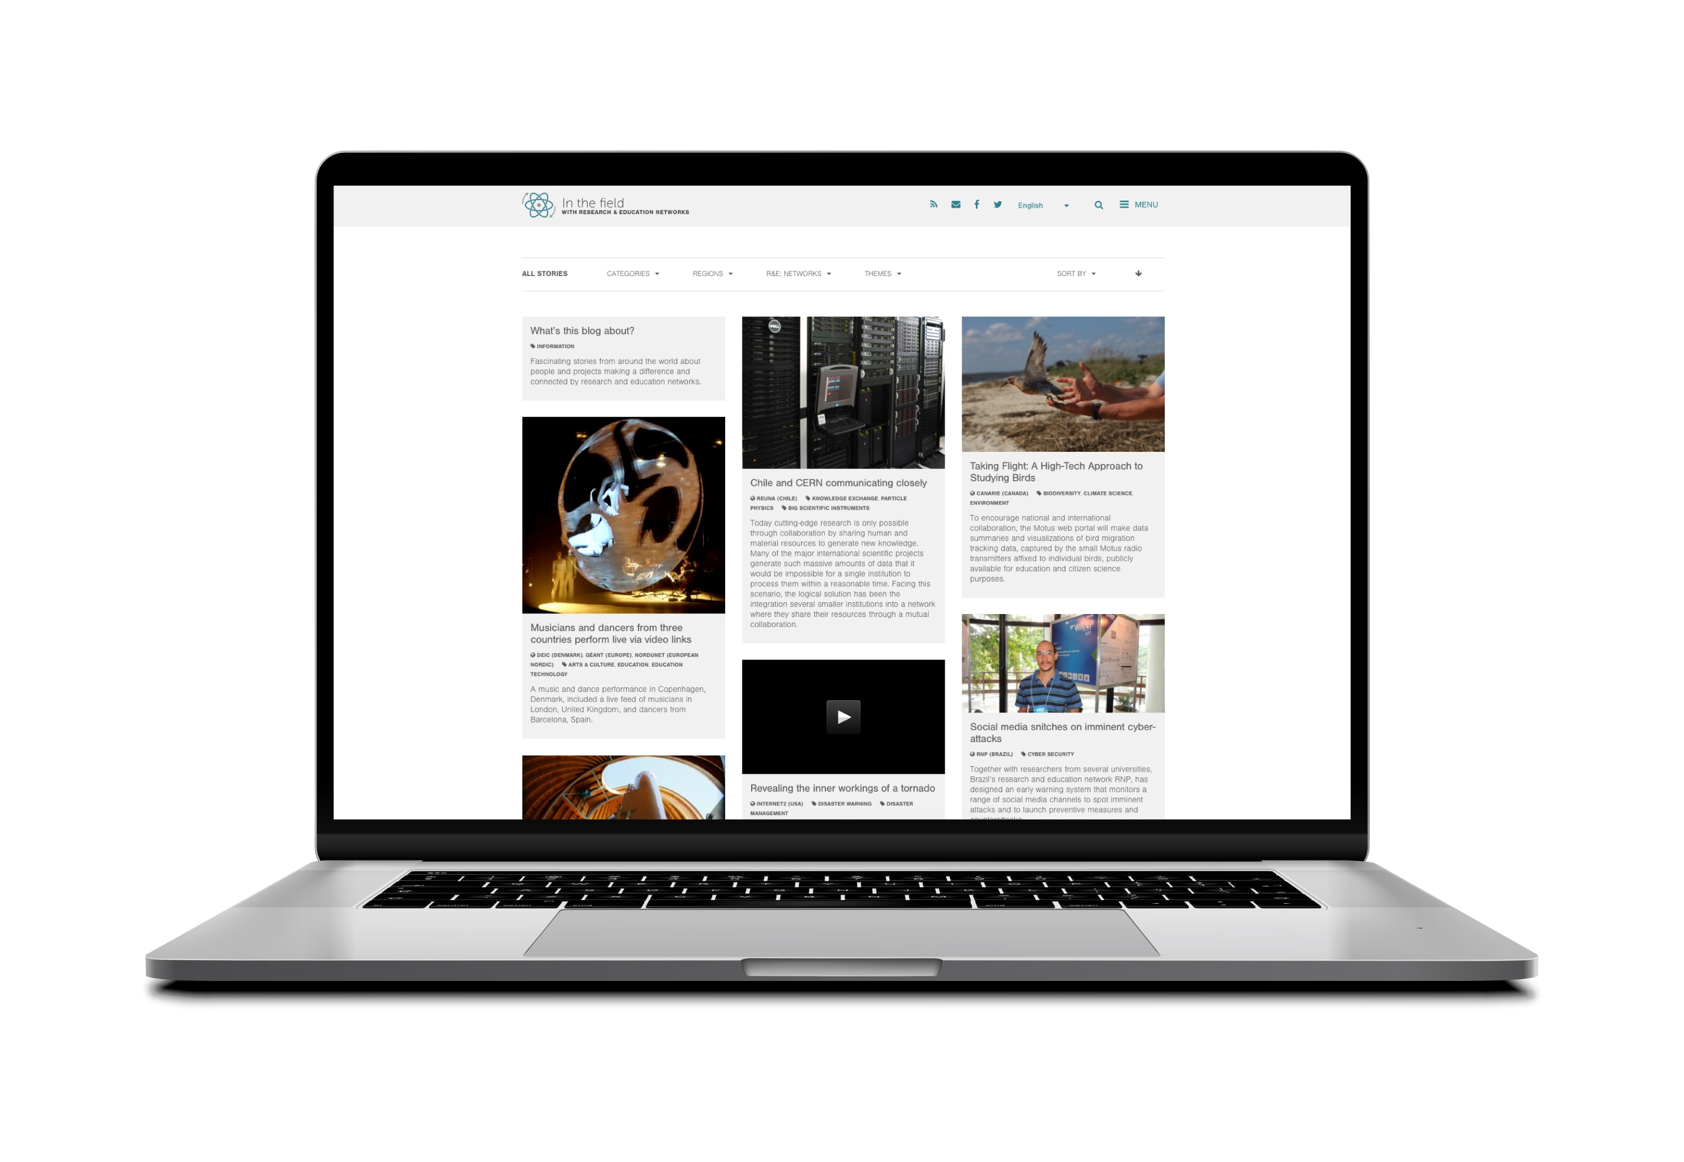
The journey of In The Field Stories
Key milestones and evolution
Version 1: 2015 launch
The Beginning
Version 3: 2025 current update
Modernised Experience
Version 2: 2018 first major update
Expansion & Structure
Notes:
Slide 6
The site officially launched in October 2015 — that was Version 1, the beginning. A simple, clean site designed to get stories out into the world.
Click
By 2018, we’d outgrown that original format. We needed a better structure to organise the growing library of content — and that led to Version 2.
Click
And now, in 2025, we’ve just launched Version 3 — a fresh, modernised experience to better support contributors, showcase stories, and keep the platform relevant for the years ahead.

Slide 7
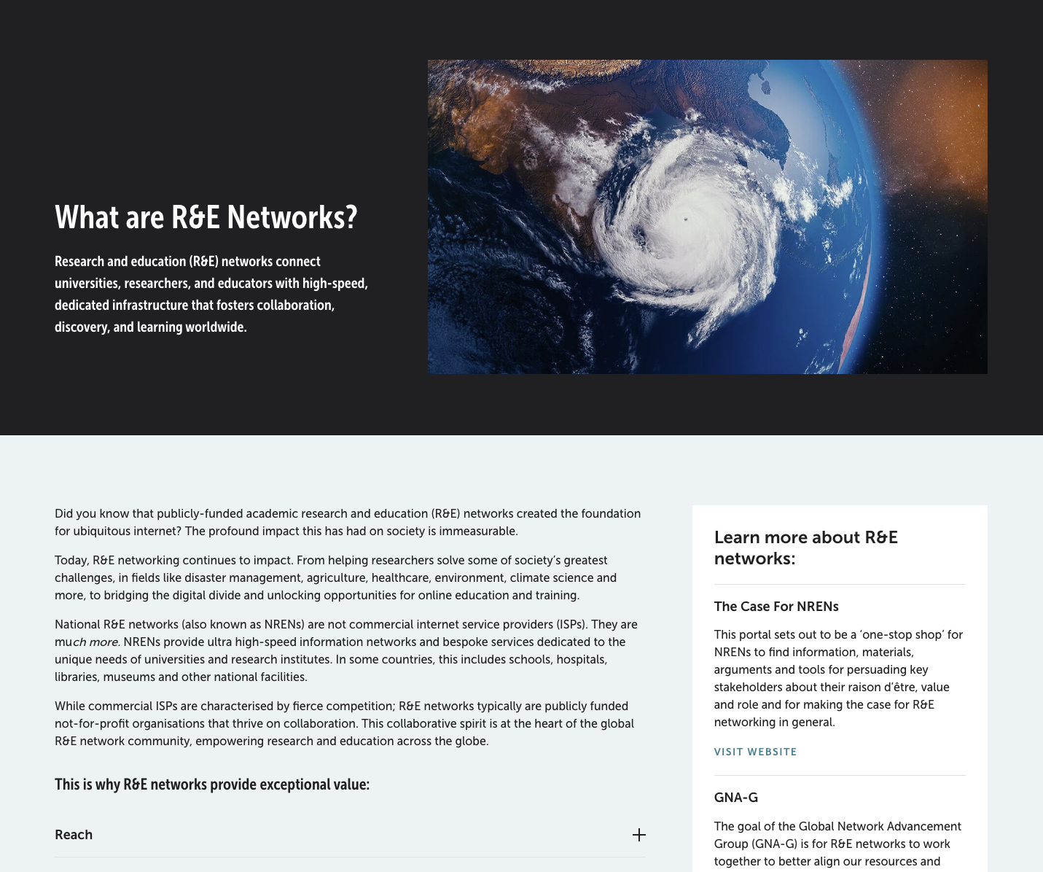
Global reach: 487 stories 109 NRENs
What’s an R&E Network?
Notes:
Since that first launch, In The Field has grown well beyond expectations.
We’ve now published 488 stories — across fields like health, climate, AI, radio astronomy, disaster response, education, and the arts — featuring the work of 109 NRENs around the world.
And remarkably, we’ve published almost one story a week for nearly 10 years, with just short breaks over holiday periods.
Click
Interestingly, one of our most visited pages is the “What’s an NREN?” explainer — it offers a high level value prop reference that can be repurposed to meet the nuanced needs of different NRENs and audiences.
As for story traffic, it often depends on global relevance and — more importantly — how much an NREN promotes it locally.
Most spikes in engagement come from the story’s country of origin, showing just how powerful local amplification can be.

Slide 8
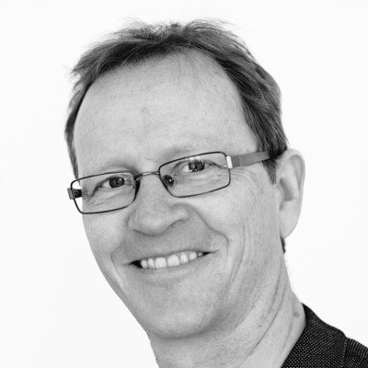
Collaborators
Morten Andersen
NORDUnet
Daniel Harris
AARNet
Notes:
Many people have contributed and supported the site over the years, and I’m grateful to all of them.
Click
But a couple of key individuals have been absolutely essential for keeping the blog going over the past several years
Thanks to NORDUnet for supporting the site from the beginning with a science journalist for a couple of hours a week.
For the past several years, that person has been Morten Andersen- who has been instrumental— sourcing stories and producing the monthly newsletter.
Click
And from my team at AARNet — thanks to Dan Harris, who’s managed social media for In The Field for several years, helping amplify stories and maintain visibility in the wider NREN space.

Slide 9
Challenges and learnings
Challenges
Learning
Sourcing stories regularly
Editorial consistency across global contributions
People-first stories resonate
Simple formats make storytelling easier
Relying on goodwill
Tech upkeep of the platform and content
Global collaboration is the key to success, reaching out directly
Stories endure — an archive of community impact
Notes:
Of course, we’ve had challenges.
Click
Sourcing stories is ongoing. While we welcome your direct submissions – the reality is there is no a lot of them, most of the time we need to reach out directly to keep the flow of content fresh. It’s time-consuming but necessary.
Editorial consistency can be tricky too — with such a global mix of voices. I do a light edit on most stories to keep them clear and readable while preserving the original voice.
We’ve relied a lot on goodwill and volunteer time, and there’s been ongoing technical upkeep — from keeping links fresh to maintaining the platform itself.
Click
But we’ve learned a lot:
People-first stories resonate.
Simple formats make storytelling easier.
Reaching out directly and repurposing your existing published stories works.
Global collaboration is the key to success.
And most importantly — stories endure. This is more than a blog — it’s a living archive of the NREN community’s impact – a rich resource of case studies for the global research and education network to use as they need.

Slide 10
Notes:
This is more than a blog — it’s a living archive of the NREN community’s impact – a rich resource of case studies for the global research and education network to use as they need. A terrific example of an enduring global NREN collaboration.

Slide 11
Storytelling in Practice

Slide 12
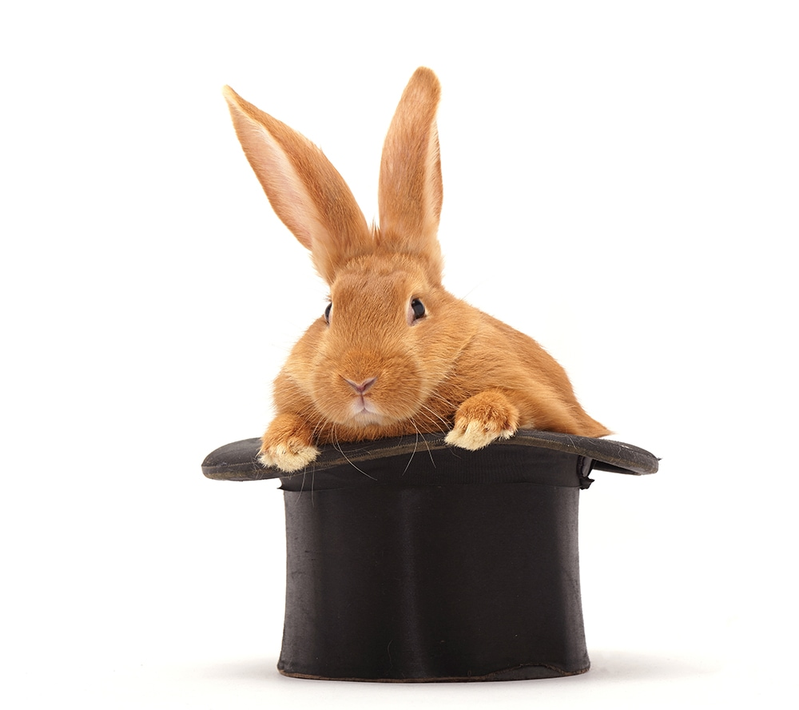
Why storytelling matters – especially in Tech
Research and infrastructure stories are complex and often invisible
Without people, they’re hard to relate to
Storytelling humanises innovation and builds understanding
“When I’m in conversation with NRENs or a representative of the user community, the site works like pulling a rabbit out of a hat. You can show a case has been described somewhere or at least something similar.”
– Cathrin Stöver - ​​GÉANT Chief Communications Officer
Stories aren’t just for sharing impact — they’re tools for conversation, collaboration, and credibility.
Notes:
Storytelling might not seem like a natural fit in the tech-heavy world of NRENs — but it’s essential.
We work behind the scenes, enabling others to do incredible things. If we don’t tell those stories, the impact often goes unseen.
Stories make the invisible visible.
They help people understand why NRENs matter — not just technically, but socially and scientifically.
One story we shared was about researchers at the
Translational Research Institute in Australia using FileSender to send huge datasets from microscopes.
The tech was impressive — but what resonated was the human side: faster collaboration, scientific progress, real-world outcomes.
And these stories aren’t just for inspiration — they’re tools.
Click
Cathrin Stover, Chief Communications Officer at GEANT said to me:
I’ve found the site very useful on many occasions, as it is by now so well populated that one can find a reference to almost all specific fields of research. So, when I’m in conversation with NRENs or a representative of the user community— the site works like pulling a rabbit out of a hat. You can show a case has been described somewhere — or at least something similar.”
The story becomes a tool. Not just a nice read — but a relatable reference, an enabler of collaboration, a door-opener, a conversation starter

Slide 13
A simple storytelling framework
What? So What? Now What?
What?
So What?
Now What?
A brief description of the project or event
Why it matters – explain the impact or insight
What happened next, or what’s possible
Notes:
You don’t need to be a writer to tell a good story. This simple structure helps turn any project into a narrative.
What? What happened? What was the problem, event, or achievement?
So What? Why did it matter? What changed as a result?
Now What? What happens next? Is there a future application or broader relevance?
It’s a helpful way to turn a technical update or a dry case study into a real story — one with purpose and relevance.
This structure works across all kinds of topics. And it makes it easier for readers (and contributors) to understand the value quickly.
On the next few slides, I’ll show you how this works in practice using real In The Field stories — starting with just the data point, then walking through how we applied this structure to bring the story to life.

Slide 14
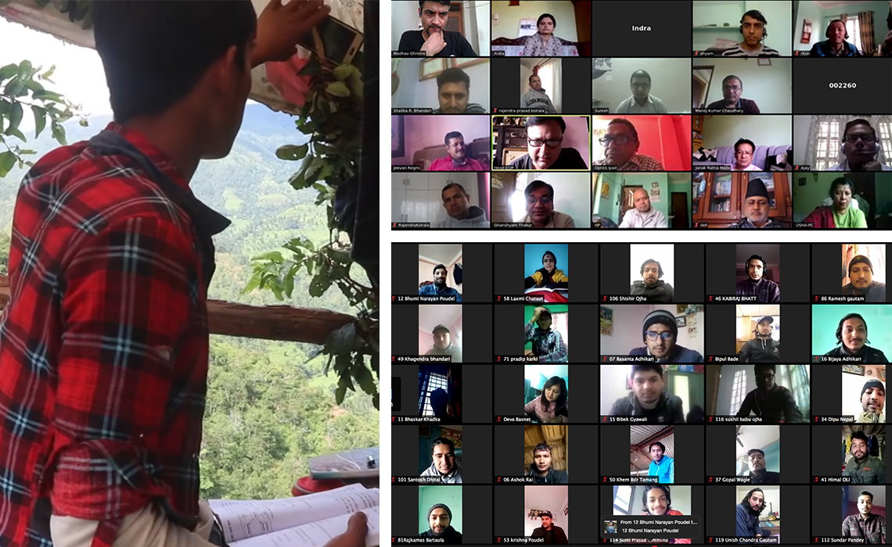
Nepal: online learning during the pandemic
Data Point: Nepal’s NREN helped universities continue academic activities during the COVID-19 lockdown using online platforms.
What?
So What?
Now What?
Schools in remote Nepal shifted to online learning using NREN infrastructure.
It kept education going during the pandemic and gave students a sense of connection.
The program continues with plans to expand access to underserved areas.
inthefieldstories.net/remote-education-relieves-second-wave-of-covid-in-nepal

Slide 15
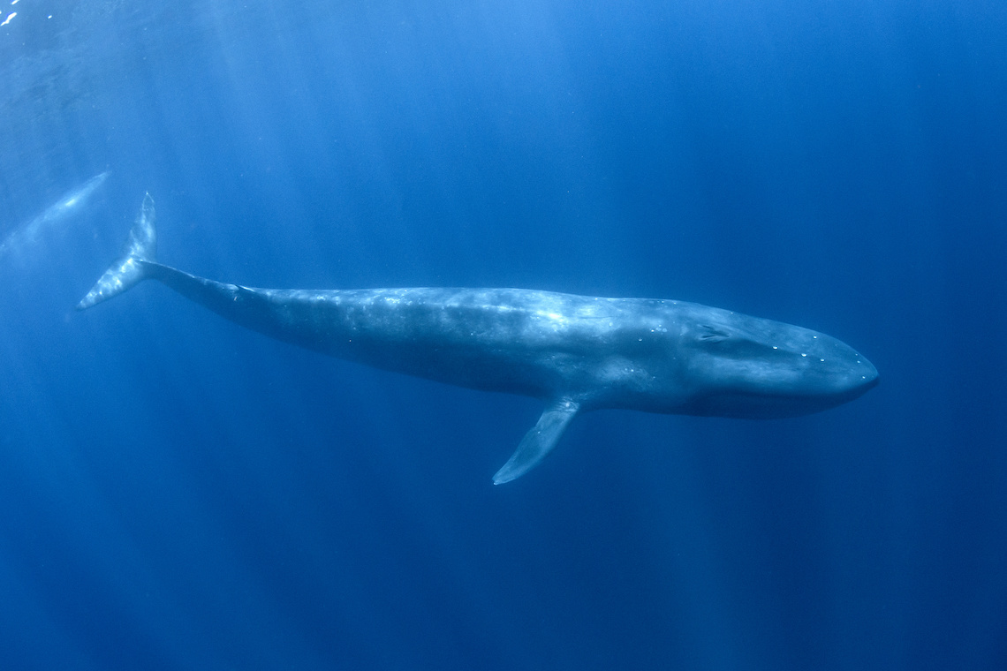
Japan: quantum computing for tsunami prediction
Data Point: Japanese researchers used quantum computing to enhance tsunami simulations.
What?
So What?
Now What?
Researchers leveraged quantum computing to model tsunami behavior more accurately and quickly.
Improved early warning systems, saving valuable response time during natural disasters.
The project became a benchmark for using supercomputing in disaster prediction research.
inthefieldstories.net/sub-sea-cables-are-the-new-science-instruments

Slide 16
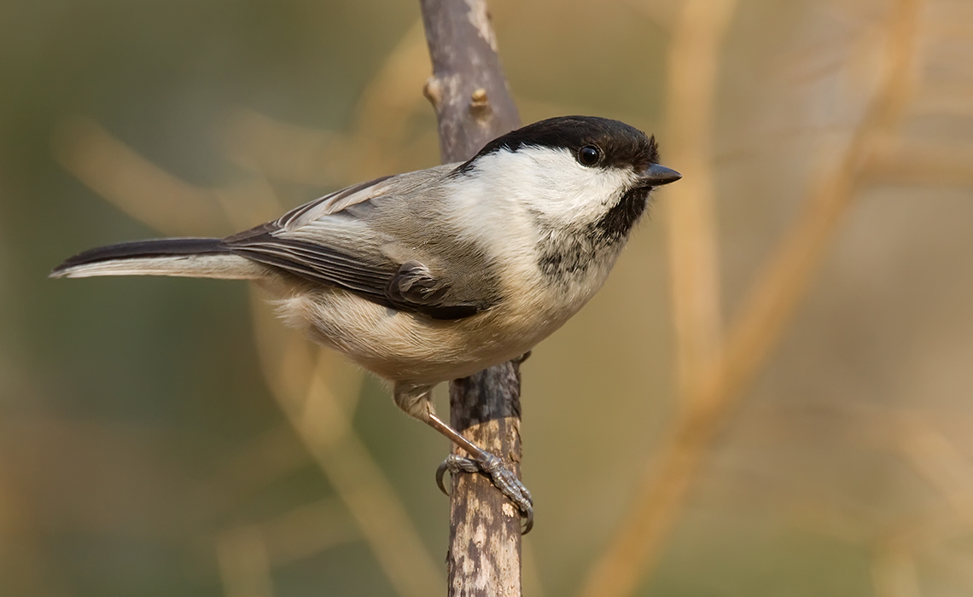
Finland: citizen science tracks bird migration
Data Point: 3.7 million bird migration recordings were submitted by Finnish citizens.
What?
So What?
Now What?
Finns participated in a national project logging bird migration observations.
The data supports research on migration patterns, climate effects, and habitats.
Feeds into the EU-funded BioDT project to model biodiversity using HPC and citizen science.
inthefieldstories.net/migrating-birds-turn-finns-into-citizen-scientists
Notes:
Each of these started with a simple data point — but with a clear structure, they became powerful stories that show the impact of what we all do.
The most compelling stories aren’t always the biggest projects. They’re the ones that connect. We’ve found that short, personal accounts — with a photo and a quote — often have the most power. So keep it authentic and aim for clarity over complexity.

Slide 17
Looking Ahead: Possibilities
Notes:
As we look to the future of In The Field, I want to share five simple ways for you to be part of what comes next.
Click
Step 1: Visit the site
We've just launched a refreshed version of the In The Field website - Version 3.
It has a cleaner, more modern layout, and it's easier to explore, contribute, and share stories.
If you haven't checked it out yet, I encourage you to take a look. Revisit a favourite story - or discover one you've never seen before.
Click
Step 2: Share the anniversary campaign
To celebrate the 10-year milestone, we're running a campaign over the coming weeks and months.
We'll be spotlighting stories from the archive as well as new stories.
You can support the campaign by resharing posts, nominating stories to feature, or encouraging your colleagues to get involved.
Click
Step 3: Think about future storytelling ideas
Looking ahead, we're seeing some strong emerging themes:
AI and the role of NRENs in powering high-performance, secure environments
Sustainability - from supporting climate research to building greener infrastructure
Underserved regions - expanding access and equity where it's needed most
These are stories worth telling – and we want to include as many perspectives as possible.
Click
Step 4: Participate – share your stories
We're always looking for new contributions.
Whether it's a story you write, one you help surface from your community, or something you co-develop with us - we'd love to feature it.
You don't have to be a writer. We can help shape and polish the content.
What matters is sharing the human side of what we enable.
Click
Step 5: What else can we do together?
This platform has always been shaped by collaboration - and we want that to continue.
We want to hear from you:
In The Field doesn't just have to be a place to publish stories. It can also be a space for campaigns, events, co-created projects - whatever we make of it together.
What else could we do with this platform?
Are there voices or topics we should focus on more? New audiences? New approaches?
[Pause and invite 1-2 quick responses from the room]
Thank you - those are exactly the kinds of ideas that will help shape where we go next.
And if something comes to mind later, I'd love to hear from you after the session - or anytime online.

Slide 18
Looking ahead: the next chapter
Visit the site
Share the Anniversary campaign
Future storytelling ideas
Participate by sharing your stories
What else can we do together?
Notes:
As we look to the future of In The Field, I want to share five simple ways for you to be part of what comes next.
Click
Step 1: Visit the site
We've just launched a refreshed version of the In The Field website - Version 3.
It has a cleaner, more modern layout, and it's easier to explore, contribute, and share stories.
If you haven't checked it out yet, I encourage you to take a look. Revisit a favourite story - or discover one you've never seen before.
Click
Step 2: Share the anniversary campaign
To celebrate the 10-year milestone, we're running a campaign over the coming weeks and months.
We'll be spotlighting stories from the archive as well as new stories.
You can support the campaign by resharing posts, nominating stories to feature, or encouraging your colleagues to get involved.
Click
Step 3: Think about future storytelling ideas
Looking ahead, we're seeing some strong emerging themes:
AI and the role of NRENs in powering high-performance, secure environments
Sustainability - from supporting climate research to building greener infrastructure
Underserved regions - expanding access and equity where it's needed most
These are stories worth telling – and we want to include as many perspectives as possible.
Click
Step 4: Participate – share your stories
We're always looking for new contributions.
Whether it's a story you write, one you help surface from your community, or something you co-develop with us - we'd love to feature it.
You don't have to be a writer. We can help shape and polish the content.
What matters is sharing the human side of what we enable.
Click
Step 5: What else can we do together?
This platform has always been shaped by collaboration - and we want that to continue.
We want to hear from you:
In The Field doesn't just have to be a place to publish stories. It can also be a space for campaigns, events, co-created projects - whatever we make of it together.
What else could we do with this platform?
Are there voices or topics we should focus on more? New audiences? New approaches?
And if something comes to mind later, I'd love to hear from you after the session - or anytime online.

Slide 19
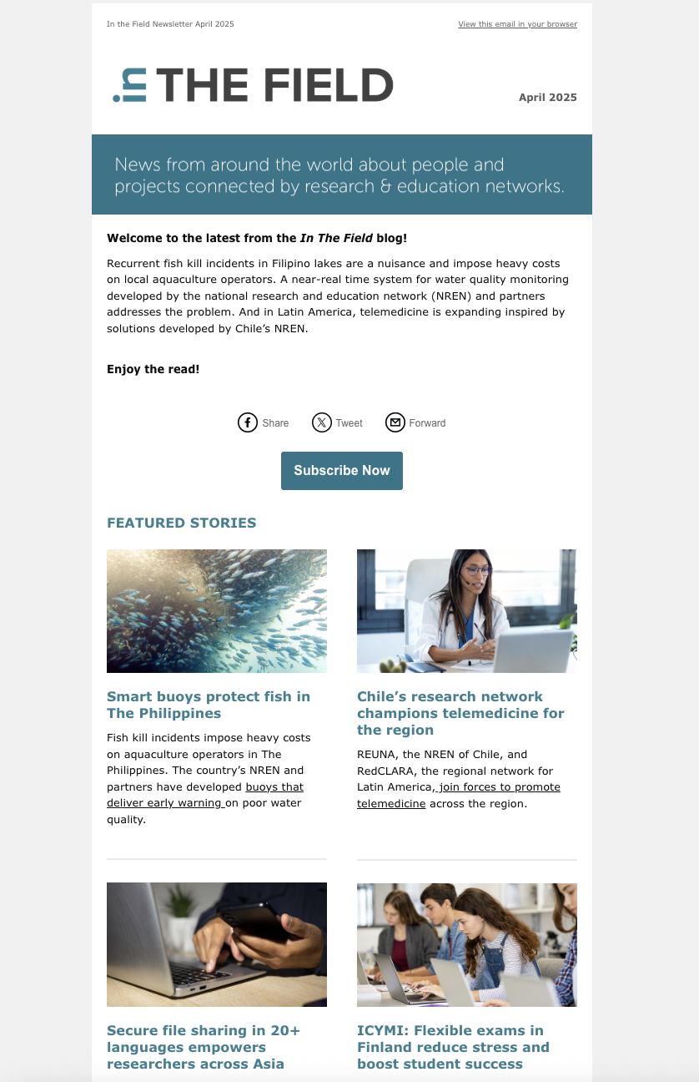
Keep in touch
In The Field Newsletter: Subscribe at eepurl.com/ccBzIz
Notes:
In The Field has always been about collaboration - and that's what makes it special.
So let's keep it going.
Let's shape the next decade of stories - together.

Slide 20
Thank You

