Slide 1
A bright future together?
what got us here might not take us there
Jan Meijer, Sikt – Norwegian Agency for Shared Services in R&E
Task lead service concepts GN5-2 Above-the-Net
Recommendations collective cloud strategy GÉANT Association
https://zenodo.org/records/14793806
TNC 2025 – 10 June 2025, jan.meijer@sikt.no
Notes:
Establish cred – initiated several European collaborative service effors, e.g. ssl certificates, FileSender, part of others, e.g. joint procurement engine.

Slide 2
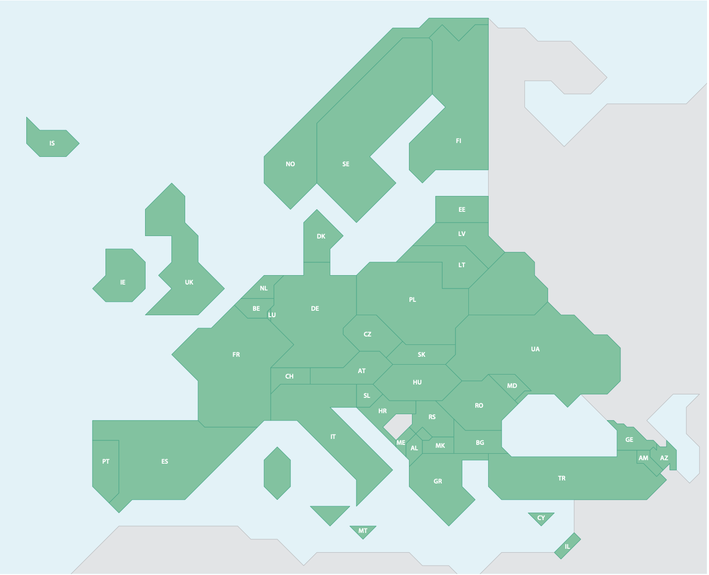
NREN perspective on current European research landscape
GEANT Association service delivery
43 NRENs + GÉANT organisation
4.100+ employees
€1.000M+ budget
43 countries
- 5.000 research organisations
- 1.2M researchers
European Research Area
- 50 pan-European RIs
- 150 large storage / processing plants
- 250 Trustworthy Data Repositories
institutions producing digital services
commercial providers
Notes:
GEANT association. Pretty strong

Slide 3
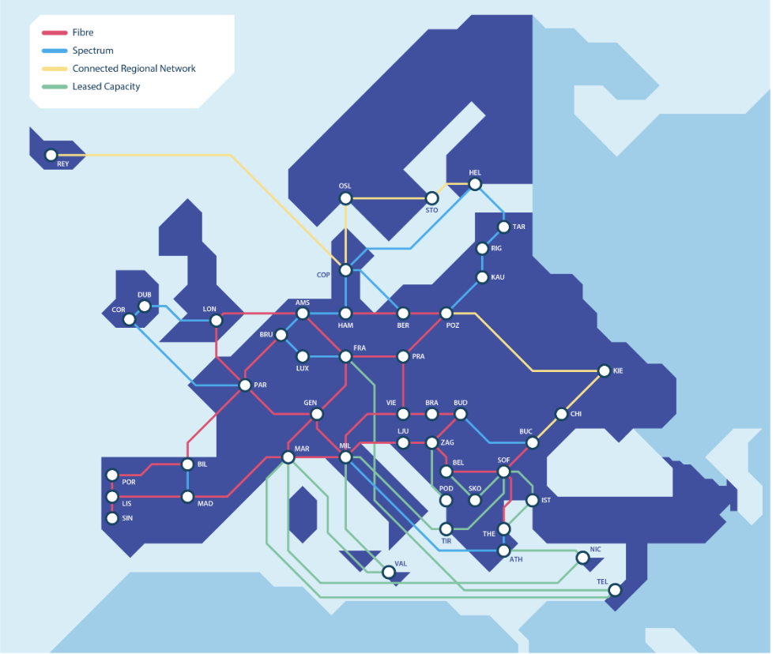
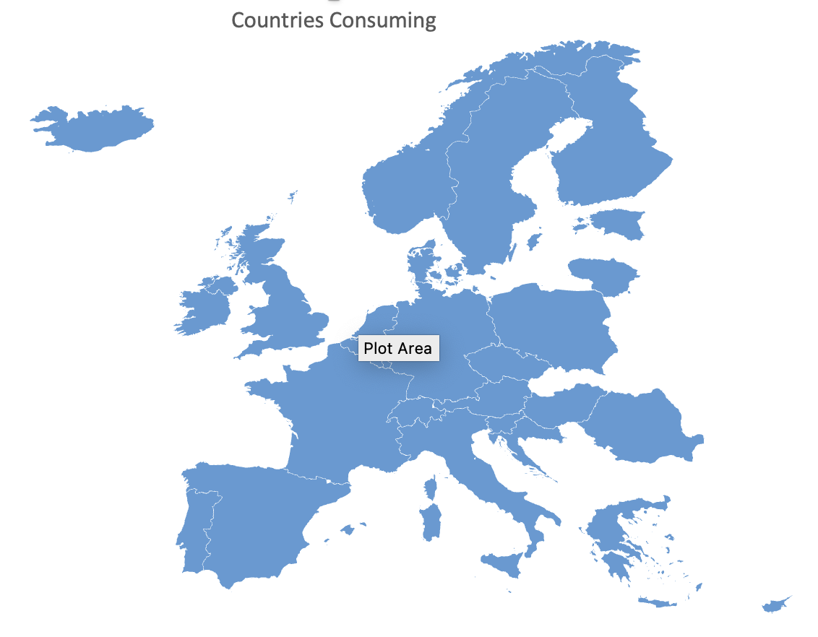
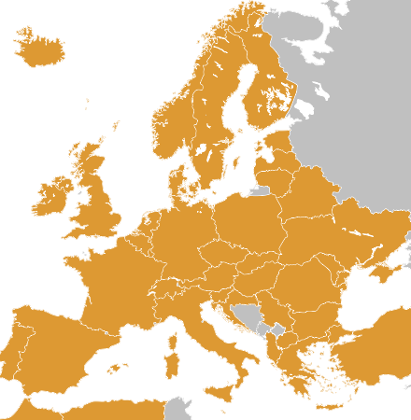
Strategic assets GÉANT Association
infrastructures
unique assets & skills
OCRE
procurement
track record
bright future!
right?
trust & commitment
eduGAIN
ability to scale
Notes:
Strategic assets and how we created those

Slide 4
Changing European R&E landscape
societal
digital transformation
sovereignty
R&E importance ++
R&E context
service quality expectations ++
integration
funding instruments
technology
<everything>-as-a-Service
commoditisation
automation
Notes:
Societal: sovereignty, Trump, AI, tech dependency, research critical
R&E context: digital infra key, need for high standard services, transnatinoal integration (EOSC, policy initiativ), NRENs from tech pioneers to R&E digital service providers
Tech: commoditisation, SaaS, infra-as-code

Slide 5
Challenges for European NREN collective
limited economy of scale for as-a-Service delivery
increased quality
cost effective
changes in collective NREN customer base & context
all research digital
single European Research Area
pan-European research infra, EOSC
increased expectations at national and European levels
NRENs = digital transformation tool
do more, better quality, less budget
Notes:
Societal: sovereignty, Trump, AI, tech dependency, research critical
R&E context: digital infra key, need for high standard services, transnatinoal integration (EOSC, policy initiativ), NRENs from tech pioneers to R&E digital service providers
Tech: commoditisation, SaaS, infra-as-code

Slide 6
Main challenge for European NREN collective
limited economy of scale for as-a-Service delivery
changes in collective NREN customer base & context
increased expectations at national and European levels
no individual European NREN will be large enough to
provide cloudy services cost-effectively over time, at ever-increasing compliance, quality and
functionality levels.
Notes:
our house is not on fire, but it’s slowly sinking into a swamp. Don’t think this is an above-the-net issue. As network automation continues, the same logic will apply there. It’ll just take longer to get there.
Societal: sovereignty, Trump, AI, tech dependency, research critical
R&E context: digital infra key, need for high standard services, transnatinoal integration (EOSC, policy initiativ), NRENs from tech pioneers to R&E digital service providers
Tech: commoditisation, SaaS, infra-as-code

Slide 7
Current operational model
production and delivery at
national level
OCRE
procurement
aggregate by
federation
eduGAIN
43 different platforms
Notes:
if we then look at how we typically do service delivery, we can see we have an issue.
it has issues. Difficult to scale, difficult to deliver coherent service, and it takes ages to upgrade.
infrastructures, created over time
federated, autonomous national deployments
and that is how we do things
that makes it difficult to act as one, to scale
Is that still the right approach? Would we do things in this way, if we should start new? Perhaps for some, perhaps not for all
Key reaosn for this: money, policy, national history
I want to argue that perhaps we should consider different ways to operate
It creaks.

Slide 8
Are we leveraging our potential?
43 countries
–5.000 research organisations
–1.2M researchers
European Research Area
–50 pan-European RIs
–150 large storage / processing plants
- 250 Trustworthy Data Repositories
- ? institutions producing digital services
GEANT Association service delivery
43 NRENs + GÉANT organisation
4.100+ employees
€1.000M+ budget
Notes:
despite our environment looking radically different than it did when we started doing things like we do. Looking at our current environment….
and we notice our model is creaking. EuroHPC hyperconnectivity. Pan-European infras having expectations.
ca. 900 research institutes (research institutes: count number of pages: https://en.wikipedia.org/wiki/Category:Research_institutes_by_country
universities in europe:
ERA: “Europe is home to close to 5,000 higher education institutions, 17.5 million tertiary education students, 1.35 million people teaching in tertiary education and 1.17 million researchers. ”

Slide 9
Are we leveraging our strategic collective assets?
infrastructures
unique assets & skills
OCRE
procurement
track record
trust & commitment
eduGAIN
ability to scale
Notes:
but we _have_ these good strategic assets

Slide 10
Why not behave as a pan-European service provider?
produce and deploy as one
economies of scale & scope
robust teams
increased quality and agility
43 countries - 5.000 research organisations - 1.2M researchers
European Research Area
delivery to institutions through 43 NRENs
single technical platform
43 NRENs + GÉANT organisation, 4.100+ employees, €1.000M+ budget
Notes:
despite our environment looking radically different than it did when we started doing things like we do. Looking at our current environment….
upgrade as one
robuster teams that can produce with
increased quality and agility
and we notice our model is creaking. EuroHPC hyperconnectivity. Pan-European infras having expectations.
ca. 900 research institutes (research institutes: count number of pages: https://en.wikipedia.org/wiki/Category:Research_institutes_by_country
universities in europe:
ERA: “Europe is home to close to 5,000 higher education institutions, 17.5 million tertiary education students, 1.35 million people teaching in tertiary education and 1.17 million researchers. ”

Slide 11
Example: large European sovereign S3 object storage infrastructure
Itch: how to produce cost-effective sovereign cloudy infra competitive over time
Hypothesis: single technical platform, jointly produced, cheaper & better
single coherent service
one technical platform – joint operations – business layer
sovereign deployment
joint financing, governance
common blueprints for storage pod
joint procurement components
single technical platform
operations
finances
sales
complexity & benefits
low
high

Slide 12
Investment proposal prep GN5-2: large European object storage infrastructure
Early observations
GEANT Association
43 NRENs + GÉANT org
4.100+ employees
€1.000M+ budget
technical: can be done, “just engineering”
producers & consumers
challenge: organising, business layer, politics
up-front federation
likely key customers: research data repos
economy of scale & scope
risk vs. reward?
start with coalition of willing and grow
make it more interesting to join than invest in new local infra, when that time comes
43 countries
–5.000 R&E organisations
–1.2M researchers
European Research Area
–50 pan-European RIs
–150 large storage / processing plants
- 250 Trustworthy Data Repos
- ? institutions producing digital services
Notes:
different solution paths for different problem spaces
where is the storage, where are the processing sites? Consolidation seems key

Slide 13
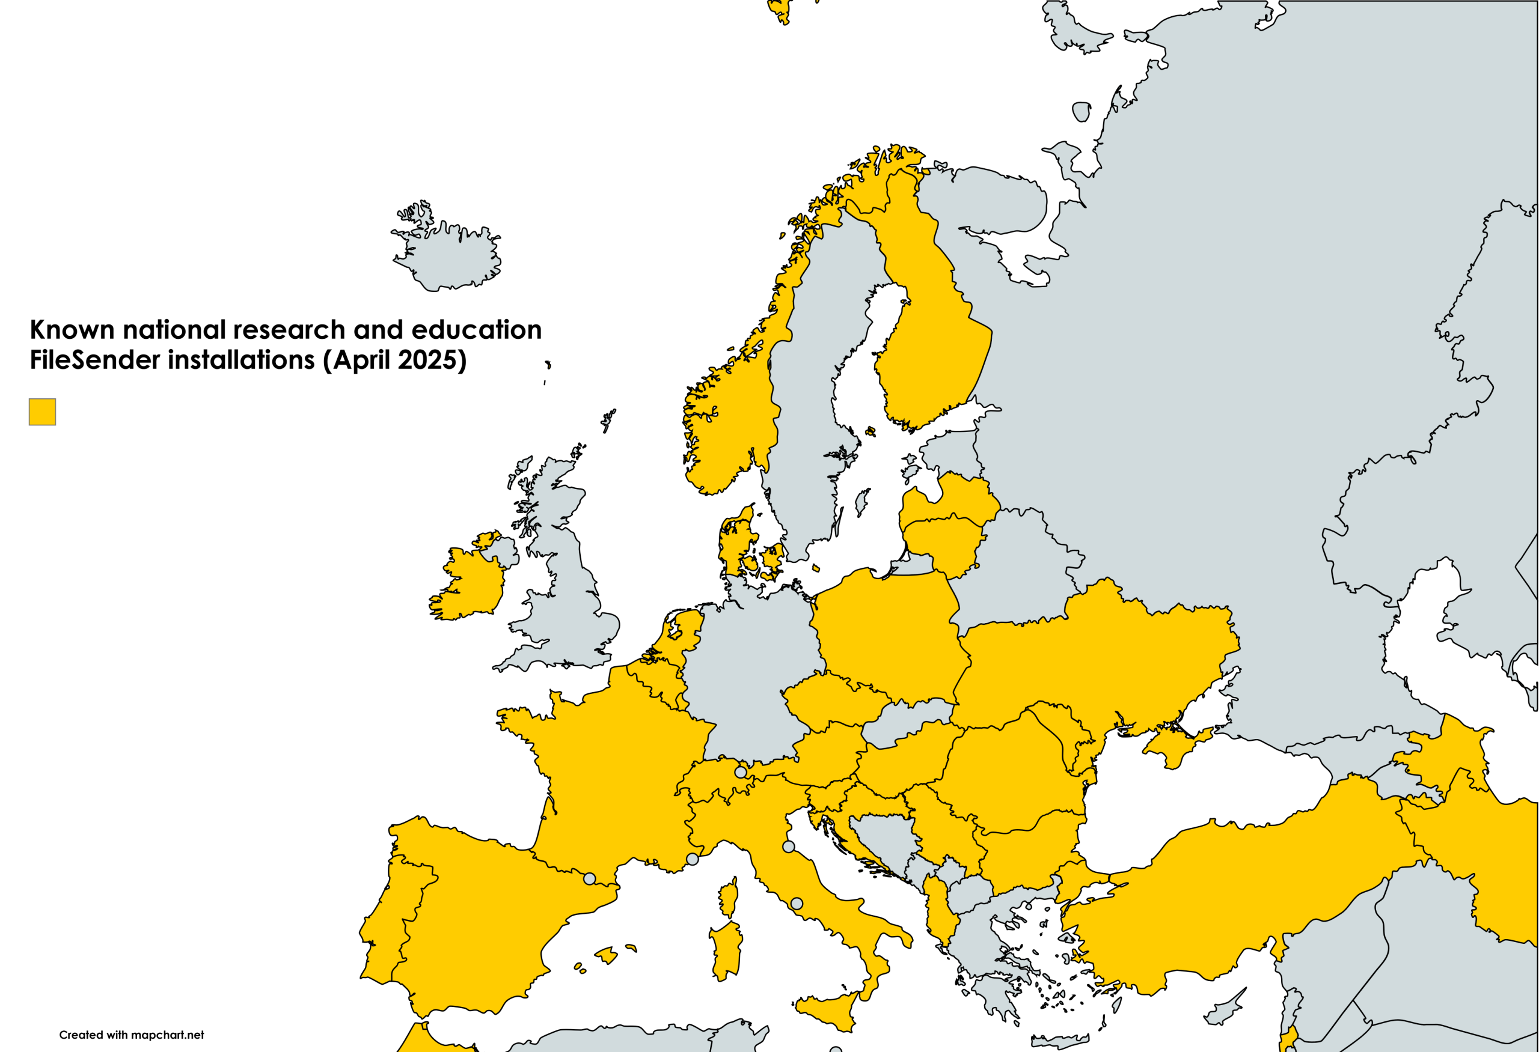
Example 2: FileSender deployment model
29 different deployment setups of the same software the most effective deployment platform?

Slide 14
Main challenge for European NREN collective
limited economy of scale for as-a-Service delivery
changes in collective NREN customer base & context
increased expectations at national and European levels
no individual European NREN will be large enough to
provide cloudy services cost-effectively over time, at ever-increasing compliance, quality and
functionality levels.
Notes:
We have a serious challenge.
our house is not on fire, but it’s slowly sinking into a swamp. Don’t think this is an above-the-net issue. As network automation continues, the same logic will apply there. It’ll just take longer to get there.
Societal: sovereignty, Trump, AI, tech dependency, research critical
R&E context: digital infra key, need for high standard services, transnatinoal integration (EOSC, policy initiativ), NRENs from tech pioneers to R&E digital service providers
Tech: commoditisation, SaaS, infra-as-code

Slide 15
A bright future together
through different types of togetherness
Recommendations collective cloud strategy GÉANT Association
https://zenodo.org/records/14793806
Questions? jan.meijer@sikt.no

