Slide 1
TNC25
Effective Stakeholder Engagement for NREN Sustainability
Experiences from RENU
By
Caroline Tuhwezeine, RENU
ctuhwezeine@renu.ac.ug

Slide 2
Outline
Outline​
01​ | About RENU​
02​ | Defining key concepts​
03​ | Examples of stakeholders – RENU case​
04​ | Forms of stakeholder engagement​
05​ | Why stakeholder engagement​
06​ | RENU's journey​
07​ | RENU’s 10 principles of stakeholder engagement​
08​ | Stakeholder Mapping​
09​ | Results and lessons so far ​

Slide 3
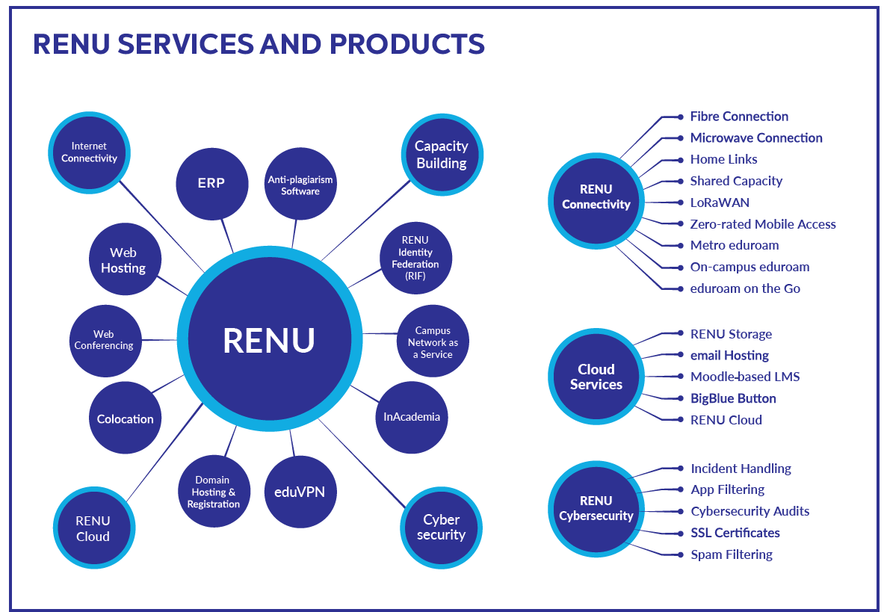
About RENU
Established in 2006
Not for profit membership-based organisation
445 members
900 connected sites
75 staff (40%F 60%M)
Goal – To improve the quality of education and research through provision of reliable connectivity and other ICT services tailored for R&E

Slide 4
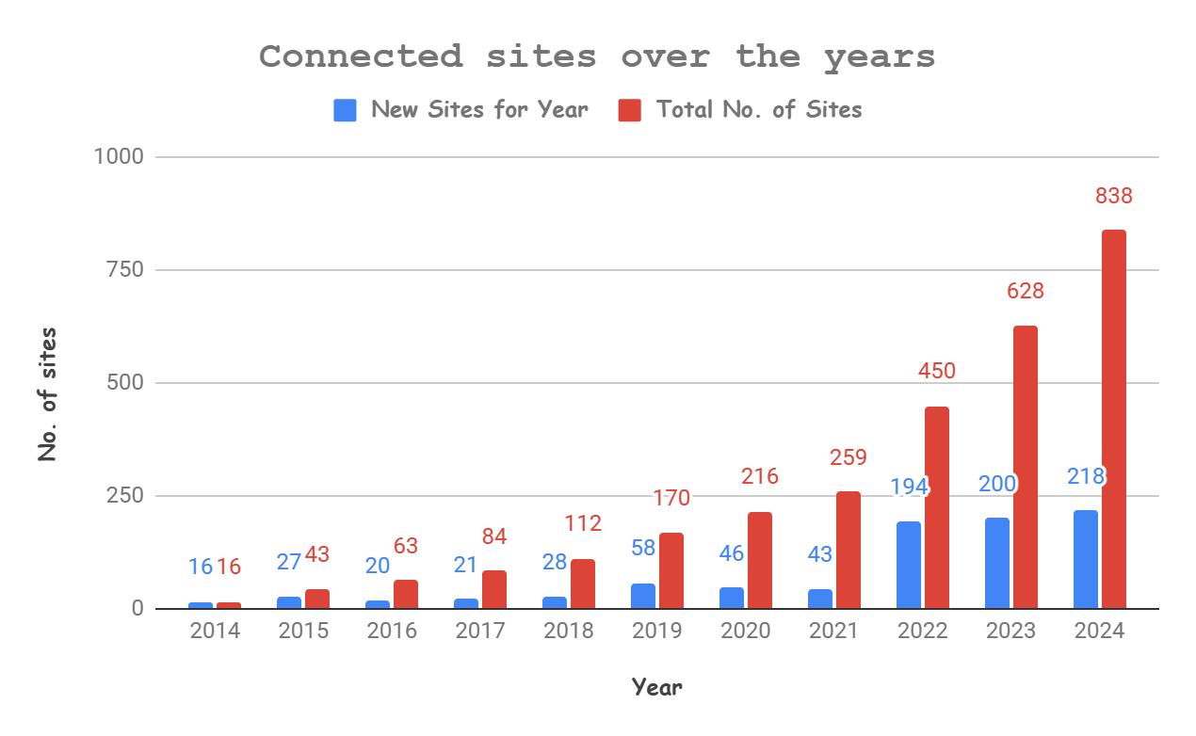
About RENU

Slide 5
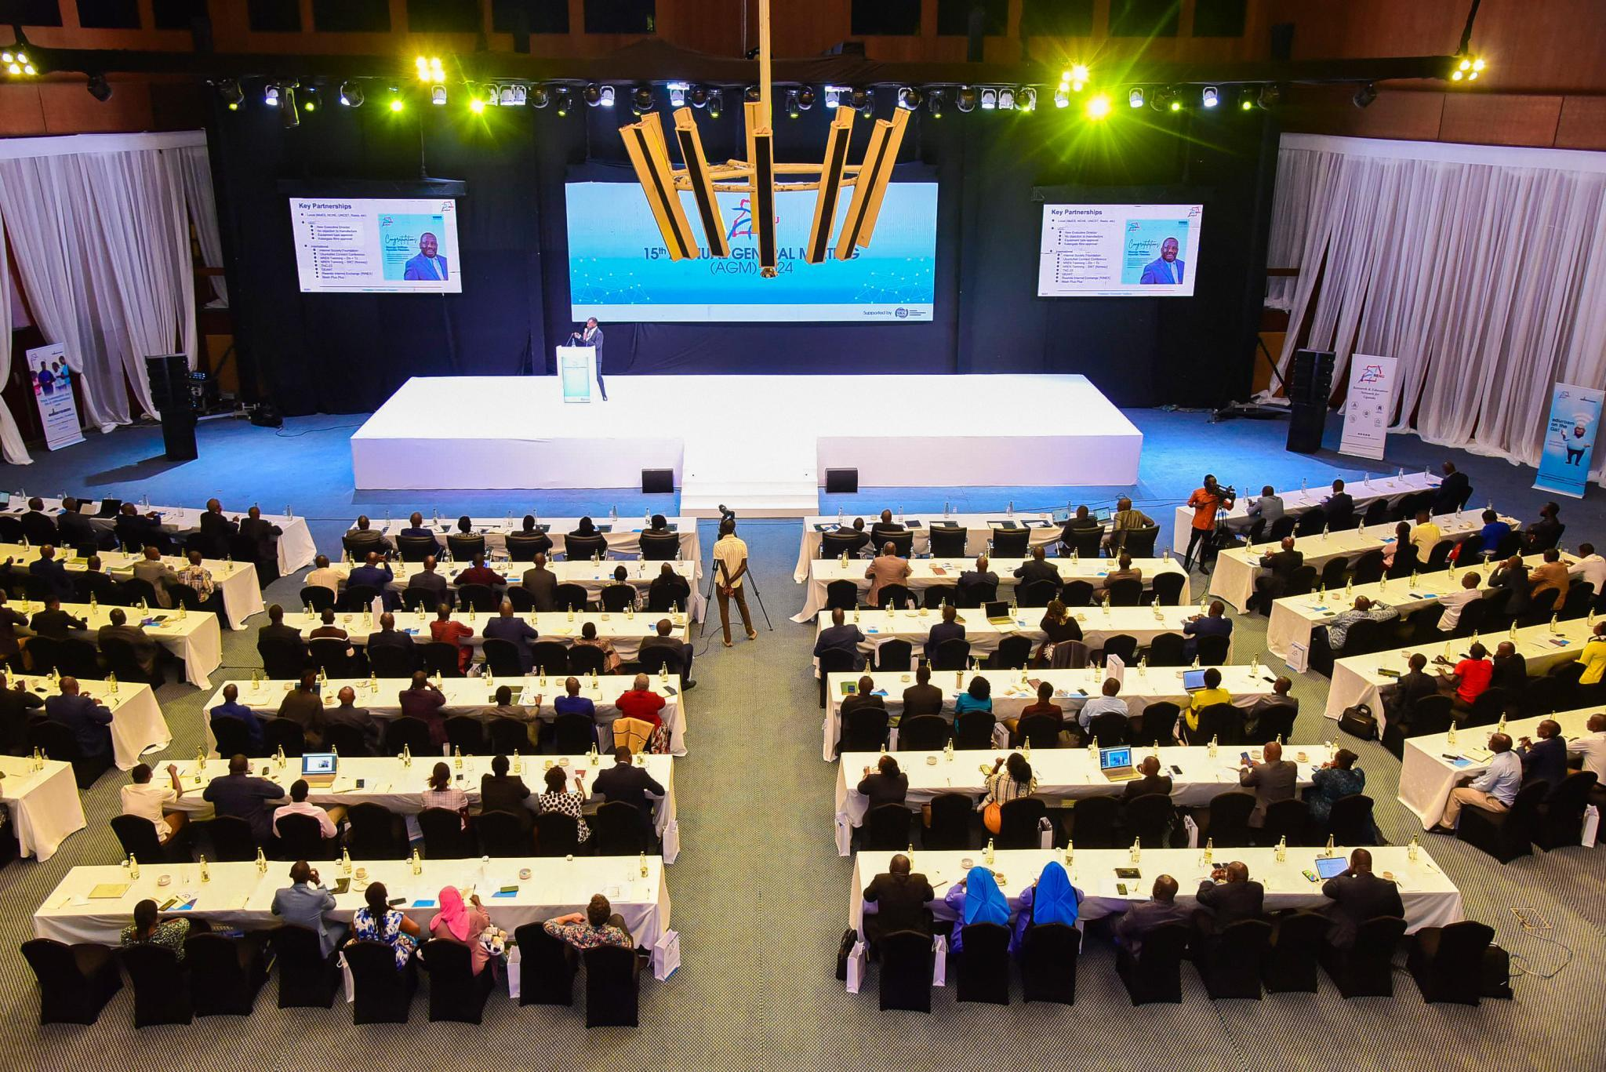

Slide 6
Defining the Key concepts of Stakeholder Engagement
Who is a stakeholder?
Any individual, group or entity that can affect, is affected by, the operations, of an organisation
What is stakeholder engagement?
The strategic, structured, and continuous process of building mutually beneficial relationships with the organisations stakeholders.

Slide 7
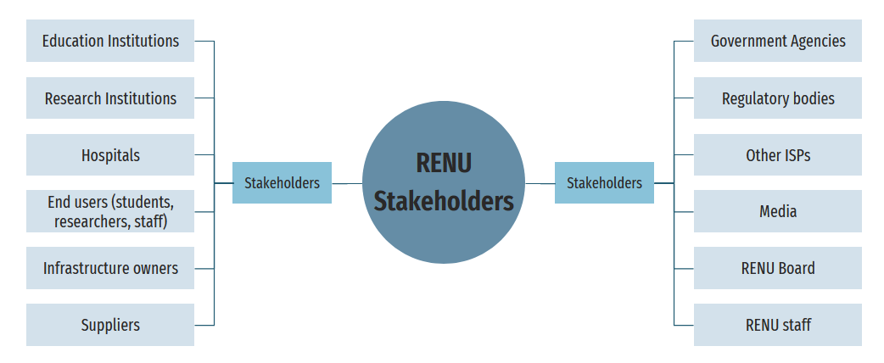
Examples of Stakeholders (RENU Case)

Slide 8
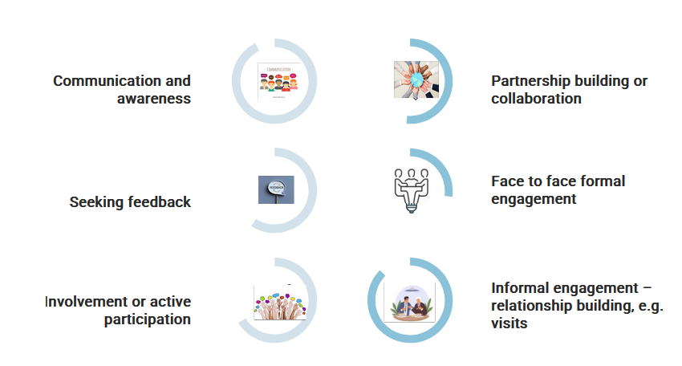
Forms of stakeholder engagement

Slide 9
Why stakeholder Engagement? Why is it Important?
Why stakeholder engagement?
Because of the evolving nature of an NREN and its ecosystem

Slide 10
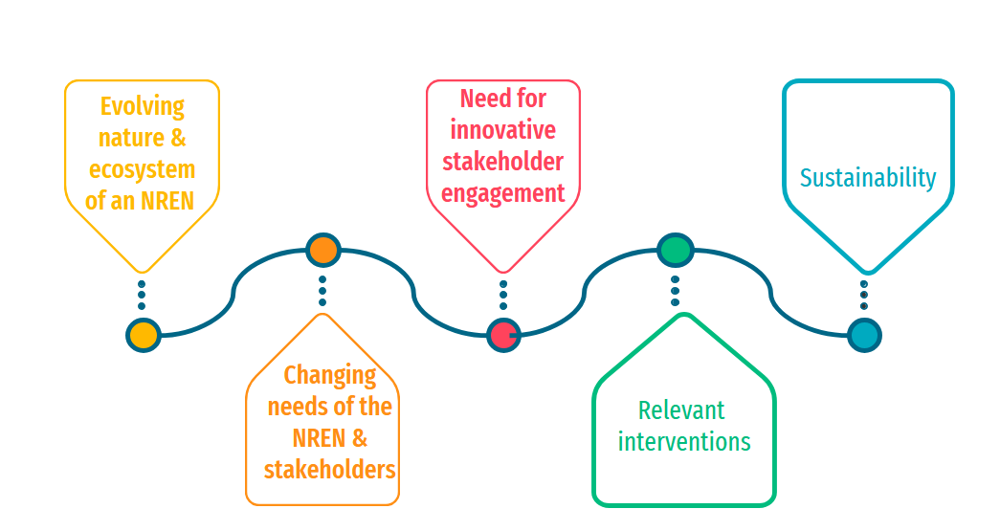
Why Stakeholder Engagement? Why is it Important?

Slide 11
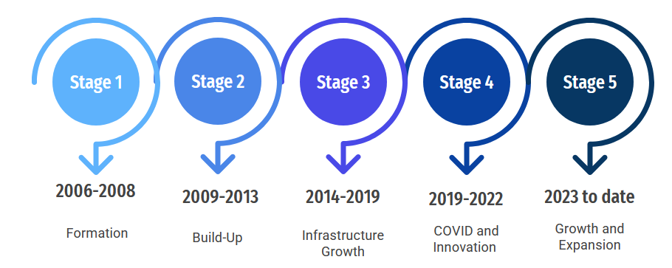
RENU’s Journey of Stakeholder Engagement

Slide 12
RENU’s Journey of Stakeholder Engagement
2014 to 2018 - Infrastructure Growth Phase | Engagement Related Actions
Few ISPs with high-priced offers RENU value proposition was low price | Technical engagements in the form of DEAs, workshops, and troubleshooting Minimal investment in marketing Ad hoc engagements Life is good!!
Virgin market Higher-tier membership growth rate Higher revenue growth rate
High member loyalty Clients came in through referrals
Focus on connectivity
Nurturing – NSRC, UCC, UA, AfricaConnect 2
Lean structure – low operational costs

Slide 13
RENU’s Journey of Stakeholder Engagement
2019 to 2022 (COVID/Innovation Phase) | Engagement Related Actions
ISPs enter R&E space with price drops & aggressive marketing Referrals became a lazy marketing strategy Need to prove relevancy in the sector Value proposition of low price starts to weaken | Established a Communications Department Developed a communication strategy Increased Awareness engagements Stepped up participation in stakeholder forums Funding partnerships Engagements – UCC
Membership from bigger-tier institutions starts to slow down Slow revenue growth
Remote study & working High need to innovate affordable services to support e-learning More resources are needed to innovate Increased operation, Admin and staff costs

Slide 14
RENU’s Journey of Stakeholder Engagement
2022 to date – Growth and Expansion | Engagement Related Actions
ISPs become more aggressive, offer competitive prices & use persuasive advertising Competition for the target intensifies Price is no longer a major selling point for RENU Value proposition shifts from low price to specialized services and quality of services | Deployment of more staff 30 to 75 Member engagement unit Business Development Unit Stakeholder engagement policy Stakeholder map Stakeholder engagement plans Grant partnership engagements CSR activities
Increase in lower-tier member growth 450 members; over 900 connected sites More human resources needed to support growth Challenges in balancing sustainability & member expectations
New technologies (e.g. Starlink satellite connections)

Slide 15
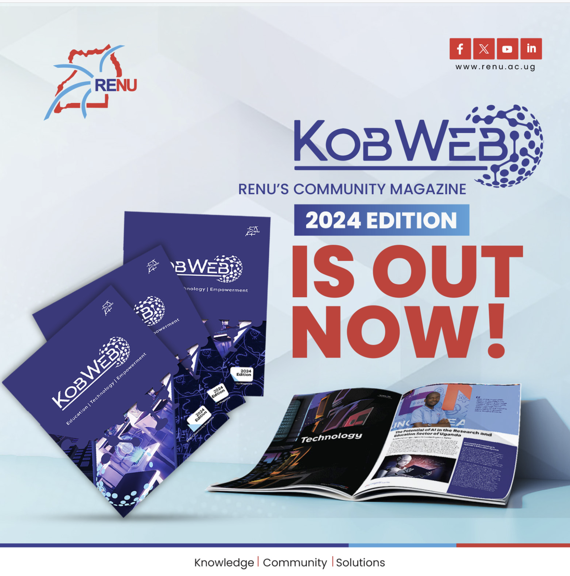

Slide 16
RENU Stakeholder Engagement Policy

Slide 17
The Need for Effective Stakeholder Mapping

Slide 18
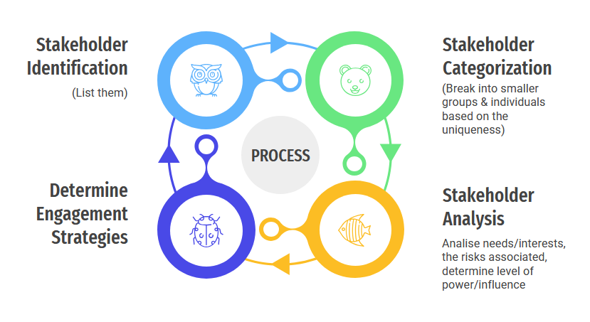
Effective Stakeholder Mapping
Private universities
Smaller public universities
Universities
Big public Universities

Slide 19
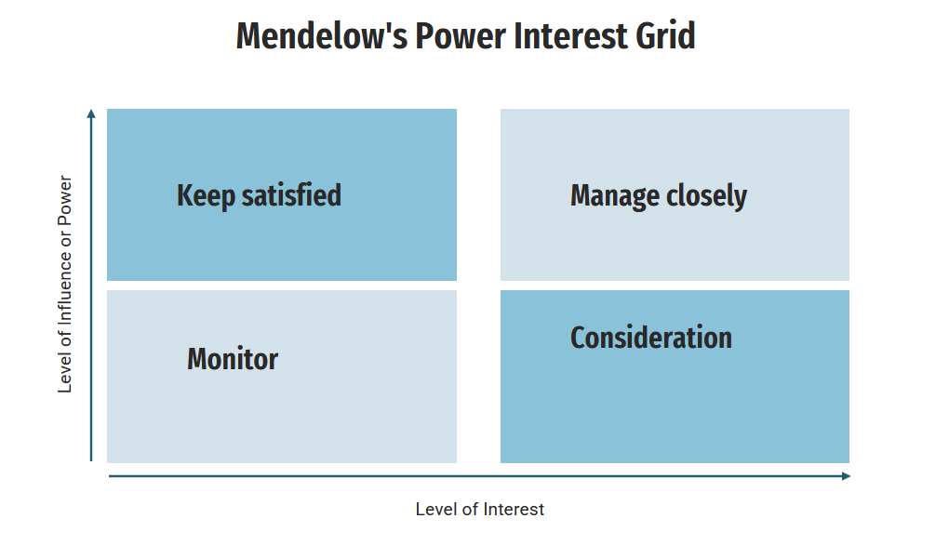
Effective Stakeholder Mapping – Analysis

Slide 20
Effective Stakeholder Mapping - Analysis
RENU Stakeholder Map
Stakeholder | Relevance to RENU | Needs and interests | Associated Risks | Level of power and interest | Engagement strategies

Slide 21
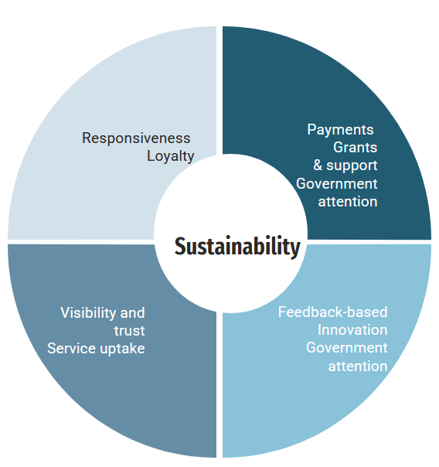
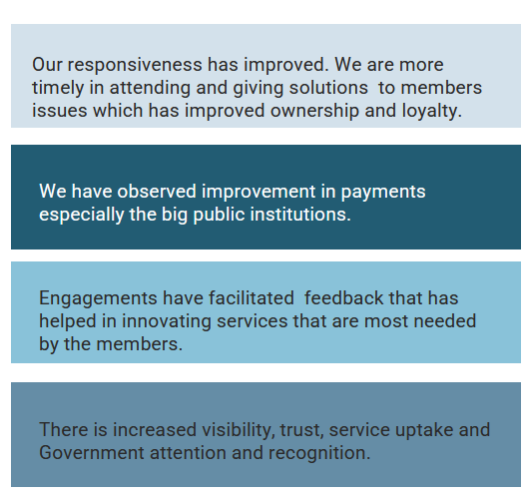
Engagement Results So Far

Slide 22
Lessons Picked So Far
Lessons​
01​ | Effective stakeholder engagement is key to the sustainability of an NREN because it helps the NREN make relevant interventions.​
02​ | Analyzing various units of an NREN's stakeholder groups eases targeted engagement. ​
03​ | Ineffective stakeholder engagement suffocates innovation​
04​ | Many times, we lose customers not because of the price we charge, rather, because we have failed to communicate the value. ​
05​ | Visibility is key in earning the trust of stakeholders.​

Slide 23
“People support what they help create.” — Marvin Weisbord
Thank You!

