Slide 1
Effective Stakeholder Engagement for NREN Sustainability - Experiences from RENU
Caroline Tuhwezeine Kumwesiga
Research and Education Network for Uganda (RENU)
12/06/2025

Slide 2
Outline​
01​ | About RENU​
02​ | Defining key concepts​
03​ | Examples of stakeholders – RENU case​
04​ | Forms of stakeholder engagement​
05​ | Why stakeholder engagement​
06​ | RENU's journey​
07​ | RENU’s 10 principles of stakeholder engagement​
08​ | Stakeholder mapping​
09​ | Results and lessons so far ​

Slide 3
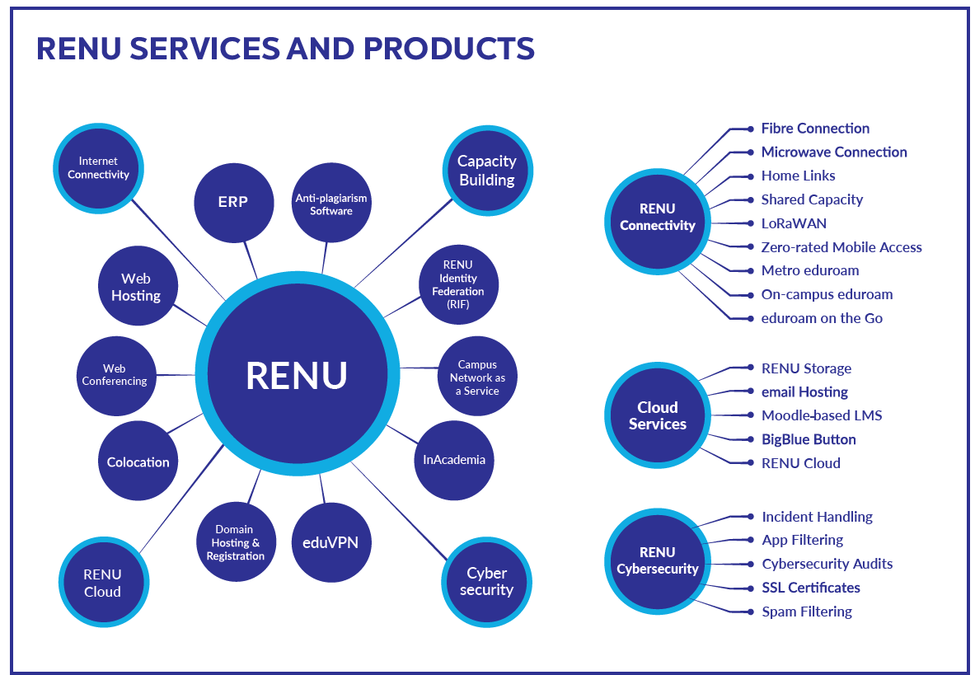
About RENU
Established in 2006
Not for profit membership-based organisation
350 members
838 connected sites
75 staff (40%F 60%M)
Goal: To improve the quality of education and research.
How? Through provision of reliable connectivity & other ICT services tailored for R&E.

Slide 4
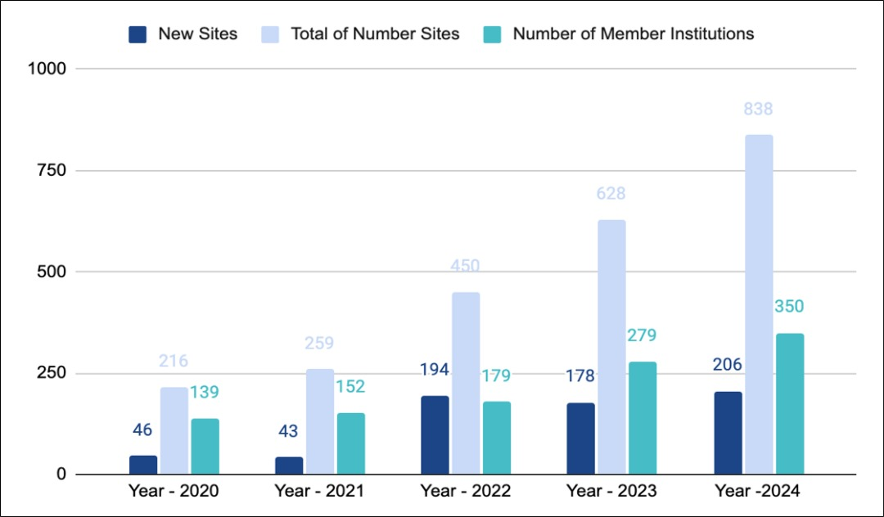
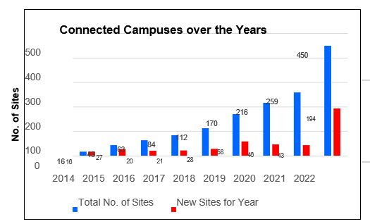
About RENU

Slide 5
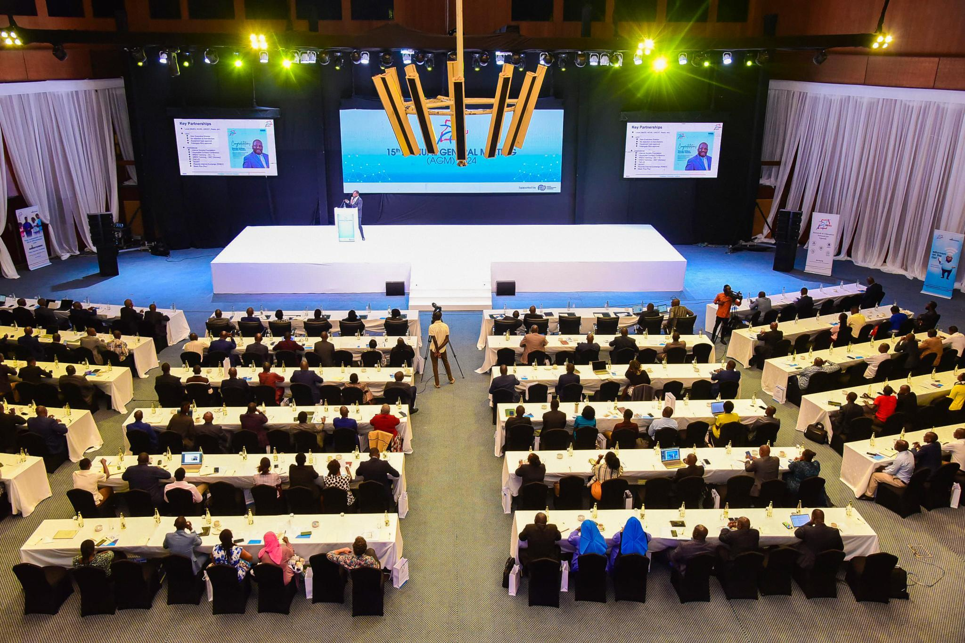

Slide 6
Defining the Key concepts of Stakeholder Engagement

Slide 7
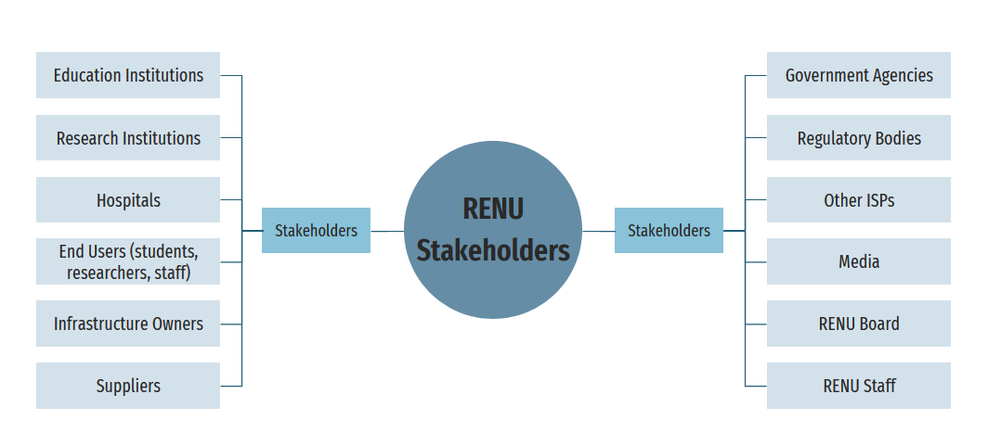
Examples of Stakeholders (RENU Case)

Slide 8
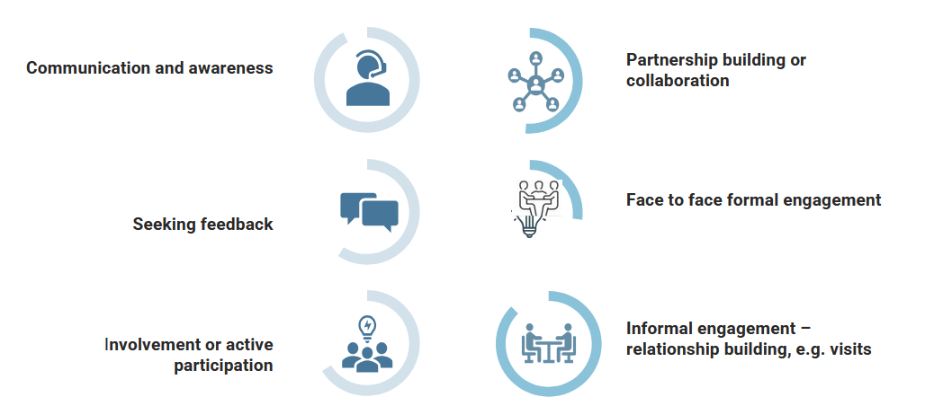
Forms of Stakeholder Engagement

Slide 9
Why stakeholder engagement?
Because of the evolving nature of an NREN and its ecosystem

Slide 10
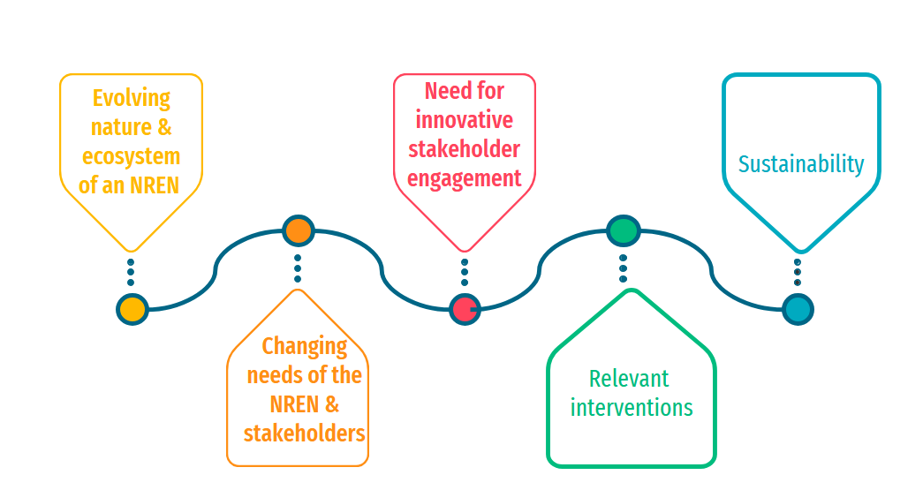
Why Stakeholder Engagement? Why is it Important?
Why Stakeholder Engagement? Why is it Important?

Slide 11
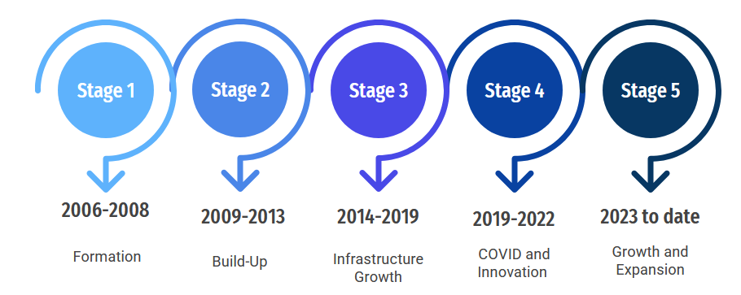
RENU’s Journey of Stakeholder Engagement

Slide 12
RENU’s Journey of Stakeholder Engagement​

Slide 13
RENU’s Journey of Stakeholder Engagement

Slide 14
RENU’s Journey of Stakeholder Engagement

Slide 15
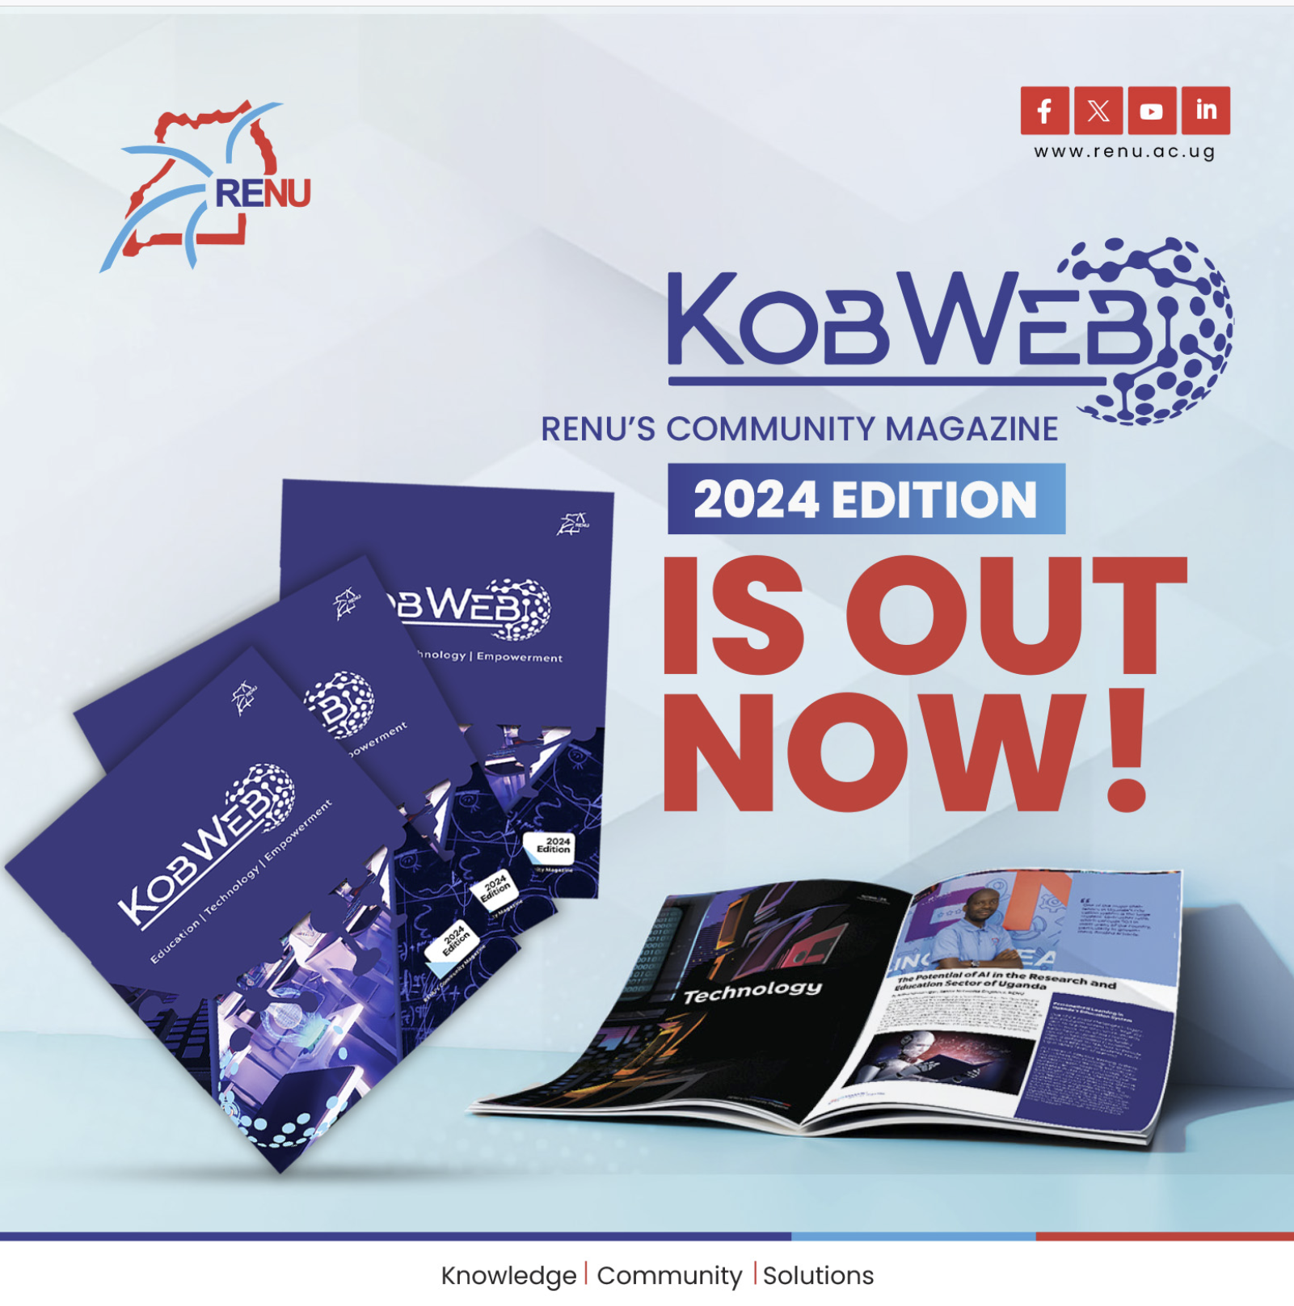

Slide 16
Principles of Stakeholder Engagement

Slide 17
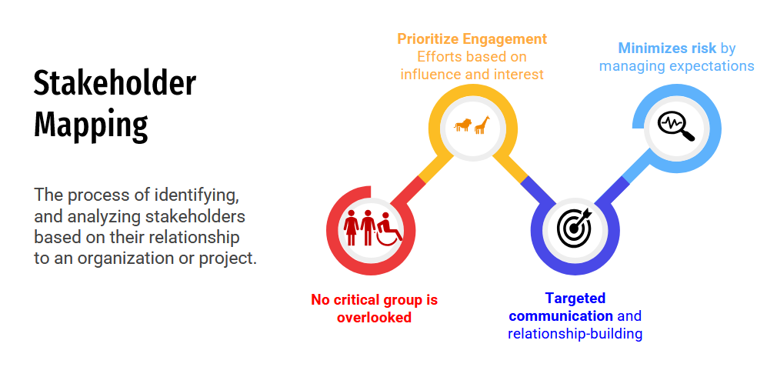
The Need for Effective Stakeholder Mapping

Slide 18
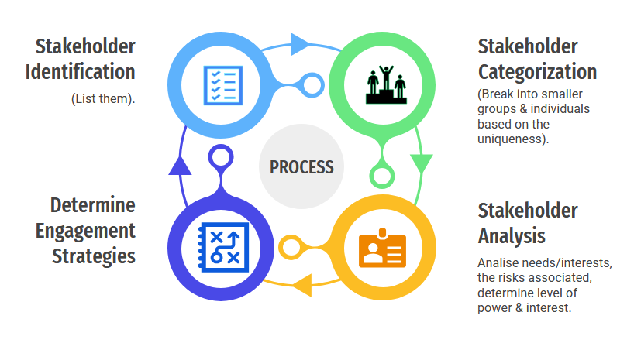
Effective Stakeholder Mapping​ ​
Private universities
Smaller public universities
Universities
Big public universities

Slide 19
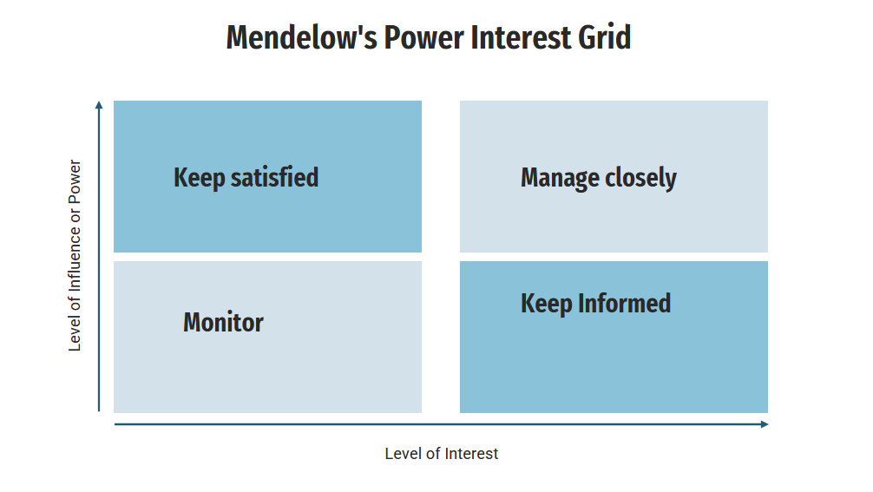
Effective Stakeholder Mapping – Analysis

Slide 20
Effective Stakeholder Mapping - Analysis
RENU Stakeholder Map Template
Stakeholder | Relevance to RENU | Needs and interests | Associated Risks | Level of power and interest | Engagement strategies

Slide 21
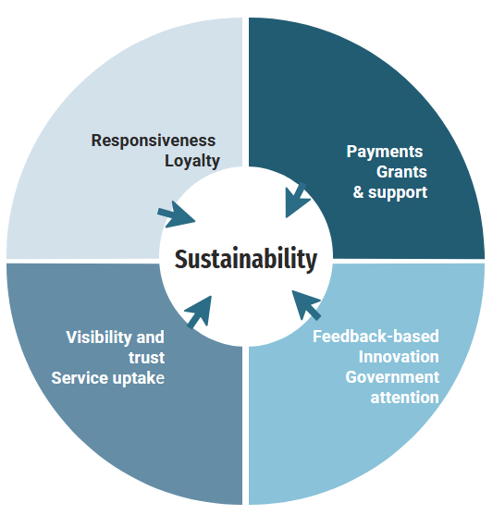
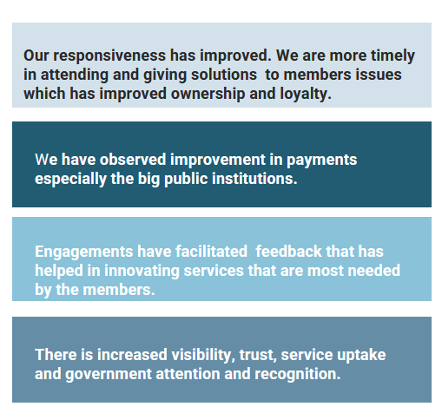
Engagement Results So Far​ ​

Slide 22
Lessons​ Picked So Far
01​ | Effective stakeholder engagement is key to the sustainability of an NREN because it helps the NREN make relevant interventions.​
02​ | Analyzing various units of an NREN's stakeholder groups eases targeted engagement. ​
03​ | Ineffective stakeholder engagement suffocates innovation​.
04​ | Many times, we lose customers not because of the price we charge, rather, because we have failed to communicate the value. ​
05​ | Visibility is key in earning the trust of stakeholders.​

Slide 23
“People support what they help create.” — Marvin Weisbord
Thank you
Presenter email: ctuhwezeine@renu.ac.ug

