Slide 1
SURF's QKD testbed deployment
NRENs in transition to a quantum-safe future
David Maier
david.maier@surf.nl

Slide 2
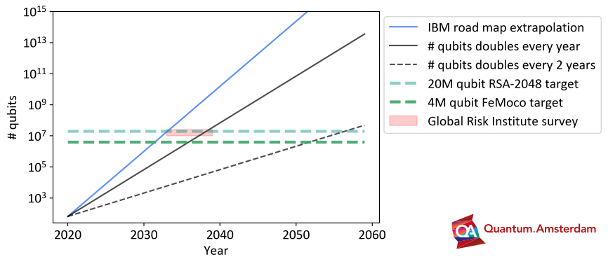
Intro: Quantum Threat vs NREN
Quantum Threat: widely-used encryption protocols (e.g. RSA, ECC) will be broken within the next decade
Classical threat: members confused about migration to quantum-safe (PQC vs. QKD?)
NRENs uniquely positioned:
Trusted infrastructure and innovation providers
At the heart of national research, education, and policy development
Embrace our role of leading the transition!

Slide 3
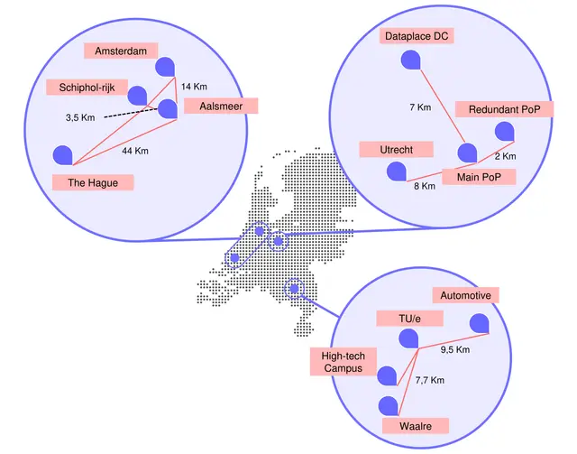
Overview QCINed
SURF: ISP / NREN use-case
QKD
PQC
11km
Government use-case
7km
Threat assesment
3 different use-cases/ focus areas
Involvement of different stakeholders (NSAs, R&E, industry)
MDI, CV/DV – QKD from different vendors
TU/e: industry
use-case
Source: https://quantumdelta.nl/qcined

Slide 4
QCINed: Challenges
Software (KMS, QKM) either proprietary, bad or both (back then)
Vendors not or barely interoperable
Available domain control models using centralized approach
Range limitation making the N in NREN impractical → QKD-as-a-Service
→ open-source KMS (key relaying, fully vendor agnostic), domain control and orchestration
QKDaaS
?
?

Slide 5
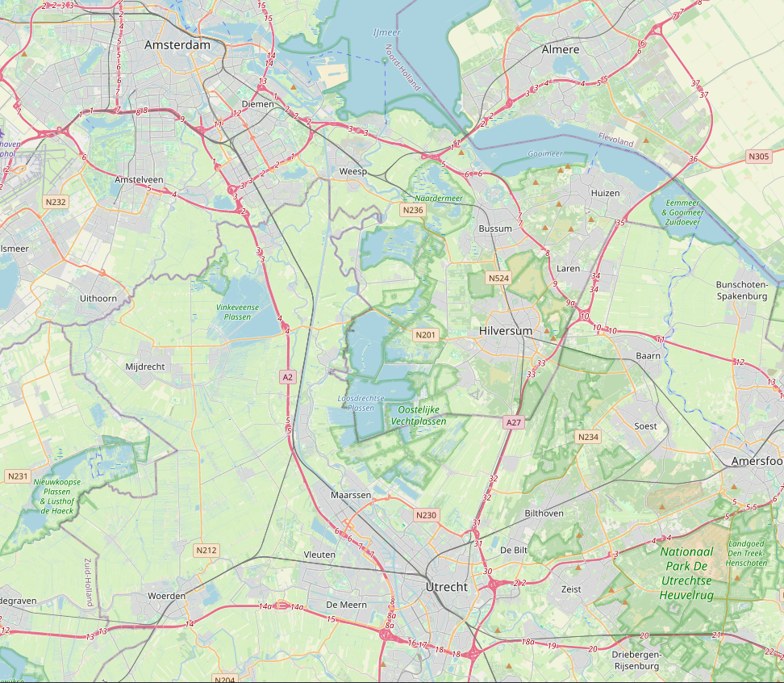
Overview QCINed @ SURF
Amsterdam HPC/ future QC
QKD-as-a-Service for R&E
Testbed connecting Amsterdam and Utrecht
Embedded in SURF service delivery
Building on our experience in network operation and A&O
Abstraction beyond (vendor-specific) hardware limitations
Open-source solutions
R&E use cases
DV-QKD
‘Long Reach’ Link
70.1km
MDI-QKD
Metropolitan network
DC
11km
Utrecht
Trusted Node
UMC
7.1km
1.8km
UniU
Source: OpenStreetMap

Slide 6
Open Software Stack
Service A&O
WorkflowOrchestrator.org
Full open-source software stack
Fully integrated with production A&O workflow orchestrator
eduQDC: quantum domain controller
eduKMS: key management server
QKD
PQC
REST API
Domain Control
eduQDC
Threat assesment
eduQKD repo
config
QKD
Vendor #1
QKD
Vendor #2
KMS
eduKMS

Slide 7
Open Software Stack
Service A&O
WorkflowOrchestrator.org
eduQDC:
Minimalist approach
Only pushes config
eduKMS:
Fully decentralized
ETSI 014
Key-relaying
Vendor agnostic
“Continuous key propagation”
QKD
PQC
REST API
Domain Control
eduQDC
Threat assesment
eduQKD repo
config
QKD
Vendor #1
QKD
Vendor #2
KMS
eduKMS

Slide 8
Open Software Stack
Service A&O
WorkflowOrchestrator.org
If you need a fully open-source software stack to get your organization into QKD: Get in touch!
QKD
PQC
REST API
Domain Control
eduQDC
Threat assesment
eduQKD repo
config
QKD
Vendor #1
QKD
Vendor #2
KMS
eduKMS

Slide 9
QKD use cases
Use case development / exploration crucial for engaging our members
“Classical” QKD use-cases
MAC-Sec
IP-Sec
TLS
Application-specific encryption
“Beyond” QKD use-cases (possible with current QKD hardware)
Secure multi-party computation via quantum oblivious transfer (see e.g. “QuGenome: Quantum Enabled Private Recognition of Composite Signals in Genome” in MadQCI)
QgeKO: Quantum Secure Distribution of Precise Global Navigation Satellite System Keys and Order

Slide 10
QKD use case PoCs @ SURF
Cloud storage (SURFDrive) using QKD enabled TLS (via openssl)
QKD enabled VPN (wireguard, eduVPN)
Student projects & hackathons (e.g. quantum-safe … : voting app, chat, TLS in RUST; ETSI client for java-script) → Application layer: e.g. QKD as session key or OTP → Transport layer: e.g. QKD as symmetric key (instead of DH) → Network layer: e.g. QKD as symmetric key in ESP in IPSec (periodic cycling) → Data link layer: e.g. QKD as symmetric key in AES-GCM in MACsec
Important: QKD only secures key exchange, not authentication (→ quantum-safe PKI using PQC for authentication)

Slide 11
Conclusions
NRENs well positioned to lead transition to quantum-safe communication → great use-cases for both QKD and PQC → trusted innovators with “neutrality” between the two solutions
A full open-source software stack is available → encourage collaboration
Use case development and stakeholder engagement is important to lead the transition
Quantum-security of a service needs to be evaluated as a whole (and will likely include PQC and QKD)

Slide 12
Thank you
Any questions?
david.maier@surf.nl

