Slide 1
Quantum-Safe Communication at Scale
Leveraging MDI-QKD for On-Demand Key Distribution
Jonathan Van Overmeir - Belnet
TNC 25
11/06/2025

Slide 2
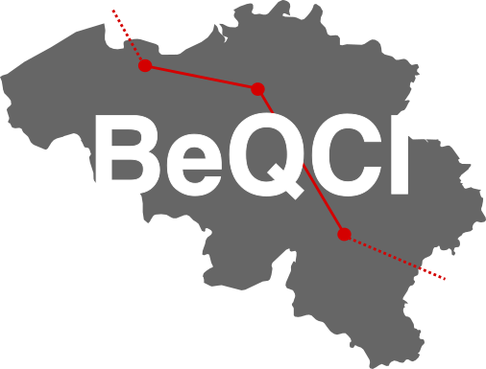
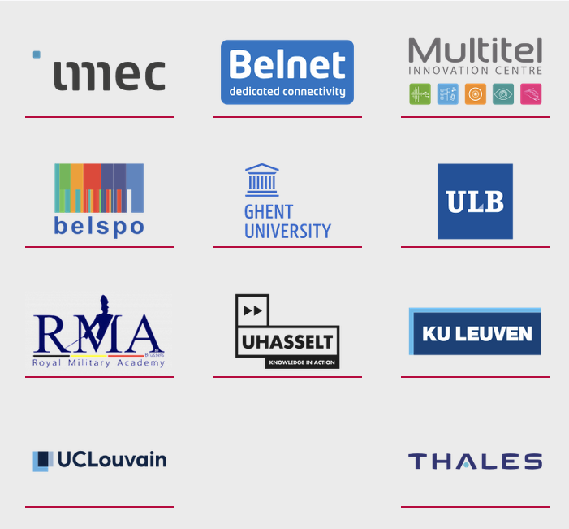
BeQCI in the EuroQCI context
BeQCI: Belgian Quantum Communication Infrastructure
Partners and roles (Belnet, universities, research centers)
National QKD backbone project, supported by EU QCI initiatives

Slide 3
What is QKD ?
QKD allows two parties to generate a shared, secret cryptographic key using quantum mechanics
Security is based on fundamental laws of physics: any eavesdropping attempt disturbs the quantum states
Key types:
DV-QKD
CV-QKD
MDI-QKD
Offers information-theoretic security against both classical and quantum adversaries

Slide 4
MDI vs traditional QKD
MDI-QKD = Measurement Device Independent Quantum Key Distribution
Measurement device :
Doesn’t require to be trusted
Increased security – No side-channel attack on the detector
Centrally located
Decrease cost
Enable star topology with linear scaling

Slide 5
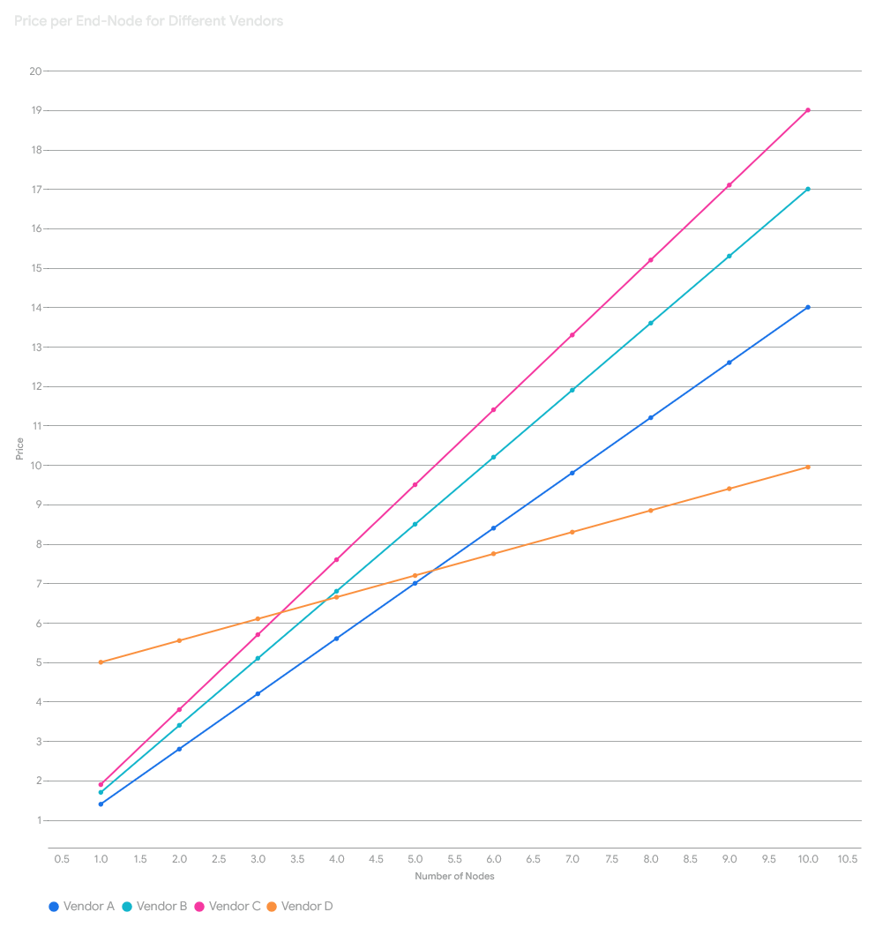
Why MDI-QKD ?
Star topologies and central untrusted nodes: a practical fit for real-world networks
The Hasselt case
The Brussels case
Highly cost-efficient for large-scale deployments:
Centralizes expensive single-photon detectors
Reduces total hardware costs by up to 50% in networks with 10 node

Slide 6
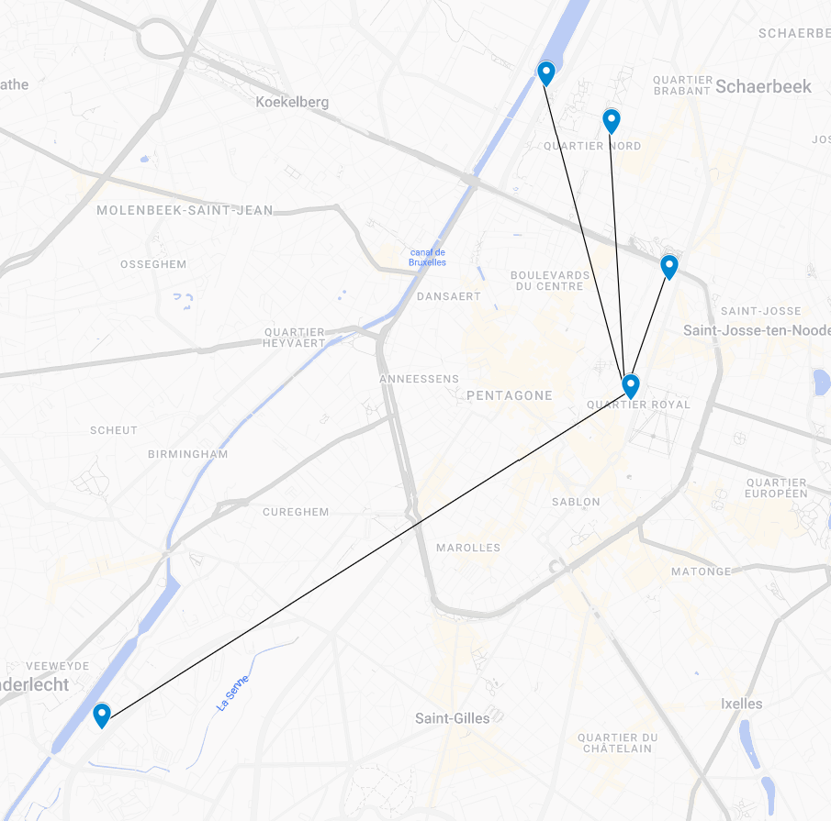
Network Architecture – Star Topology
Each node independently sends quantum signals to relay
Central node performs Bell state measurements
Supports scalable user communication
In small concentrated area, it is way better fit than classical QKD, even more with shared location

Slide 7
On-Demand Key Distribution Workflow
Request-based key generation process
Orchestration layer: request, match, transmit keys
Integration with classical key management systems
API-based access control and distribution
Client-side encryption

Slide 8
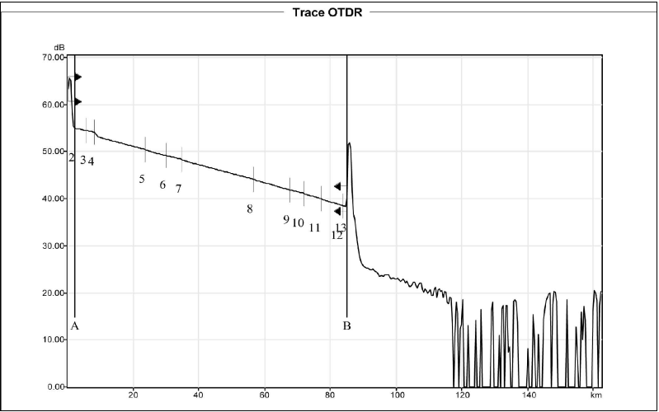
The Fiber Frontier
Maximum operational distance: ~100 km with current telecom fibre infrastructure
Resilience to loss and noise: robust up to 40 dB channel loss
Channel stability
No functional quantum repeater yet

Slide 9
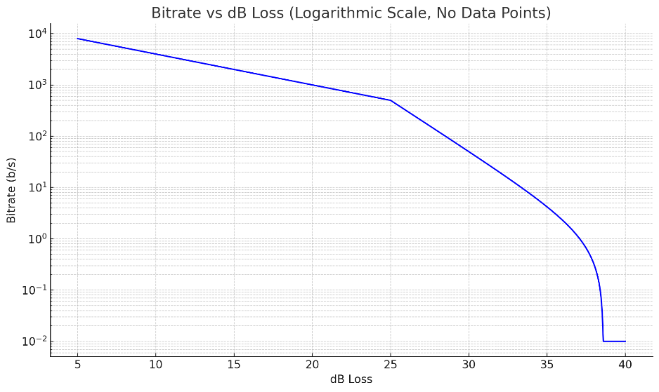
Can it keep up?
Key rates:
20 dB loss: 1000 b/s
25 dB loss: 500 b/s
30 dB loss: 50 b/s
Max range up to 40dB
Unsuitable for bulk data, no One-time Pad possibility
Redundancy is hard
Power cut is the biggest ennemy

Slide 10
Roadmap and Future Plans
Finish BeQCI deployment beyond pilot phase
CEF call joint with Netherlands and Luxemburg
Try to consider using MDI-QKD in your environment !
If you have a good fit, it could save you a whole bunch of money
The more people on board, the more issue will be resolved

Slide 11
Thank you
Any questions?
Contacts:
Jonathan@belnet.be – Jo@belnet.be
BeQCI link and resources :
https://beqci.eu/

