Slide 1
Institute of Mathematics and Computer Science University of Latvia
On Quantum-Secure Layer 3 (IP) and Layer 2 Networking
(and a bit of Layer 4)
Sergejs Kozlovičs, Rihards Balodis, Ināra Opmane
TNC25 @ Brighton, UK
June 11, 2025

Slide 2
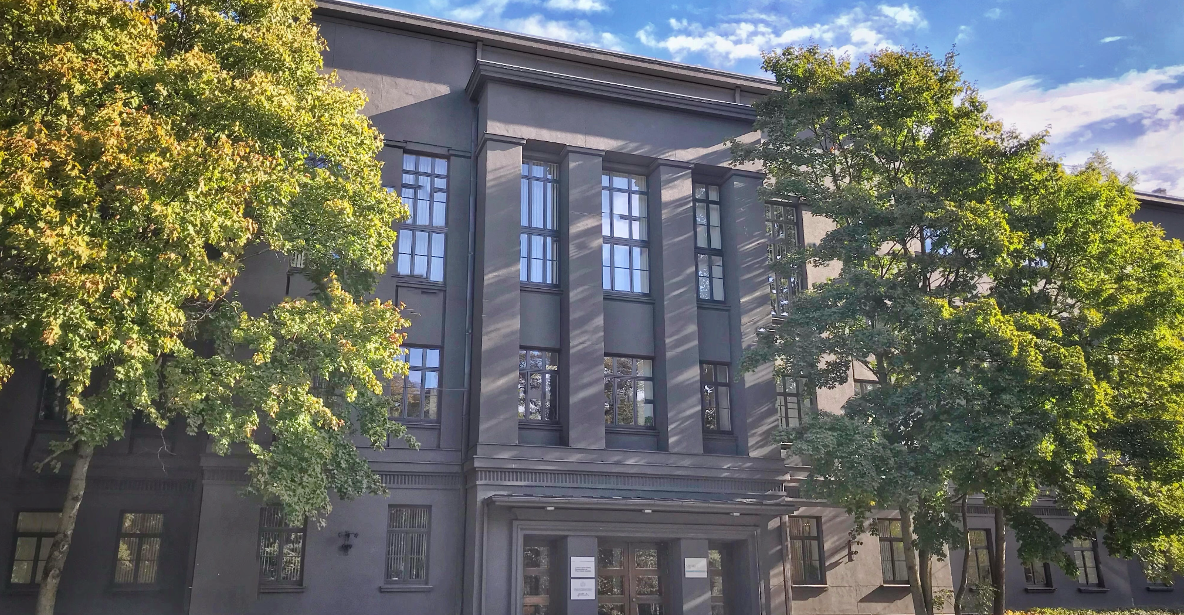
IMCS UL Institute of Mathematics and Computer Science of University of Latvia
Founded:
1959
Now:
One of the largest and most influential research institutions in Latvia, EU
Formerly:
The Latvia Computing Center

Slide 3
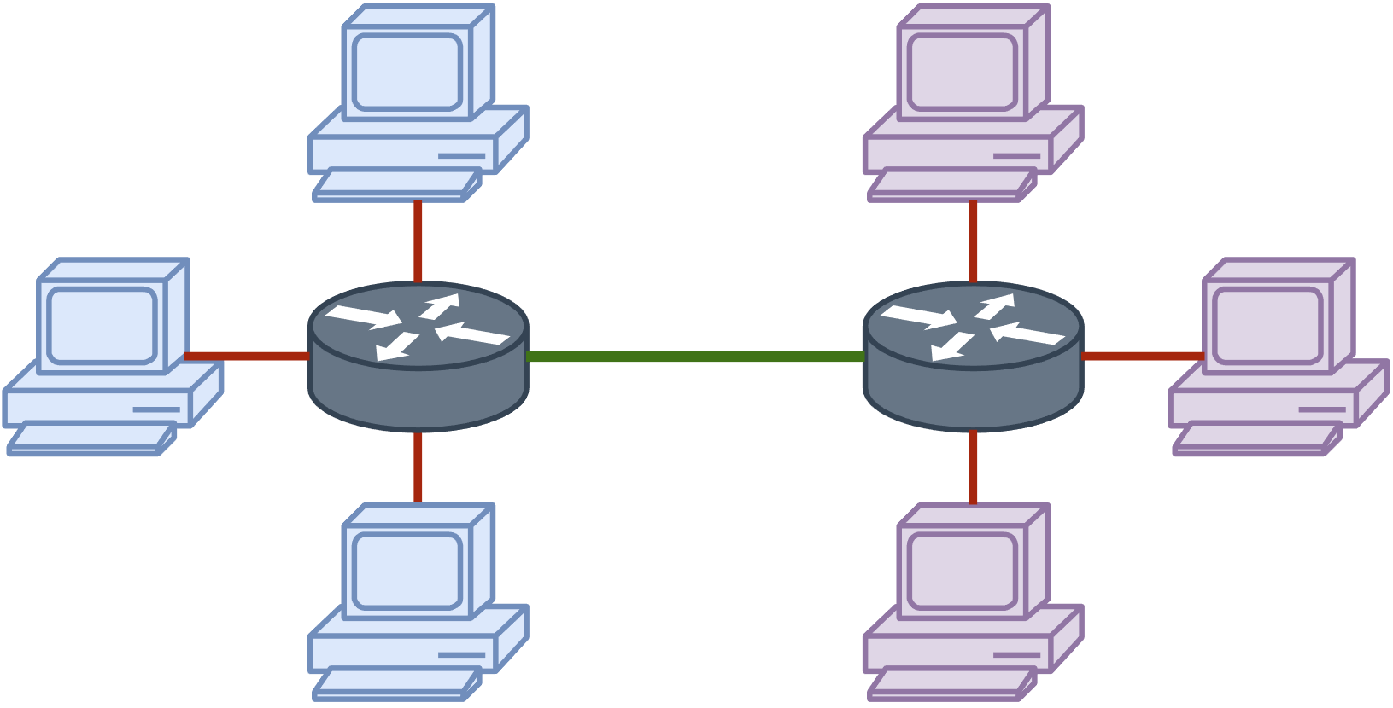
IMCS UL: Latvian/Baltic/European Internet
1990-ties:
IMCS UL connects Latvia to the global Internet
Before 2000-ties:
IMCS UL actively cooperated with DANTE and NORDUNET, and partnered with the TEN34 (19 countries) and BaltNet projects
Since 2000-ties:
IMCS UL has been a partner in all GÉANT projects GN1/2/3/4 Latnet/Sigmanet (part of IMCS UL) is a long-term GÉANT partner
IMCS UL is is a partner now (we maintain a GÉANT node)
August, 1990: first e-mail via a modem connection
October, 1992:
Riga-Tallinn permanent link, 2400 bits/second

Slide 4
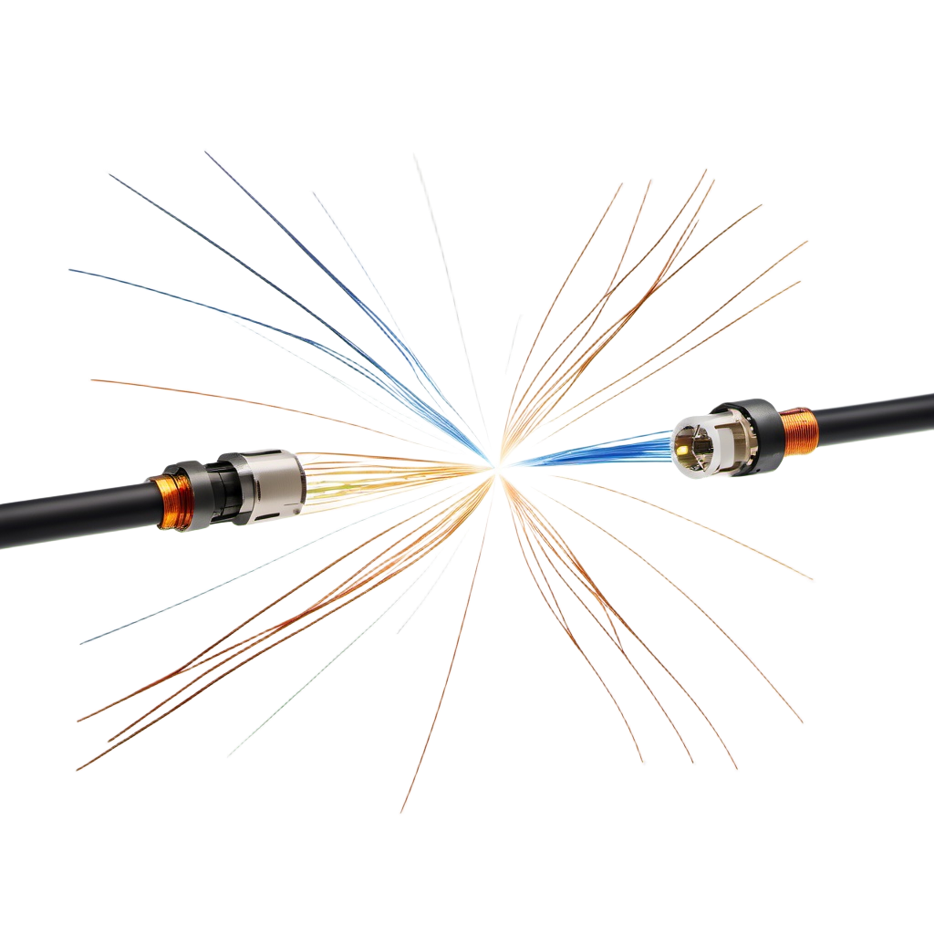
IMCS UL: Quantum Connections
2019, and 2020-ties:
IMCS UL introduces the very first quantum communication Channels in Latvia
Since 2023:
Conventional telecommunications industry partners (LVRTC, TET, ECO) turn towards quantum communications
2019:
the first in-lab quantum link
2021:
the first metropolitan-scale link in Riga (33km), with partners

Slide 5
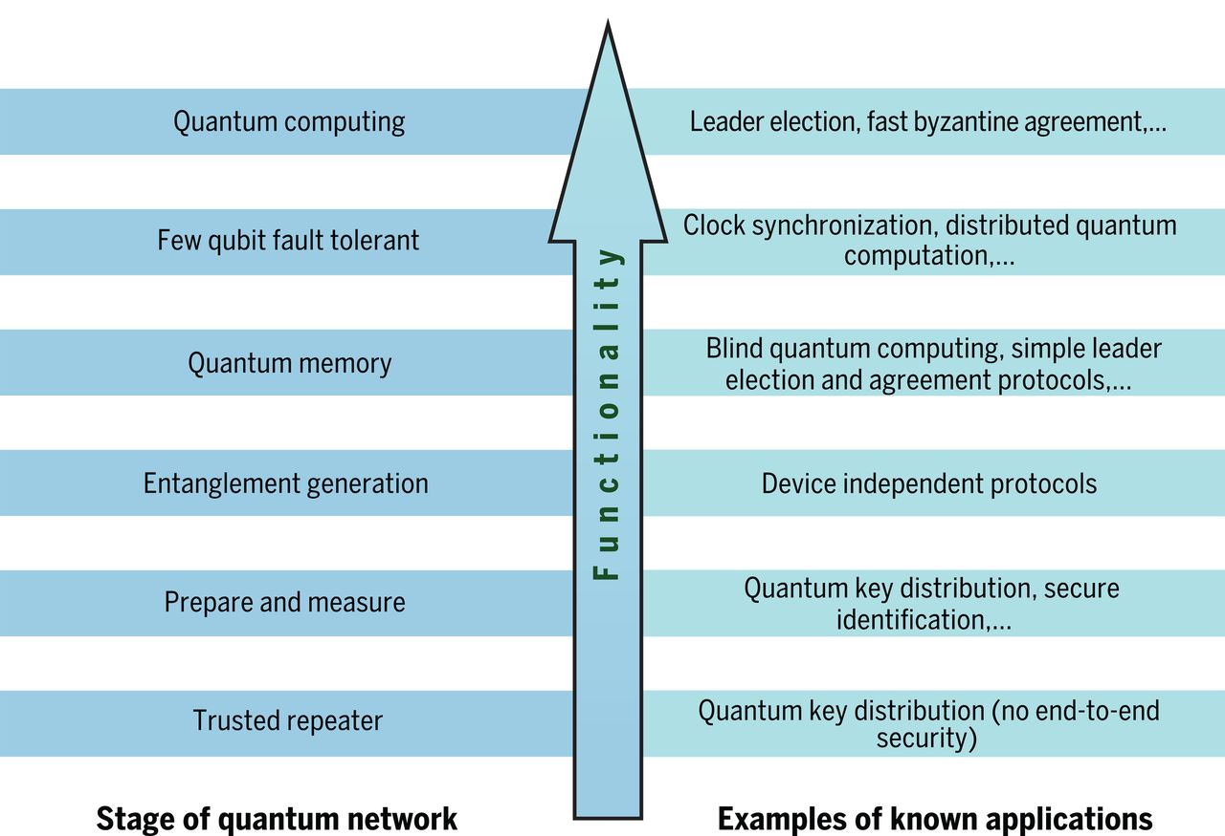
Towards the Quantum Internet
Stephanie Wehner et al. Quantum internet: A vision for the road ahead. Science 362, eaam9288 (2018)

Slide 6
Towards the Quantum Internet
The Quantum Internet can wait (entanglement distribution, distributed quantum computing...)
Quantum-secure key exchange cannot wait!

Slide 7
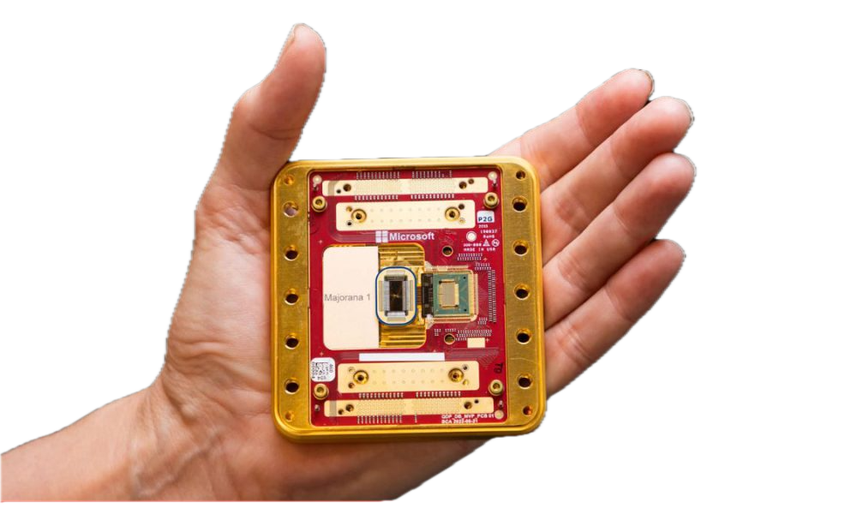
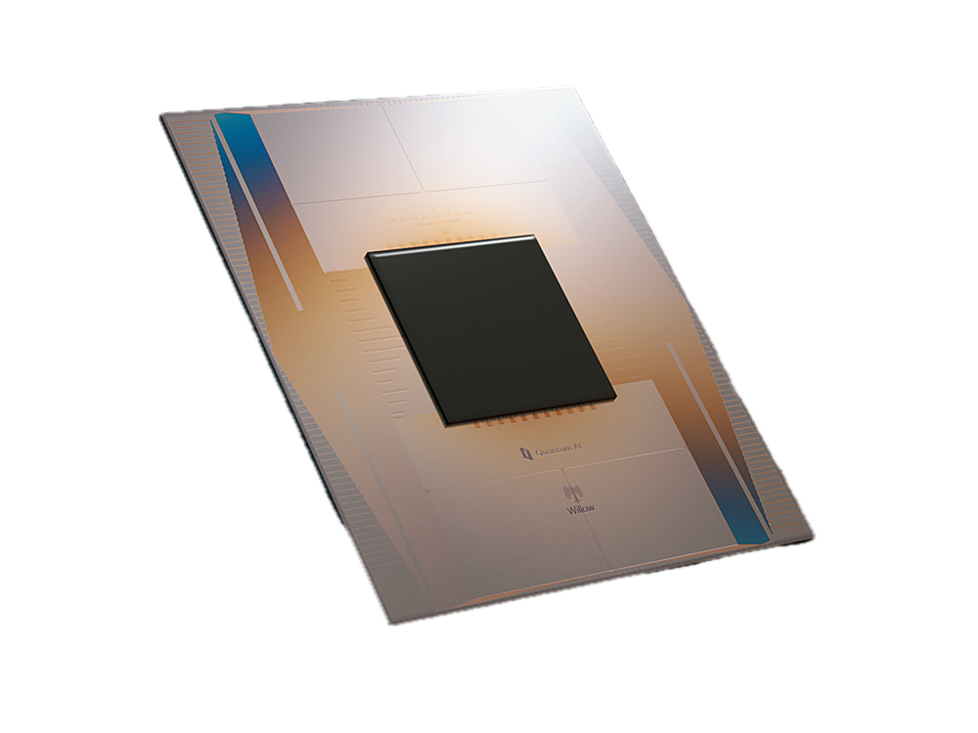
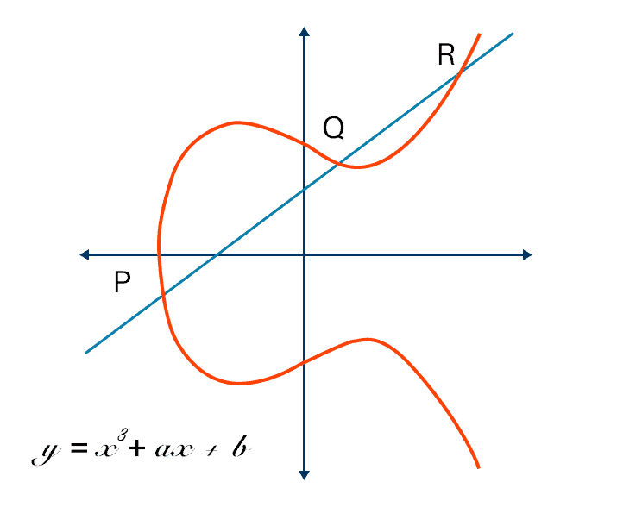
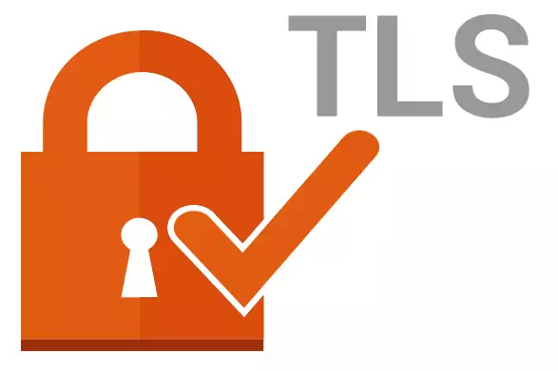
The Quantum Threat
TLS 1.3 and below
ECC, RSA,
...

Slide 8
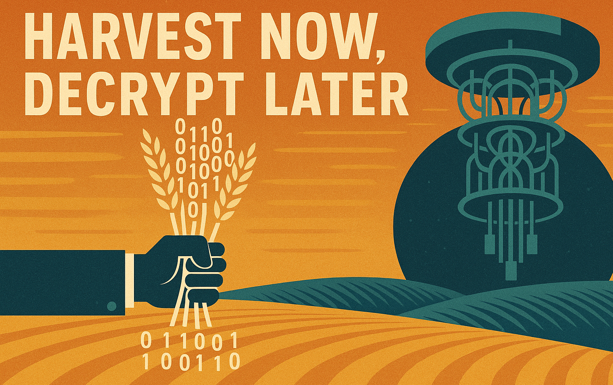
Harvest Now, Decrypt Later
Most quantum-vulnerable algorithms should be:
deprecated by 2030 and
disallowed by 2035.
[NIST Internal Report, NIST IR 8547, “Transition to Post-Quantum Cryptography Standards”]

Slide 9
Our Motto: Fight Quantum with Quantum!
entropy
QRNG
QKD
quantum hardware
entropy
quantum-safe
algorithms
PQC
AES, OTP
considered quantum-safe (believed to be hard problems for the quantum computer)
considered quantum-safe
(AES: limited speedup by Grover’s search; OTP is information-theoretically secure)

Slide 10
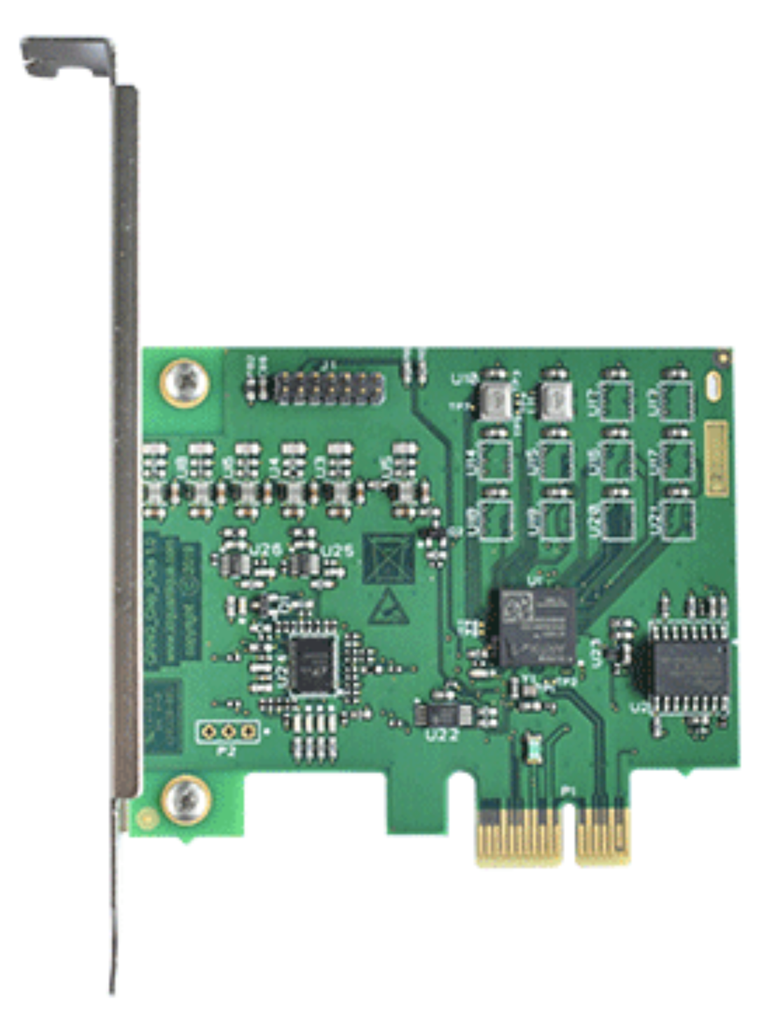
QRNGs: Quantum Random Number Generators
Each QKD device must have one.
QRNGs are essential for PQC algorithms:
uniform bitstring sampling
nonces
seeds
salt...
Quantum Random Number Generators utilize inherently random quantum processes (nuclear decay, photon behaviour, quantum vacuum fluctuations)

Slide 11
Our QRNG as a Service
We developed:
QNRG as a Service (qrng.lumii.lv), 2022
the first QRNG service secured with PQC
Linux kernel module (/dev/qrandom0 simulation)
Windows DLL with Detours (non-open-source)
D-Bus QRNG service
OpenSSL3 provider

Slide 12
Our Motto: Fight Quantum with Quantum!
entropy
QRNG
QKD
quantum hardware
entropy
quantum-safe
algorithms
PQC
AES, OTP
considered quantum-safe (believed to be hard problems for the quantum computer)
considered quantum-safe
(AES: limited speedup by Grover’s search; OTP is information-theoretically secure)

Slide 13
QKD vs. PQC
QKD | PQC
Perfect Forward Secrecy | Vulnerabilities can be found in the future Have to withstand the test of time
Information-Theoretically Secure | Not Information-Theoretically Secure
Non-breakable unless Quantum Mechanics are false | Believed to be quantum-safe Breakable with unlimited computational power
Expensive: devices and infrastructure needed | Operates on existing Internet infrastructure
Difficult to configure and maintain | Integrates well into existing software and Public Key Infrastructure (PKI)
No authentication | Provides Authentication and Encryption (AE)

Slide 14
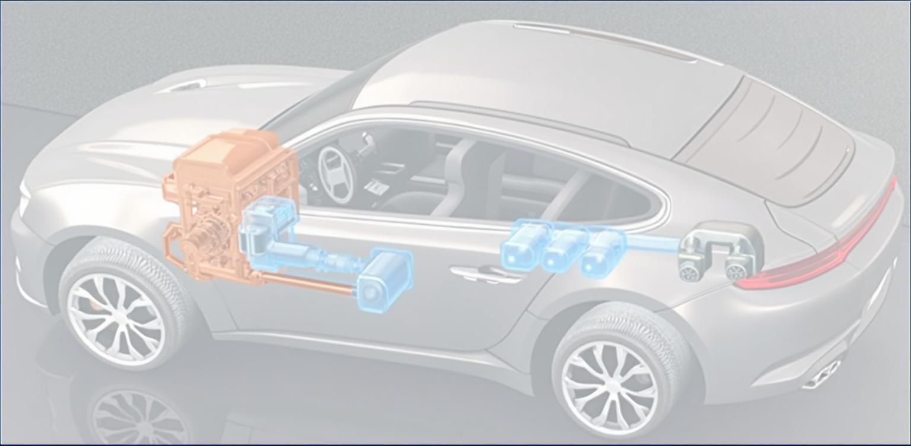
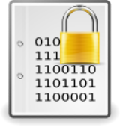
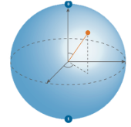
The Four-Wheel Drive Engine Model (Hybrid!)
PQC
NIST selected
Juniper
QKD
IDQ
Cisco

Slide 15
GÉANT + QKD: The Problem
Infinera DTN-X optical equipment over dark fibre
Dark fibre is good for quantumness!
But: Optical Transport Network (OTN) switching…
Optical routing/switching is a problem, since we cannot copy an unknown quantum state

Slide 16
GÉANT + QKD: The IDEA!
QKD as a Service
“WP6 Task 1 is currently reviewing network support requirements for Quantum Technology and quantum key distribution/exchange (QKD/QKE) technology in order to consider its applicability as a service for use by the GÉANT community.”
[NETDEV: https://wiki.geant.org/display/NETDEV/QT]

Slide 17
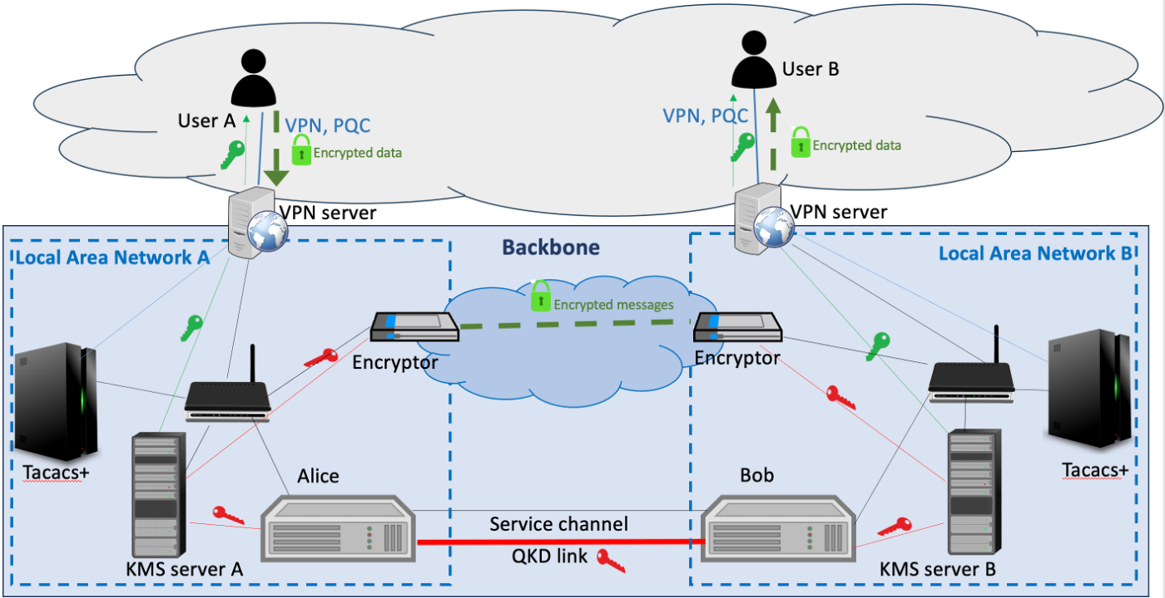
Our Solution #1: the Backbone
Replace your cable with our backbone!
We offer a network segment (trunk) secured with quantum keys.

Slide 18
Our Solution #1: the Backbone
Can be implemented via:
L2 encryptors with QKD support (Centauris)
L3 routers/firewalls with QKD support (Cisco, Juniper)
certified devices!
preferrably, with PQC support

Slide 19
Our Solution #2: Access via PQC VPN
L2/L3 VPN:
classical
and PQC

Slide 20
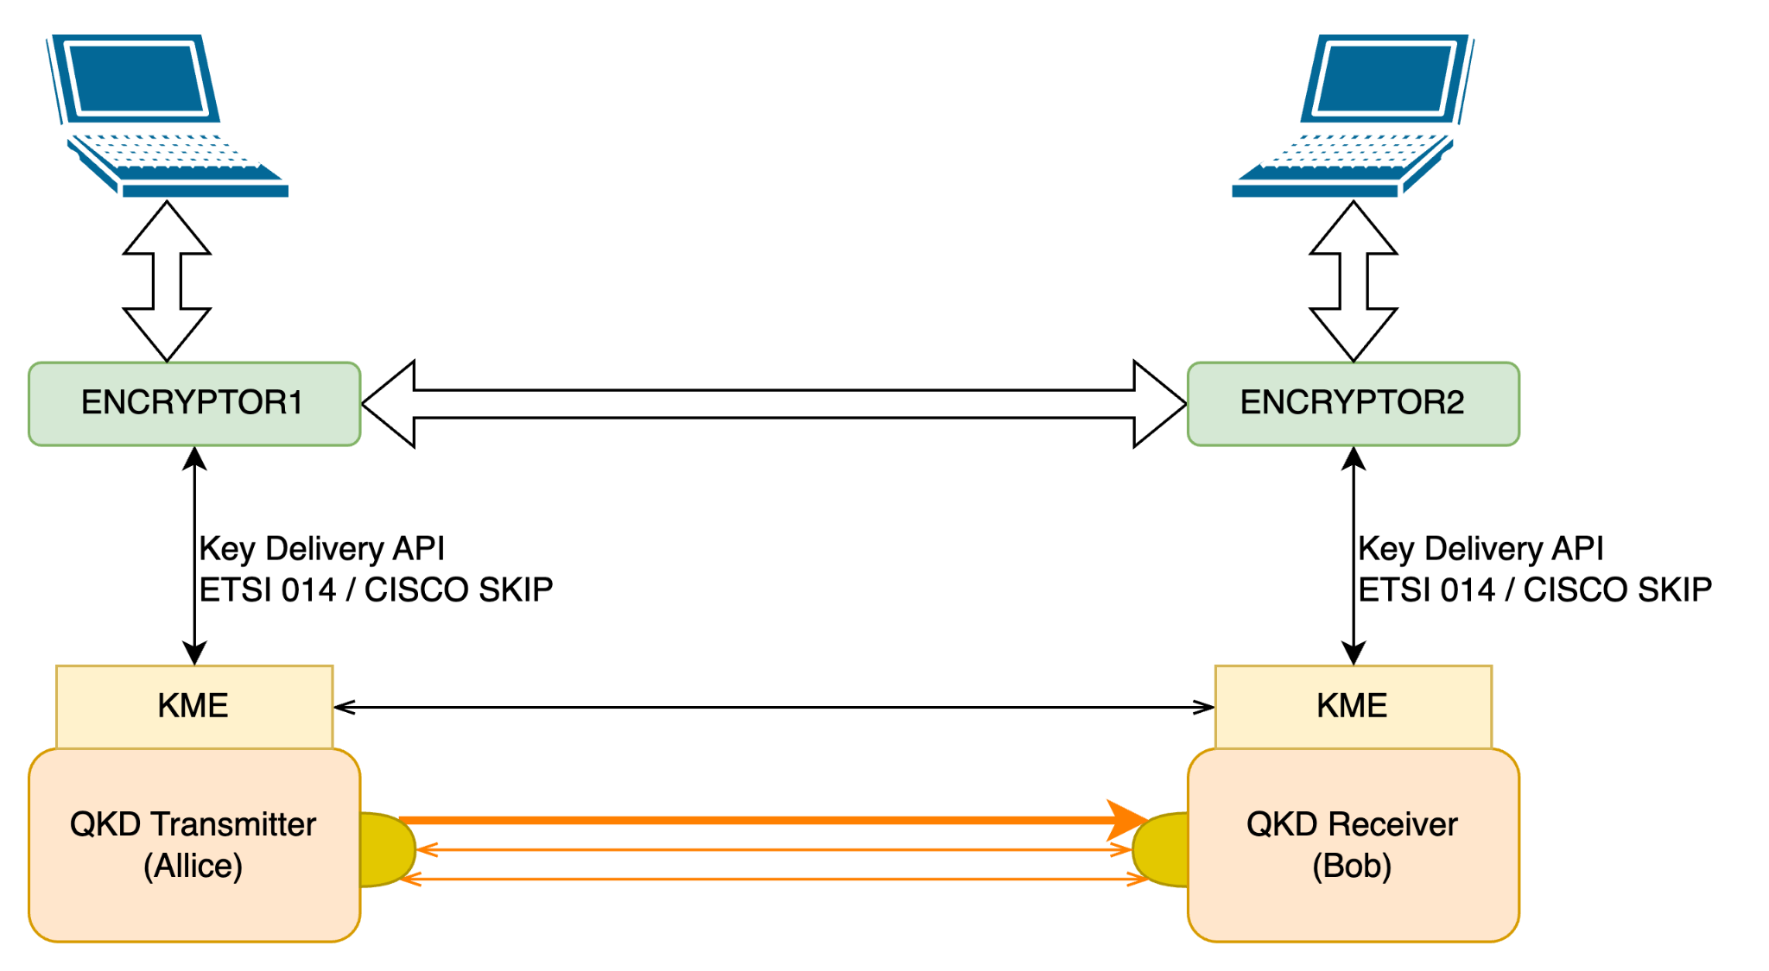
One More Problem, Sorry ☹
PROBLEM:
distance ~150km
(for most commercial QKD devices)

Slide 21
Trusted Nodes

Slide 22
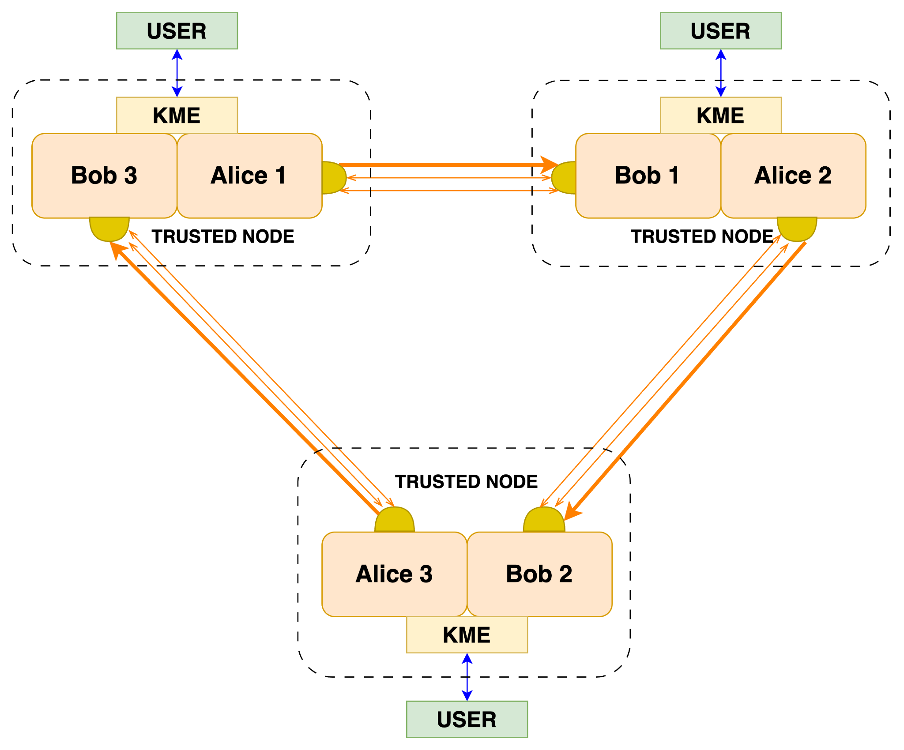
Complex Topologies
In the LatQN project, we are implementing the "triangle" topology between different partners in Latvia
=> latqn.eu
(part of EuroQCI)
Key Relay algorithms are needed
We have to sacrifice some QKD keys for that (a precious resource!)
The research is supported by the European Union, project No. 101091559 ”Development of experimental quantum communication infrastructure in Latvia (LATQN)”.

Slide 23
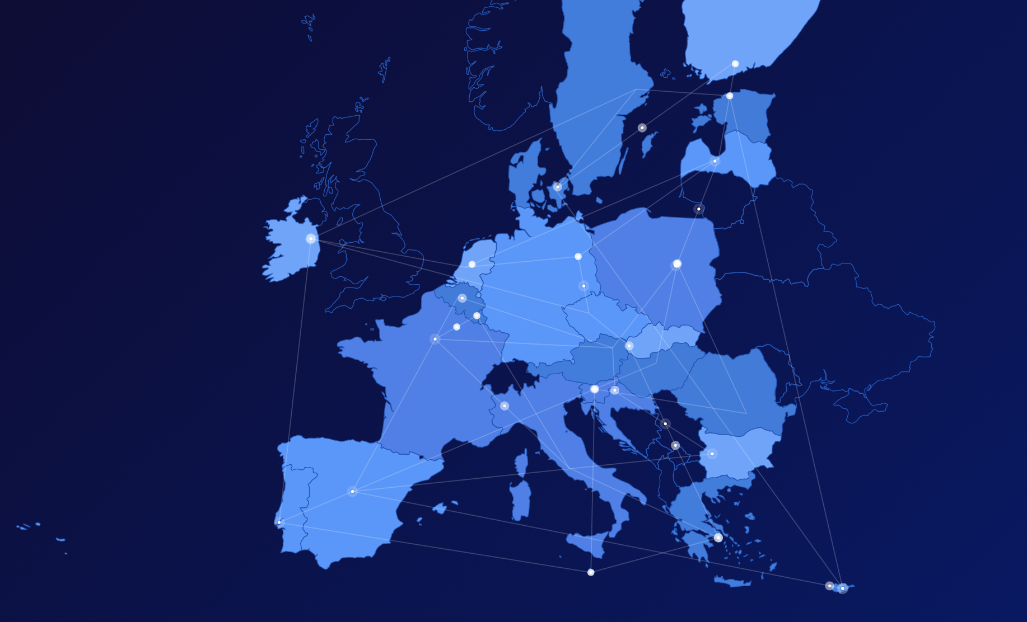
EuroQCI = European
QKD "Internet"

Slide 24
How to provide QKD as a Service for end users without L2/L3 hardware or VPN software?

Slide 25
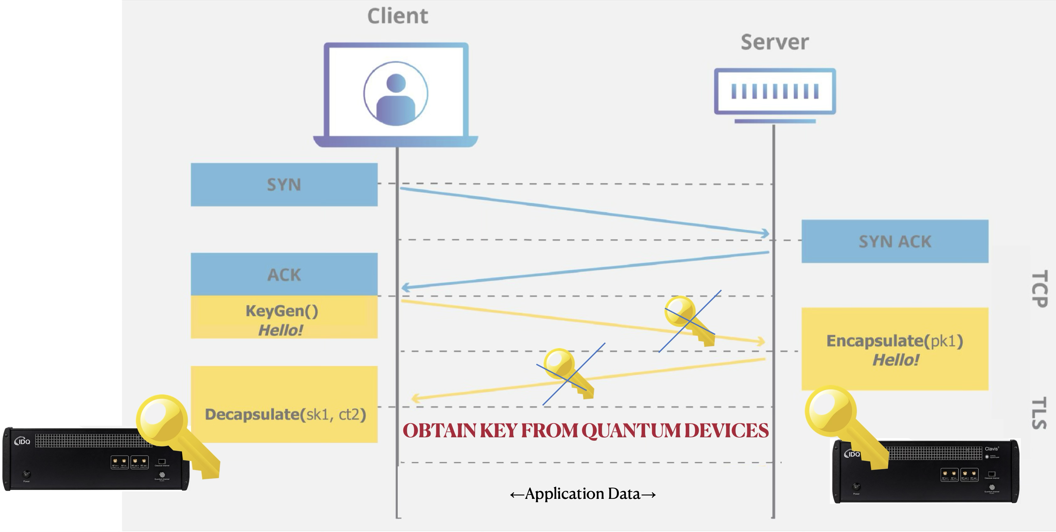
Our Solution #3: TLS (Layer 4) Integration
We developed a library (Java and native) that implements TLSv1.3 secured with quantum keys
We replace TLS Key Exchange with an abstract Key Encapsulation Mechanism, KEM (like in PQC)
“Quantum KEM” does not exchange keys but obtains them from quantum devices

Slide 26
Our Solution #3: TLS (Layer 4) Integration
“Quantum KEM” implementations:
Direct ETSI QKD GS 014
Direct CISCO SKIP
Our original double-secure Butterfly Protocol

Slide 27
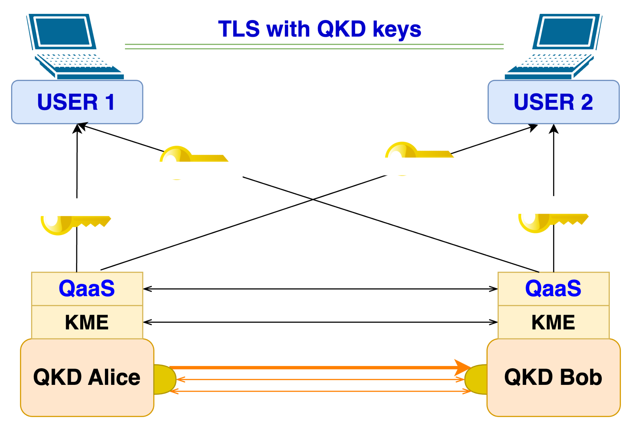
Our Double-Secure Butterfly Protocol
qkd.lumii.lv
QKD as a Service via our
Butterfly Protocol
with
TLSv1.3 integration

Slide 28
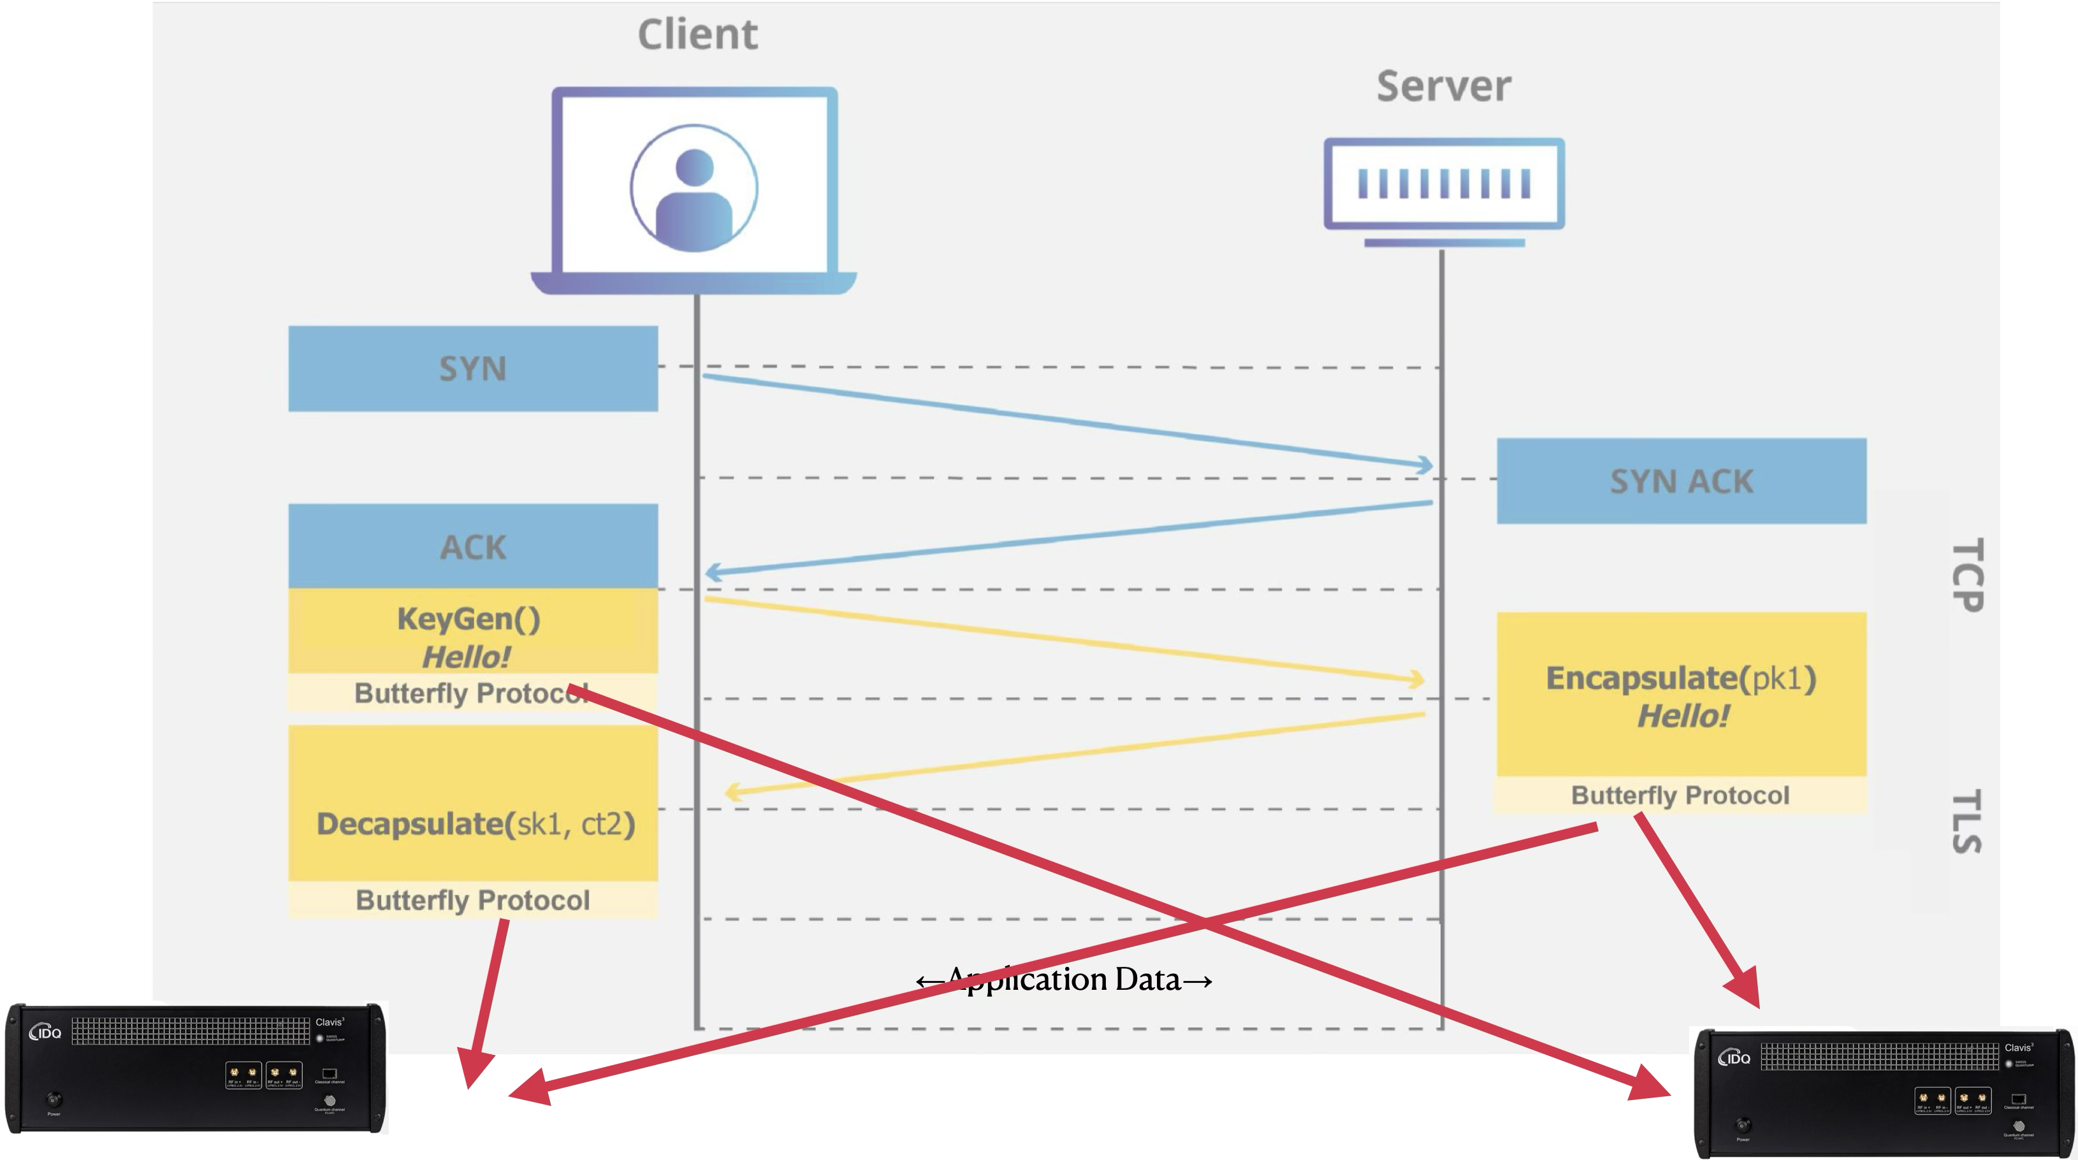
Butterfly Protocol as KEM in TLSv1.3

Slide 29
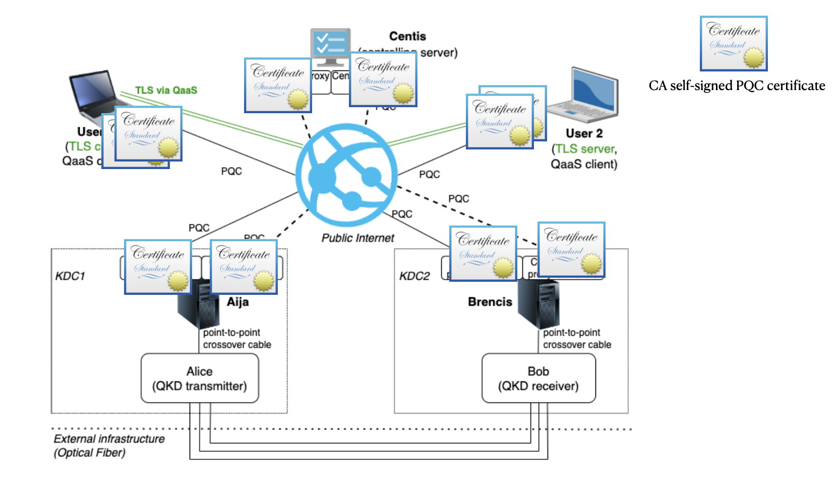
Please do not take technology for granted!

Slide 30
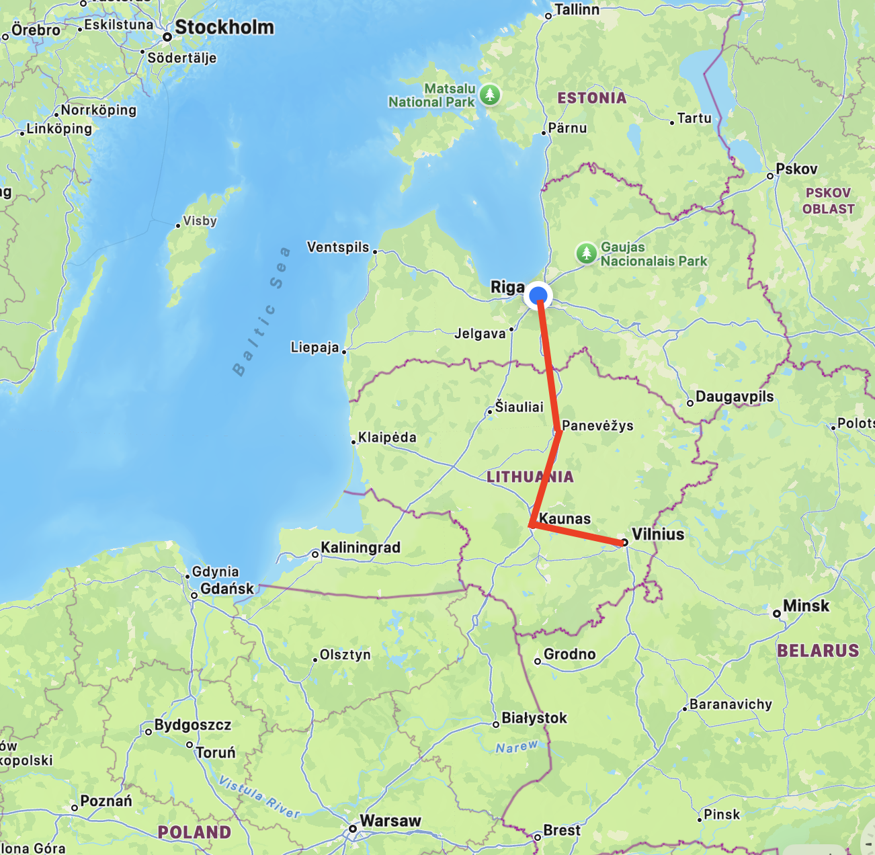
Further Projects
Lat-LitQN:
Riga (LV) - Kaunas (LT) - Vilnius (LT)
with the ability to connect to Poland
Quantum Shield for Data:
Quantum-Secure Access to the Cloud
Quantum-Secure Backups for Data

Slide 31
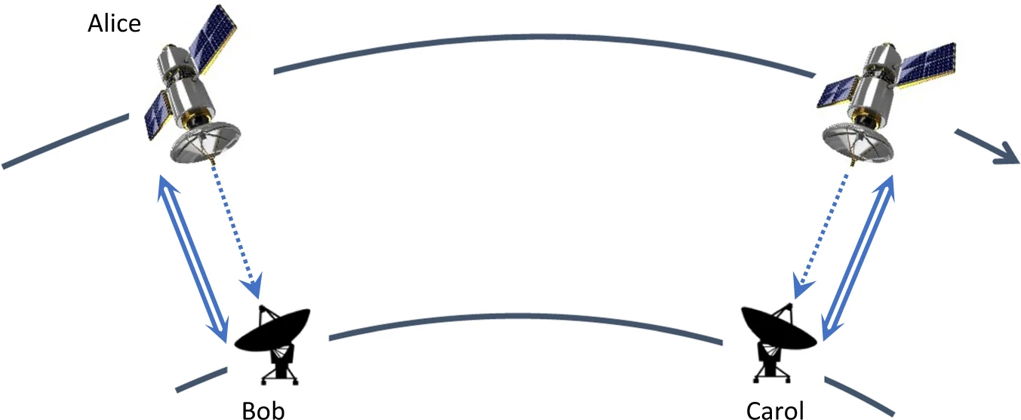
Satellite QKD?
Satellites could help establish long-distance QKD without the need for trusted nodes.
Entanglement-based protocols can be utilised (although quantum memory is required in some cases).
We and the satellites:
During 1997-1999, IMCS UL operated an international satellite channel between IMCS UL (LV) and Crawford Communications (US)
During the Lat-LitQN project, we are going to do research on QKD via satellites
Huttner, B., Alléaume, R., Diamanti, E. et al. Long-range QKD without trusted nodes is not possible with current technology. npj Quantum Inf 8, 108 (2022). https://doi.org/10.1038/s41534-022-00613-4

Slide 32
Thank you
Any questions?
sergejs.kozlovics@lumii.lv
imcs@lumii.lv

