Slide 1
Breaking the Mold: Building the Future Cyber Workforce with Non-Traditional Talent
Nathaniel Mendoza – TACC - nmendoza@tacc.utexas.edu
Jennifer Schopf - TACC - jms@tacc.utexas.edu
Jason Zurawski – ESnet – zurawski@es.net

Slide 2
Problem Statement
Increasing the Cyberinfrastructure workforce is challenging
Finding and retaining talent is highly competitive, and requires careful thought on ways to cultivate and encourage individuals
This must go beyond the methods that are commonly used through traditional university education.
Breaking the Mold: Building the Future Cyber Workforce with Non-Traditional Talent

Slide 3
Problem Statement
The Technology Training for Non-Traditionals (TNTs) program seeks to increase the cyberinfrastructure workforce with participants who have followed non-traditional paths to their chosen field.
This experience will create a future that is brighter together through mentoring, hands-on experience with advanced networks and systems, and leveraging a broad community of supportive alumni and advocates.
Breaking the Mold: Building the Future Cyber Workforce with Non-Traditional Talent

Slide 4
The International Conference for High Performance Computing, Networking, Storage, and Analysis - SC
Long history, dating back to 1988
Held annually in November
Sponsored by the Association for Computing Machinery (ACM) and the Institute of Electrical and Electronics Engineers (IEEE)
Forum for researchers, engineers, and scientists to present their latest work, exchange ideas, and learn about the latest advances in high-performance computing and related fields.
Breaking the Mold: Building the Future Cyber Workforce with Non-Traditional Talent

Slide 5
What is different about SCinet?
It has an exhibition where suppliers, researchers, and funding agencies all come together
It has contributors that compete to provide products and services, but work together to create a solution for SCinet
opportunities for interoperability exploration
It has a great set of people working together to create this solution
Breaking the Mold: Building the Future Cyber Workforce with Non-Traditional Talent

Slide 6
SC by the Numbers
Attendees
SC24: 18,830 (Atlanta)
SC23: 14,295 (Denver)
SC22: 11,830 (Dallas)
SC21: 6,694 (St Louis, hybrid)
SC20: 7,446 (Virtual)
SC19: 13,918 (Denver)
SC18: 13,029 (Dallas)
490+ exhibitors
250+ Technical Sessions, Workshops, and Birds of a Feather sessions
800+ total Volunteers SC24 wide
Breaking the Mold: Building the Future Cyber Workforce with Non-Traditional Talent

Slide 7
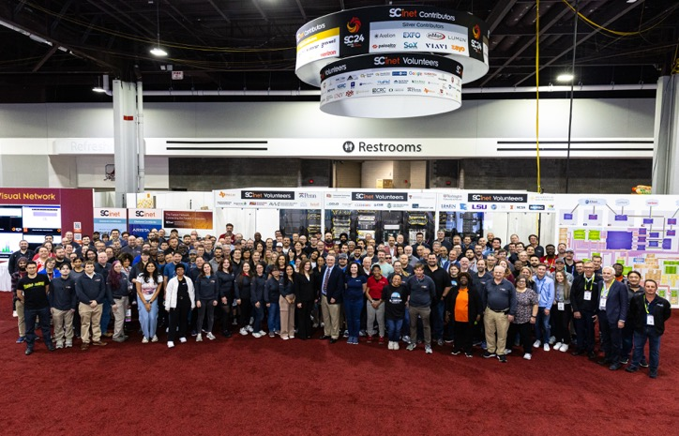
What is SCinet?
1 year to design, 1 month to build, 1 week to operate, 1 day to teardown
SC24 Statistics
200 volunteers
8 countries and 34 states represented
114 different organizations from around the world
36 contributors loaning $47M in hardware, software, and services
9445#’s of Loaned Hardware
8.41Tbps of wide area network capacity on 27 circuits
Includes 18 x 400Gbps connections
450+ Wireless Access points deployed
35.5+ miles of fiber optic cable installed
798 Optics
511 Helpdesk Tickets
Breaking the Mold: Building the Future Cyber Workforce with Non-Traditional Talent
7

Slide 8
SCinet Challenges
All volunteer team
Almost all of our hardware is donated
Supply chain is a big factor
Extremely tight timeline.
Customer service and performance troubleshooting until end of show
Breaking the Mold: Building the Future Cyber Workforce with Non-Traditional Talent
8

Slide 9
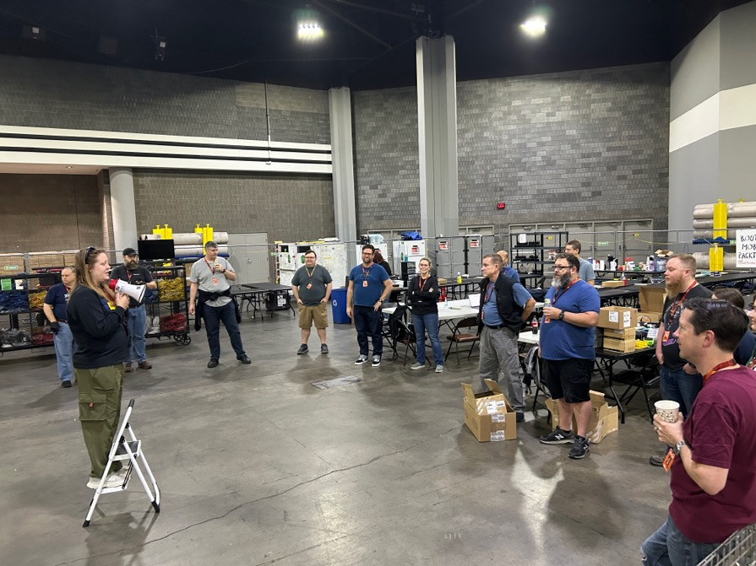
What do 200+ people do?
SCinet is made up of 18 different teams with diverse skills sets
Automation
Cluster
Communications
Contributor Relations
DevOps
Edge
Fiber
Help Desk
INDIS
Logistics
Network Research Exhibition
Network Security
Physical Security
Power
Project Management
Routing
Volunteer Services
WAN Transport
Breaking the Mold: Building the Future Cyber Workforce with Non-Traditional Talent
9
Notes:
finance, physical security, digital experience

Slide 10
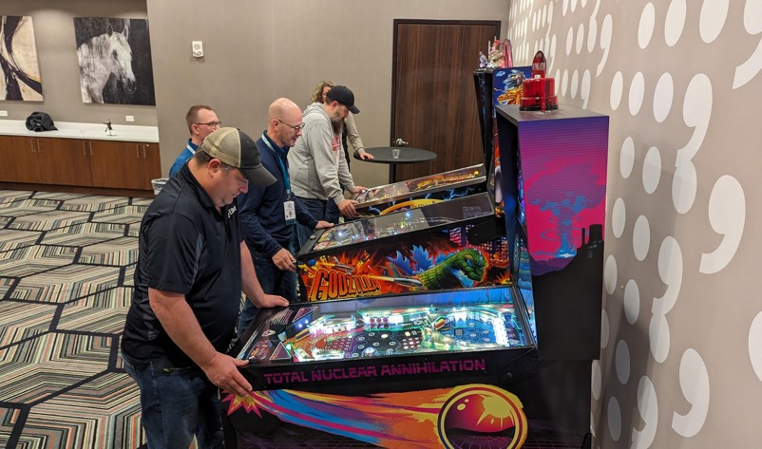
What Do Volunteers Get?
Experience building a network from the ground up
Work on latest technology from vendors
Working with a diverse set of vendors and technologies.
Large professional network of the best network engineers
Breaking the Mold: Building the Future Cyber Workforce with Non-Traditional Talent

Slide 11
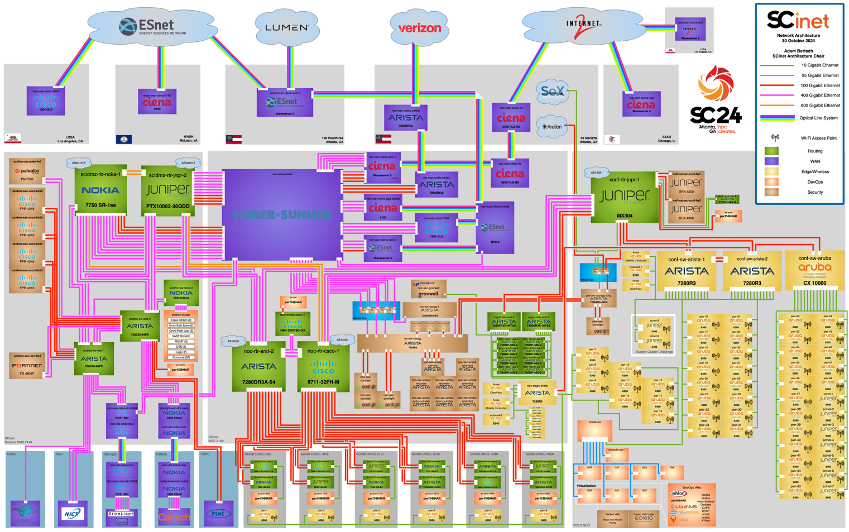
Breaking the Mold: Building the Future Cyber Workforce with Non-Traditional Talent

Slide 12
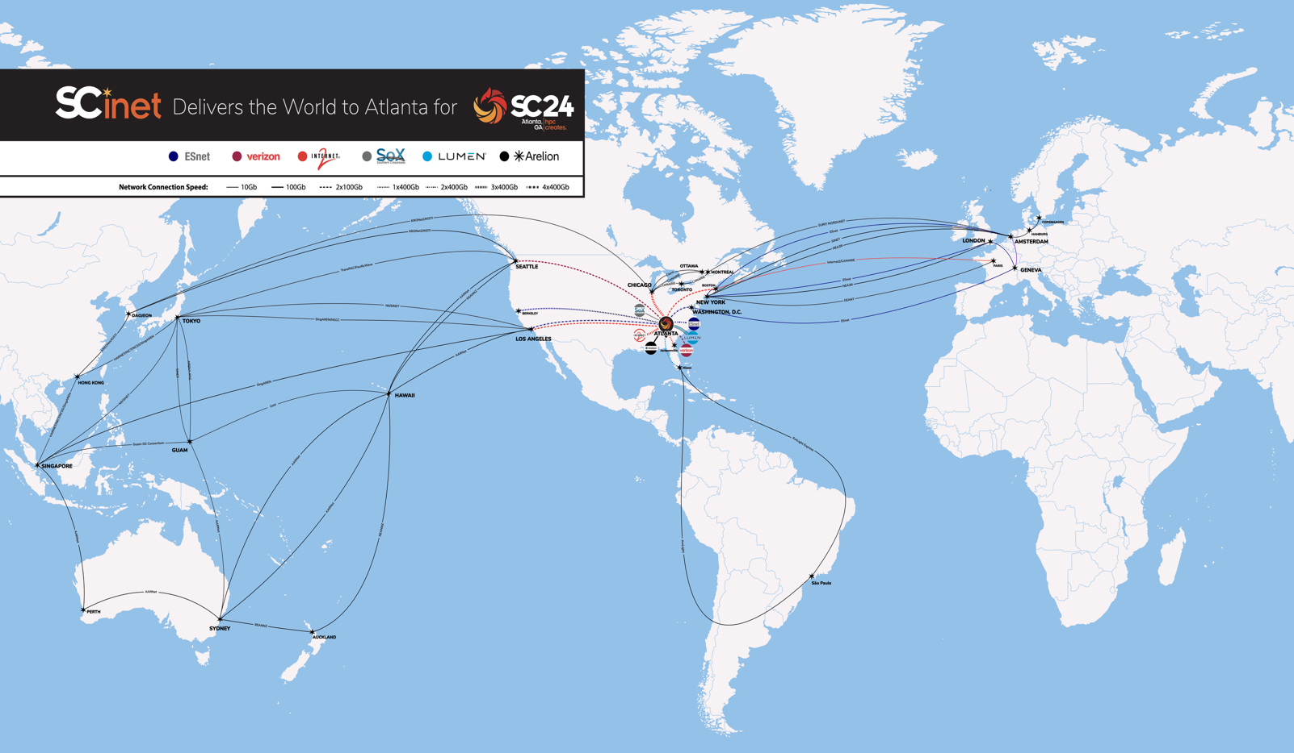
Breaking the Mold: Building the Future Cyber Workforce with Non-Traditional Talent

Slide 13
Experiences at SCinet
36 Applied for TNT at SC24 in Atlanta.
3 were accepted
2 participated (one had to withdraw for personal reasons)
Attendees:
Danika Anderson-Gary – Contributor Relations Team
Halli Hewett – Edge Networking Team
Breaking the Mold: Building the Future Cyber Workforce with Non-Traditional Talent

Slide 14
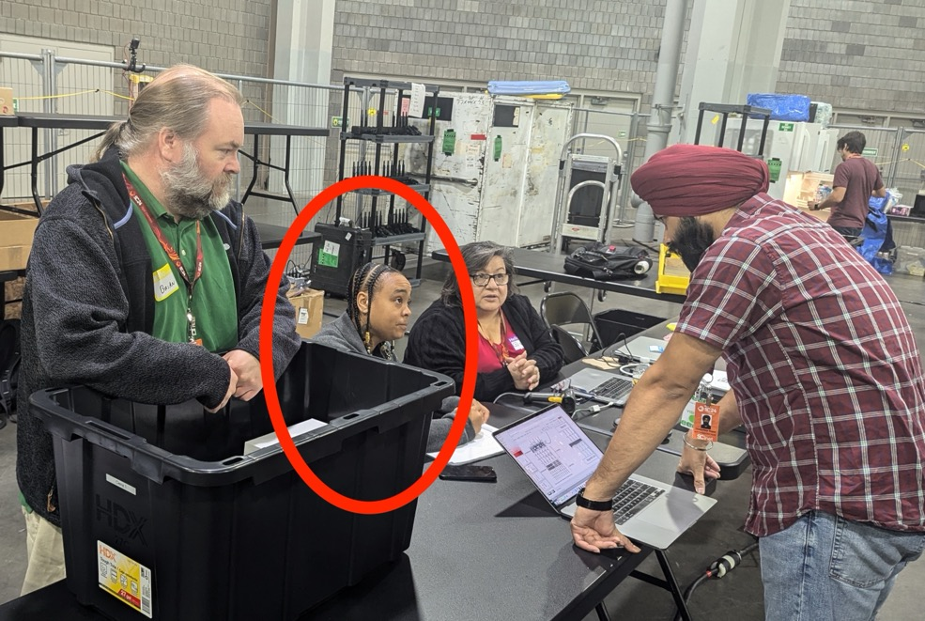
Experiences at SCinet - Danika
Background: Single mother and fraud analyst for financial services company.
Technical Experience: Some Python programming
SCinet Responsibilities: Inventory of loaned equipment, interactions with engineers and marketing professionals.
Breaking the Mold: Building the Future Cyber Workforce with Non-Traditional Talent

Slide 15
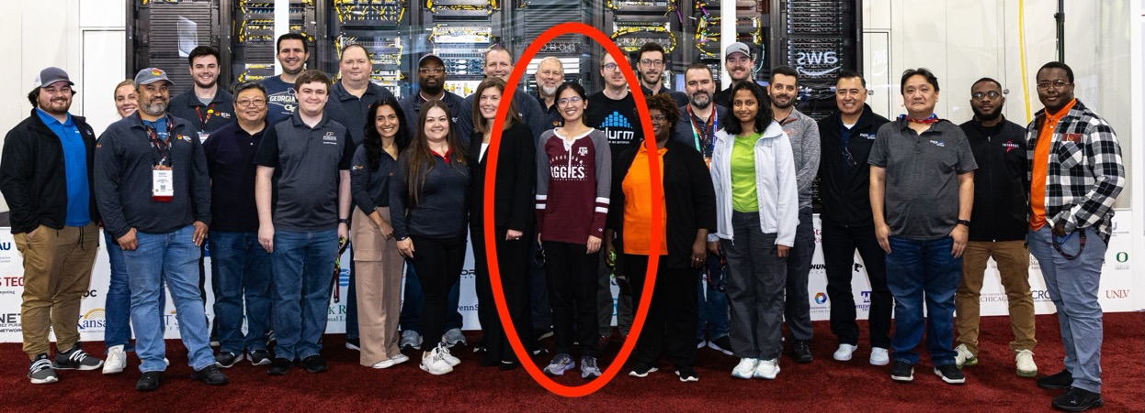
Experiences at SCinet - Hallie
Background: Barista. 1st generation citizen and 1st year college student at Texas A&M.
Technical Experience: Industrial Management, some Cybersecurity
SCinet Responsibilities: Deployment and operation of wireless infrastructure. Troubleshooting connectivity for attendees
Breaking the Mold: Building the Future Cyber Workforce with Non-Traditional Talent

Slide 16
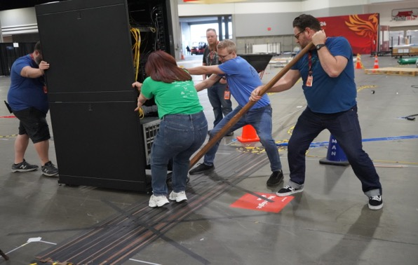
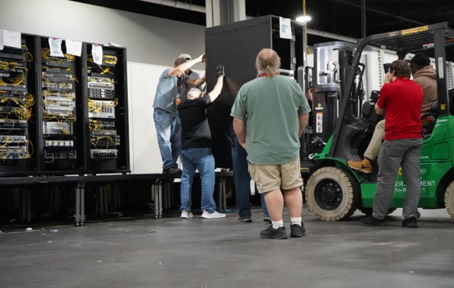
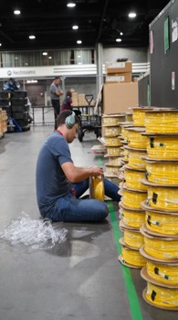
Experiences at SCinet
Both attendees appreciated the ability to work with technology through emersion
Experience was overwhelming at first – had no background and received a lot of coaching
Breaking the Mold: Building the Future Cyber Workforce with Non-Traditional Talent

Slide 17
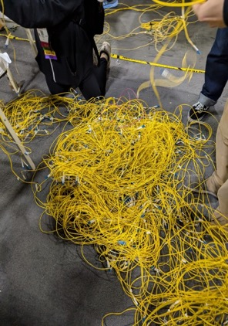
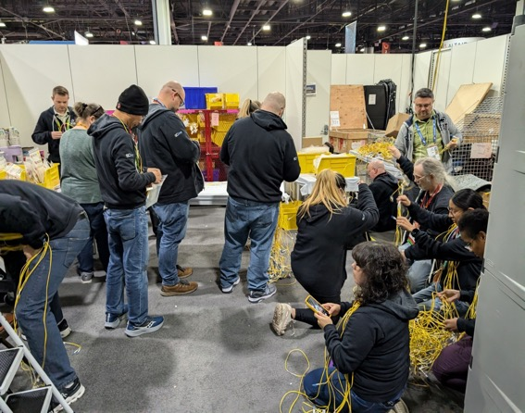
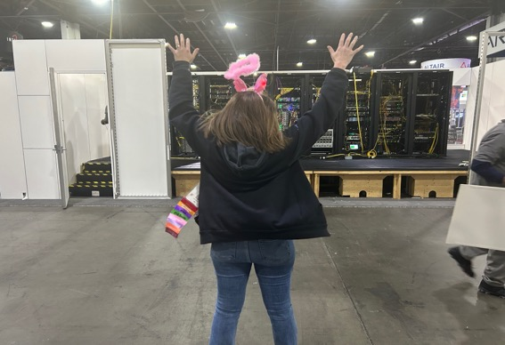
Experiences at SCinet
Hard to be on site for more than a couple of days due to work / school / personal circumstances
Both would return if they were able to get time away
Breaking the Mold: Building the Future Cyber Workforce with Non-Traditional Talent

Slide 18
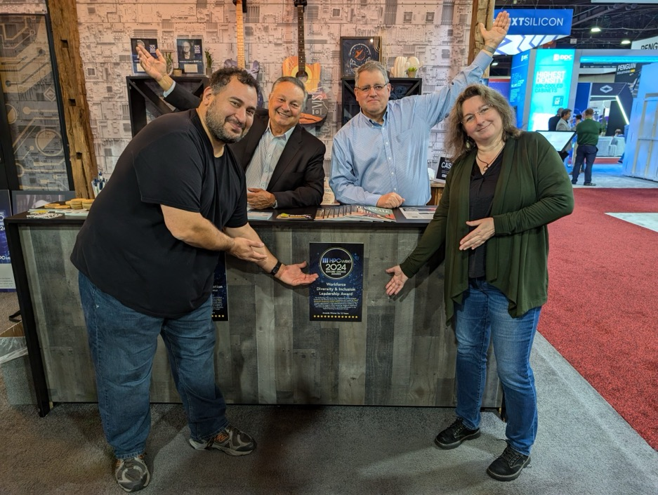
Breaking the Mold: Building the Future Cyber Workforce with Non-Traditional Talent

Slide 19
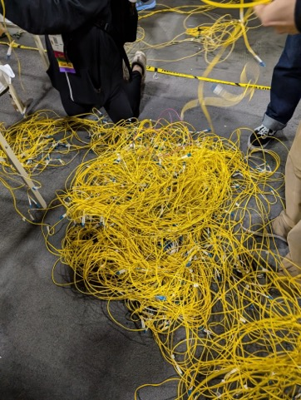
SCinet Teardown
Show Floor closes ~3pm Thursday
NOC emptied out and all crates and boxes are moved into the space
Show Floor Friday 8am
Factory reset equipment
Remove all patches
de-energize, remove from rack, inventory, pack up, ship.
Commodity network must remain live till conference closes at Noon.
SC24 a small portion must remain live until 3pm for digital experience
SCinet Onboarding

Slide 20
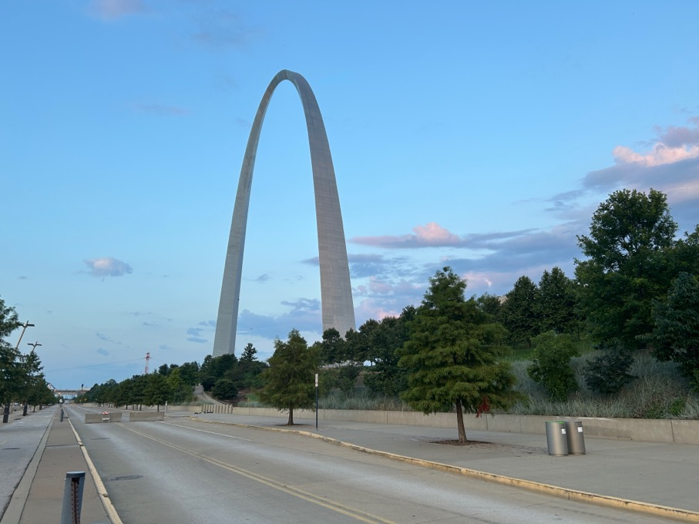
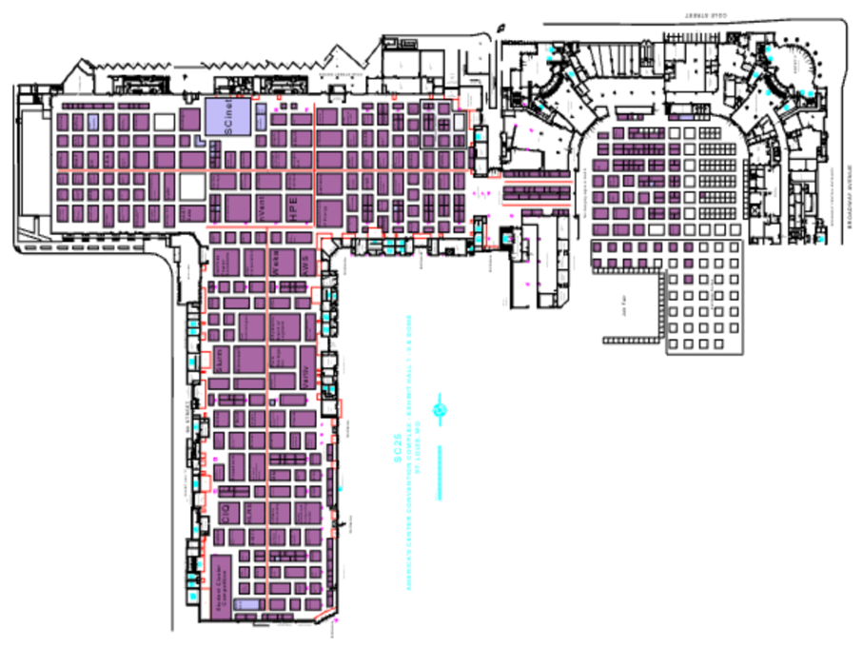
Looking Forward to SC25
Breaking the Mold: Building the Future Cyber Workforce with Non-Traditional Talent

Slide 21
TNT Expectations
Accepting 2-4 participants
Call is still open, and receiving applications
Building upon the experiences from Danika and Hallie
Virtual training via TACC in HPC-affiliated technologies
Sharing experiences with SCinet and students at UT Austin
Breaking the Mold: Building the Future Cyber Workforce with Non-Traditional Talent

Slide 22
Questions
Thank You!
Breaking the Mold: Building the Future Cyber Workforce with Non-Traditional Talent

