Slide 1
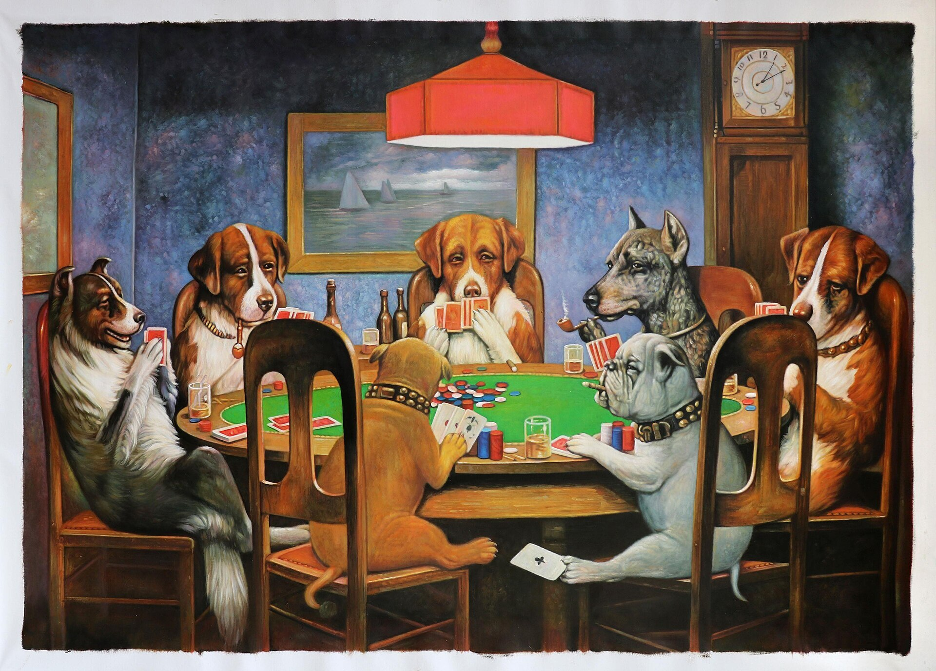
IT’S ALL IN THE CARDS
Mary Friedrich Director, ShareIT and Member Relations, Cybera
Notes:
Please resize the green highlight block so that your entire title fits inside the block. Don’t worry if it needs to go over two lines, just drag it down.

Slide 2
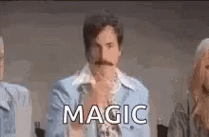
The Magic Formula
04
Notes:
When employees work together to ignite passion and tap into purpose, individual, team, and company performance improve. Building a strong performance culture involves two streams: instituting clear accountability mechanisms and improving employee experience. The goal is to create an enabling, inclusive culture that also has a performance edge.

Slide 3
Vendor meetings
Performance reviews
Projects
KPIs/metrics
Budgets
Hiring
Integrations/implementations
Strategic portfolio/road mapping
Scheduling
Approvals
ONE-TO-ONE DIALOGUE
Notes:
Organization results are impacted by engaging and retaining employees…. One person at a time. There is no easy way around it. If you want to increase talent results for your organization, department, or team, you must take action at the individual employee level.
This is why one to one dialogue is the foundation of engaging and retaining employees. It creates the opp ffor you to really understand what

Slide 4
The Framework: One-to-one Dialogue
WHAT
WHY
ACTION
REALITY

Slide 6
keeppeople.com

Slide 8
3 Simple Steps
Lay out the cards
The sorting
Employee driven talent action plan
Notes:
Engagement and Retention Cards® help managers and individuals identify the key drivers impacting performance, engagement, development, retention, and the drivers impacting implementing strategic initiatives to achieve goals.
Each person has a set of “most critical” needs, which when achieved within their current work situation causes them to engage, perform at their best, develop, and want to stay at the organization.

Slide 9
Lay out the cards

Slide 11
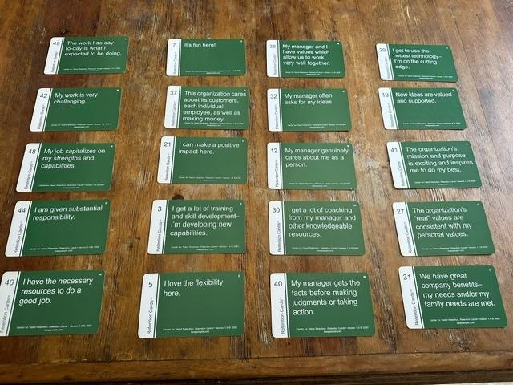
W E M O
W = The work
E = Work environment
M = Managers actions
0 = Organization characteristics

Slide 12
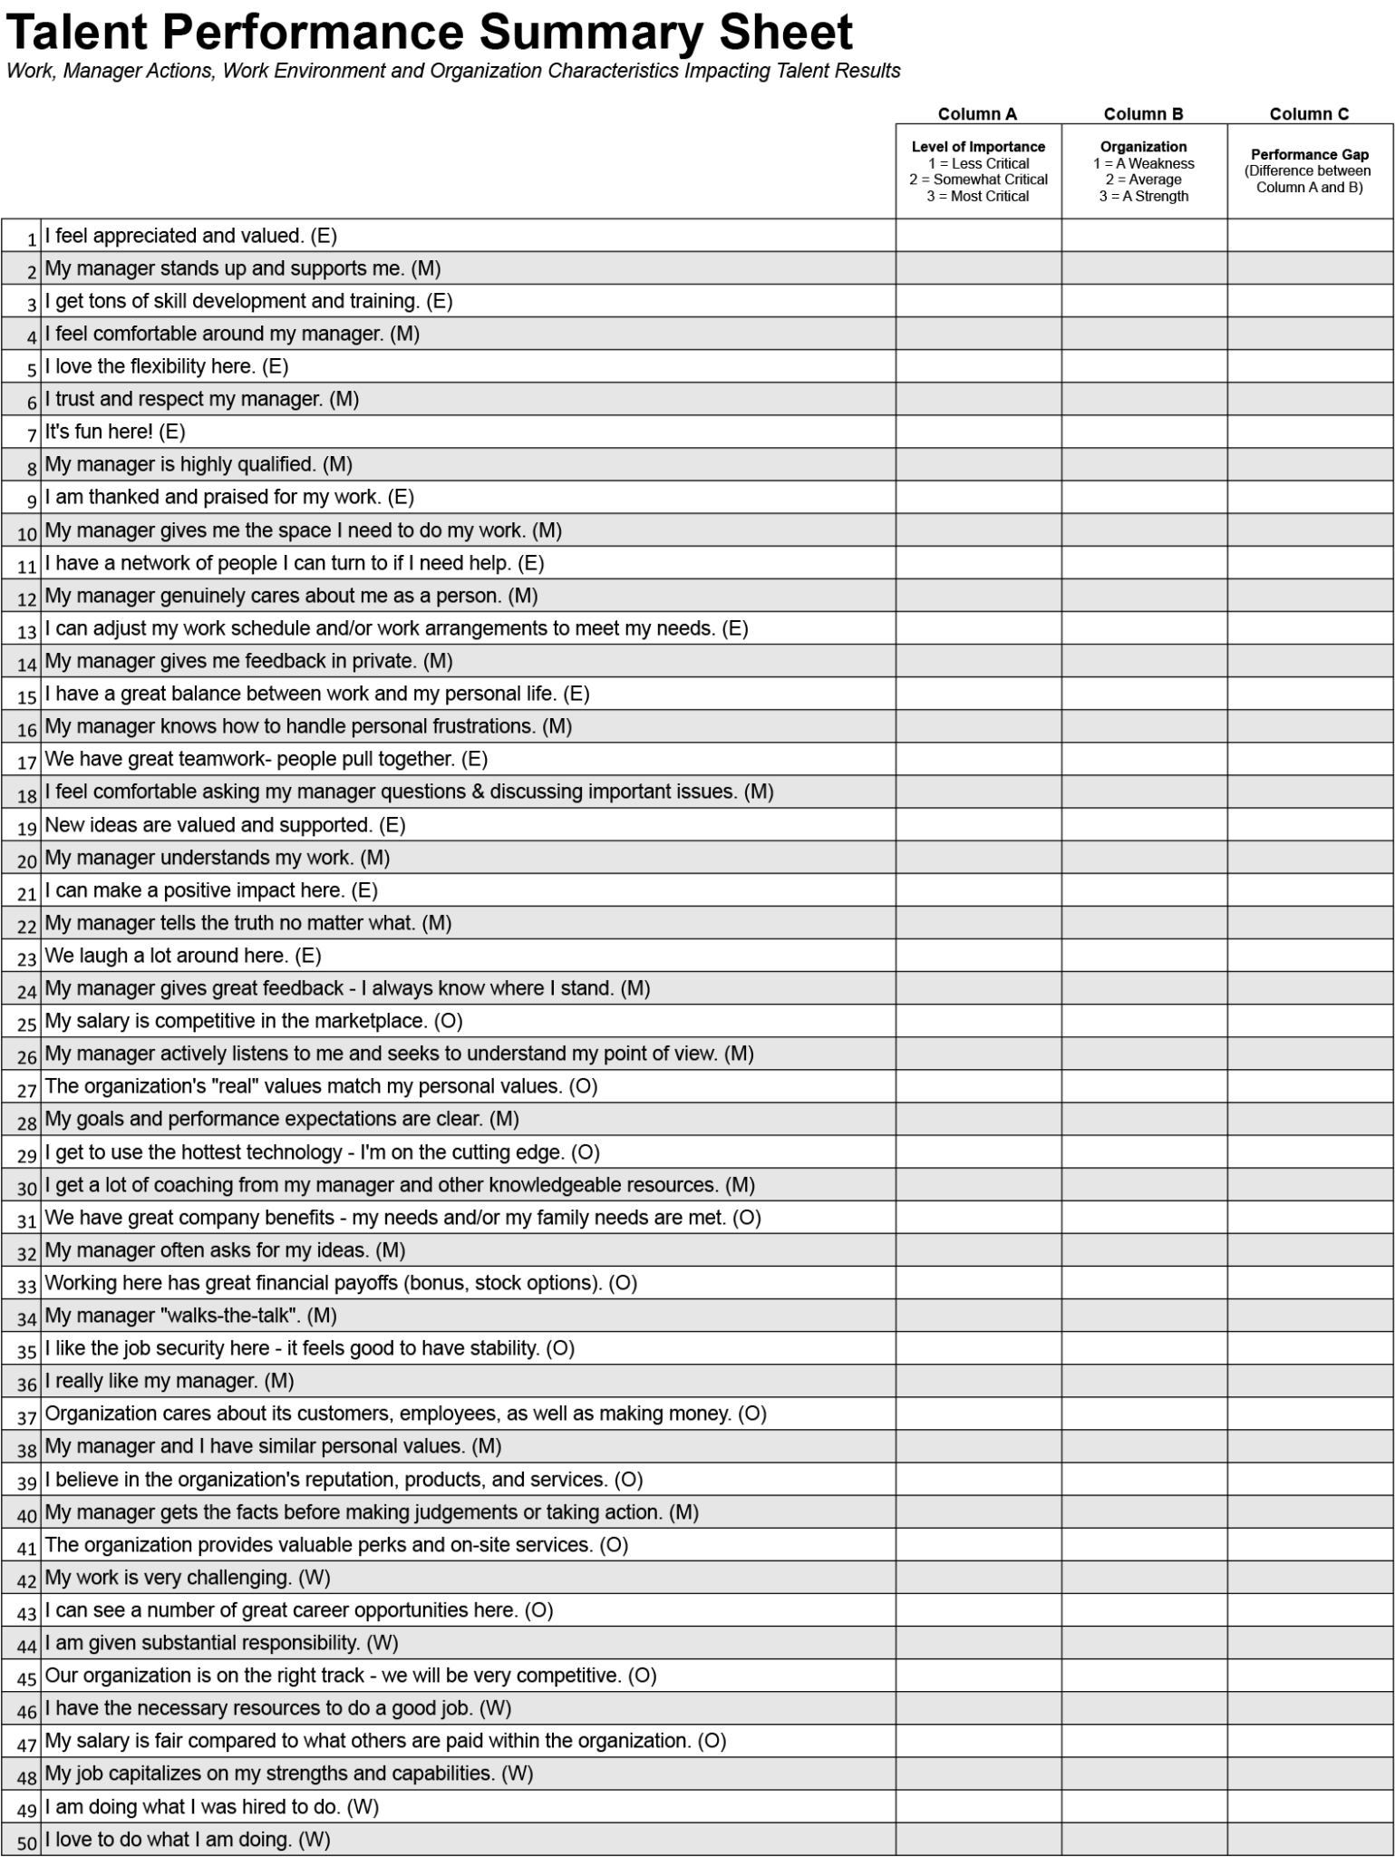

Slide 13
The sorting

Slide 14
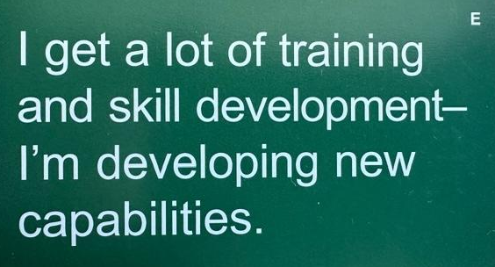
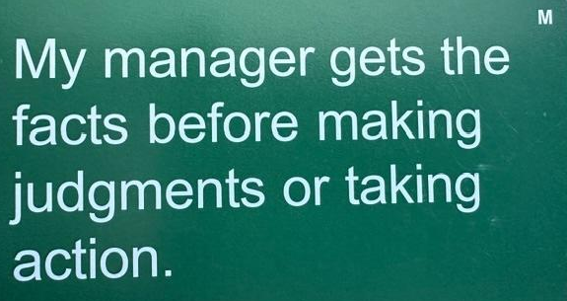
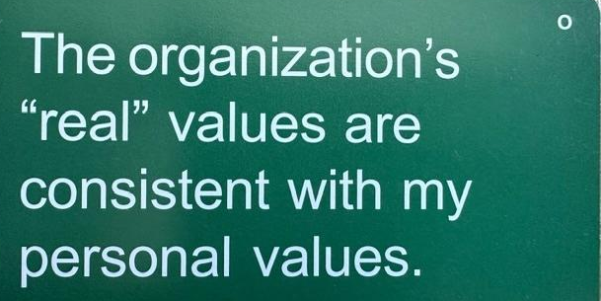
W
E
M
O
Employee ”most critical" needs
What an employee wants out of a job...
The type of work situation each employee prefers...
The relationship an employee desires with his/her manager…
The type of organization an employee wants to be a part of…
Employee current situation
The work
Manager actions
The work environment
Organization characteristics
FIT
Notes:
#4 Most Critical Needs
Leaders use the TALENT Drivers to understand that each person has a set of “most critical” needs that determine how they engage, perform, develop, and want to stay

Slide 15
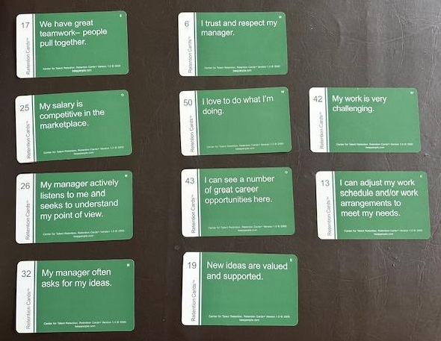

Slide 16
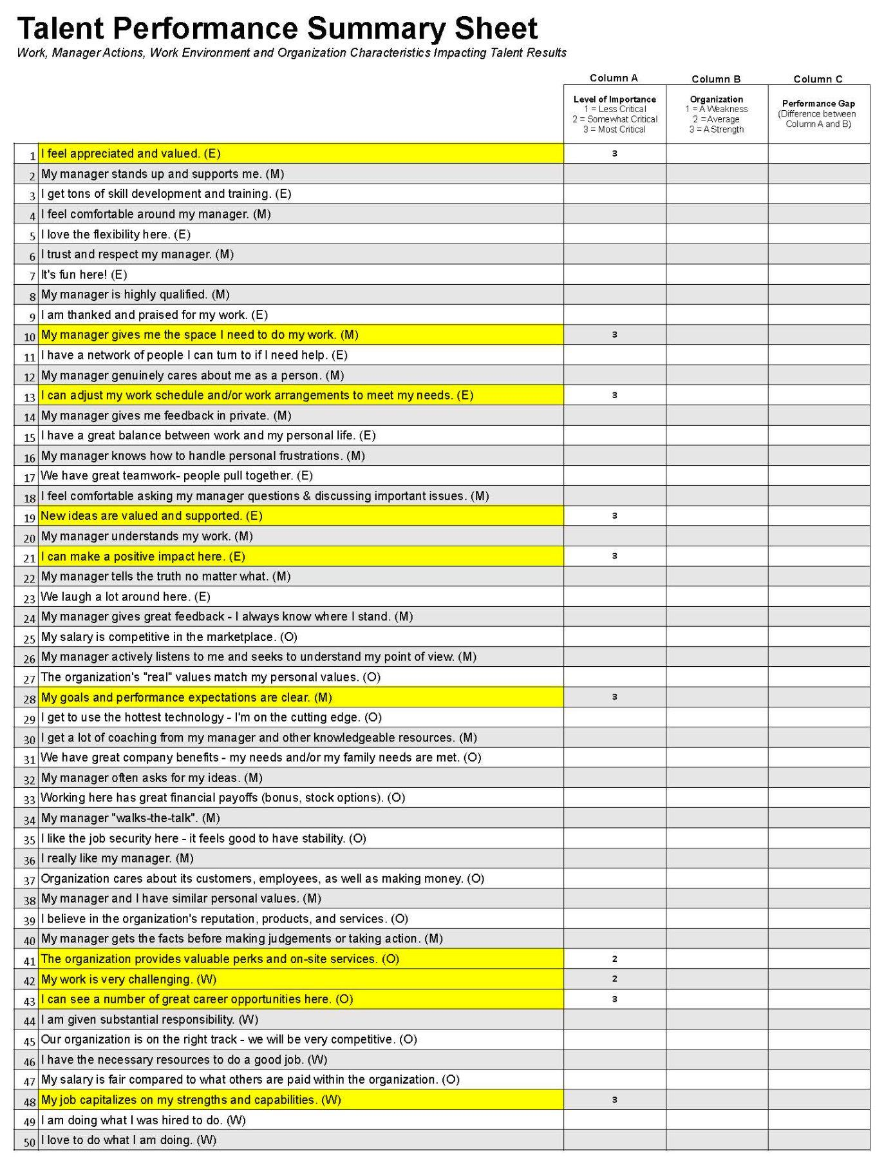
WHAT
WHY
ACTION
REALITY

Slide 17
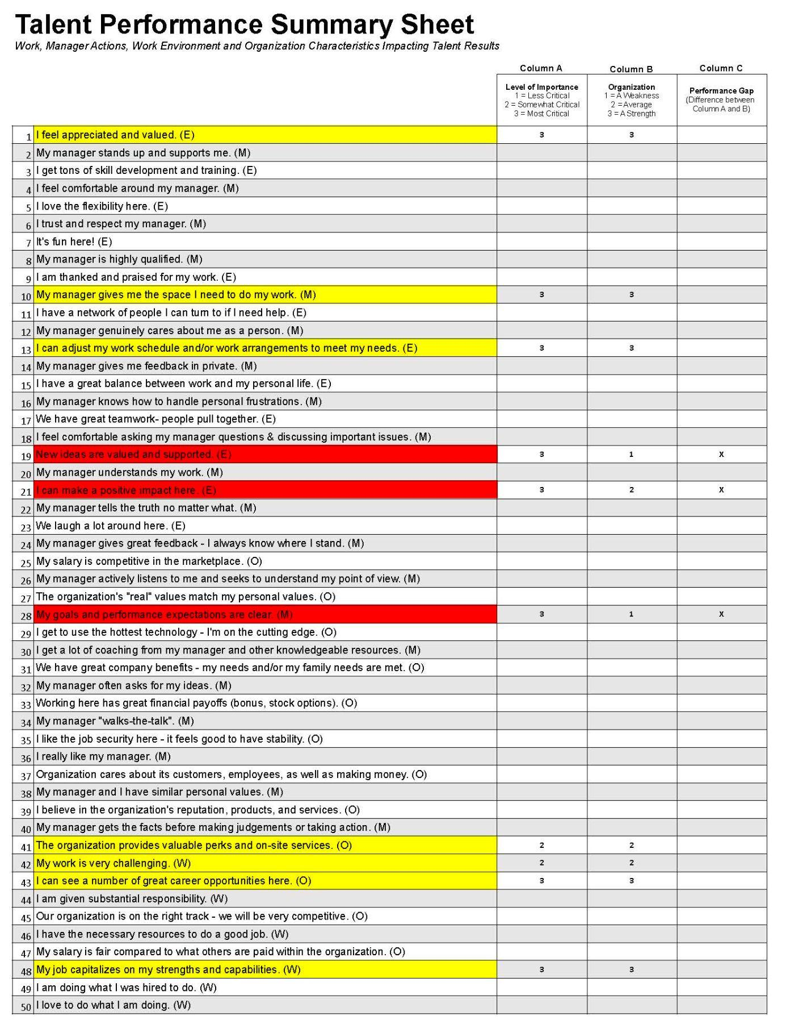
WHAT
WHY
ACTION
REALITY

Slide 18
The action plan

Slide 19
Developed for: Jane Doe Date: June 18, 2024
The Current Situation Record the team member’s ‘most critical’ needs and the current performance
Most Critical Needs | Current Performance (Strength, Average, Weakness)
(19 - E)) My ideas are valued and supported | Weakness
(21 - E) I can make a positive impact here | Average
(28 - M) My goals and expectations are clear | Weakness
(41 - O) The organization provides great perks and on-site services | Average
Key Areas Which Require Action: My ideas are valued and supported My goals and expectations are clear The organization provides great perks and on-site services
Take Action | Involve |  | Manage Expectations
Do the following: Bring two new ideas to team for potential shared IT procurement Create roadmap for member retrospectives and project debriefs 3 month, 6 month and 1 year goals | Work with ________to do the following: Procurement Committee representatives Advisory Committee representatives HR department lead |  | Manage expectations around the following: 4 day work week Flex for summer months - June - September for ½ day Friday off - with additional hour from Monday - Thursday
Team Member Actions What actions can the team member take to increase the performance around his or her ‘most critical’ needs? What is the team member willing to be involved with to make a difference in the current situation? Does the team member understand why we are not able to address the specific performance gap?
Action |  | By When
Book 3 sessions virtually with a member representative from each of the HE sector - College, Polytechnic and University - create a questionnaire and send ahead of the meeting to discuss |  | End of July 2024
Draft proposal for member retrospective sessions - focussing on intent of sessions, value statement, improvement items for contract management |  | End of August 2024
Book initial goal setting session with Manager - co create 3, 6, and 12 month roadmap with KPIs - then bi-weekly check-in sessions |  | July 15, 2024
WHAT
WHY
ACTION
REALITY

Slide 20
The Result
CLARITY
Outline what’s important within their life and work situation
Individual capabilities
SHARE
Openly talk with others about what’s important
ACTION
Take action to make an impact
IMPACT
Individuals
I’m happy, I’m developing, I engage, I want to stay, and I’m healthy
Organization
Deliver results (productivity, quality)
Make changes/innovate Manage costs
Build culture
CARE
Actively show that they care about each person
CONNECT
Connect around the real drivers within life and work
ACTION
Take action to make an impact
Leader capabilities

Slide 21
keeppeople.com

Slide 22
THANK YOU!
Mary Friedrich Director, ShareIT and Member Relations, Cybera
mary.friedrich@cybera.ca
Notes:
Images from www.unsplash.com https://unsplash.com/@wyxina

