Slide 1
Turning Bureaucracy into Trust
The case of going beyond compliance in trustworthy AI development

Slide 3
Necessary Evil
Foundation for Trust

Slide 5
EU AI Act - A long time coming…
we are here
Provisional political agreement after EU Commission published AI Act proposal in April 2021
AI Act is published in OJ and enters into force
Aug 2027
Dec 2023
Jun 2024
Final technical negotiations, formal adoption, and linguistic revision
AI Act applies and is fully enforceable
ENTRY INTO FORCE PHASE
EIF + 36 months (Aug 2027)
AI Act fully applies, incl. high-risk AI duties in Annex II
EIF + 12 months
GAI duties apply
EIF (Jun 2024)
EIF + 6 months
Prohibited AI systems phase-out
EIF + 24 months
AI Act mostly applies, incl. high-risk AI duties in Annex III

Slide 6
AI governance strategy
Human oversight
Risk mitigation
Transparency in AI-generated content
and more…
View our pledge

Slide 7
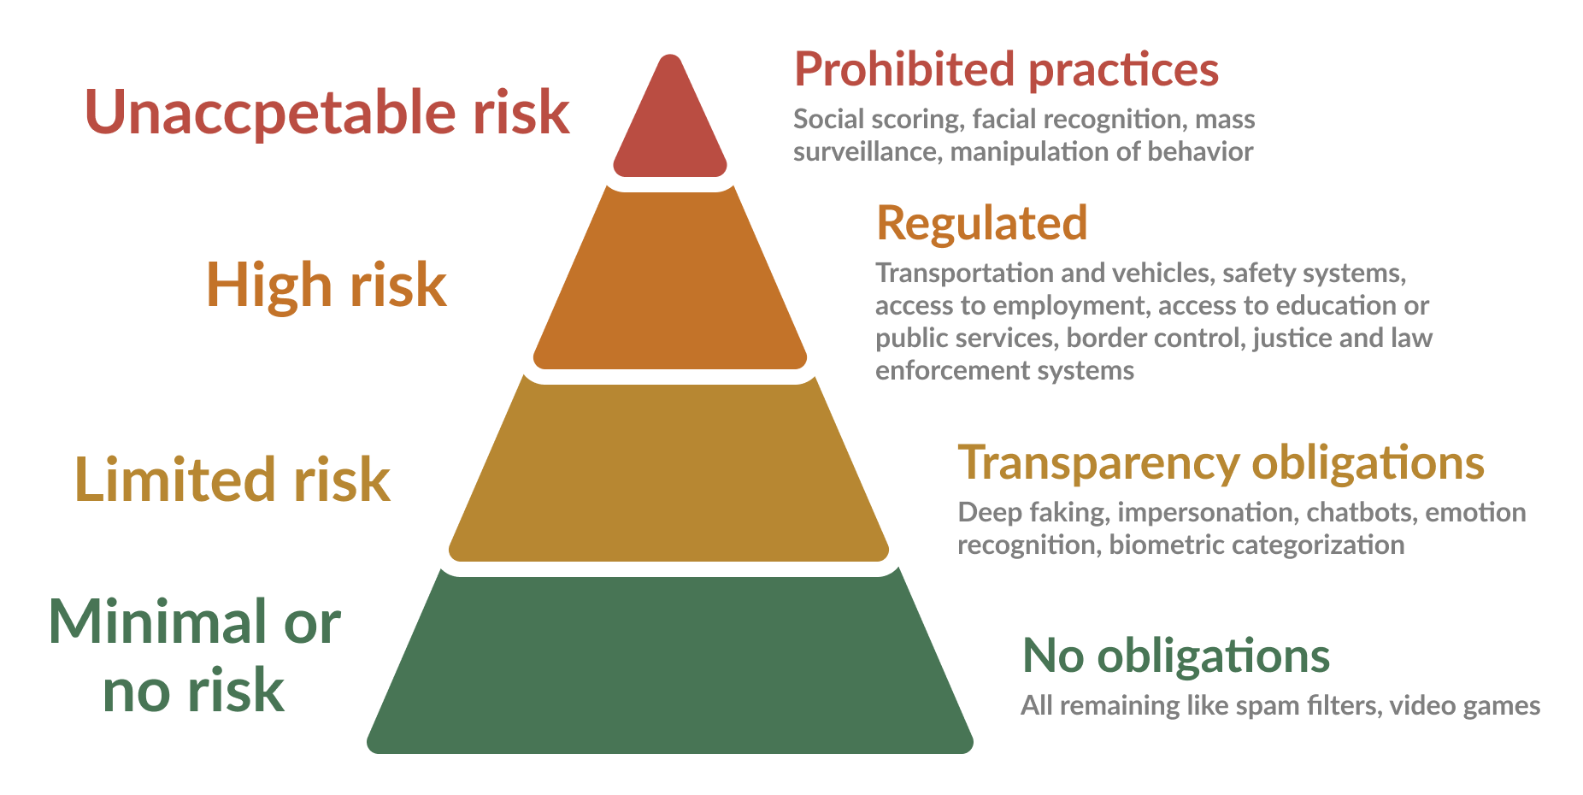
AI Act: A risk based approach

Slide 8
Where does education sit?
Well, it depends…

Slide 9
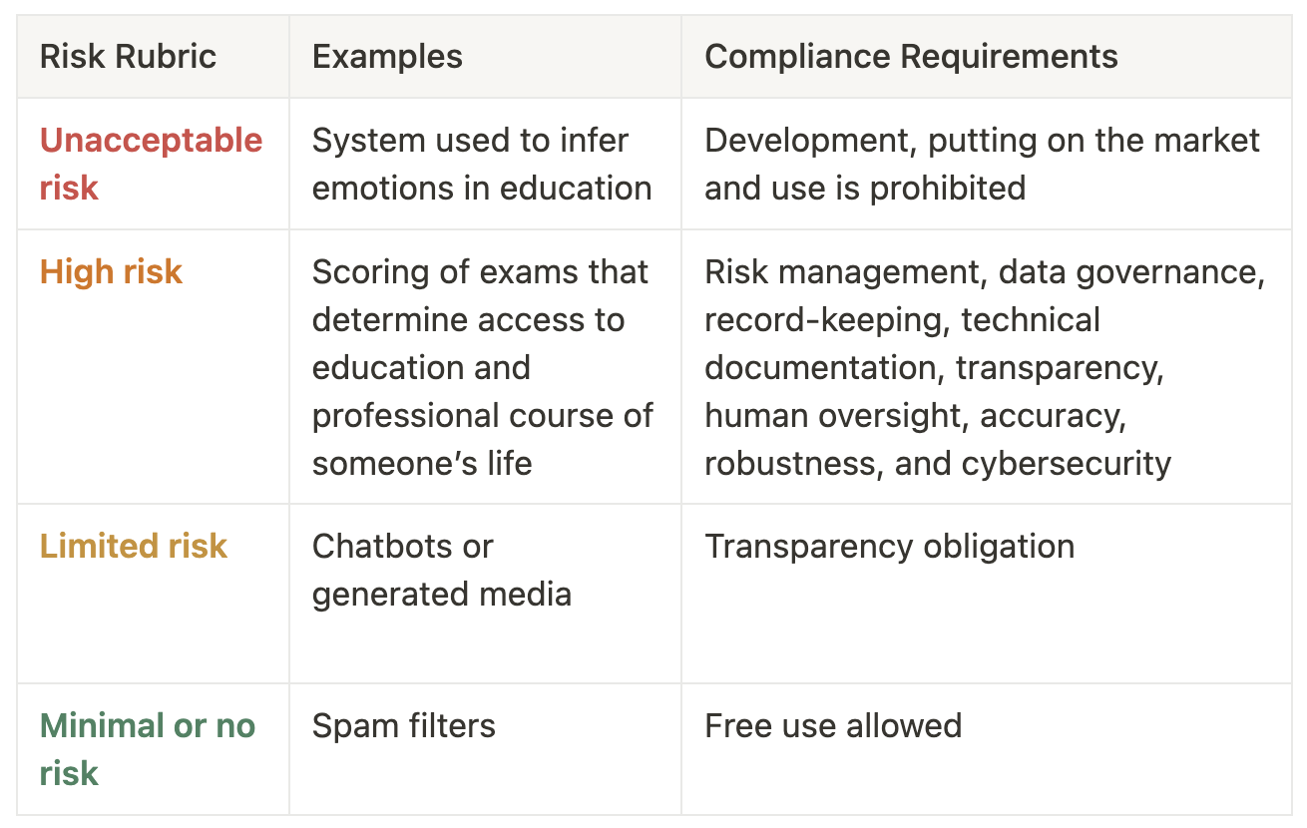
System poses significant risk to health, safety, fundamental rights of any person
System poses risks associated with lack of transparency in AI usage

Slide 10
Unacceptable risk
Article 5 - Prohibited AI Practices
(1)(f) The placing on the market, the putting into service for this specific purpose, or the use of AI systems to infer emotions of a natural person in the areas of workplace and education institutions, except where the use of the AI system is intended to be put in place or into the market for medical or safety reasons
Source: https://eur-lex.europa.eu/eli/reg/2024/1689/oj#d1e1907-1-1
Notes:
Prohibited AI practices
the placing on the market, the putting into service for this specific purpose, or the use of AI systems to infer emotions of a natural person in the areas of workplace and education institutions, except where the use of the AI system is intended to be put in place or into the market for medical or safety reasons;

Slide 11
High risk
ANNEX III, Article 3 - High-risk AI systems referred to in Article 6(2)
Education and vocational training:
(a) AI systems intended to be used to determine access or admission or to assign natural persons to educational and vocational training institutions at all levels;
(b) AI systems intended to be used to evaluate learning outcomes, including when those outcomes are used to steer the learning process of natural persons in educational and vocational training institutions at all levels;
(c) AI systems intended to be used for the purpose of assessing the appropriate level of education that an individual will receive or will be able to access, in the context of or within educational and vocational training institutions at all levels;
(d) AI systems intended to be used for monitoring and detecting prohibited behaviour of students during tests in the context of or within educational and vocational training institutions at all levels.
Source: https://eur-lex.europa.eu/eli/reg/2024/1689/oj#d1e1907-1-1

Slide 12
*
Exceptions if… The AI system doesn't significantly harm people's health, safety, or fundamental rights, including not heavily influencing decision-making. For example:
It performs a small, procedural task.
It improves the outcome of something a human has already completed.
It detects patterns or deviations in decision-making but doesn’t replace or strongly influence the human decision, and a proper human review is still in place.
It helps prepare an assessment related to a high-risk use case, but doesn't make the decision itself.
Notes:
Prohibited AI practices
the placing on the market, the putting into service for this specific purpose, or the use of AI systems to infer emotions of a natural person in the areas of workplace and education institutions, except where the use of the AI system is intended to be put in place or into the market for medical or safety reasons;

Slide 13
The AI Pact in Practice
FeedbackFruits AI design principles for proportional de-risking of applications

Slide 14
AI-assisted grading of student discussion contributions

Slide 15
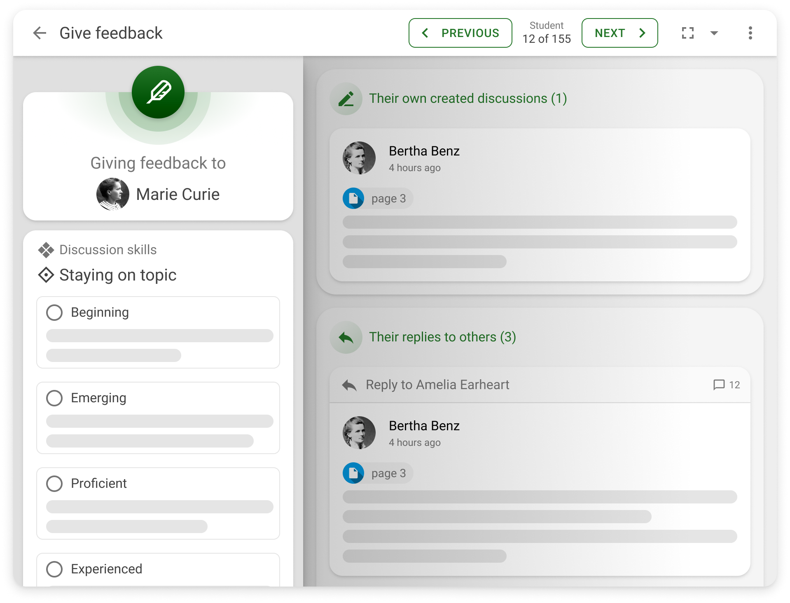

Slide 16
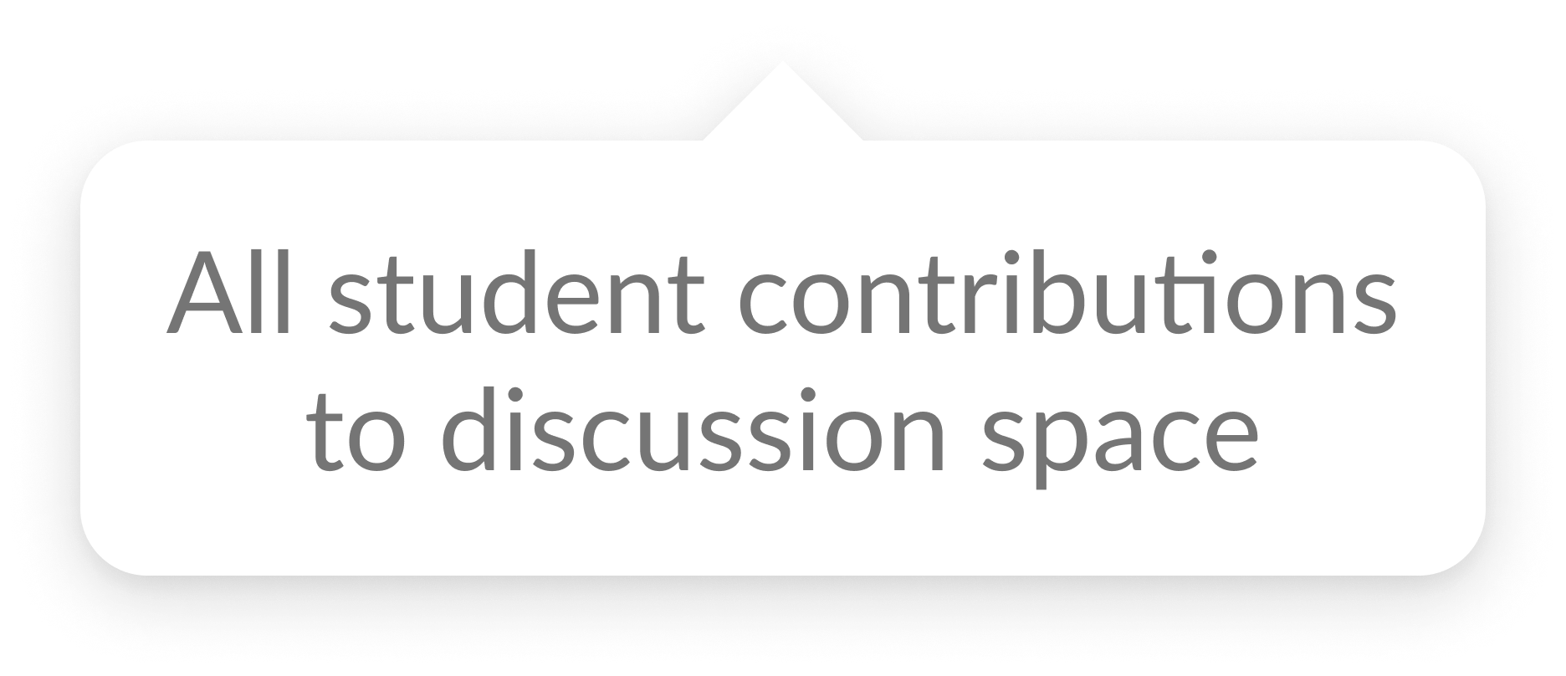

Slide 17
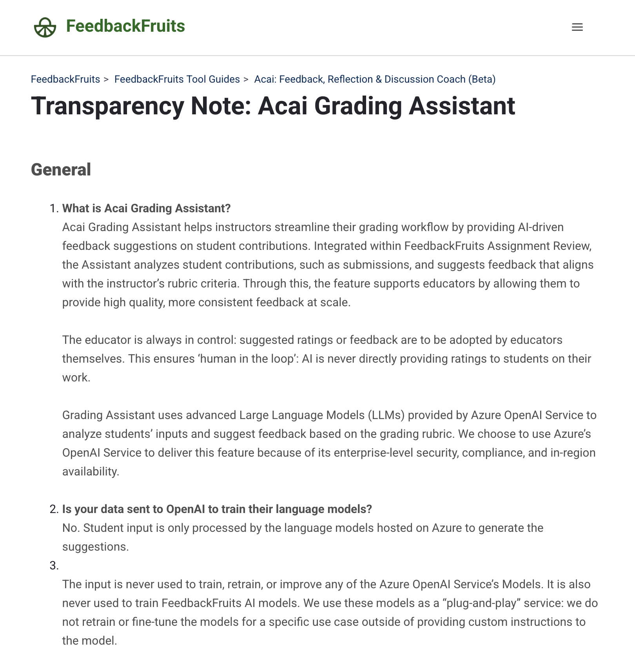
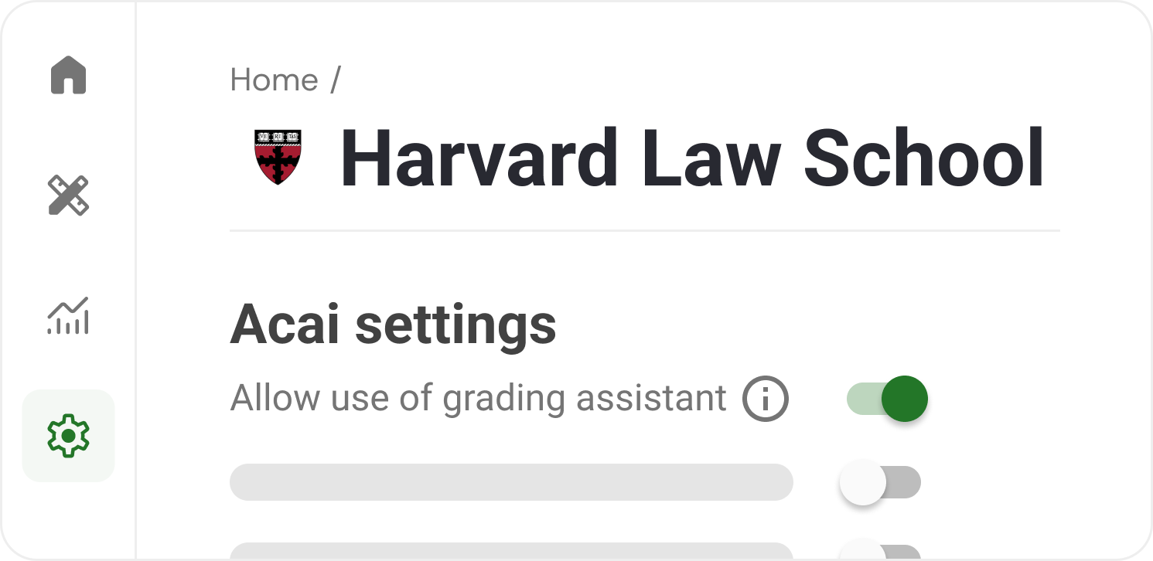

Slide 18
Stakeholder: Institution
Applied principles:
Transparency
Data ownership
Institutional control

Slide 20
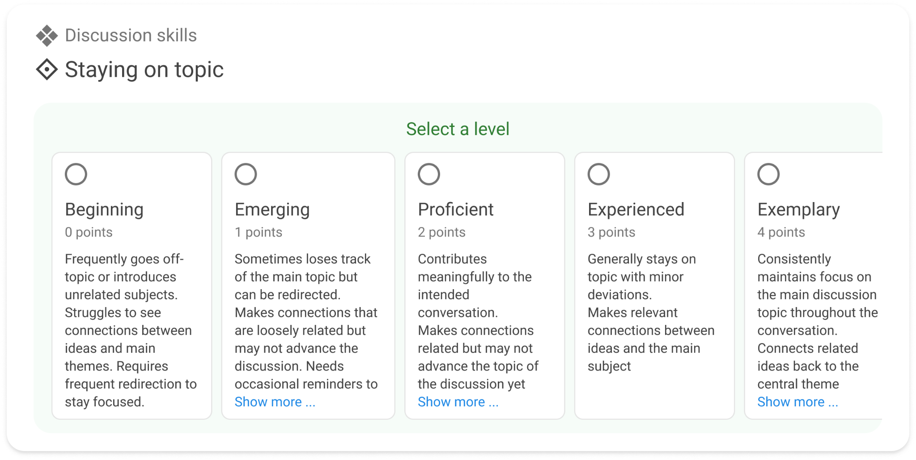

Slide 21
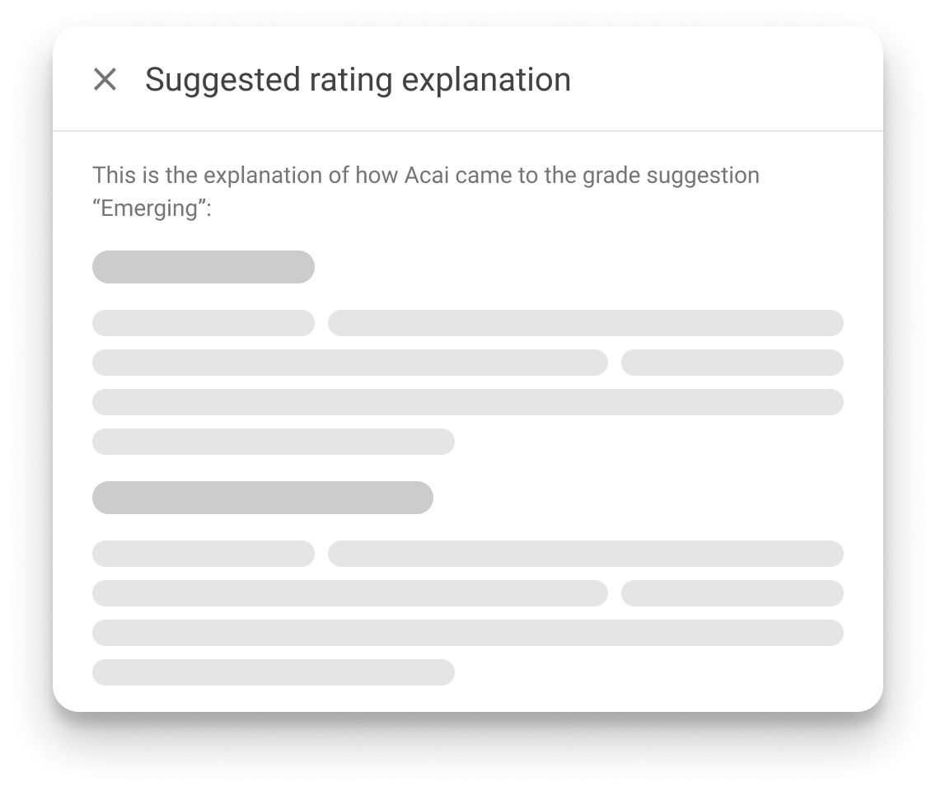
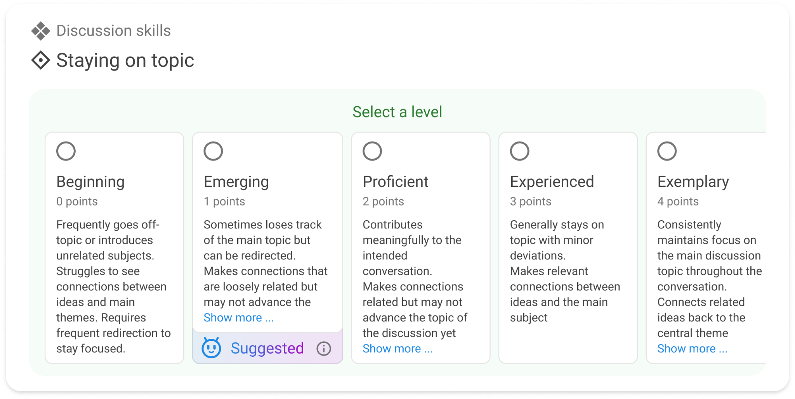

Slide 22
Stakeholder: Teacher
Applied principles:
Transparency
Interpretability

Slide 23
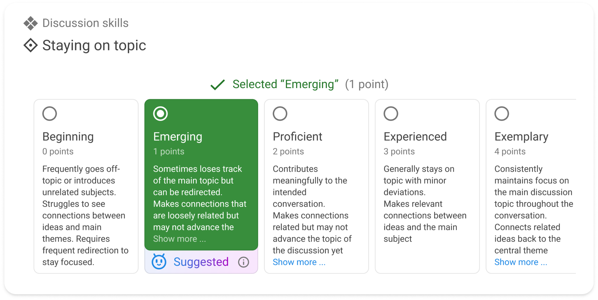

Slide 24
Stakeholder: Teacher
Applied principles:
Human in the loop
Explicit sign-off

Slide 26
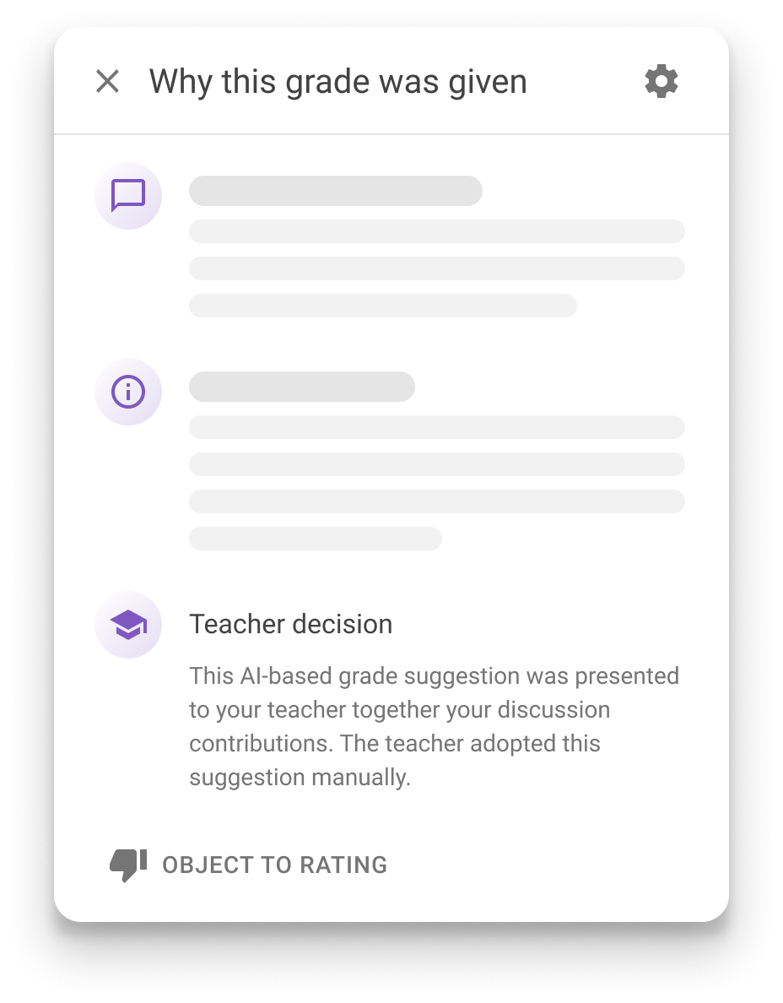
Stakeholder: Student
Applied principles:
Transparency
Interpretability
Right to object

Slide 27
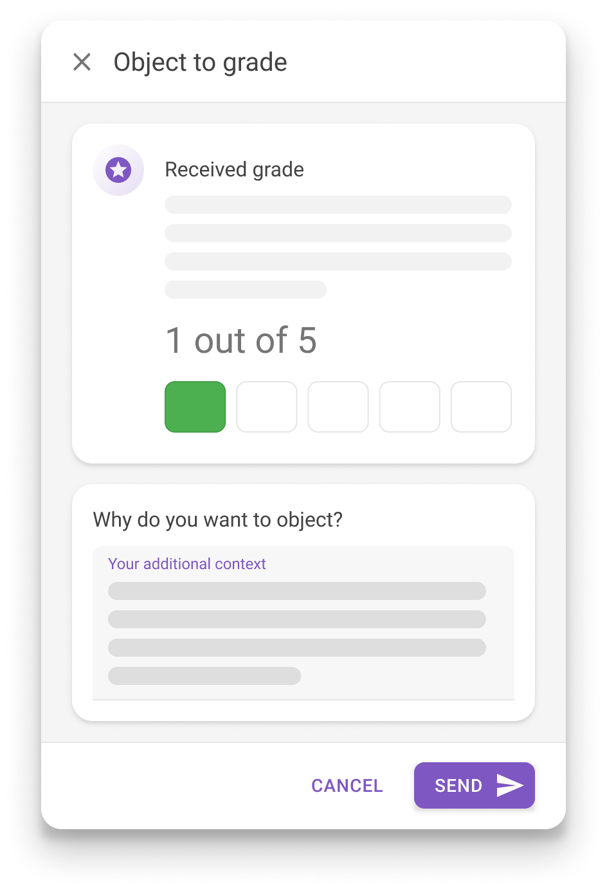
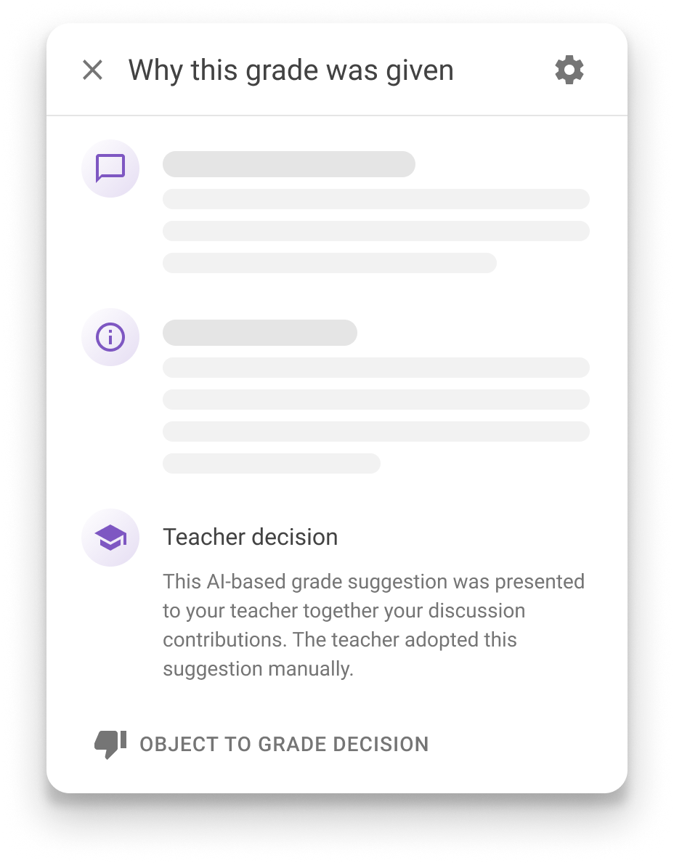

Slide 28
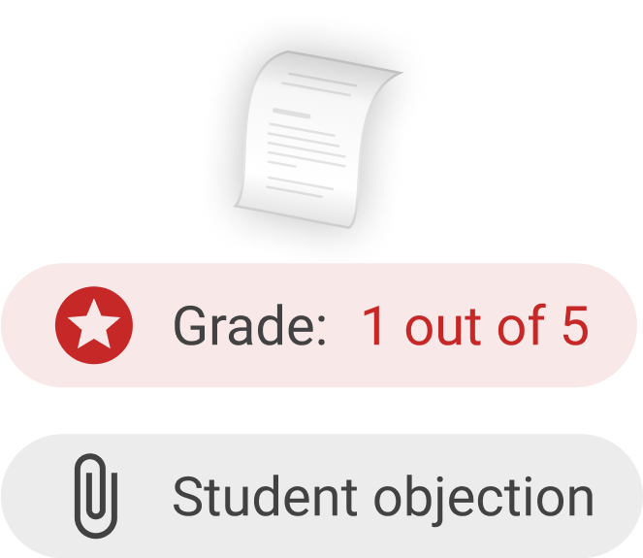

Slide 29
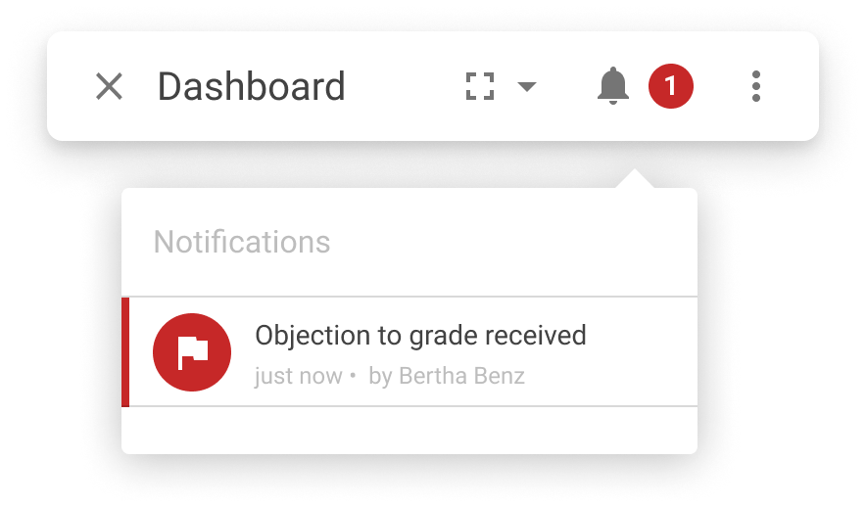

Slide 30
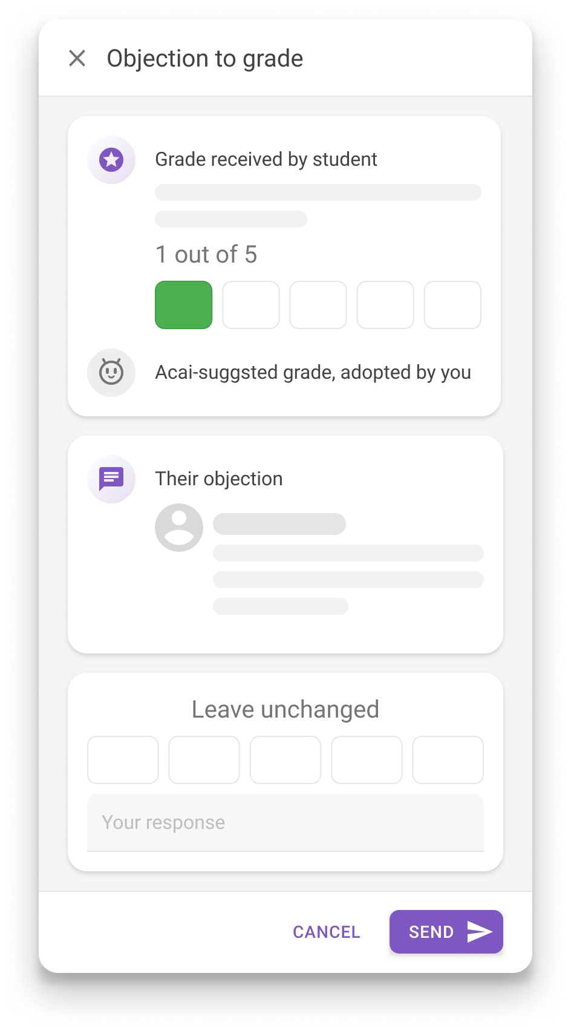

Slide 31
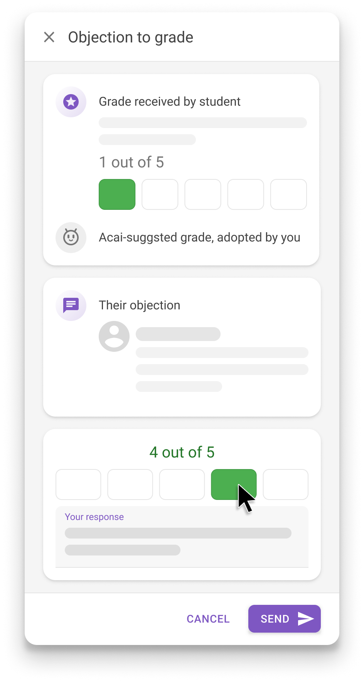

Slide 32
Stakeholder: Teacher
Applied principles:
Student right to object
Human in the loop

Slide 33
Trust
Confidence in commitment and integrity
Compliance
Adherence to standards

Slide 34
Overview of how we strive to build trust
View trust page
In-depth and real-time compliance dashboard
View Trust Center

Slide 37
Thank you!
Any questions or feedback?

