Slide 1
Unlocking the Potential of Network Monitoring Data for Scientific Research
TNC 2025
Gustavo Araújo (RNP)
José Rezende (RNP)

Slide 2
Summary
Introductions
CT-MON Challenges in 2024
Monitoring Tools
What to do with this data?
Some results and lessons learn
Conclussion and Future Work

Slide 3
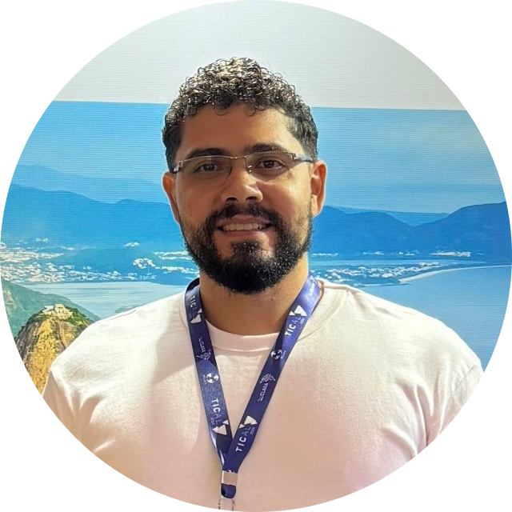
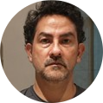
Introductions
Gustavo Araújo
R&D Coordinator at RNP
gustavo.araujo@rnp.br
José Rezende
Academic Advisor at RNP
jose.rezende@rnp.br

Slide 4
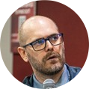
Network Monitoring Technical Committee (CT-MON)
Advisory committee of RNP that brings together network monitoring experts to track technical advances and provide strategic recommendations for the evolution of monitoring services.
Vitor Zanotelli (UFES)
Antonio Aragão Rocha (UFF)
Daniel Neto (RNP)
Giovani Comarela (UFES)
Marcos Schwarz (RNP)
Gustavo Araújo (RNP)
José Rezende (RNP)

Slide 5
Challenges 2024
Develop tools to make that data accessible to external audiences, such as researchers in the networking field
Explore how network monitoring data can actually contribute to scientific research. What can researchers do with this data that truly supports their work?
What actions can we take to encourage researchers to use this data? How to engage the community?

Slide 6
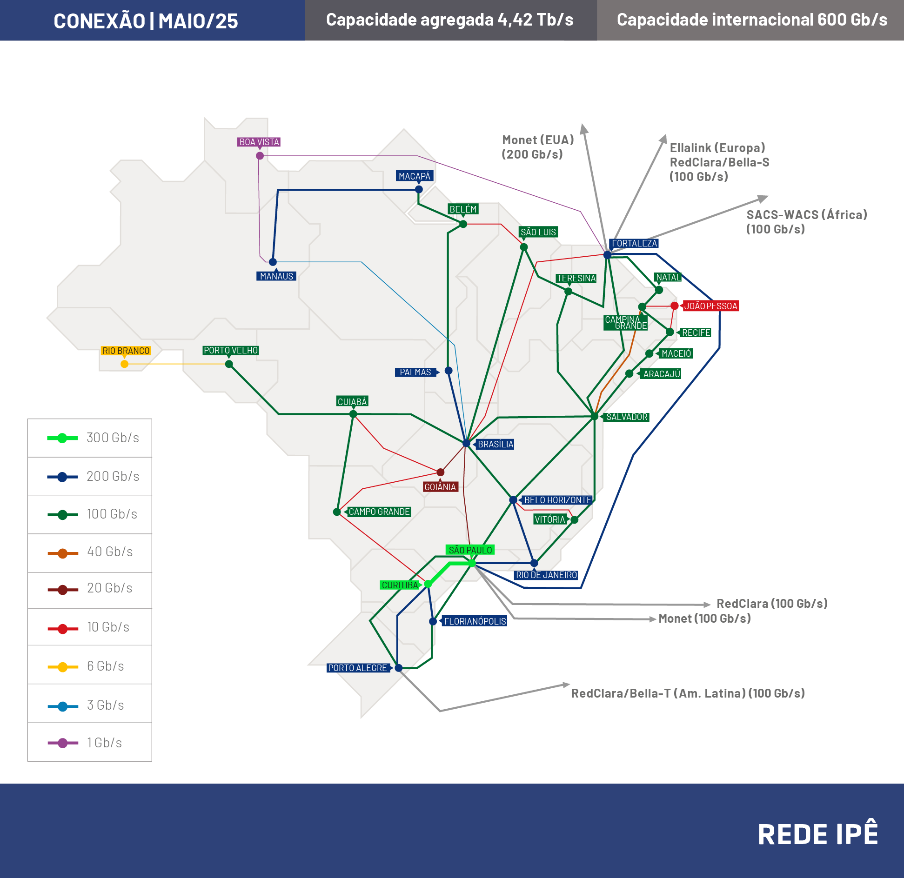
RNP Network
The RNP connects universities and research and education institutions with secure internet and services
27 Points of Presence

Slide 7
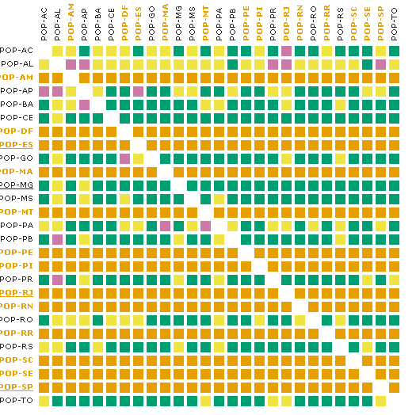
Monitoring Tools
MonIPÊ: PoP-to-PoP Measurements
Network Metrics:
Delay
Packet Loss
One-way Delay
Bandwidth (BBR)
Bandwidth (CUBIC)
Traceroute

Slide 8
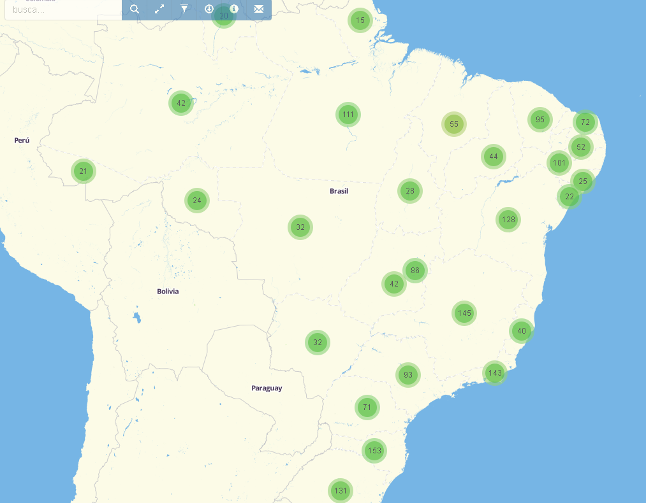
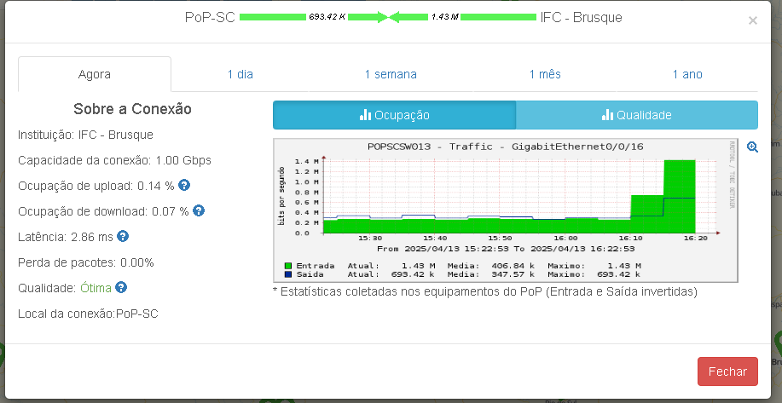
Monitoring Tools
Via Ipê: PoP-to-Institution Measurements
Network Metrics:
Delay
Packet Loss
Bandwidth Utilization
Bandwidth Capacity

Slide 9
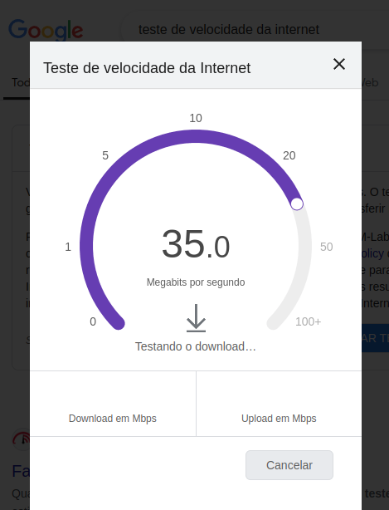
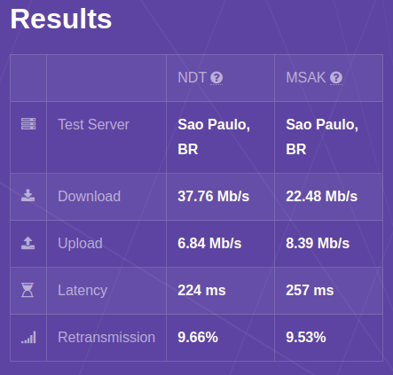
Monitoring Tools
M-Lab: open and collaborative internet measurement lab
Focus on accessibility and public data availability
Integration with Google BigQuery to facilitate data analysis
Partnership between RNP and M-Lab
Expansion of the number of servers and the reach of the M-Lab network in Brazil
Storage and processing of measurement data in Google Cloud Storage
https://speed.measurementlab.net/

Slide 10
Monitoring Tools
M-Lab: open and collaborative internet measurement lab
NDT (Network Diagnostic Tool)
Tests your connection's transmission rate and provides a sophisticated diagnosis of issues limiting speed.
Packet Headers
Collects packet headers for all incoming TCP flows and saves each flow’s packet capture in a .pcap file.
Reverse Traceroute
Measures the return network path to a user from two selected network points.
TCP Info
Collects statistics on active TCP connections on the M-Lab platform using tcp-info.
Neubot DASH
DASH was designed to measure network quality by emulating a video streaming player.
Trace Route
Collects path information for each connection to the M-Lab platform.

Slide 11
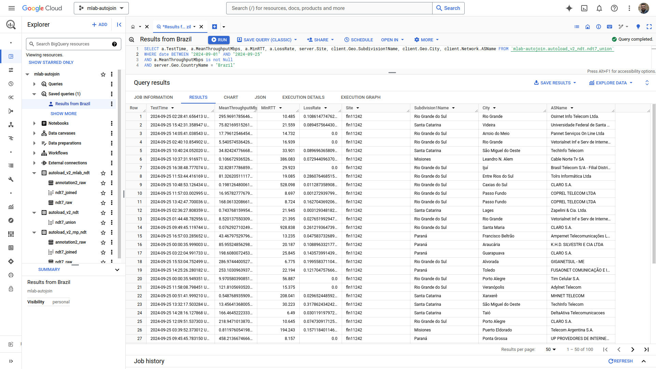
Google BigQuery

Slide 12
In recent years, with the advancement of technologies that enable AI, these technologies have been increasingly used to support the monitoring and identification of data traffic patterns in computer networks
Could we use the growing hype around generative AIs and intelligent solutions for network management and control?
CT-MON has started to consider and explore the benefits of Artificial Intelligence and Machine Learning techniques in its technology foresight activities.
We invite the community to play a game!!!

Slide 13
Datachallenge Context
Problem: related to selection of the best server for content delivery to a client
Practical example: streaming videos, where it is crucial to ensure quality and smoothness
Measurements collected over the course of one month using both MonIPÊ and M-Lab
Methodological freedom: open use of methods such as statistics, machine learning, AI, etc.

Slide 14
Challenge Context
DF
RJ
CE
RTT
Dash
Traceroute
BA
PI
ES

Slide 15
Problem Definition
The task of the challenge will be to answer a set of queries. Each query refers to a client-server pair and contains information from all DASH, RTT, and traceroute measurements for a time interval (unknown to the participants). For each query, challenge participants must predict the mean and standard deviation of the DASH measurements for the next two measurements.

Slide 16
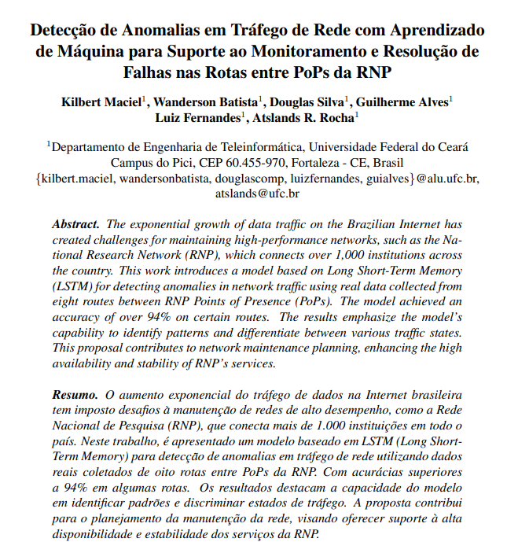
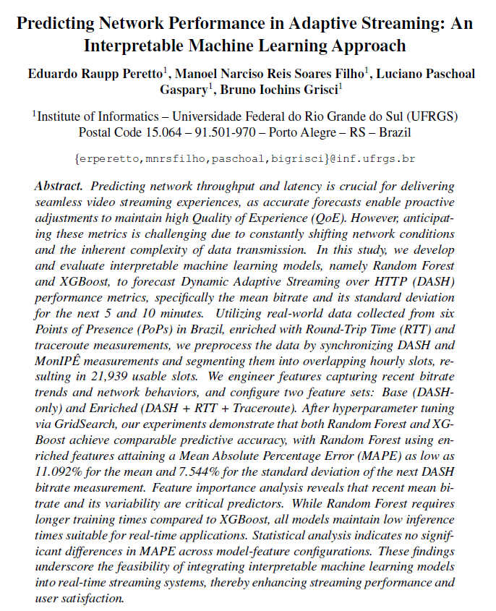
Results: Awards
The top three teams are awarded a project funded by CT-Mon
The goal of the projects is to continue studies to improve the proposed solutions or to explore other aspects of the dataset
At the end of each project, the team has to submitted a complete paper to a conference or a journal

Slide 17
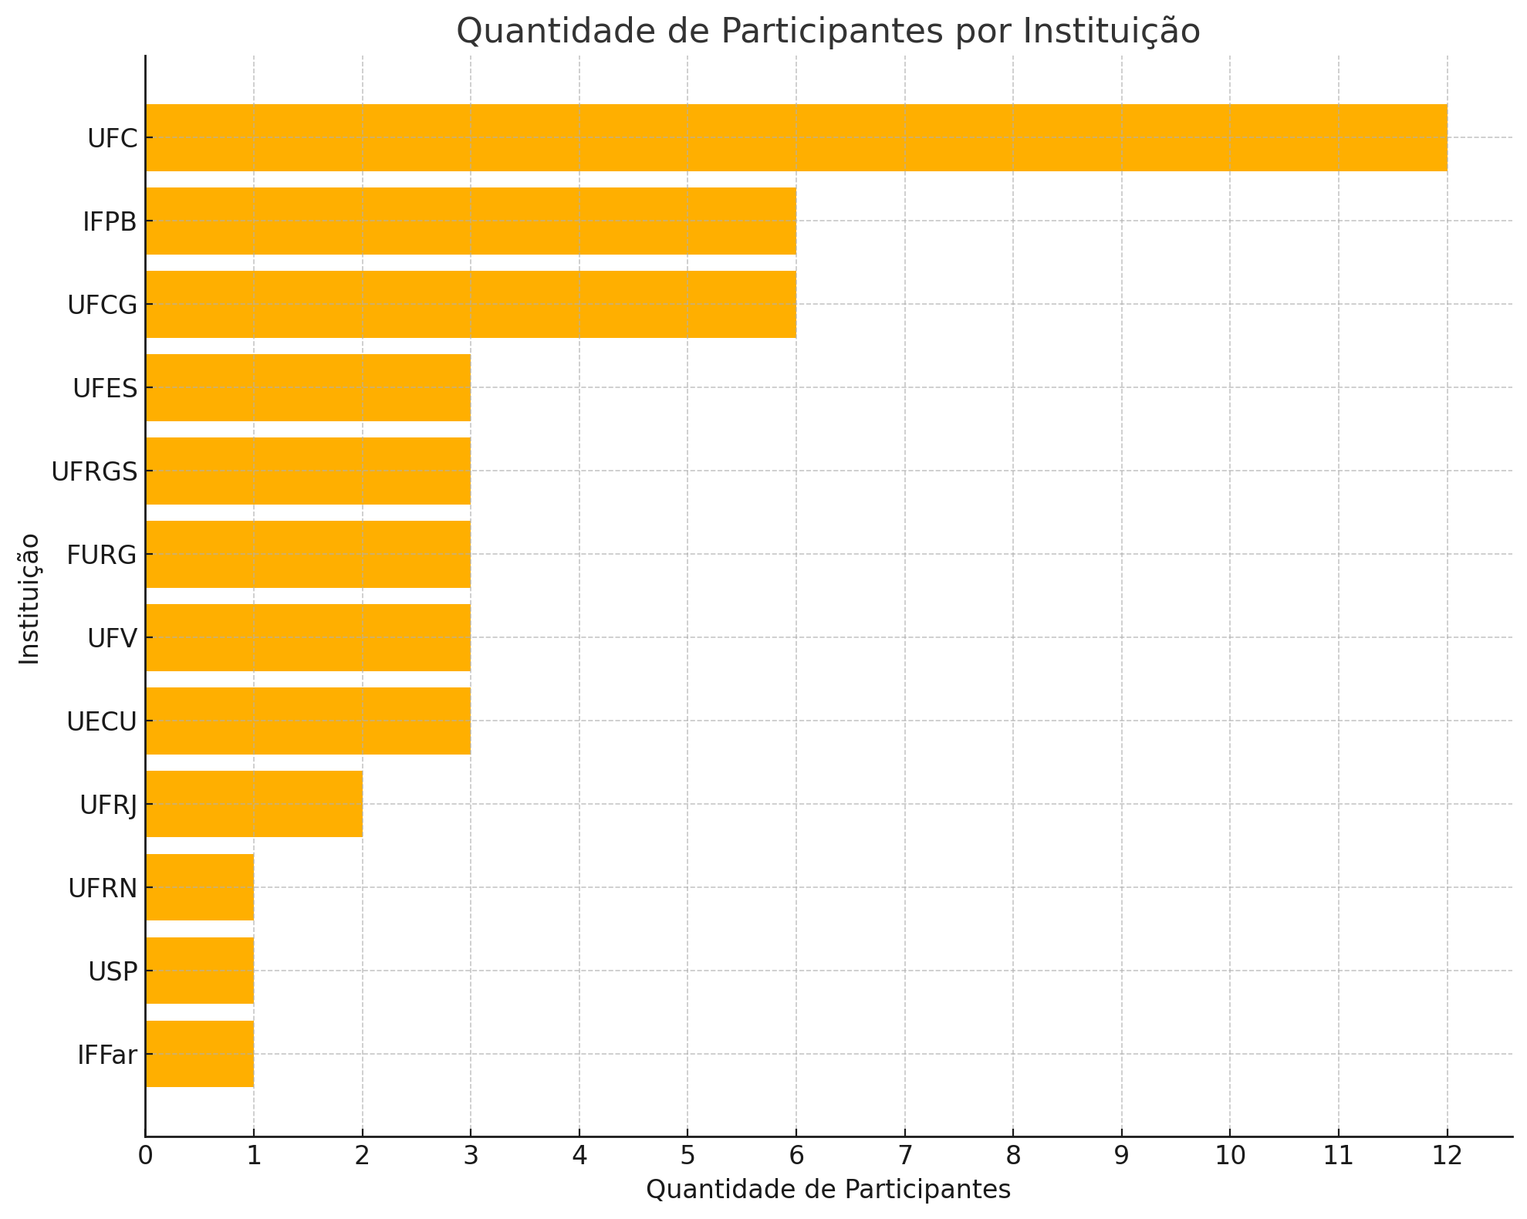
Results: Participations
44 total participants
14 teams
12 different institutions

Slide 18
Results: Network Data Catalog
Description of RNP data, including the meaning of each data point, the collection location, and the time of the measurement
Glossaries of technical terms associated with the collected data
Relationship between the collected data and research work
Information on the administrative management of the collected data and guidance on how to access them

Slide 19
Results: Network Data Repository
Public Access Repository (https://dadosderede.rnp.br/)
Possibility of collaboration with the community
Transparency in the dissemination of research data
Reuse by other researchers and scientists
Reproducibility of results
Describe network data
Extraction and normalization of network data
Research data sharing

Slide 20
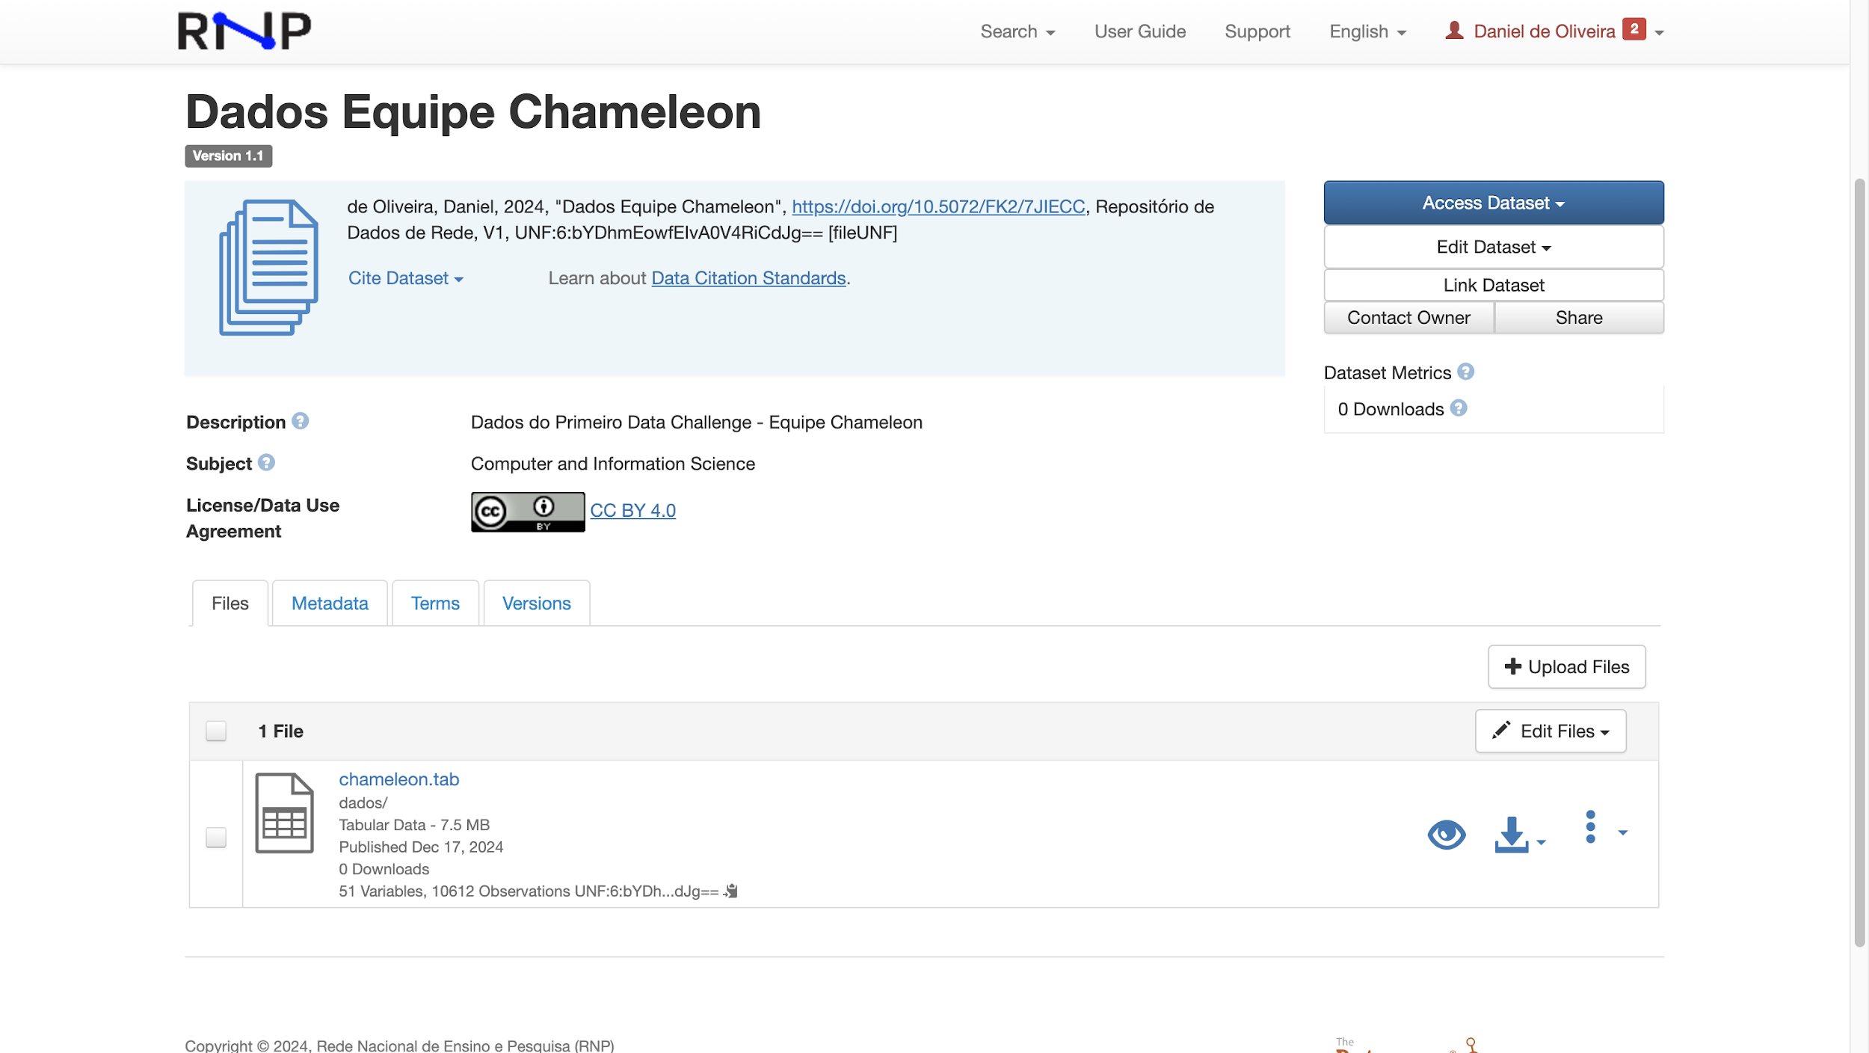
Metadata
Data Files

Slide 21
Conclusions and Future Work
What we learned
The challenge sparked engagement across the community
3 research works were developed with the data
Future Work
A new QoE-themed challenge coming in late 202
Planning a global edition to reach the international community
Create virtual labs to explorer digital twins
I have a invitation for you!!!!

Slide 23
Thanks! Now lets go to the questions! Gustavo Araújo gustavo.araujo@rnp.br José Rezende jose.rezende@rnp.br

