Slide 1

Title slide
Automating International Guest Student Enrollment
Peter Havekes – Ben Parker

Slide 2


Introduction
Peter Havekes
Ben Parker
Technical Product Manager
Project Manager
peter.havekes@surf.nl
b.b.parker@tue.nl
Working on Trust & Identity solutions at SURF
Working on EuroTeQ alliance mobility solutions

Slide 3

Agenda
01
02
03
What is euroteq
What is eduXchange
Automating Enrollment
04
05
06
Organising
Lessons learned
Whats Next

Slide 4

Chapter blue
What is EuroTeQ?

Slide 5
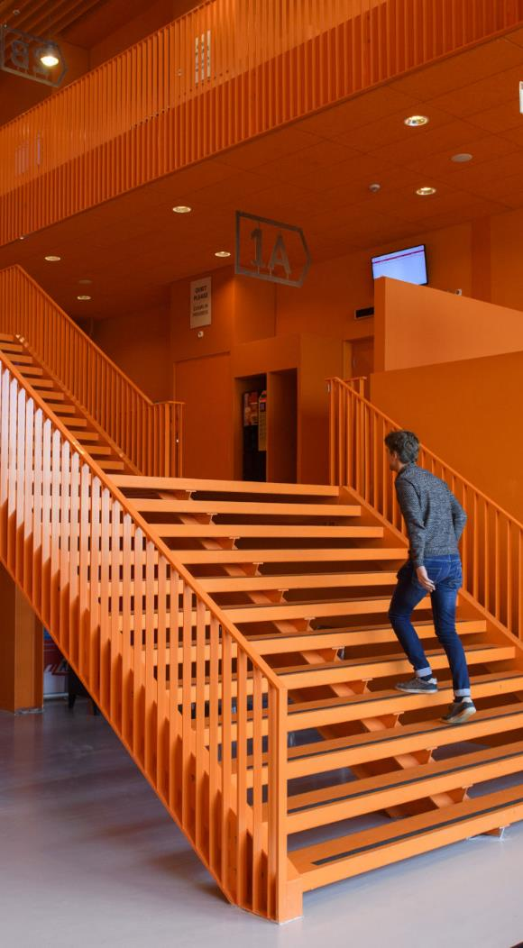
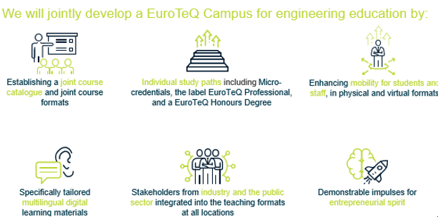
What is EuroTeQ?
A European University Alliance formed of leading universities of science and technology, spread across Europe, situated in innovation eco-systems and with great collaboration experience.

Slide 6
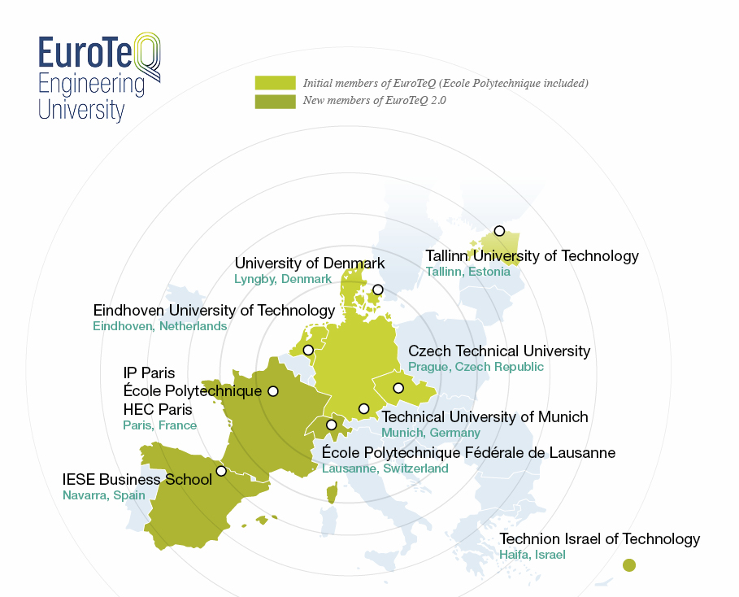

Slide 7

What is EuroTeQ?
Ambitious mobility goal: 50% of our graduates shall have a EuroteQ experience in 2030
One of EuroTeQ’s five core activities is:
Building the EuroTeQ Campus, a platform for open education, delivering high-quality research-led teaching to a peer group of over 115,000 students. Our graduates will have intercultural and multilingual competences, an entrepreneurial mindset, think and act responsibly and be ready to lead a competitive and sustainable Europe into the future.

Slide 8

Principles of the EuroTeQ alliance
Fostering the student experience:
'seamless student mobility'
Growth of the international campus – 50% of students study at another institution
Creating scalable systems and processes
Building on existing good practice

Slide 9
Chapter green
What is eduXchange?

Slide 10
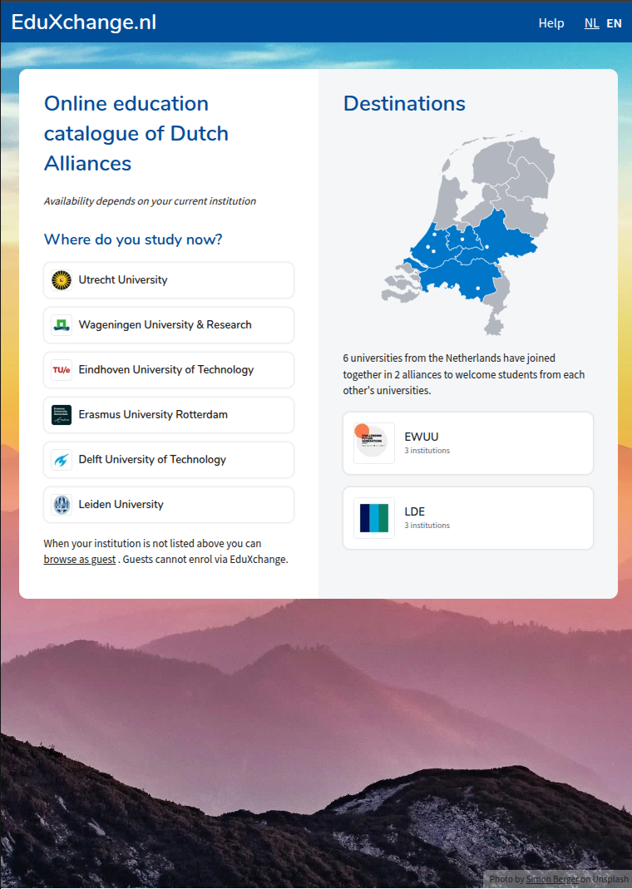
What is eduXchange
Catalog + Enrollment
  Let students search, browse and select courses or minors
Designed for two Dutch University Alliances
  6 universities
Copied to EU Aliance

Slide 11

Designing eduXchange
Privacy-by-design
  SURF processes as little data as possible Data
  exchange directly between institutions: no central database
  The student is in control
Automation
  No manual back-and-forth of documents, manual registration, etc.
  All processes must be digitalised and automated as much as possible
Generic Infrastructure
  Using open standards and open-source components
  Scalable to other settings, so generic design

Slide 12




eduXchange.nl components
OEAPI (OOAPI in Dutch), a standard for unlocking educational data: from educational offerings, to grades, to credits, from timetables to free workplaces
SURFeduhub, a central place where educational data from an institution can be offered to various data customers in a uniform and secure manner
eduXchange, a front-end for showcasing educational offerings
eduID, an overarching digital student identity, independent of an institution
Subscription and result broker, for orchestration of student data between institutions
SURFconext API security, for protecting communication between guest and host institutions

Slide 13



eduXchange.nl -> europe
OEAPI, a standard for unlocking educational data: from educational offerings, to grades, to credits, from timetables to free workplaces
SURFeduhub, a central place where educational data from an institution can be offered to various data customers in a uniform and secure manner
eduXchange, a front-end for showcasing educational offerings
eduID, an overarching digital student identity, independent of an institution
Subscription and result broker, for orchestration of student data between institutions
SURFconext API security, for protecting communication between guest and host institutions

Slide 14


eduXchange.nl -> europe
MyAcademicID was funded by the Connecting Europe Facility programme in 2019-2020 in the context of the European Student Card initiative and delivered on the core promise to enable students to authenticate for their studies abroad using their home student account thanks to eduGAIN.
The project resulted in the creation of an identity and access management platform combining both eIDAS and eduGAIN for the authentication on e-services related to the Erasmus+ programme

Slide 15
Chapter yellow
Automating Enrolment

Slide 16
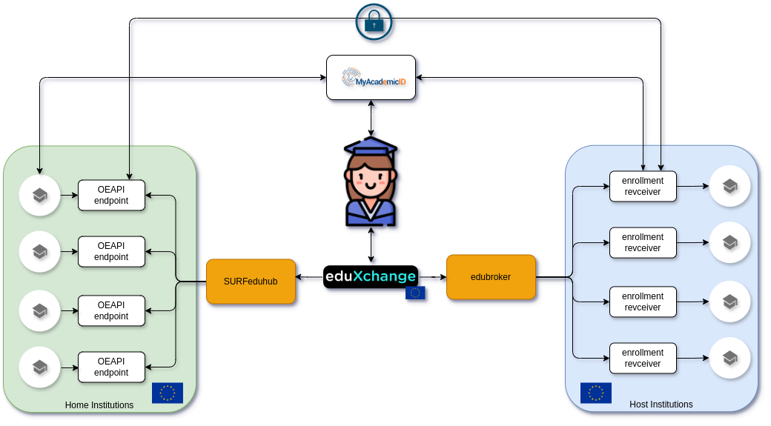

Slide 17
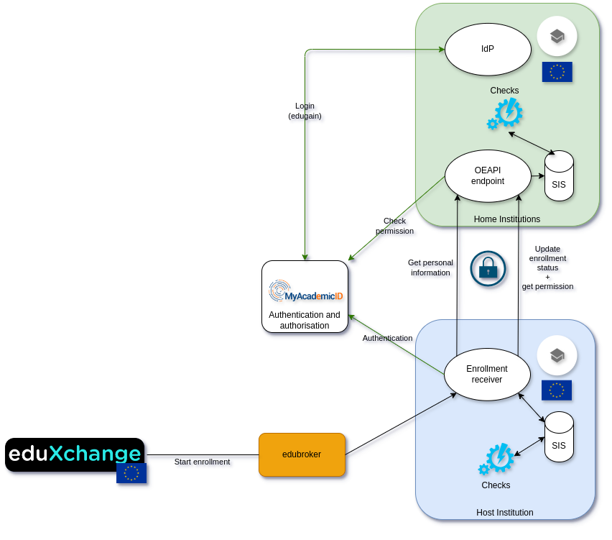
No shared identifier
Student in control
Authentication at home institution
Business logic at both institutions

Slide 18
Automating enrolment
To allow the peer-to-peer approach between home and host university, all partners needed to build:
Additional OOAPI endpoints to handle data relating to students and their desired enrolment
Protect these endpoints using oauth + MyAcademicID
Their own ‘enrolment receiver’ module, which handles applications for enrolment via the edubroker

Slide 19
Chapter green
Organising

Slide 20
Process so far
An adapted version of existing enrolment process was designed by SURF, to fit the European alliance context
Each university was tasked with creating and installing the new components required (API endpoints and enrolment receiver)
There is ongoing work about the minimum data required to enrol a student across all the universities. Extension fields exist for attributes that don’t (currently exist in the OOAPI)
Testing using a demo-broker, within and across universities who are ready. Two hackathon-style gatherings for intensive testing

Slide 21
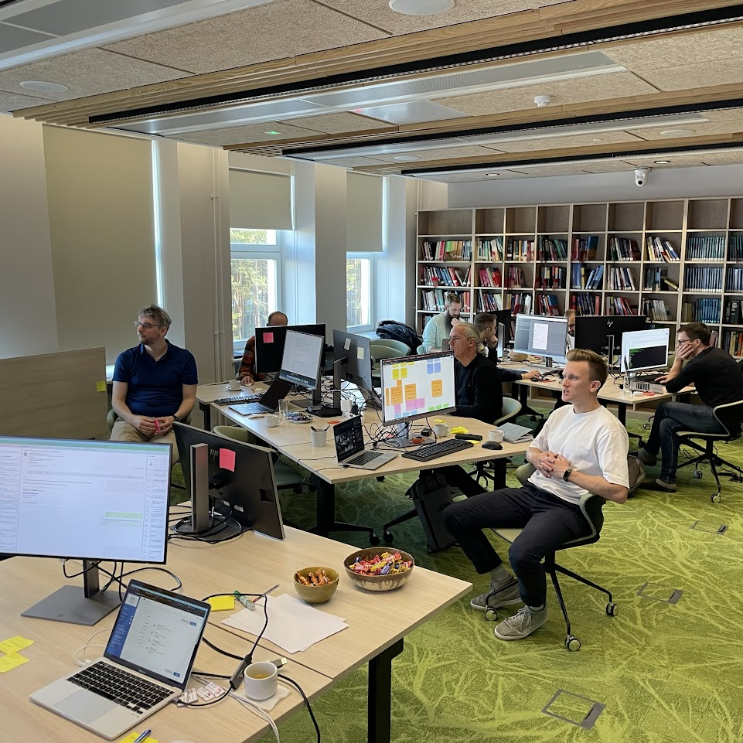
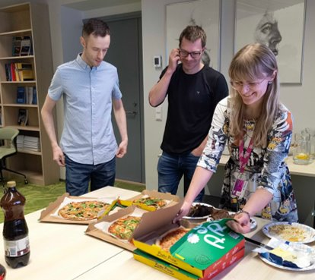
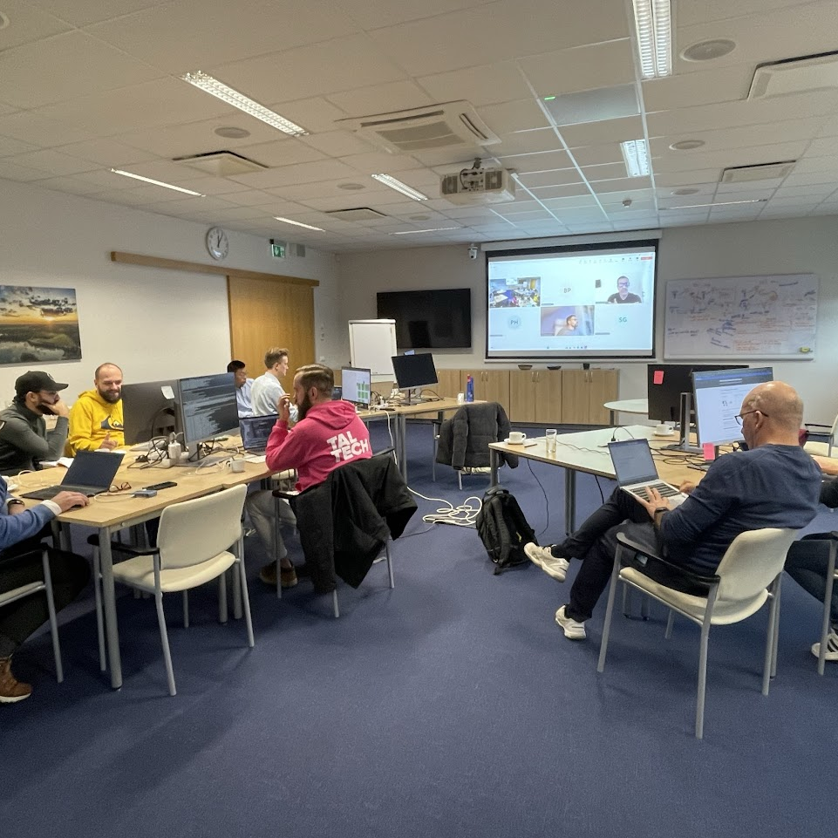
Hackathons

Slide 22
Chapter orange
Lessons Learned

Slide 23
Lessons learned
Different IDs exist at each institution; building upon a tool that makes use of edugain is helpful
Data gaps - not all universities have the same data requirements for registering and enrolling students, and sometimes it is held in varying formats
New fields - Capturing ‘association state’ (enrolment status of the student) from both home and host university is a change for most institutions
Hackathon-style testing results in faster changes and fixes

Slide 24
Chapter blue
What's next?

Slide 25
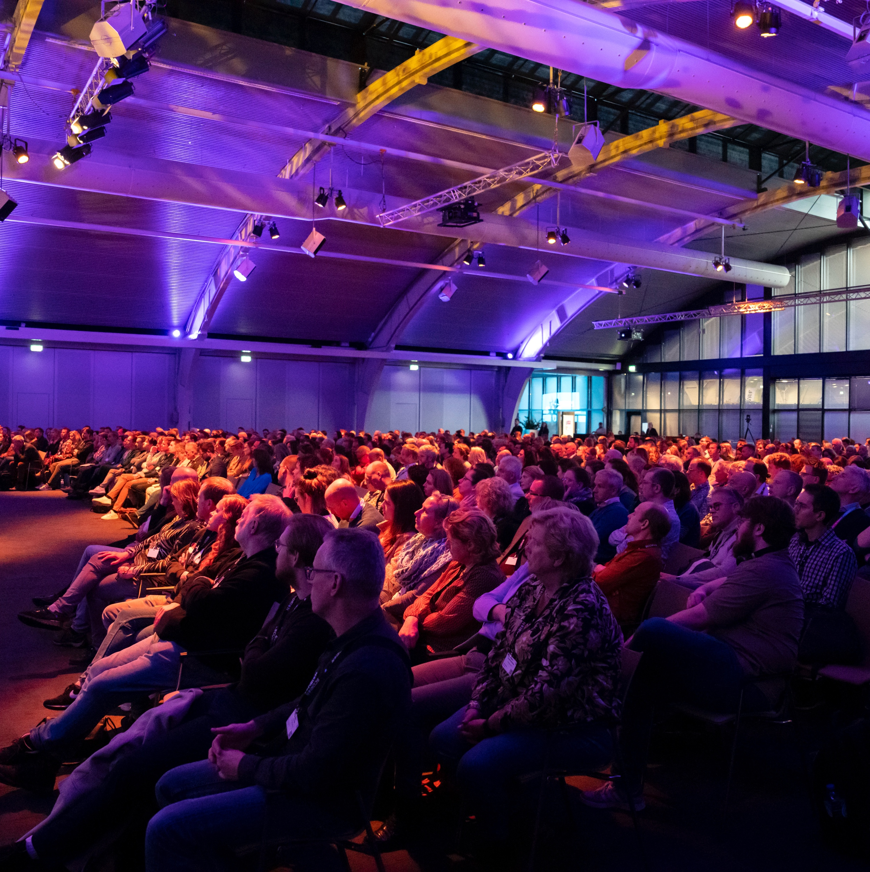


Other interested EU Alliances

Slide 26

What’s next?
Inclusion of all EuroTeQ partners via MyAcademicID
MyAcademicID for professional learners
Via eIDAS
Other alliances using the same solution
World Domination

Slide 27
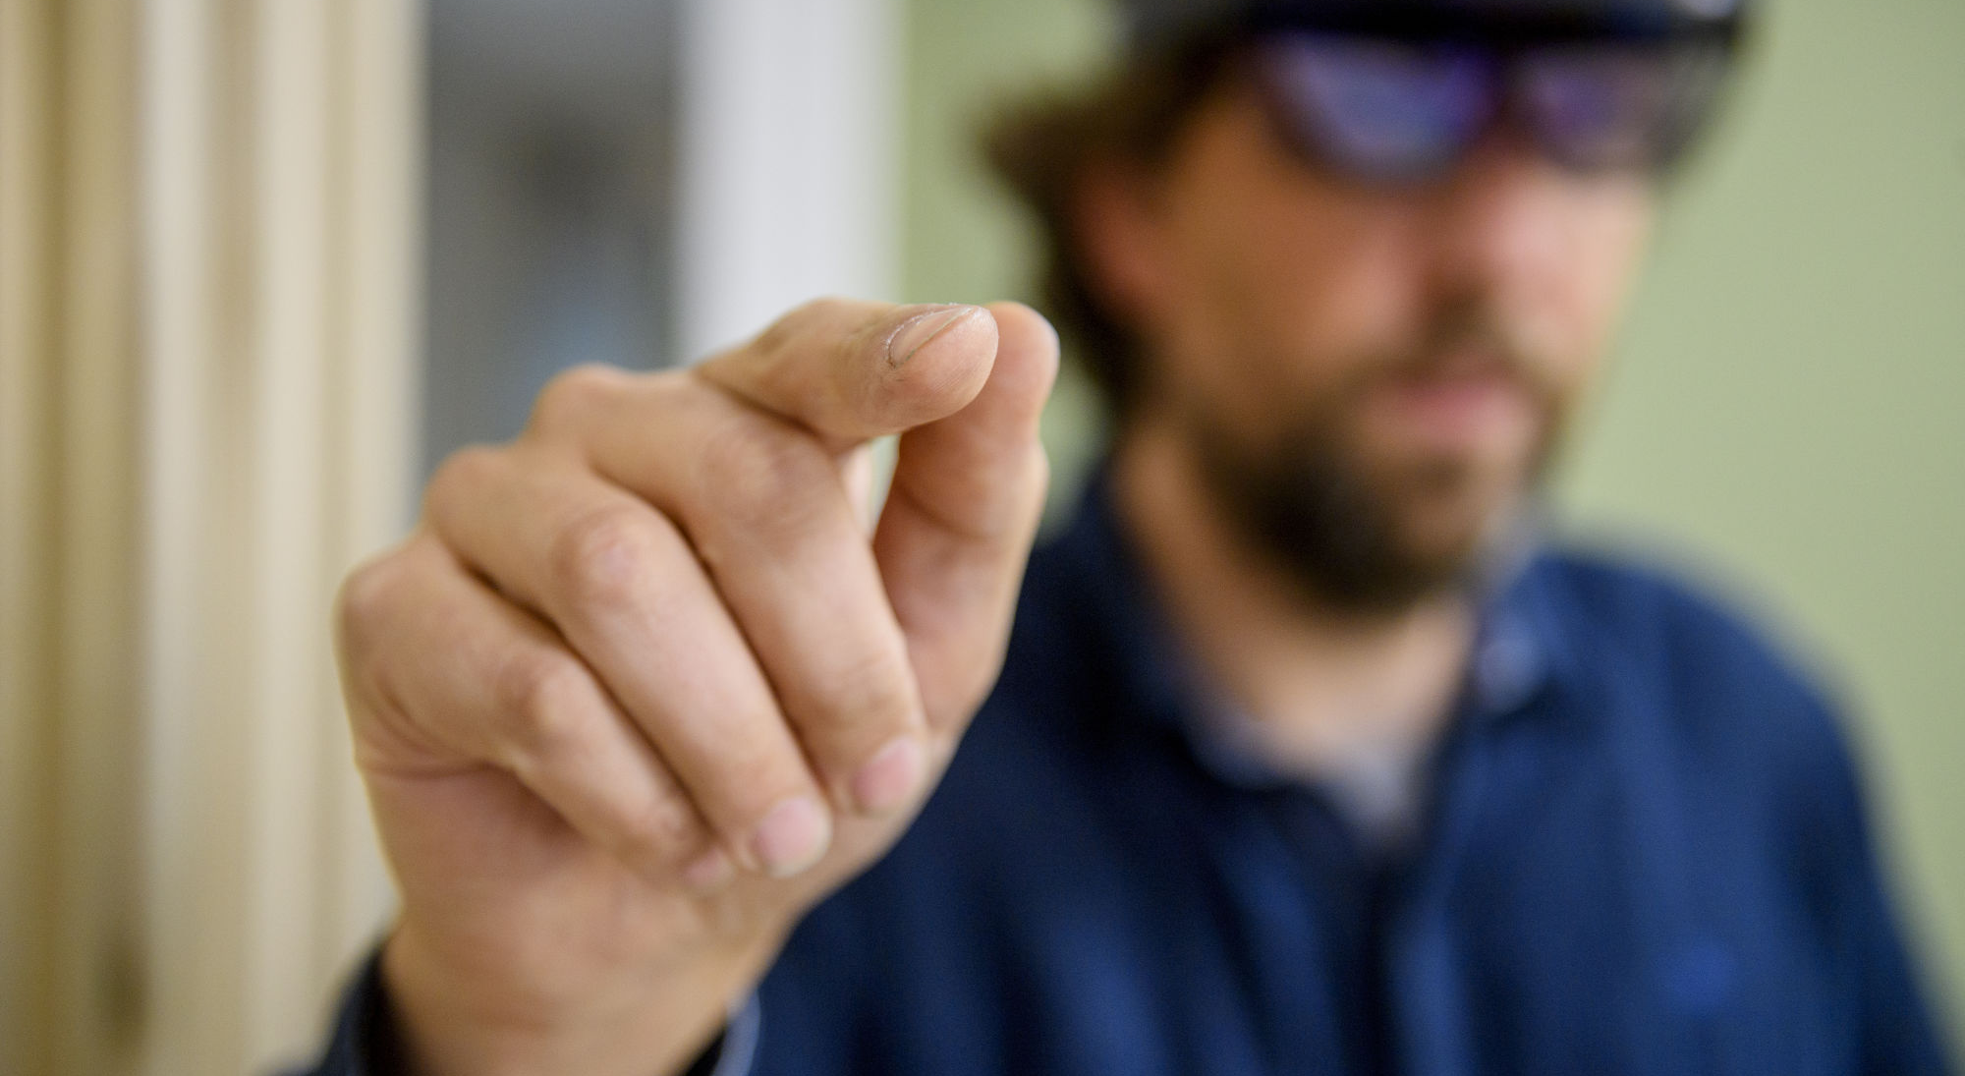
Closing slide
Thank you for
your attention!
Address
Mail address
Phone number

