Slide 1

Enabling Cross-Border Access to Ladok
Fredrik Domeij, Ladok Consortium
Pål Axelsson, Sunet
TNC25

Slide 2
Account linking
To link an external user account to a user identity in a system, allowing access using the external account
There are two ways of doing this linking
A common identifier that is shared between the internal system and the external user account
  Examples are the national identity number or the European Student Identifier (ESI)
Log in to the system with the external user account when the user is already logged into the system

Slide 3
Account linking information
The system that allows account linking needs a persistent user identifier to be able create and keep a link to the external user
  Examples are subject-id, eduPersonPrincipalName, pairwise-id and the European Student Identifier
The system that allows account linking may need extra information about the external user account, typically
  Basic user information such as name and e-mail address
  Identity assurance
    REFEDS Assurance Framework or national assurance profiles
  Authentication assurance
    REFEDS Multi-Factor Authentication (MFA) Profile

Slide 4
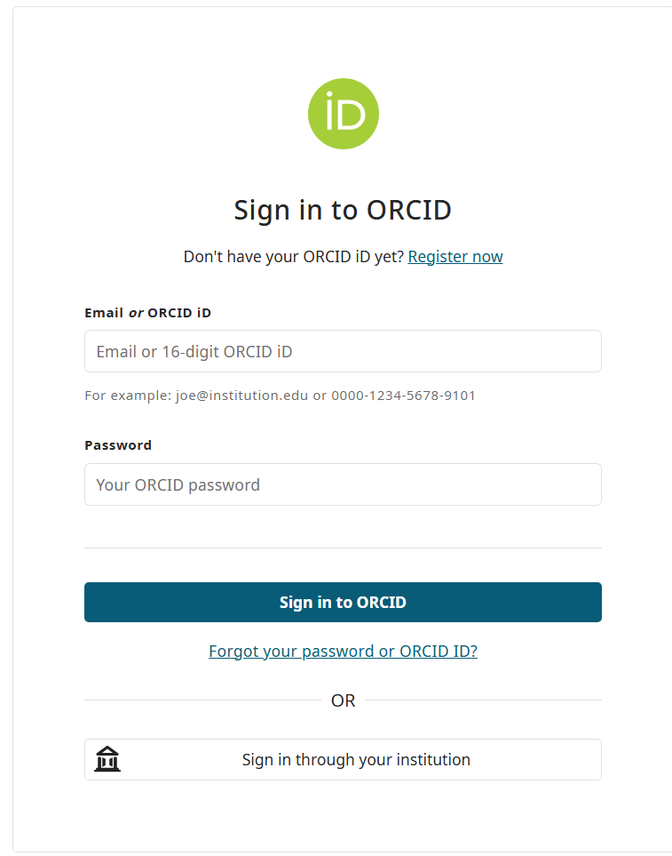
ORCID as the basic example
If you have an ORCID Profile at https://orcid.org/ you can connect to your organisational login as long as your identity provider release enough attributes to ORCID
To connect you choose “Sign in through your institution”
  If not connected you need to login with your ORCID account the first time.

Slide 5
Cross-Border Access to Ladok
How students get their Swedish university account
How students can retain access to Ladok after completing their studies
How international students can get a consistent identity experience throughout their student journey

Slide 6



What is Ladok?
Ladok is the primary Student Information System of higher education institutions in Sweden
Developed by the Ladok Consortium consisting of 41 Swedish member universities and university collages
Used by teachers and students daily to manage students, courses, registrations grades and degree certificates
Ladok is used by:
About 27 000 teachers and administrators
About 350 000 active students
Information about 3,2 millions students in the system

Slide 7




Getting a Swedish university user account for access to Ladok
Create account
Admission
Submit application
Swedish personal identity number
Compare name and date of birth
Swedish personal identity number
Service Desk
Receive account
Identification
Swedish university

Slide 8
What do students do in Ladok?
During studies
  Course registration
  Exam registration
  Export transcript of records
  Apply for a degree certificate
  Download signed degree certificate
After studies
  Export transcript of records
  Apply for a degree certificate
  Download signed degree certificate
When students return home, many lose their Swedish university user account and, by that, access to Ladok
Swedish university account
Swedish university account

Slide 9
Two identified challenges for international students
The small challenge: Let students remain access to Ladok after completed studies
The big challenge: Consistent identity management throughout the student journey

Slide 10
Account Linking in Ladok
To link an external user account to a user identity in a system, allowing access using the external account
Before returning home:
  Log in from a Swedish university
  Account Linking
    Without logging out, authenticate using another login method
    The user identifier from the authentication is stored in Ladok
  Later log in using the other login method

Slide 11
Example
A student linking their home university account to Ladok

Slide 12
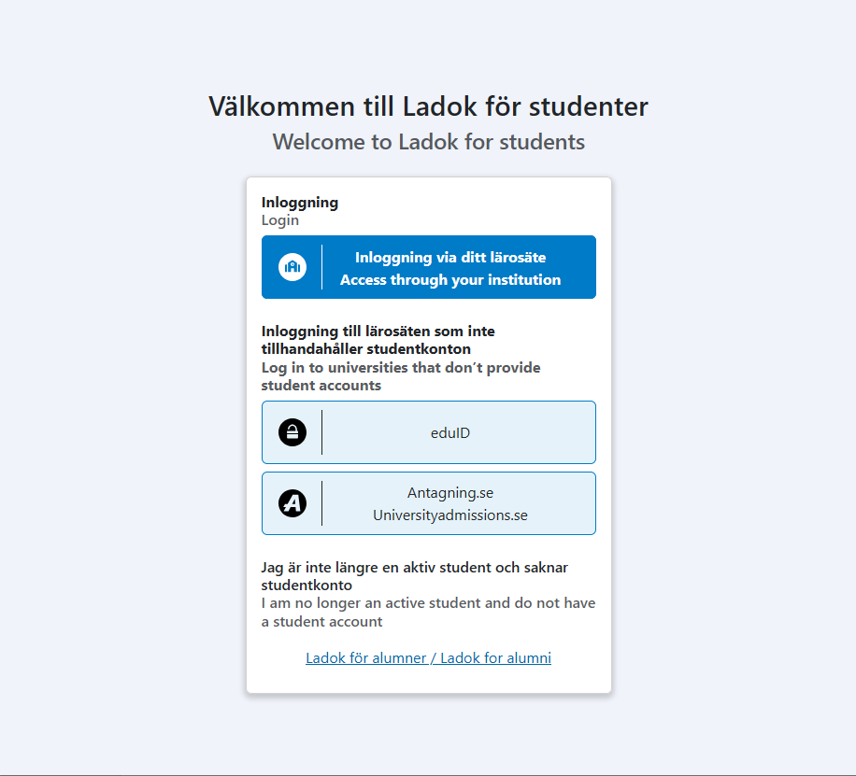
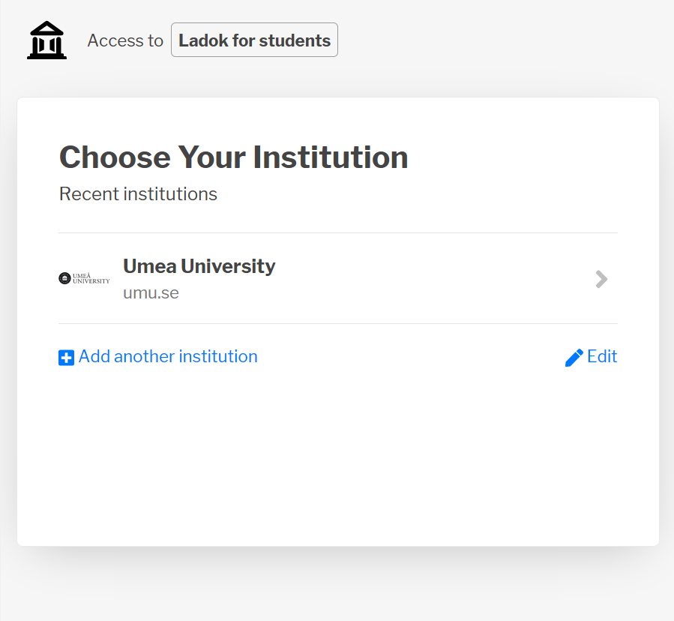
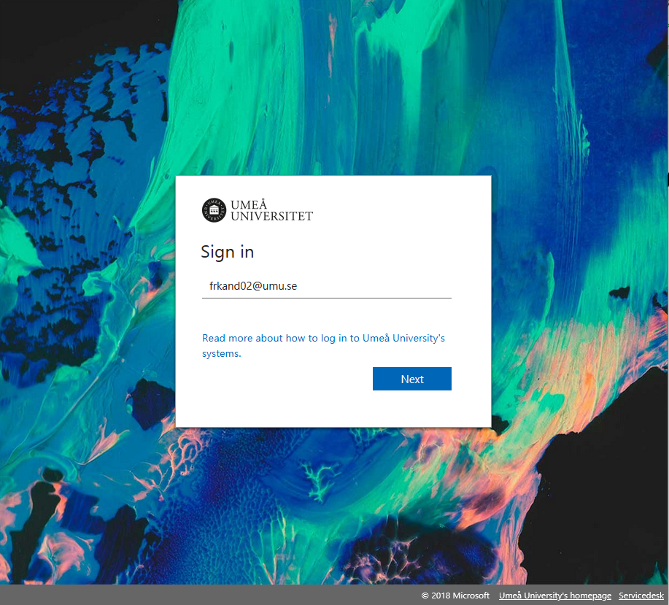
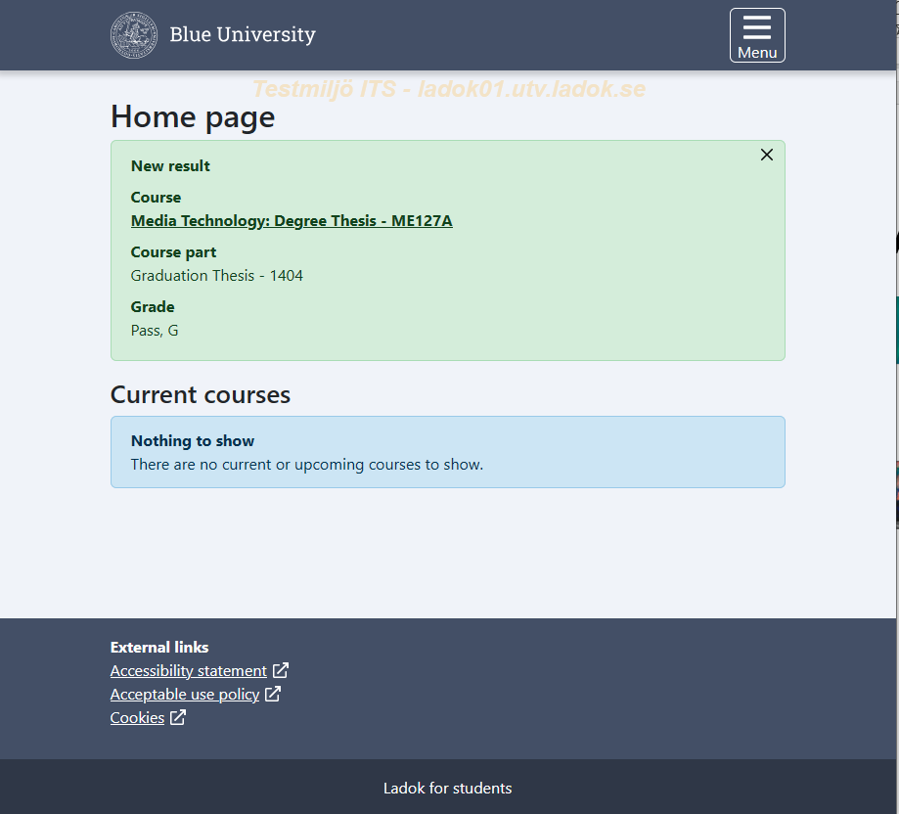
1. Log in to Ladok from a Swedish university
SWAMID
Ladok for students
SeamlessAccess
Umeå University IdP
Access through
your institution
Ladok for students
norEduPersonNIN:
198104059293
User identifiers
Type | Value
Swedish Personal Identity Number | 198104059293

Slide 13
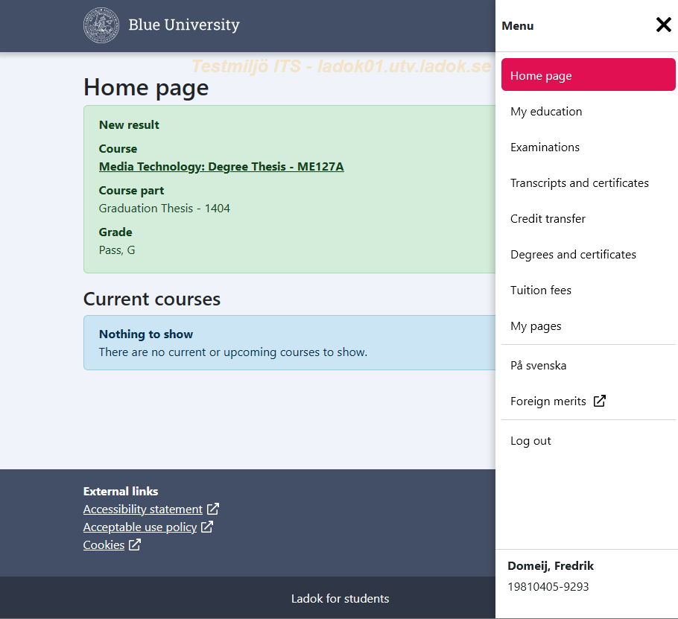
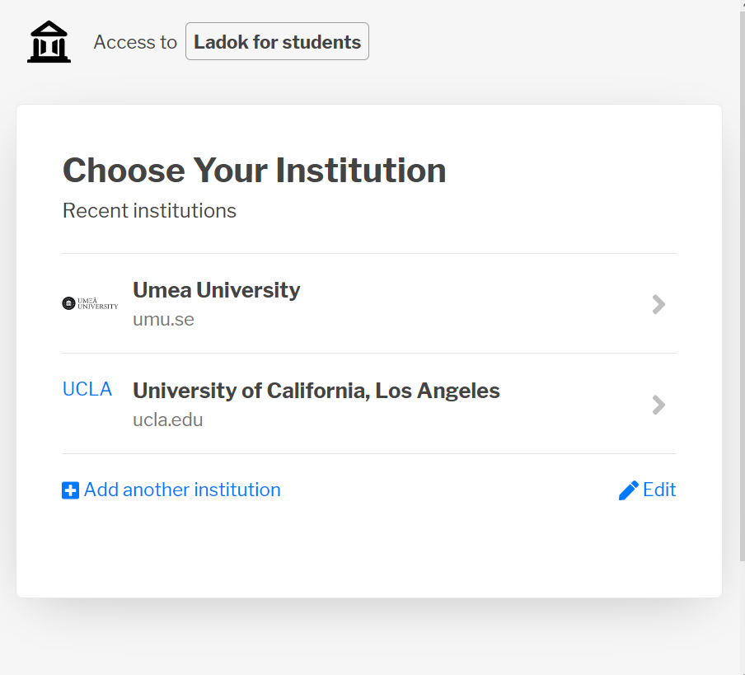
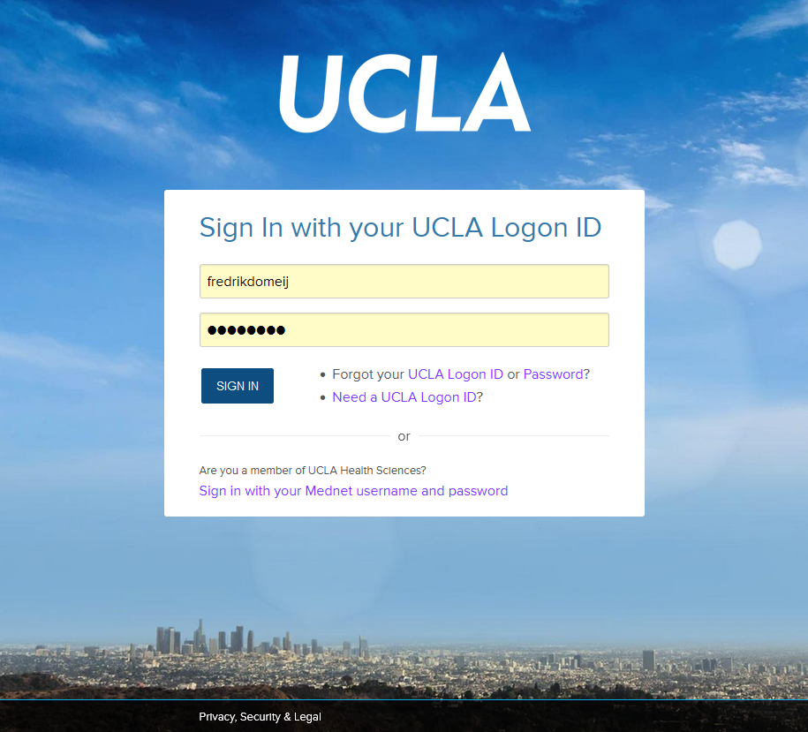
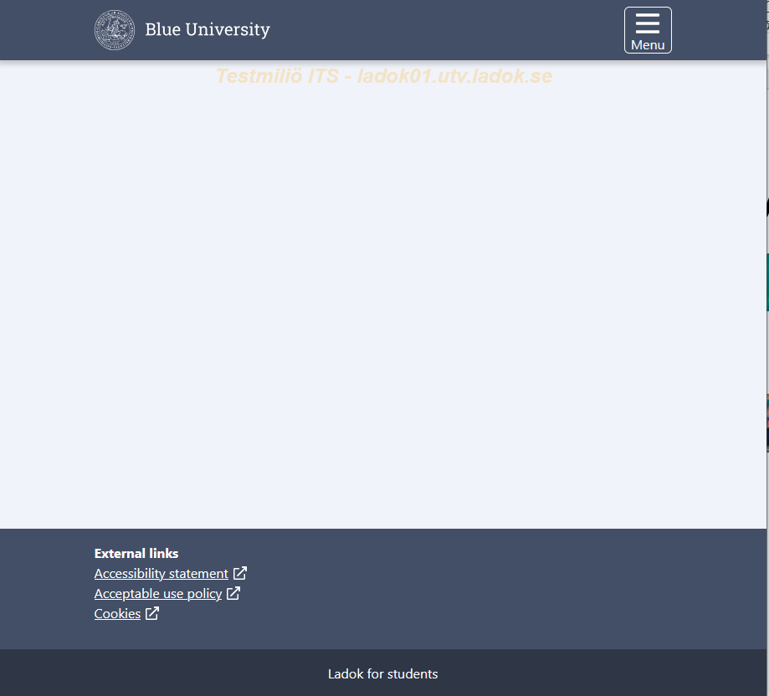
2. Account Linking with home university account
- store user identifier
eduGAIN
Ladok for students
SeamlessAccess
University of California IdP
Add login method
Ladok for students
subject-id:
fredom@ucla.edu
Additional login methods
Home university | User name | Action
UCLA | fredom@ucla.org | Delete
User identifiers
Type | Value
Swedish Personal Identity Number | 198104059293
subject-id (added) | fredom@ucla.edu

Slide 14
3. Later log in with home university account
eduGAIN
Ladok for students
SeamlessAccess
University of California IdP
Access through
your institution
Ladok for students
subject-id:
fredom@ucla.edu
User identifiers
Type | Value
Swedish Personal Identity Number | 198104059293
subject-id | fredom@ucla.edu

Slide 15
User identifiers
Examples
subject-id (like eduPersonPrincipalName/ePPN, but non-reassignable)
ESI (European Student Identifier)
eIDAS (European Government e-ID)
Freja-UPI (Freja eID+, a free Swedish Government e-ID, supports ePassports from 167 countries)
User identifiers
Type | Value
Swedish Personal Identity Number | 198104059293
subject-id | fredom@ucla.edu
subject-id | frkdoj01@uni-frankfurt.de
eIDAS | DE:fo4bae1waes0phieaida6aixveanga
ESI | urn:schac:personalUniqueCode:int:esi:uni-frankfurt.de:5c…
Freja-UPI | 7288-694855-8676
A student can have many user identifiers, and multiple of the same type

Slide 16
User identifiers cont.
The user identifier must always be assigned to the same individual
The Identity Assurance level must correspond to SWAMID AL2
REFEDS Assurance Framework (RAF) – medium
eIDAS – substantial
Swedish Government e-ID – Level of Assurance 2

Slide 17
Login methods in Ladok
Government e-ID
SWAMID
Ladok for students
Swedish personal identity number
Swedish e-ID
Swedish personal identity number
eIDAS
EU e-ID
Swedish universities
Freja-UPI
Freja eID+
by ePassports
eduGAIN
ESI
subject-id
subject-id
EU
universities
Non-EU universities
Users confirmed
by ePassports
Implemented
Planned

Slide 18
Integrating with eduGAIN
Getting attributes/assurance
REFEDS Personalized Access Entity Category
  subject-id
  Name
  Assurance (RAF)
European Student Identifier Entity Category
  ESI
Error handling
REFEDS Deployment Profile for errorURL

Slide 19
Consistent identity management throughout the student journey
Admission
(subject-id)
Integration
(subject-id)
Swedish
universities
Application
(subject-id)
Log in
(subject-id)
Account creation
(subject-id)
User identifier
Use external user account to
Submit initial application to studies in Sweden
Access information regarding tuition fees in Ladok
Create a Swedish university account
Access Ladok after returning home
Non-EU university

Slide 20
Consistent identity management throughout the student journey
Integration
(ESI, subject-id)
Swedish
universities
Learning Agreement
(ESI)
Log in
(ESI, subject-id)
Account creation
(ESI, subject-id)
EU
university

Slide 21
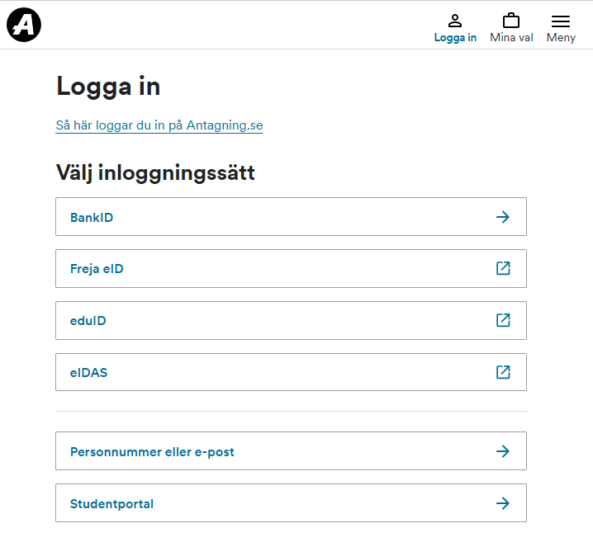
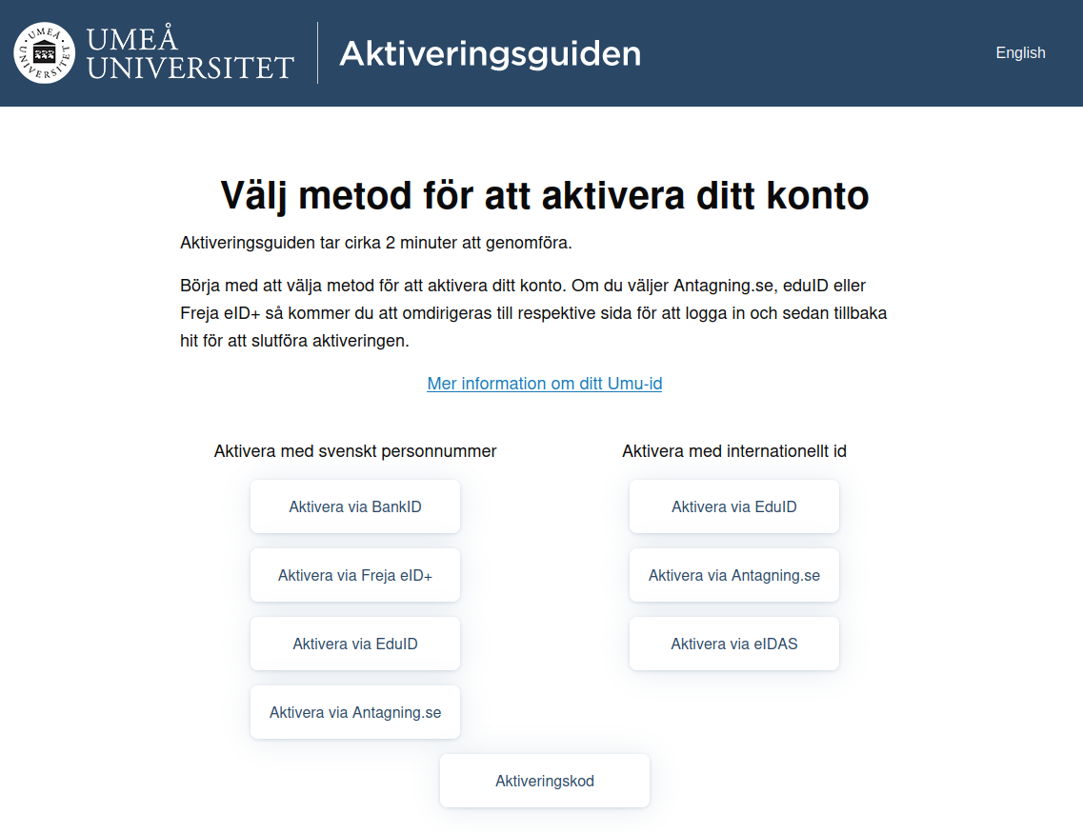
Consistent identity management throughout the student journey
Universityadmissions.se
Ladok for students
Swedish universities
Swedish personal identity number
eIDAS
ESI
subject-id
Freja-UPI
Swedish personal identity number
eIDAS
ESI
subject-id
Freja-UPI
Implemented
Planned

Slide 22

Any questions?
Please contact me at
eduGAIN or Internet2 Slack
fredrik.domeij@umu.se
Generate an image of happy, international students.

