Slide 1
Leveling Up Identity Assurance: MFA, Phishing Resistance, and the Path Forward
BRIGHTON, UK | 12 JUNE 2025
Albert Wu
InCommon Federation Manager
Internet2 | InCommon
Notes:
Identity and Access Management (IAM) professionals, IT staff, researchers, and administrators within the Research & Education (R&E) community. Main Goal: To inform attendees about the evolving landscape of identity assurance in R&E federations, specifically regarding phishing-resistant MFA and IAL2 requirements, and to empower them with knowledge about upcoming changes, implementation considerations, and opportunities for involvement.

Slide 2
The Evolving Landscape of R&E Identity Assurance
US federal granting agencies stepping up cybersecurity requirements
Cyber insurance impacting campus cybersecurity / IAM implementations
What is InCommon doing about all this?
I am reporting from a US perspective today. Is your region/locale seeing similar developments?
Notes:
Session Overview / Why We're Here
Headline: The Evolving Landscape of R&E Identity Assurance
Key Points:
Increasing demands for strong authentication and verifiable identity assurance.
Driven by evolving research and funding agency requirements (e.g., NIH, NSF).
Focus on how R&E federations are adapting and evolving standards.
What you'll learn today:
The urgency behind phishing-resistant MFA.
Key definitions and standards from REFEDS.
InCommon's alignment efforts and practical considerations.
How to get involved in shaping the future.
Visual: A "road ahead" or "growth" metaphor, emphasizing progress and adaptation.

Slide 3
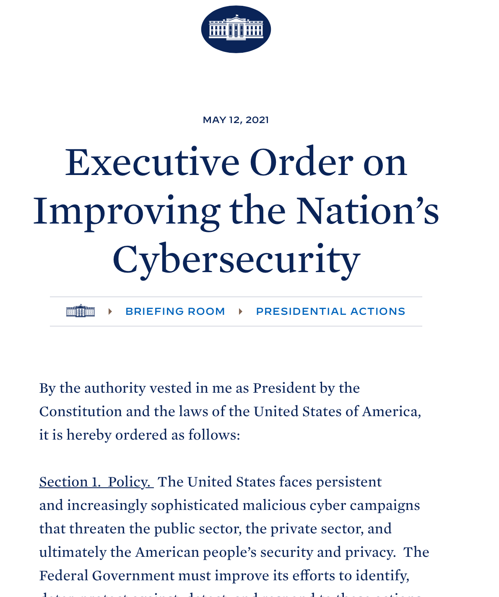
Federal Cybersecurity Mandates Reshape Research Collaboration
In 2021, the White House issued Executive Order on Improving the Nation’s Cybersecurity. This call to action spurred a renewed focus on Federal Information Security Modernization Act (FISMA) compliance among agencies.
Although FISMA technically applies to federal agencies, agencies are applying FISMA requirements toward providers and partners interacting with agencies.
Notes:
II. The "Why": Current Challenges & Drivers (~5-6 minutes)
Slide 3: The Threat Landscape: Why "Good Enough" Isn't Enough
Headline: The Evolving Threat: Why "Good Enough" MFA Isn't Enough Anymore
Key Points:
Rise of sophisticated phishing attacks (credential harvesting, MFA bypass).
Vulnerabilities in traditional MFA (SMS OTP, push notifications susceptible to social engineering).
Significant impact on research data, intellectual property, and institutional reputation.
Visual: Simple icons representing phishing, a compromised lock, and data loss.

Slide 4
Federal Cybersecurity Mandates Reshape Research Collaboration
Access to:
controlled datasets
student information
research administration portals
Needs:
multi-factor authentication
stronger identity assurance
data protection
Although FISMA technically applies to federal agencies, agencies are applying FISMA requirements toward providers and partners interacting with agencies.
Notes:
Access to:
controlled datasets
student information
research administration portals
Needs:
multi-factor authentication
stronger identity assurance
data protection

Slide 5
National Institute of Health Led the Way
NIH began requiring all users accessing the eRA research portal to perform MFA in 2021.
It also laid out a vision to strengthen identity proofing for controlled dataset access.
Hundreds of InCommon participant schools implemented compatible MFA to enable PI access eRA using their campus SSO.
https://spaces.at.internet2.edu/display/federation/get-nih-ready

Slide 6
National Science Foundation requires MFA for research.gov
NSF began requiring MFA for research.gov in Fall of 2024.
It also indicated that it would require phishing-resistant MFA for users with sensitive access in the future. *
Effective on October 27, 2024, all external users must first complete a one-time MFA enrollment process and use the selected MFA method to sign into Research.gov… All Research.gov users must set up a primary MFA sign-in method to access Research.gov…
National Science Foundation Dear Colleague Letter October 11, 2024
* NSF did not specify a date, but we know we have a gap: there is no way to signal ”phishing-resistant MFA” in the current REFEDS MFA Profile.
https://new.nsf.gov/funding/information/dcl-multifactor-authentication-implementation-researchgov

Slide 7
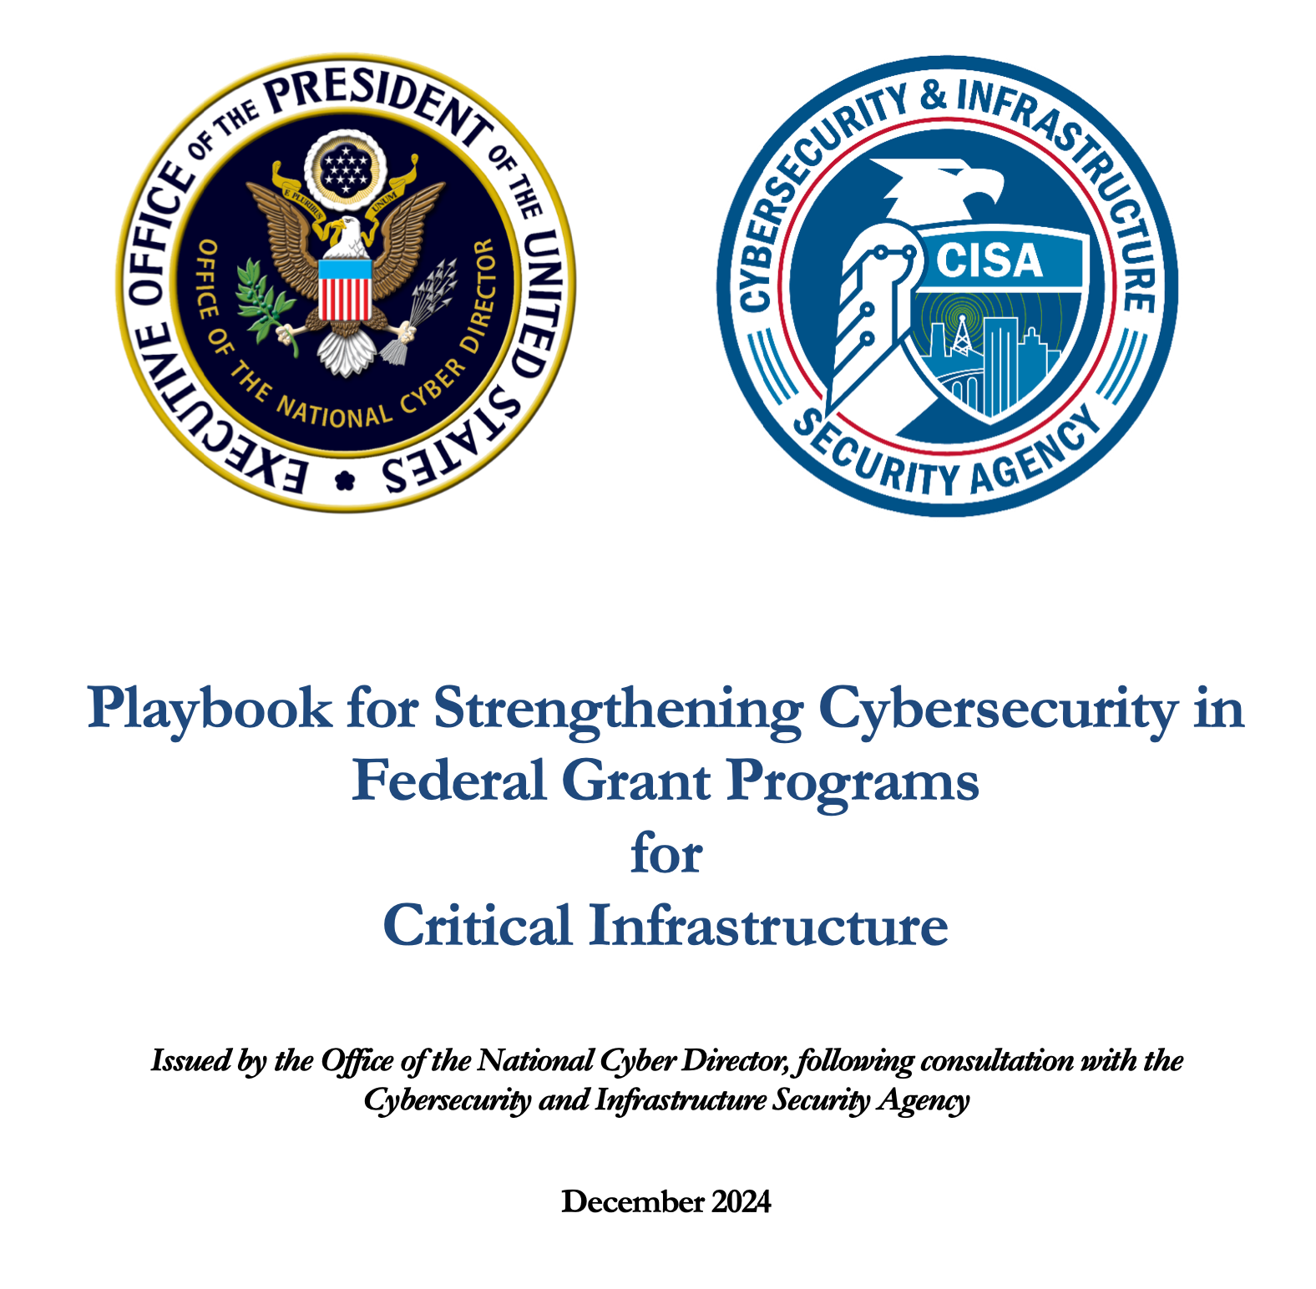
CISA Steps Forward
In December 2024, the Cybersecurity and Infrastructure Security Agency (CISA) and Office of the National Cyber Director (ONCD) published Playbook for Strengthening Cybersecurity in Federal Grant Programs for Critical Infrastructure to enable grant-making agencies to incorporate cybersecurity into their grant programs, and to enable grant-recipients to build cyber resilience into their grant-funded infrastructure projects.
https://www.cisa.gov/resources-tools/resources/playbook-strengthening-cybersecurity-federal-grant-programs-critical-infrastructure

Slide 8
NIH Announces Identity Assurance Requirements
In May 2025, NIH began requiring users accessing certain Controlled-Access Data Repositories (CADRs) via the Researcher Auth Service (RAS) to meet NIST Identity Assurance Level 2 (IAL2) requirements.
NIH will accept REFEDS Assurance Framework IAP-HIGH from R&E Federated Identity Providers.

Slide 9
The Climb: Growing Federal Expectations for Identity & Access Assurance
May 2025
NIH requires NIST IAL-2 to access controlled datasets
Dec 2024
CISA publishes Playbook for Strengthening Cybersecurity in Federal Grant Programs
NSF requires MFA when accessing research.gov
Oct 2024
… and indicates that it’ll require phishing-resistant MFA for users with sensitive access in the future.
2021
NIH requires MFA when accessing eRA.

Slide 10
How is InCommon Involved?
2021
Get NIH Ready
Hundreds of InCommon IdPs added support for REFEDS MFA and released attributes per Research & Scholarship Entity Category
https://spaces.at.internet2.edu/display/federation/get-nih-ready
2021
REFEDS Assurance Framework Implementation Guidance for InCommon Participants
http://doi.org/10.26869/ti.157.1
2024
REFEDS Assurance Framework 2.0 Implementation Guidance for InCommon Participants https://spaces.at.internet2.edu/display/aawg/Consultation+for+the+2024+Assured+Access+Working+Group+Report
2025
REFEDS MFA Profile Working Group
Working with REFEDS community, update MFA Profile to include phishing-resistant MFA definitions and signals
Notes:
Slide 4: A History of Collaboration: NIH & Higher Ed
Headline: NIH & Higher Ed: A Proven Path of Secure Collaboration
Key Points:
2021: NIH mandated MFA for the eRA research portal.
Required all users to perform MFA for access.
Also set a vision to strengthen identity proofing for controlled dataset access.
Community's Response: The Higher Education community delivered!
Hundreds of InCommon participant schools rapidly implemented compatible MFA.
Ensured PIs and research administrators maintained seamless access to eRA using their campus SSO.
"This successful partnership established a strong foundation for addressing evolving identity assurance needs."
Visual: A timeline graphic showing "2021: eRA MFA" leading to "Today: IAL2/IAP-High." Or, interlocking gears representing collaboration.

Slide 11
REFEDS Assurance Framework 2.0 Implementation Guidance for InCommon Participants
Institutions can meet RAF2 identity assurance requirements—especially for remote users—by using existing campus processes (like HR, admissions, or ID card offices) and/or third-party proofing services, depending on the assurance level needed.
Many campuses already do identity proofing for other reasons (e.g., ID cards, I-9s, admissions), which may meet RAF2 requirements.
You don’t need to reinvent identity proofing—use what’s already in place, validate as needed, and bring in external tools or vendors if required.
Consultation (just ended) - https://spaces.at.internet2.edu/display/aawg/Consultation+for+the+2024+Assured+Access+Working+Group+Report
Notes:
III. The "What": Defining Phishing-Resistant MFA (~4-5 minutes)
Slide 7: What is Phishing-Resistant Authentication?
Headline: The Proposed Definition: Phishing-Resistant Authentication
Key Points (Normative):
"Makes it essentially infeasible for a remote attacker to gain sufficient information (e.g., by deceiving the user) to successfully authenticate as the user."
"Cannot rely on secrets (passwords, OTPs, challenges) that a remote attacker could realistically capture and reuse."
"Requires direct interaction between the legitimate user and their intended Trusted Verifier (e.g., your IdP, the Relying Party)."
Crucial Nuance: "Does not protect against other attacks like malware, device compromise, or insider threats."
Visual: A simple diagram showing a user interacting directly with a "Trusted Verifier," with an attacker in the middle being ineffective. Icons for FIDO keys or client certificates can represent the mechanism.

Slide 12
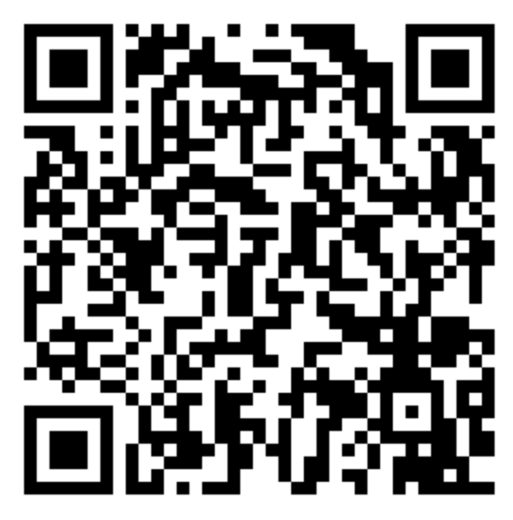
2025 REFEDS MFA Profile WG
Oct 2024
March 2025
June 2025
EOY 2025
National Science Foundation (NSF) announces plan to require phishing-resistant MFA for users with sensitive access.
REFEDS convenes the MFA Profile Working Group to develop phishing-resistant MFA support in the REFEDS profile.
WG releases proposed phishing-resistant MFA definition for community discussions and feedback.
WG expected to complete Profile update and submits REFEDS MFA Profile 2.0 for community consultation.
https://new.nsf.gov/funding/information/dcl-multifactor-authentication-implementation-researchgov
https://refeds.org/a/2998
https://docs.google.com/document/d/19GswmRlvUtKYRU5RlcmA0xLFxpDa8Eye3W9wR95mXQo/

Slide 13
What is Phishing-Resistant MFA?
A form of Multi-Factor Authentication that ensure that only the legitimate user, interacting directly with their intended Trusted Verifier, can successfully complete the authentication process—even if an attacker tries to direct the user to a spoofed verifier.
Essentially:
WebAuthn / FIDO2
Certificate-Based Authentication
Trusted devices.
Smart cards (PIV/CAC)
Notes:
Slide 9: REFEDS MFA Profile WG: Leading the Charge on PR-MFA
Headline: REFEDS MFA Profile WG: Leading the Charge on Phishing-Resistant MFA
Key Points:
Launched April 24, 2025: The 2025 REFEDS MFA Profile Working Group is now officially active.
Directly Addressing Demands: This work directly addresses requirements from organizations like the NSF and aligns with NIH's IAL2 needs.
Core Objectives: The WG is meticulously working to:
Define & Signal: Update profiles to clearly define phishing-resistant MFA and its signaling mechanisms.
Global Alignment: Analyze and map to international standards (NIST 800-63, FIDO, eIDAS).
Community Consensus: Engage extensively with the R&E community.
Timeline for Impact: Expected completion and publication of the updated profile by January 2026.
Visual: A roadmap graphic showing the phases of the working group (assessment, drafting, consultation, finalization) with key dates.

Slide 14
The REFEDS Working Group Needs Your Feedback
There is a lot of fuzziness around Phishing-Resistant MFA. The WG has proposed a definition along with key discussion points.
We need your input.
Proposed Definition and Discussion Points: https://docs.google.com/document/d/19GswmRlvUtKYRU5RlcmA0xLFxpDa8Eye3W9wR95mXQo/
eduGAIN Slack: #assurance-mfa-subgroup
wiki: https://wiki.refeds.org/display/GROUPS/MFA+Subgroup
Notes:
Key Points: Phishing-Resistant MFA is as much a security concept as it is a marketing term.
We have not found a universal, precise, technical definition of phishing-resistant MFA (if you know of one, please let us know).
Yet we need to move forward. We need a common definition in order to create interoperable, trusted PhrMFA across R&E: we have proposed a definition, and a bunch of discussions that led to that definition.
Please visit the doc and provide feedback by commenting on the doc.
If you are attending REFEDS Meeting tomorrow morning, the WG will be making an update.
Better yet, join the WG.

Slide 15
Cyber Insurance: Another Driver for (Stronger) MFA and Identity Assurance
Technical Controls
Multi-Factor Authentication (MFA)
Endpoint Detection and Response
Regular and Secure Backups
Patch Management
Email Security
Governance and Administration
Incident Response Plan
Security Awareness Training
Privileged Access Management (PAM)
Identity and Access Management (IAM)
Additional Risk Controls
Phishing-Resistant MFA
Zero Trust Architecture
Third-Party Risk Management
Documentation Often Requested
MFA Deployment Evidence
Backup Strategy and Logs
Security Policy Documents
Risk Assessment and Penetration Test Results
Audit Reports
In a 2024 (US) education institutions survey,
79%
of respondents had Cyber insurance coverage.¹
1. https://edtechmagazine.com/higher/article/2024/06/survey-reveals-top-cybersecurity-issues-education
Notes:
Some reports have suggested that over 80% of US education institutions have been victims of cyberattacks.
Large % now carry cyber insurance
Common cyber insurance requirements
i.e., to obtain insurance, campuses have had to step up their IAM game.
Risk: absent clear, detailed, easy to follow R&E guidance, campuses are mostly “buying their way out of this” -> vendor solutions are dictating how things are implemented.

Slide 16
What Does It Mean?
MFA is ubiquitous on campus.
“Enhanced MFA” as a risk management requirement is on the rise.
Identity Governance and Assurance are front and center in current thinking.
It is more than "authentication”. It is “Trusted Access”
Mostly happening as campus cybersecurity efforts; Not connected to federated access.
How do we harness this momentum to advance campus cybersecurity and build greater confidence in federated identity?
1. https://edtechmagazine.com/higher/article/2024/06/survey-reveals-top-cybersecurity-issues-education
Notes:
IV. The "How": Implementation & Alignment (~6-7 minutes)
Slide 10: The REFEDS Assurance Framework (RAF) & IAP-High
Headline: The Foundation: REFEDS Assurance Framework (RAF) and IAP-High
Key Points:
RAF specifies levels of identity assurance and authenticator management.
IAP-High (Identity Assurance Profile High) is a specific assertion within RAF that signifies Identity Assurance Level 2 (IAL2) and includes the use of phishing-resistant MFA (AAL2/AAL3).
This is the signal NIH requires for CADR access.
Visual: A simple pyramid or tiered diagram representing RAF levels, with IAP-High prominently highlighted.

Slide 17
Get Involved
Join REFEDS Interoperability Profile Working Groups - Standards work doesn’t work unless there is broad participation.
Federation Operators - Deploy interoperable standards in your locale.
Resource Providers – State your cybersecurity needs; do it together.
We need to work together — to align on policy, clarify implementation, and build guidance that helps us all meet these requirements in a way that works across borders, systems, and communities.”
Notes:
“Everyone’s being pushed to adopt stronger authentication and assurance. But if we each respond in isolation — following different interpretations and vendor paths — we lose the very interoperability that federated identity is built on.
That’s why we need to work together — to align on policy, clarify implementation, and build guidance that helps us all meet these requirements in a way that works across borders, systems, and communities.”
To meet rising global demands for MFA and identity assurance, we must work together — across institutions and borders — to ensure interoperability at the policy level, and to develop precise, implementable guidance for consistent deployment.

