Slide 1
Unlock Argus
Transform Your NOC Through the GÉANT-Argus Collaboration!
Saket Agrahari
Brighton – Community Hub
Wednesday, 11 June 2025

Slide 2
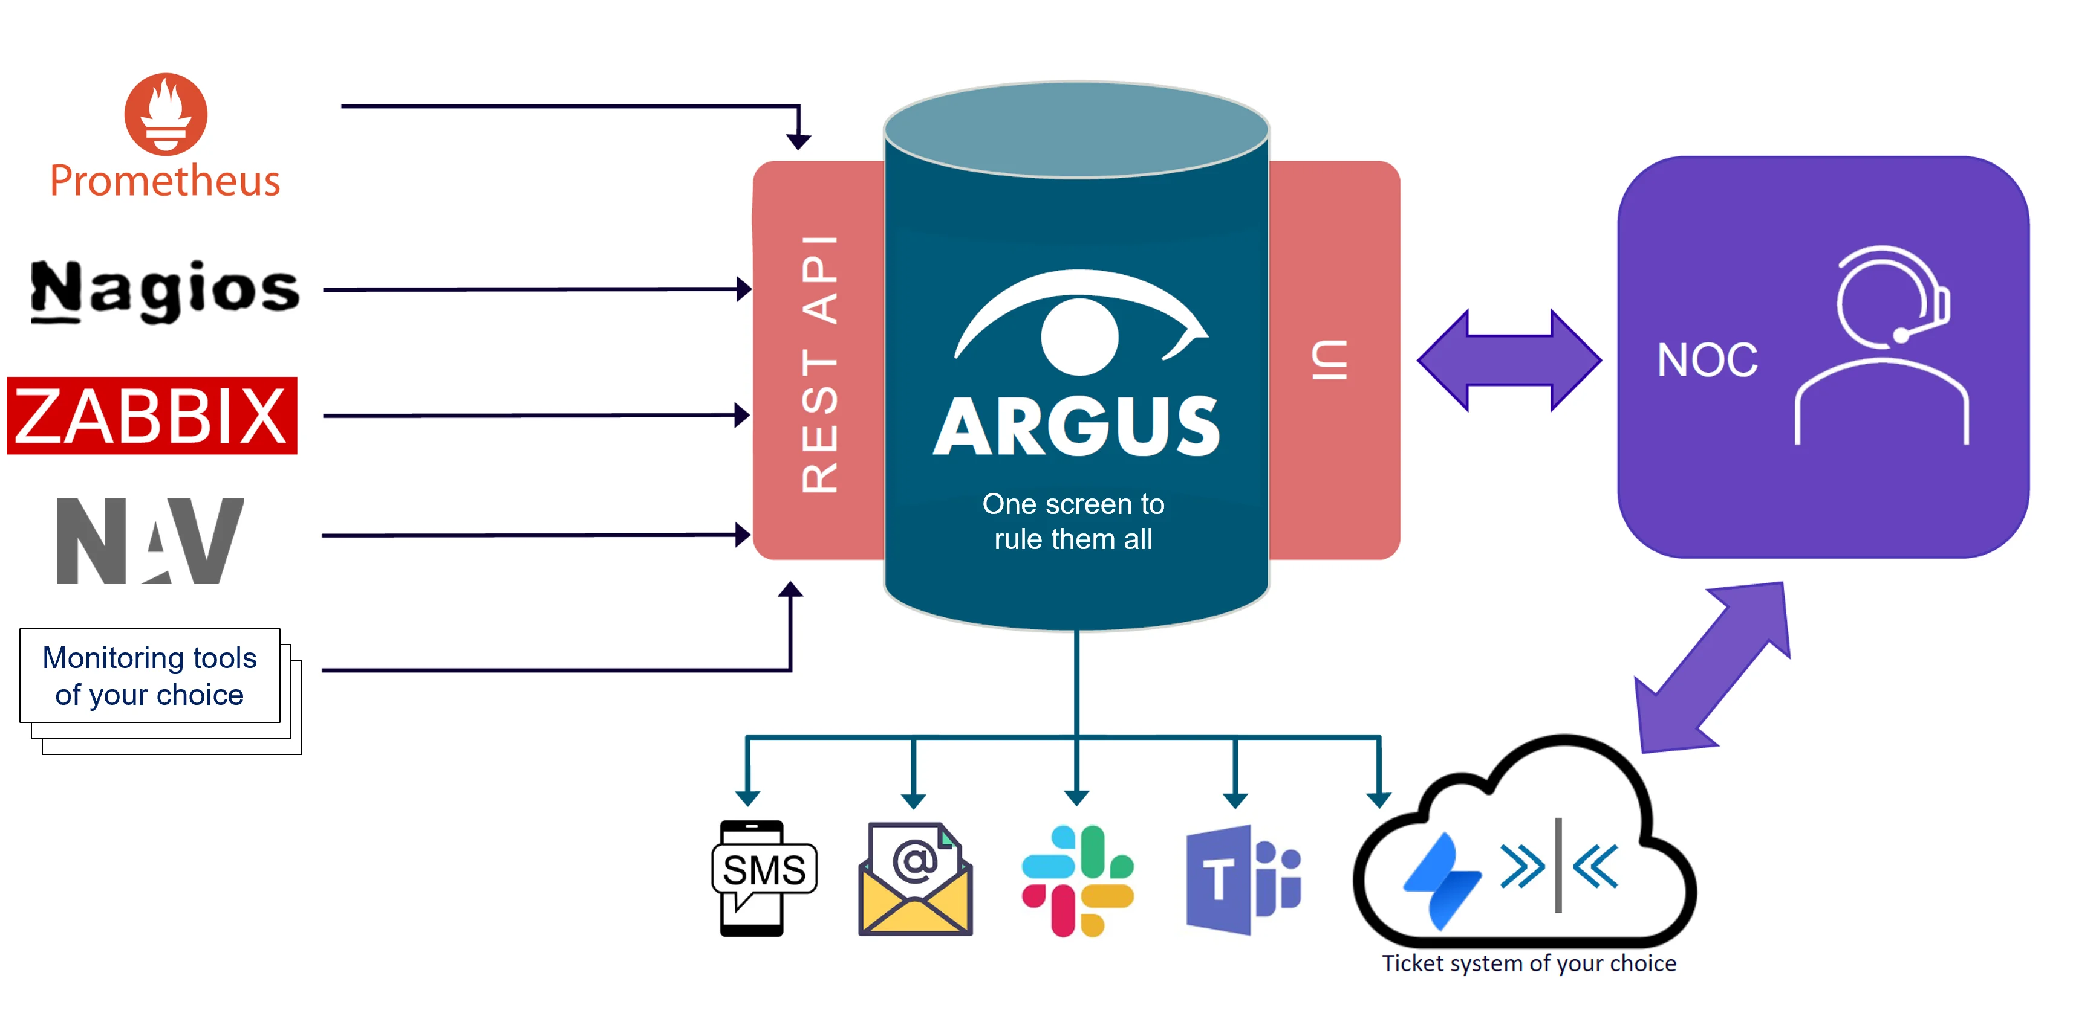
Argus is…
A tool to aggregate incidents from numerous monitoring systems into a single, unified dashboard
Both an incident management system and a notification system
Source agnostic and domain independent
Open source

Slide 3

Géant NOC Dashboard
Interacted by NOC team, service desk and first line support team
Tightly integrated with NE’s, config, services
Automated upstream correlation
TTS integration: business rules are encoded in the correlation logic
Different columns & views (e.g. NE/POP details, multi-level Ack)
Incidents have complex lifecycles, evolve over time
Extra functionality and “widgets” specific to the GÉANT stack

Slide 4
Argus in a nutshell
IN
Any state to monitor:
    alarms, events, changes, updates, deviations…
One or more monitoring systems via glue-services:
    NAV, Nagios, Juniper MIST, Aruba Cloud, Zabbix…
Notification media plugin:
    SMS, Email, MS Teams, Slack…
Ticketing system plugin:
    Jira, RT
Out
One screen to rule them all
Essential filtering
Ability to tag alarms with arbitrary
metadata
Ability to classify by severity
Personalized notifications
Automated ticket generation

Slide 5


Sikt & GEANT: Building Together
Sikt: Creator and maintainer of Argus
GEANT: Early adopter, contributor
Joint development of “geant-argus” on top of Argus vanilla
**Up-to-date Stack:** Django +htmx + tailwind and integrated FE and BE into single workspace enables fast feature delivery and easy maintenance

Slide 6
Motivation of Argus into GÉANT NOC
A new Incident Dashboard UI was required
Previous GUI architecture had reached end shelf life
  Overcomplicated abstraction
  Breaking dependencies that need the complete overhaul
  Hard to maintain
Legacy Software Stack
  Old spring framework, old Tomcat and deprecated java version,
  Complex deployment process
Full DIY rewrite ??

Slide 7
From Argus to geant-argus: Our Experience
geant-argus: Customizations and extensions for GEANT’s needs
Source-dependent modules built on top of Argus’ agnostic core
Contributed improvements back to Argus upstream making investment of effort
Collaboration on styling
Smooth transition from our old UI to new geant-argus-dashboard
Notes:
• Share enhancements with the community
• Start with Argus vanilla for core functionality

Slide 8
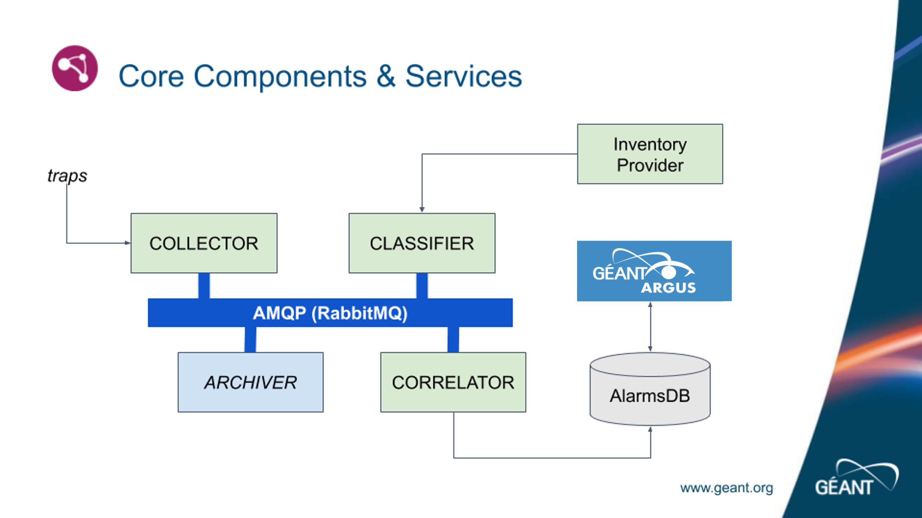
Argus to geant-argus: Our Experience

Slide 9
Risks & Considerations
Data Model Misalignment
Argus DB and Correlator DB use separate data models that require continuous synchronization and vigilant maintenance to avoid inconsistencies.
Codebase Duplication
Two distinct codebases increase complexity and require ongoing attention, refactoring, and care to ensure long-term maintainability.

Slide 10
References
Argus Documentation : https://argus-server.readthedocs.io/en/latest/
Github Links :
Argus : https://github.com/Uninett/Argus
Geant-Dashboard GUI : https://github.com/GEANT/geant-argus

Slide 11
Demo..

Slide 12
Thank you
Any questions?
saket.agrahari@geant.org

