Slide 1
Community Hub “Twinning for Collaboration”
Dr. Leonie Schäfer (DFN) – Chair of the GÉANT Twinning Programme
TNC 2025
Brighton, UK
Thursday, 12th June 2025

Slide 2
GÉANT Twinning: Driving NREN Impact
What is it?
Facilitates NREN partnerships for mutual growth
Collaboration among equals
How it works?
Collaborative project planning with defined objectives and deliverables
Limited funding supporting EU NRENs personal and Programme participant’s travel.
6-month duration
Dissemination of project outcomes to the wider community
Getting Involved
Opportunities for mutual visits and knowledge exchange
Next Submission: October 2025
More info:
twinning@geant.org
Key Goals
Facilitating the sharing of expertise and best practices
Supporting the development of new services and infrastructure
Building lasting relationships between NRENs

Slide 3
Unlock Your NREN's Potential with Twinning
Knowledge Transfer: Learn directly from peers
Capacity Building: Enhance your NREN's skills
Service Development: Jointly build new services
Global Networking: Forge lasting international connections

Slide 4
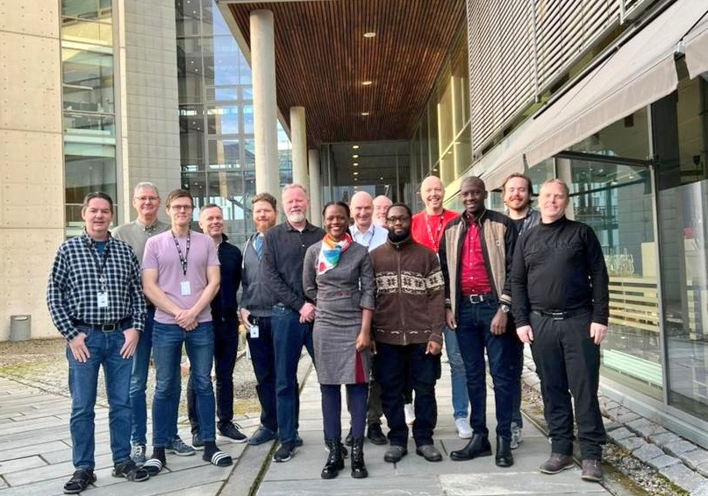
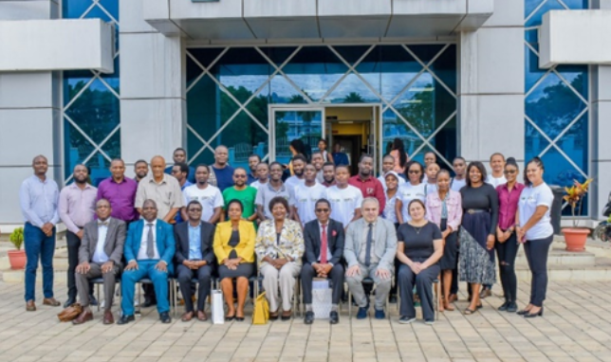
2024 Twinning Projects
Norway
Uganda
Malawi
Armenia
Collaboration: CNaaS
Collaboration: HPC, IPv6, CERT, Marketing

Slide 5
2025 Twinning Projects
Kenya
United
Kingdom
Netherlands
Sri Lanka
Collaboration: eduroam for remote areas
Collaboration: Service adoption
Missing picture of KENET– JISC Twinning
Missing picture of SURF – LEARN Twinning

Slide 6
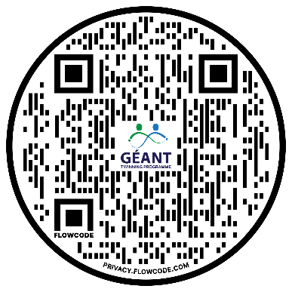
Connect, Collaborate, Create: Get Involved!
Connect & Discover: Find Your Twinning Partner
Explore & Plan: Visit Our Wiki https://wiki.geant.org/x/igA2Lg
Develop Your Proposal: Outline your collaboration idea
Get Support: Contact the Twinning Chair twinning@geant.org

Slide 7
NREN Twinning Programme: Jisc and KENET
David Patterson
Head of International, Jisc

Slide 8
Twinning Programme

Slide 9
Benefits for both NRENs
KENET Objectives
Improved efficiency
Stakeholder engagement
Value awareness
Increased uptake of eduroam
Organization policies
Alignment of Interests
Capacity building
Knowledge exchange
Extending eduroam
Connecting schools
Bridging the digital divide
Long-term relationship
Jisc Objectives
Extending eduroam
Enabling research
Schools engagement
Knowledge exchange
Digital divide
Resilience

Slide 10
Positives

Slide 11
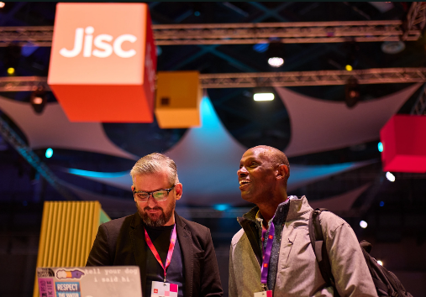
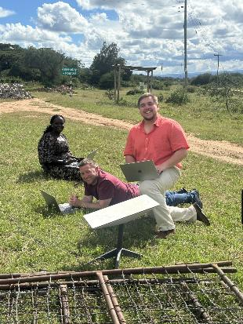
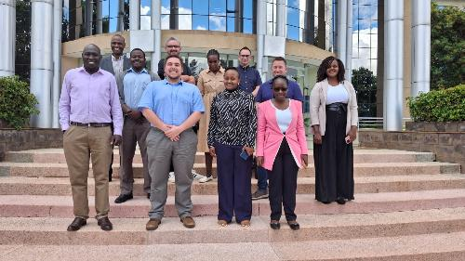
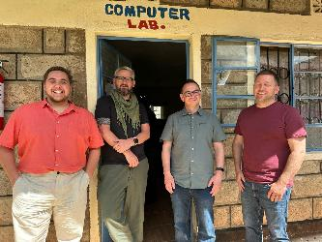
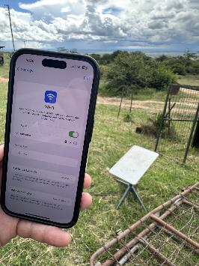
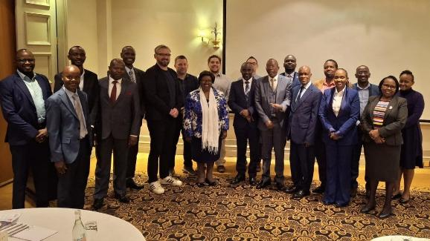
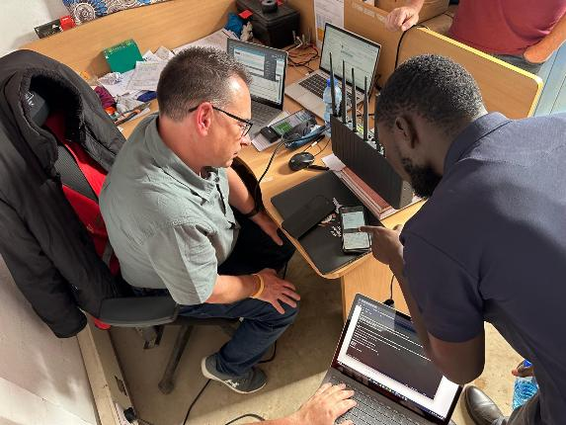
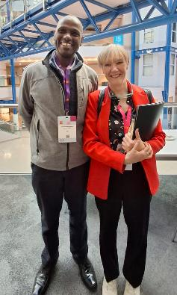
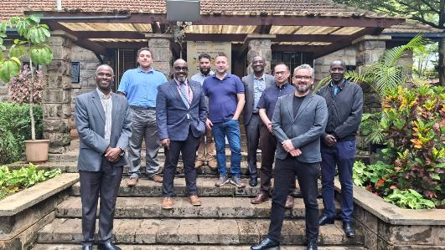

Slide 12
Considerations
Notes:
Do it, or do it properly – it’s a choice
Time and effort
Communications
Culture
Logistics
Commitment
Marketing
Stakeholder management
Exhaustion

Slide 13
Summary: We are big fans of the Twinning Programme
Notes:
Do it, or do it properly – it’s a choice
Time and effort
Communications
Culture
Logistics
Commitment
Marketing
Stakeholder management
Exhaustion

Slide 14
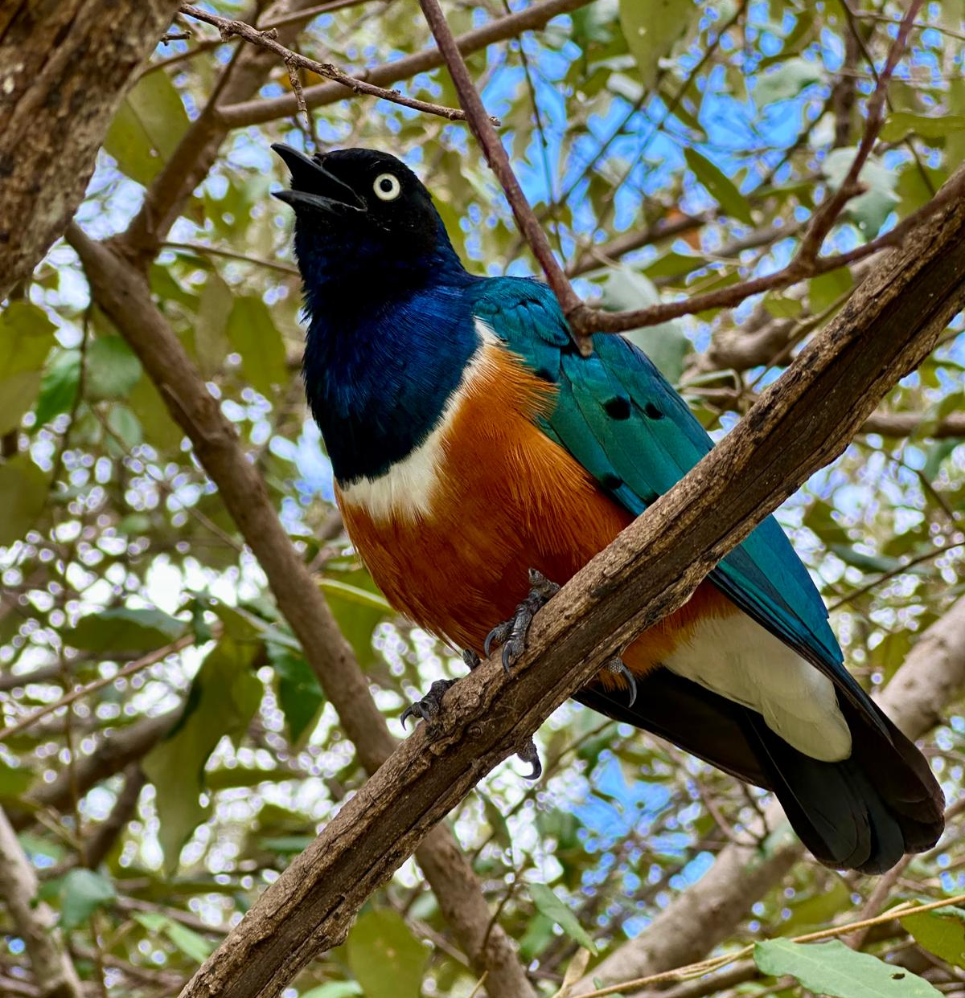
David Patterson
Head of International
david.patterson@jisc.ac.uk

Slide 15
NREN TWINNING PROJECT
LEARN-SURF Twinning Project: Enhancing NREN Service Adoption
Shashini Withanage
Assistant Manager - Projects & Solutions, LEARN
12th June 2025, TNC25 – Community Hub”

Slide 16
INTRODUCTION
LEARN-SURF Twinning Project: Enhancing NREN Service Adoption
The LEARN-SURF Twinning Project focuses on leveraging SURF’s Life Cycle Portfolio Management Processes to increase the uptake of services offered by LEARN among its constituents
Goal: Improve the adoption of LEARN’s services through strategic service management, marketing, and user engagement, informed by SURF’s best practices and expertise.
The collaboration includes joint activities such as workshops, knowledge exchange sessions, and marketing strategy development to enhance LEARN’s service portfolio and expand its reach

Slide 17
PROJECT OBJECTIVES
Objective 1
Objective 2
Objective 3
Apply SURF’s Life Cycle Portfolio Management Processes to ensure LEARN’s services meet the evolving needs of its constituency
Improve service adoption at LEARN by refining service delivery, support, and communication strategies.
Enhance LEARN's marketing efforts, leveraging SURF's expertise to strengthen outreach and engagement.

Slide 18
EXPECTED OUTCOMES
Increased Service Uptake
Stronger Service Portfolio
Improved Communication & Engagement
Long-Term Sustainability
Higher adoption of LEARN’s services across the higher education and research sectors in Sri Lanka, driven by the strategic application of life cycle management
A well-managed portfolio that aligns with the needs of LEARN’s members, resulting in more relevant and impactful services.
A foundation for continuous service improvement and long-term sustainability
More effective communication strategies and engagement with stakeholders, leading to stronger connections and better service adoption

Slide 19
PROJECT TIMELINE
Assessing and Finalising the outputs
Visit to SURF
April 2025
July 2025
September 2025
October 2025
Initiation and planning
Visit to LEARN

Slide 20
THANK YOU!
www.ac.lk
shashini@learn.ac.lk
+94772228074

