Slide 1
Building a Network Data Repository
Carolina Felicissimo carolina.felicissimo@rnp.br
Gustavo Araújo gustavo.araujo@rnp.br

Slide 2
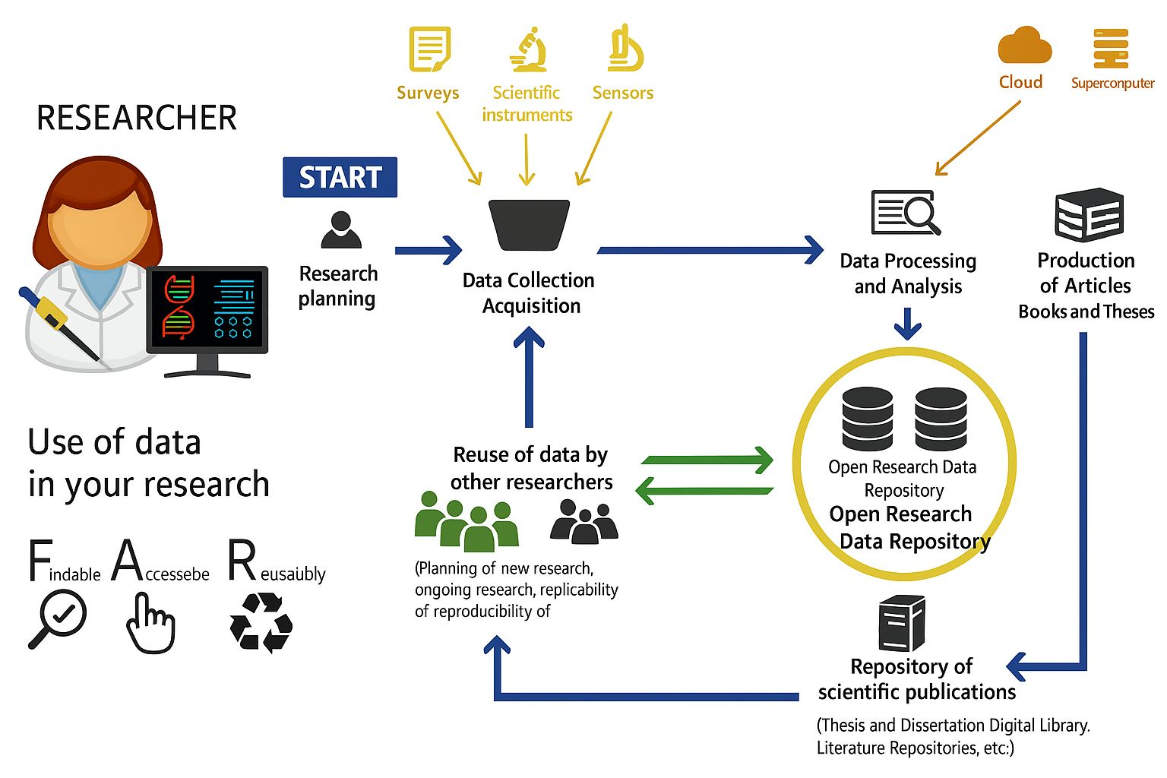

Slide 3
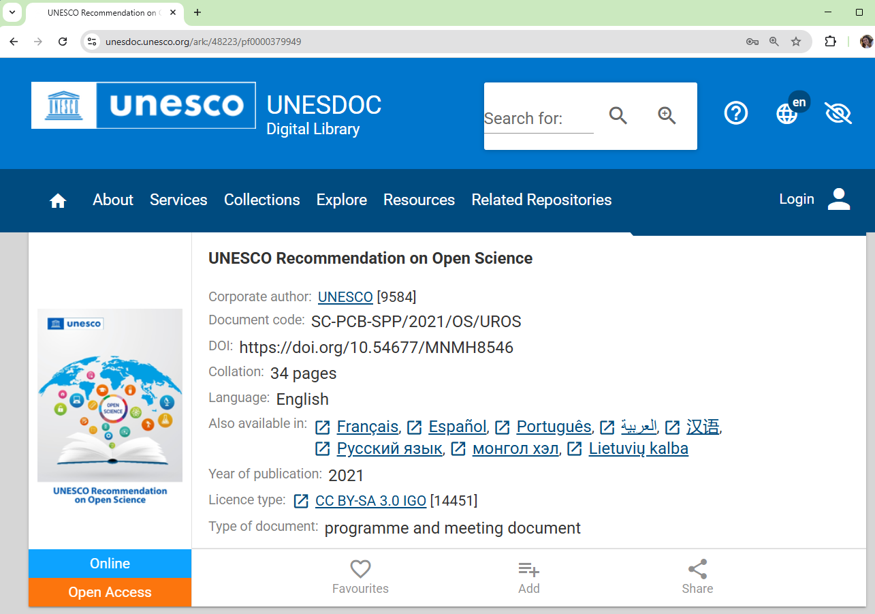

Slide 4
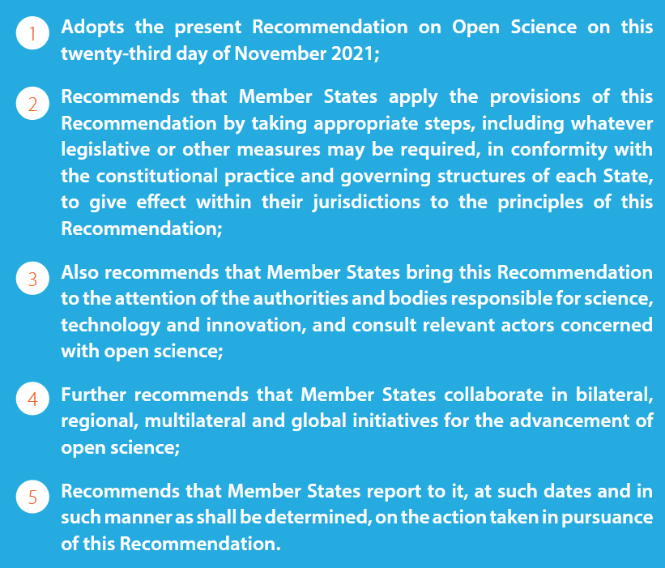
[https://doi.org/10.54677/MNMH8546]

Slide 5
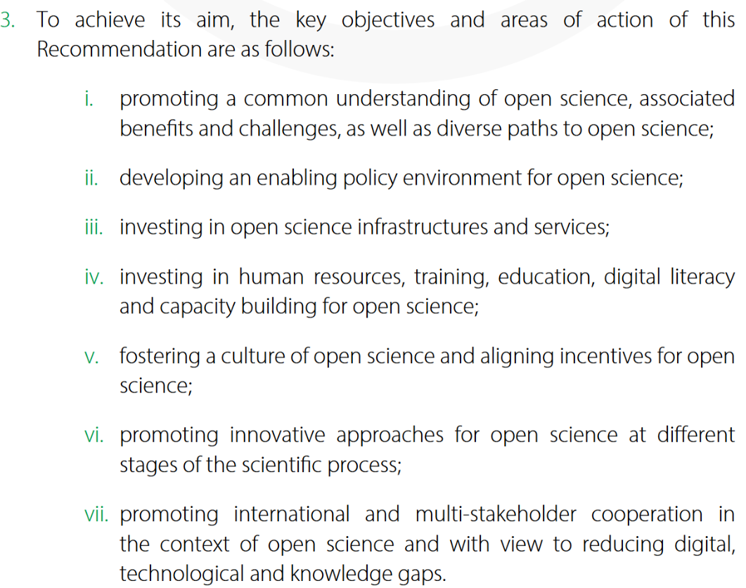
[https://doi.org/10.54677/MNMH8546]

Slide 6
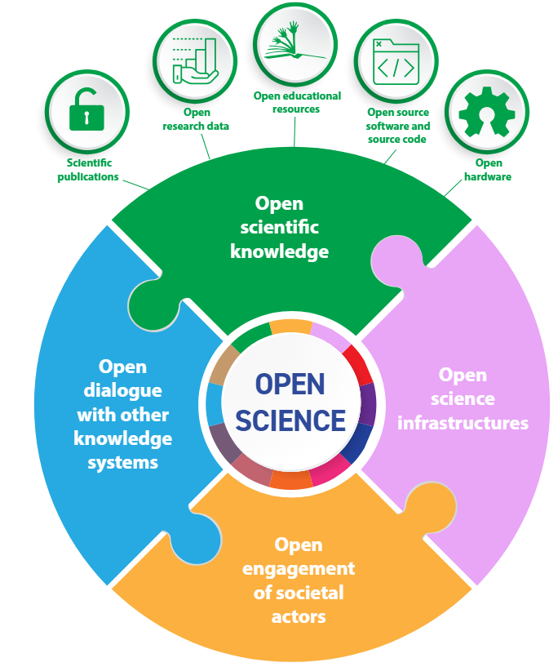
[https://doi.org/10.54677/MNMH8546]

Slide 7
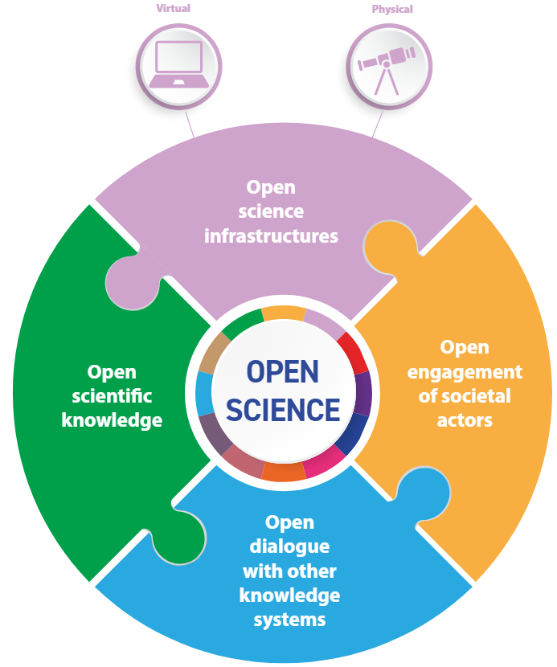
[https://doi.org/10.54677/MNMH8546]

Slide 8
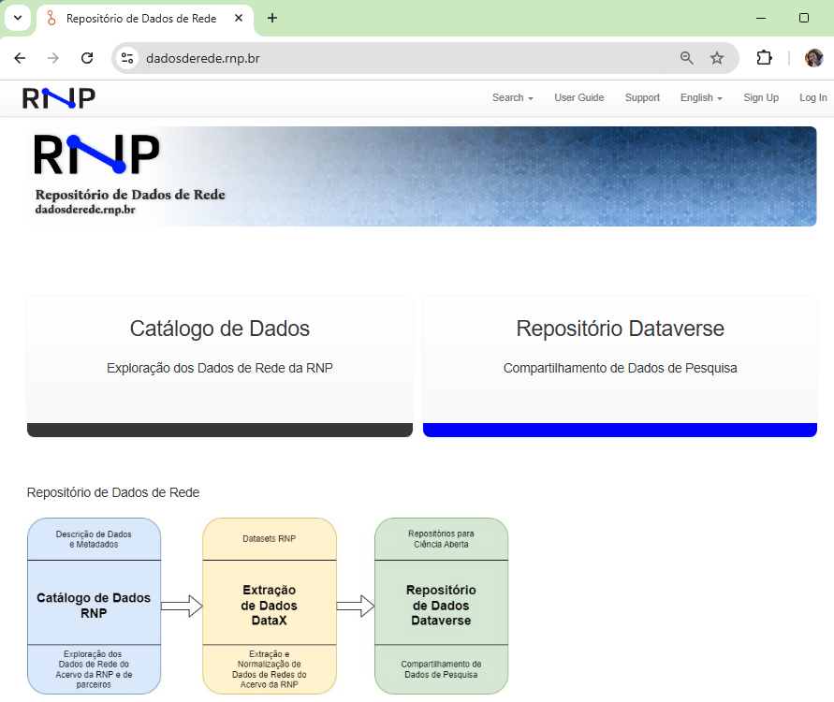
RNP Data Catalog
Data Extraction
Data Repository
Describe network data
Extraction and normalization of network data
Research data sharing

Slide 9
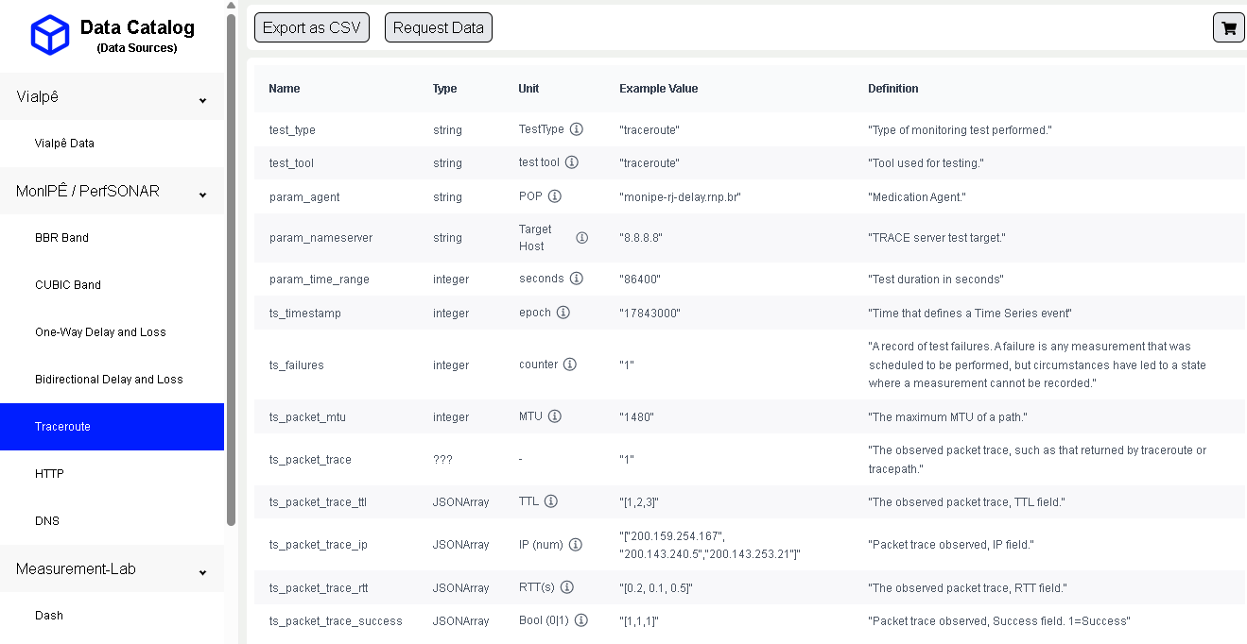

Slide 10
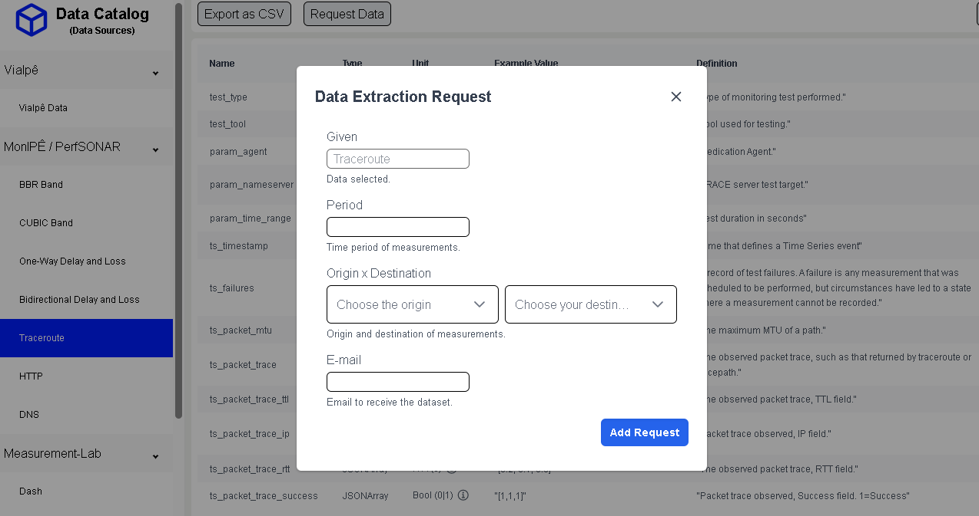

Slide 11
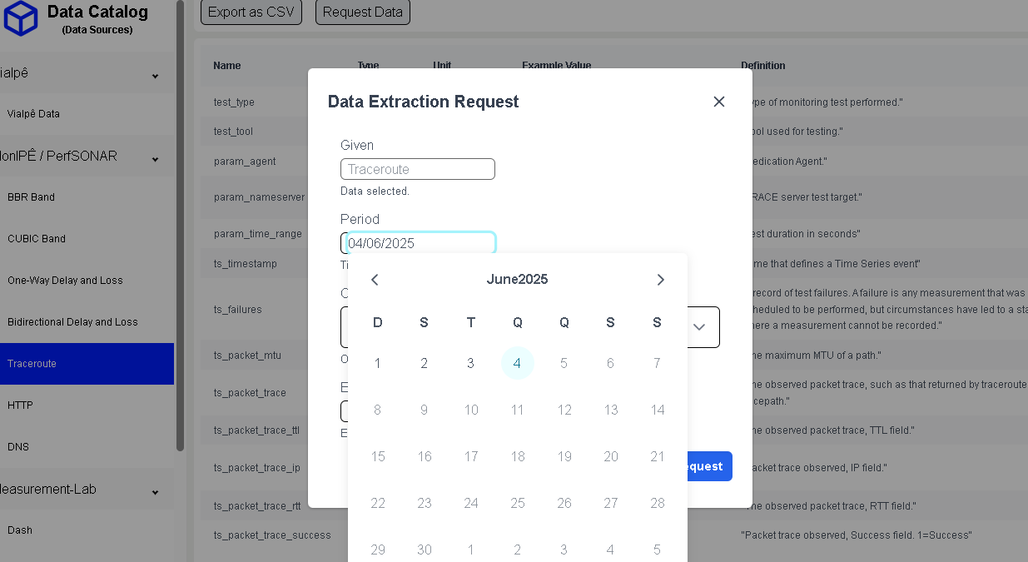

Slide 12
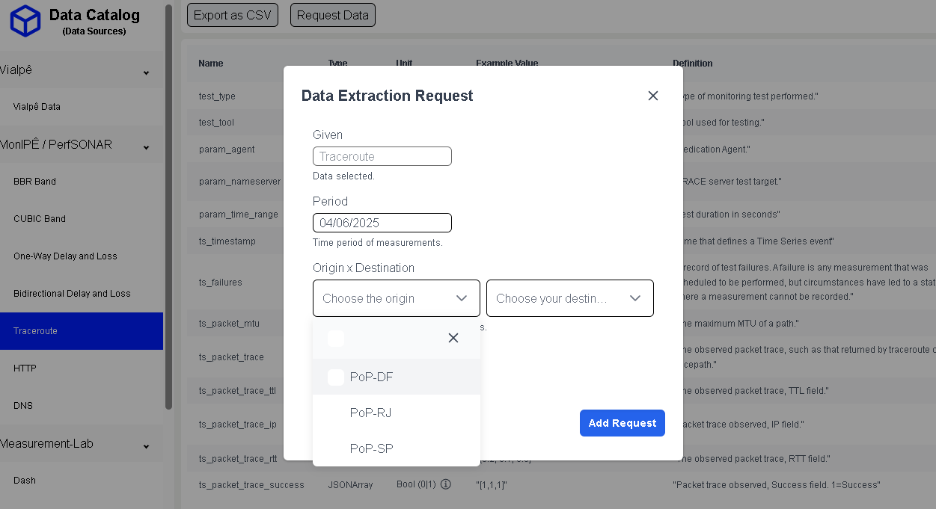

Slide 13
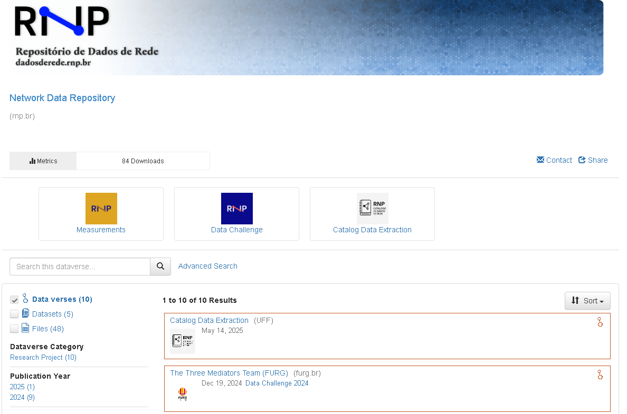

Slide 14
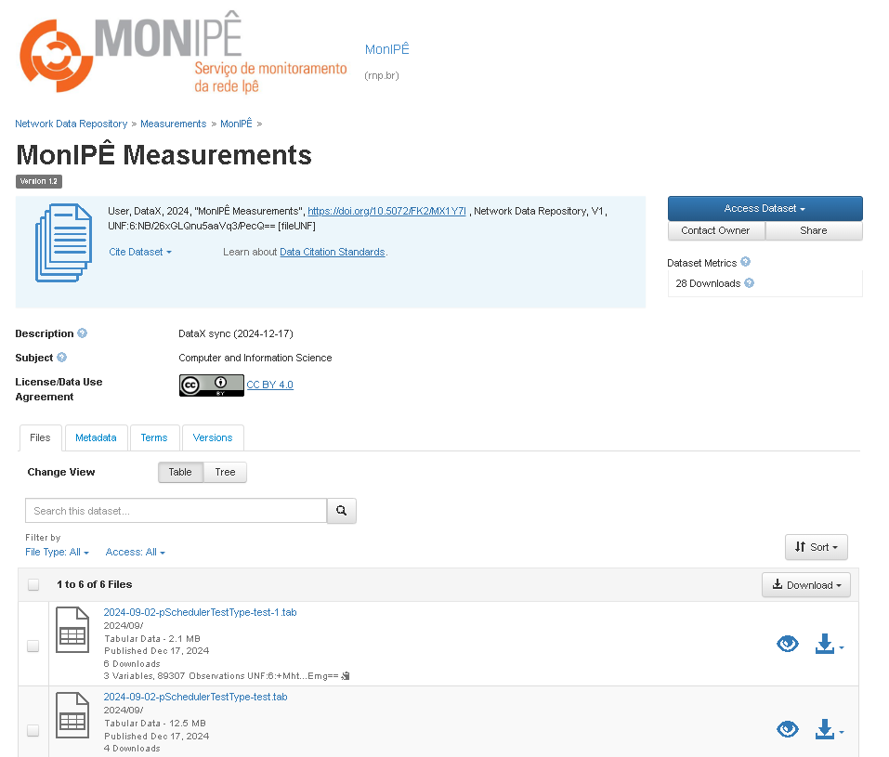

Slide 15
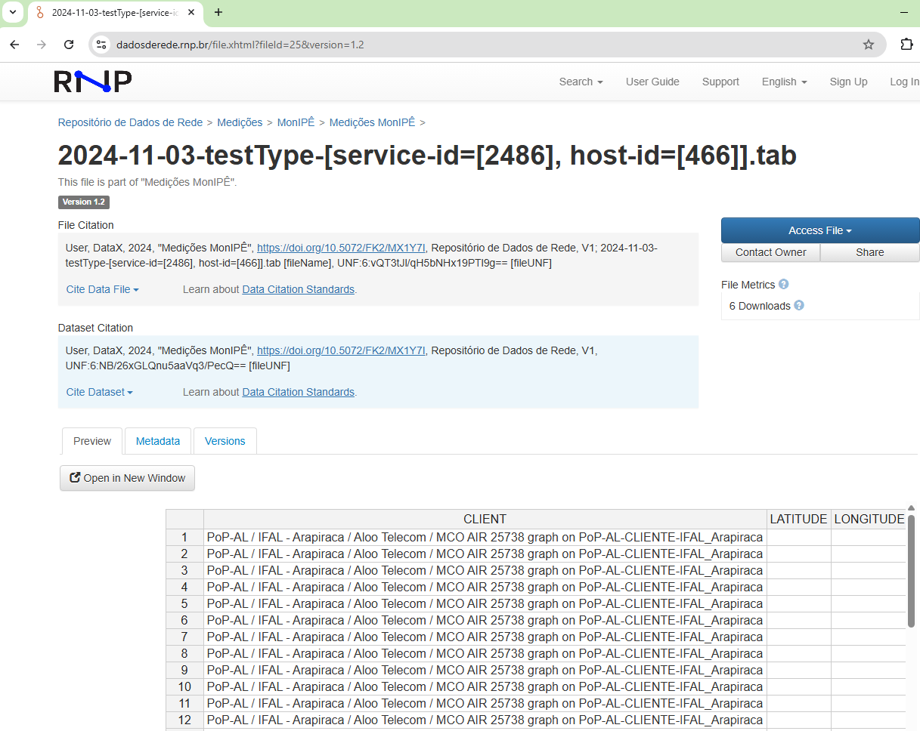

Slide 16
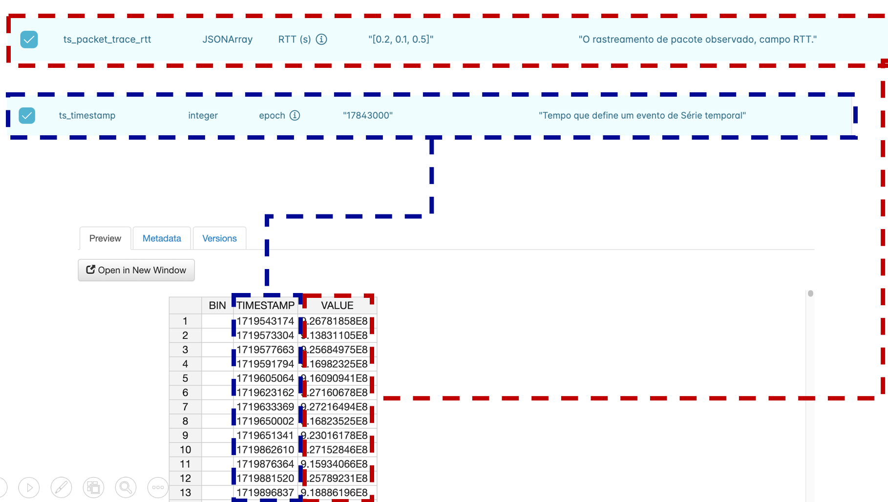

Slide 17
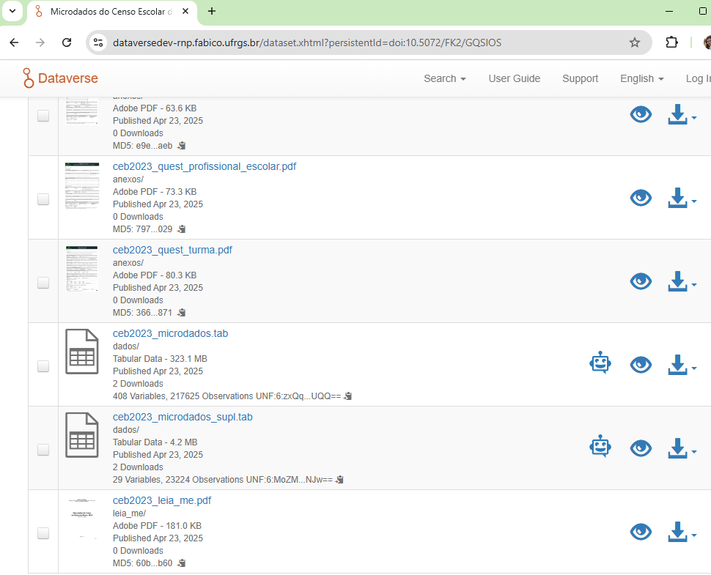

Slide 18
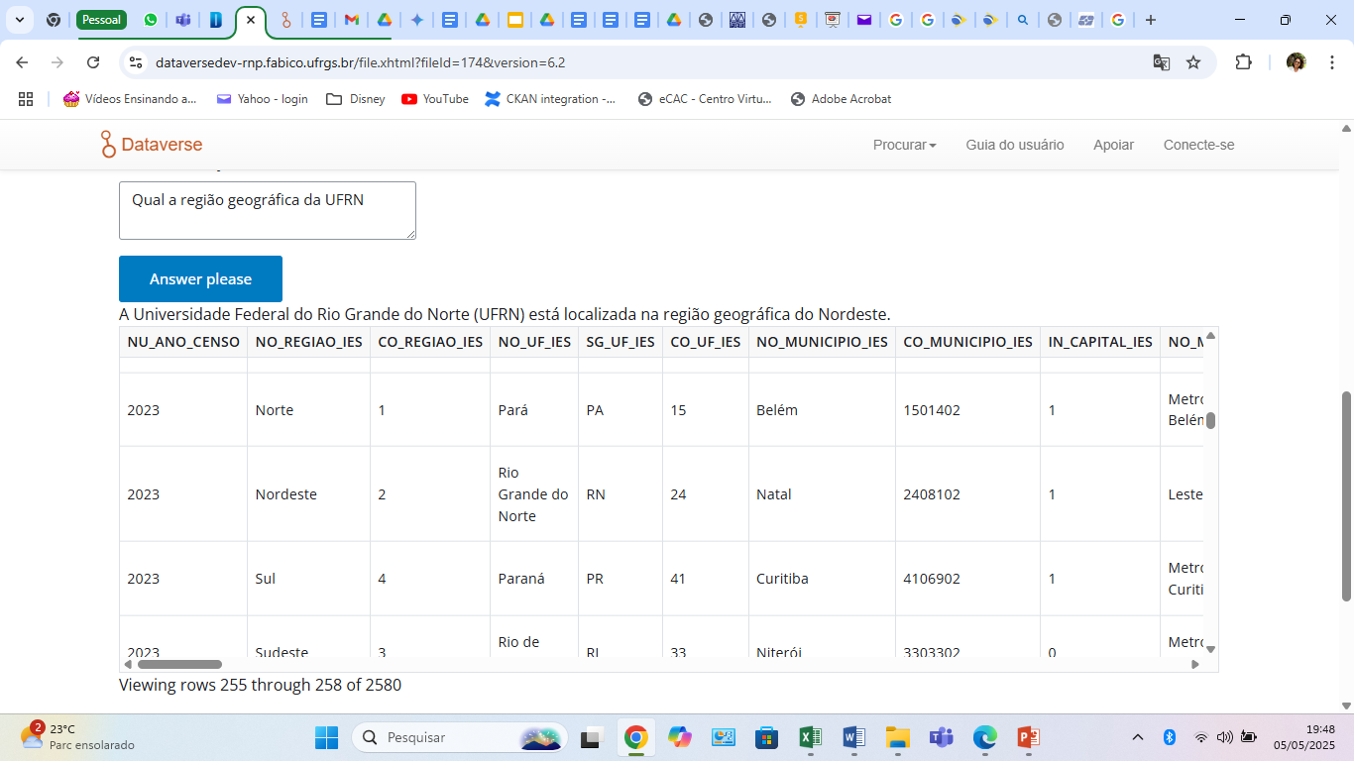

Slide 19
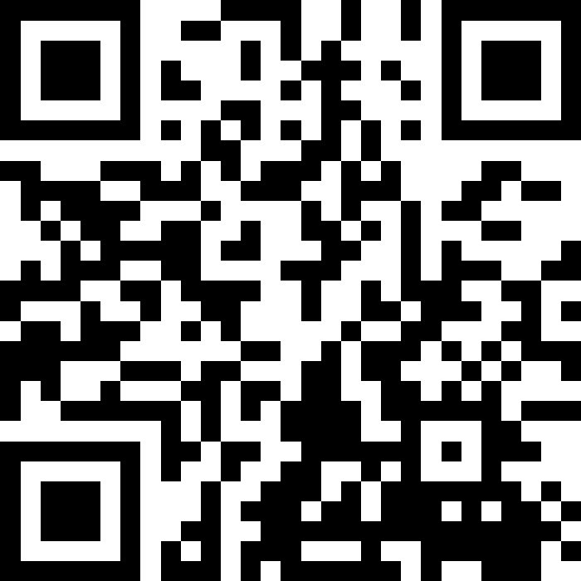
Let’s talks!!!
Now let's move on to the interactive part:
We want to hear your perspective
Access the QR Code and let's talk

Slide 20
Obrigada

