Slide 1
Community Hub 2025
Stronger Together: NRENs in a Changing World
GÉANT Community for NRENs by NRENs: A Changing Landscape
Naira Kocharyan (ASNET-AM), Olga Popcova (RENAM)
10.06.2025

Slide 2
GÉANT Community for NRENs by NRENs: A Changing Landscape
EaP NRENs – ASNET-AM (Armenia), AzScienceNet (Azerbaijan), GRENA (Georgia), RENAM (Moldova) and URAN (Ukraine) – invite you to a dialogue and a thinking space about GÉANT Community as a living entity, the entity that evolves in response to the technological, financial, and socio-political changes around us.
With all the changes that impact NRENs (and their constituents) how can the GÉANT Community programme be further optimised to support NRENs?

Slide 3
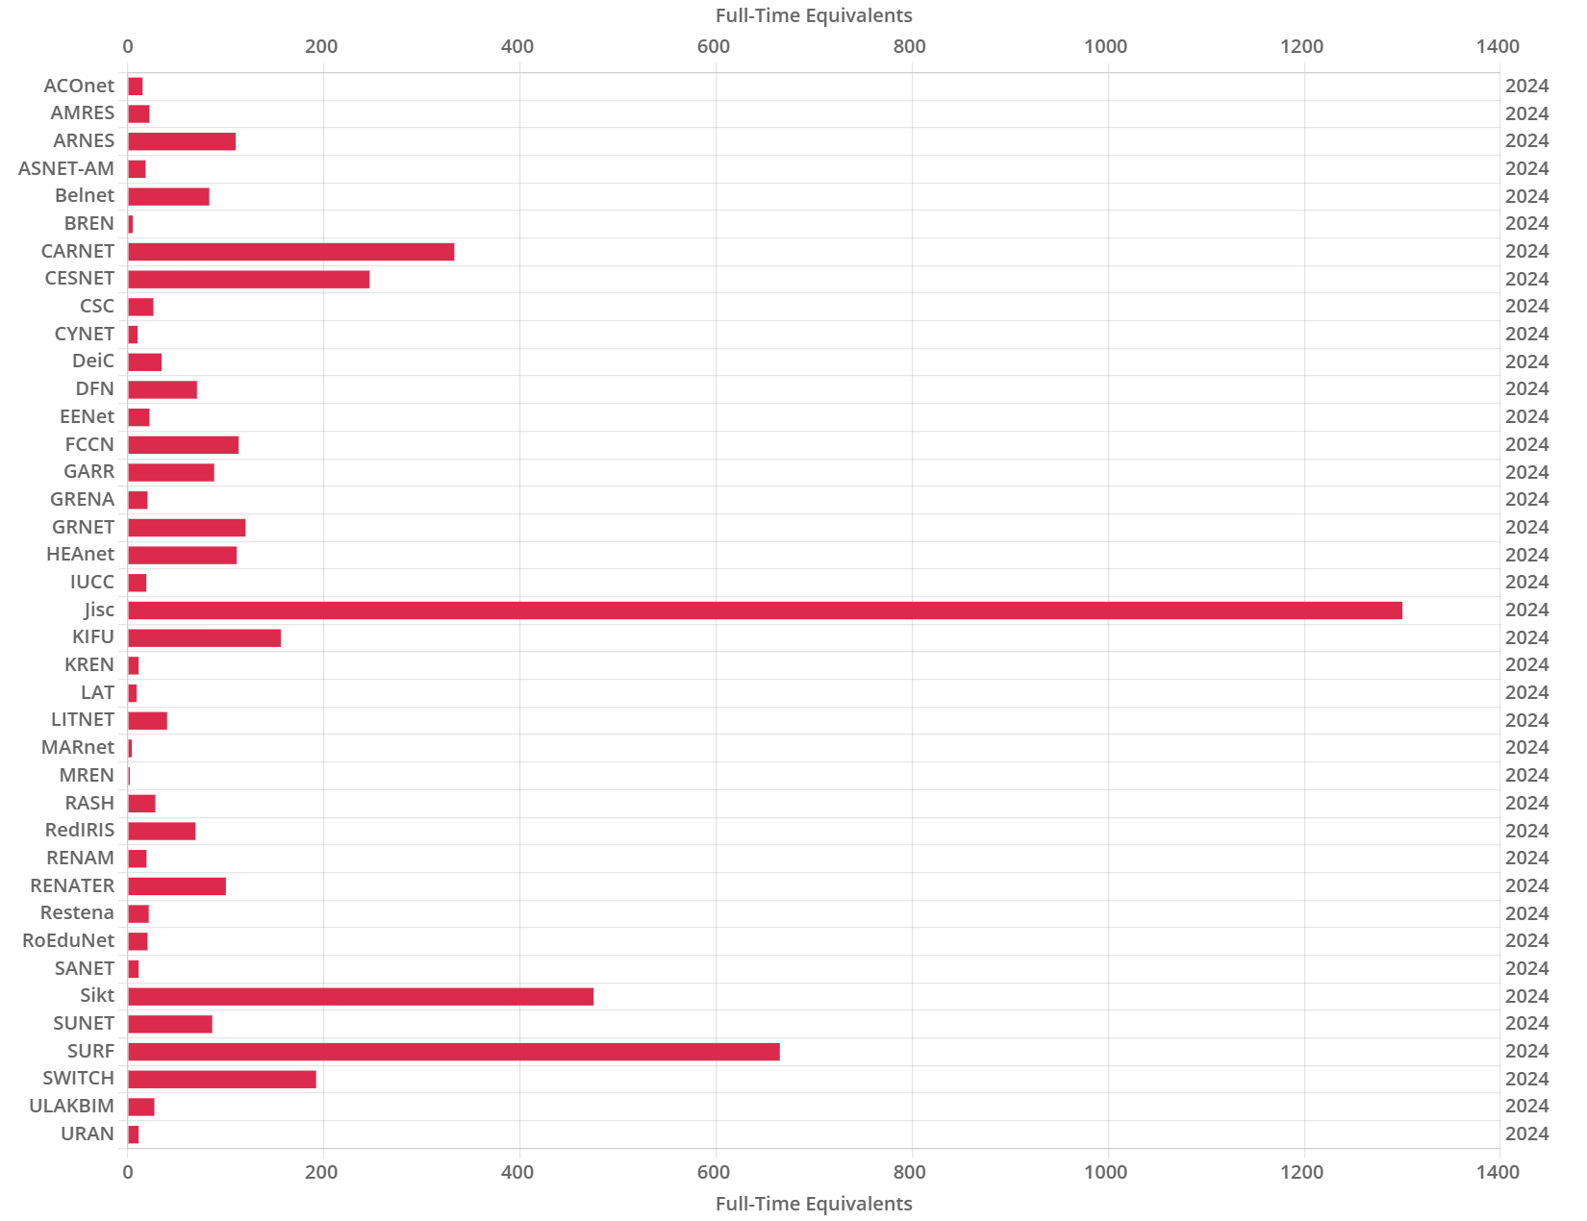
GÉANT Community for NRENs by NRENs: A Changing Landscape
The session is a discussion space to share thinking about impact, scale and change management for smaller-size NRENs (≤ 20 persons).
Compendium Data 2024:
14 of 39

Slide 4
GÉANT Community for NRENs by NRENs: A Changing Landscape
1) Is it more difficult for a smaller-size NREN? If so, why and in what way?
2) What are the main challenges faced by a smaller size NREN?
3) Is there an advantage of being a smaller size NREN?
4) What can be helpful strategies here in mitigating an (adverse) impact?

Slide 5
Thank you
Any questions?

