Slide 1
Support for URAN — Lessons Learnt
Humanitarian Support in the Community Programme
Tetiana Preobrazhenska (URAN, Ukraine)
TNC25 Community Hub
10 June 2025

Slide 2
Introduction
Ukrainian NREN URAN has operated under war for over three years.
The GÉANT community's support has been vital.
We share lessons learnt and explore a new humanitarian support initiative for NRENs in crises.
1

Slide 3
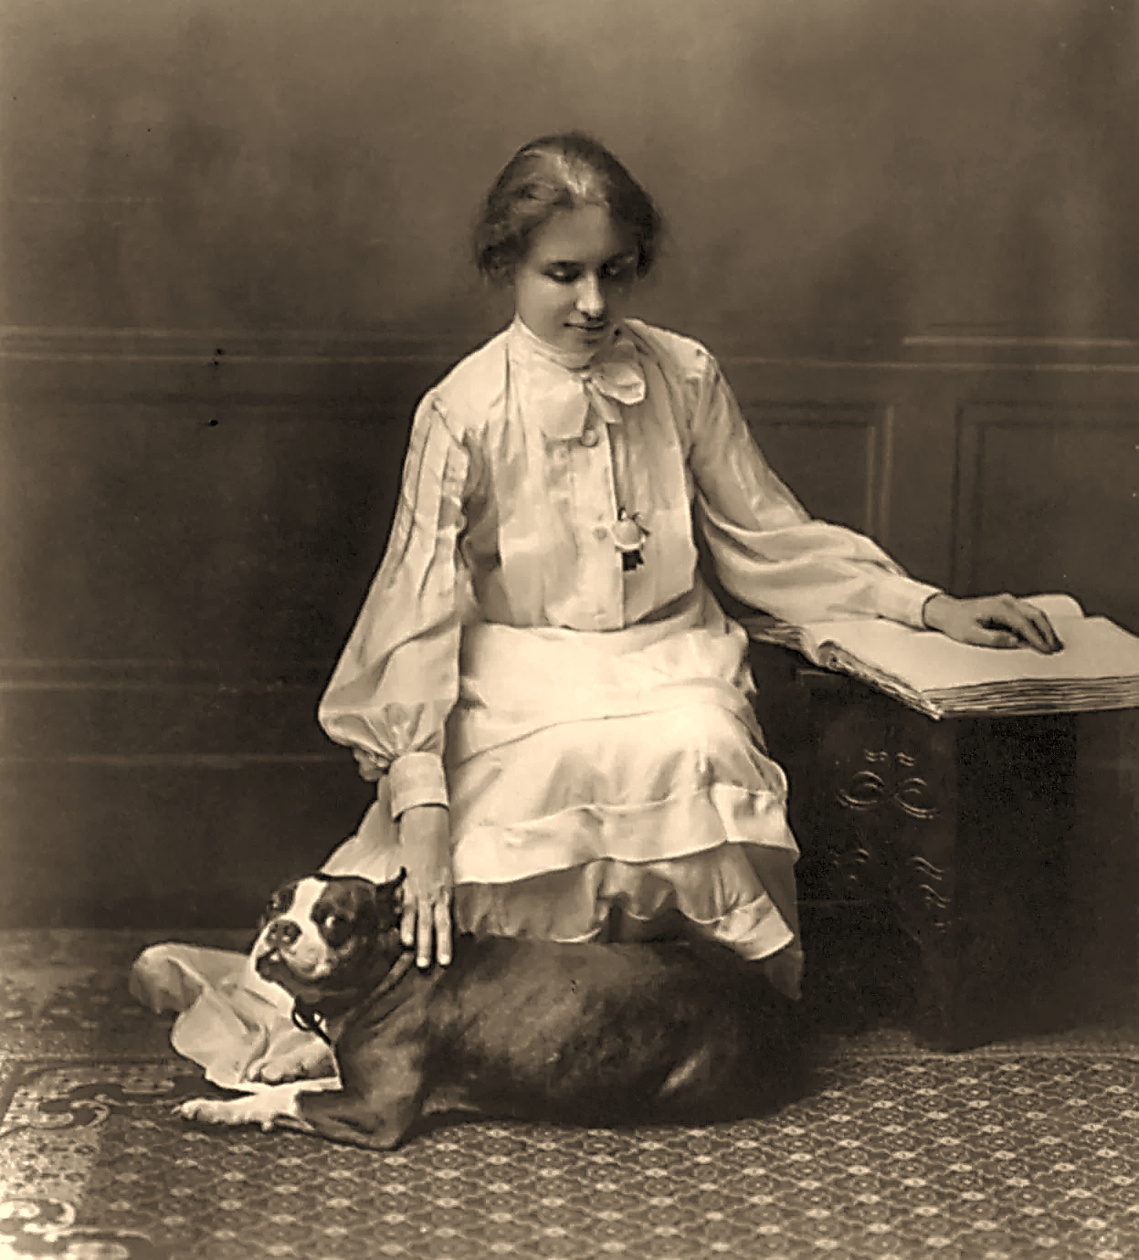
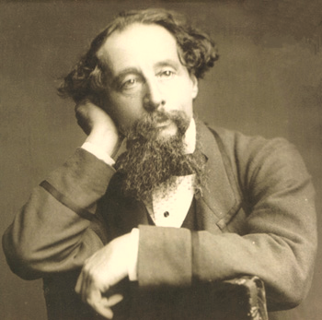
“Alone, we can do so little; together, we can do so much.”
- Helen Keller American author, disability rights advocate, and political activist
“No one is useless in this world who lightens the burden of it for anyone else.”
- Charles Dickens English novelist and social critic
“It is not enough to be compassionate – you must act.”
- Dalai Lama XIV Spiritual leader of Tibetan Buddhism and Nobel Peace Prize laureate
2

Slide 4
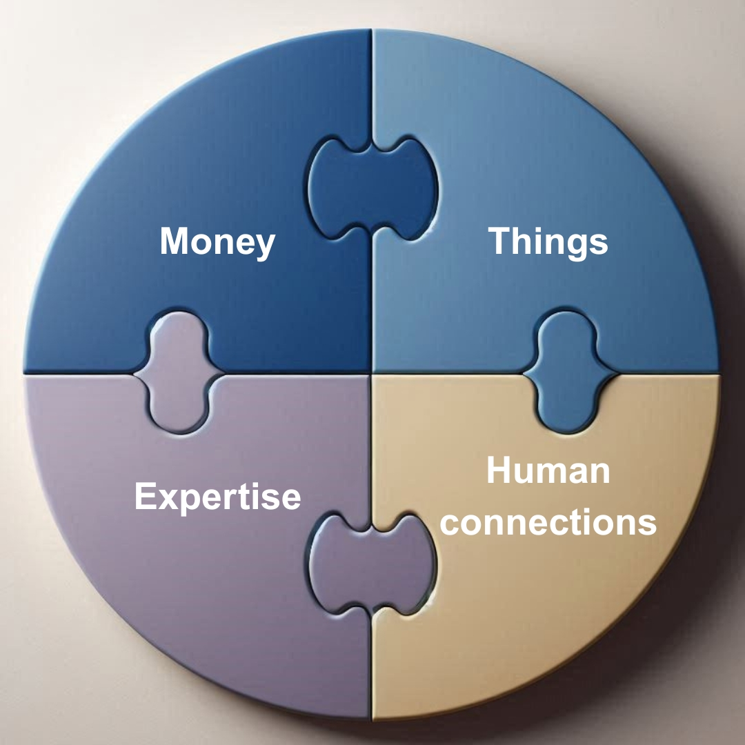
Lesson 1: There are various categories of help needed
Four
main categories:
3

Slide 5
Category 1: Financial support (Money)
Funding cuts during crises reduce income; expenses rise.
Emergency Relief Fund:
- operational expenses;
- essential equipment (laptops, generators);
- energy independence (power units, fuel).
💡URAN example - financial initiative by GÉANT and Vietsch Foundation
4

Slide 6
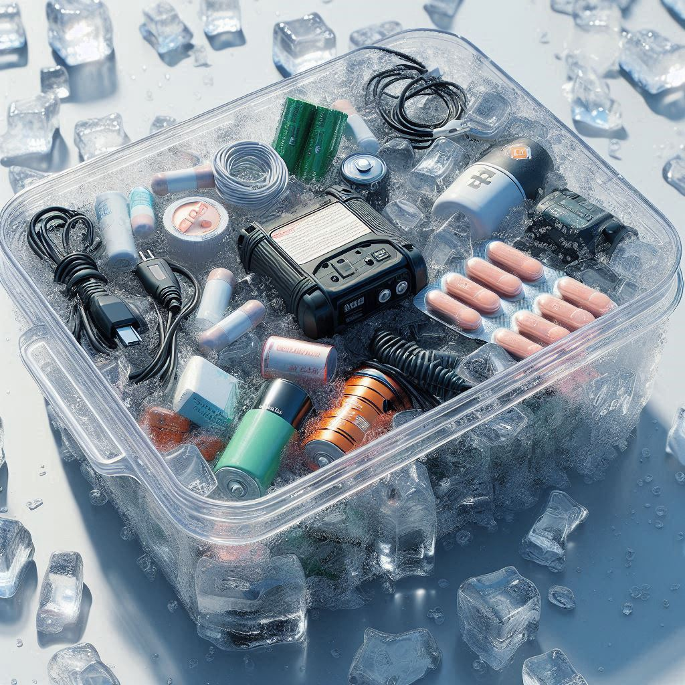
Category 2: Material support (Things)
Any material resources gathered and distributed to a NREN in crisis (depending on the type of crisis):
- equipment (laptops, generators);
- medical kits, first aid materials, hygiene products;
- solar panels, portable chargers or alternative energy systems;
- ready-to-eat meals or clean drinking water;
- clothes.
🧡URAN examples: laptops from Computer Aid, generator from PSNC
5

Slide 7
Category 3: Expertise support
Remote help to a NREN facing staff shortages due to crises:
- crisis management and response strategies;
- trainings & workshops;
- remote IT support for infrastructure maintenance.
🧠 Examples: CLAW, TALON exercises, IT software (like NMaaS)
6

Slide 8
Category 4: Human Connection
When you find yourself in a crisis your moral suffers a lot.
What can help:
- virtual coffee breaks and events to boost morale;
- kind messages;
- emotional support to overcome isolation;
- care parcels.
🎁URAN examples: Christmas parcels and letters, personal messages and
e-mails
7

Slide 9
Video of URAN team unpacking a Christmas parcel

Slide 10
Lesson 2: Support must match current needs
NMaaS Feb-March 2022
Generator Dec 2022
Parcels Jan 2023
Laptops Dec2023&Apr 2024
Parcels Jan 2025
Needs evolve over time.
It is important to provide the support that is needed right now.
Examples from URAN:
🧭 Stay in touch, respond to current needs
9

Slide 11
Lesson 3: Beware of bureaucracy
Support efforts can be blocked by legal frameworks. Customs clearance can delay and complicate aid delivery.
Example: Christmas parcels blocked due to legal entity status: books = “potential goods”
👇 Always:
Before sending aid, coordinate with recipient
Prepare documents together
10

Slide 12
Lesson 4: The power of community
URAN survived because of you
The crisis continues, and ongoing help remains crucial
Together, NRENs can overcome any challenge
💪 Let’s prepare to help others
11

Slide 13
Proposal for a new initiative: Humanitarian Support Group
Financial support
Collect funds for targeted crisis initiatives
Material support
Gather and distribute critical equipment and supplies
Expert support
Provide expertise and remote assistance during staff shortages
Psychological support
Maintain morale and productivity in difficult times
Goal:
Support NRENs in crises
12

Slide 14
Mentimeter
www.menti.com
13

Slide 15
Discussion
Is the group a good idea?
Is it feasible?
Would you join?
🔍 What should we consider when creating it?
14

Slide 16
Thank you
Any questions?
borita@uran.ua

