Slide 1
EU Liaison / Public Affairs Clinic
Policy – Are we shaping the future or fulfilling the vision of others?
Edit Herczog, Hendrik Ike (GÉANT), Tanja Maier (GÉANT)
TNC Community Exchange,12 June 2025

Slide 2
Community and Intergovernmental methods
Drafting
Adopting
Implementing
Pre-Lisbon
Post-Lisbon
Source: The new EU labyrinth
by Guéguen-Marissen (modified by EH)

Slide 3
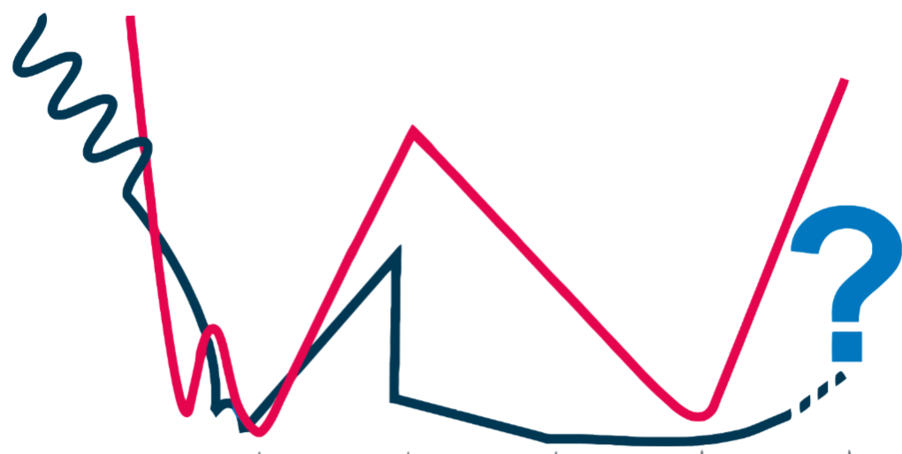
Pre- and Post-Lisbon curves of influence
Pre-Lisbon
Post-Lisbon
Ability to Influence
Drafting
1st Reading
2nd Reading
Conciliation
Comitology
Source: The new EU labyrinth
by Guéguen-Marissen

Slide 4
Policy Shaper
Policy Maker
Agenda-setting
Pre-proposal phase of a policy
Internal positions (strategy-aligned) ahead of time
Give input when door is open -> consultations
Policy Taker
Interest representation and lobbying
Amend policy proposal through engagement with decision-makers
Give input when door is almost closed
Execute policy once it is adopted

Slide 6
EU Liaison
WP2T4 – Policy Engagement
SIG-Policy
Dedicated GÉANT Staff focussed on Policy
In-depth analysis of European Policy & Funding
Public Affairs department of organisation
Represents wider community practitioners
Gathering point for both input and dissemination
EU +
Represents Public Affairs work in the project
Bridge between community and EU Liaison
Updates Project Governance
Knowledge Exchange

Slide 7
Questions?
Upcoming legislations?
Why is competitiveness the new buzz?
Who is the Tech Commissioner?
Is education an EU responsibility?
Strategic Agenda 2024-2029?
(and why does everything lead back to this)
Digital Partnerships with other countries?
EU long-term strategies?
EU tech sovereignty in a globalized world?

Slide 8
Thank you
Any questions?
Presenter email

