Slide 1
Business Platform for OpenStack Clouds
Presented by Nino Tsulaia
Georgian Research and Educational
Networking Association GRENA
www.grena.ge
nino@grena.ge
Funded by GÉANT Innovation Programme
09.06.2025 - 13.06.2025

Slide 2
What Problem Are We Solving?
Managing OpenStack is powerful… but complex.
No Dedicated Admin and Customer UIs
Non intuitive User Interface,
No built-in billing and invoicing
Difficult to scale and customize.
09.06.2025 - 13.06.2025

Slide 3
Introducing BP-OSC
All-in-one SaaS for OpenStack clouds.
Includes Admin UI, Customer UI, Config Portal, Billing and Configurable Invoicing.
Deployed as a single, integrated solution.
09.06.2025 - 13.06.2025

Slide 4
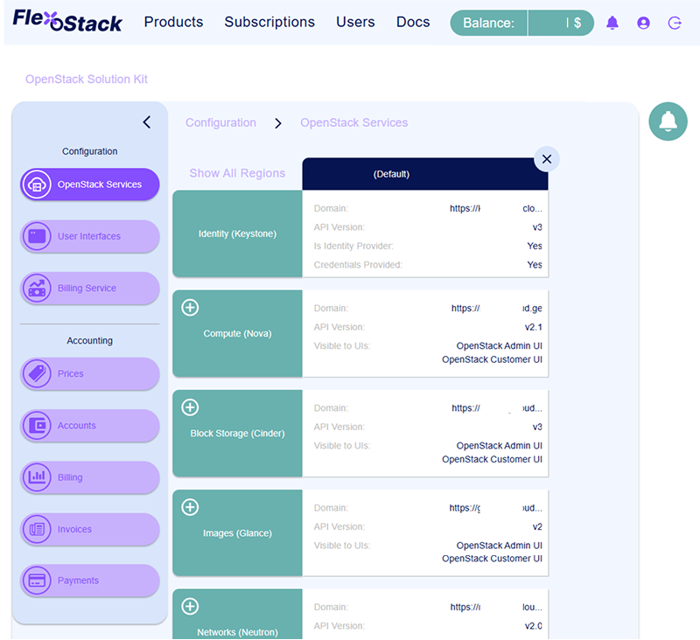
flexostack.io Your Mission Control Portal
09.06.2025 - 13.06.2025

Slide 5
Dedicated Admin UI
Modern, secure, customizable web app for OpenStack cloud management.
Full control over services, billing, and analytics.
Supports standard OpenStack APIs
09.06.2025 - 13.06.2025

Slide 6
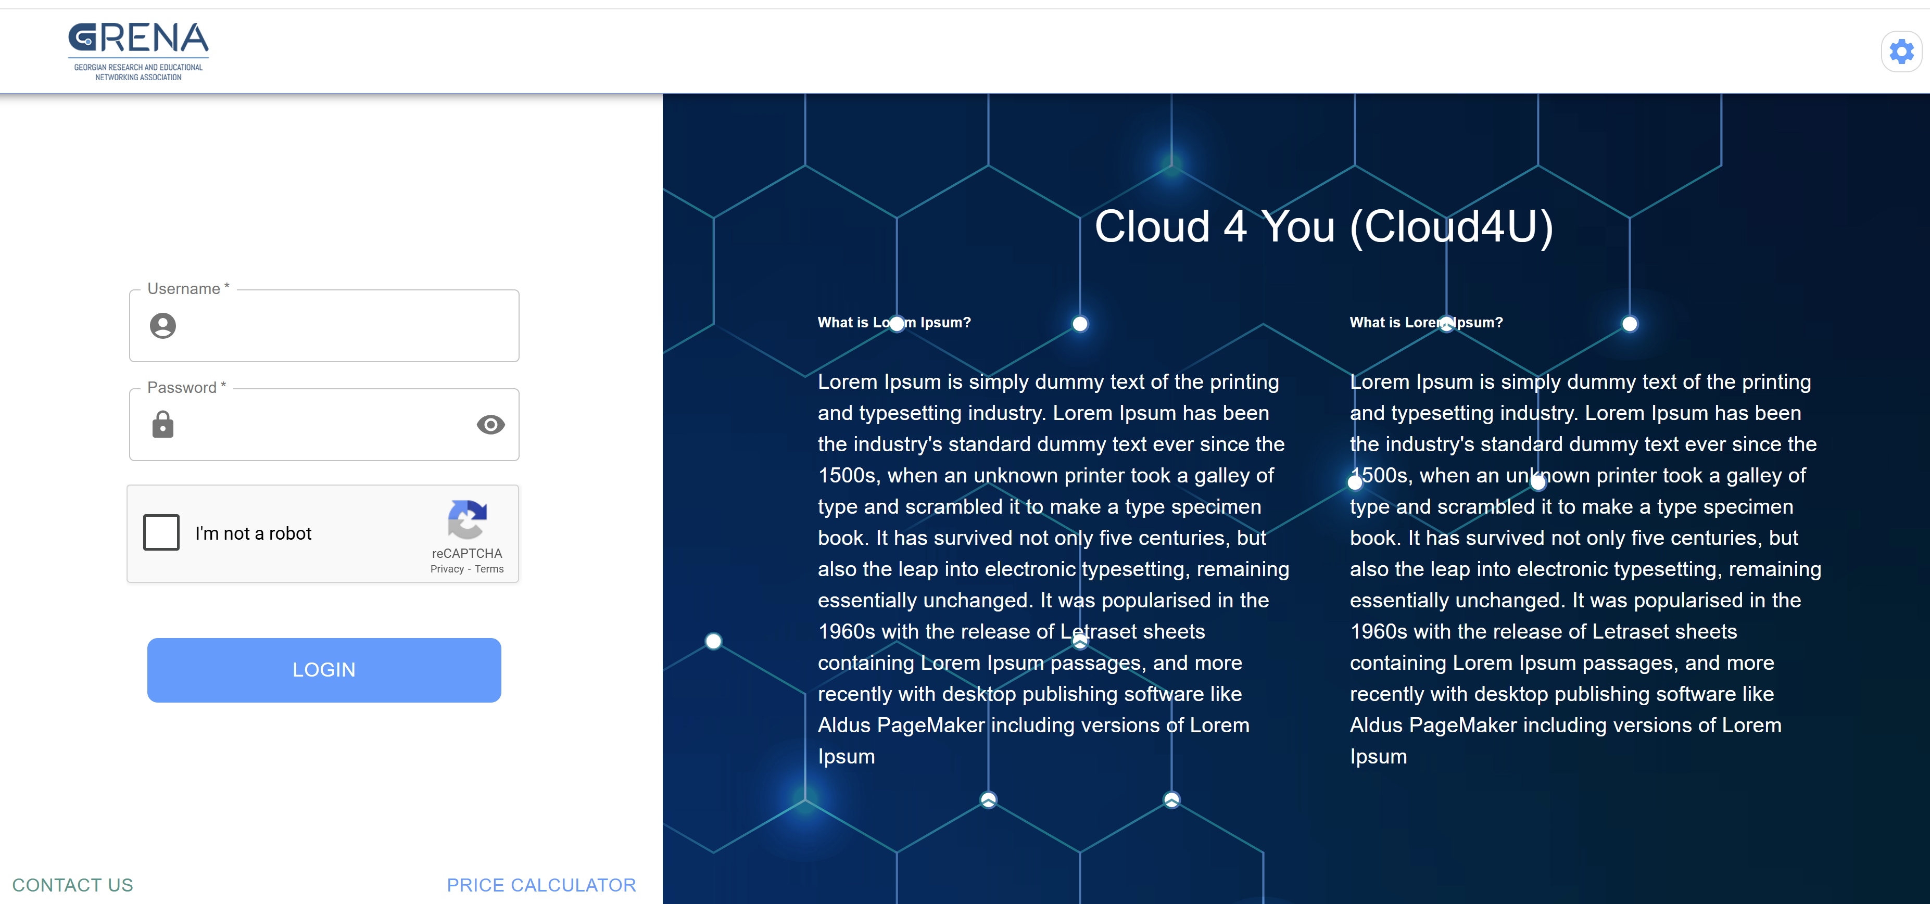
Dedicated Customer UI
Customizabel UI for Cloud Provider’s customers to manage own resorces
Resource usage analytics and planning
Payments
09.06.2025 - 13.06.2025

Slide 7
Billing System
Supports prepaid and postpaid accounts.
Pricing per Region
Auto or manual invoicing.
Payments tracking
REST API and analytics
09.06.2025 - 13.06.2025

Slide 8
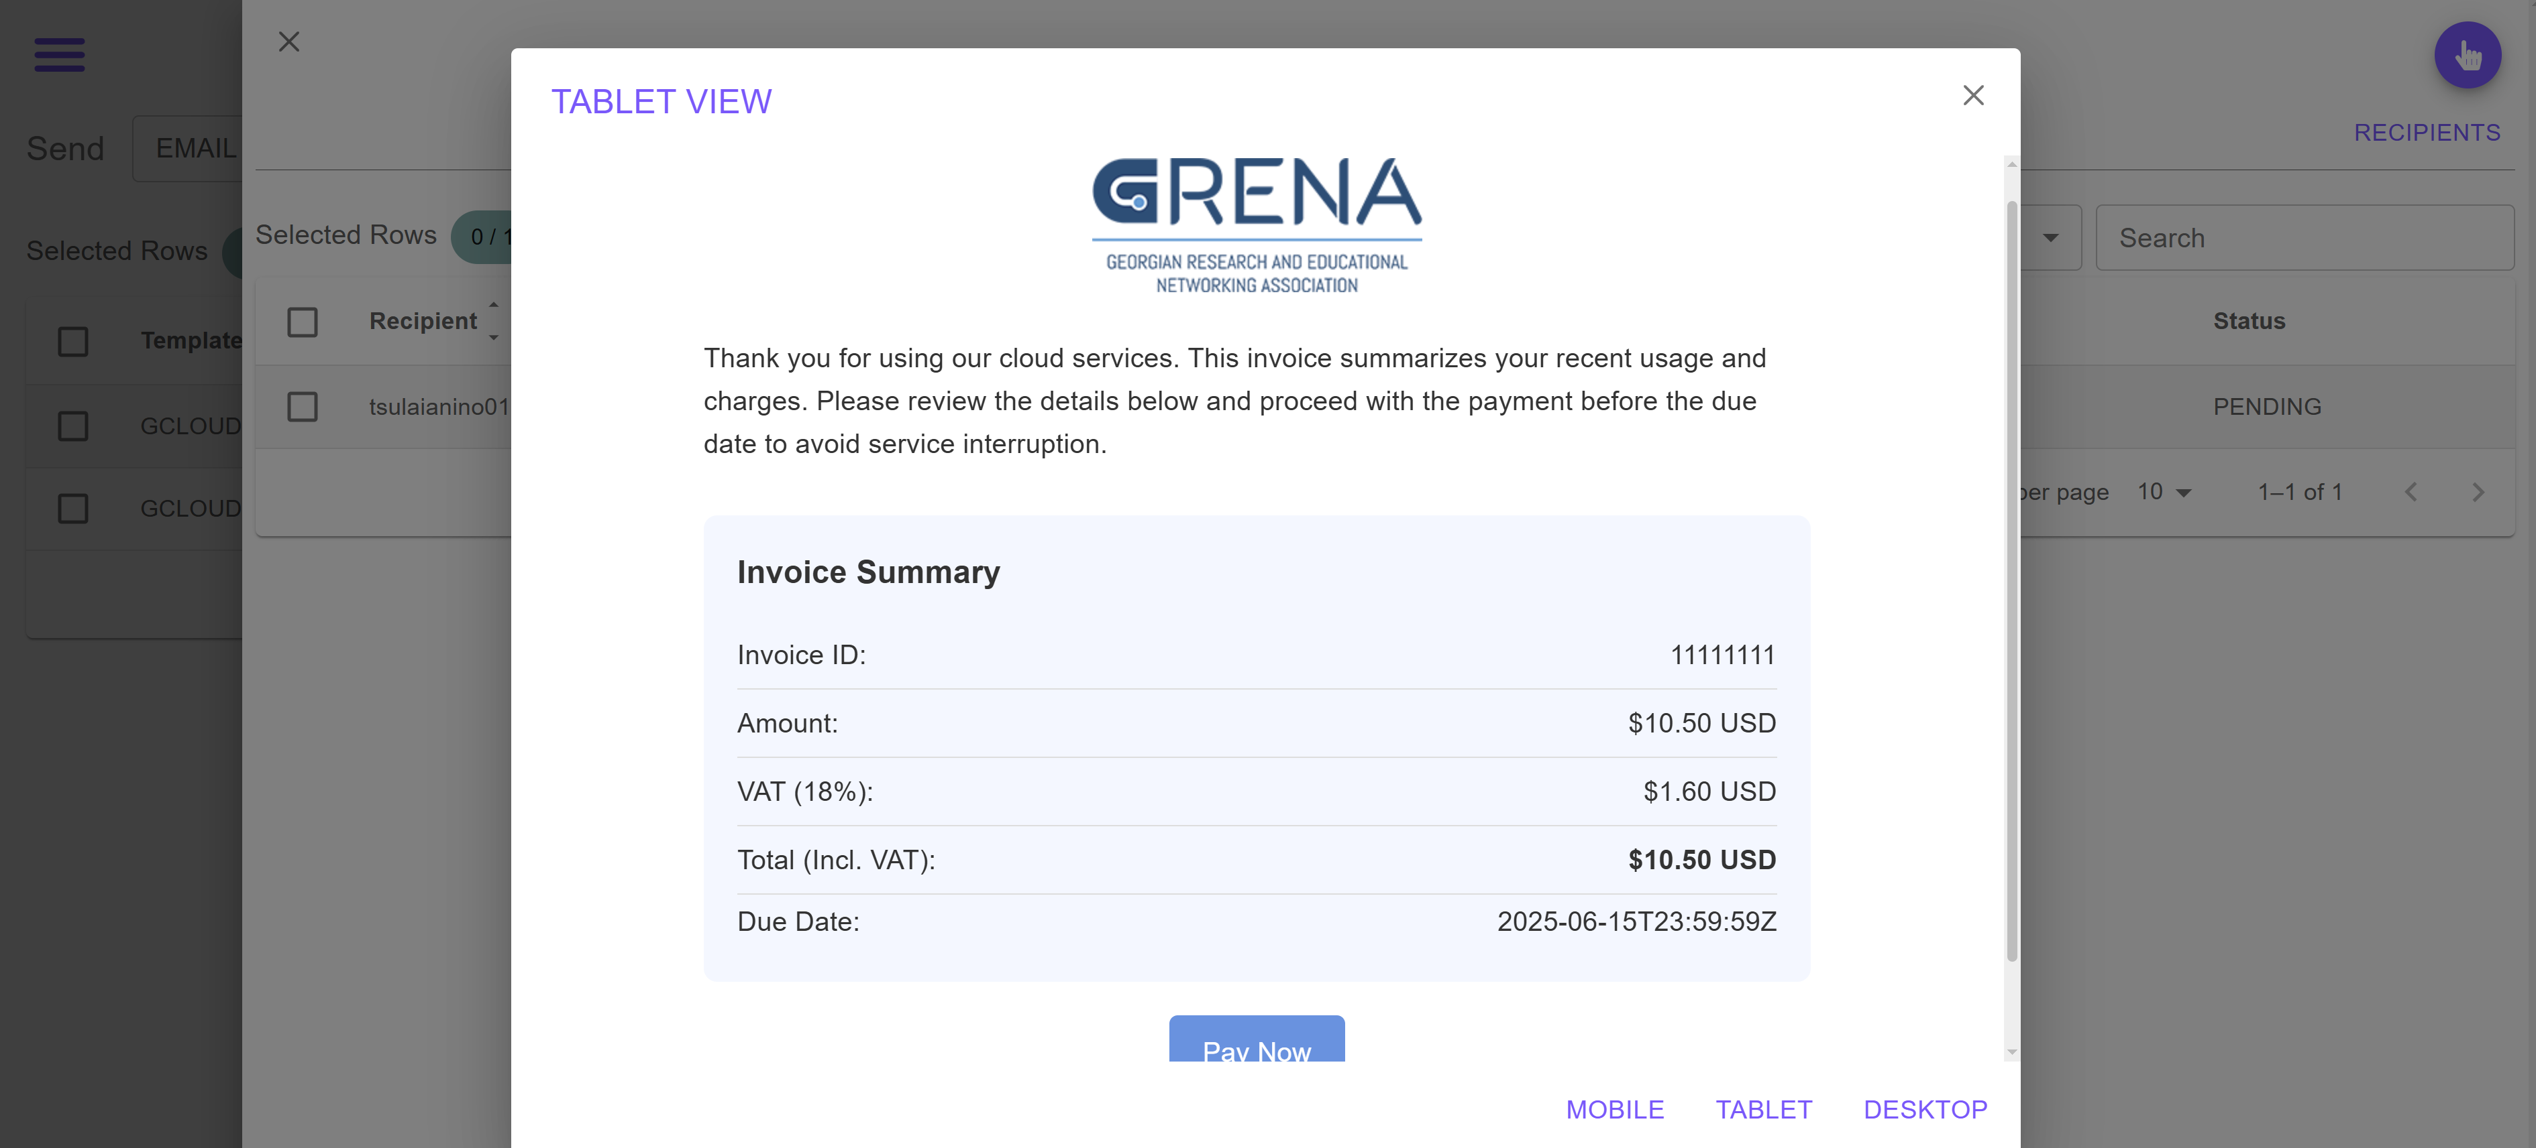
Invoicing Service - iSender
Embeddable web app of automated invoicing service.
Create templates, feed or import recipients’ data, schedule or manually dispetch invoices.
Manage sender sources
09.06.2025 - 13.06.2025

Slide 9
Why It Matters
Streamlined OpenStack management.
Monetize infrastructure effortlessly.
Ready-to-use. No coding or deployment needed.
09.06.2025 - 13.06.2025

Slide 10
Join Us
Register account at https://flexostack.io
Configure access and billing options of your OpenStack cloud services
Access your cloud resources with Admin and Customer UIs
We welcome collaboration and adoption.
09.06.2025 - 13.06.2025

Slide 11
Thank you for attention!
Questions?
Nino Tsulaia
Georgian Research and Educational
Networking Association GRENA
www.grena.ge
nino@grena.ge
09.06.2025 - 13.06.2025

