Slide 1
FedXAI4DNS
Explainable AI for DNS Security in Privacy-aware NREN Federations
Mary Grammatikou, mary@netmode.ntua.gr
National Technical University of Athens
11 June 2025

Slide 2
Agenda
Problem Statement
Proposed Approach
Underlying Technologies & Methods
Key Takeaways
Conclusions, Impact & Sustainability

Slide 3
Problem Statement
Malicious software uses algorithms to produce seemingly random domain names, hiding its control servers and evading traditional filters
These are called Domain Generation Algorithms (DGAs), which automatically produce large sets of pseudo‑random domains to prevent detection
Our goal is to accurately identify which domains have been generated by DGAs—distinguishing malicious, auto‑generated names from legitimate ones
Notes:
Malware today often hides its communication channels using a technique called Domain Generation Algorithms, or DGAs. These are algorithms that create many random-looking domain names, making it hard to detect and block the servers the malware communicates with.
Instead of using a single, known domain that can be easily blacklisted, DGAs produce hundreds or thousands of fake domains every day. This way, even if some domains are detected and blocked, others are still available for the malware to use.

Slide 4
Main Challenges in DGA detection
We aim to address three interrelated challenges in modern DGA detection:
Detecting DGA Domains with Traditional Approaches
DGAs generate large volumes of often invalid domain requests
Traditional blacklists struggle to keep up and quickly become outdated
Machine learning can detect subtle patterns to identify DGA domains — even ones never seen before
Data Diversity Across Organizations
Different entities (e.g., NRENs) encounter both shared and unique DGA variants
No single entity sees the full DGA threat landscape
Collaborative data sharing is key to capturing diverse patterns and building resilient ML models
Privacy & Compliance Constraints
Sharing raw DNS or network traffic can breach privacy laws and institutional policies
These restrictions make centralized model training impractical
Privacy-preserving approaches (e.g. Federated Learning) are essential for cross-institutional collaboration
Notes:
In summary, we need a way to build strong, adaptable detection models—while still protecting privacy and working across diverse data environments.

Slide 5
Proposed Approach
To tackle the aforementioned challenges, we employ the following techniques:
Deep Learning
Binary deep neural networks (Multi-Layer Perceptrons - MLP’s) for benign vs malicious DNS traffic classifications
Federated Learning (FL)
For collaborative DGA name classifiers without sensitive data exchanges among participants (e.g. NRENs)
SHapley Additive exPlanation (SHAP)
Interpreting classification decisions in a model-agnostic manner
Notes:
We use Deep Learning to classify DNS traffic as either benign or malicious.
Federated Learning allows us to collaboratively train accurate models across different organizations—without ever sharing
sensitive DNS data. That’s a big step forward in making cybersecurity solutions more privacy-respecting.
We incorporate SHAP (Shapley Additive exPlanation) to interpret and explain the model’s classification decisions. SHAP is useful because it’s model-agnostic, meaning it can explain results regardless of the underlying model type.

Slide 6
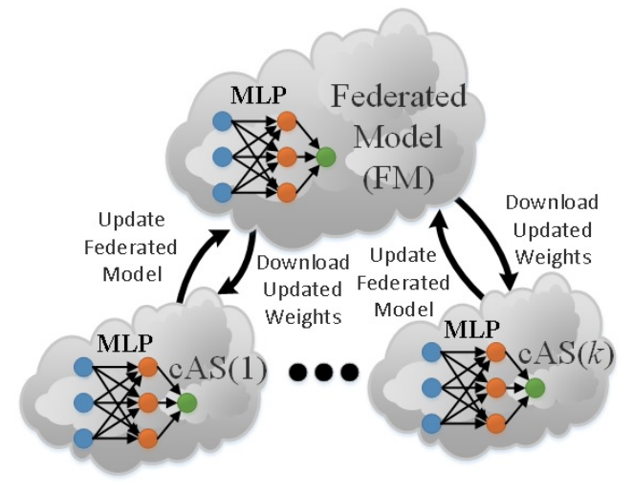
Key Takeaways (1/2)
Federated Learning is promising for collaboratively developing accurate DGA name classifiers without sensitive attack and benign data exchanges
Federated models outperform local models in most cases (best accuracy: 92.65%)
Notes:
These results demonstrate that it’s not just a theoretical idea—it actually works well in practice, even in the context of complex and evolving threats like
DGAs.

Slide 7
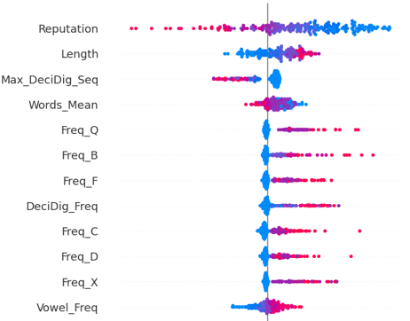
Key Takeaways (2/2)
SHAP is a promising technique for interpreting the operation of ML-based DNS security mechanisms
Advanced visualizations enable administrators to understand feature importance
Notes:
We’re looking at a SHAP summary plot for our MLP model. This type of plot helps us understand which features had the most influence on the model’s predictions. On the y-axis, we see the most important features, ranked from top to bottom.
For example, we can see that 'Length' is a key feature. Red dots with high SHAP values here suggest that longer domain names often led the model to predict DGA—which makes sense.

Slide 8
Integration and testing in NRENs NOCs
Pilots and tests at NRENs
A number of NRENs could be the pilots
A number of tests could be executed in real environment
Results could be used for future improvements on security issues
Results could be analysed and used for further improvements on security
Notes:
In the long run, these deployments can offer real security value—while also informing future research and development.

Slide 9
Conclusions, impact & sustainability
🔹 FL enables secure collaboration
🔹 SHAP makes ML interpretable
🔹 Future: Real-world NREN deployment
Notes:
Our long-term goal is to support a more secure and collaborative internet infrastructure, where privacy and detection performance go hand in hand.

Slide 10
Thank you
Any questions?
fedxai4dns@netmode.ntua.gr
Project implementation available from: https://github.com/netmode/FedXAI4DNS

