Slide 1
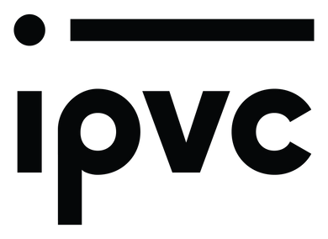
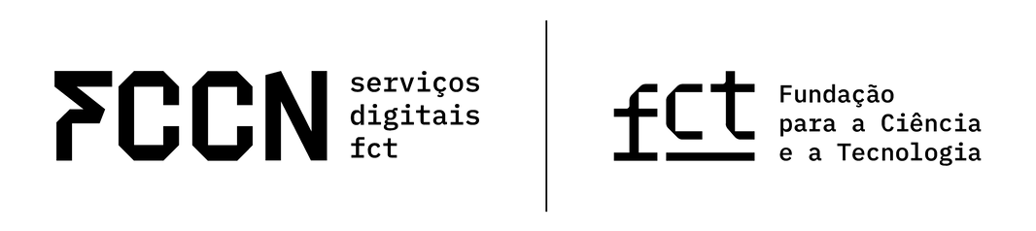
Zero trust for NRENs
because even your network lies

Slide 2
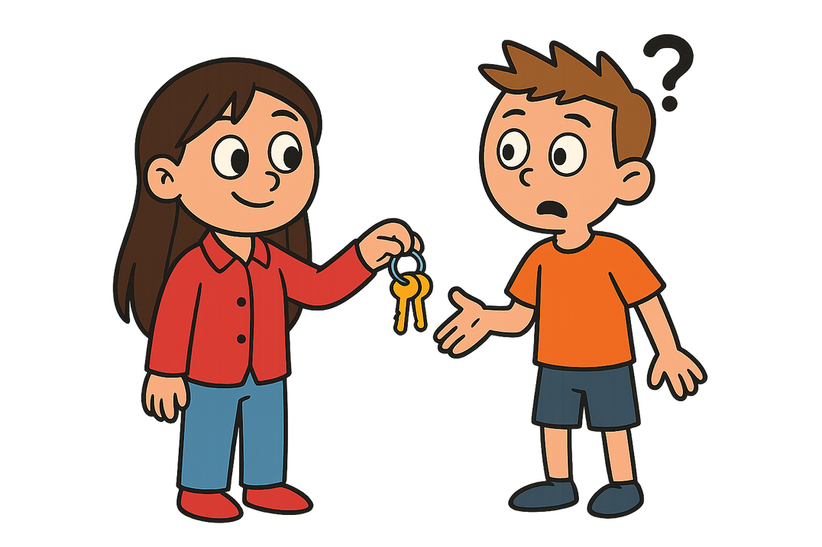
Challenge
1st Take your house keys
2nd Hand them to the person next to you
3rd Tell them your exact address
2

Slide 3
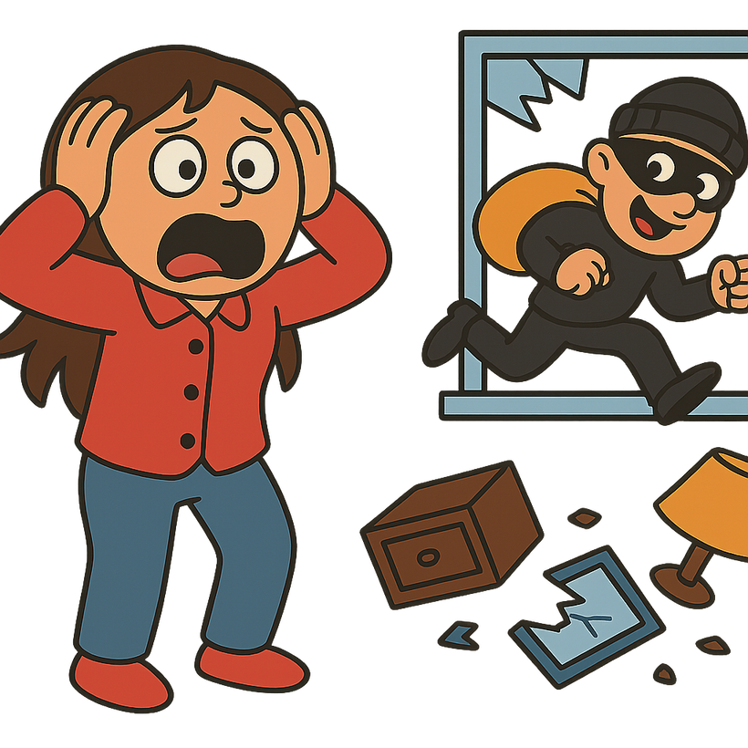
Networks are like bad roommates
they let the wrong people in and don’t notice until it’s too late
3

Slide 4
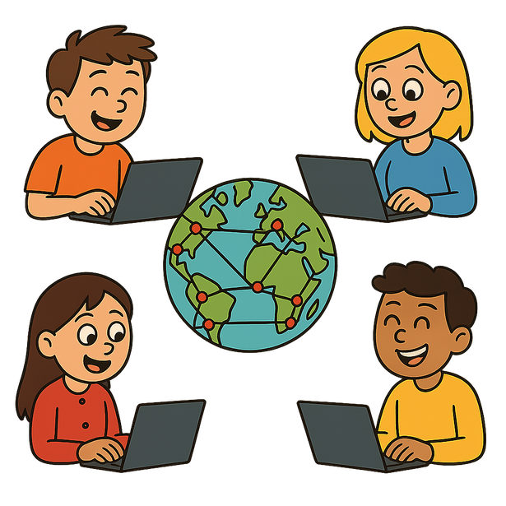
National Research and Education Networks
Open
Accessible
Collaborative
4
Notes:
NRENs — National Research and Education Networks — are designed to be open,
collaborative, and accessible.
They connect researchers, universities, and institutions
across the globe. That’s beautiful for research, but it’s a nightmare for security.

Slide 5
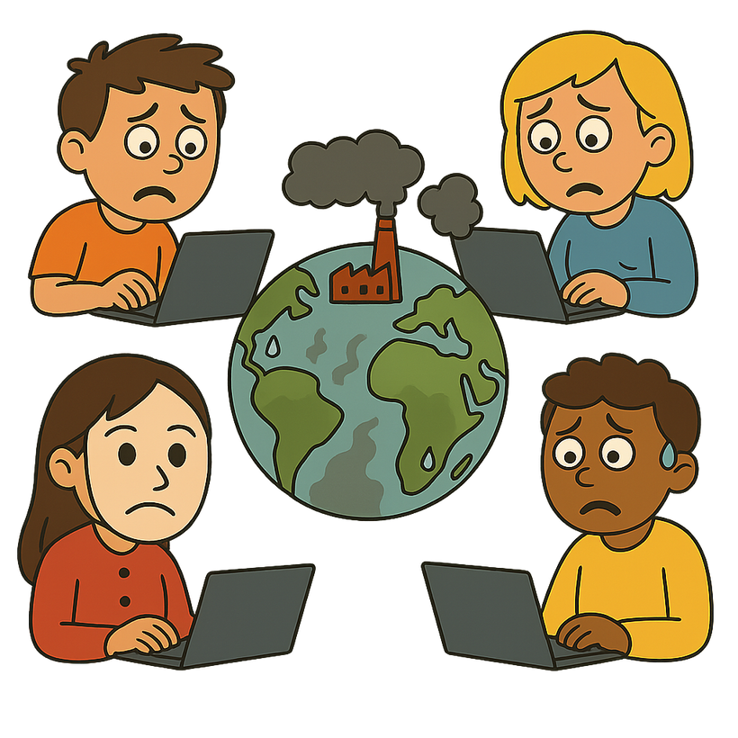
National Research and Education Networks
Multi-institutional access
Federated identities
Cross-border regulations
Highly valuable data
Complex compliance demands
5
Notes:
Think of it: multi-institutional access, federated identities, cross-border regulations, and
highly valuable data - all in one giant, trusted network. Now add outdated security models
and complex compliance demands.
In this environment, a single weak link, a vulnerable IoT device, an unsecured identity
provider, a misconfigured service can open the door to lateral movement, data
breaches, and legal consequences.
And the worst part? Many of these threats blend in. They look like legitimate users until it’s
too late.

Slide 6
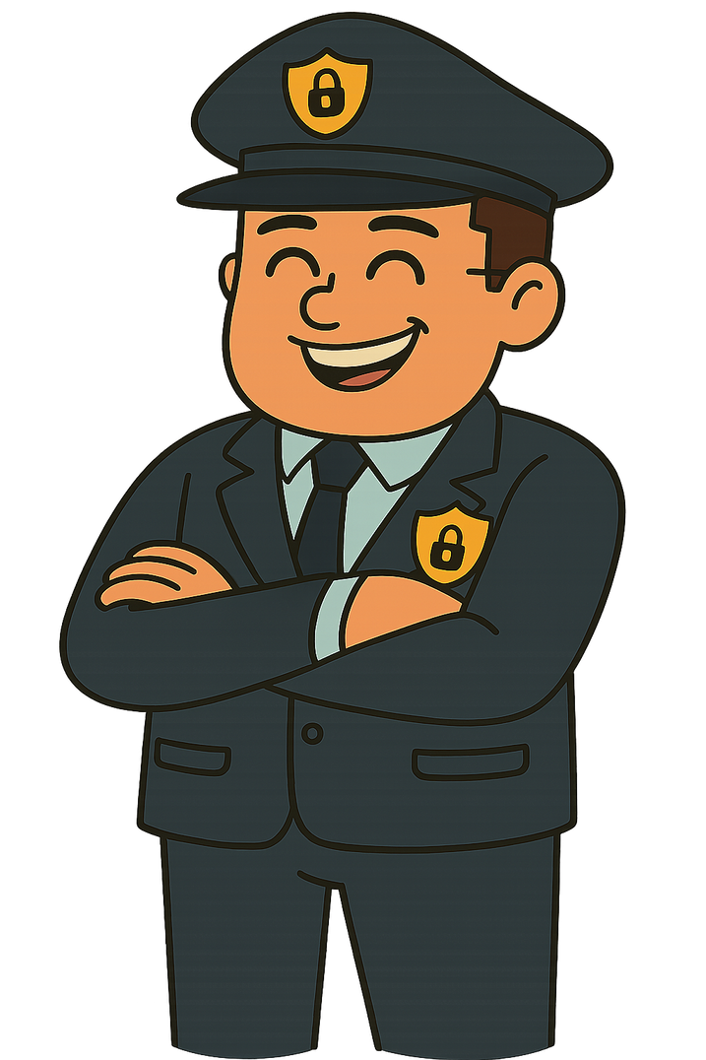
Zero Trust
Never trust, always verify
6
Notes:
So what’s the solution? Zero Trust.
Imagine a bodyguard at every door, checking IDs, verifying your story, and logging your
visit. That’s Zero Trust in a nutshell: never trust, always verify.
Traditional networks trusted everything inside their walls. But that model breaks the
moment an attacker gets in.
Zero Trust flips the logic: the goal is not just to prevent
threats, but to expect them and react quickly to minimize their impact.

Slide 7
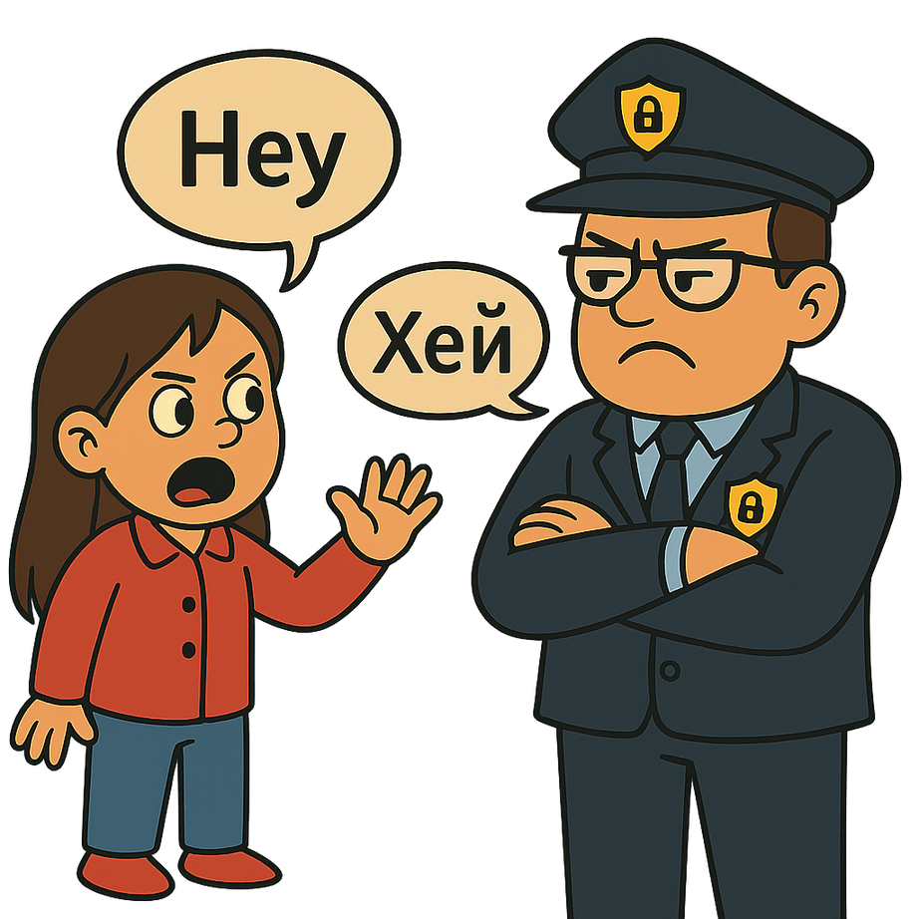
Zero Trust
isn’t plug-and-play
7
Notes:
Now, the thing is: implementing Zero Trust isn’t simple, especially in a globally connected, multilingual environment like an NREN.
The framework is powerful, yes, but it’s not plug-and-play. It’s a shift in culture, architecture, and mindset. Regulations such as GDPR can pose additional challenges to implementing Zero Trust.
Let’s return to our house. Imagine a Russian-speaking bodyguard guarding your door. He won’t let you in because he needs to see your ID first but you can’t understand what he’s saying. I’m Portuguese I don’t speak Russian!
That’s what security and compliance often feel like today: technical, legal, multilingual, and incredibly hard to navigate.

Slide 8


isn’t plug-and-play…
A risk-based, AI-powered guidance platform for NRENs
A Zero-Trust approach
Understands your language
Maps your network
Tracks regulations
Recommends tools
No jargon, just smart support
8
Notes:
My idea? An AI-powered risk assessment assistant built specifically for complex
environments like NRENs.
It speaks your language, understands your network structure, maps risks, tracks
international regulations, and even recommends security tools or frameworks tailored to
your environment.
No jargon. No guesswork. Just smart, adaptive support.

Slide 9
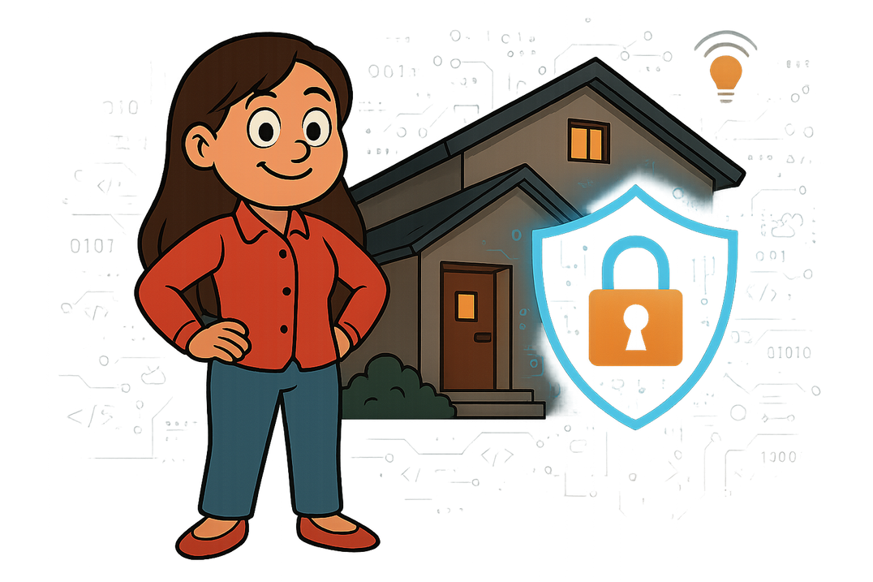

Security isn’t about building higher walls,
it’s about building smarter doors
9
Notes:
Security isn’t about building higher walls. It’s about building smarter doors.
With AI and Zero Trust, we can stop being reactive. We can start predicting threats, anticipating them, and personalizing responses.
The future isn’t a fortress—it’s a fluent, intelligent system that adapts to your needs, no matter where you are or who you connect with.

Slide 10


A secure world for NRENs
even if your network lies to you
Thank you
Aurora Vasconcelos
aurorabsvasconcelos@gmail.com
10
aurora-vasconcelos
Notes:
Imagine a future where you can confidently hand your keys to anyone, because you know that in your home, you have an amazing bodyguard capable of evaluating who, when, and why someone should be allowed into your space, keeping your private and valuable belongings secure.
A future where compliance is simple, risks are understandable, and security is proactive— even in a world where your network might lie to you.

