Slide 1
Simplifying Digital Signatures: How RNP's One-Time Certificate Approach Bridges Security and Usability
Ricardo Custódio, PhD
UFSC
Jean Carlo Faustino, PhD
RNP
Notes:
Good afternoon everyone, my name is Jean.
I am a service manager at RNP (Brazilian NREN)
and today I will speak on behalf of Professor Custódio who is the co-author of this presentation, but unfortunately cannot be present here.

Slide 2
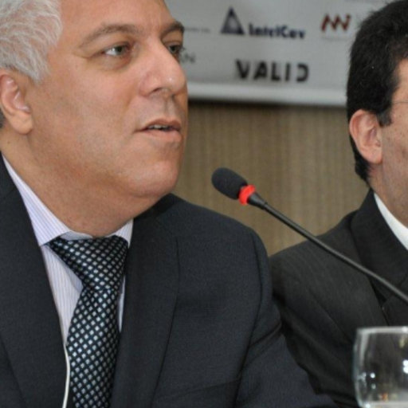
Introduction
Ricardo Custódio is a Full Professor at the Department of Informatics and Statistics at the Federal University of Santa Catarina (UFSC), where he leads the Laboratory for Security in Computing (LabSEC).
He has supervised over 65 undergraduate, master’s, and doctoral students and has authored more than 70 academic works
Notes:
Ricardo Custódio is a Full Professor at the Federal University of Santa Catarina (UFSC), where he leads the Laboratory for Security in Computing (LabSEC).
With thirty years of experience as a teacher, he is one of the greatest Brazilian experts in digital certification. And RNP has had a two-decade partnership with him and his laboratory.

Slide 3
Introduction
Notes:
Over the past twenty years, we have built innovative solutions in the digital certification segment.
And one of these solutions concerns the signing of digital documents through the issuance of certificates created on demand - which is the scope of this presentation.

Slide 4
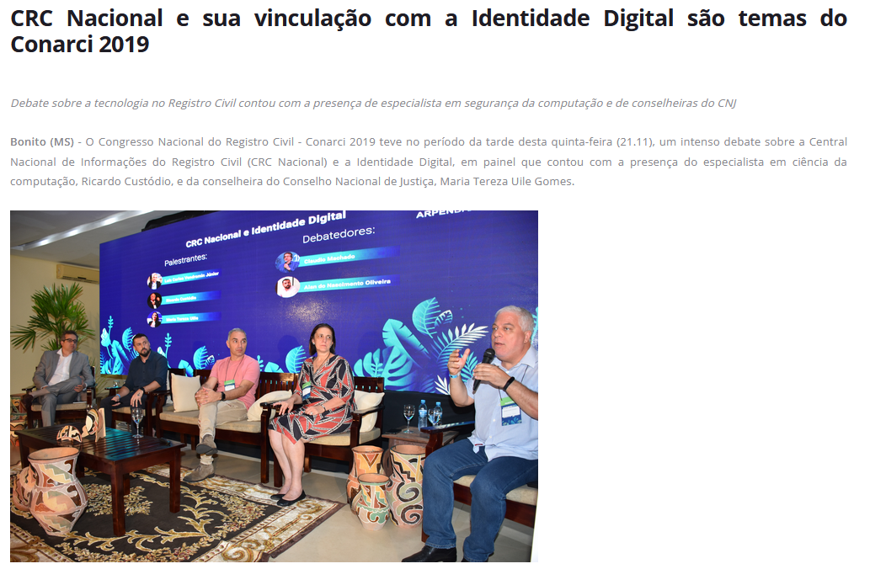
Introduction
https://sinter.ufsc.br/2023/02/08/mocambique
https://arpensp.org.br/noticia/90698
More than 2.000.000 documents have already been signed
Notes:
This solution has already been adopted by some universities; by the Brazilian judicial system; and by the state of Mozambique as the main tool for signing digital documents.
In the Brazilian judicial system, more than two million documents have already been signed.

Slide 5
What is it?
Advantages
How it works
Requirements
Future prospects
Notes:
In this presentation, we will cover the following aspects of this solution:
# include

Slide 6
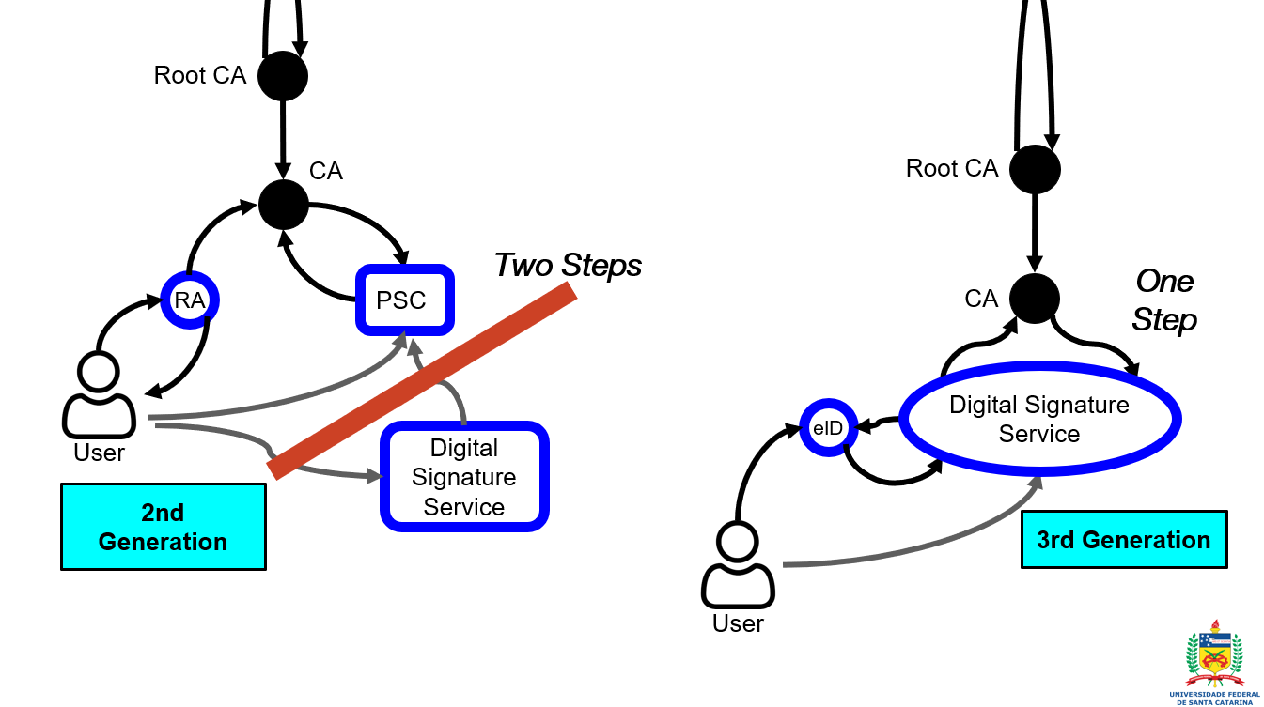
1 - What is it ?
Notes:
The service in question corresponds to the implementation of a type of third-generation digital certificate.
In this paradigm, the request, storage and long-term management of private keys is replaced by the creation of a unique certificate for each document, which is created during the signing task.

Slide 7
2 - Advantages
More credibility;
Facilities and cost savings;
Certificates valid for 100 years;
Protection against future Cryptographically Relevant Quantum Computer (CRQC) attacks.
US$ 0,0028
per sign
Notes:
As the result, we have...
More credibility in the digital documents that were signed;
User authentication does not require the use of tokens or cloud storage, providing facilities and cost savings (at RNP, each certificate costs less than a penny);
The certificates now has the lifetime of 100 years;
The certificates are protected against future Cryptographically Relevant Quantum Computer (CRQC) attacks because there are no private key to be broken;

Slide 8
on-demand certificate service
3 - How it works
Academic
management
system
on-demand
certificate
service
Notes:
Access to the service is done through API from the academic management systems of institutions.
Therefore, when the user needs to sign a document, just click on the API button, which then transfers the document to the RNP service, which generates a certificate on demand and returns a new version of the file.

Slide 9
on-demand certificate service
3 - How it works
a quick and painless path to advanced signature
Notes:
Therefore, the adoption of the service is done transparently for the end user.
At the same time, the document acquires the credibility and security of the so-called advanced signature.

Slide 10
4 - Implementation requirements
Strategic decision;
Structural adoption in the processes;
Adequacy of the academic system.
Notes:
However, the Implementation require the following aspects of client institutions:
# read

Slide 11
5 - Future Prospects
The service can be adopted by the different academic management systems that exist in Brazilian universities;
The service can help in the Brazilian Digitalization project of academic documents;
The adoption of the solution is being studied by other Latin American countries.
Notes:
At the moment, we have the following future prospects:
# read

Slide 12
Final Considerations
Notes:
As an academic solution, it has incorporated the results of new research with the possibility of being adopted in different scenarios and countries.
So, If you have a context where this solution could be interesting, we are open to collaboration. Thank you!

Slide 13
Thank you!
Ricardo Custódio, PhD
ricardo.custodio@ufsc.br
UFSC
https://labsec.ufsc.br/
Jean Carlo Faustino, PhD
Jean.carlo@rnp.br
RNP
https://www.rnp.br/
Notes:
Thank you!

