Slide 1
Breaking silos with the DevOps mindset.
By
Isaac Ainamaani

Slide 2
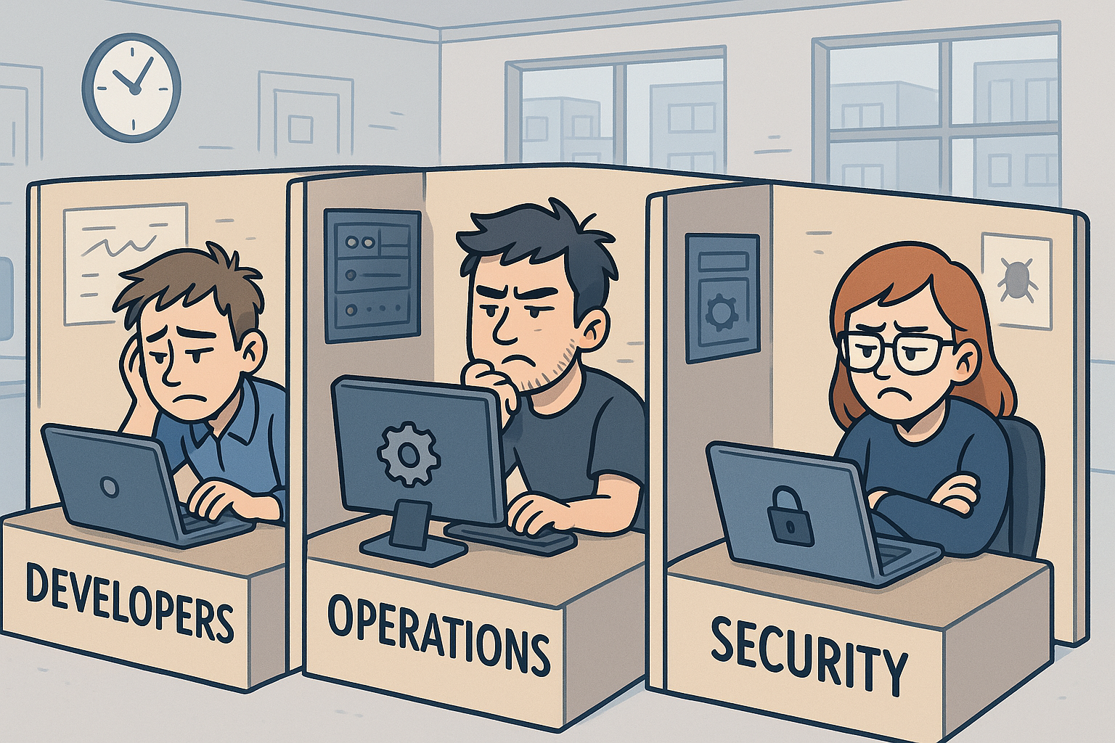
Silos cause delays, finger pointing leading to frustration.

Slide 3
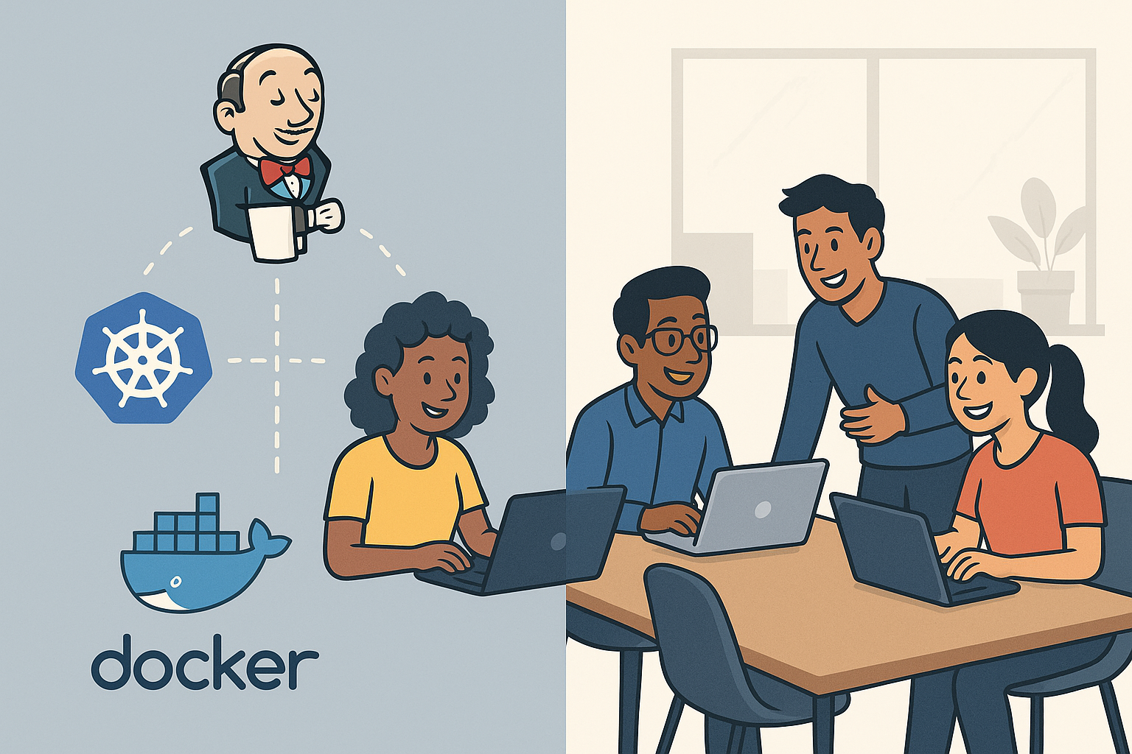
DevOps isn’t just tools, it’s a cultural shift.

Slide 4
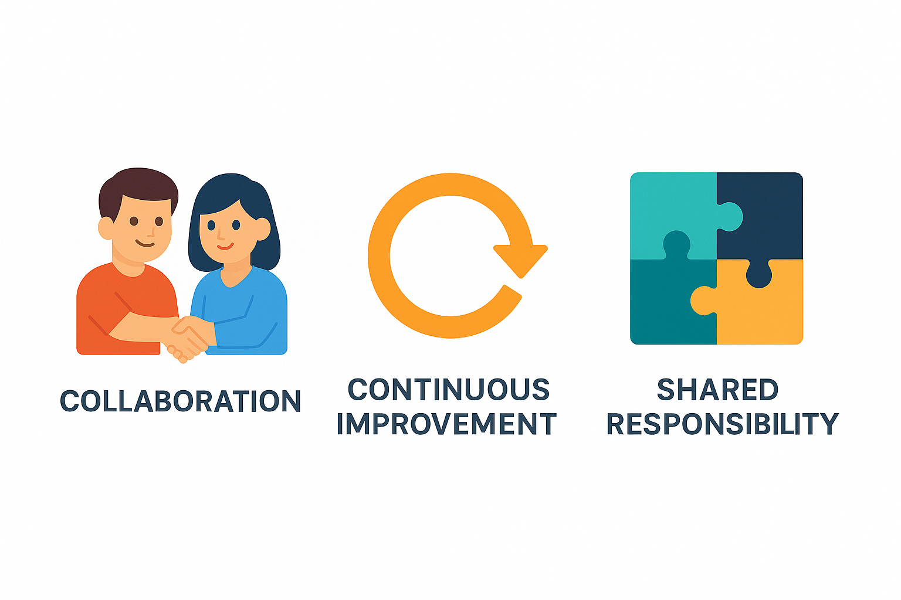

Slide 5
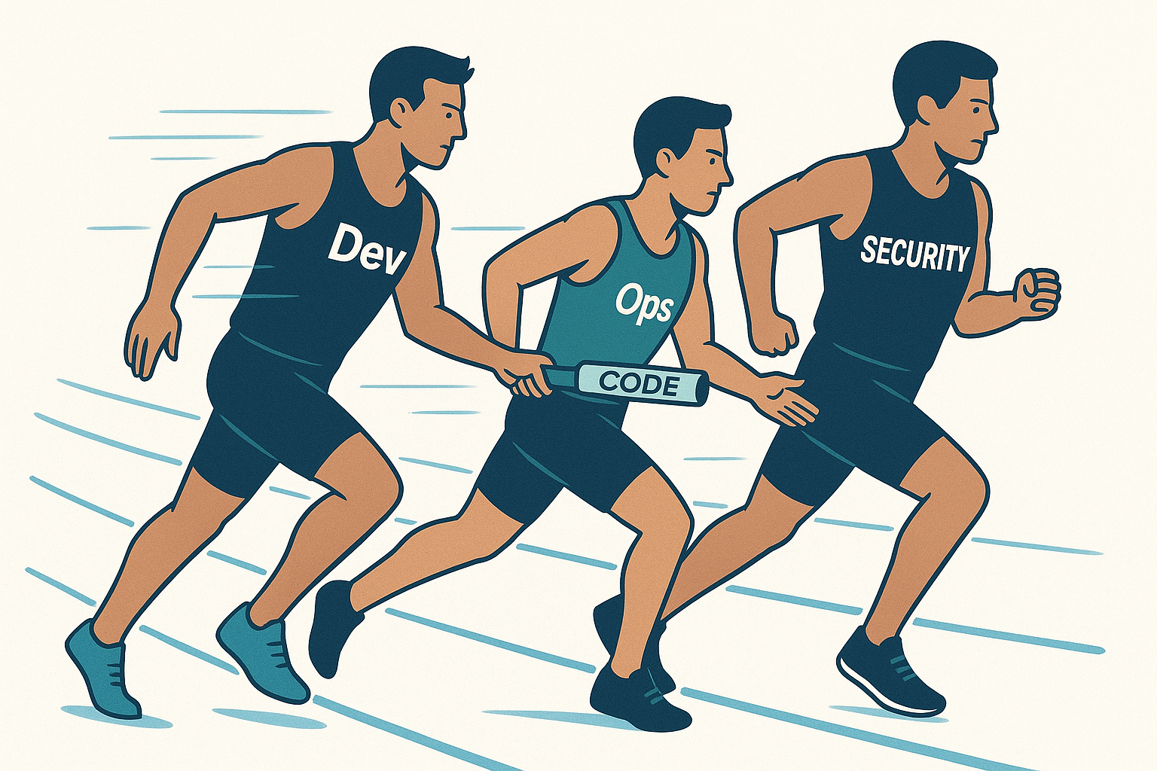
DevOps is a relay, the team wins, NOT an individual.

Slide 6
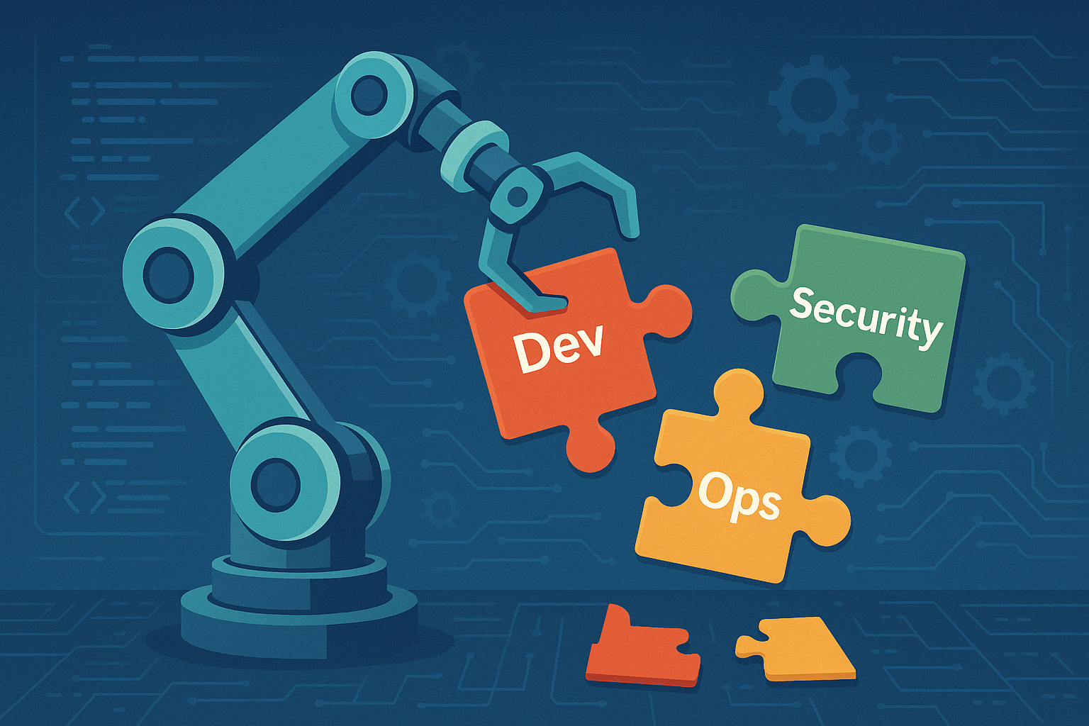
You can’t automate yourself out of a broken culture.

Slide 7
Thank you
iainamaani@renu.ac.ug

