Slide 1
Killing Two Birds with one Node
Research and Education Network for Uganda (RENU)
Namuddu Caroline
Brighton, UK
11TH JUNE 2025

Slide 2
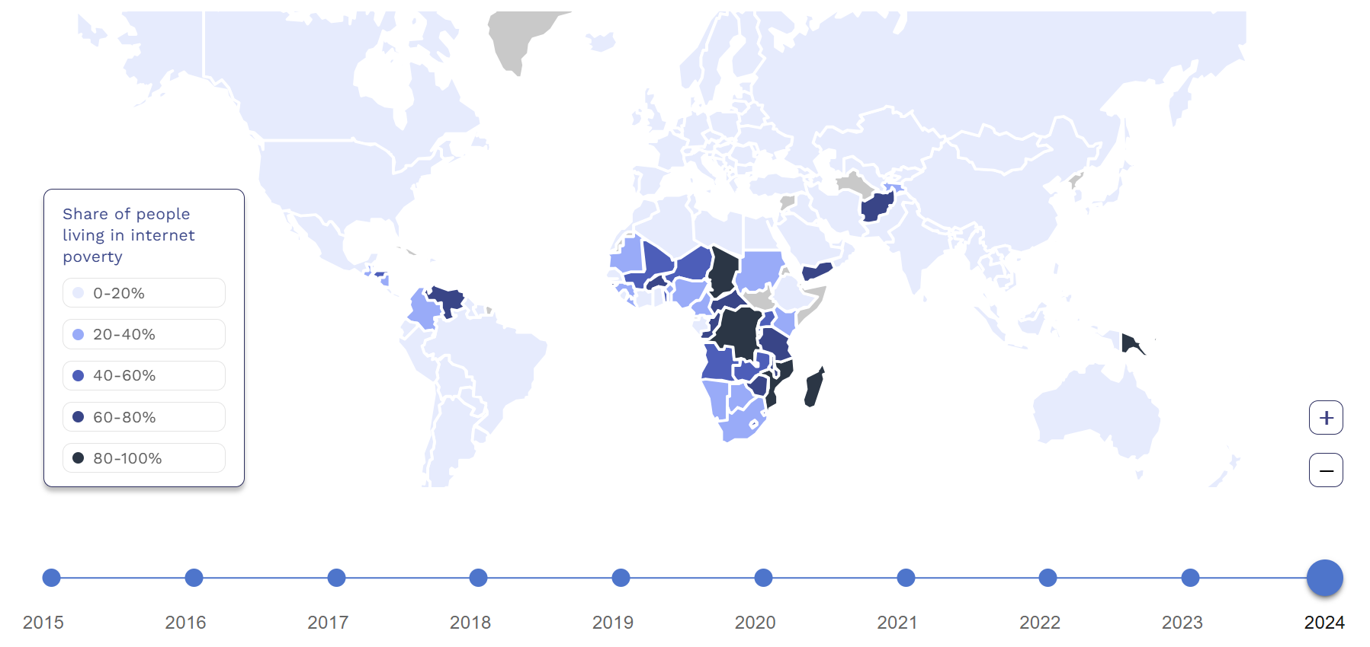
Bird 1 - Internet Poverty

Slide 3
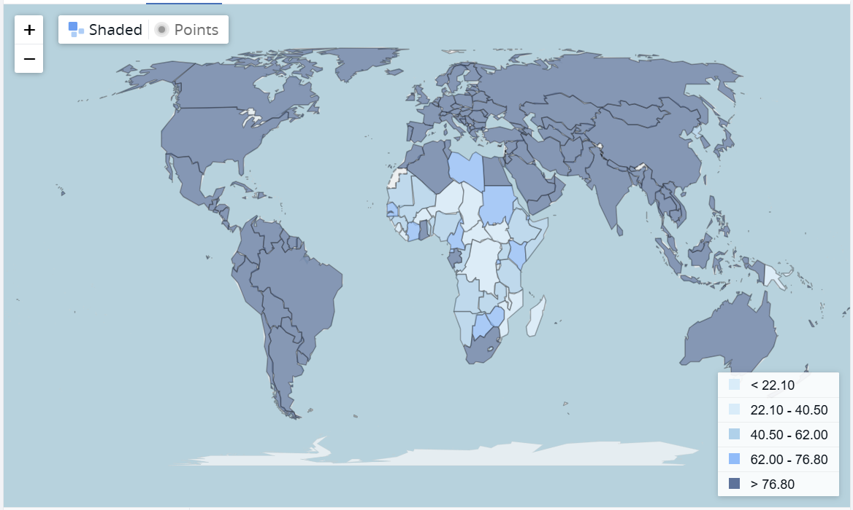
Bird 2 - Electricity Access

Slide 4
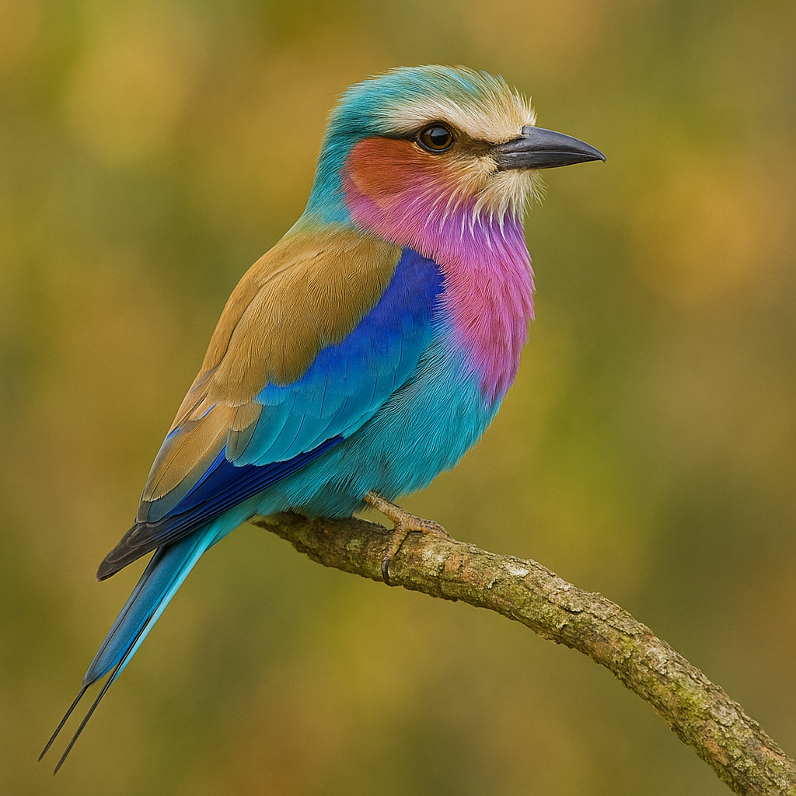
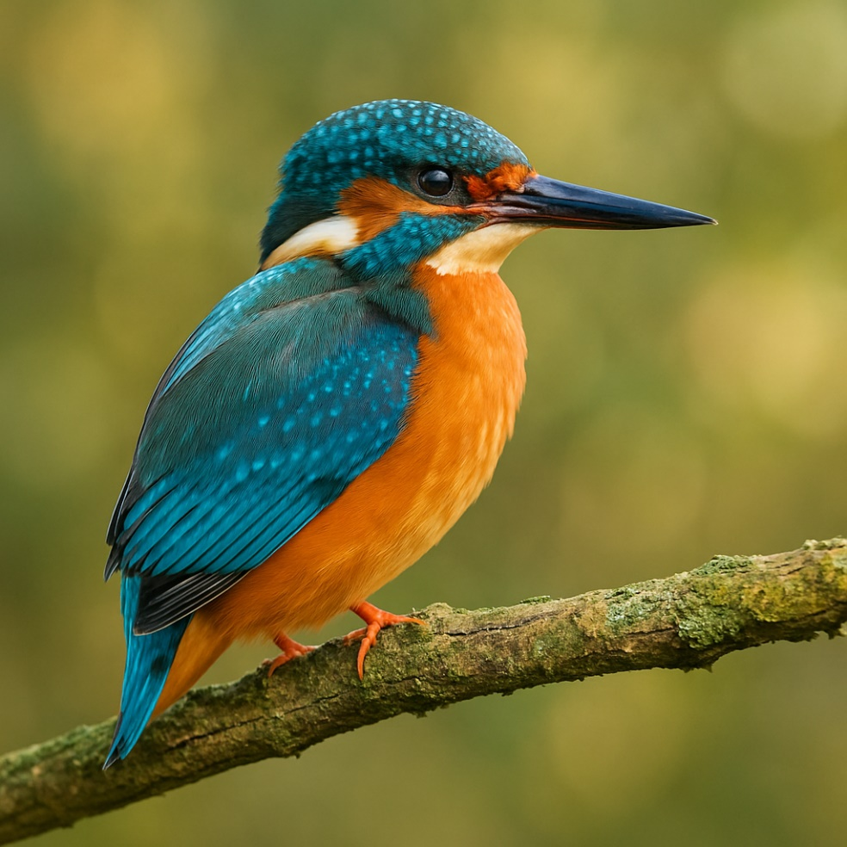
Lilac-breasted roller & Kingfisher

Slide 5
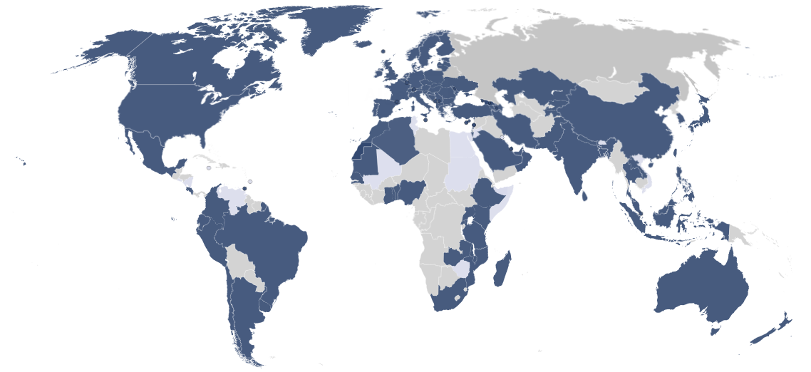
eduroam Map

Slide 7
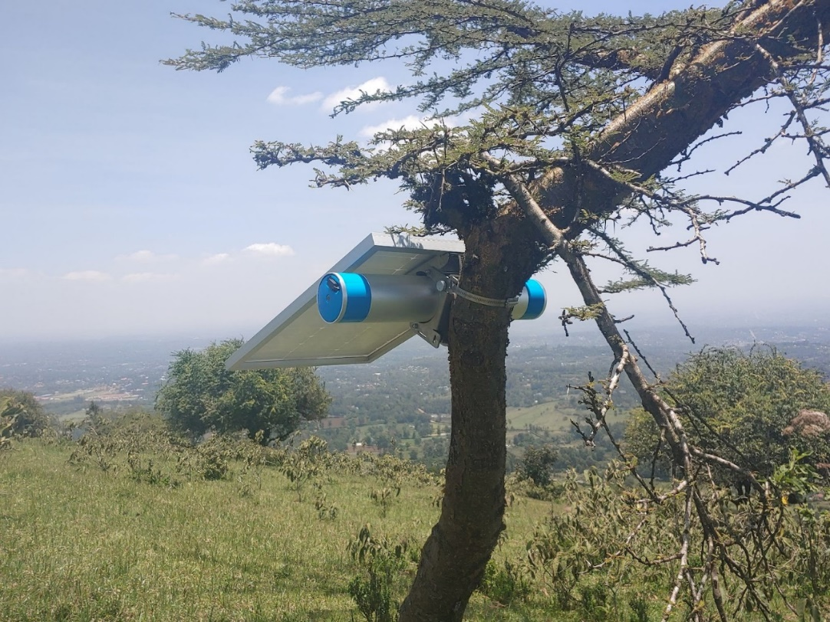
Our Node - The S618 Solar-Powered Router
Comprehensive Solution for Providing Wi-Fi Anywhere
1.2kWh battery up to 5 days
Multiple last mile Technologies
Power over ethernet – 802.3af/at
Range of up to 350m line of sight
Up to 500 concurrent connections
2.5 Gbps throughput
GPS & LoRaWAN
Mesh networking

Slide 8
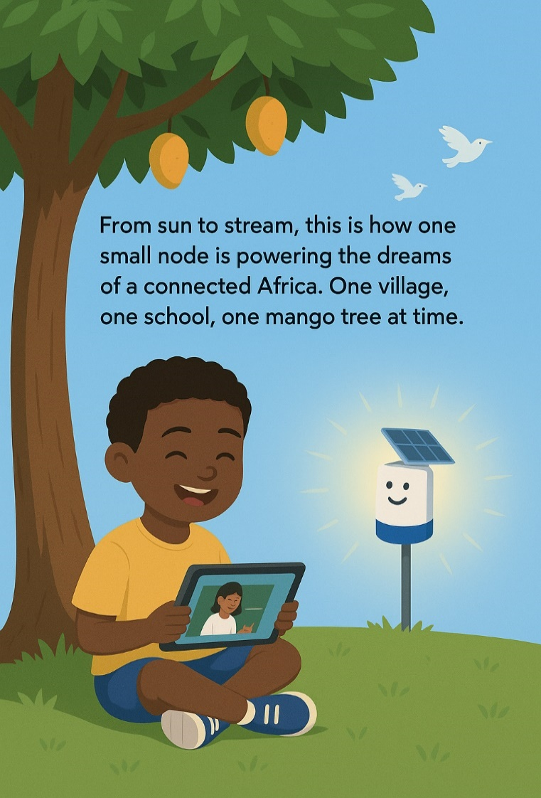
Notes:
From sun to stream, this is how one small node is powering the dreams of a connected Africa. One village, one school, one mango tree at a time.”

Slide 9
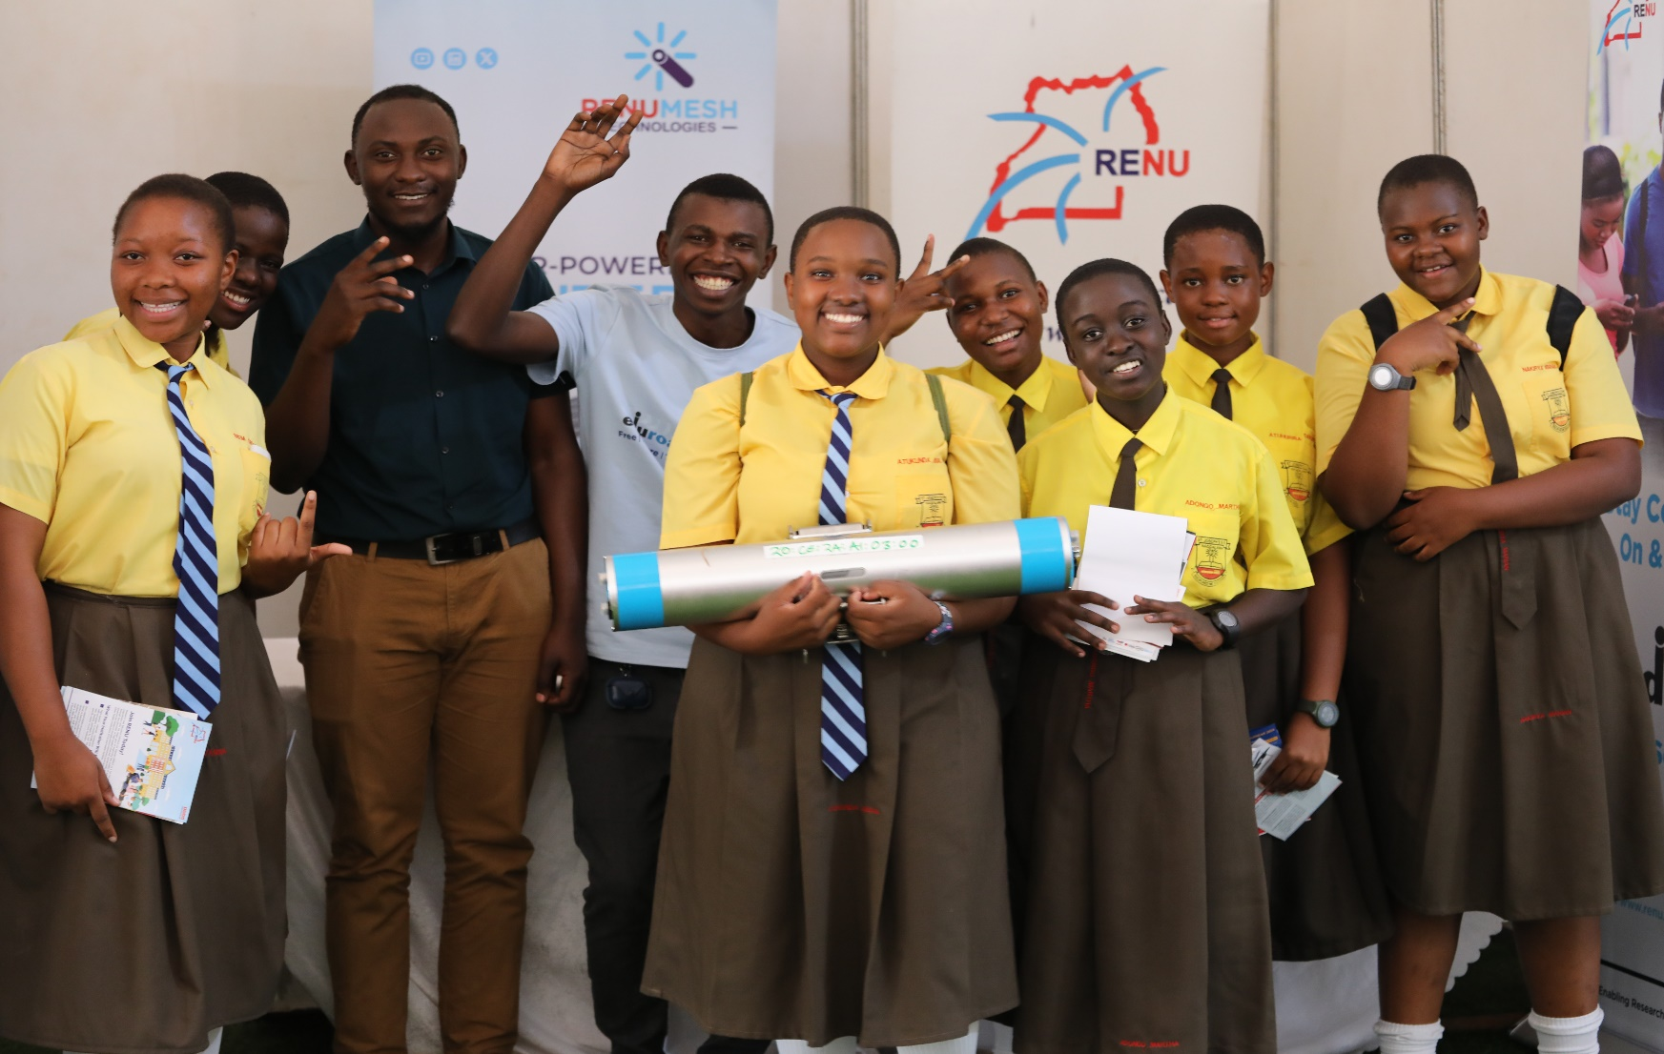
Notes:
From sun to stream, this is how one small node is powering the dreams of a connected Africa. One village, one school, one mango tree at a time.”

Slide 10
Thank you
Any questions?
cnamuddu@renu.ac.ug

