Slide 1
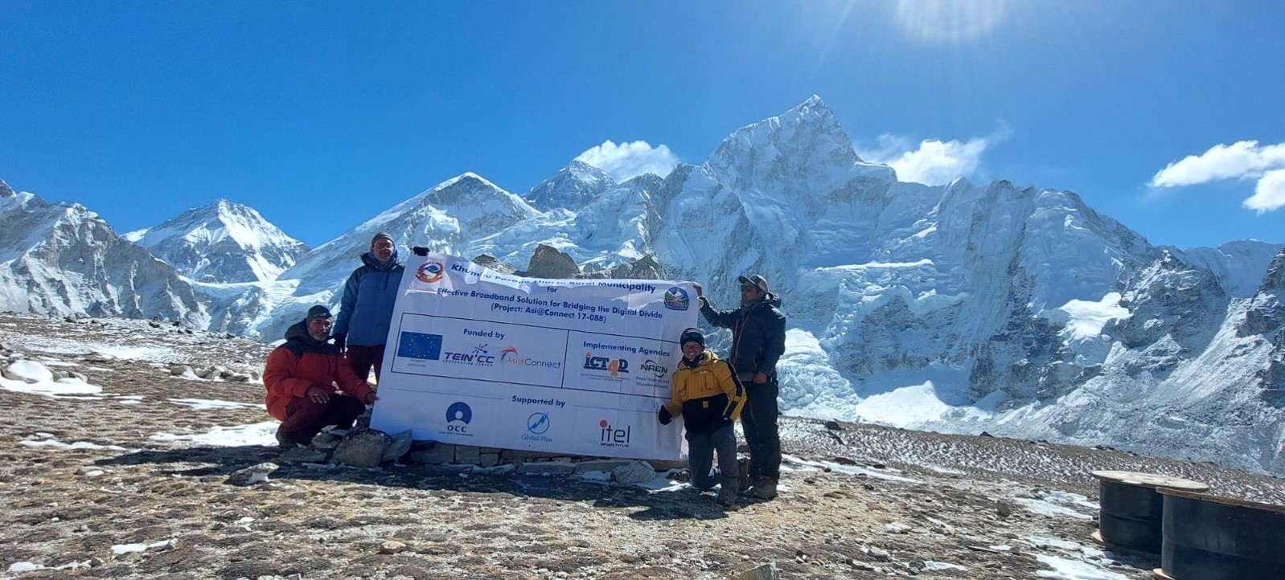
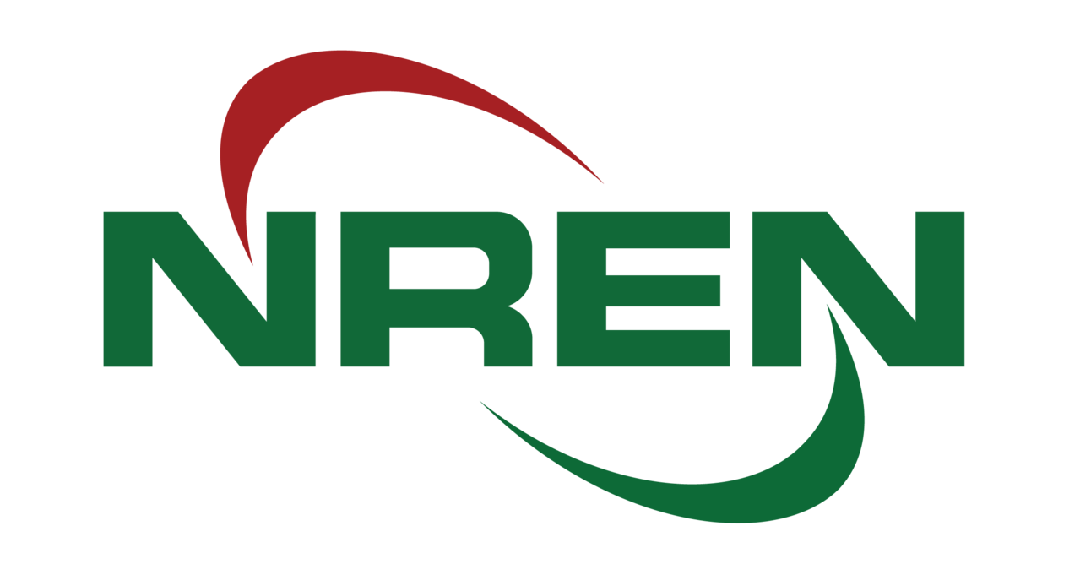
Calling for REN Engagement in Climate Research Collaboration in Nepal
Rajan Parajul, PhD
Executive Director, Nepal Research and Education Network

Slide 2
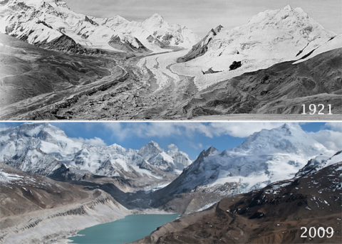
The Melting Himalayas - A Global Threat
Record-Breaking Heat — The years 2023 and 2024 have been officially confirmed as the hottest years on record (World Meteorology Organization).
The 'Third Pole' is warming at an alarming rate—two-thirds faster than previously observed and faster than the global average (ICIMOD).
Himalayan glaciers are melting at a rate of 43 cm/year since 2000, leading to the formation of 21 high-risk glacial lakes.
Photos by David Breashears, George Mallory. Courtesy of Royal Geographic Society

Slide 3
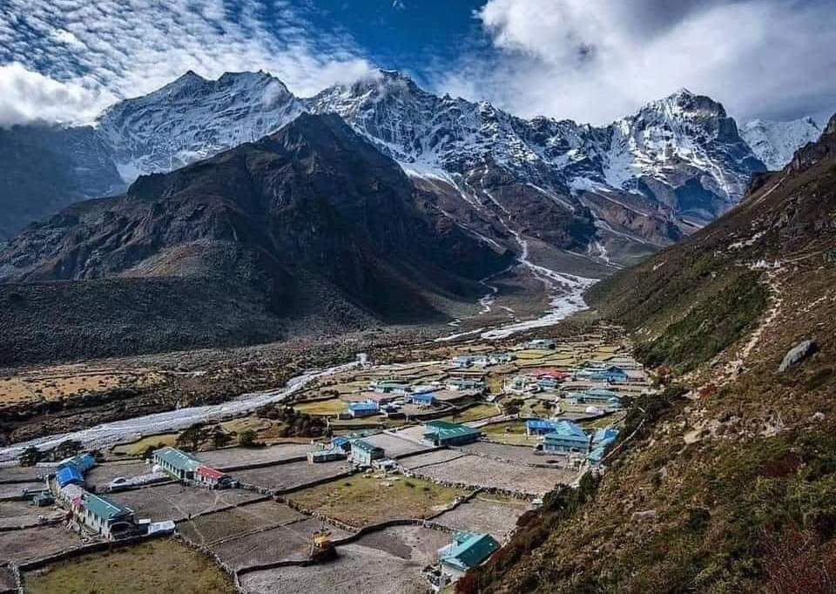
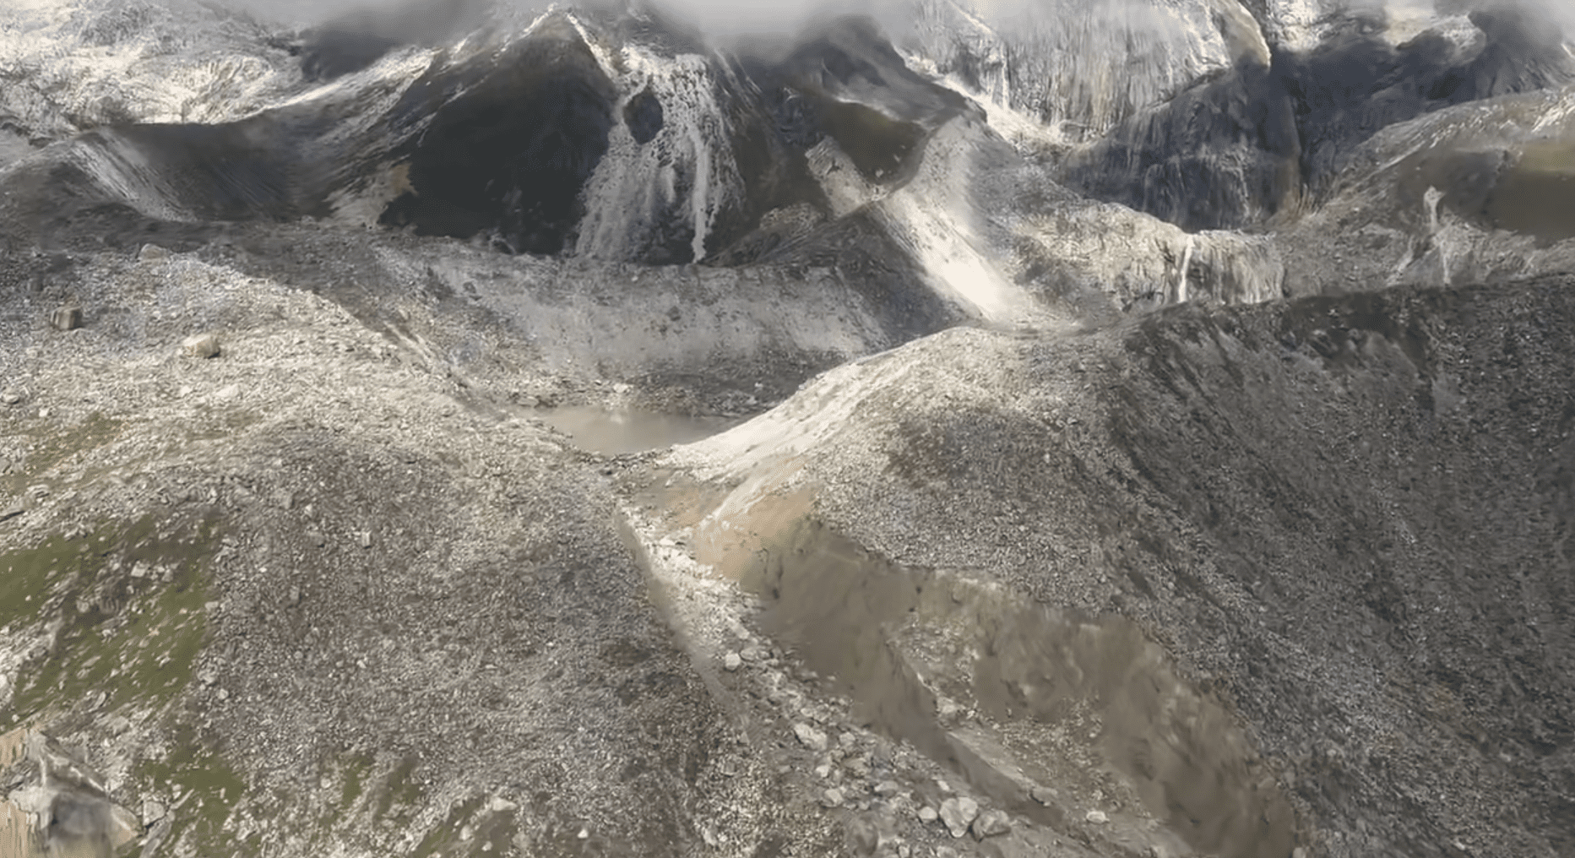
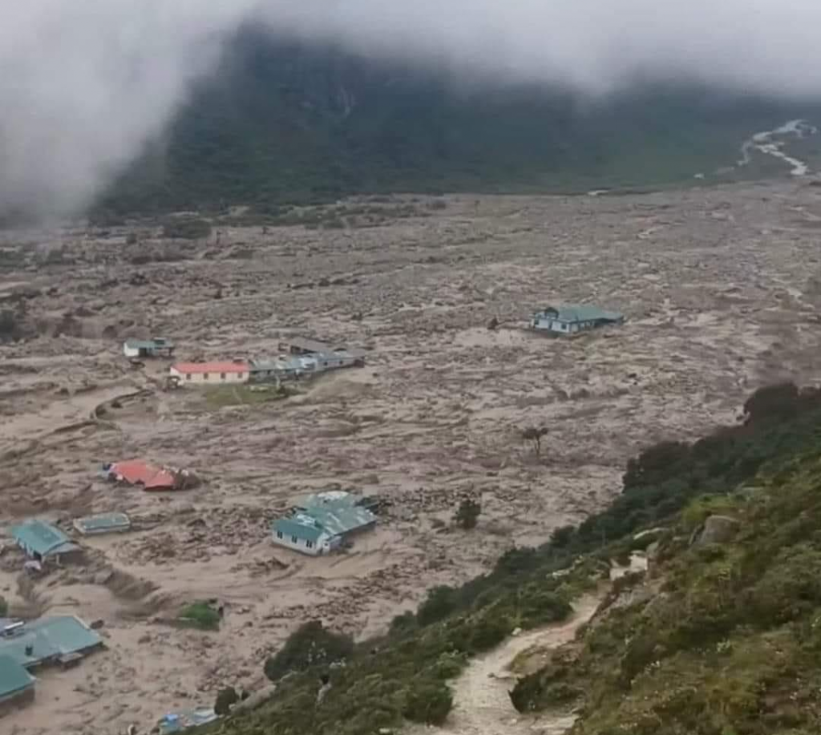
GLOF and Climate Hazards Escalate
The average number of Glacial Lake Outburst Flood (GLOF) events per decade is now nearly five times higher than before 1950.
In August 2024, two of the five glaciers above Thame Village in the Everest region burst, triggering a devastating flood.

Slide 4
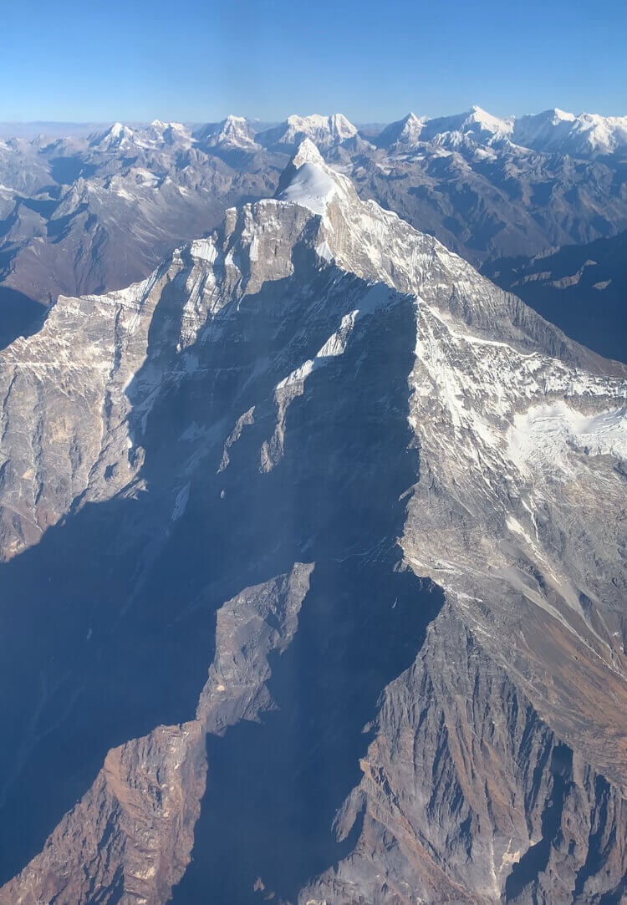
Climate Data Gaps in the Himalayas
The Himalayas are ground zero for climate change science— but critical data gaps persists:
📉 “Data-scarce region,” warns the IPCC – Limited ground observations weaken climate models.
🌫️ Black Carbon & Pollution Impact – Still poorly measured, yet vital to understanding glacier melt.

Slide 5
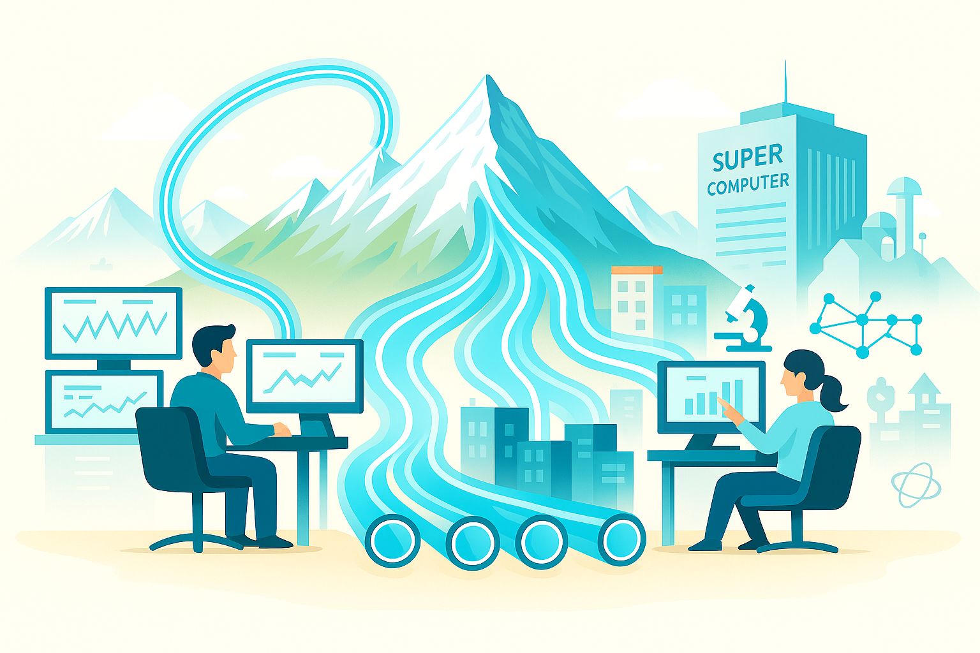
Bridging the Gaps: What’s Needed
Strengthen Connectivity —Enable high-speed transfer of data from remote sensors and ground stations.
Connect Climate Researchers—Facilitate global, cross- collaborations among researchers to diversify knowledge, unique datasets, and specialized equipment.
Access to Virtual Science—Provide cloud tools and HPC for data analysis and advanced modeling.

Slide 6
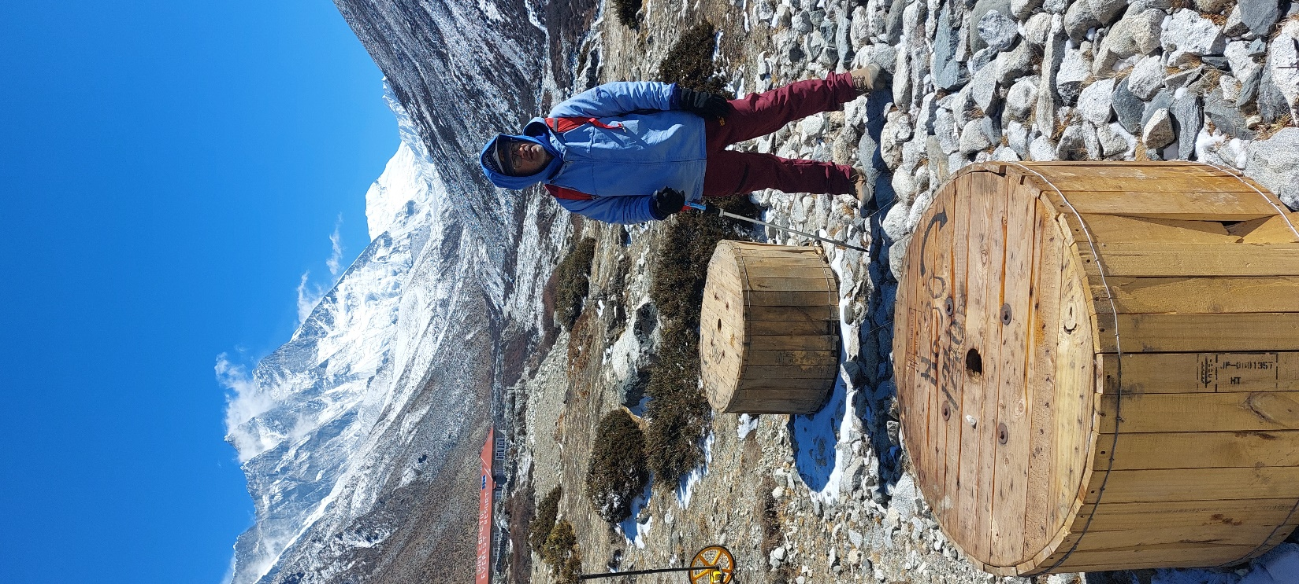
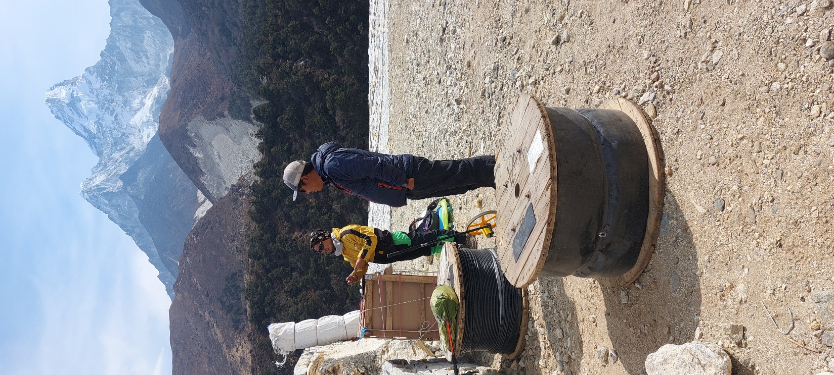
Linking Everest region to the Global REN backbone
With Asi@Connect support, ICT4D and NepalREN is implementing ITU-T L.110 Standards OFC Network from Namche Bazaar to Kala Patthar near Everest Base Camp.
The project requires additional funding for layout and commissioning.
Additionally, need to extend the OFC from Surke to Namche which will provide 100% OFC from Everest region to the Global REN.

Slide 7
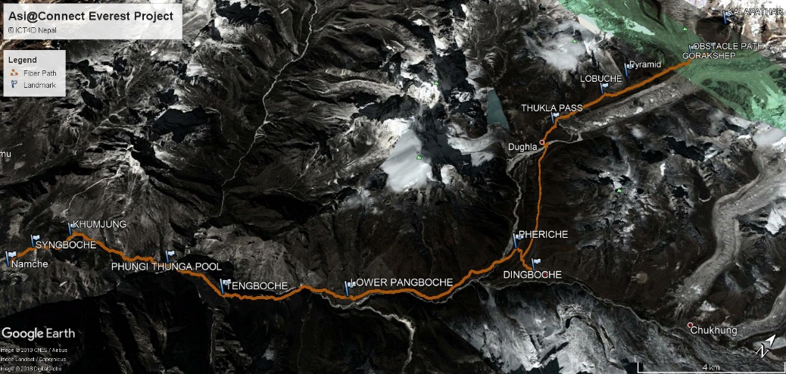
Call to Action — Let's Collaborate for Climate Research in Himalayas
1. Complete the Everest connectivity project as a critical foundation for climate monitoring and research partnership.
2. Build partnerships with global climate institutions, universities, and researchers.
3. Establish high-altitude labs and data systems to support continuous monitoring, innovation, and early warning systems.

