Slide 2
IDENTIFYING
01
OPEN SCIENCE AND FAIR DATA
02
SUPERCOMPUTING / HPC
03
SUSTAINABILITY

Slide 3
TARGETING
OUTREACH
GOVERNMENT BODIES
THE PUBLIC
RESEARCH COMMUNITY
STUDENTS

Slide 5
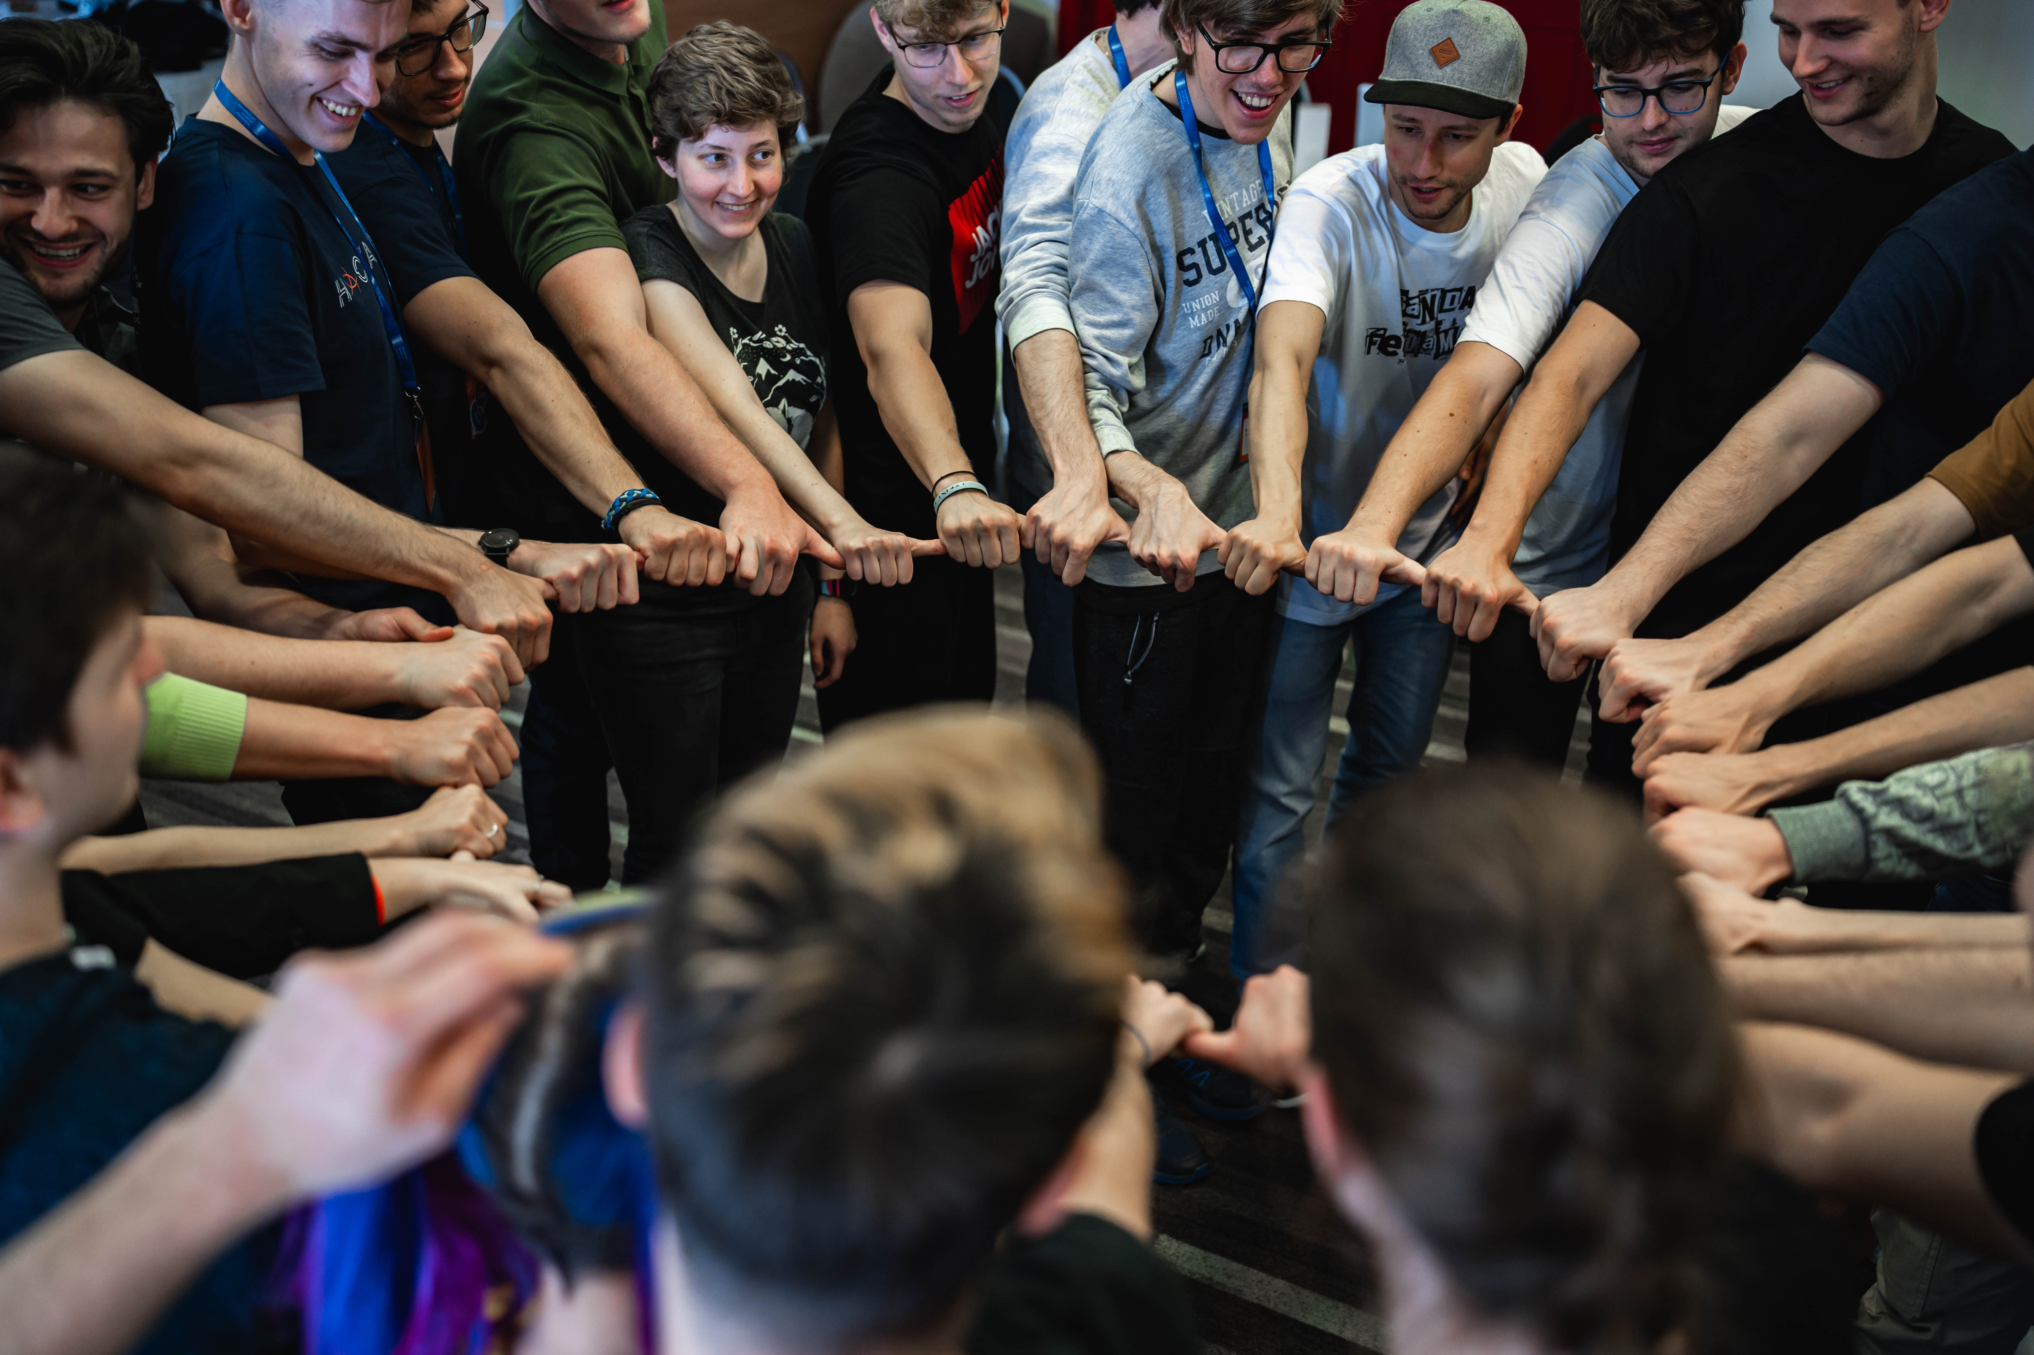
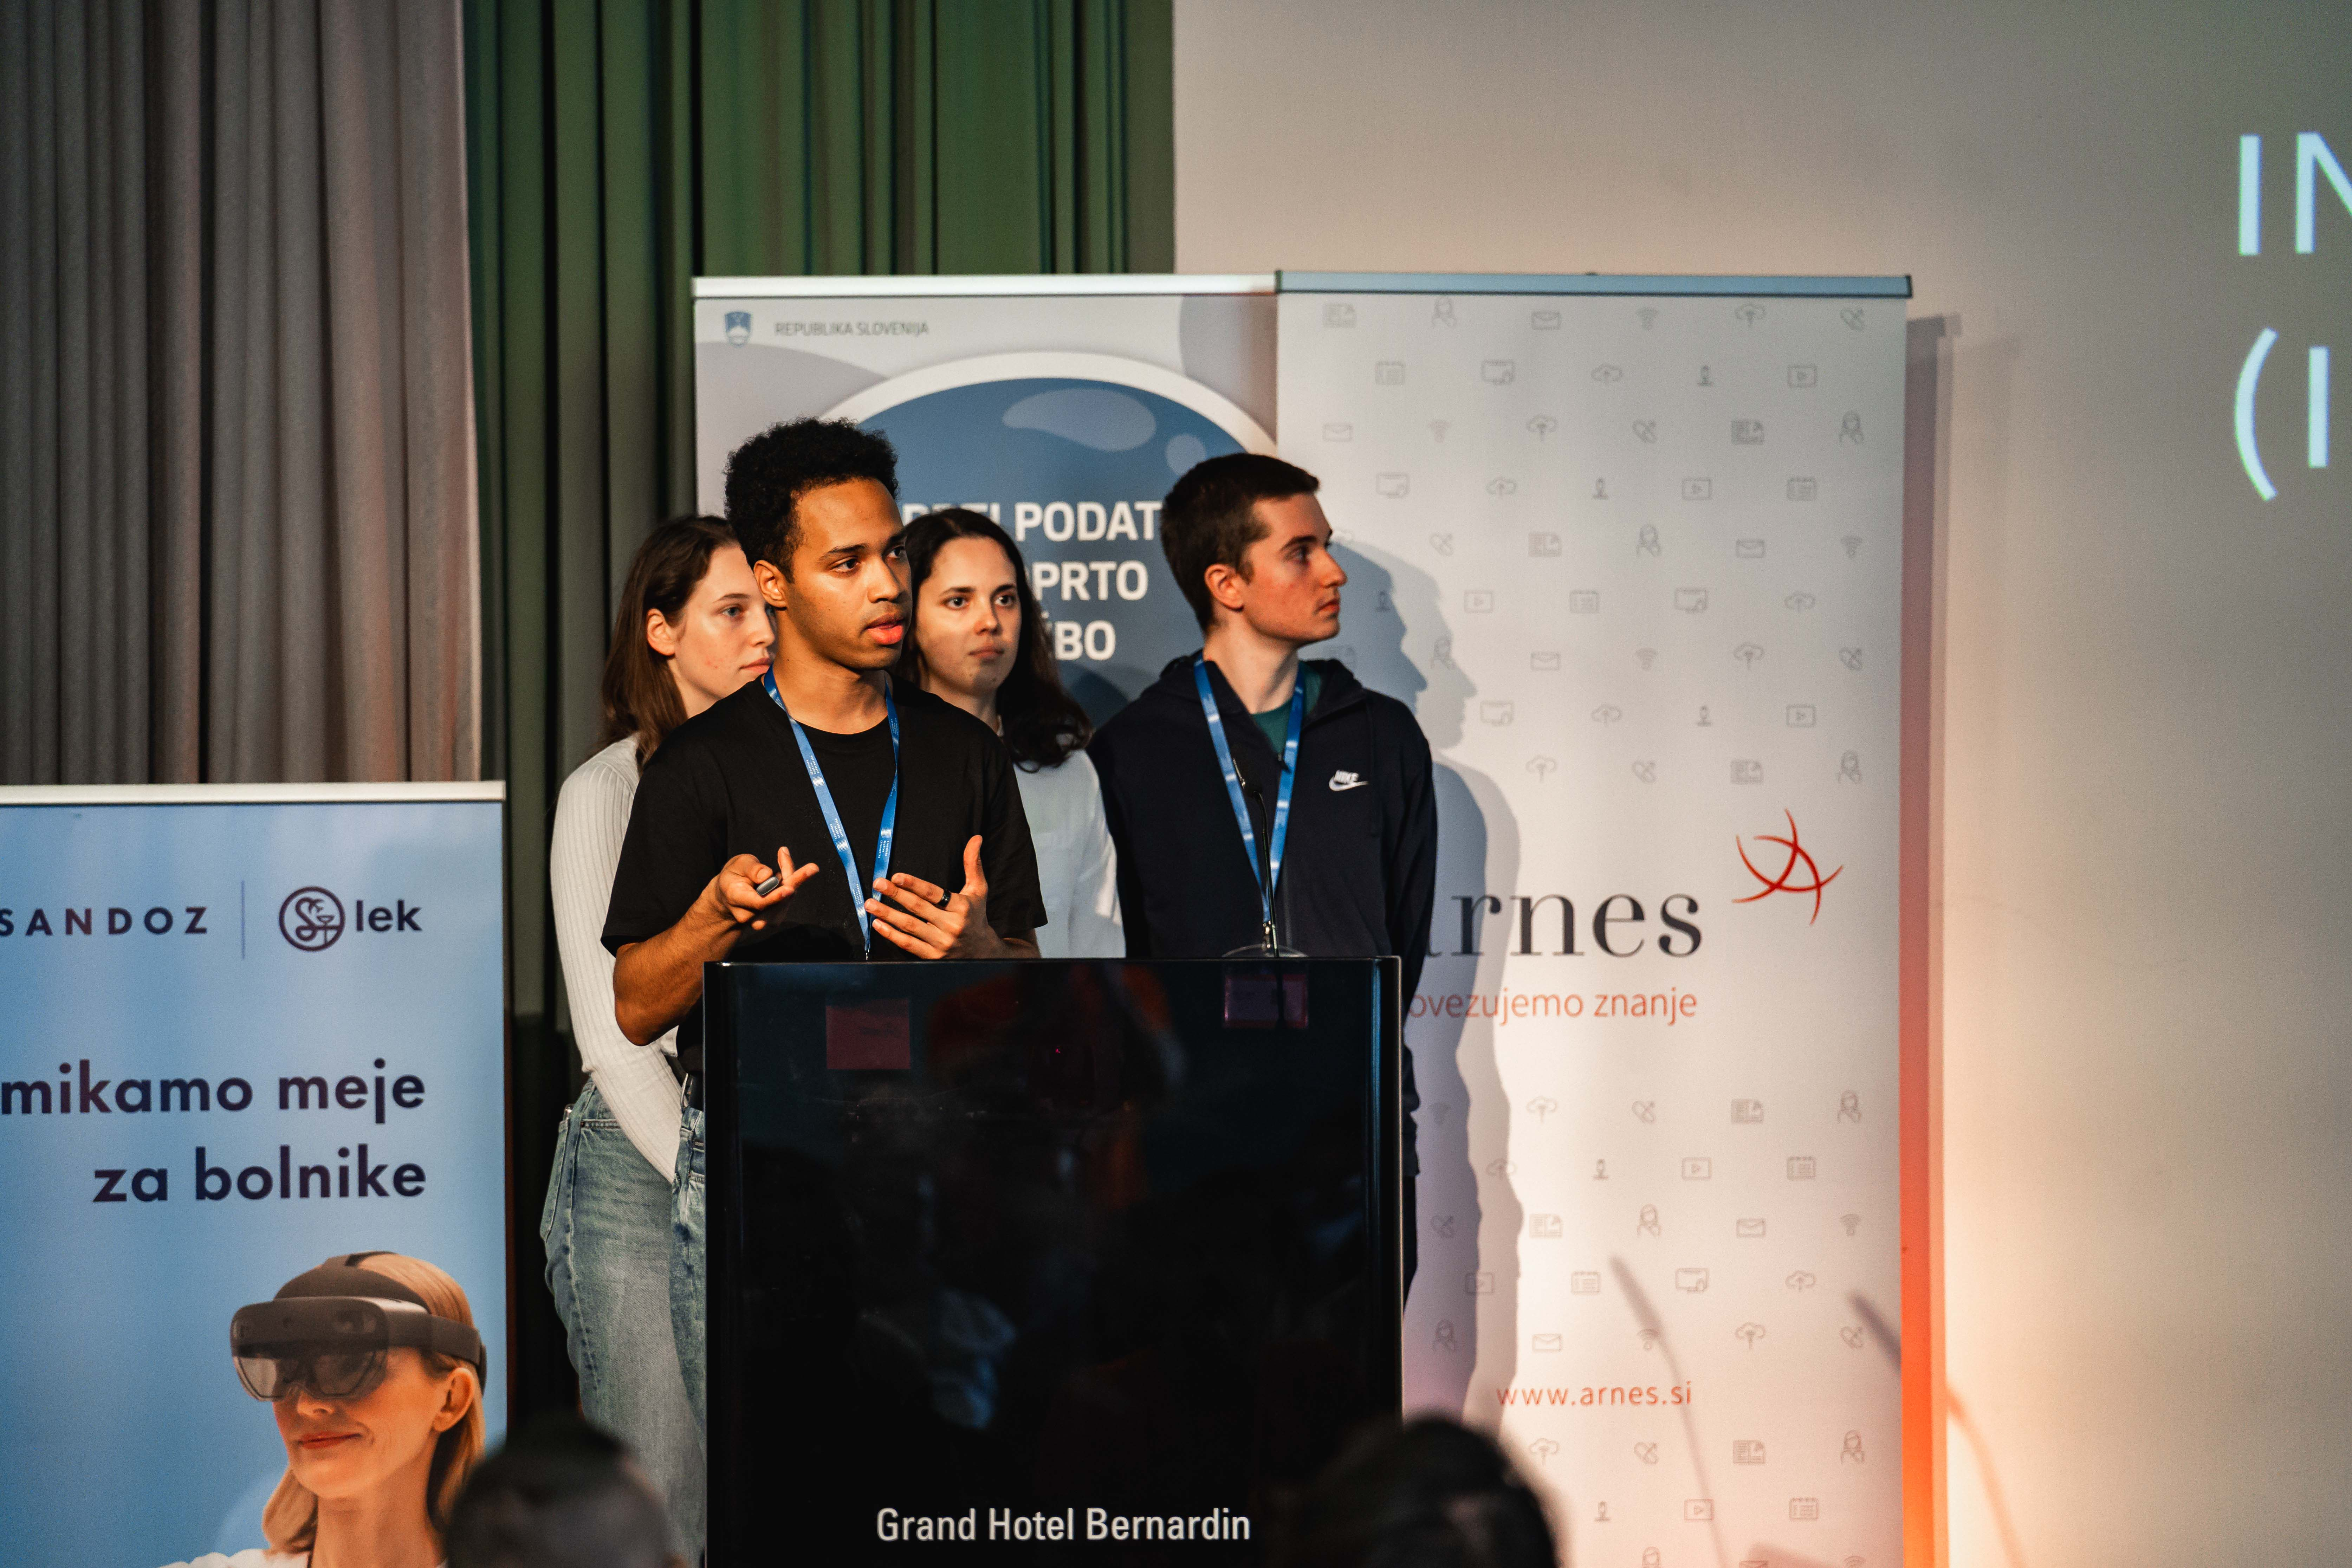
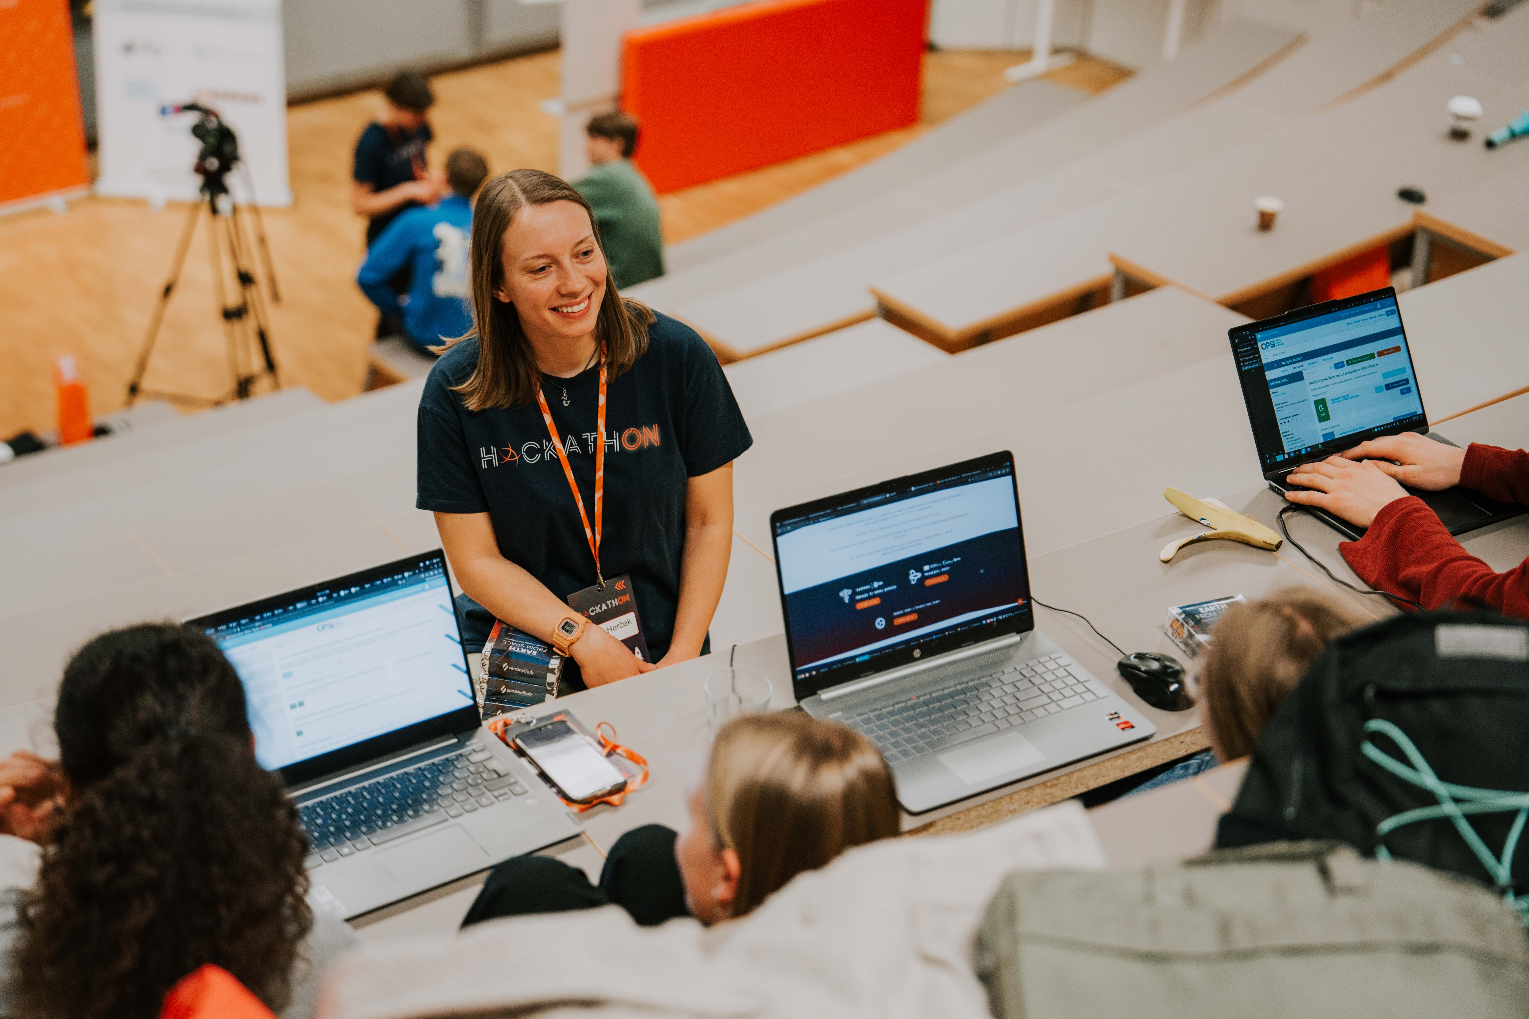
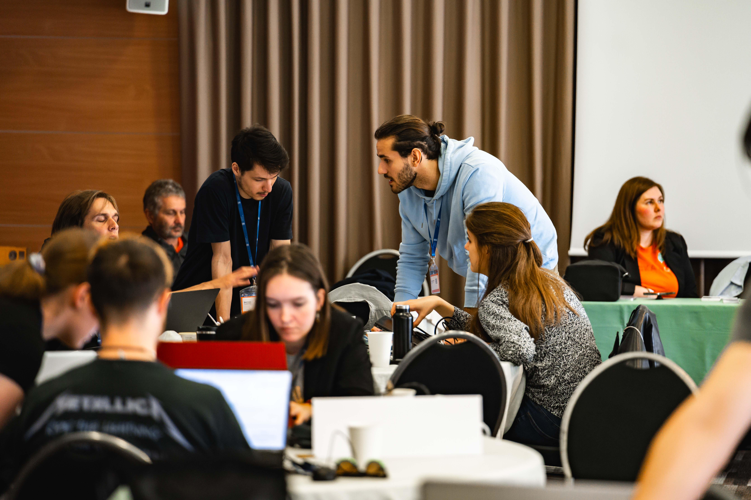

Slide 7
