Slide 1
Tales of FEII
Sunet’s Journey through Function, Efficiency, Innovation & Integration
Richard Freitag

Slide 2
Sunet is the Swedish University Computer Network

Slide 3
Sunet – The Swedish National Research and Education Network
Founded in the 1980s – Paved the way for the establishment of the general internet in Sweden
Experience since 1985
Nation-wide high-speed computer network – 9 300 km of fibre
National academic identity infrastructure
99.999% Network availability
24/7 Operations Centre
Services for Swedish higher education institutions, public authorities, museums, and other public organizations
Part of Vetenskapsråded (VR) – The Swedish Research Council

Slide 4
FEII & RFC 2119 Overview
FEII in Context: Off-the-shelf solutions + Mandatory & Optional Requirements
RFC 2119: Defining “MUST”/”MUST NOT”, “SHOULD”/”SHOULD NOT” and “MAY” for clarity and consistency
Why it matters: Precise requirement levels streamline communication and expectations

Slide 5
Function – Baseline “MUSTs” - Off-the-Shelf Requirements
Core Services: Off-the-shelf solutions
RFC 2119: “MUST” requirements implement foundational operations
Reduced Complexity: Vendor documentation and support

Slide 6
Efficiency – Non-functional “SHOULDs”
Scaling and Performance: The system SHOULD be able to handle massive amounts of data
Minimal Human Interaction: Automation is a strong SHOULD for large-scale ops
KPIs and non-functional requirements: Throughput, Latency, Reliability

Slide 7
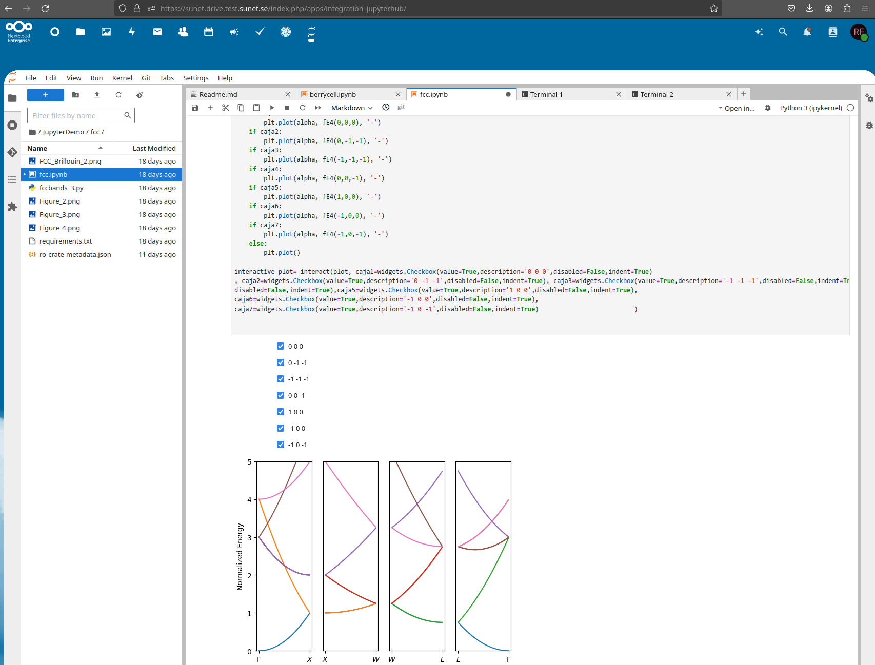
Innovation – “MAY” and experimental features
Vendor Gaps: Some advanced features MAY not exist initially
PoC: A pilot feature for specialised use case
Risk Management: Begin with “MAY”, elevate to “SHOULD” or “MUST” if successful

Slide 8
Integration – Compliance & Cross-Module Consistency
Holistic Ecosystem: Modules MUST integrate seamlessly
API Uniformity: Modules SHOULD use standard protocols
Policy Enforcement: Security & compliance checks MUST NOT conflict with technical implementation (and vice versa)

Slide 9
Best Practices
Use “MUST” for critical funcationality
Apply “SHOULD” for recommended scalability and performance
Reserve “MAY” for experimental/optional expansions
Continuously update requirement levels as features mature
Map RFC 2119 to FEII: A powerful combination for clarity and structure

Slide 10
Sunet Tales of FEII

Slide 11
A tale of (many) functions: Nextcloud v24 → v25 → v26 → v27 → v28 → v29 → v30 → v31...
RFC 2119: Basic EFSS functionality MUST continue to work after upgrades
Problem: New versions introduce features and potentially regressions
Resolution: Monitoring and continuous testing at a global scale

Slide 12
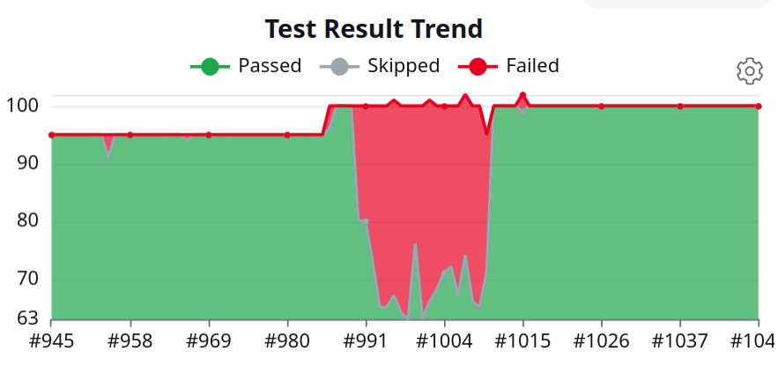
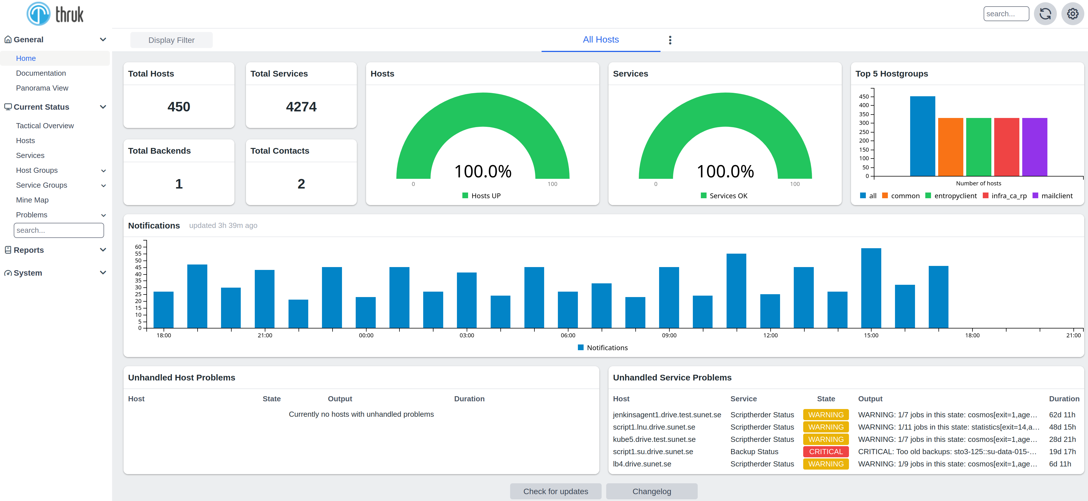
A tale of (many) functions: Nextcloud v24 → v25 → v26 → v27 → v28 → v29 → v30 → v31...

Slide 13
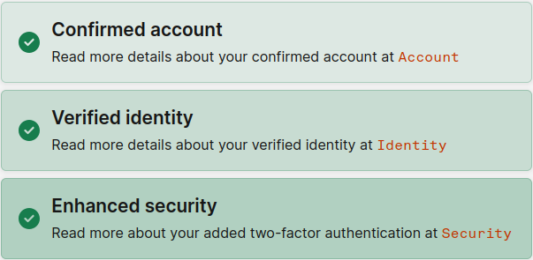
Tale of Innovation: eduID Connect
Problem: Operating Identity providers with identity assurance and multifactor authentication can be challenging
Resolution: Extend tried and tested solution (eduID.se)
Effect: Security & Compliance

Slide 14
Tale Efficiency: Multi Data-Centre Deployment
Redundancy: Three data centres SHOULD ensure seamlessly distributed load
Observation: One data centre hindered performance in ~1/3 of uses
Action: MUST diagnose network latency and client routing

Slide 15
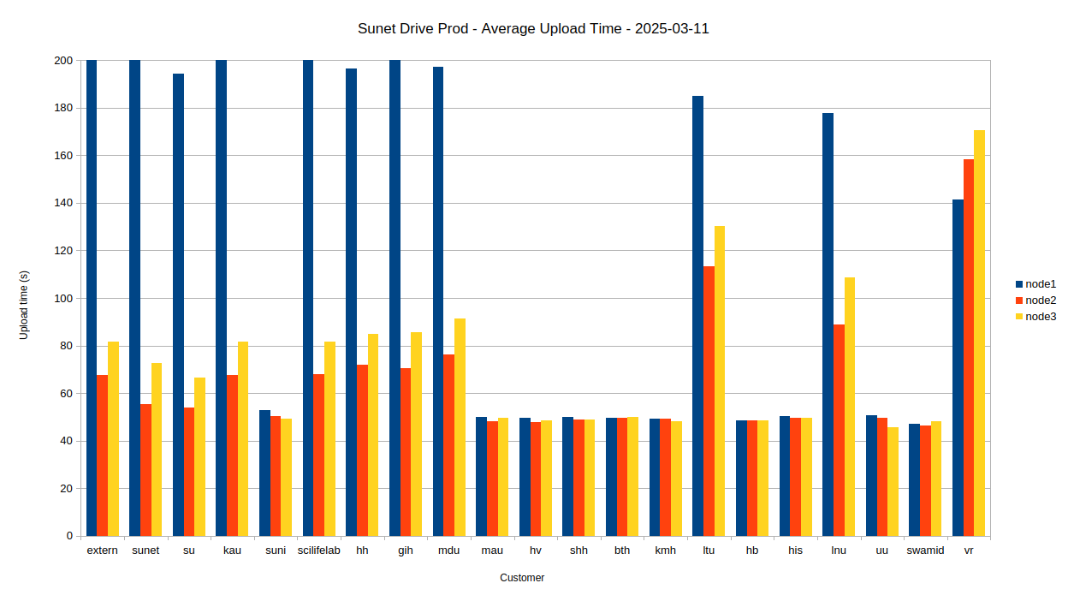
Tale Efficiency: Multi Data-Centre Deployment
Best performance for non-clustered nodes
Good performance for node2/node3 of clustered nodes
Bad performance for node1 in dco/kalix
The ‘good enough’ solution was chosen

Slide 16
Tale of Integration: Surf/Sunet Research Cloud (PoC)
Problem: Scientists require easy acces to compliant compute-resources
Resolution: Adapt Surf Research Cloud to provision resources in Swedish Data Centres
Effect: Solution that is secure, compliant, and cloud-agnostic
Did you miss the BoF on Wednesday?

Slide 17
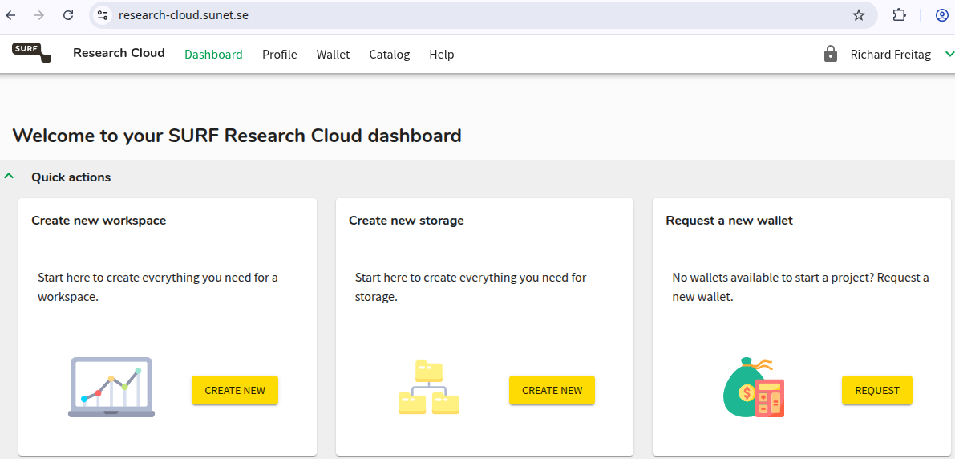
Tale of Integration: Surf/Sunet Research Cloud

Slide 18
Is this all new?

Slide 19
Douglas Adams – Rules that describe our reactions to technology
1. Anything that is in the world when you’re born is normal and ordinary and is just a natural part of the way the world works.
2. Anything that’s invented between when you’re fifteen and thirty-five is new and exciting and revolutionary and you can probably get a career in it.
3. Anything invented after you’re thirty-five is against the natural order of things.

Slide 20
Thank you
freitag@sunet.se

