Slide 1
Hidden Routes: The Invisible Impact of MANRS
Abdalla Alfaramawi
Brighton, UK
12/06/2025

Slide 2
MANRS and Hidden Routes
Notes:
Securing our networks has long been a priority for the NREN community.
In the last few years, there has been a big push to adopt MANRS BGP security in order to stop route leaks and hijacks.
Now, these security measures are great, they stop malicious attackers and innocent human error from taking down our internet connection,
but sometimes, these measures create roadblocks that divert internet traffic, which results in slower connections for the end user.
For the last year, I've been working on this exact challenge in the GÉANT network,
and today I’ll tell you what hidden routes are and why you too should start uncovering them within your network.

Slide 3
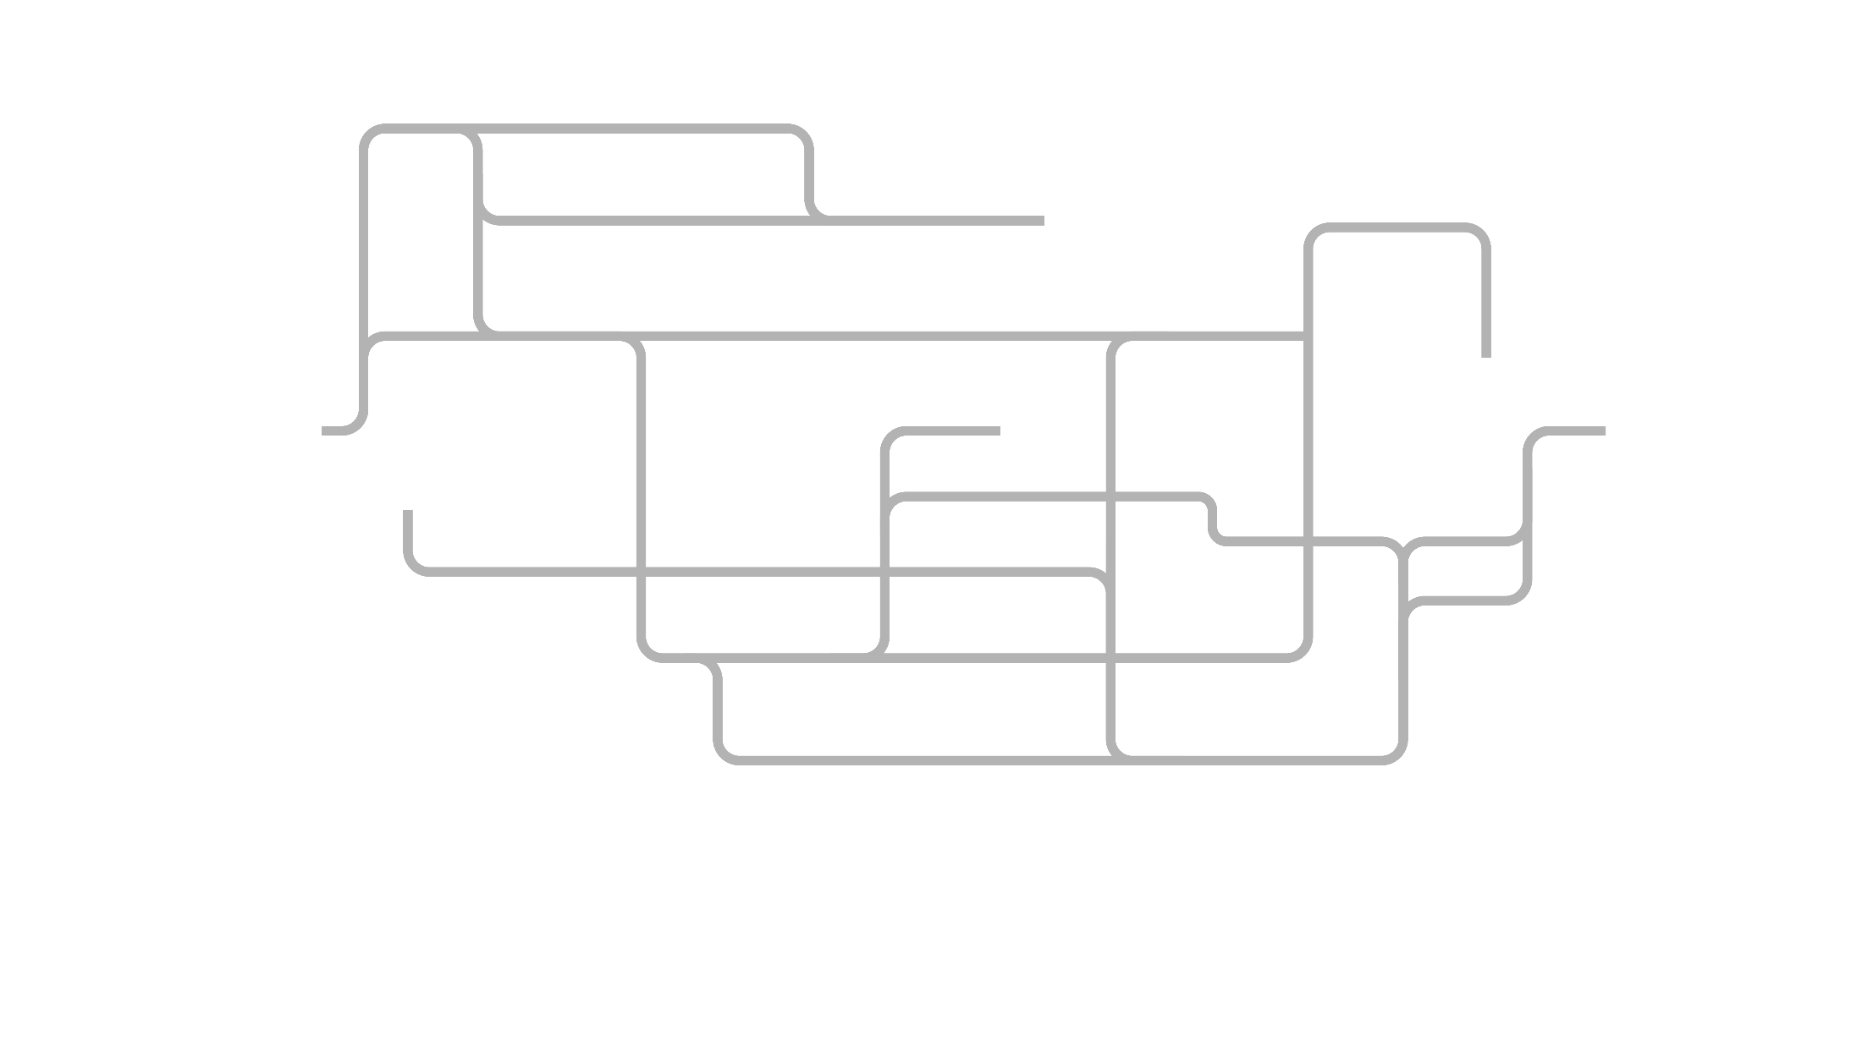
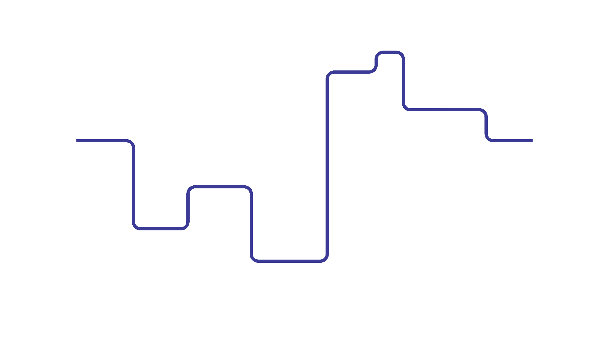
You
Internet
NREN
Commercial ISP
- Strict Filtering
- Full MANRS Compliance
- Loose Filtering
- Partial or No MANRS Compliance
Notes:
This is the route your traffic takes every day to connect to the Internet.
Nothing wrong with it. You can access your favourite websites, the university servers and online courses.
Sometimes you complain that it’s slow, but it’s not a big deal.
[CLICK] There are many other routes that your router doesn’t pick though, even if they’re sometimes faster.
[CLICK] Why is that?
Imagine with me that a university uses two service providers for their internet connections:
one through an NREN with strict security filters [CLICK], and one via a commercial ISP[CLICK].
If the route through the NREN is blocked by these filters, the traffic will shift to the commercial link.
and that might not seem like a big deal—until users start seeing their internet speeds drop because of the sub-optimal routing,
or the university sees their commercial provider’s bill spike because of the shift of traffic.

Slide 4
You
Internet
University
NREN
Commercial ISP
- Strict Filtering
- Full MANRS Compliance
- Loose Filtering
- Partial or No MANRS Compliance
RPKI-Invalid Prefix
RPKI-Invalid Prefix
Notes:
By default, BGP does not have any built-in security. It relies on external security mechanisms like RPKI, and prefix list filters created from RIR databases.
These security layers work well together, but there’s a catch
[CLICK] when a route doesn’t meet the filtering criteria, for example, if it’s RPKI invalid
[CLICK] it gets dropped! and That’s the good news. The bad news? It gets dropped silently.
It’s never propagated, and it doesn’t show up in most monitoring tools, and of course, the traffic keeps flowing through another path that’s allowed the prefix.
That’s what we call a hidden route. So, you might ask, how do we maintain our security measures without compromising on performance?

Slide 5
Making the Invisible Visible
83%
14%
3%
RPKI Invalid
Missing Route Object
Import Policy
Notes:
At GÉANT we realized that to fix this, we first had to see it.
We developed a custom script that scans our network for hidden routes,
and once we had visibility of every hidden routes within our network we started categorizing each one by the reason of rejection.
Most rejections were due to legitimate traffic engineering policies, but approximately 1 out of 5 routes were rejected because of a missing route object or because it was RPKI invalid.
The fix for this was to reach out to the affected NRENs and explain what was happening.
In one Case an NREN had missed registering 5 route objects, which meant that any traffic destined for the 2000 IP addresses under those routes could not pass through GÉANT.
We guided them on how to fix their route object, and connectivity was restored within a few days.

Slide 6
Efficient
Resilient
Secure
Notes:
Our experience at GEANT taught us an important lesson: as networks adopt more secure BGP practices, more and more of these hidden routes will appear,
whether due to mistakes, or legitimate attacks. [CLICK] In order to differentiate between the two, we need to monitor not just what gets in, but what’s getting filtered out.
Hidden routes are silent failures. If we ignore them, we risk degraded service, frustrated users, and poor routing decisions.
Exposing these routes and engaging our community to resolve them [CLICK] can make our networks more efficient and resilient, all without compromising security. Thank you very much.

Slide 7
Thank you
abdalla.alfaramawi@geant.org

