Slide 1
Exploring XDP the new addition to the CESNET NDK
Richard Hyroš

Slide 2
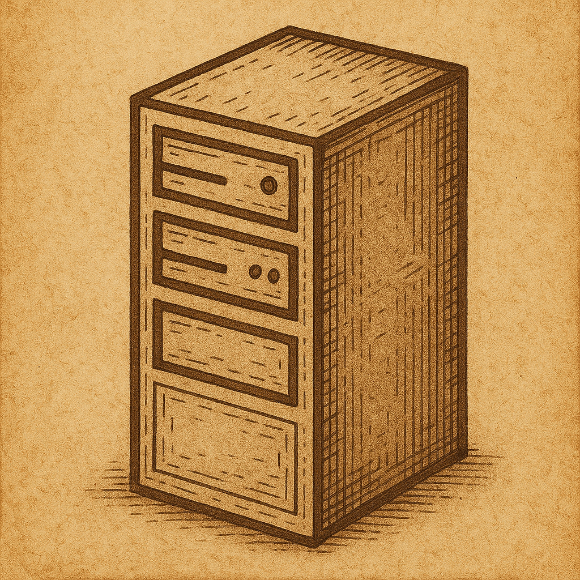
THE BATTLE FOR PERFORMANCE
Traffic grows
CPU cannot keep up
What to do?
Notes:
Imagine you have a server and you operate a networking application.
As more users connect and traffic increases, your system starts to slow down.
You need more processing power.
So, what are your options?
- New machines => money
- Optimize your application to take up fewer resources
takes time, money => diminishing returns.
But what if there was an easy way?
The mystery solution is running the decision logic in the KERNELSPACE.
This is what XDP (eXpress Data Path) is about.

Slide 3
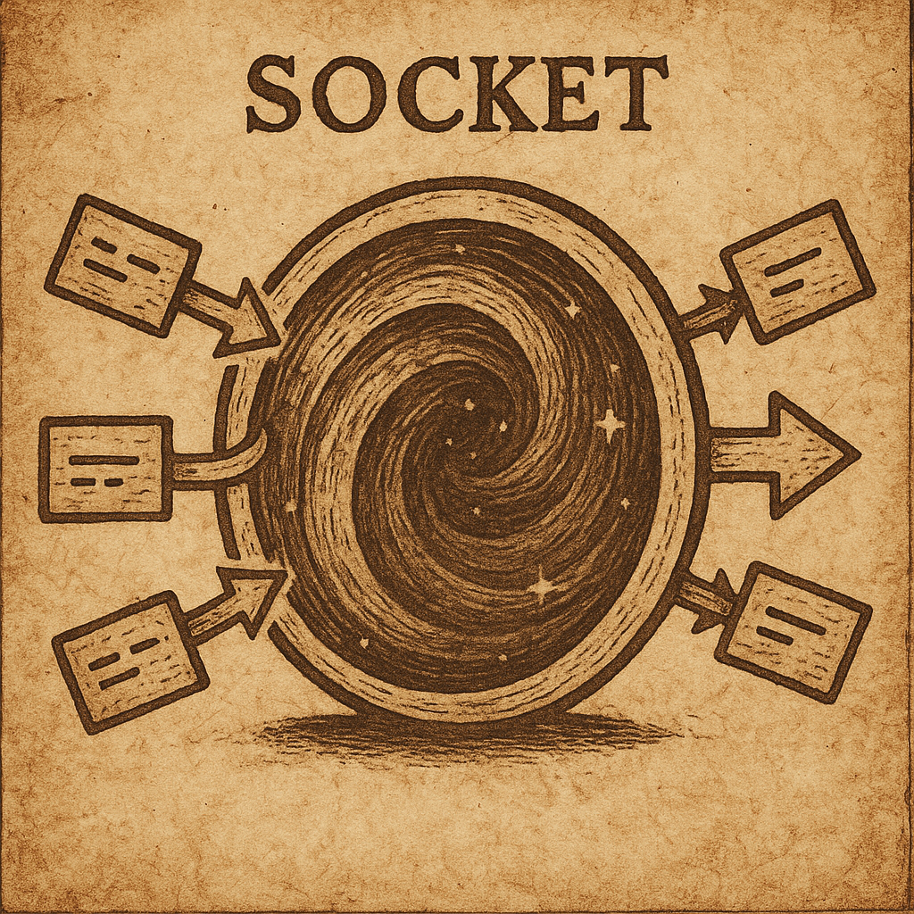
GETTING PACKETS IN YOUR APPLICATION
YOUR APPLICATION MAGIC
PACKETS
Notes:
To understand XDP, let's first look at how your network application works.
Your application communicates to the network through a socket.
You see this socket as a magic gate.
The application has no clue what happens on the other side of the gate.
This is on purpose, so that the programmers can focus on what is important to your application.
But when the performance is on the table, this is the place where we can look to make some gains, and XDP makes this very easy.
So let's take a peek behind this gate.

Slide 4
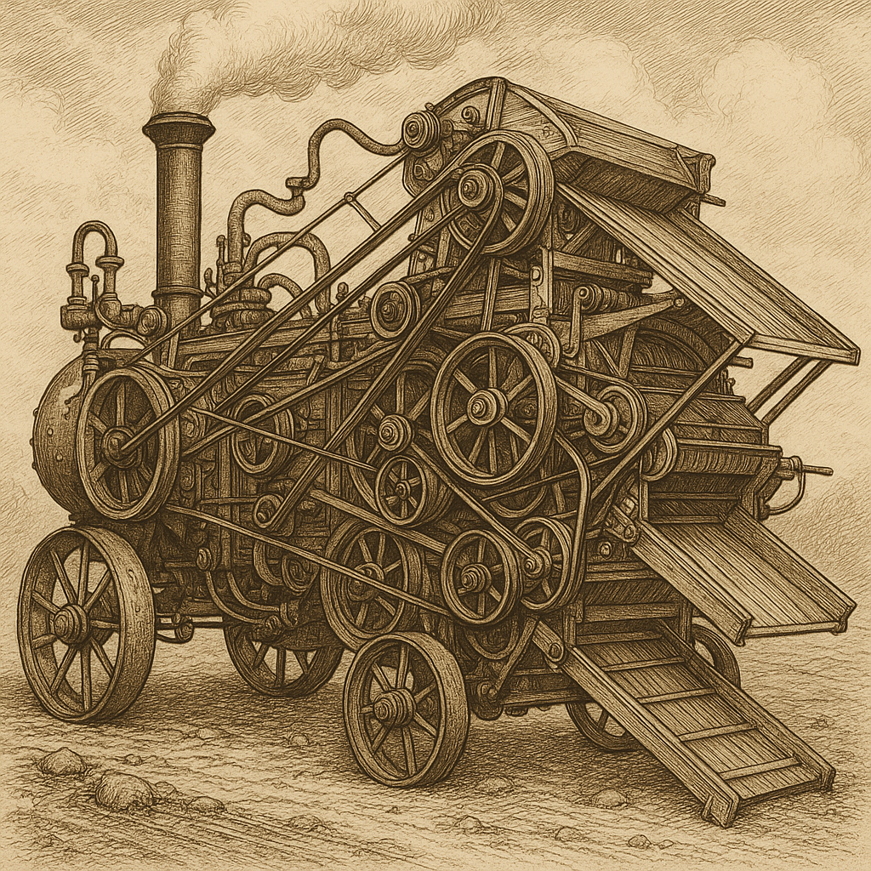
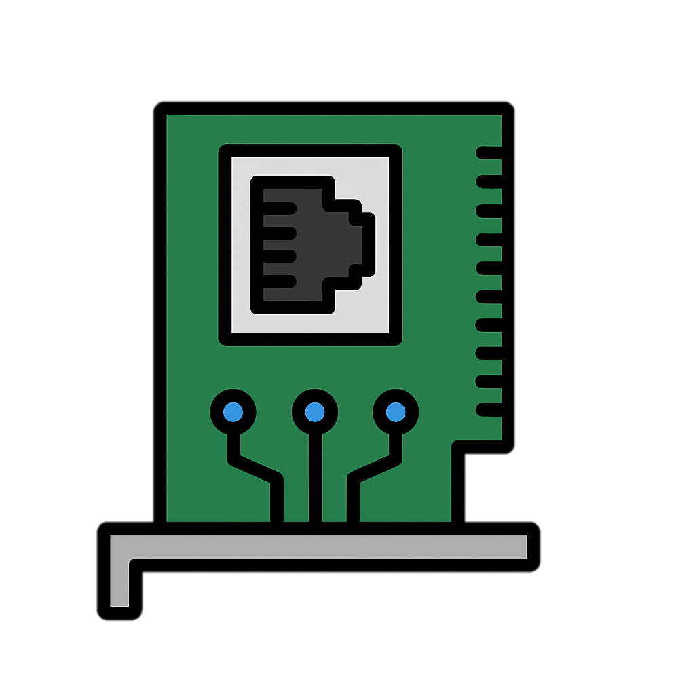
NETWORKING PIPELINE
KERNEL SPACE
USER SPACE
XDP
PROGRAM
YOUR
MAGIC
NETWORK CARD
NETWORK DRIVER
NETWORK STACK
SOCKET
APPLICATION
Notes:
This is a pipeline of packets from the moment they arrive at your network card to the moment when you receive them in your application.
We can divide this pipeline into two parts:
The first on the right is the USERSPACE, which is where your application lives. Here, you are safe under the operating system's protection, and nothing bad can happen.
And then on the left, there is KERNELSPACE, this is TERRA INCOGNITA or "UNKNOWN LAND", dangerous to the explorers.
Programmers don't look at KERNELSPACE, because any mistake that you make here will most likely result in a crash of your system.
You might remember an automatic update that grounded all airplanes worldwide not so long ago. That was a result of running faulty code in the kernel.
The socket then acts as a gate between the two.
XDP allows you to load a program that runs in the KERNELSPACE.
This is what makes it special.
This program is guaranteed to be safe, so you won't have to worry about crashing.
Why would you want to do this?
It is because of what comes right after XDP.
The NETWORK STACK.

Slide 5
KERNEL NETWORK STACK
A LOT OF CPU TIME
FROM THE INTERNET
TO YOUR APPLICATION
Notes:
This piece of the operating system is like a very complicated machine that does everything networking.
This is your main bottleneck, which defines the performance of your system.
XDP then allows you to decide what exactly goes into the network stack.
Let's imagine a scenario.
Your application wants to download something from the network.

Slide 6
KERNEL NETWORK STACK
A LOT OF CPU TIME
100%
OF THE PACKETS
10%
OF THE PACKETS
FROM THE INTERNET
TO YOUR APPLICATION
Notes:
But since your data is not the only thing on the network, you only actually need 10 percent of the traffic.
The issue is that 100 percent of the packets are still passed to the network stack.
This overwhelms your CPU and causes your performance issues.
Your system is now bottlenecked.

Slide 7
XDP PROGRAM AS A FILTER
KERNEL SPACE
USER SPACE
PASS 10%
XDP
PROGRAM
YOUR
MAGIC
DROP 90%
NETWORK CARD
NETWORK STACK
SOCKET
APPLICATION
Notes:
Now, by loading the XDP program, we can prefilter the traffic before the packets are sent to the network stack.
By doing no work on the packets we don't need, we save performance and make our application faster.
And the best thing? You can easily test this without changing anything in your application.
This is the simplest example, but XDP gives you more flexibility than just dropping the packets you don't need.

Slide 8
XDP PROGRAM AS A FILTER
KERNEL SPACE
USER SPACE
PASS
XDP
PROGRAM
YOUR
MAGIC
DROP | TX | REDIRECT
NETWORK CARD
…
NETWORK STACK
SOCKET
APPLICATION
Notes:
You can also change the packet contents and transmit them back to the internet.
You could implement a whole application to run in the KERNELSPACE, with maximum performance. The sky is the limit here.

Slide 9
REAL-WORLD APPLICATIONS
Load Balancing
DDoS Mitigation
Network Monitoring
Notes:
Right now, XDP applications are already used to accelerate LOAD BALANCING, DDOS PROTECTION, or NETWORK MONITORING.
But there is one more thing XDP allows you to do. In fact, it is why it is called the eXpress Data Path.

Slide 10
XDP ZERO COPY / AF_XDP
KERNEL SPACE
USER SPACE
REDIRECT TO USERSPACE
XDP
PROGRAM
YOUR
MAGIC
NETWORK CARD
NETWORK DRIVER
NETWORK STACK
AF_XDP
SOCKET
AF_XDP
APPLICATION
Notes:
In this mode, called AF_XDP or zero-copy, you go around the network stack and avoid the bottleneck altogether.
This requires a special application.
Since you bypass the network stack, you must now do some of the hard work yourself.
This is more difficult, but you push the performance to a whole new level.

Slide 11
WHY USE XDP?
Linux native – you already have this.
Loading XDP filter is easy.
Not just a filter, you can make smart kernel applications.
AF_XDP elevates your performance to a whole new level.
Testable without support.
Notes:
XDP is Linux native solution, so if you use Linux, all this is already on your system and ready to use.
You can test XDP on any new version of Linux in slow mode at any time.
But if you want maximum performance and flexibility, you need driver support.
This is now newly available on our CESNET NDK FPGA platform.

Slide 12
Want to know more?
You can contact me at
hyros@cesnet.cz
All images generated by AI.
Notes:
I thank you for your attention.
I would love to answer any of your questions, so feel free to contact me if you found XDP interesting.

