Slide 1
AI and DH in action
Proste Pismo - platform for plain language communication
Tomasz Parkoła, 12.06.2025

Slide 2
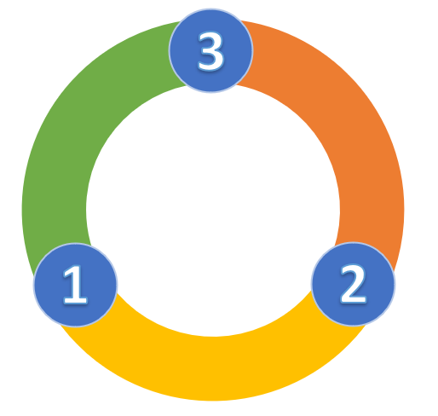
Challenge
Business to Customer communication
Customer support
Negative reception, many additional questions, need for clarification. Often need to correct erroneous decisions based on a misinterpretation of an earlier letter. Additional work and consumption of officials' time. Longer waiting time for recipients of letters.
Official communication
Business and administration prepares official letters in accordance with legal requirements and administrative standards. Habit of using complex language. Reluctance (by lawyers) to change the way letters are prepared.
Customer satisfaction
Difficulty understanding the content of a letter received. Frustrated, often misinterprets the writing. Sometimes needs to ask for clarification or makes wrong decisions based on their own incorrect interpretation of the letter.

Slide 3
Approach
Cooperation and synergy
UMP
Poznan City Hall (UMP)
Need to improve communication with the citizen. Official letters are written in complex language, the recipient has difficulty understanding their content.
Adam Mickiewicz University in Poznań (UAM)
Polish language scholars and experts in the field of plain language, Prof. Karolina Ruta-Korytowska and Prof. Jarosław Liberek are interested in examining the a collection of official writings.
Poznan Supercomputing and Networking Center (PSNC)
Technology partner has knowledge of how to build a tool to support researchers' work on source material such as official letters.
PSNC
UAM

Slide 4
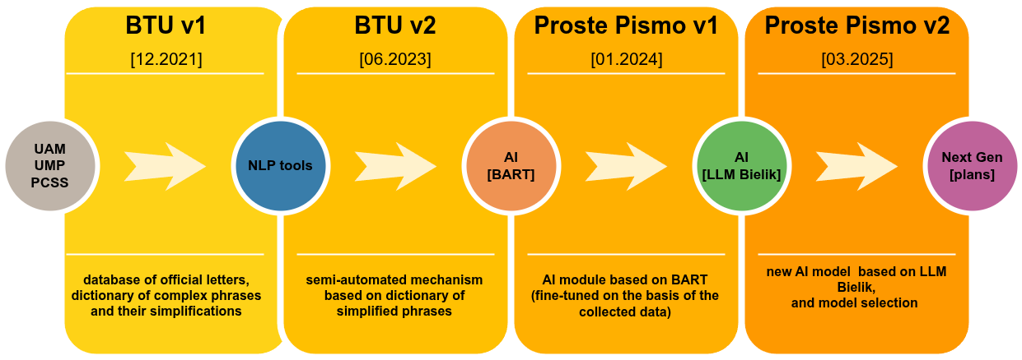
Approach
Proste Pismo – development stages (2021-2025)

Slide 5
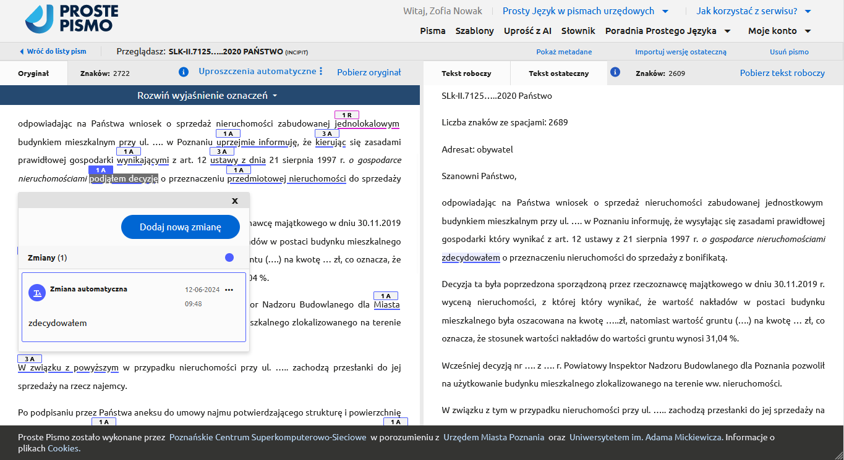
Approach
Proste Pismo – letter edition view

Slide 6
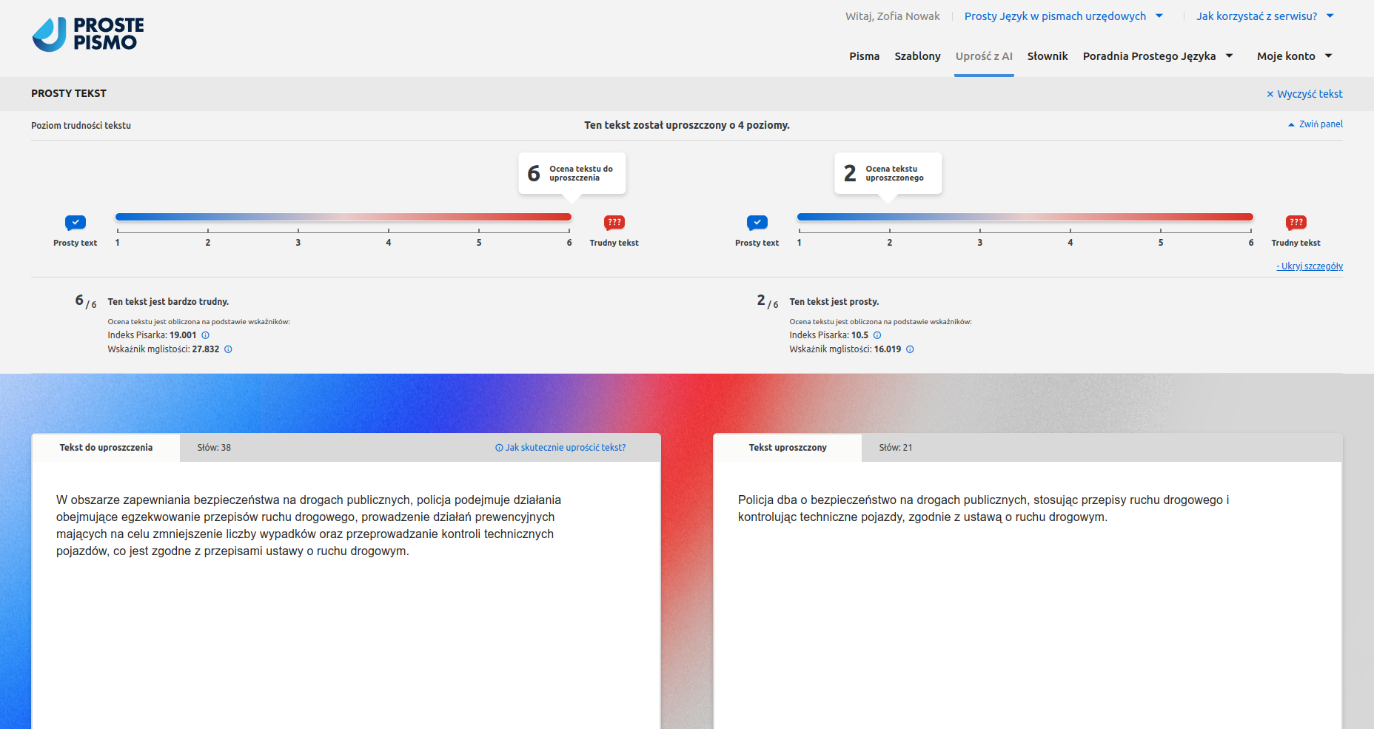
Approach
Proste Pismo – simplify with AI

Slide 7
Effects – key benefits
01
A tool for business and administration
Simplifying the content of letters using AI
Automatic dictionary-based changes
Possibility of defining reusable letter templates
02
A tool for researchers (e.g. linguists)
Ability to test official language on real data
Ability to build a dictionary of complex phrases
Providing expertise for fine-tuning AI models
03
Improving communication accessibility for recipients
Clear and comprehensible content of the letters received (objectively measured simplicity of language)
Efficient and rapid understanding of the text
Less frustration and negative perception
04
Economic and public image benefits
Improving communication with the customer
Reducing the number of complaints and additional enquiries from letter recipients
Improving the image and performance of the office
05
Impactful deployments
Poznań City Office
Chancellery of the Prime Minister for the Polish Presidency of the EU

Slide 8
Plans and activities
Development plans and directions
using AI to compose the content of emails and other messages, e.g. for marketing or promotional activities of public authorities
extending the analytical part of the tool - providing advice on a specific part of the text, e.g. changes at sentence or paragraph level, and on a specific aspect,
e.g. grammar or syntax
updated as new LLM models become available, fine-tuning more models
use of the ETR (easy to read) standard for certain documents
Additional activities
the UAM has launched a postgraduate course on plain language and published a guide for officials
training for civil servants organised by UMP, UAM and PSNC.

Slide 9
Thank you for your attention
tomasz.parkola@pcss.pl

