Slide 1
The Art of Tough Talks:
How to Say the Hard Things Without Making It Weird
Sabrina Feula
BCNET

Slide 2
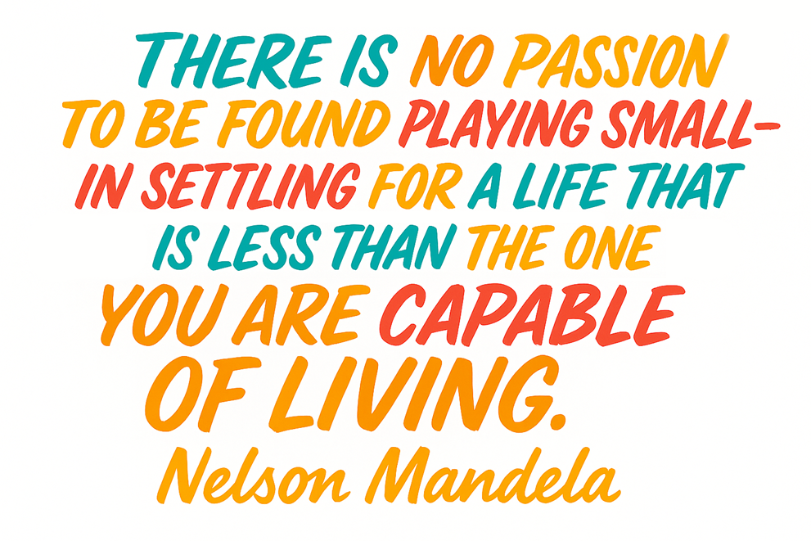
Notes:
Have you ever try to solve a problem by… doing absolutely nothing?
Same. Wishing maybe the universe will handle it. Or the other person will forget. . Or get abducted by aliens — honestly, any option is better except actually talking about it.
Hi, I’m Sabrina Feula from BCNET in beautiful Vancouver Canada — and today, we’re diving into something that ties most of us in knots: tough conversations.
You know the ones. Your stomach tightens. Your heart races and Your brain whispers, “Maybe if I wait a little longer, this whole thing will sort itself out.”
But nope. That feeling still lingers there. Like the annual cyber phishing test — fully aware you opened the email... and still didn’t click the link.

Slide 3
Notes:
Turns out, avoiding tough conversations is practically a group sport.
57% of people would do almost anything to sidestep one.
And get this: 37% have considered quitting their job entirely just to escape a difficult chat. (11% actually did. Bold move.)
Some folks don’t just dodge — they delay like pros. One in four has postponed a tough conversation for six months, while others hold out for a year… or even two. Sound familiar
So, if you’ve been silently hoping the issue will disappear on its own — you’re in excellent company. The good news? You don’t have to stay stuck there.
Here are a few tried-and-tested tips that have worked for me — and might just help you face that next tough conversation

Slide 4
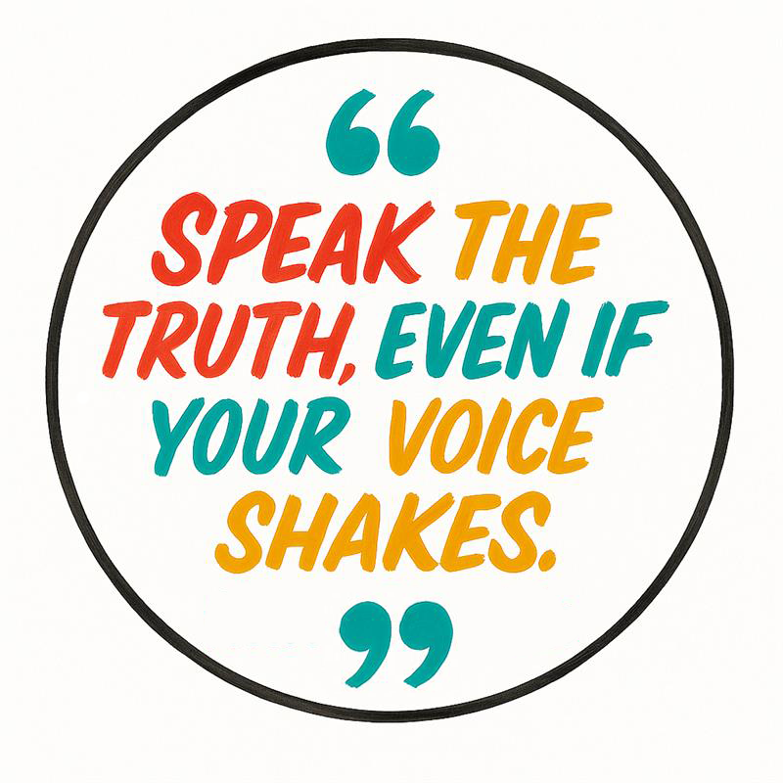
Mindset Check Before the Tough Talk
You’re not in a courtroom — no need to win
Use curiosity, not judgment: 'Help me understand...’
Breathe first. Speak second
Notes:
Step one: Mindset Check Before the Tough Talk
Before you step into the conversation, pause. Ground yourself. Your mindset matters as much as your message. . I would also recommend avoiding having them if you don’t think you have adequate time for it, before a weekend.
You're Not in a Courtroom — No Need to Win
This isn’t about scoring points or proving someone wrong. Your role isn’t to be “right” — it’s to relate. Approach it like a dialogue, not a deposition.
Lead with Curiosity, Not Judgment
Judgment closes minds. Curiosity opens them. Ask: “What might I not be seeing yet?” or “Help me understand your take.” Breathe First. Speak Second.
Seriously. Take one full breath before you reply. That moment of pause can be the difference between “professional” and “guess who’s in HR tomorrow.”
Bonus: Hydrate & Regulate
Nervous system 101: a sip of water can calm your body so your brain can do its job- also if having bullet points handy helps you feel more confident in having the conversation – more power to you!
water.

Slide 5
Name the Awkward
Reduces tension by naming the elephant.
Signals psychological safety—you’re not pretending everything’s fine.
Builds trust by modeling openness.
Notes:
Step two: Name. The. Awkward.
Why It Matters
Avoiding or glossing over discomfort doesn’t build trust — it erodes it. When tension is present, others can sense it, even if unspoken. Acknowledging it directly sets a foundation of honesty, clarity, and mutual respect. Practicing in front of a mirror, taking a few deep breathes before the conversation or listening to your hype song can help set the framework before your conversation
DO:
Address the situation with calm, respectful transparency.
Signal your intent for a productive, open dialogue.
Normalize discomfort as part of healthy collaboration and leadership. Which we’ll talk more about in the next slide.
DON’T:
Pretend everything is fine (“toxic positivity”)
Delay the conversation unnecessarily
Minimize the issue or deflect with humor or vagueness
I see things Differently.

Slide 6
Conversation Starters for Tough Talks
This isn’t an easy conversation to have….
I’d like to unpack what just happened…..
I’d like to talk about something that might be a bit uncomfortable, but I think it’s important.
I want to share some thoughts…..
I know this might not be an easy topic — I appreciate you being willing to talk about it.

Slide 7
After the Conversation: Now What?
Check in afterwards
Appreciate the effort
Clarify next steps
Notes:
Step three: You Did It — But You’re Not Quite Done
You navigated the hard conversation. That deserves a deep breath — but not full emotional hibernation.
Because here’s the thing: The real impact often happens after the dialogue ends.
Follow-Through Is Where the Trust Builds
Keep the momentum going with three simple steps: ✔ Check in — show you're still engaged ✔ Express appreciation — acknowledge the effort it took ✔ Confirm next steps — clarity beats assumptions
You don’t need a standing ovation — just something like:
“Thanks for being open — I really appreciated our conversation. Just to recap what we agreed on…”
And Here’s the Encouraging Truth
It gets easier. I promise — every time you have one of these conversations, it gets a little less daunting, a little more natural, and a lot more rewarding.
These small follow-ups send a big message: Respect. Integrity. Reliability. Even when it’s hard.

Slide 8
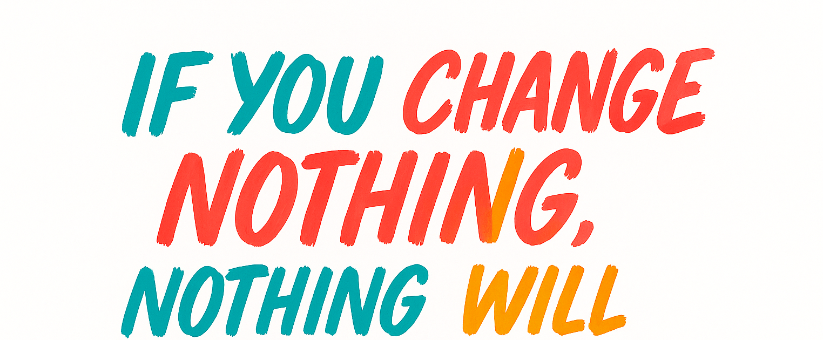
Notes:
Thank you — and may all your next tough conversations be just a little less weird.

Slide 9
Thank you
sabrina.feula@bc.net

