Slide 1
Building Trust
Lightening Strike: Second Strike
Edit Herczog
Brighton, TNC 2025
Thursday, 12 June 2025

Slide 2
TRUST, DISTANCE, PARTIES
Trust depends on :
Number of participants
Distance
TRUST
Parties * Distance

Slide 3
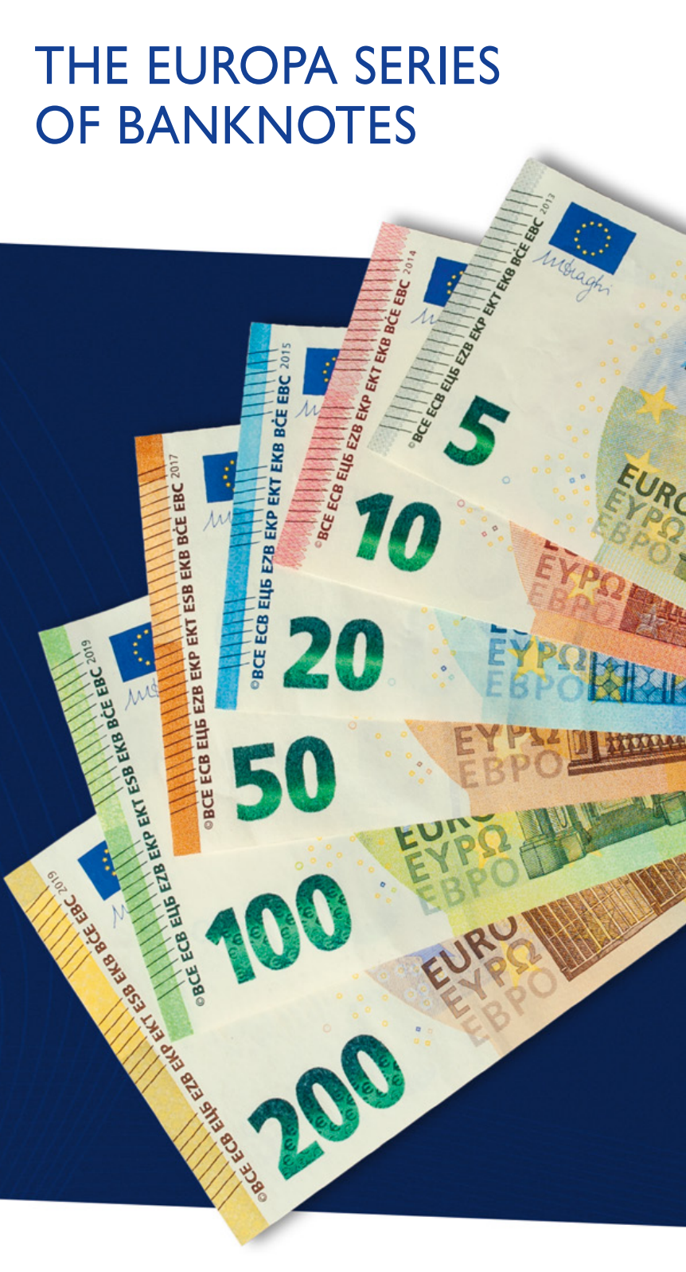
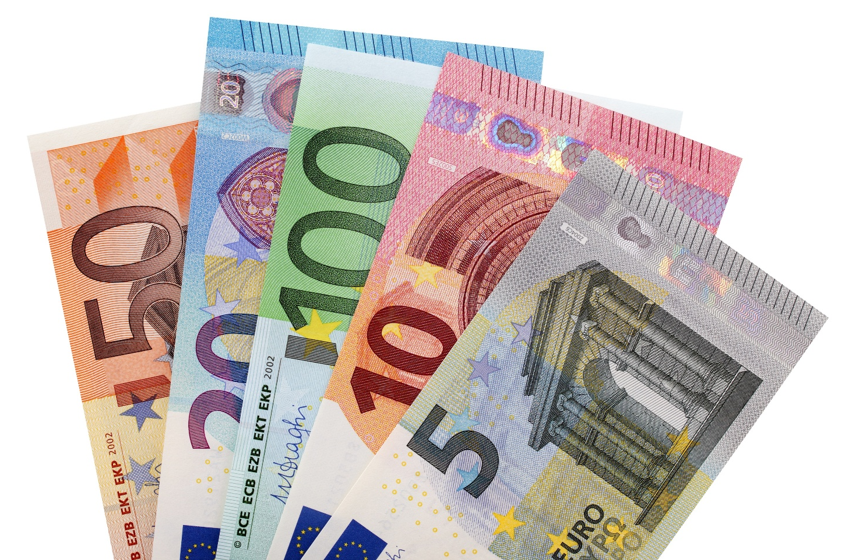
EURO currency
Means of exchange
Entrusted
Given value by users
Scalable
Secure

Slide 4
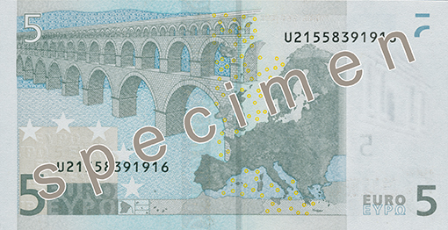
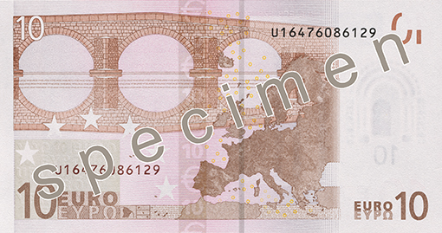
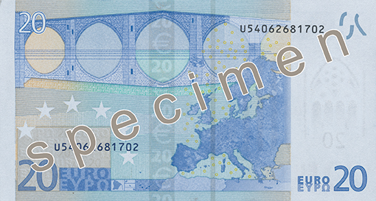
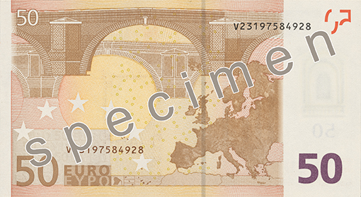
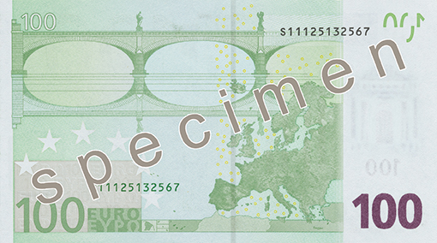
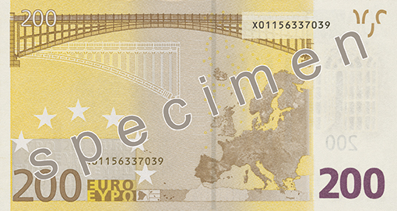
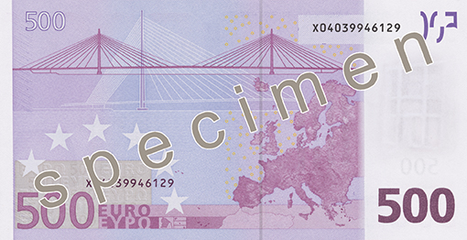
Connectivity

Slide 5
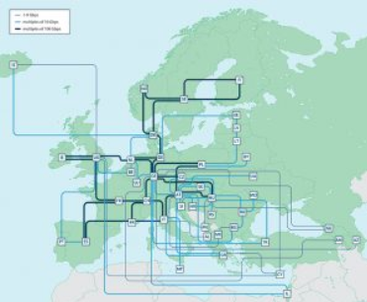
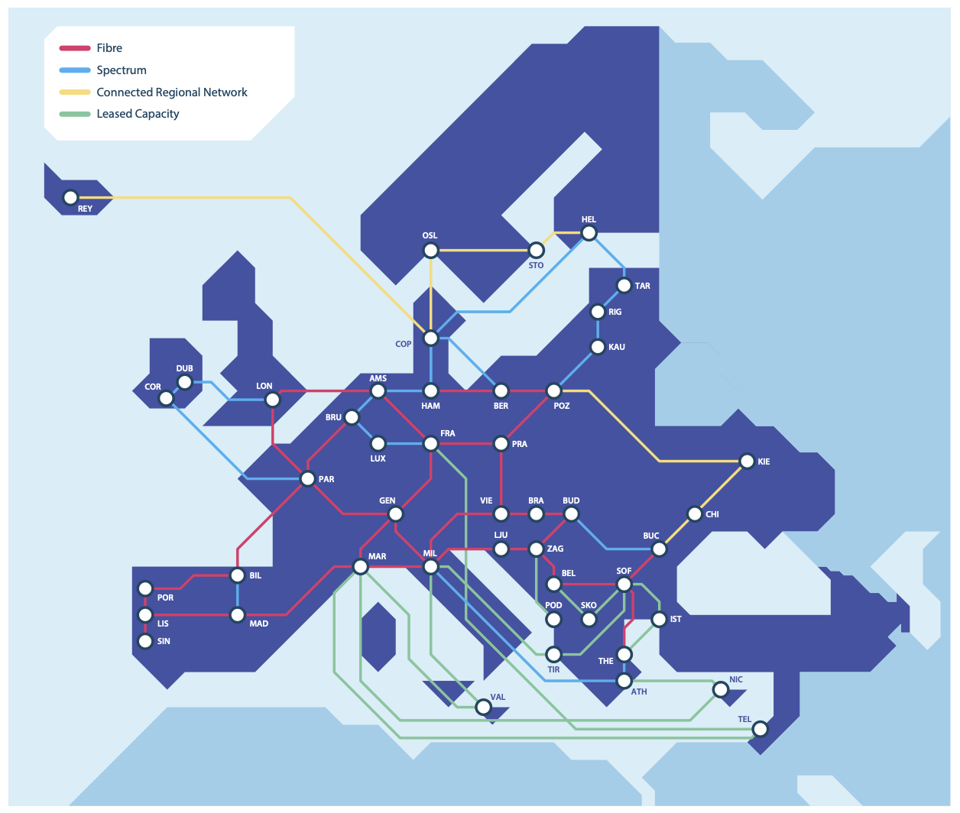

Slide 6
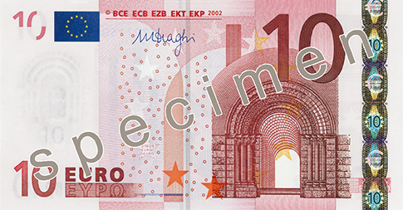
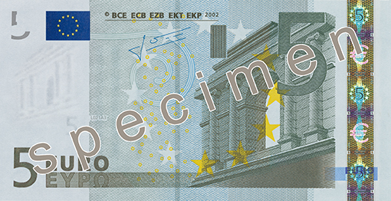
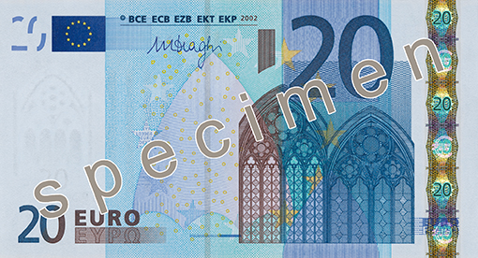
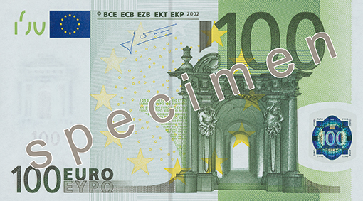
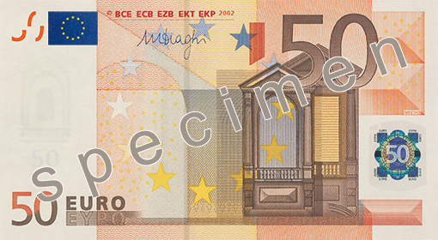
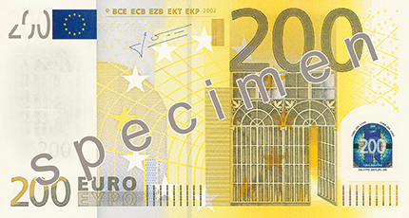
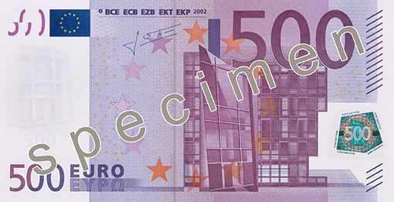
Access

Slide 8
Research Commons /currency
: „géanto”
G
Means of exchange
Entrusted
Given value by users
Scalable
Secure
Connectivity
Access
Transformation (Digital)

Slide 9
Thank you
Any questions?
edit.herczog@geant.org

