Slide 1
What Are Bridges Made Of
Mira Stanic | Partner Relations | GÉANT
Brighton
12 June 2025

Slide 2
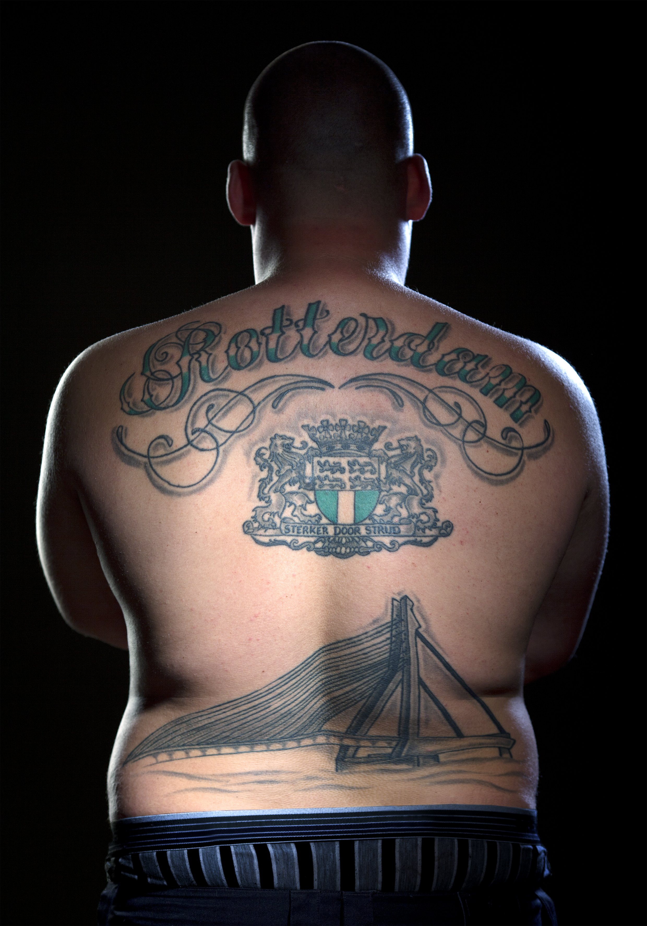
Image: Erasmus Bridge tattoo Jeffrey Philipsen © Hilbert Krane

Slide 3
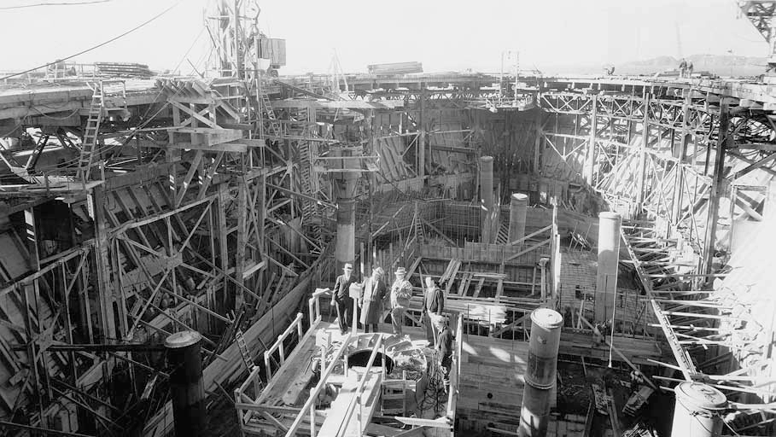
Image: The Golden Gate Bridge, Highway and Transportation District (GGBHTD)

Slide 4
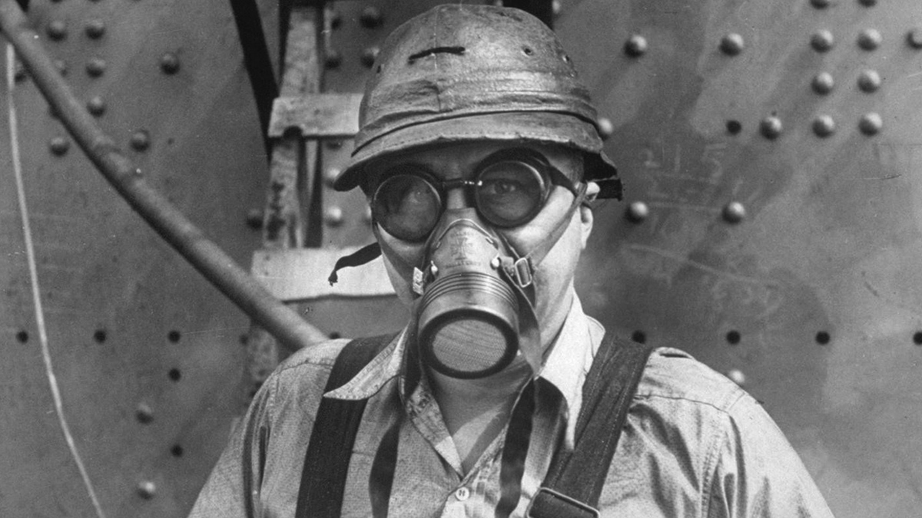
Image: The Bancroft Library, Construction Photographs of the Golden Gate Bridge collection

Slide 5
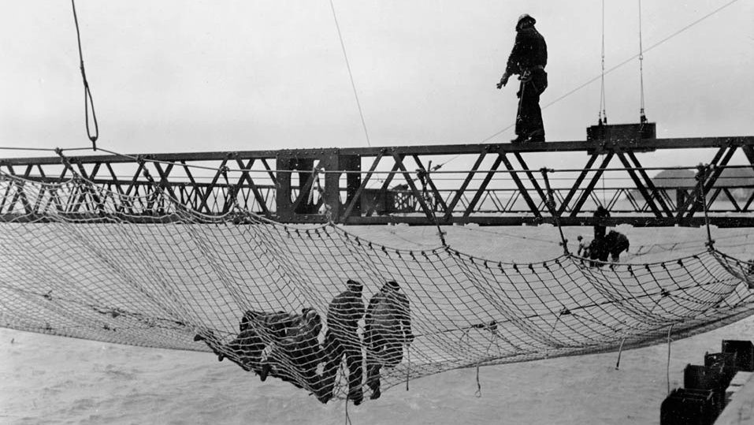
Image: Construction workers in the Golden Gate Bridge net, The Associated Press (AP)

Slide 6
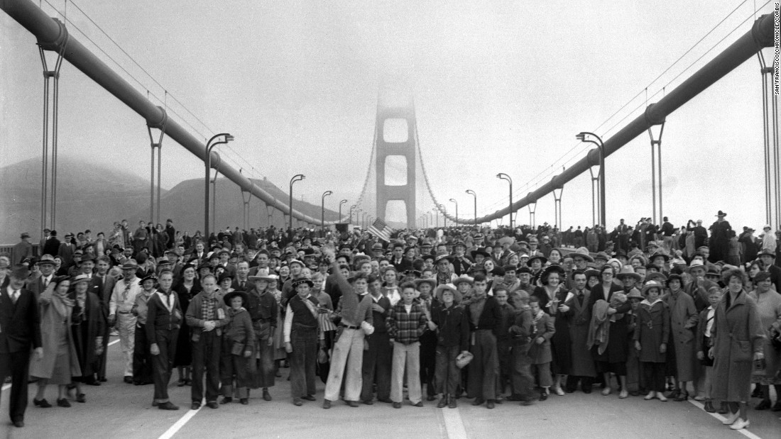
Image: San Francisco Chronicle/Corbis
Golden Gate Bridge, Constructing Catwalks, San Francisco Subjects Photography Collection, PC-SF, California Historical Society.

Slide 7
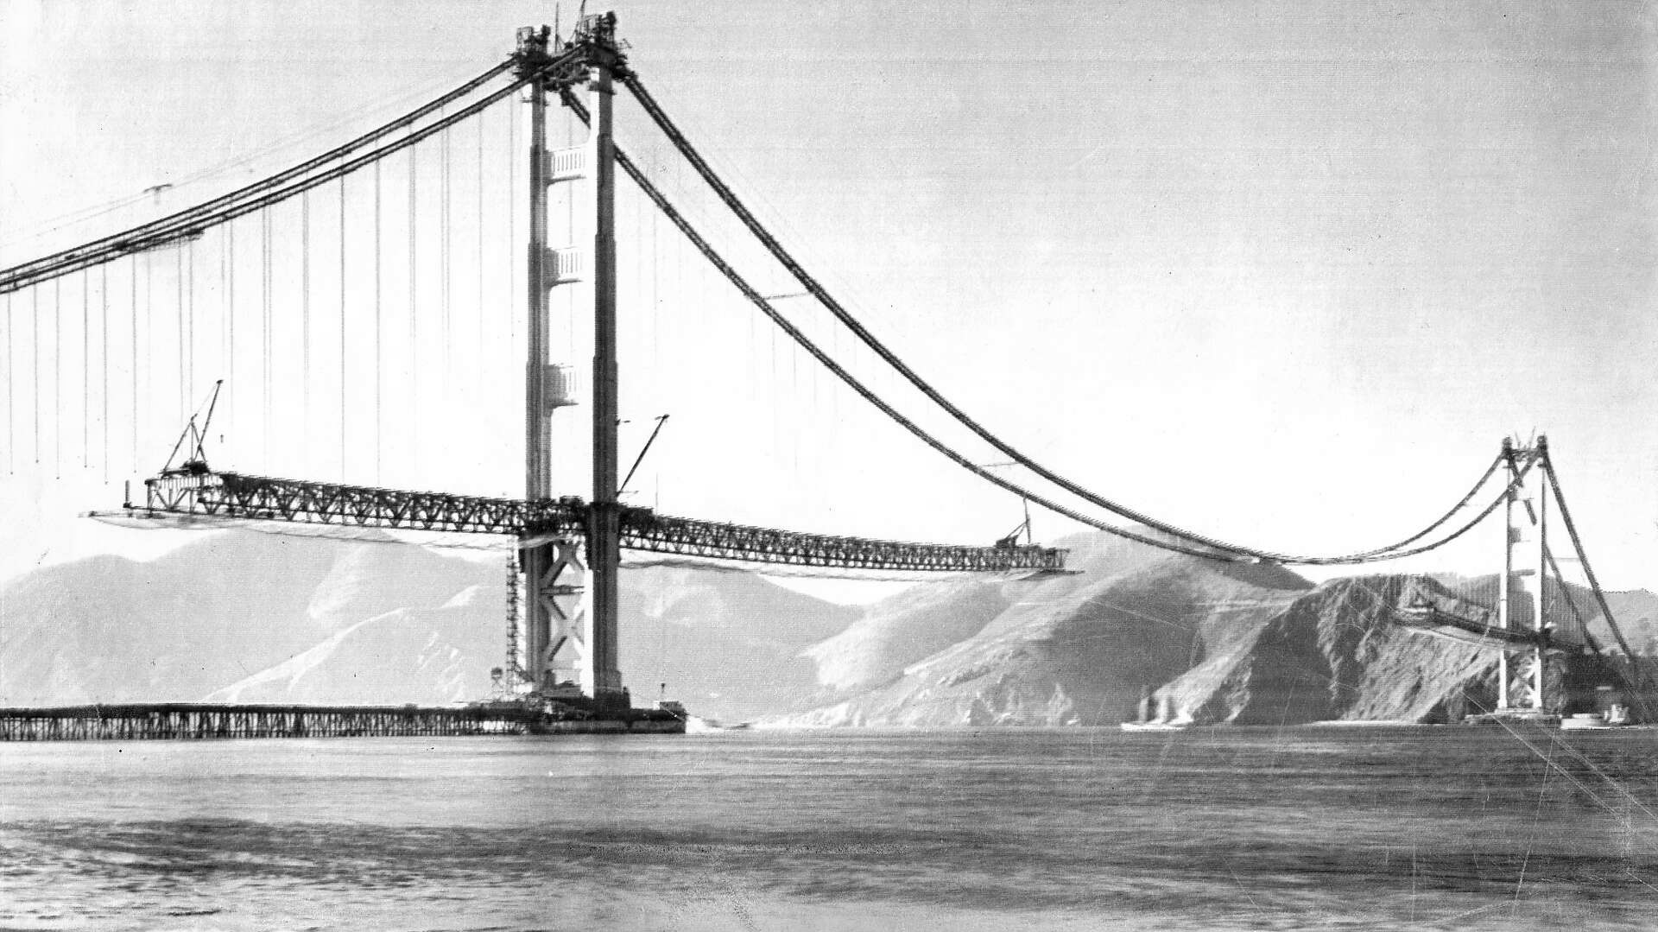
Image: United Press International

Slide 8
The scaffolding, the respirator masks, the safety nets, the neighbours, the leap of faith – the things that don’t show up in structural analysis, work plans or performance metrics
Translation Work
Reading the Room
Strategic Timing
Invisible Advocacy
Trust Building

Slide 9
The GÉANT Values
Community
Trust
Innovation
Passion

Slide 10

At present, we know much better what trust does than what trust is.
Castaldo, S., Premazzi, K., & Zerbini, F. (2010). The meaning(s) of trust. A content analysis on the diverse conceptualizations of trust in scholarly research on business relationships. Journal of Business Ethics, 96
Dual phenomenon
Attitude – Choice
Subjective – Behavioral
Cognitive – Affective
Temporal component
Building relational capital

Slide 11


The impact of trust on satisfaction and long-term orientation of business relationships is even much greater than the direct impact of economic performance.
Iwona Otola, Marlena Grabowska, Zoran Krupka, Trust and Organizational Resilience, Routledge Studies in Trust Research, Routledge, New York, 2023
Negotioation costs
Levels of conflict
Cost of monitoring and control mechanisms
Information sharing
Cooperation
Organisational performance and resilience
In times of disruption or change, trust enables behaviors that anticipate problems, adapt to new conditions, and help restore stability.

Slide 12
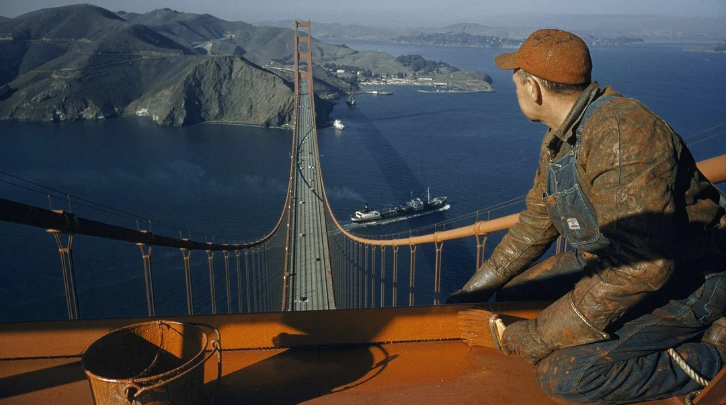
Image: David Boyer, National Geographic Image Collection

Slide 13
Thank you
mira.stanic@geant.org

