Slide 1
Intercontinental Connectivity
Meeting Long-term Needs
Sebastiano Buscaglione, Tom Fryer (GÉANT)
TNC25 Community Hub
Thursday, 12th June 2025

Slide 2
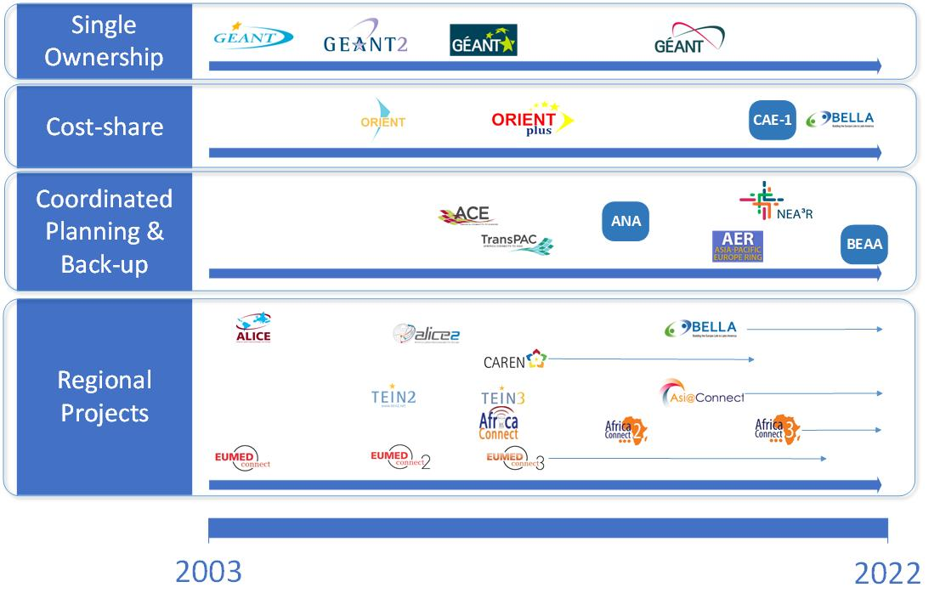
A Brief History of GÉANT’s Intercontinental Connectivity Activities

Slide 3
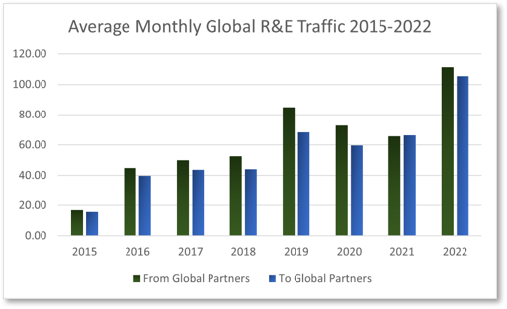
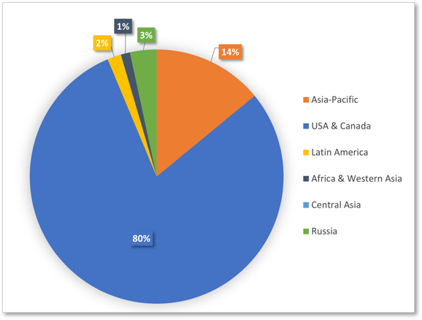
Intercontinental Traffic History at the Start of GN5-IC1

Slide 4



Forecasting Future Traffic Levels & Connectivity Needs
3 x Average Traffic @ 30% annual growth
+ Big Science Forecast Peak
__________________________________
Future Peak Capacity Need
_________________________________________
Example:
Direction | Projected Ave | Projected Peak | ITER | Genomics | Total Projected Maximum
Ingress | 31 Gbps | 94 Gbps | 100 Gbps | 100 Gbps | 294 Gbps
Egress | 18 Gbps | 55 Gbps | 100 Gbps | 100 Gbps | 255 Gbps

Slide 5
How to Decide What to Do and What Not to Do…
Pillar 1: Serving European R&E
Pillar 2: Global Collaboration
Pillar 3: European Autonomy

Slide 6

Working Together is Crucial
GÉANT Membership
European RENs
ASREN, CANARIE, ESnet, Internet2, NII, NKN, RedCLARA, TEIN, UbuntuNet Alliance, WACREN…
REN Global Partners
DG CNECT, DG ENEST,
DG INTPA, DG MENA
EC
EIB, (instruments - CEF)
MEDUSA, TIS, IslaLink, EllaLink…..
Financial Institutions
TELCO partners
Notes:
Costs easily runs in the 10s (or even 100s) of millions + maintenance!
Risks are high – Instability, war, uncertainty of projects success
Partners are not members
Regulatory and tax challenges
Dependencies -> long systems crossing many regions
Our demand can be insufficient to justify initial investment

Slide 7
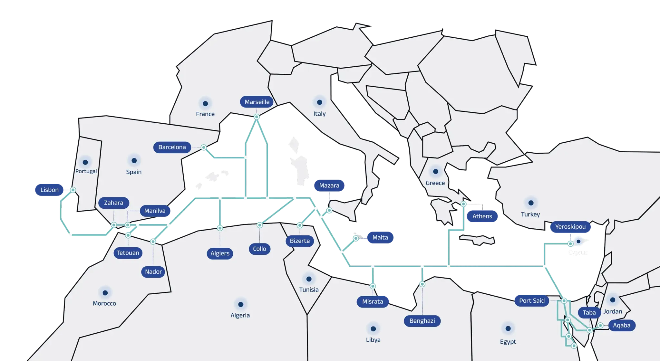
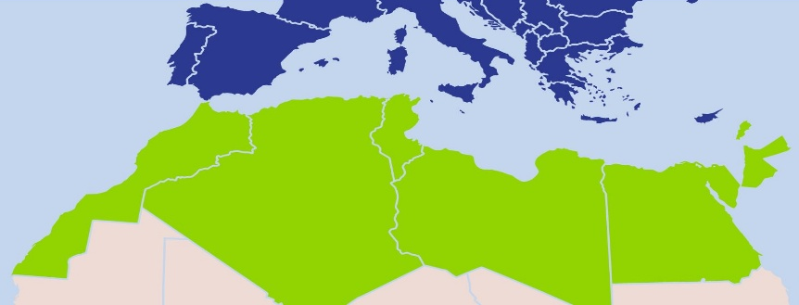

Proof of Concept: Medusa R&E Connectivity for North Africa
€40 million EU funding to deliver long-term capacity for North African NRENs
Contractual blueprint established with EC and EIB
200Gbps international connectivity deployed for Algeria, Egypt, Morocco & Tunisia
European ASREN PoPs: Marseille (France) and Yeroskipou (Cyprus)
10-year O&M covered by EU funding, as well as IRU (for cable lifetime) and initial deployment of 200Gbps.
Deployment is supported by EUMEDplus (DG MENA)

Slide 8
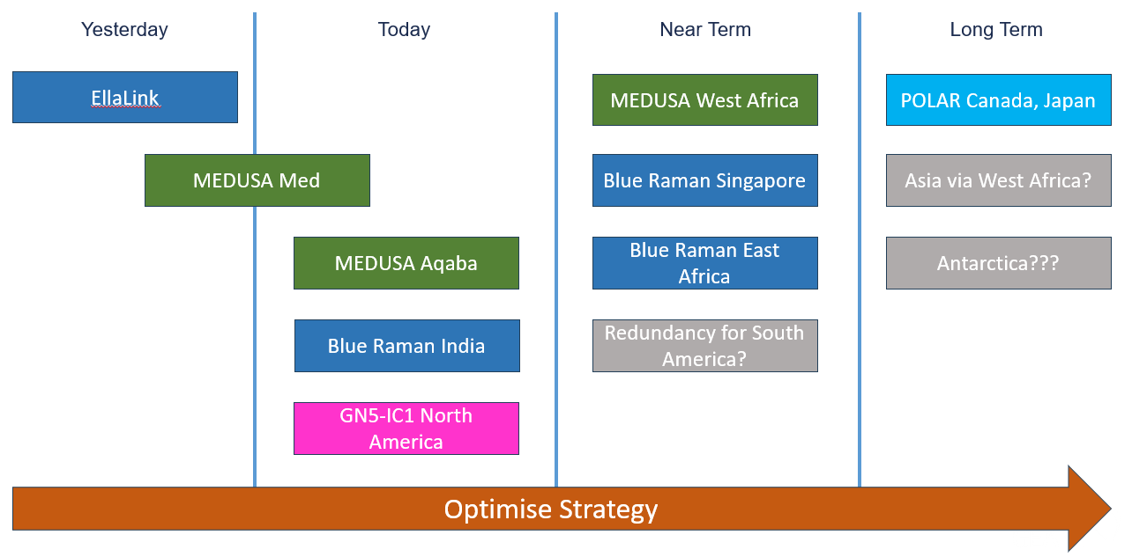
Projects GÉANT is Tracking

Slide 9
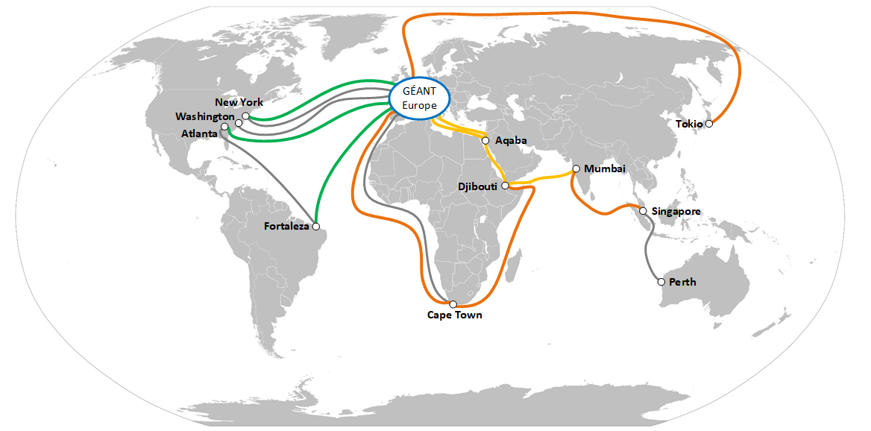
What Might This Look Like?

Slide 10
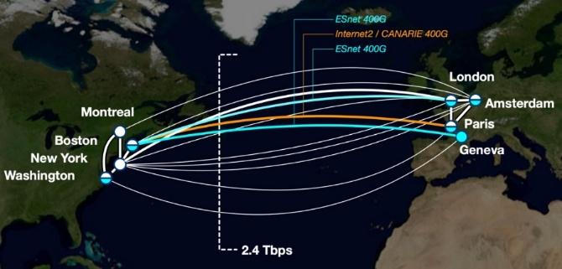
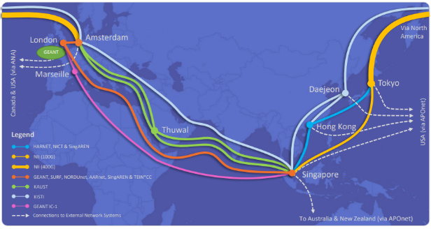
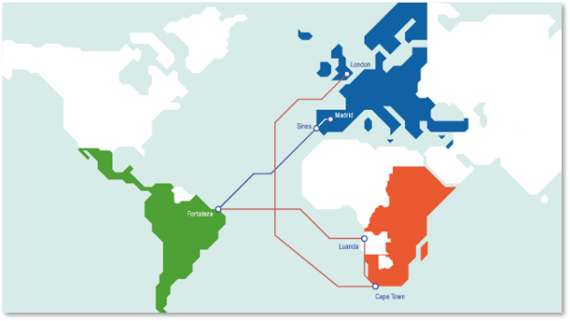
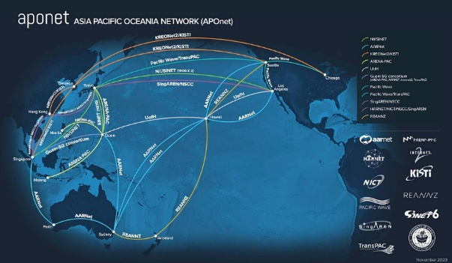
Existing collaborations for Mutual Resilience and Planning
Advanced North Atlantic collaboration (ANA)
Asia-Pacific Europe Ring (AER)
Bridging Europe, Africa & the Americas (BEAA)
Asia-Pacific Europe Ring (AER)

Slide 11
Thank you
Any questions?
Presenter email

