Slide 1
Fibre Sensing for NRENs
Security and Governance
Chris Atherton
Brighton
11/06/25

Slide 2
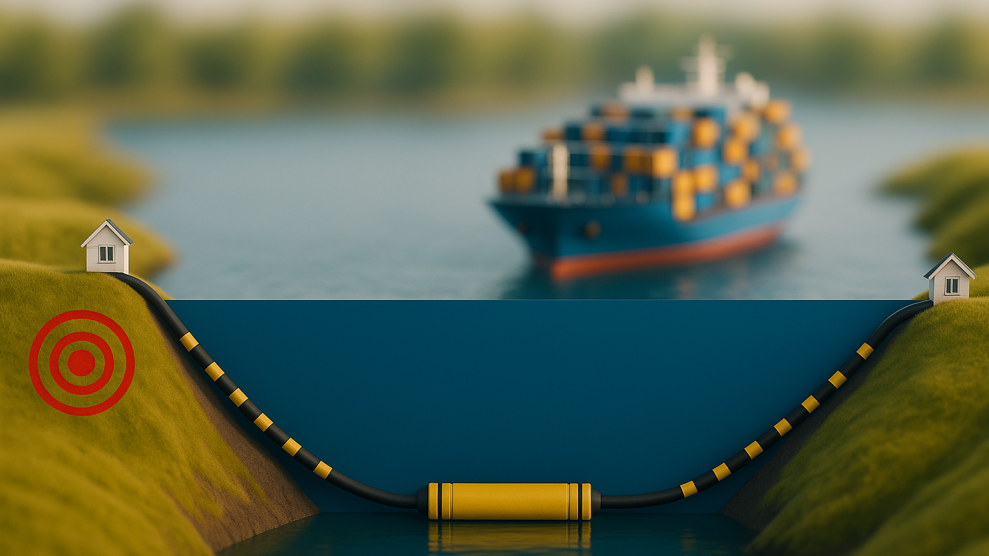
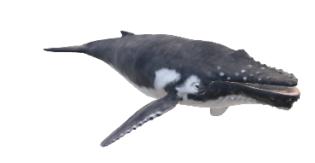

Two types of sensing
Dry plant / Optical fibre sensing
Submarine telecoms cable
Earthquake
Wet plant sensing
SMART cable sensor
Created using ChatGPT GPT-4.5

Slide 3
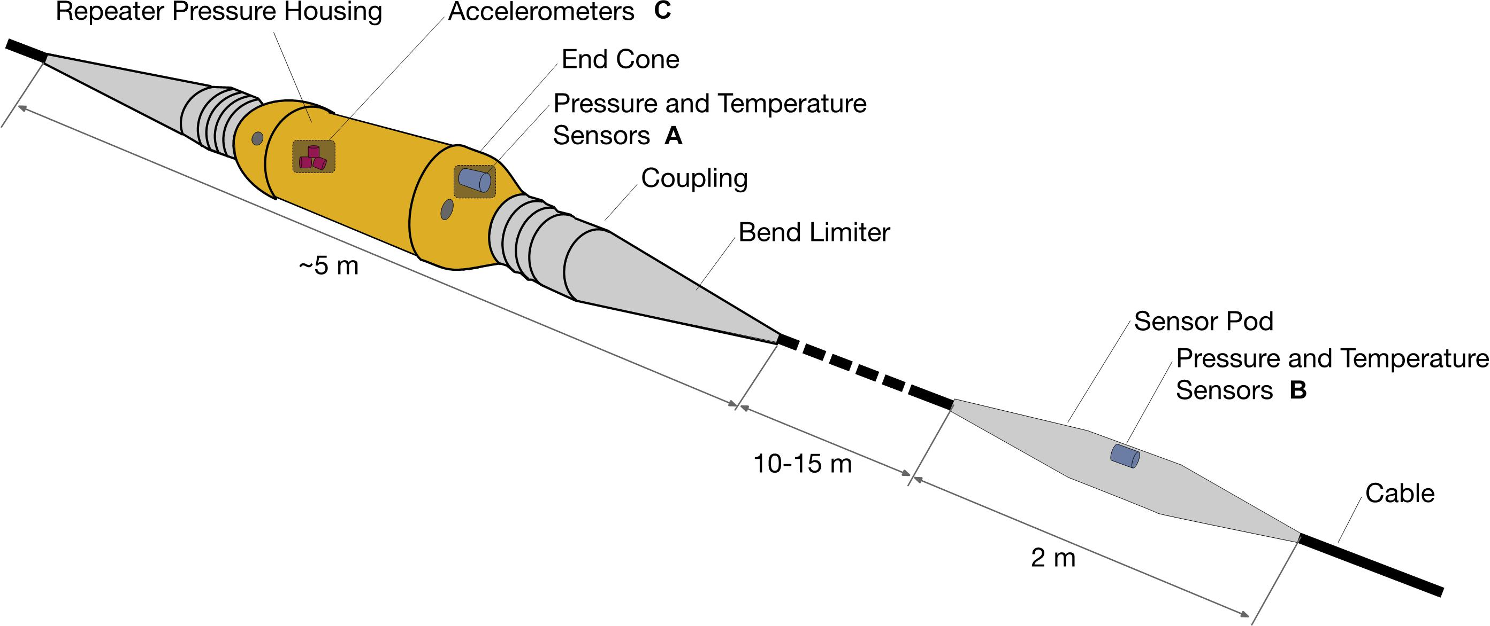
SMART Cable concept
Howe et al., (2019, August 2). Smart cables for observing the Global Ocean: Science and implementation. SMART Cables for Observing the Global Ocean: Science and Implementation. Retrieved June 10, 2022, from https://www.frontiersin.org/articles/10.3389/fmars.2019.00424/full
Notes:
https://www.frontiersin.org/articles/10.3389/fmars.2019.00424/full
JTF wants to install temperature, pressure and seismic sensors on the repeater units on a cable system for future newly deployed cables.
Some manufacturers are reticent. The cables have to operate for 20+ years and they don’t want to introduce any risk or systems which don’t have a proven design life.

Slide 4
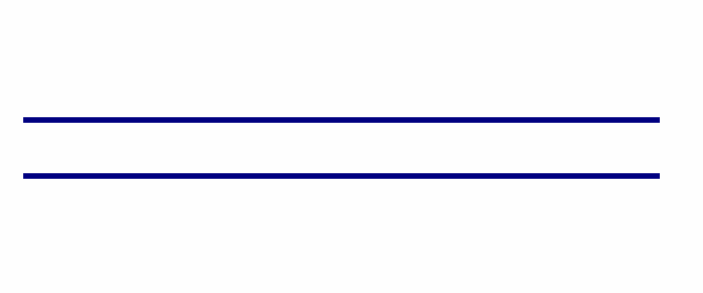
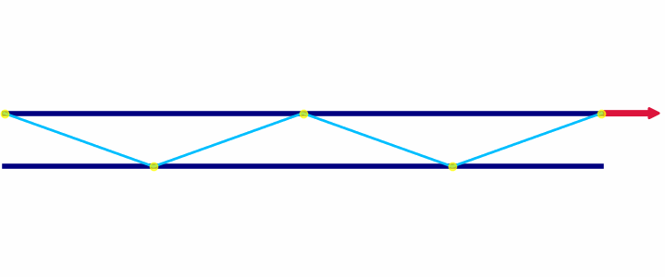
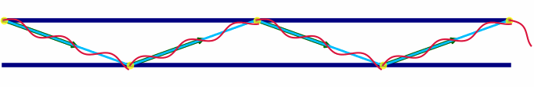
Optical Fibre Sensing techniques
DAS
SOP
IPD
Distributed Accoustic Sensing
State of Polarisation
Introformetric Phase Detection
Uses reflections from impurities in the fibre when a laser light hits the side, to measure stretch and strain.
Uses the changes in position of the laser light as it exits the fibre to detect changes made to the cable the laser light travels through.
Uses the changes in the time of arrival of the laser light when compared against a reference signal to detect changes to the cable

Slide 5
A thing to consider – a cable system
SMART CC node
Repeater
Land
Cable Landing Station B
DAS
Repeater
Cable Landing Station A
Land
SOP + IPD

Slide 6
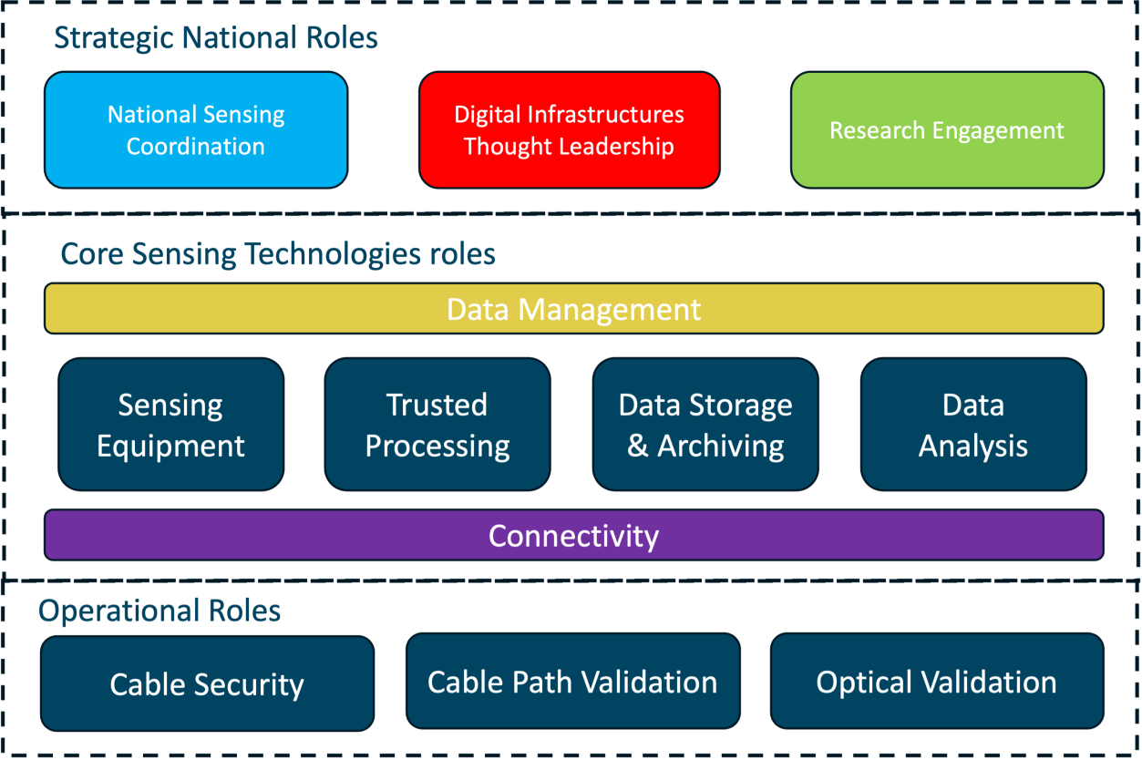
Fibre Sensing roles
Presentation main title heading

Slide 7
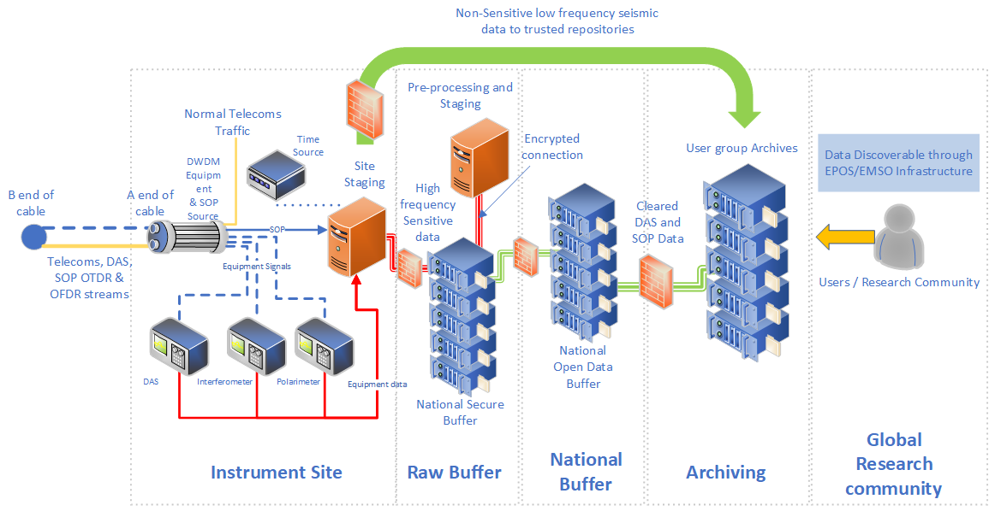


The high-level instrument architecture – per site
National Data Management policies
Open Science Data
Management policies (FAIR)
Notes:
The concept is to investigate integrating DAS, SOP, SOP OTDR and SOP OFDR techniques, then integrating the different infrastructures involved, maximising on each others strengths. The aim is not to create a new parallel research infrastructure but to integrate and compliment existing infrastructures together.
Not for the NRENs or GÉANT to do research into earthquakes, tsunami’s and the likes, but to provide the infrastructure and services necessary for researchers to do their work, in the most easy, scalable and streamlined way possible.
To create a multi domain data source.

Slide 8


Slide 9

Aim
Investigate utilising existing telecom cables, rather than dedicated submarine fibre, for monitoring the earth and oceans, without disrupting the telecoms traffic.
Notes:
Fix this slide
See if we can simplify and increase the size of the letters.
"Standardised architecture" for example
"Roadmap and strategy for sustainable instrument"

Slide 10
Objectives
Standardised architecture
Research-Infra data dissemination
3 geographic locations
Produce open, machine readable, long-term datasets.
Develop in collaboration with research communities.
Defining training and capacity building
Roadmap and strategy for sustainable instrument
Scientifically validate deployments
Notes:
Fix this slide

Slide 11
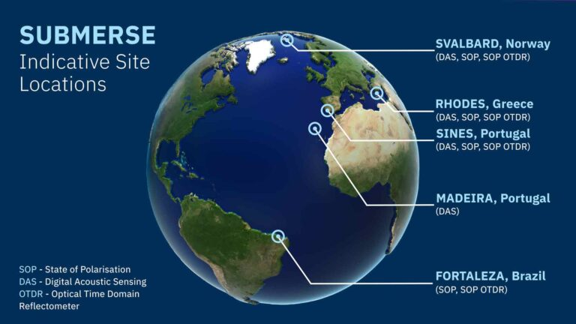
Preveza,

Slide 12
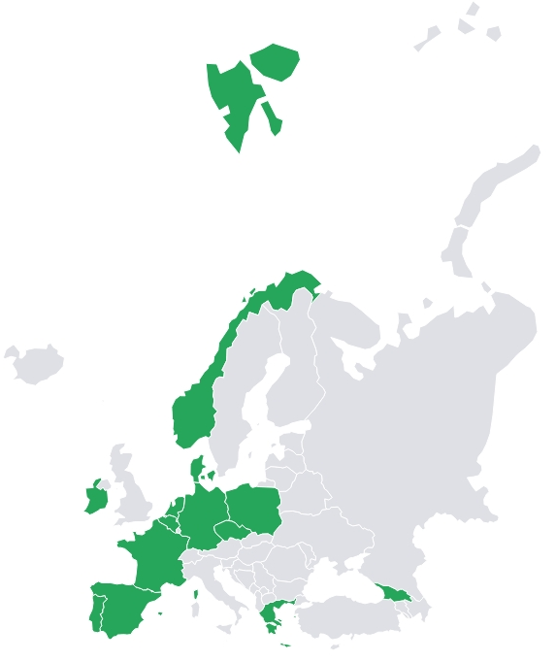















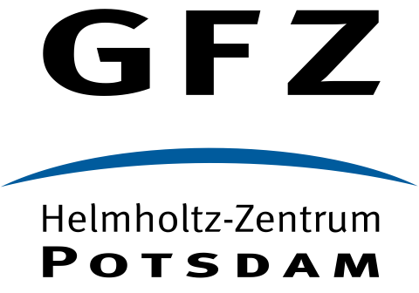




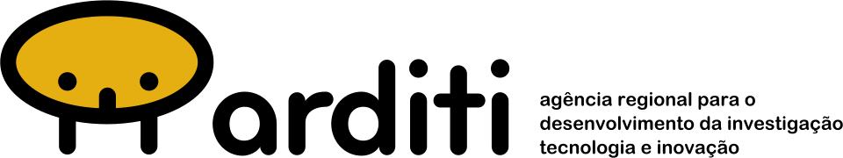

Consortium Members
36 Month Project – finished April 2026
Research Organisations
NRENs
Commercial organisations
Notes:
8 NRENs

Slide 13

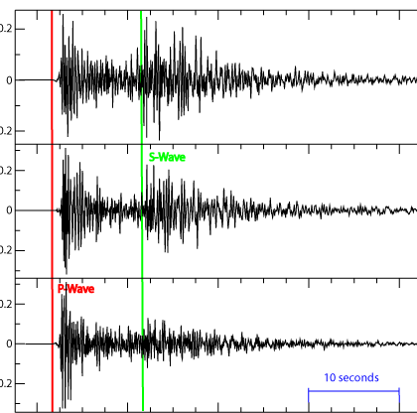
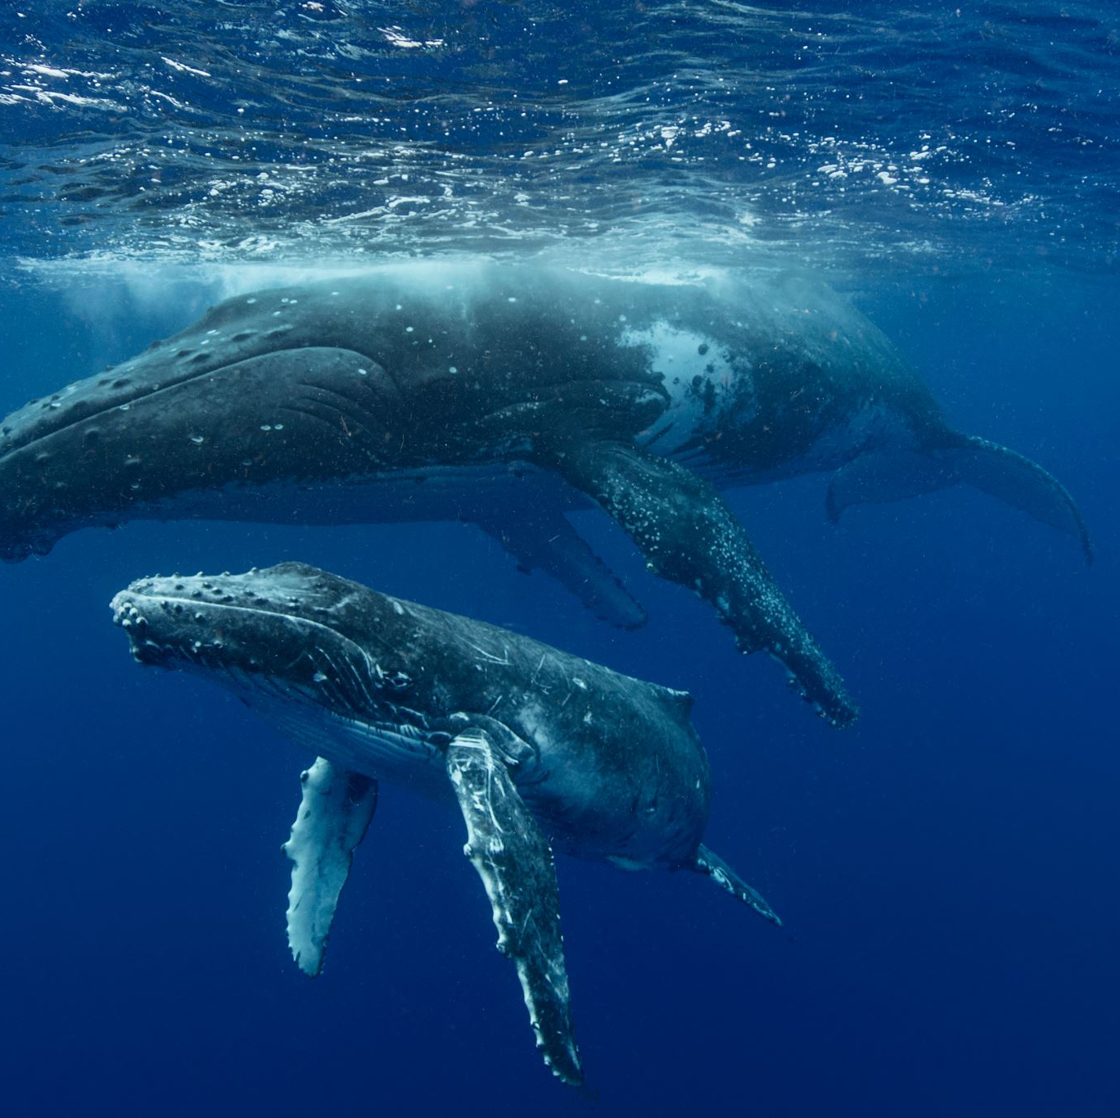
Scientific Communities
Oceanography
Seismology
Marine Biology
Notes:
=

Slide 14
Our problem:
Data needs to be organised

Slide 15

Giving a can of food without an opener
Data is sometimes like a can of food.
Comes in a can (format)
Contains food which needs to be processed (data)
To access it you need the right tin opener (tools)
Not all the cans work with the tools you have

Slide 16


1 to 1 is easy
Nice data!
Sharing data with proprietary formats is easy if you share the means of accessing that data (the tools).
Thanks!

Slide 17
1 to many is hard
Oooo data!
Errm..
Sharing data with proprietary formats is difficult if you don’t share the means of accessing that data (the tools) with many people.
  Requires consistency
  Can lead to vendor lock in
  Reduces usability
I know!
(This is meant to be a wall)

Slide 18
F.A.I.R data
This is where data management and Findable, accessible, interoperable and reusable (F.A.I.R.) data principles come in
When data is F.A.I.R it is usable.
Yes please!
x 5
Data anyone?

Slide 19
A key missing ingredient
Our community is more aware of the accessibility part. But there is a key element in interoperability which is required.
Say what now?
Ujbe Jkakye?

Slide 20
Interoperability
This is a can of tomato soup
What is this?
Dit is een blik tomatensoep
People need to understand something to use it fully.
We need a shared and broadly applicable language for knowledge representation
That requires a means to define concepts such that people can understand.
Esta es una lata de sopa de tomate.
Dette er en dåse tomatsuppe

Slide 21
Why ontologies are important
In SUBMERSE we have 4 “communities” and they all speak their own language
Researcher
Operator
Manufacture
Project support
Each role is important
Each has their own language and interpretation
Without a shared interpretation, we’re not able to share information easily.
(This is where the ontology comes in)

Slide 22
Data management challenges
From qualitative interviews with 15 participants the top 3 requirements for SUBMERSE were:
A system that can grow and scale with new data, experiments, and stakeholders;
The organisation and secure publication of data and metadata;
The capability for users to extract critical information from a continuous data stream
However, we have some data management challenges:
We don’t want all the data – we can generate 7TB per site per day
We don’t all agree on the metadata to be used (in some cases it’s not been defined)
Each of the research groups has their own definition of critical information
We can’t share all of the data as some of it is presumed sensitive

Slide 23
Governance

Slide 24
Fibre Sensing roles
GN5-1
Presentation main title heading

Slide 25
The key roles
One organisation can’t
perform all these roles
Fibre owner (and operator)
Interrogator owner
CLS co-lo provider
Interrogator vendor/manufacturer
NREN/centralised data compute(and HPC)
Edge compute (normally the same as interrogator owner)
NREN/data storage provider
NREN/Connectivity provider
Scientific research groups (there are many)
Data analysis
Trusted/approved data analysis
National government (and their various state and local agencies)
Data stewardship/data management

Slide 26

Commercial operators are waking up
Commercial operators have realised there’s a business opportunity here.
Models for dissemination will be determined by those who own the data.

Slide 27
Commercial opportunity? – 80 different uses for fibre sensing
Save Money
Cable condition monitoring
Cable fatigue monitoring
Cable abrasion monitoring
Thermal change monitoring
Cable threat monitoring
  Seabed fishing
  Anchoring
  Sabotage
Seabed placed structural condition monitoring
Insurance risk reduction
Make money
Surveillance in Ocean
  Seismic imaging
  Earthquake monitoring
  Tsunami monitoring
  Marine life monitoring
  Oceanographic monitoring
  Natural resource exploration and monitoring
  Surface vessel monitoring
  Insurance risk evaluation
  Windfarm monitoring
Surveillance from Ocean
  Sensor Validation
  Aircraft monitoring
  Geodesic macro effect monitoring

Slide 28
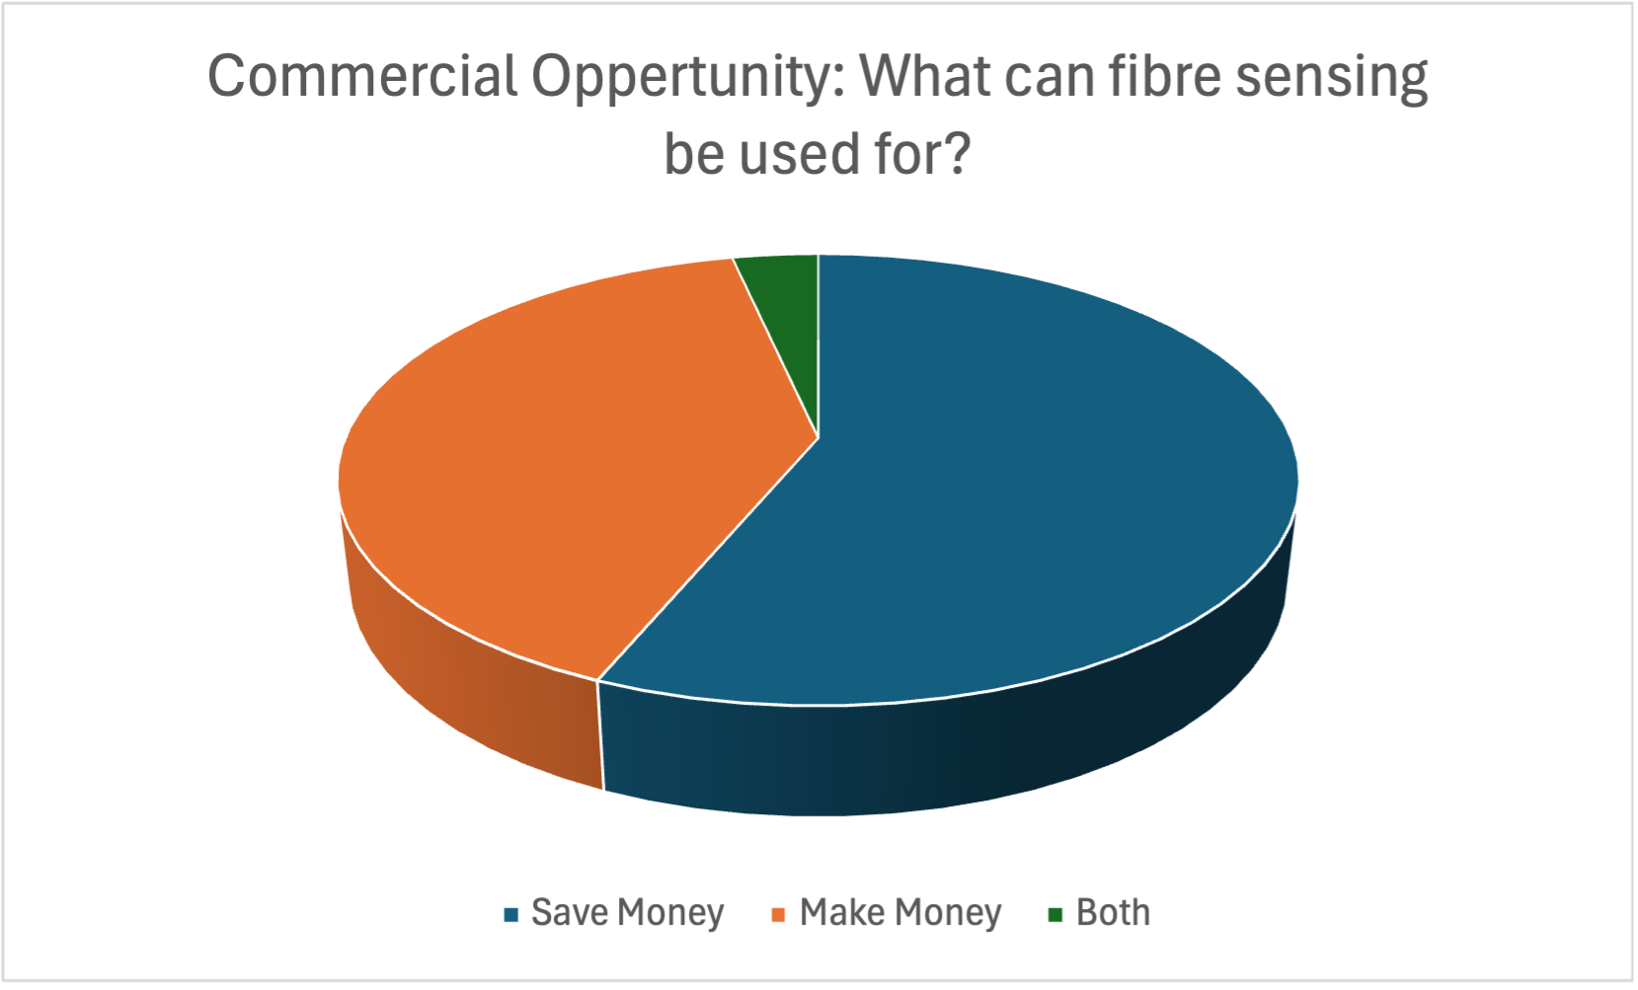

Slide 29
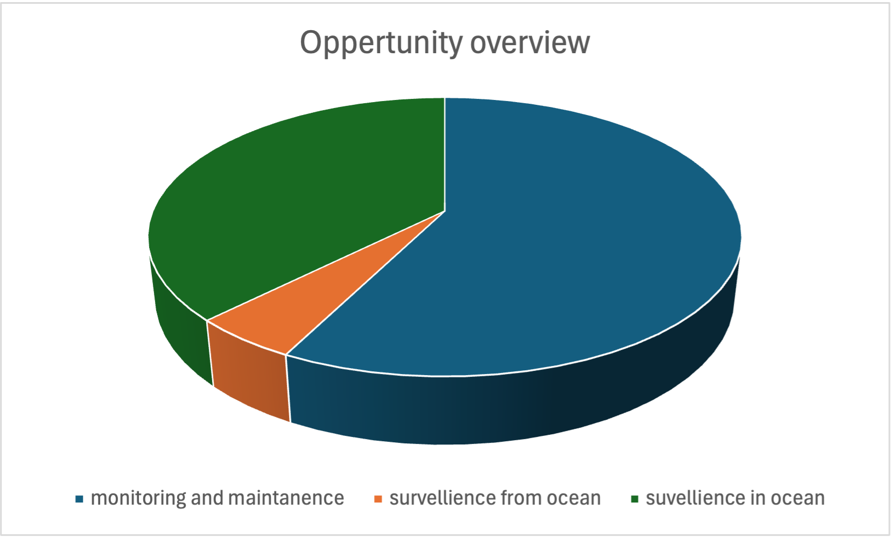
Another way of looking at it: Use case focus

Slide 30
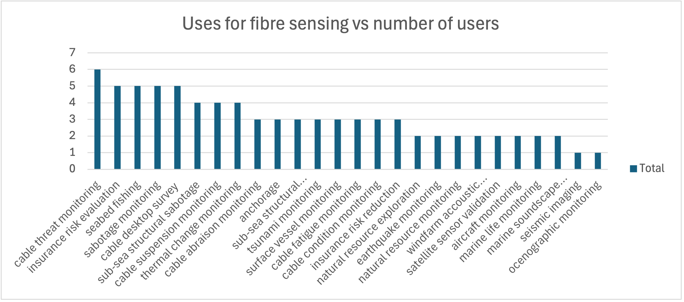
The type of uses vs types of potential service users

Slide 31
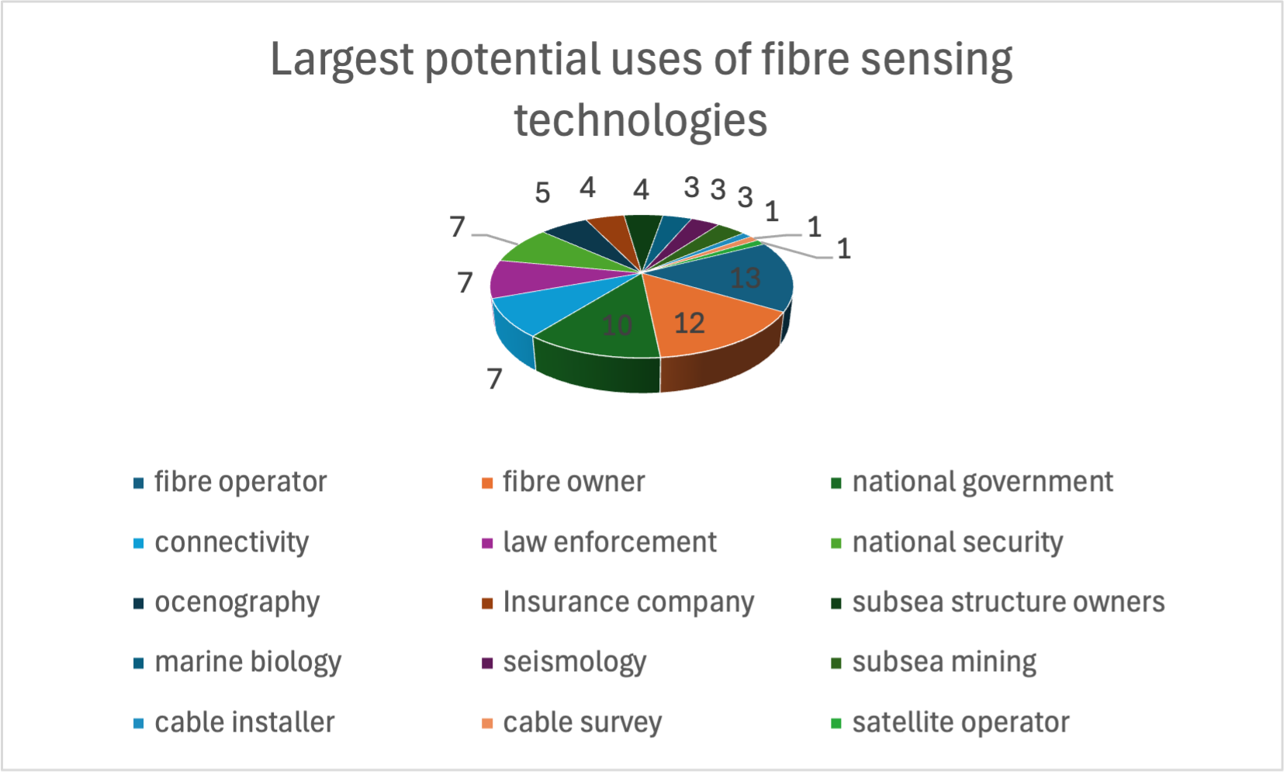
The breakdown of the potential users

Slide 32
What should we do about it?

Slide 33
Thank you
Any questions?
Presenter email

